Slide 1

RECOVERY-RS Respiratory Support: Respiratory Strategies in COVID-19; CPAP, High-flow, and standard care
Site Training – Data Collection

Slide 2





Acknowledgements

Slide 3
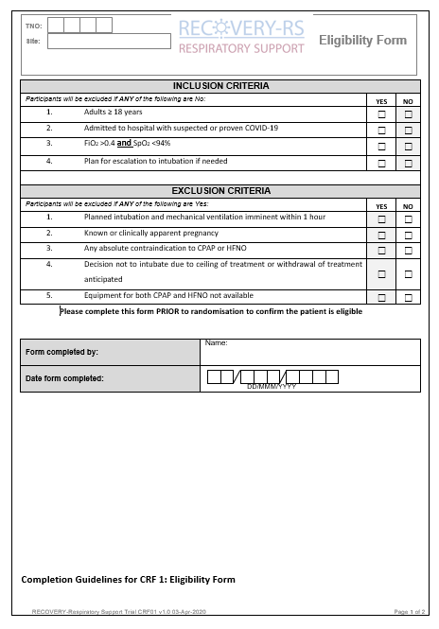
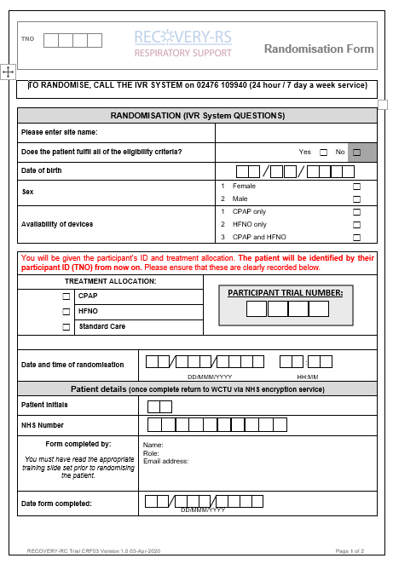
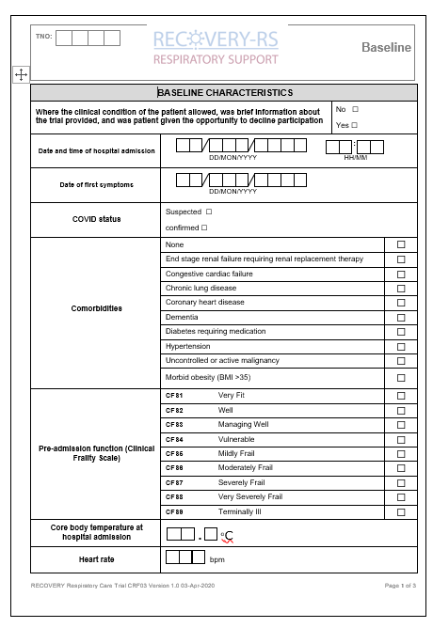
Data entry / eCRF
Bespoke online database - initial data to be entered:
* To include Personal Identifiable Data
Eligibility Form
Randomisation Form *
Baseline Form

Slide 4
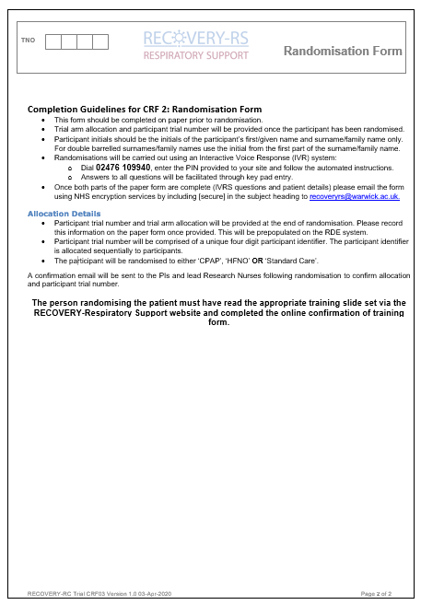
Data entry / eCRF
Generic site user ID
Provided by email
following ‘green light’ approval
Paper/Electronic
Optional whether paper CRF’s
used prior to entry
Personal Identifiable Data
Collected on Randomisation CRF and entered onto the randomisation eCRF. PID will be anonymised upon data entry to allow storage

Slide 5
Data collection
Visit | 1 | 2 | 3 | 4
Visit Window (No. Weeks ± No. Days) | Day 0 Baseline | Regular in-hospital reviews (at least weekly) | Day 30 (+/- 2 days)† | Hospital discharge†
Baseline data collection | ✓
Randomisation | ✓
Intervention | ✓* | ✓*
Adverse events |  | ✓ | ✓ | ✓
Survival status |  | ✓ | ✓ | ✓
Outcome assessment |  |  | ✓ | ✓
*- Intervention will be delivered up to point of death, decision to palliate, tracheal intubation, or clinical determination that no ongoing need
†- Participants to be followed-up to day 30 or hospital discharge, whichever comes later

Slide 6
Follow up
If patient still in hospital complete follow-up eCRF at 30 days post randomisation or hospital discharge whichever is the later
*If patient discharged before day 30, trial team will obtain survival data through data linkage
Data Collection
ICU/hospital admission status
Ventilation duration
AEs (treatment failure, need for other treatments, renal function, renal replacement therapy)
Survival status*

Slide 7
Withdrawal
Participants may be discontinued from the trial treatment and/or the trial at any time without prejudice
Please notify Warwick CTU of any withdrawals
Complete the withdrawal form on the online database
Data Collected
Data collected up until withdrawal point will automatically be used unless participant specifically requests otherwise
Follow-up
Unless a participant explicitly withdraws their consent, they will be followed-up wherever possible and data collected as per the protocol until the end of the trial
Withdrawal Options
Withdraw from trial treatment
Withdraw completely
Document
Date of withdrawal in Medical Notes

Slide 8
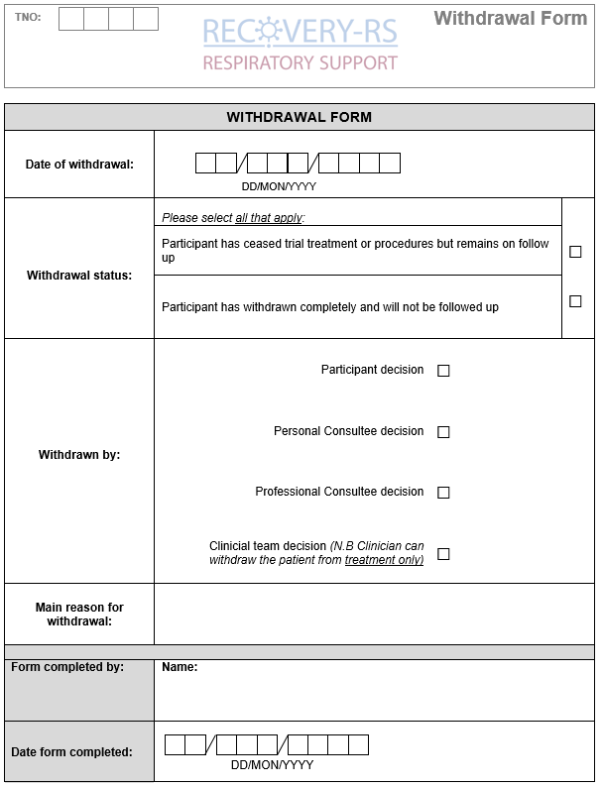
Withdrawal form

Slide 9
Safety reporting
Only AE’s listed below and clearly related to the use of CPAP or HFNO or expected to be recorded. Record AE’s on the online database
The following are expected adverse events and will be recorded in the CRF; they predominantly relate to the use of CPAP, as there are minimal AEs reported for HFNO:
Interface intolerance due to excessive air leaks
Pain
Cutaneous pressure sore or pressure area
Claustrophobia
Oro-nasal dryness
Respiratory acidosis with pH <7.25 prior to intubation
Haemodynamic instability
Vomiting
Aspiration of gastric contents
Notes:
PI to assess causality

Slide 10
Safety reporting
Only SAEs that occur from the time of randomisation, through to and including 30 days after cessation of trial intervention, must be reported to WCTU
Scan and email completed SAE forms to WCTUQA@warwick.ac.uk within 24 hours, or as soon as is practicable, of becoming aware of the event
Events that do NOT need to be reported as SAEs:
Death
Organ failure
Pneumonia
Intubation
Tracheostomy
Notes:
PI to assess causality

Slide 11
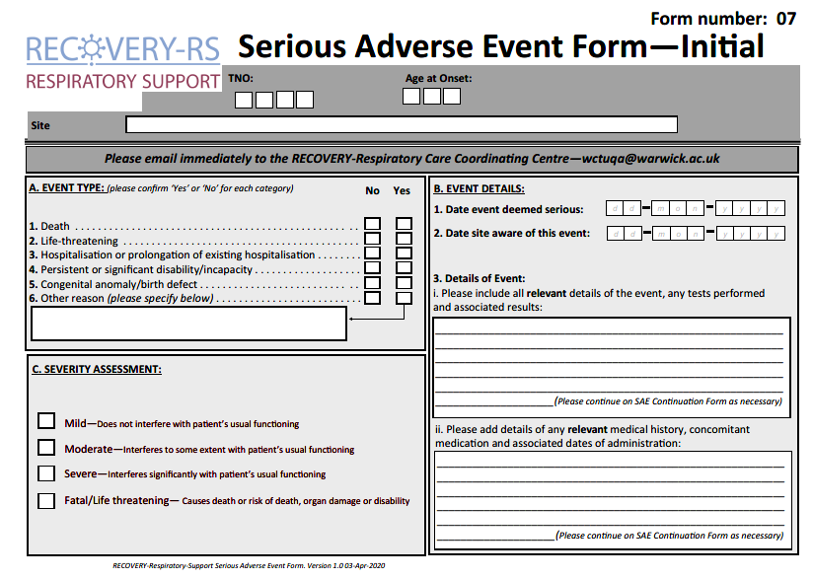
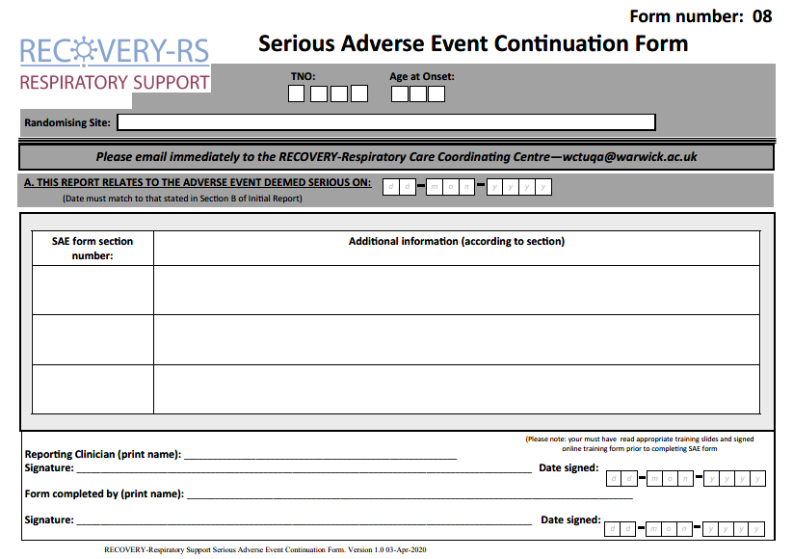
SAE forms

Slide 12
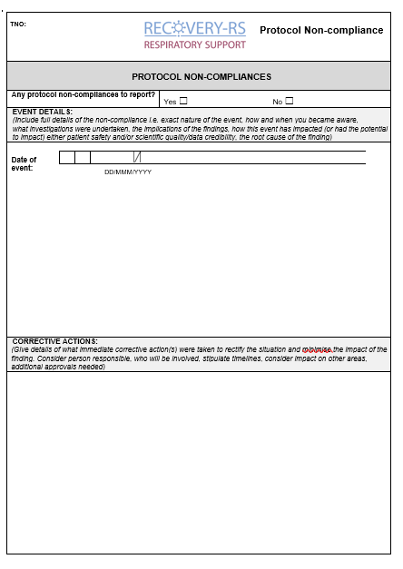
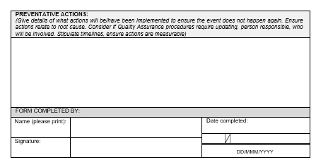
Non-compliance
Report any non-compliances immediately to WCTU straight onto online database
(within 24 hours of becoming aware)
Examples of non-compliances:
Patient doesn’t receive intervention they are randomised to
Patient is ineligible
Patient Identifiable Data sent without encryption
Staff member not completed trial training on website
No active effort to follow up patients to obtain retrospective consent if they regain capacity or to approach consultee for consent
Patient requests withdrawal of data but site does not inform Warwick CTU

Slide 13
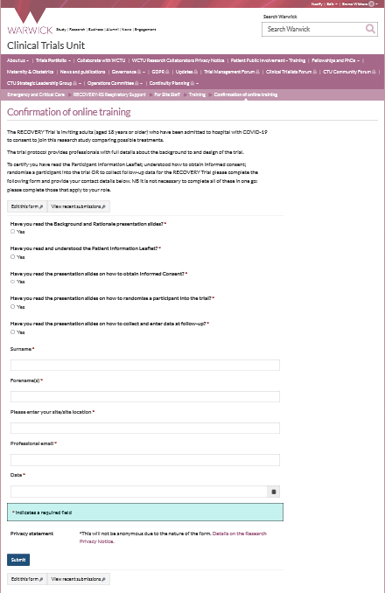
Training requirements QA
Training is available on the trial website
As a minimum the PI of the site must complete and sign off all training modules on the website
PI to ensure that staff (e.g. doctor, nurse, research practitioner) have the appropriate knowledge and understanding of trial
All training should be recorded on the Confirmation of Online Training Form
Optional GCP training available on website
There is no need for the PI to provide a CV and GCP certificate.

Slide 14
Study oversight
Investigator Site File (ISF)
Available on website
Close Out
Resolve any outstanding queries
Collect any outstanding data
Ongoing responsibilities
Site to archive trial documentation and data (at least 10 years)
Monitoring
Central monitoring approach will be developed that will take into account the challenging circumstances and staff pressures
Notes:
How do you want to be informed of amendments?

Slide 15
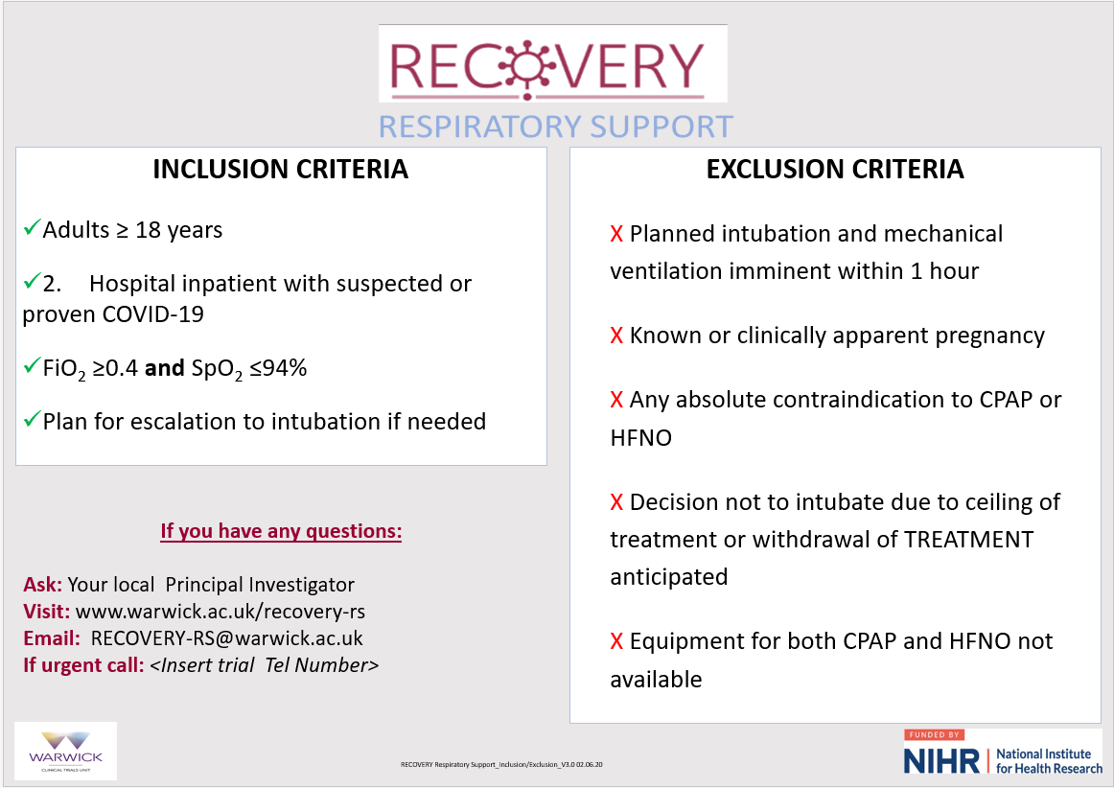
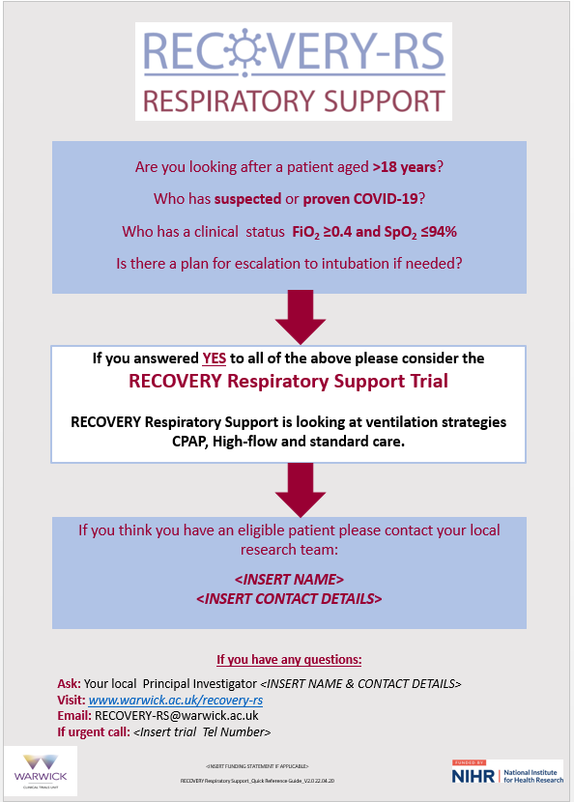
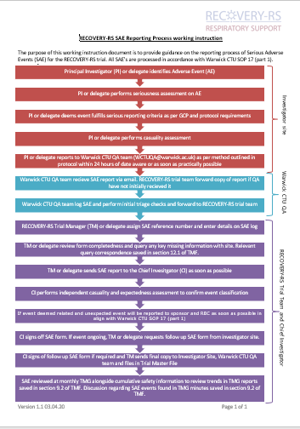
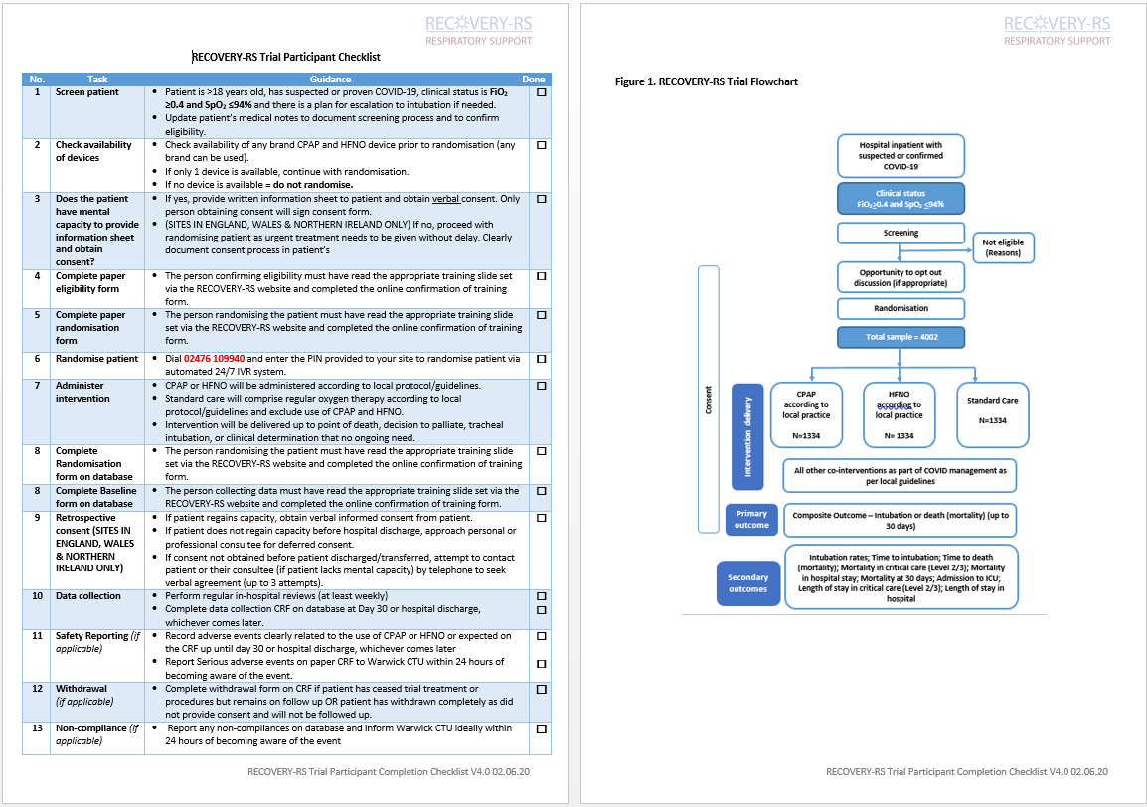
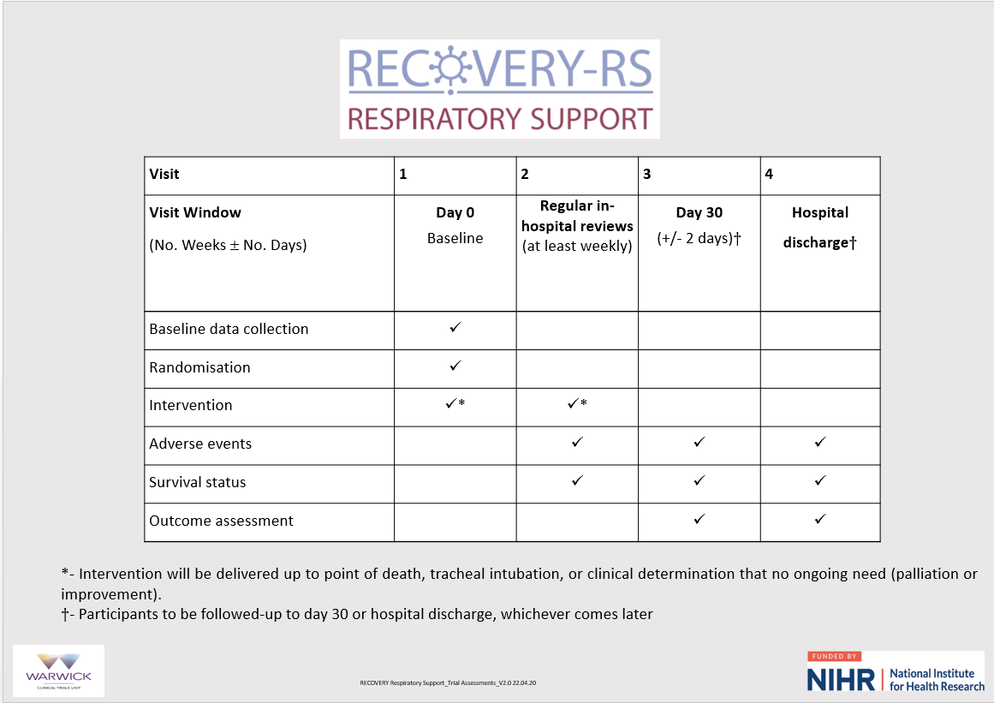
Aide memoirs – available on website

