Slide 1

RECOVERY-RS Respiratory Support: Respiratory Strategies in COVID-19; CPAP, High-flow, and standard care
Site Training – How to randomise

Slide 2





Acknowledgements

Slide 3

Eligibility
Inclusion criteria
Adults ≥ 18 years
Hospital inpatient with suspected or proven COVID-19
FiO₂ >0.4 and SpO₂ <94%*
Plan for escalation to intubation if needed
Exclusion criteria
Planned intubation and mechanical ventilation imminent within 1 hour
Known or clinically apparent pregnancy
Any absolute contraindication to CPAP or HFNO
Decision not to intubate due to ceiling of treatment or withdrawal of treatment anticipated
Equipment for both CPAP and HFNO not available
*Requirement for oxygenation should be ongoing (not transient)

Slide 4
Screening
Site research team attend/contact hospital clinical areas
Treating known or suspected COVID-19 patients
Liaise with clinical staff to identify patients
Acute Hypoxaemic Respiratory Failure
Doctor/nurse/research team can assess and confirm eligibility prior to randomisation – complete eligibility form
Justification for patient meeting all eligibility criteria
Clearly documented in the patient’s medical notes

Slide 5
Randomisation
Check availability of CPAP and/or HFNO device prior to randomisation (any brand of device can be used)
None
Do not randomise
Option 1 Randomisation
CPAP vs standard care
Devices available?
Only one
(CPAP or HFNO)
Option 2 Randomisation
HFNO vs standard care
Both CPAP & HFNO available
Option 3 Randomisation
CPAP vs HFNO vs standard care

Slide 6
Safety Alert: High-Flow Oxygen
Dr Ganesh Suntharalingam - President, Intensive Care Society
Urgently ensure liaison between clinicians and hospital oxygen engineering teams to ascertain:
the maximum flow rate from your VIE
any additional limitations to oxygen delivery owing to pipework architecture
calculate the maximum number of patients who can be treated with high flow devices such as wall CPAP and communication of this to the relevant clinical teams
undertake a daily count of the number of high-flow systems where the potential oxygen flow rate exceeds 10 L/min (this will include most wall CPAP systems, High Flow Nasal Oxygen (HFNO), some non-invasive ventilators used in acute settings, and many ventilators used in critical care units or operating theatres)
implement safety measures to prevent accidental O2 system failure (such as limiting the number of these devices available for clinical use)
“low oxygen pressure alarms” = indication of approaching flow limitation
TAKE URGENT ACTION: Review usage, reduce demand, escalate for engineering assistance

Slide 7
Randomisation
Patients will be randomised to a 1:1:1 ratio
Interactive Voice Response (IVR) system (24/7 service) Call 02476 109940
PIN access to be provided by email following ‘green light’ to begin recruitment – generic username for each site
*PID is redacted on entry
Completed paper form to be filed in ISF
Complete
Randomisation form Paper
Randomise
Using IVR
Database
PID to be entered directly into database*

Slide 8
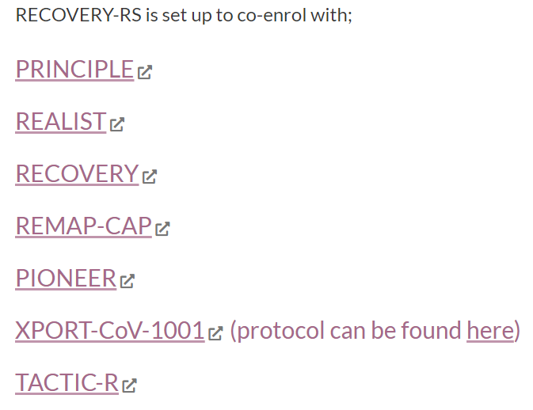
Co-enrolment
Co-enrolment will be reviewed on a case-by-case basis in accordance with NIHR-supported co-enrolment guidelines
We will maintain a list of trials we are co-enrolling with on the trial website

Slide 9
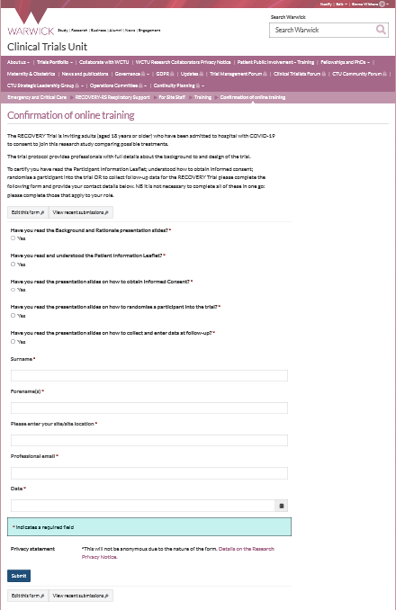
Training requirements QA
Training is available on the trial website
As a minimum the PI of the site must complete and sign off all training modules on the website
PI to ensure that staff (e.g. doctor, nurse, research practitioner) have the appropriate knowledge and understanding of trial
All training should be recorded on the Confirmation of Online Training Form
Optional GCP training available on website
There is no need for the PI to provide a CV and GCP certificate.

Slide 10
Study oversight
Investigator Site File (ISF)
Available on website
Close Out
Resolve any outstanding queries
Collect any outstanding data
Ongoing responsibilities
Site to archive trial documentation and data (at least 10 years)
Monitoring
Central monitoring approach will be developed that will take into account the challenging circumstances and staff pressures
Notes:
How do you want to be informed of amendments?

Slide 11
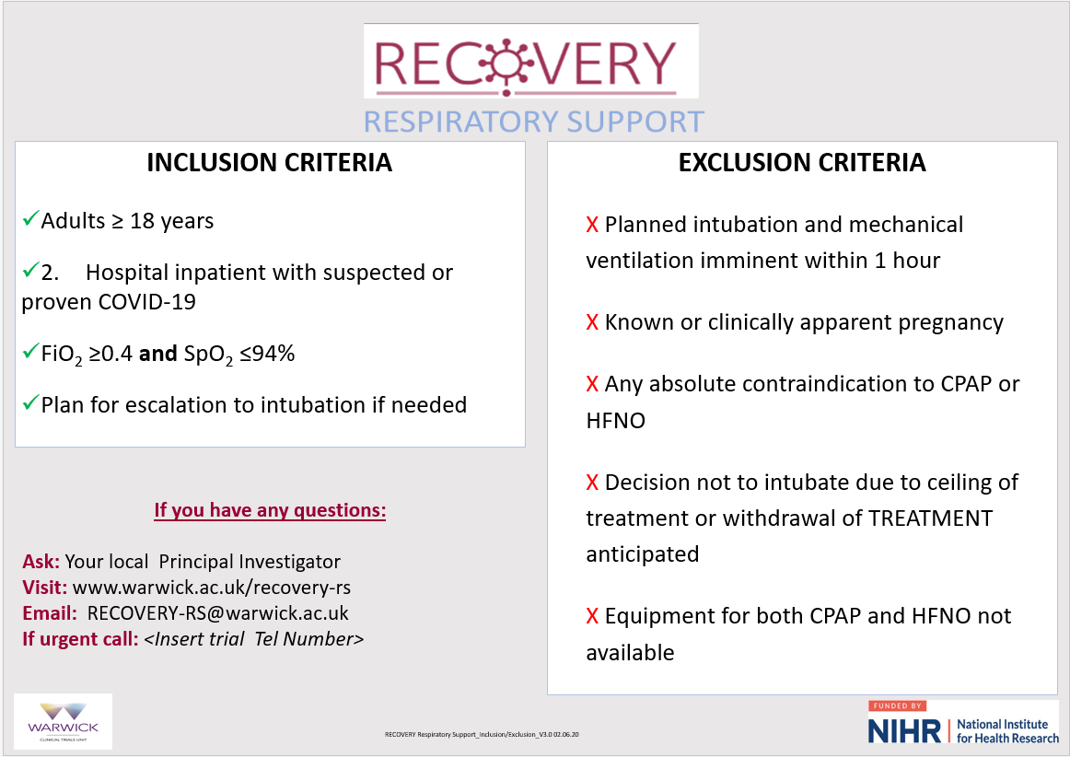
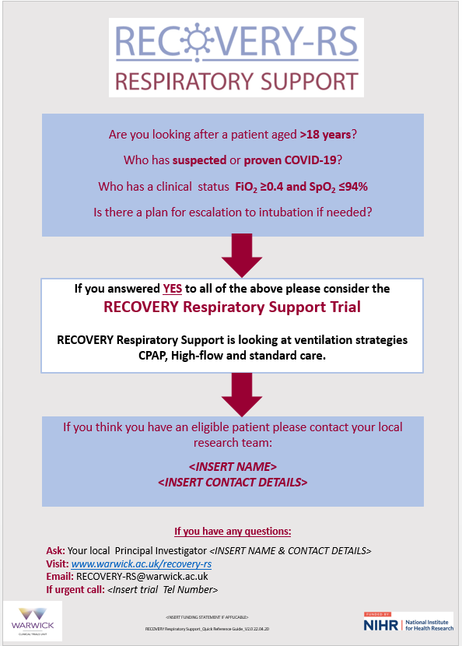
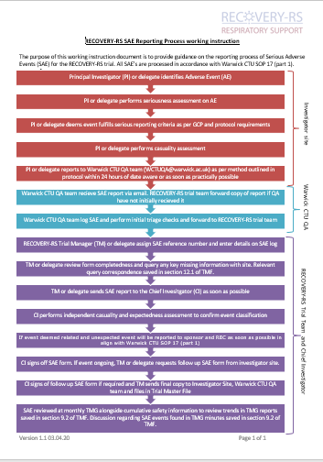
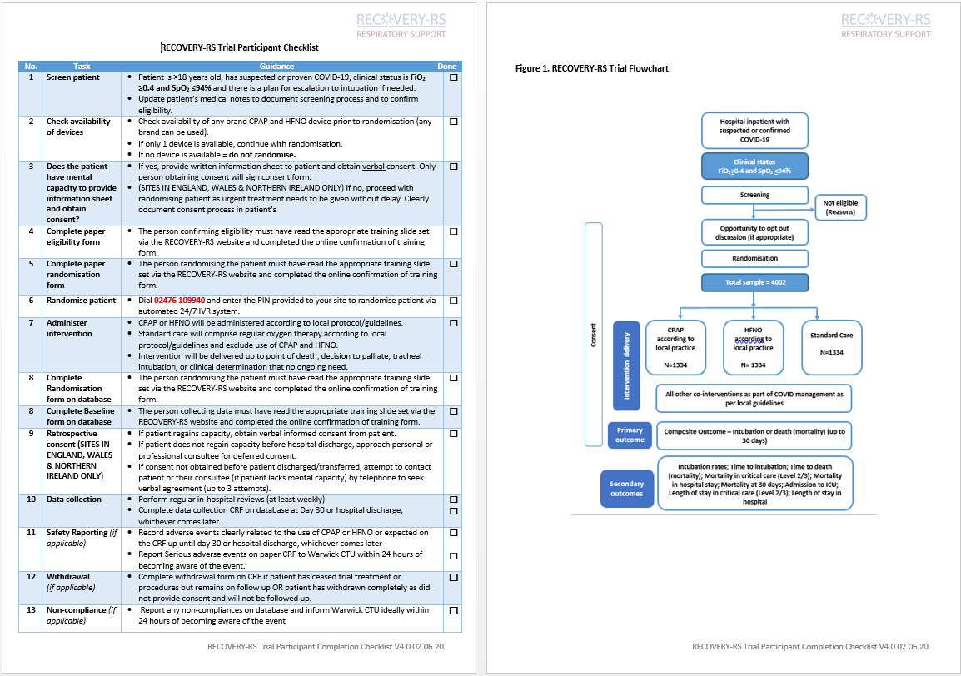
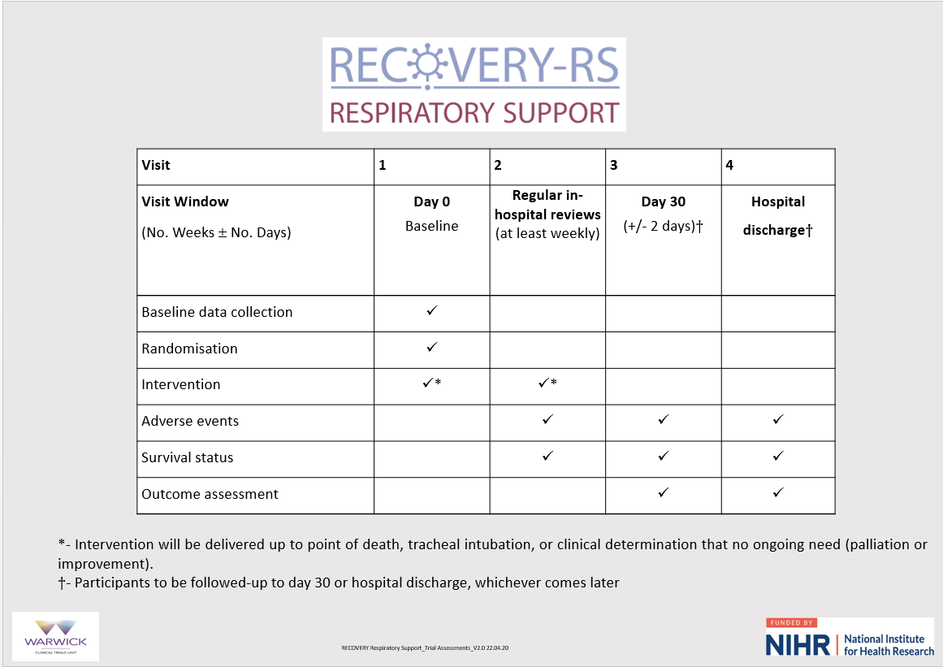
Aide memoirs – available on website

