Slide 1

RECOVERY-RS Respiratory Support: Respiratory Strategies in COVID-19; CPAP, High-flow, and standard care
Site Initiation Visit
V6.0 04 June 2020

Slide 2





Acknowledgements

Slide 3
General Study Information
Chief Investigator | Prof. Gavin Perkins & Prof. Danny McAuley
Sponsor | University of Warwick
Funder | National Institute for Health Research
Co-ordinating Centre | Warwick Clinical Trials Unit
Contact | RECOVERY-RS@warwick.ac.uk
Website | www.warwick.ac.uk/recovery-rs

Slide 4
Background and need for trial
COVID-19: wide spectrum of clinical severity, ranging from asymptomatic to critically illness
Acute hypoxaemic respiratory failure- important complication
Excess demand on limited ventilator availability and critical care bed capacity is currently being witnessed worldwide
Uncertainty as to best strategy to reduce need for tracheal intubation in COVID-19

Slide 5
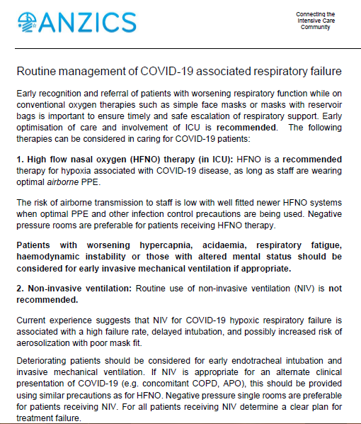

Slide 6
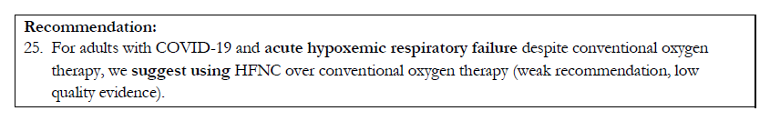

Slide 7
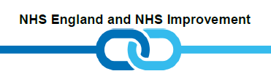
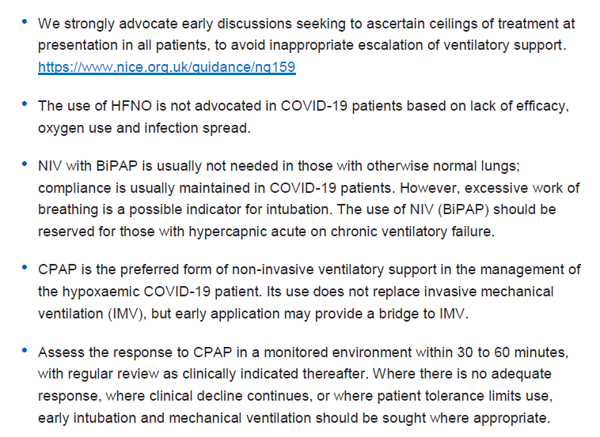

Slide 8
What are sites doing in practice?
Variable practice
Oxygen only pathway – straight to intubation
CPAP, with potential for HFNO
No CPAP – oxygen therapy
HFNO

Slide 9

Editorial from Ireland
Don’t dismiss role of HFNO

Slide 10
Need for trial
COVID-19
  New disease; different physiology
  Evidence base for interventions lacking
  Other anecdotal therapies (anti-IL-G, hydroxychloroquine, MSCs) now being evaluated in clinical trials
  Benefits and potential risks of each approach
  BUT….no high quality evidence base for guiding clinical practice
Urgent need for trial of High Flow Nasal Oxygen (HFNO) vs Continuous Positive Airway Pressure (CPAP) vs standard care oxygen

Slide 11
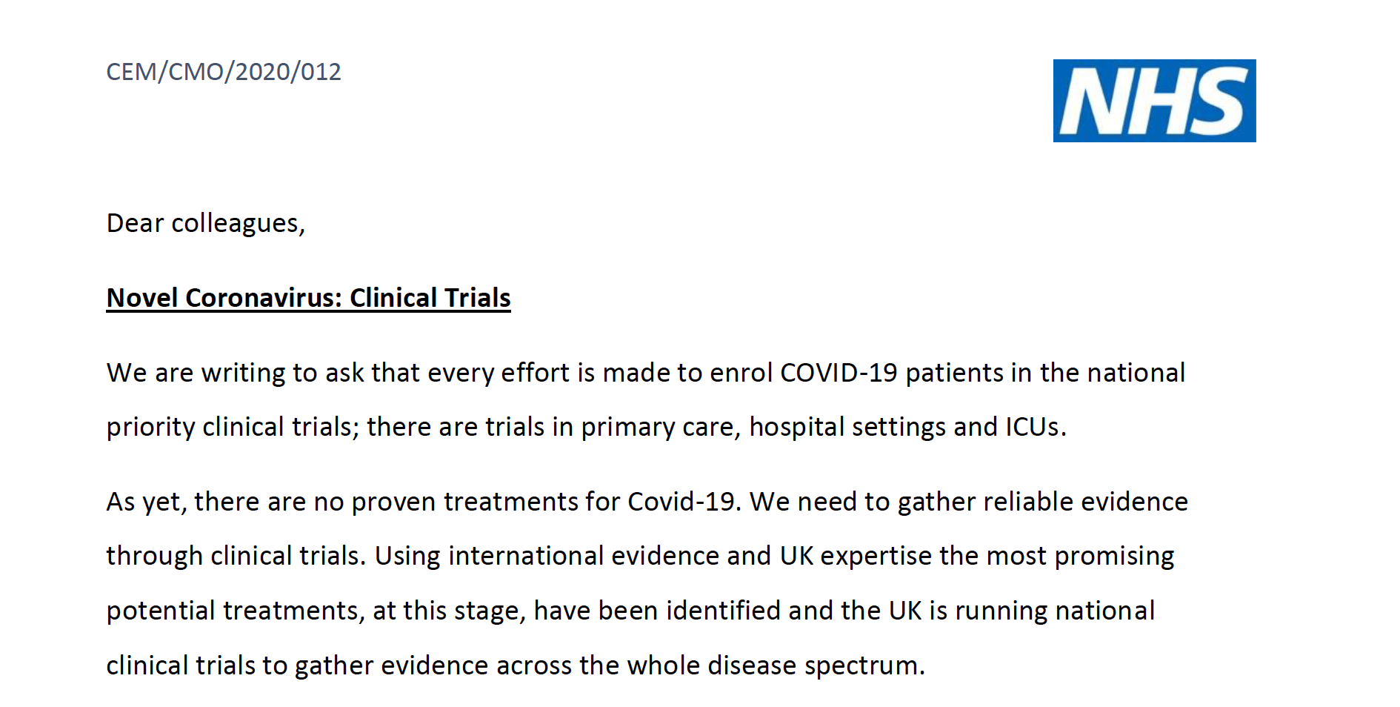


RECOVERY-RS is listed as a priority UPH study:
https://www.nihr.ac.uk/covid-studies/study-detail.htm?entryId=282338

Slide 12
Aim of trial
To determine if CPAP or HFNO is clinically effective compared to standard care (excluding CPAP or HFNO) in relation to intubation and mortality in patients with confirmed or suspected COVID-19

Slide 13
Design
Adaptive, randomised controlled, open label trial comparing CPAP vs HFNO vs standard care*
Multi-centre 60+ NHS hospitals or purpose built-hospitals
Adult, critically ill patients, with suspected or confirmed, COVID-19
Overall recruitment target 4002 patients over 12 months
* Uncertainty/equipoise between UK and ANZICS guidance regarding the use of CPAP and HFNO

Slide 14
Outcomes
Primary outcome
Intubation or mortality
within 30 days
Secondary outcomes
Intubation rates
Duration of invasive ventilation
Time to intubation
Time to death (mortality)
Mortality in critical care (level 2/3)
Mortality in hospital stay
Mortality at 30 days
Admission to ICU
Length of stay in critical care (level 2/3)
Length of stay in hospital
AEs/SAEs

Slide 15

Eligibility
Inclusion criteria
Adults ≥ 18 years
Hospital inpatient with suspected or proven COVID-19
FiO₂ >0.4 and SpO₂ <94%*
Plan for escalation to intubation if needed
Exclusion criteria
Planned intubation and mechanical ventilation imminent within 1 hour
Known or clinically apparent pregnancy
Any absolute contraindication to CPAP or HFNO
Decision not to intubate due to ceiling of treatment or withdrawal of treatment anticipated
Equipment for both CPAP and HFNO not available
*Requirement for oxygenation should be ongoing (not transient)

Slide 16
Screening
Site research team attend/contact hospital clinical areas
Treating known or suspected COVID-19 patients
Liaise with clinical staff to identify patients
Acute Hypoxaemic Respiratory Failure
Doctor/nurse/research team can assess and confirm eligibility prior to randomisation – complete eligibility form
Justification for patient meeting all eligibility criteria
Clearly documented in the patient’s medical notes

Slide 17
Randomisation
Check availability of CPAP and/or HFNO device prior to randomisation (any brand of device can be used)
None
Do not randomise
Option 1 Randomisation
CPAP vs standard care
Devices available?
Only one
(CPAP or HFNO)
Option 2 Randomisation
HFNO vs standard care
Both CPAP & HFNO available
Option 3 Randomisation
CPAP vs HFNO vs standard care

Slide 18
Randomisation
Patients will be randomised to a 1:1:1 ratio
Interactive Voice Response (IVR) system (24/7 service) Call 02476 109940
PIN access to be provided by email following ‘green light’ to begin recruitment – generic username for each site
                *PID is redacted on entry
Completed paper form to be filed in ISF
Complete
Randomisation form Paper
Randomise
Using IVR
Database
PID to be entered directly into database*

Slide 19
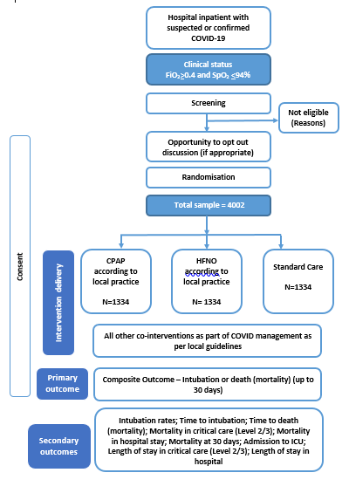
Trial Flow Diagram

Slide 20
Trial Interventions
Ensure clear plans and safety measures in place in relation to oxygen usage and flow
1. Continuous Positive Airway Pressure
2. High Flow Nasal Oxygen
3. Standard care
CPAP will be administered according to local protocol/guidelines. Details of initial settings (PEEP and FiO₂) will be recorded on the CRF
HFNO will be administered according to local protocol/guidelines
Standard care will comprise regular oxygen therapy according to local protocol/guidelines, and exclude use of CPAP and HFNO
Administration of all interventions are left to clinical discretion for management

Slide 21


Trial Interventions
Ensure clear plans and safety measures in place in relation to oxygen usage and flow
1. Continuous Positive Airway Pressure
2. High Flow Nasal Oxygen
Both intervention arms are aerosol generating. Ensure appropriate PPE (as per national guidelines) are used.
Administration of all interventions are left to clinical discretion for management

Slide 22
Safety Alert: High-Flow Oxygen
Dr Ganesh Suntharalingam - President, Intensive Care Society
Urgently ensure liaison between clinicians and hospital oxygen engineering teams to ascertain:
the maximum flow rate from your VIE
any additional limitations to oxygen delivery owing to pipework architecture
calculate the maximum number of patients who can be treated with high flow devices such as wall CPAP and communication of this to the relevant clinical teams
undertake a daily count of the number of high-flow systems where the potential oxygen flow rate exceeds 10 L/min (this will include most wall CPAP systems, High Flow Nasal Oxygen (HFNO), some non-invasive ventilators used in acute settings, and many ventilators used in critical care units or operating theatres)
implement safety measures to prevent accidental O2 system failure (such as limiting the number of these devices available for clinical use)
“low oxygen pressure alarms” = indication of approaching flow limitation
TAKE URGENT ACTION: Review usage, reduce demand, escalate for engineering assistance

Slide 23
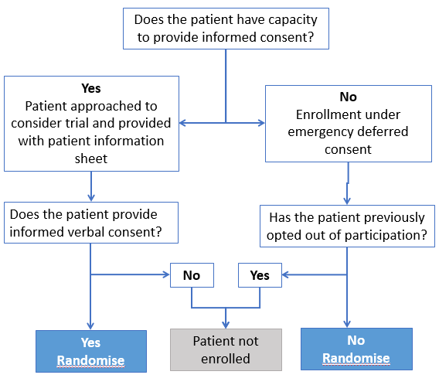
Consent process (England, Wales and Northern Ireland)
*
* Ensure the patient is informed if only one intervention (CPAP or HFNO) is available
Notes:
Main process

Slide 24
Deferred consent (England, Wales and Northern Ireland)
If patient regains capacity, they should be given the option to consent/withdraw
* Long version available on website if requested
Documents including the PIS can be found on the website
If consent not obtained before patient discharged/transferred, attempt to contact patient or their consultee (if patient lacks mental capacity) by telephone to seek verbal agreement (up to 3 attempts).
Provide details of website which contains PIS to download (www.warwick.ac.uk/recovery-rs/patients)
Explain
Trial and go through short Patient Information Sheet*
Consent
Obtain VERBAL CONSENT ONLY from patient
Document
Verbal consent on deferred consent form

Slide 25
Consultee opinion (England, Wales and Northern Ireland)
If patient does not re-gain capacity by hospital discharge, approach a personal or professional consultee
Personal consultee before professional consultee, if there is one available
* Long version available on website if requested
Documents available on website under Patient Tab
Explain
Trial and go through short Patient Information Sheet*
Objection
Ask if objection to research expressed by patient
Document
Verbal confirmation of non objection on declaration form
Notes:
Due to visiting restrictions, it is likely that a personal consultee will not be available, in which case the opinion of a professional consultee will be sought.
Likely that personal consultee consent will be several days after enrolment.

Slide 26
Deferred Consent
The deferred consent process, including assessment of capacity, will be undertaken by a member of the team delivering the trial at the hospital (e.g. doctor, nurse, research practitioner)
Personal Consultee
Contact by telephone
Documents available on website
A person who is:
engaged in caring for the participant (not professionally or for payment) or is interested in his/her welfare, and
is prepared to be consulted
Professional Consultee
Ordinarily registered medical practitioner who has no connection with the trial and is willing to be consulted

Slide 27
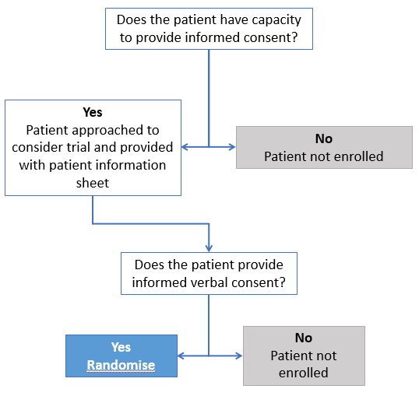
Consent process (Scotland)
Ensure the patient is informed if only one intervention (CPAP or HFNO) is available
Notes:
Main process

Slide 28
Consent process (Scotland)
For patients that lack capacity, it is not practical or appropriate to consult a guardian/welfare attorney prior to enrolment without placing the potential participant at risk of harm from delaying treatment.
These processes will also not be feasible or safe to undertake in order to minimise risk of viral transmission to those involved.
Significant limitations have been placed on the visitation of COVID-19 patients and therefore a guardian is unlikely to be immediately be available, and to attempt contact via telephone will delay treatment. Therefore these patients will not be entered into the study as Scottish regulation do not allow emergency deferred consent.
Notes:
Main process

Slide 29
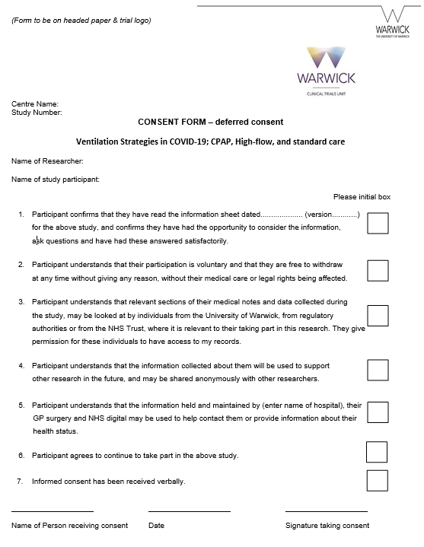
Consent process
Consent should be received verbally from both patients and consultees to reduce risk of infection transmission
Only person receiving consent should sign the consent/declaration form
Three signed copies:
  One for ISF
  One for patient/consultee
  One for medical notes
Do not send copies of consent forms to Warwick CTU. They should be stored securely at site
Consent should be documented in the patient’s medical notes

Slide 30
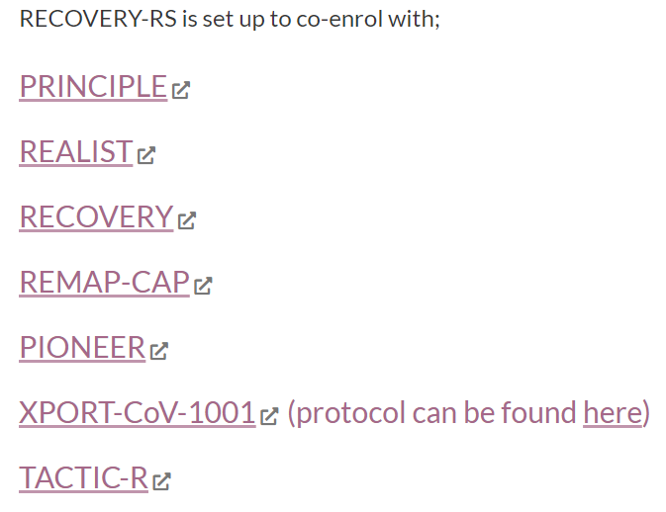
Co-enrolment
Co-enrolment will be reviewed on a case-by-case basis in accordance with NIHR-supported co-enrolment guidelines
We will maintain a list of trials we are co-enrolling with on the trial website

Slide 31
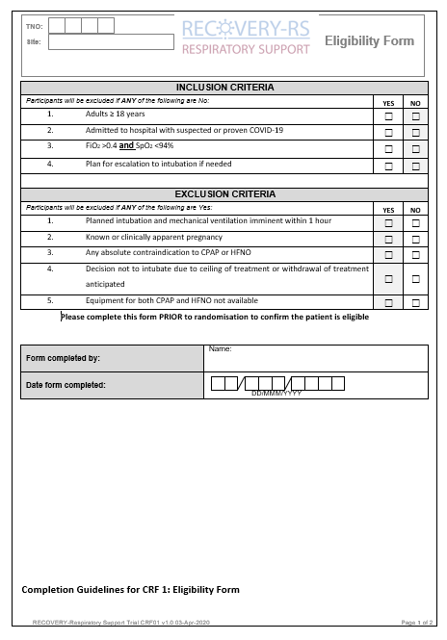
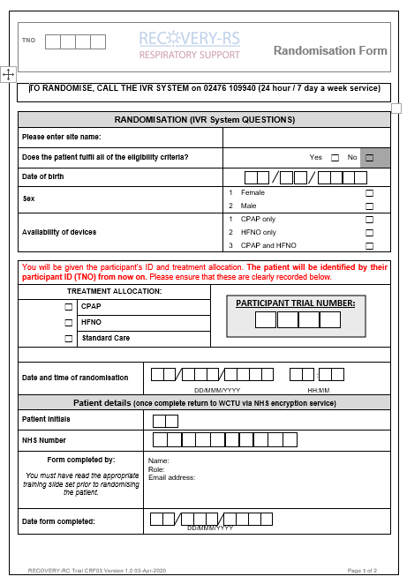
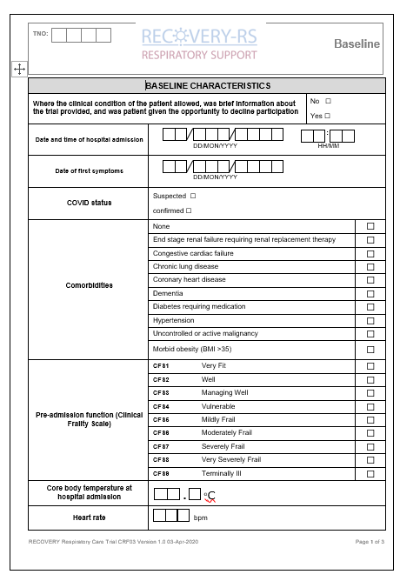
Data entry / eCRF
Bespoke online database - initial data to be entered:
* To include Personal Identifiable Data
Eligibility Form
Randomisation Form *
Baseline Form

Slide 32

Data entry / eCRF
Generic site user ID
Provided by email
following ‘green light’ approval
Paper/Electronic
Optional whether paper CRF’s
used prior to entry
Personal Identifiable Data
Collected on Randomisation CRF and entered onto the randomisation eCRF. PID will be anonymised upon data entry to allow storage

Slide 33
Data collection
Visit | 1 | 2 | 3 | 4
Visit Window (No. Weeks ± No. Days) | Day 0 Baseline | Regular in-hospital reviews (at least weekly) | Day 30 (+/- 2 days)† | Hospital discharge†
Baseline data collection | ✓
Randomisation | ✓
Intervention | ✓* | ✓*
Adverse events |  | ✓ | ✓ | ✓
Survival status |  | ✓ | ✓ | ✓
Outcome assessment |  |  | ✓ | ✓
*- Intervention will be delivered up to point of death, decision to palliate, tracheal intubation, or clinical determination that no ongoing need
†- Participants to be followed-up to day 30 or hospital discharge, whichever comes later

Slide 34
Follow up
If patient still in hospital complete follow-up eCRF at 30 days post randomisation or hospital discharge whichever is the later
*If patient discharged before day 30, trial team will obtain survival data through data linkage
Data Collection
ICU/hospital admission status
Ventilation duration
AEs (treatment failure, need for other treatments, renal function, renal replacement therapy)
Survival status*

Slide 35
Withdrawal
Participants may be discontinued from the trial treatment and/or the trial at any time without prejudice
Please notify Warwick CTU of any withdrawals
Complete the withdrawal form on the online database
Data Collected
Data collected up until withdrawal point will automatically be used unless participant specifically requests otherwise
Follow-up
Unless a participant explicitly withdraws their consent, they will be followed-up wherever possible and data collected as per the protocol until the end of the trial
Withdrawal Options
Withdraw from trial treatment
Withdraw completely
Document
Date of withdrawal in Medical Notes

Slide 36
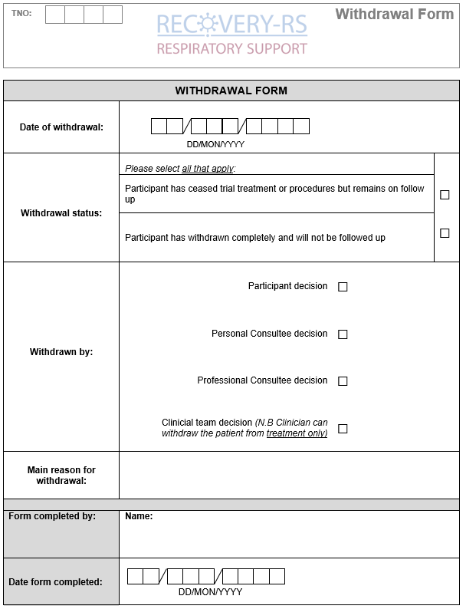
Withdrawal form

Slide 37
Safety reporting
Only AE’s listed below and clearly related to the use of CPAP or HFNO or expected to be recorded. Record AE’s on the online database
The following are expected adverse events and will be recorded in the CRF; they predominantly relate to the use of CPAP, as there are minimal AEs reported for HFNO:
Interface intolerance due to excessive air leaks
Pain
Cutaneous pressure sore or pressure area
Claustrophobia
Oro-nasal dryness
Respiratory acidosis with pH <7.25 prior to intubation
Haemodynamic instability
Vomiting
Aspiration of gastric contents
Notes:
PI to assess causality

Slide 38
Safety reporting
Only SAEs that occur from the time of randomisation, through to and including 30 days after cessation of trial intervention, must be reported to WCTU
Scan and email completed SAE forms to WCTUQA@warwick.ac.uk within 24 hours, or as soon as is practicable, of becoming aware of the event
Events that do NOT need to be reported as SAEs:
  Death
  Organ failure
  Pneumonia
  Intubation
  Tracheostomy
Notes:
PI to assess causality

Slide 39
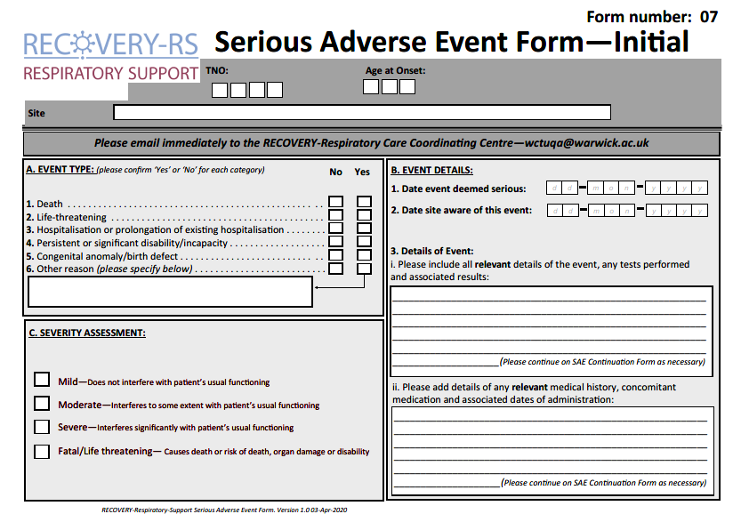
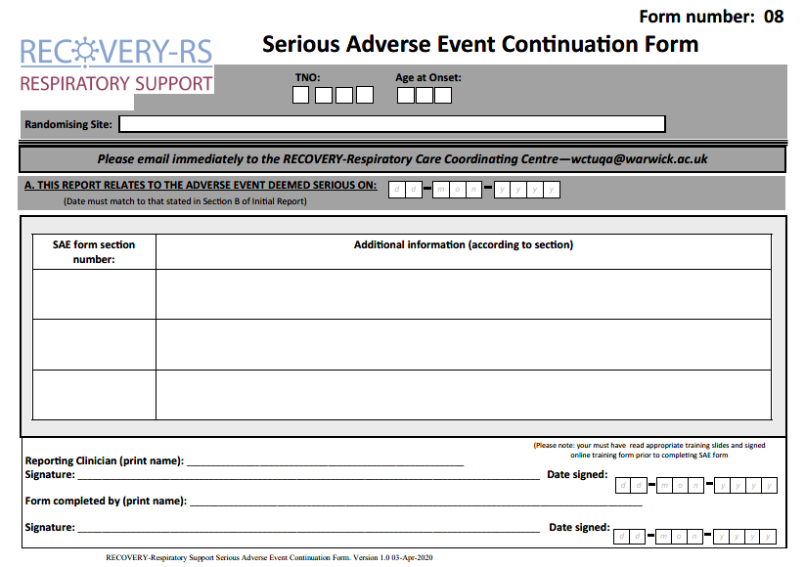
SAE forms

Slide 40
Study oversight
Investigator Site File (ISF)
Available on website
Close Out
Resolve any outstanding queries
Collect any outstanding data
Ongoing responsibilities
Site to archive trial documentation and data (at least 10 years)
Monitoring
Central monitoring approach will be developed that will take into account the challenging circumstances and staff pressures
Notes:
How do you want to be informed of amendments?

Slide 41
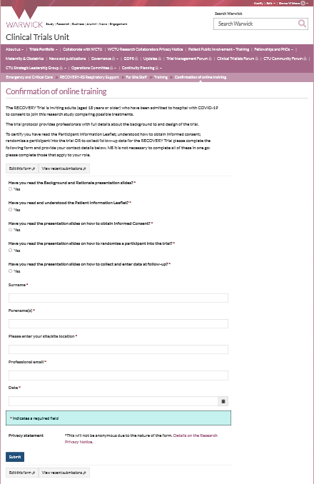
Training requirements QA
Training is available on the trial website
As a minimum the PI of the site must complete and sign off all training modules on the website
PI to ensure that staff (e.g. doctor, nurse, research practitioner) have the appropriate knowledge and understanding of trial
All training should be recorded on the Confirmation of Online Training Form
Optional GCP training available on website
There is no need for the PI to provide a CV and GCP certificate.

Slide 42
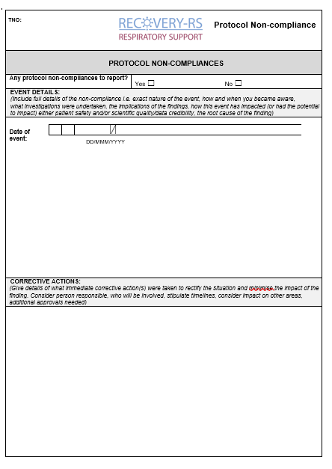
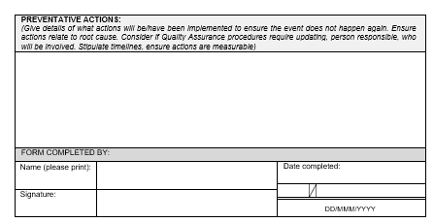
Non-compliance
Report any non-compliances immediately to WCTU straight onto online database
(within 24 hours of becoming aware)
Examples of non-compliances:
Patient doesn’t receive intervention they are randomised to
Patient is ineligible
Patient Identifiable Data sent without encryption
Staff member not completed trial training on website
No active effort to follow up patients to obtain retrospective consent if they regain capacity or to approach consultee for consent
Patient requests withdrawal of data but site does not inform Warwick CTU

Slide 43
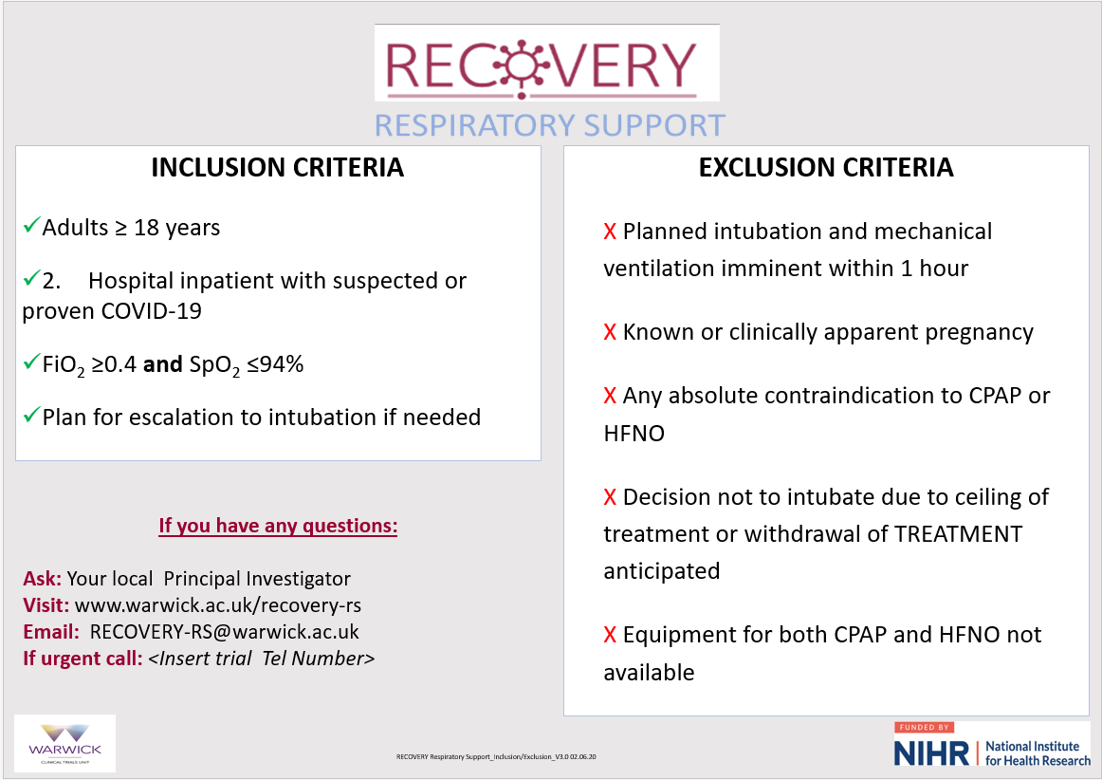
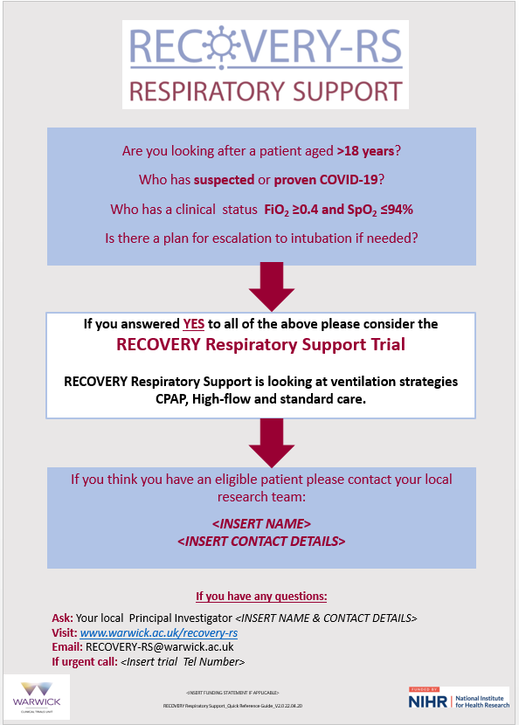
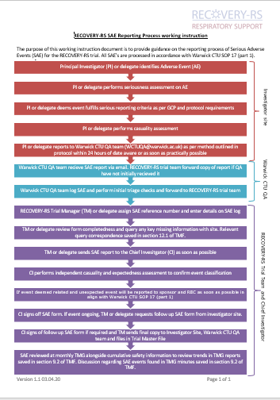
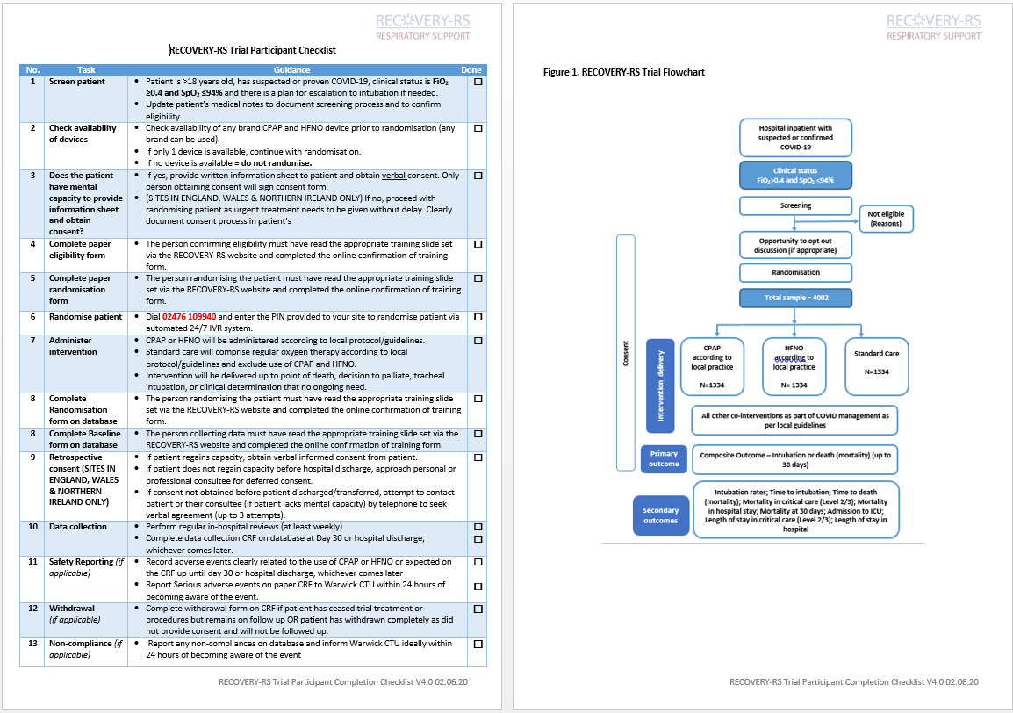
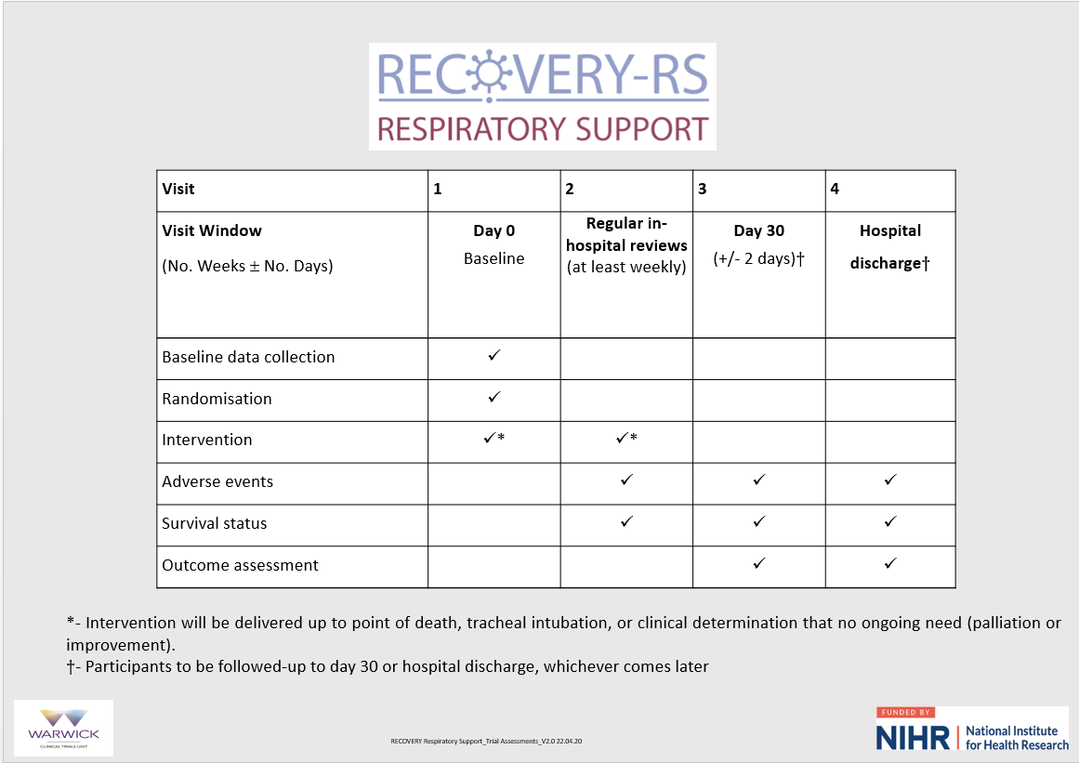
Aide memoirs – available on website

Slide 44

Questions?

