Slide 1










Welcome to
CRF Clinic
Registration, Baseline Assessment, Eligibility and Randomisation CRFs
Thursday 20th July 2023 12:00-12:30
Housekeeping:
This meeting is being recorded
Mute your microphone on joining
You can submit questions via the Q&A section at the top of the webinar
  There will be dedicated Q&A time at the end of the session

Slide 2
Registration to Randomisation Process & CRFs
Complete
Randomisation CRF (on paper)
Randomise
Using IVRS
Register
via trial database
Baseline Assessment and Eligibility CRFs
Completed on Database
First Dispense of IMP
within one working day of randomisation
Confirmation of Patient Consent
Trial Participant Number Allocation
Snapshot of patient clinical parameters when entering the trial
Complete and enter on the trial database PRIOR to Randomisation
Confirmation of Patient Eligibility
Collect 16 weeks of FBC & transfusion history from medical notes, or from registration
Schedule Trial Specific Assessments
Confirm consent verbally with the patient prior to randomising
Collation of data required to randomise to hand for the IVRS call
Trial Treatment Allocation
Explain dosing regimen to patient, issue Patient Diary card and ID card
Generate Prescription
Dispense and Start IMP
First Dispense of IMP within one working day of randomisation.
The patient should start IMP within 3 days of randomisation at the latest

Slide 3
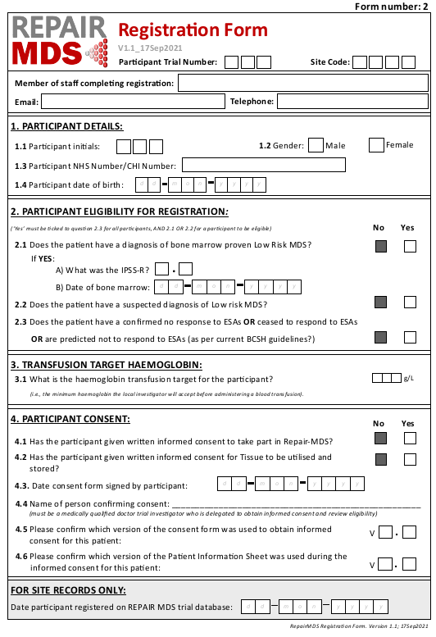
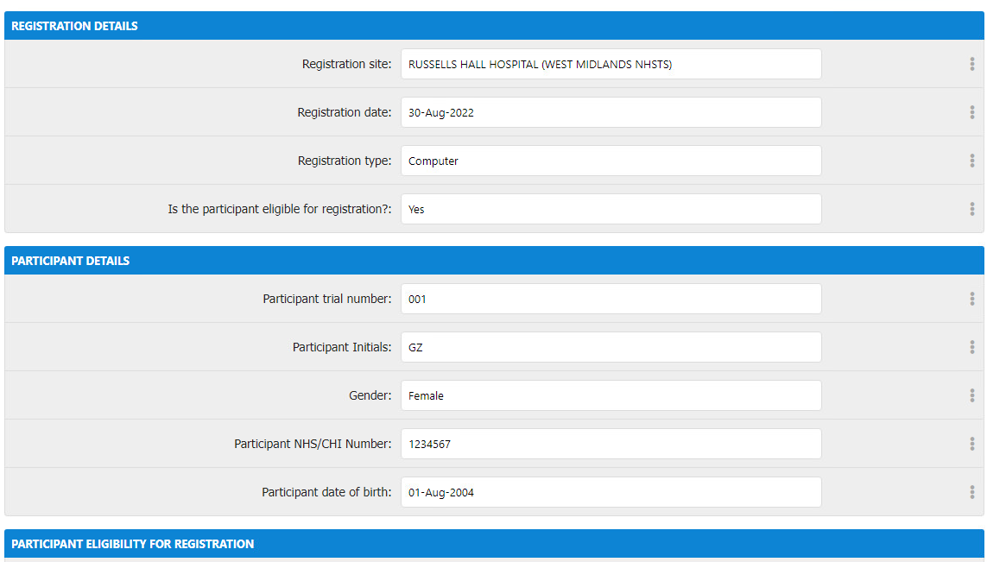

Registration Form V1.1
Complete
Randomisation CRF (on paper)
Randomise
Using IVRS
Register
via trial database
Baseline Assessment and Eligibility CRFs
Completed on Database
First Dispense of IMP
within one working day of randomisation
Provides:
Patient Details
Eligibility for Registration – Snapshot of the patient at the point of registration
Sets a Haemoglobin Transfusion Target
Provides details of consent and PIL used
When Complete a Registration From?
Confirmed as eligible for REGISTRATION
Given the PIL and sufficient time to consider the trial
Patient confirms they would like to become a participant
Notes:
Specific database training will be arranged

Slide 4
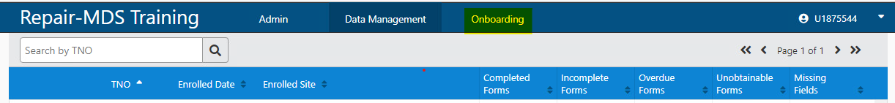
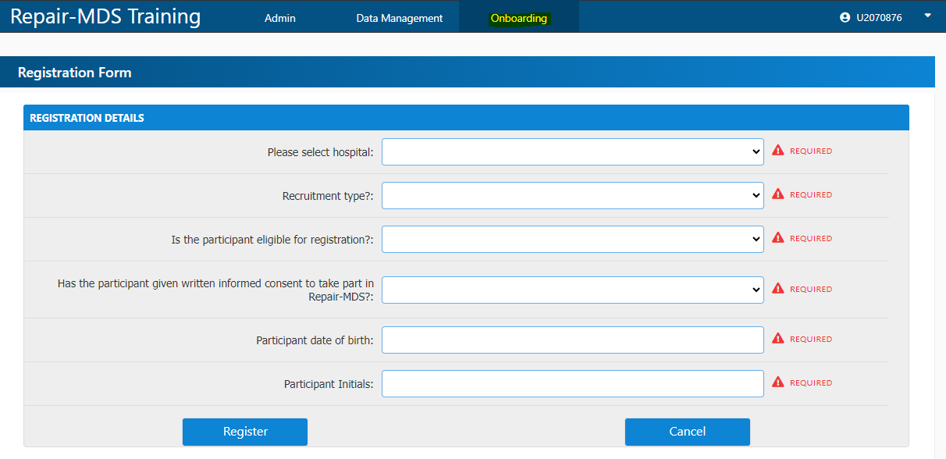
How to Register a Patient
Obtain Consent from the patient using the current ICF form
Review the CRF (paper or Database via “Onboarding” tab) and collect all the information required
Access the Trial Database to allocate the Trial Number (TNO) by completing the “Onboarding” tab
Please note: A participant is not “registered” for recruitment figures until a TNO is allocated.
Only 4 fields required for 1st step of registration for TNO Allocation:
  1. Is the participant eligible for registration?
  2. Has the participant given written informed consent to take part in REPAIR-MDS?
  3. Participant date of birth
  4. Participant Initials
Notes:
Specific database training will be arranged
If you are not sure if a registration has been successful go back to the participant manger page and you will be able to see if a new TNO has been Allocated

Slide 5
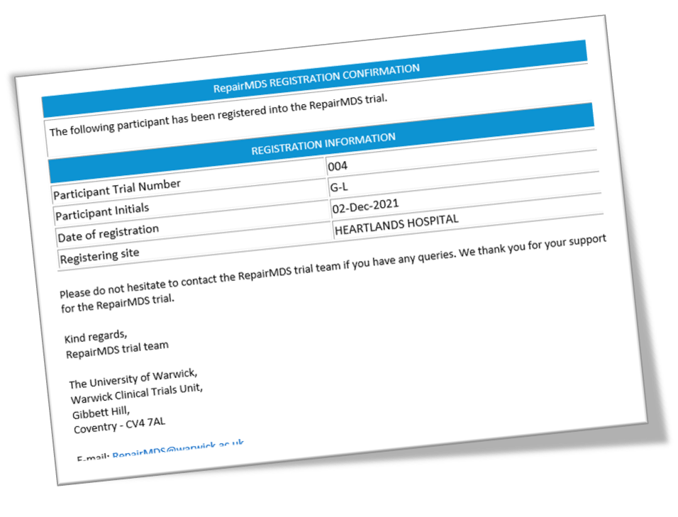
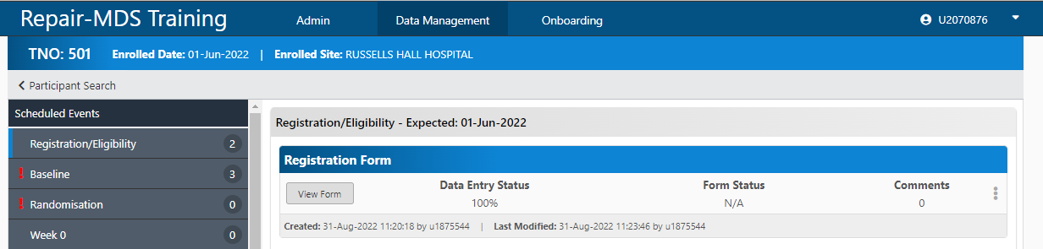
How to Register a Patient
Obtain Consent from the patient using the current ICF form
Review the CRF (paper or Database via “Onboarding” tab) and collect all the information required
Access the Trial Database to allocate the Trial Number (TNO) by completing the “Onboarding” tab
Nominated Site Team members and trial office will receive confirmation of registration via email
Enter further fields on Registration Form via “Participant manager” under “Data Management” tab
Notes:
Specific database training will be arranged

Slide 6
Registration Form V1.1 – Reminders
Patients must EITHER:
  have a bone marrow proven diagnosis of low risk MDS
  OR
  suspected diagnosis of low risk MDS to be registered.
Bone samples should be taken after registration and within Baseline Assessment Period for IPSS-R calculation and confirmation of the patient’s eligibility prior to randomisation.
4.2 Has the participant given written informed consent for Tissue to be utilised and stored? refers to the participant’s consent to providing Samples for Science
The date of bone marrow performed during baseline should not be entered on the registration form

Slide 7

Registration to Randomisation Process & CRFs
Complete
Randomisation CRF (on paper)
Randomise
Using IVRS
Register
via trial database
Baseline Assessment and Eligibility CRFs
Completed on Database
First Dispense of IMP
within one working day of randomisation
Confirmation of Patient Consent
Trial Participant Number Allocation
Snapshot of patient clinical parameters when entering the trial
Complete and enter on the trial database PRIOR to Randomisation
Confirmation of Patient Eligibility
Collect 16 weeks of FBC & transfusion history from medical notes, or from registration
Schedule Trial Specific Assessments
Confirm consent verbally with the patient prior to randomising
Collation of data required to randomise to hand for the IVRS call
Trial Treatment Allocation
Explain dosing regimen to patient, issue Patient Diary card and ID card
Generate Prescription
Dispense and Start IMP
First Dispense of IMP within one working day of randomisation.
The patient should start IMP within 3 days of randomisation at the latest

Slide 8

Registration to Randomisation Process & CRFs
Complete
Randomisation CRF (on paper)
Randomise
Using IVRS
Register
via trial database
Baseline Assessment and Eligibility CRFs
Completed on Database
First Dispense of IMP
within one working day of randomisation
Confirmation of Patient Consent
Trial Participant Number Allocation
Snapshot of patient clinical parameters when entering the trial
Complete and enter on the trial database PRIOR to Randomisation
Confirmation of Patient Eligibility
Collect 16 weeks of FBC & transfusion history from medical notes, or from registration
Schedule Trial Specific Assessments
Provides:
The data required to confirm Patient Eligibility & the baseline which Haematological Improvement will be measured against for each patient
Overview of the patient’s health prior to starting IMP
When Complete a Baseline From?
After registration and prior to randomisation
MUST be complete on the database prior to randomising
Confirm consent verbally with the patient prior to randomising
Collation of data required to randomise to hand for the IVRS call
Trial Treatment Allocation
Explain dosing regimen to patient, issue Patient Diary card and ID card
Generate Prescription
Dispense and Start IMP
First Dispense of IMP within one working day of randomisation.
The patient should start IMP within 3 days of randomisation at the latest

Slide 9
How to Complete Baseline Assessment Form V2.0
1. Collate all the data required by:
  Reviewing the medical notes for the historic data available
  Arrange appointments for study specific investigations
Study specific investigations must be done after consent has been given by the patient and a TNO has been allocated (after Registration)
Data Collection from Existing Medical Notes | Study Specific Investigations
Full Blood Counts | Bone Marrow (including cytogenetics)
Transfusion History | Liver and Spleen Ultrasound
 | ECG
 | Blood Film
 | Baseline Assessment Bloods
Up to 16 weeks of historic data can be collated from the patients' medical notes for Full Blood Counts and transfusion history
Notes:
Confirmation of Patient Eligibility
16 weeks of FBC & transfusion history required:
Retrospective – results from the patients notes/ record
Prospective – investigations planned prior to randomisation
OR a Combination e.g., 8 weeks from medical notes and 8 weeks between registration and randomisation

Slide 10
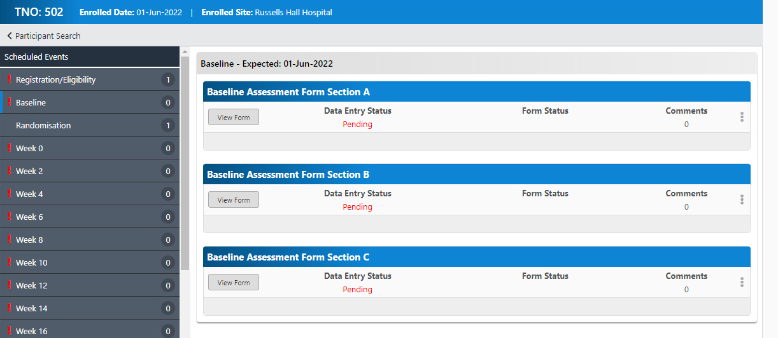
How to Complete Baseline Assessment Form V2.0
2. Enter the data on the trial database:
  Baseline Assessment form is broken down into 3 sections on the database – all need to be completed!

Slide 11
How to Complete Baseline Assessment Form V2.0
2. Enter the data on the trial database:
  Baseline Assessment form is broken down into 3 sections on the database – all need to be completed!

Slide 12
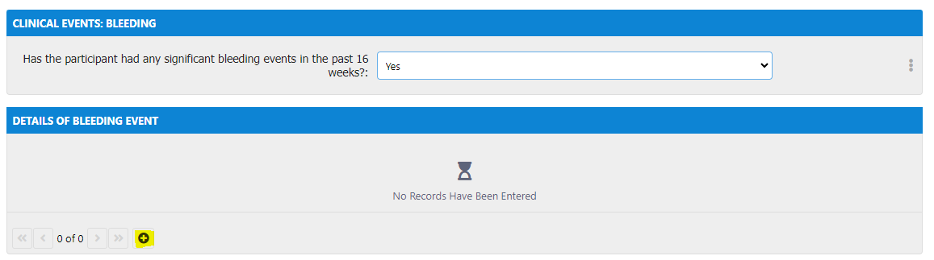
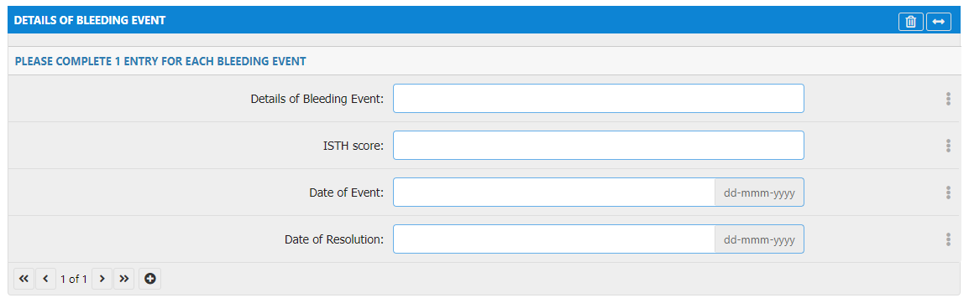
How to Complete Baseline Assessment Form V2.0
2. Enter the data on the trial database:
  Baseline Assessment form is broken down into 3 sections on the database – all need to be completed!
  Provide all FBCs recorded for the patient within the Baseline Assessment Period. At least 2 pre-transfusions FBCs taken 7 days apart are required
Remember to activate the sub-forms across the CRF by:
Activate the sub-form by clicking on the little “+” icon (highlighted in yellow)
Enter the data in the newly active fields
Add as many sub-form pages you need by clicking on the “+” again
Remember to save the form before exiting the CRF

Slide 13
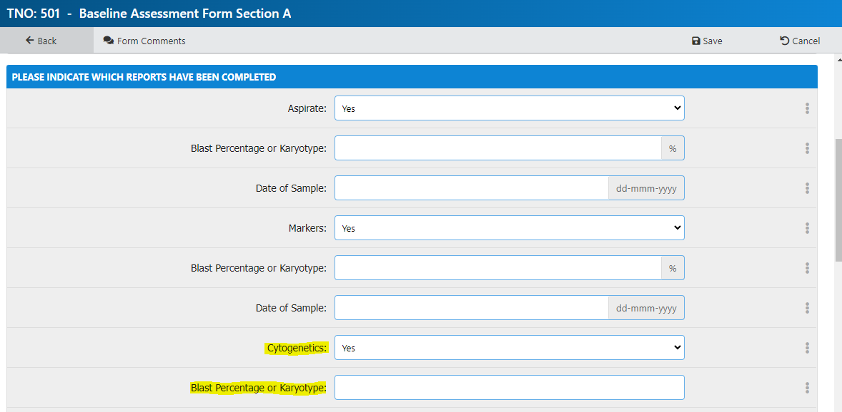
How to Complete Baseline Assessment Form V2.0
3. Enter bone marrow Cytogenetics results under “Blast Percentage or Karyotype”. As a minimum, please confirm the cytogenetics category.
4. Enter the start and stop date for current medications:
  If the exact date is unknown, please enter at least the year and set the month the “June”.
  If the medication is ongoing, please tick “Ongoing”.
Cytogenetic prognostic subgroups | Cytogenetic abnormalities
Very good | -Y, del(11q)
Good | Normal, del(5q), del(12p), del(20q), double including del(5q)
Intermediate | del(7q), +8, +19, i(17q), any other single or double independent clones
Poor | -7, inv(3)/t(3q)/del(3q), double including -7/del(7q), Complex: 3 abnormalities
Very poor | Complex: >3 abnormalities

Slide 14
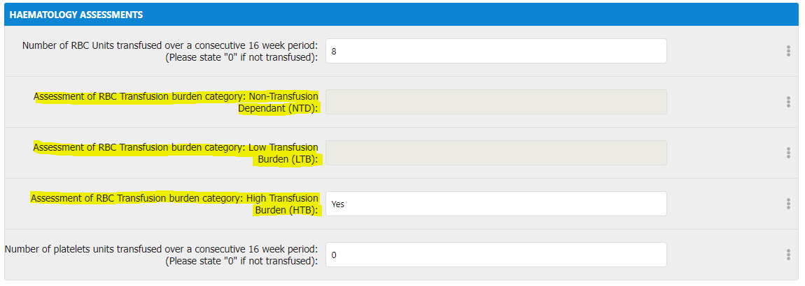
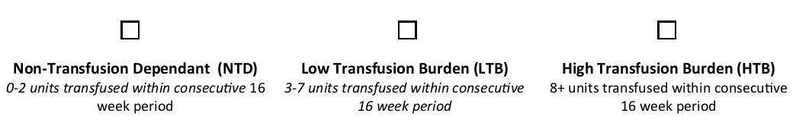
How to Complete Baseline Assessment Form V2.0
5. The below investigations are essential results for calculation of the IPSS-R score and confirmation of patient eligibility prior to randomisation:
  FBC (Haemoglobin, Absolute Neutrophil Count,Platelets)
  Bone Marrow (Blasts, Cytogenetics)
6. Select which RBC Transfusion Burden category applies (i.e. NTD, LTB or HTB) according to the number of units transfused within consecutive 16-week baseline assessment period
Ensure results used for calculation of IPSS-R score are documented in the medical notes.
IPSS-R Score Calculator: https://www.mds-foundation.org/ipss-r-calculator/

Slide 15
Eligibility Form v1.0 – Key Reminders
Register
via trial database
Baseline Assessment and Eligibility CRFs
Completed on Database
Complete prior to Randomisation
Confirmation of Patient Eligibility
Eligibility must be assessed and confirmed by a medically qualified member of the team who is included on the site delegation log
The question; “Is the participant a woman of childbearing potential, pregnant or lactating” Should only be ticked ‘N/A’ if the patient is male.
If the patient is deemed not eligible prior to randomisation, confirm the reason(s) as to why the patient is not eligible
  E.g., If the patient is ineligible due to IPSS-R Score being less or equal to 3.5 than the question: “Does the participant have a diagnosis of Myelodysplastic Syndrome with an IPSS-R Score of less than or equal to 3.5” should be ticked as “No”

Slide 16
Registration to Randomisation Process & CRFs
Complete
Randomisation CRF (on paper)
Randomise
Using IVRS
Register
via trial database
Baseline Assessment and Eligibility CRFs
Completed on Database
First Dispense of IMP
within one working day of randomisation
Confirmation of Patient Consent
Trial Participant Number Allocation
Snapshot of patient clinical parameters when entering the trial
Complete and enter on the trial database PRIOR to Randomisation
Confirmation of Patient Eligibility
Collect 16 weeks of FBC & transfusion history from medical notes, or from registration
Schedule Trial Specific Assessments
Confirm consent verbally with the patient prior to randomising
Collation of data required to randomise to hand for the IVRS call
Trial Treatment Allocation
Explain dosing regimen to patient, issue Patient Diary card and ID card
Generate Prescription
Dispense and Start IMP
First Dispense of IMP within one working day of randomisation.
The patient should start IMP within 3 days of randomisation at the latest

Slide 17
Randomisation Form V1.0 – Key Reminders
Complete
Randomisation CRF (on paper)
Randomise
Using IVRS
Register
via trial database
Baseline Assessment and Eligibility CRFs
Completed on Database
First Dispense of IMP
within one working day of randomisation
Ensure that the stratification variables are correct prior to randomising via the IVRS system:
  Transfusion Dependence Category
  Prognostic Scoring System
  for MDS (IPSS-R) Score
  3. Participant’s Age at Randomisation
Centrally we will calculate the Transfusion Dependence category using the number of RBC Units transfused over 16 weeks recorded on the Baseline Assessment Form and cross-check if it matches the transfusion dependence category recorded at randomisation
Centrally we will calculate the IPSS-R score using the results provided during the Baseline Assessment Period and cross-check if it matches the IPSS-R score recorded at Randomisation
Stratification variables cannot be amended after treatment allocation – ensure you have these correct when calling IVRS system!

Slide 18
Registration to Randomisation Process & CRFs
Complete
Randomisation CRF (on paper)
Randomise
Using IVRS
Register
via trial database
Baseline Assessment and Eligibility CRFs
Completed on Database
First Dispense of IMP
within one working day of randomisation
Confirmation of Patient Consent
Trial Participant Number Allocation
Snapshot of patient clinical parameters when entering the trial
Complete and enter on the trial database PRIOR to Randomisation
Confirmation of Patient Eligibility
Collect 16 weeks of FBC & transfusion history from medical notes, or from registration
Schedule Trial Specific Assessments
Confirm consent verbally with the patient prior to randomising
Collation of data required to randomise to hand for the IVRS call
Trial Treatment Allocation
Explain dosing regimen to patient, issue Patient Diary card and ID card
Generate Prescription
Dispense and Start IMP
First Dispense of IMP within one working day of randomisation.
The patient should start IMP within 3 days of randomisation at the latest

Slide 19
Randomisation Form V1.0 – Key Reminders
Trial Manager will issue PIN required to access IVRS system
Interactive Voice Response (IVR) system (24/7 service):
+44 (0)2475 429 999
Automated email randomisation confirmation and treatment allocation will be sent to the trial office & site team (research and pharmacy).
Information required for IVRS randomisation:
  Trial Number
  IPSS-R Risk Group
  Confirmation of eligibility
  Transfusion Dependence
  Confirmation of consent
  Participants age at randomisation
Complete
Randomisation CRF (on paper)
Randomise
Using IVRS
Register
via trial database
Baseline Assessment and Eligibility CRFs
Completed on Database
First Dispense of IMP
within one working day of randomisation
Notes:
Press * at anytime to repeat the question

Slide 20
Registration to Randomisation Process & CRFs
Complete
Randomisation CRF (on paper)
Randomise
Using IVRS
Register
via trial database
Baseline Assessment and Eligibility CRFs
Completed on Database
First Dispense of IMP
within one working day of randomisation
Confirmation of Patient Consent
Trial Participant Number Allocation
Snapshot of patient clinical parameters when entering the trial
Complete and enter on the trial database PRIOR to Randomisation
Confirmation of Patient Eligibility
Collect 16 weeks of FBC & transfusion history from medical notes, or from registration
Schedule Trial Specific Assessments
Confirm consent verbally with the patient prior to randomising
Collation of data required to randomise to hand for the IVRS call
Trial Treatment Allocation
Explain dosing regimen to patient, issue Patient Diary card and ID card
Generate Prescription
Dispense and Start IMP
First Dispense of IMP within one working day of randomisation.
The patient should start IMP within 3 days of randomisation at the latest

Slide 21
Registration to Randomisation Process & CRFs
Complete
Randomisation CRF (on paper)
Randomise
Using IVRS
Register
via trial database
Baseline Assessment and Eligibility CRFs
Completed on Database
First Dispense of IMP
within one working day of randomisation
Confirmation of Patient Consent
Trial Participant Number Allocation
Snapshot of patient clinical parameters when entering the trial
Complete and enter on the trial database PRIOR to Randomisation
Confirmation of Patient Eligibility
Collect 16 weeks of FBC & transfusion history from medical notes, or from registration
Schedule Trial Specific Assessments
Confirm consent verbally with the patient prior to randomising
Collation of data required to randomise to hand for the IVRS call
Trial Treatment Allocation
Explain dosing regimen to patient, issue Patient Diary card and ID card
Generate Prescription
Dispense and Start IMP
First Dispense of IMP within one working day of randomisation.
The patient should start IMP within 3 days of randomisation at the latest

Slide 22

Questions and Discussion

Slide 23
Useful Tools and Links
ISTH Bleeding Score: https://bleedingscore.certe.nl/
IPSS-R Score Calculator:
https://www.mds-foundation.org/ipss-r-calculator/
Trial Website: https://warwick.ac.uk/fac/sci/med/research/ctu/trials/repairmds/
  for Investigator Materials and Patient Information
Protocol Appendix will be corrected with next Substantial Amendment
Double check the required units for IPSS-R calculators

Slide 24

Upcoming Events – Save the Date
REPAIR-MDS CRF Clinics
30-minute Sessions Focusing on CRF and Database Training
  12:00–12:30 Friday 25th August: Response Evaluation
  CRF Overview
  Register via https://events.teams.microsoft.com/event/f5c631c9-df4c-4f3e-ae1b-8190e5e9bad2@09bacfbd-47ef-4465-9265-3546f2eaf6bc
  12:00–12:30 Tuesday 19th September: Dose Monitoring CRF Overview
  Register via https://events.teams.microsoft.com/event/7feaf027-9c02-43d3-81dc-c5bc06115dbd@09bacfbd-47ef-4465-9265-3546f2eaf6bc

Slide 25
Thank you!

