Slide 1











Welcome to
INVESTIGATOR MEETING
Recruitment Top Tips
Tuesday 4th July 2023 12:30-13:30
Housekeeping:
This meeting is being recorded
Mute your microphone on joining
Submit your feedback when polls as they become active
You can submit questions via the Q&A section at the top of the webinar
  There will be dedicated Q&A time at the end of the session

Slide 2
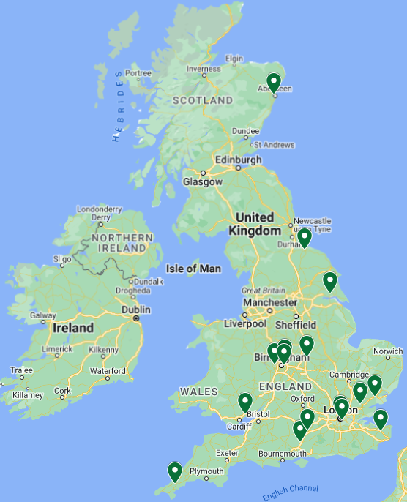
REPAIR-MDS Progress to Date
Site Recruitment: 16 open sites
  14 Sites in England
  1 Site in Scotland
  1 Site in Wales
Participant Recruitment:
  24 patients registered
  15 patients randomised
Live Interactive Map can be accessed via the trial website on: REPAIR-MDS Participating Sites (warwick.ac.uk)

Slide 3
REPAIR-MDS Progress to Date
Only 5 more randomisations to hit Safety Milestone!
Milestones:
Safety Analysis n=20 Futility Anaylsis n=40 Overall Analysis n=120

Slide 4

Difficulties of Recruitment
“Cinderella” group of patients:
  Multiple co-morbidities
  Often not properly diagnosed (may not have had a previous marrow)
  Conservatively treated but major use of resources – transfusions, time on day unit, admissions for infections, bleeding
Hidden in lots of general haematology clinics
  May not be obvious how many patients there are
Can we share best practice on how to overcome these difficulties?

Slide 5
Overall Recruitment Strategies
Opening Sites
Go to where the patients are:
Public and Patient Involvement and Engagement (PPIE):
Understanding Our Target Population:
Opening sites and recruiting from district general hospitals with large numbers of transfusion dependent MDS patient
Twitter and online (Trial Website etc)
BSH Annual meeting
Blood cancer UK Clinical Trials Support Team
MDS UK Patient Support Group
Online Meetings
Hosting Trial Information/ Materials
Older population that may not be as tech savvy
Patient Forums & Focus Groups (face to face)
Leaflets on day units and outpatients
Increasing the number of open sites
Aiming for a wide geographical spread
Utilising a more direct approach:
Associate PI Scheme

Slide 6
Overall Recruitment Strategies

Slide 7
An Overview of How to Recruit
How to identify patients for REPAIR-MDS?
When and who should you pre-screen for REPAIR-MDS?
Statins and other eligibility issues for REPAIR-MDS

Slide 8
Identifying Patients
Clinics
  Very few speciality clinics for MDS patients except in tertiary care
  Nurse led transfusion clinic
Day units
  Lists of transfusion dependent patients
Prescriptions of ESA: Darbepoetin or Eprex
  Lists from Pharmacy

Slide 9
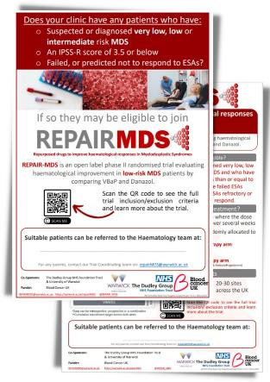
Contact Other Local Hospitals
Flyers and Posters available
PIs can approach colleagues in local hospital trusts
(don’t forget your own hospitals and colleagues!)
We can also approach other hospitals directly if requested
Are patients prepared to travel?
Can continue to have transfusions locally but need to
collect the data.
Trial visits must be on site (counting tablets, blood tests and prescriptions)
Are other hospital nearby prepared to be sites for REPAIR MDS?

Slide 10
When Should You (Pre-)Screen?
Any Stable Low Risk MDS
Assess against the inclusion & exclusion criteria
Newly Diagnosed
Check epo levels:
High epo levels are unlikely to respond to ESA
Evidence for >200 not responding – Guidelines suggest using Anaemia/GCSF score
We will amend so clinician's decision as to suitability for ESA
Monitor for symptoms
On ESA Already?
Are they responding adequately?
8 weeks on adequate dose of ESA and no response (don’t under treat)
Anticipate loss or failure of response
Symptomatic
Transfusion Dependent
Bleeding – not necessarily extreme thrombocytopenia
Shorter history of transfusion might be more likely to respond
Please document these!
Recurrent infections with neutropenia or poor neutrophil function
Add to
pre-screening log
Notes:
Use guidelines as a guide only – please use your clinical judgement for the best outcome for your patient as you normally would

Slide 11



Inclusion and Exclusion Criteria
Common Exclusions
Eligible for ESA/ having has ESA or G-CSF within last 16 weeks
You CAN reassess patients' multiple times
Prostate cancer – biopsy proven
Is an androgen dependent tumour
Previous history of thrombosis

Slide 12
Eligibility: Exclusion Criteria
Abnormal liver function (if patient has Gilbert’s syndrome, then abnormal direct Bilirubin is an exclusion)
Cockcroft Gault CrCl < 20ml/min
Current systemic treatment for low risk MDS
History of Allogeneic Bone Marrow Transplant
History of having received ESAs and/or G-CSF in the past 16 weeks
Currently receiving statin medication for Secondary Prophylaxis of Cardiovascular Disease , Cerebrovascular Disease or Peripheral Vascular Disease
Currently receiving fibrate medications
Currently receiving sodium valproate, carbamazepine or phenytoin for treatment of epilepsy
Prior cytotoxic chemotherapy or hypomethylating agents for AML/MDS (e.g. Azacitidine)
Concurrent active malignancy requiring treatment
History of any Androgen Dependent Tumour (patients with Prostate Cancer are Excluded when a biopsy proven diagnosis of Prostate Cancer has been made OR their PSA is known to be elevated OR they are on active treatment for Prostate Cancer, including hormonal therapy)
Currently receiving Vitamin K-Antagonist Anticoagulation (though patients receiving DOACs (direct oral anticoagulants) can be included)
History of Venous Thrombo-Embolism (VTE)
Cardiac Failure NYHA Class III or IV
Women of childbearing potential, pregnant or lactating
The physician or patient consider VBaP or danazol to be inappropriate for the patient
Known HIV
Abnormally high CK level
Presence of isolated del 5q
Acute Porphyria
Contraindications to any of the trial medications or known hypersensitivity to any of the investigational products (see Protocol Appendix C for contraindications)
Previous randomisation in the REPAIR-MDS trial
Participation in a clinical trial of an investigational medicinal product in the last 90 days

Slide 13
Patients on Statins
Remember: Statin use for PRIMARY prophylaxis is not an exclusion criteria
Is exclusion if taken for secondary prophylaxis
  i.e. previous cardiovascular disease (CVD)
  MI, Stroke, Peripheral arterial occlusive disease
NB Must stop statin before starting trial medication (i.e. at randomisation).

Slide 14
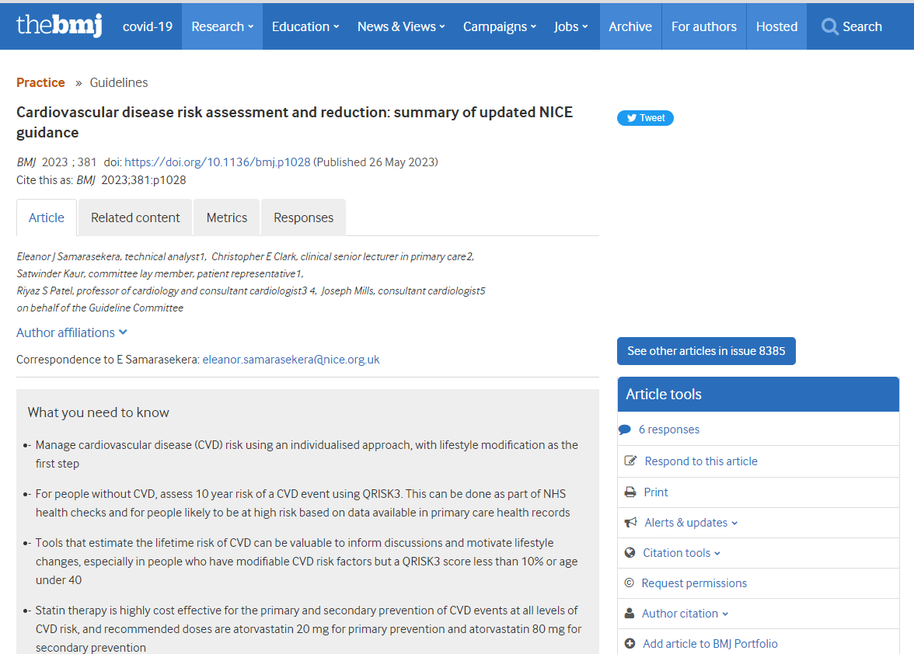
Current NICE guidelines cg181
See recent BMJ 2023; 381;p1028 Summary of NICE Guidance http://dx.doi.org/10.1136/bmj.p1028
“Offer atorvastatin 20mg for the primary prevention of CVD to people who have a 10-year QRISK3 score of 10% or more”
Implies 10% risk of CVD over next 10 years

Slide 15
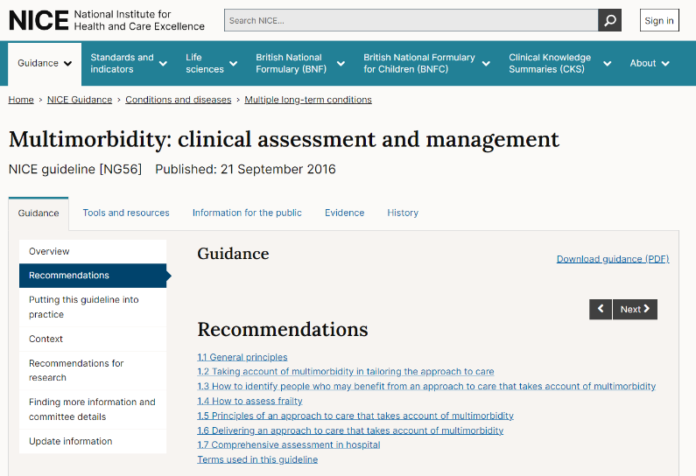
NICE Multimorbidity Guidelines NG56
1.6.13 Take into account the possibility of lower overall benefit of continuing treatments that aim to offer prognostic benefit, particularly in people with limited life expectancy or frailty.
Recommendations | Multimorbidity: clinical assessment and management | Guidance | NICE

Slide 16
IPSS-R
 | No. pts | Very Low | Low | Intermediate | High | Very High
Patients (%) | 7012 | 19% | 38% | 20% | 13% | 10%
Survival*** |  | 8.8 | 5.3 | 3.0 | 1.6 | 0.8
AML/25%***^ |  | NR | 10.8 | 3.2 | 1.4 | 0.7
***Medians, years ^Median time to 25% AML evolution
Greenberg, Tuechler, Schanz et al, Revised International Prognostic Scoring System (IPSS-R) for Myelodysplastic Syndrome, Blood 120: 2454, 2012.

Slide 17
Risk-benefit of statins for primary prevention of CVD in low risk MDS?
For patients with QRISK3 >10%
Median survival 8.8 years – nuanced decision
25% risk of AML over 10 years
Median survival only 5.3 years
25% risk AML over 3 years and only 3 years median survival
Very Low Risk
Low Risk
Intermediate
Risk

Slide 18
PPIE representative Sophie Gasson
Has been in contact with sites
Can help with logistics, questions and potentially with patient involvement and engagement locally
There is also help from MDS UK (MDS Patient Support Group: Information & Help for those affected by MDS)

Slide 19
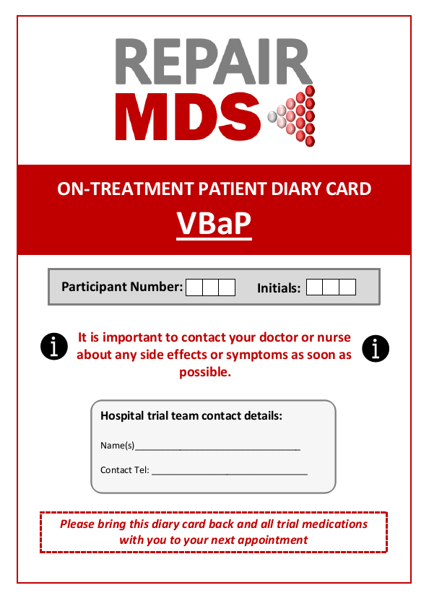
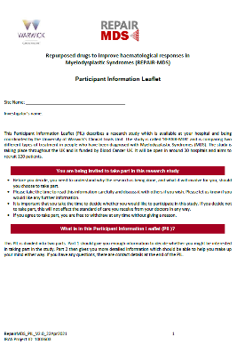
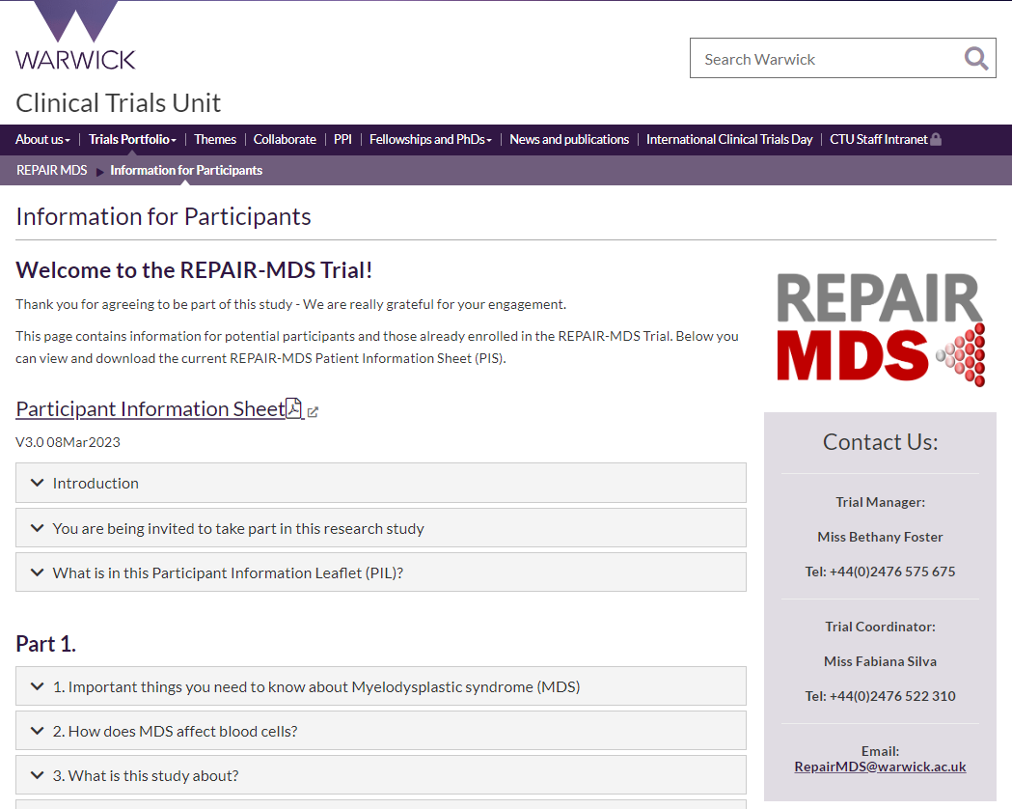
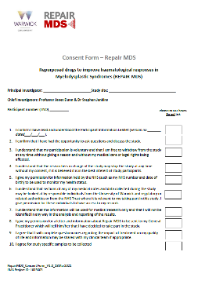
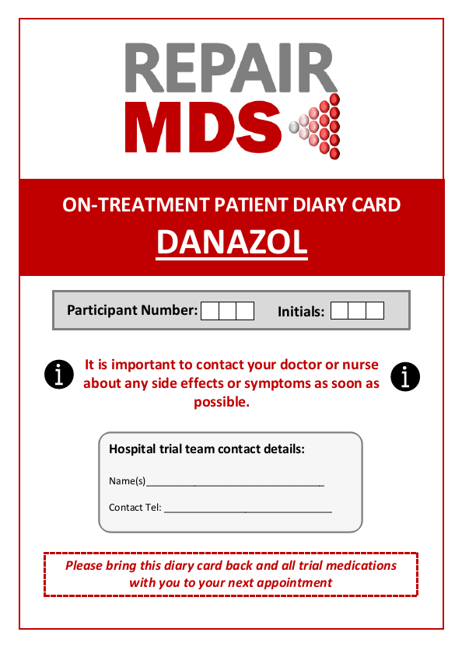
Patient Facing Materials

Slide 20
Good Practice Feedback
What has worked for you?
Do let us know!
Problems?
We can try to help and even feed into changes of the protocol
Influence process changes to help improve the trial going forward
Share across the trial to help other site teams
After safety milestone there will likely be changes to support recruitment and trial progress

Slide 21

Summary
Do find ways of producing complete lists of MDS patients
  Day unit lists
  Clinic lists
  Transfusion lists
  Prescriptions of ESA
Advertise to nearby district general hospitals
  We do understand travel will be an issue
Look at new patients and those on ESAs
Please feedback what works and is not working, - we can all learn and improve

Slide 22

Questions and Discussion

Slide 23
Useful Tools and Links
ISTH Bleeding Score: https://bleedingscore.certe.nl/
IPSS-R Score Calculator:
https://www.mds-foundation.org/ipss-r-calculator/
Trial Website: https://warwick.ac.uk/fac/sci/med/research/ctu/trials/repairmds/
  for Investigator Materials and Patient Information
Protocol Appendix will be corrected with next Substantial Amendment
Double check the required units for IPSS-R calculators

Slide 24

Upcoming Events – Save the Date
REPAIR-MDS CRF Clinics
30-minute Sessions Focusing on CRF and Database Training
  12:00–12:30 Thursday 20th July: Registration, Baseline Assessment, Eligibility & Randomisation CRFs Overview
  12:00–12:30 Friday 25th August: Response Evaluation
  CRF Overview
  12:00–12:30 Tuesday 19th September: Dose Monitoring CRF

Slide 25
Thank you!

