Slide 1

Site Training – Safety Reporting and
Data Collection
SIV slide set V4.0

Slide 2
Safety reporting
Any Serious Adverse Events (SAEs) that occur from the time that the patient is randomised, through to and including 28 calendar days after the last administration of IMP must be reported to WCTU.
Send completed paper SAE forms to WCTUQA@warwick.ac.uk within 24 hours of becoming aware of the event.
Events that do NOT need be reported as SAEs:
  Death
  Persistent or significant disability/incapacity
  Organ failure
  Any other events relating to the underlying illness/injury
SmPCs for Mannitol and HTS can be found in your site file.
Slide 38
Notes:
Reporting window can be extended if investigator site feels it is relevant to the IMP
If patient is randomised, but does not receive IMP - SAEs to reported up to and including 28 calendar days after randomisation.
SmPCs: Mannitol 10% and 15% Baxter Healthcare Ltd, 20% Fresenius Kabi Limited. Hypertonic saline 2.7% and 5% Fresenius Kabi Limited, 30% Torbay and South Devon NHS Foundation Trust, Torbay Pharmaceuticals

Slide 3
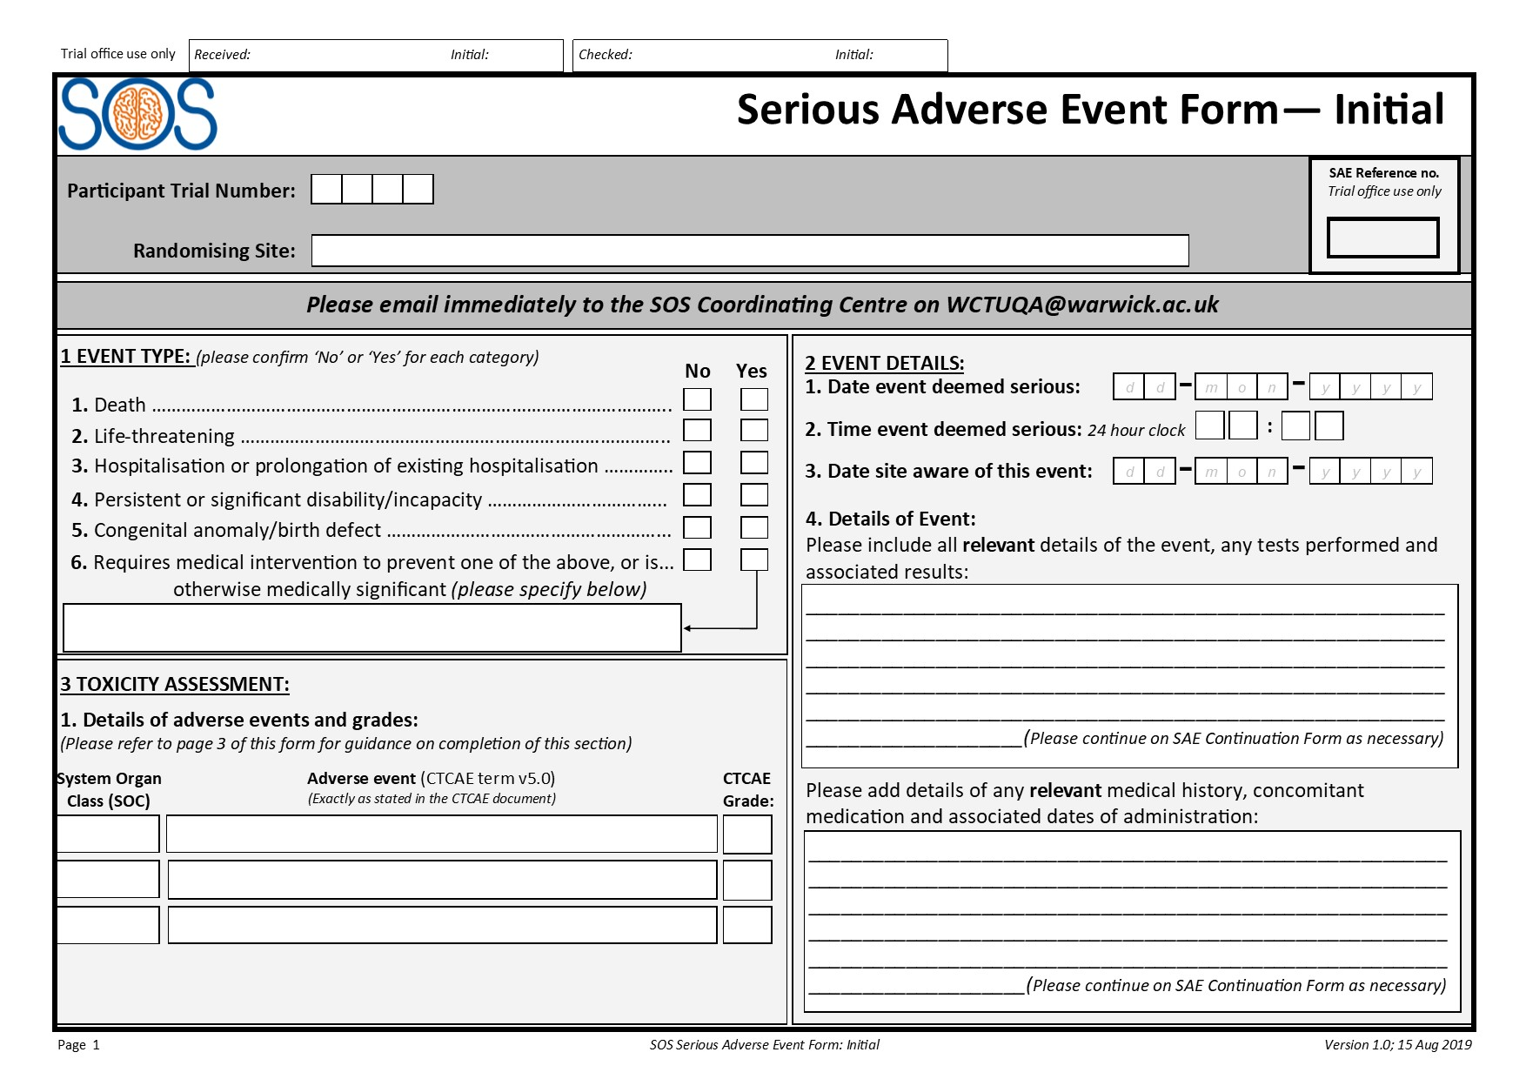
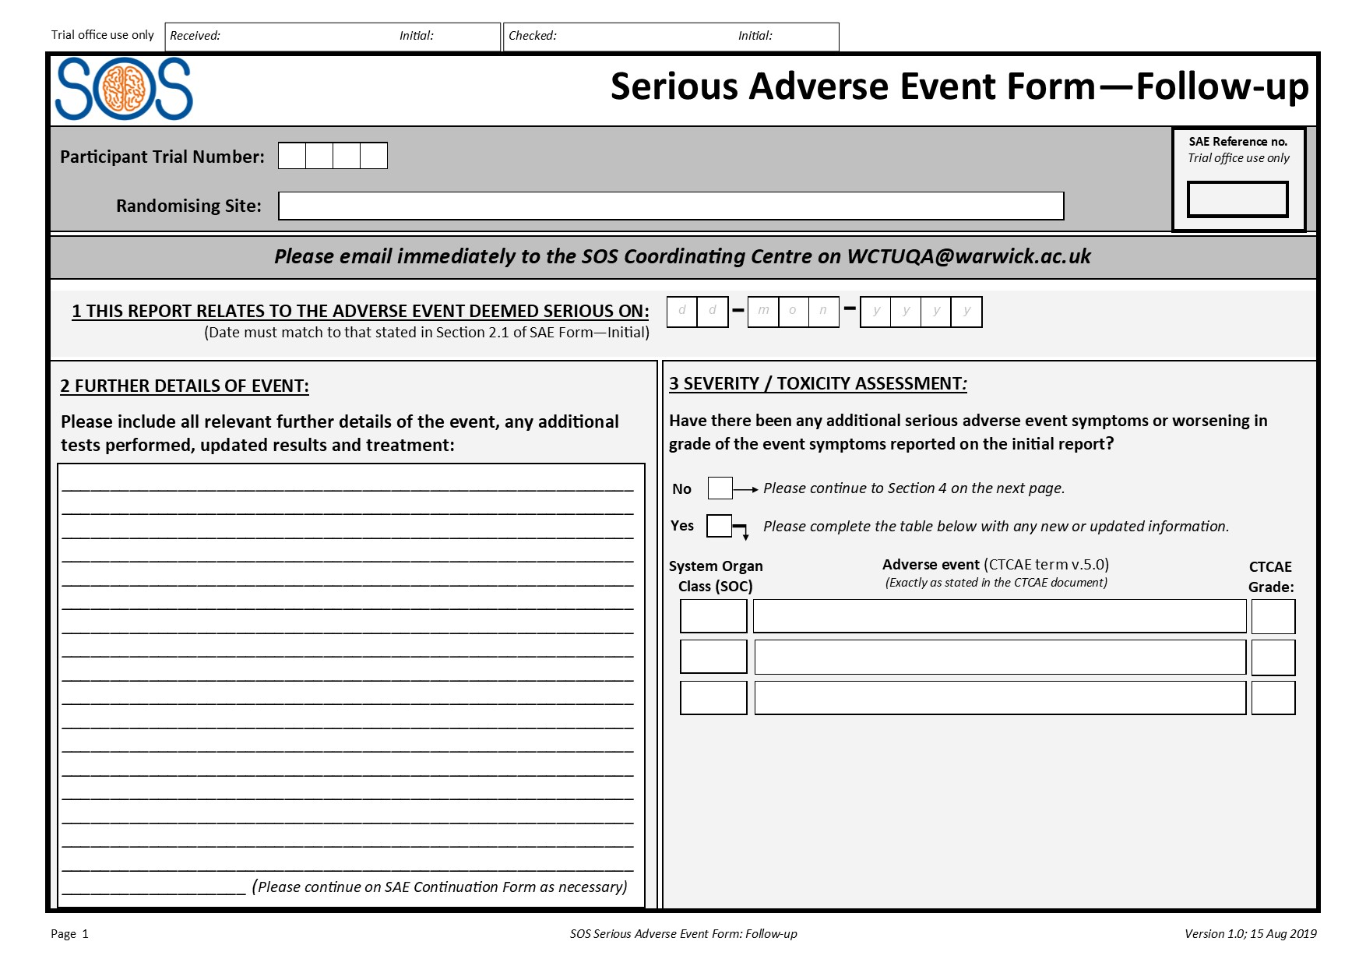
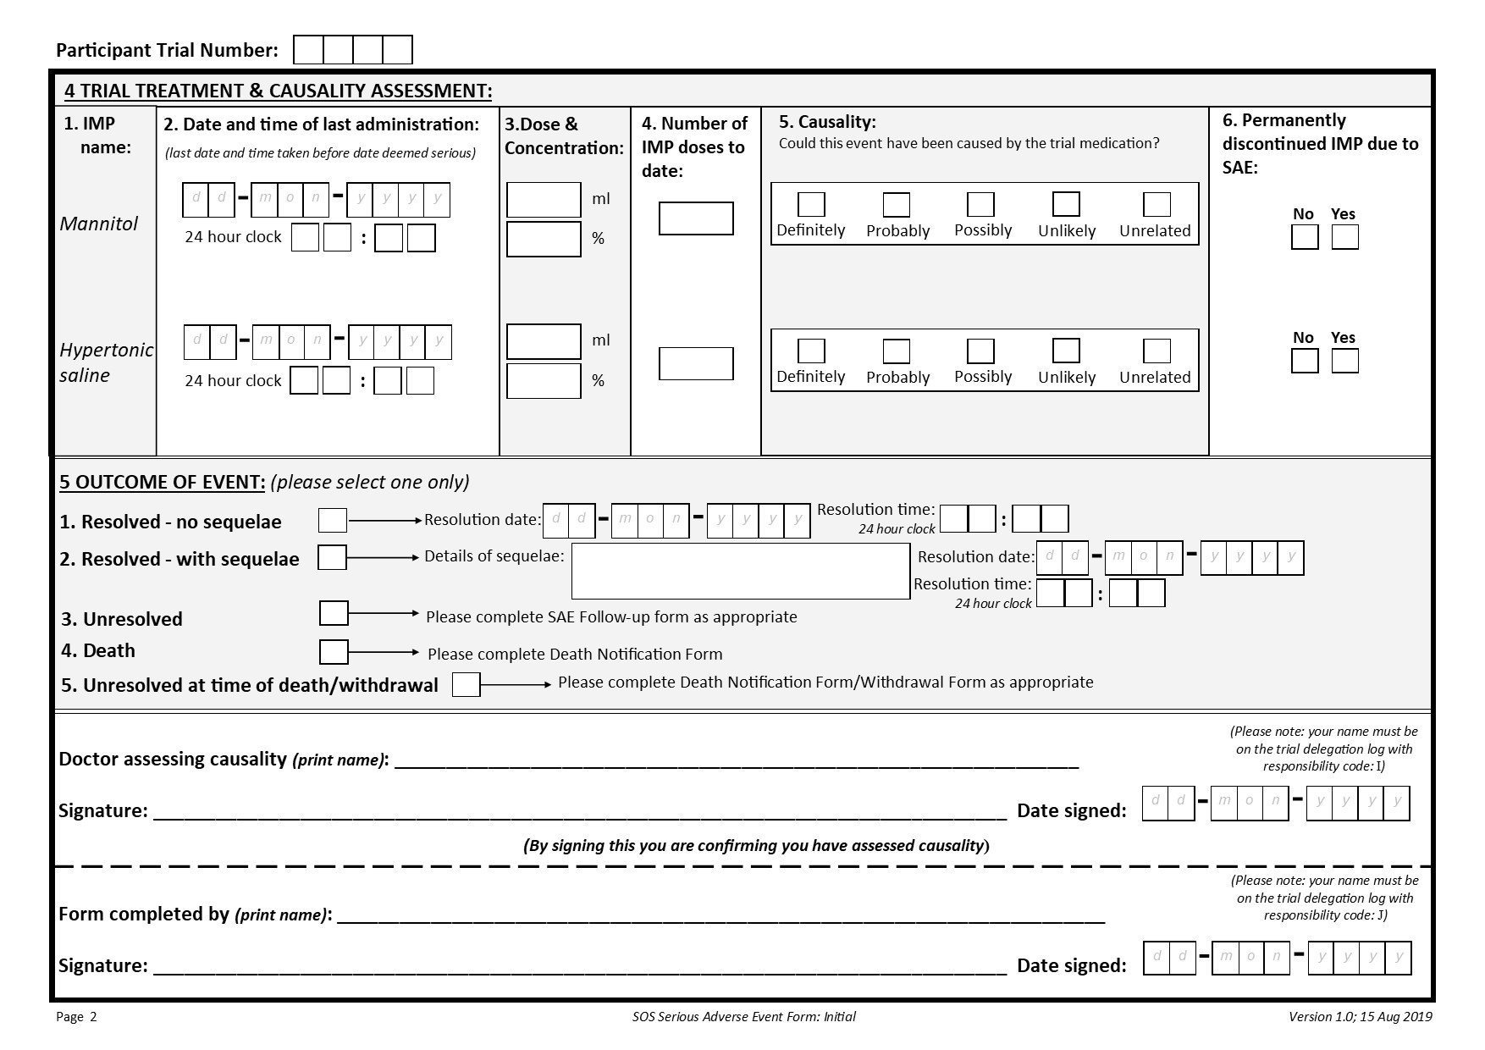
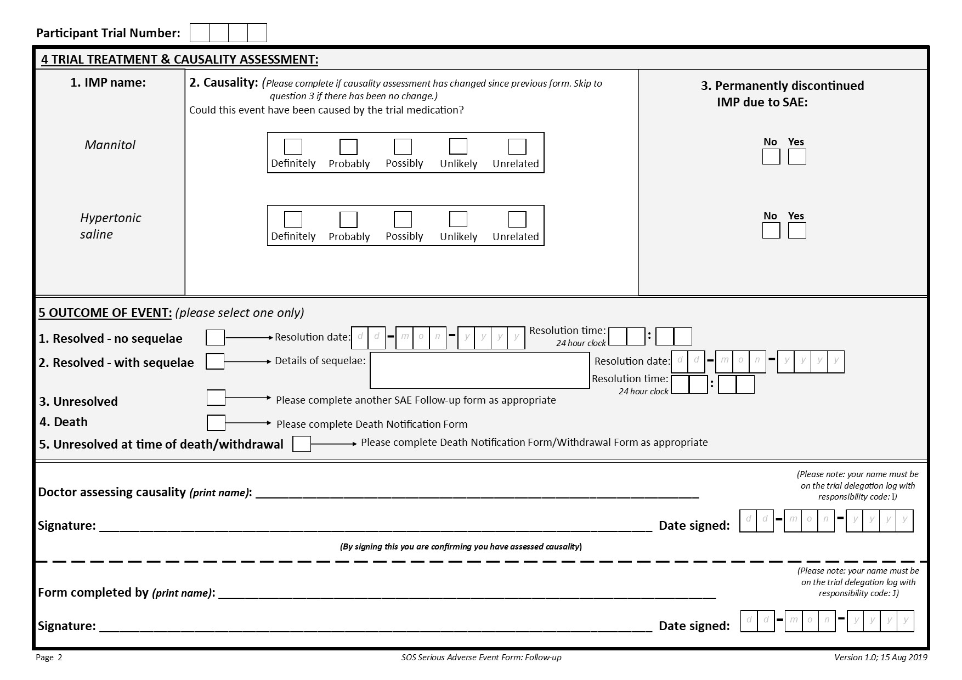
SAE Forms
Signed paper copies should be emailed to WCTU.
Slide 39
Notes:
SAE Continuation Form is available if required
Requirement to be on delegation log for doctor assessing and the person completing the form.

Slide 4
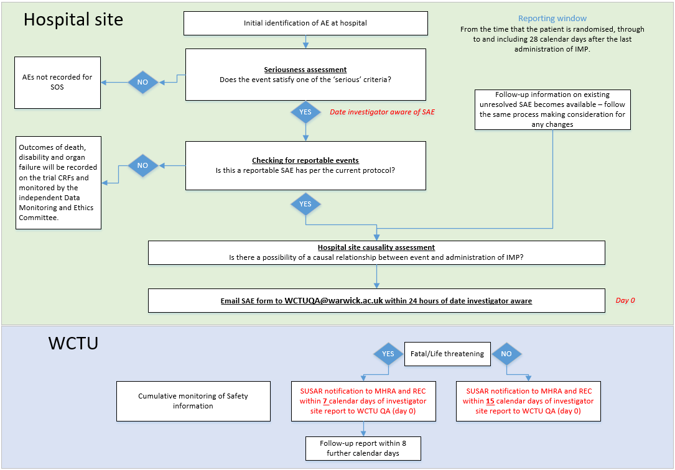
CRFs collect certain AE information.
No separate form required.
If SAE is considered related to IMP and unexpected
Slide 40
Notes:
Certain expected AEs are recorded on CRFs
Expand on what WCTU's role is - Clinician assessing causality and trial team assessing expectedness using RSI

Slide 5
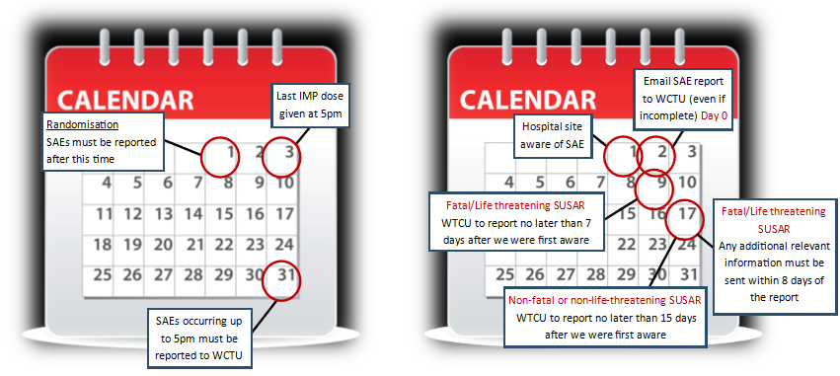
Safety reporting timelines
Slide 41

Slide 6
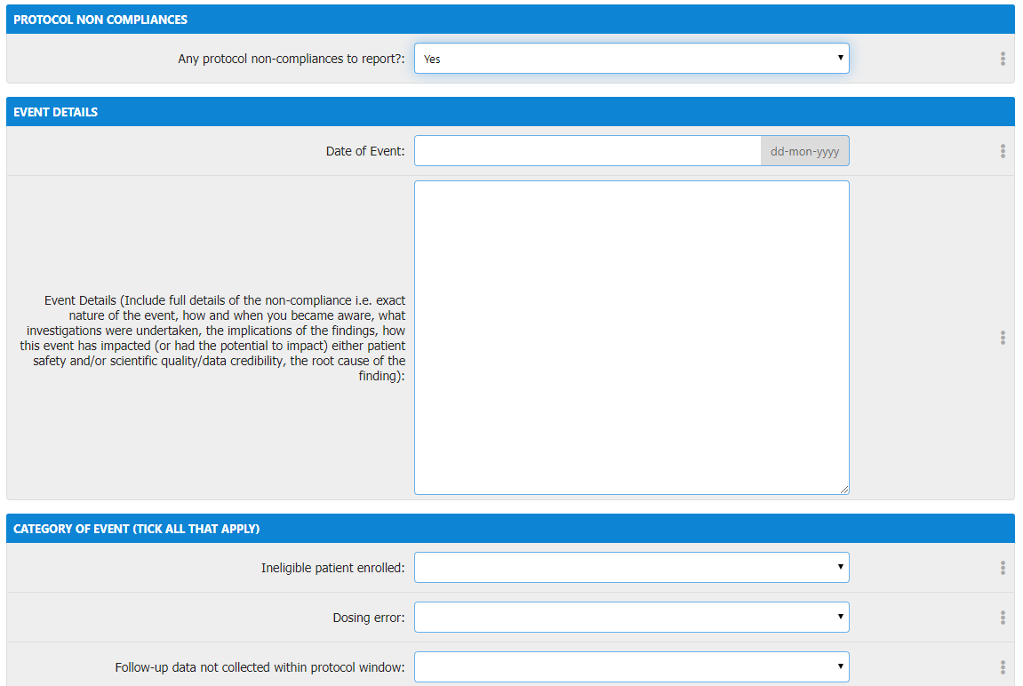
Non-compliance
Report any non-compliances immediately (within 24 hours of becoming aware)
Complete online non-compliance form for non-compliances related to an individual participant.
For general site level non-compliances, please complete the non-compliance form separately and email to WCTU.
Slide 42
Notes:
Complete online non-compliance form for all non-compliances linked to a participant.
For general site level non-compliances (not linked to a particular participant) e.g. lost the ISF – please complete the separate form electronically or by hand and send to WCTU by email.
If you need any help or come across a non-compliance that believe is serious or requires urgent attention, please call or email the WCTU.

Slide 7
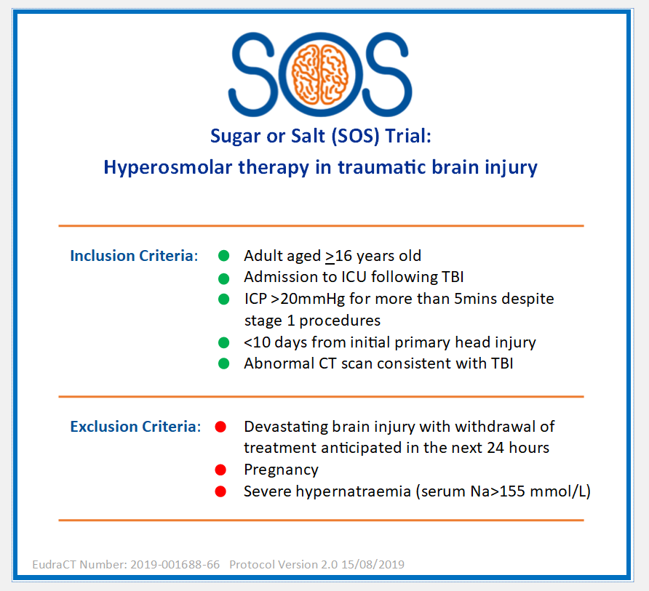
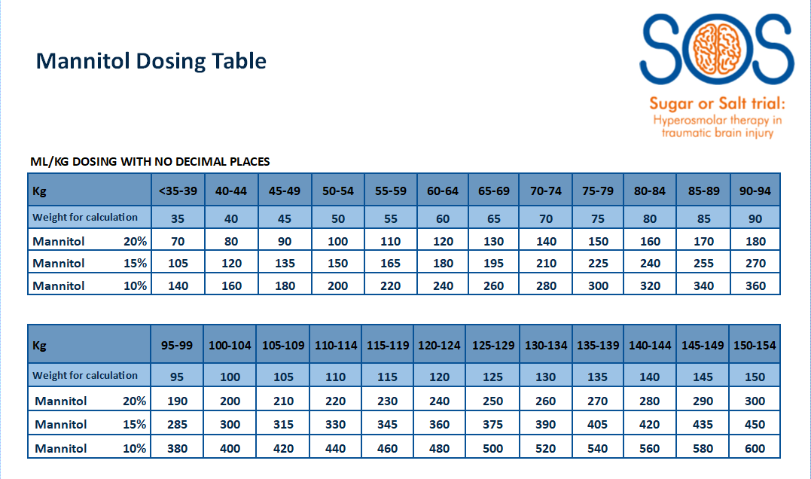
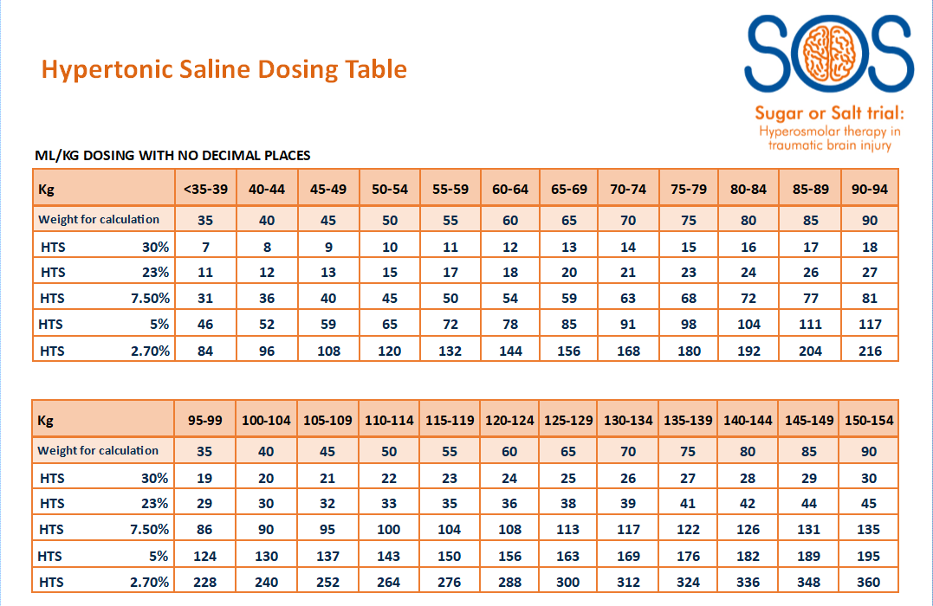
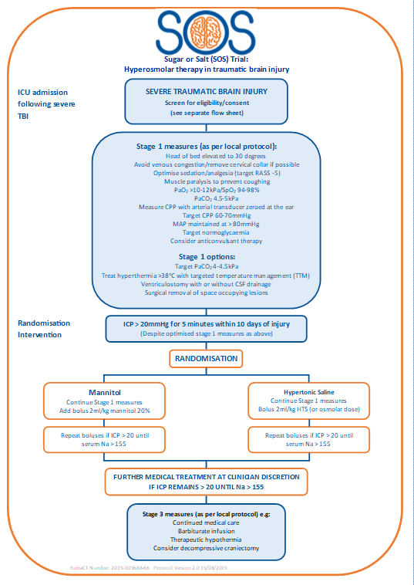
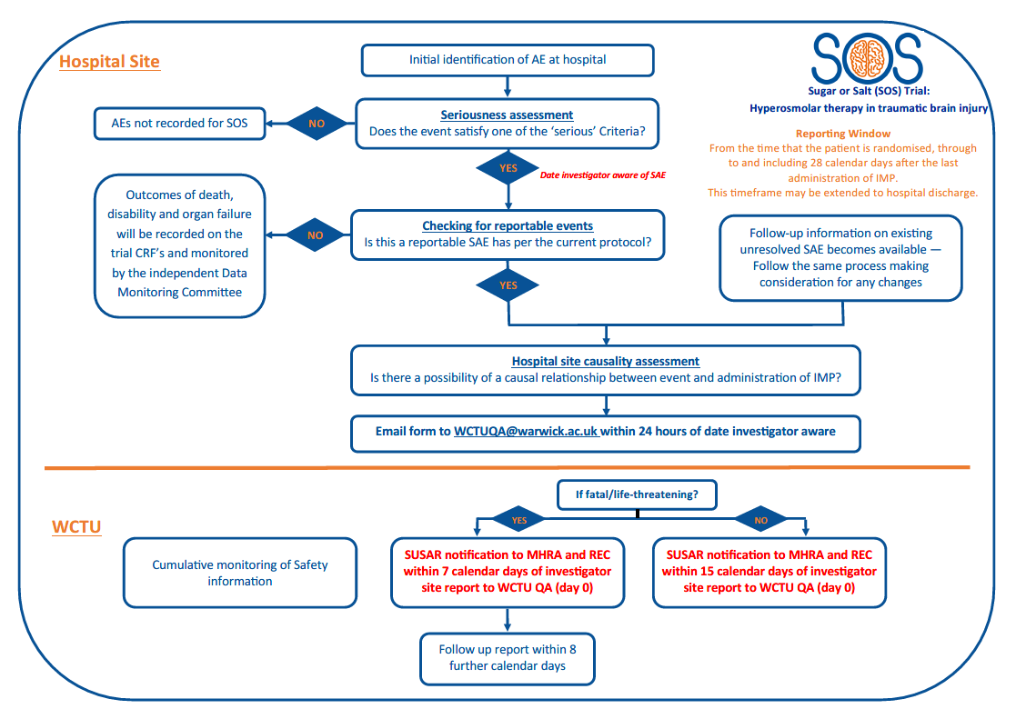
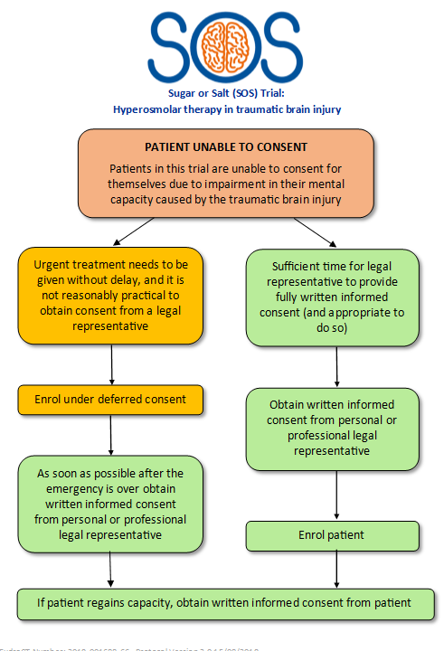
Available tools
Pocket sized/A4 aide memoires available from WCTU:
Eligibility criteria
Dosing conversion
SAE process
Consent process
Treatment intervention flowchart
Slide 47
Notes:
These are examples – let us know if there’s anything else that would be useful!

Slide 8
Data Collection
Bespoke online database
Log ins will be provided to individual trial staff once appropriate training has been completed.
User ID to be provided by email following ‘green light’ approval to begin recruitment. Password will be provided over the telephone
Training version of database to be made available to sites to practice and gain familiarity of the system
Paper CRFs can be used as a back up in cases where there are issues logging in to the online database.
Slide 49
Notes:
Please use browsers Edge or Chrome – this is covered in the Data Collection Guide
Browser Compatibility
Internet Explorer Not compatible
Edge Fully supported (recommended)
Chrome Fully supported (recommended)
Firefox Not supported but usable
Safari Not supported (unknown usability)
Opera Not supported (unknown usability)

Slide 9
Data Collection - CRFs
Case Report Forms | Events
 | Pre Randomisation | Randomisation | Hospital stay | 3 months | 6 months | 12 months | End of Trial
Screening and Eligibility | ●
Informed Consent | ● | ● | ●
Randomisation |  | ●
Patient and Legal Representative Identifiers |  |  | ●
Baseline |  |  | ●
Study Drug Administration |  |  | ●
ICP Monitoring |  |  | ●
Daily Data |  |  | ●
Concomitant Treatments |  |  | ●
Critical Care Discharge |  |  | ●
Hospital Discharge |  |  | ●
Follow-up Day 90-360 (mortality) |  |  |  | ● | ● | ●
Serious Adverse Events
Non-compliances
Withdrawal form
Death Information
3 month follow-up questionnaire |  |  |  | ●
6 month follow-up questionnaire |  |  |  |  | ●
12 month follow-up questionnaire |  |  |  |  |  | ●
End of Trial |  |  |  |  |  |  | ●
Slide 50

Slide 10
Follow-up
Where possible follow-up should be done by a blinded member of staff
Daily data collection while ICP monitored/while on ICU
Mortality status at 3/6/12 months (if patient still in hospital)
Critical care discharge info
Hospital discharge info
Modified Oxford Handicap Score and EQ-5D at discharge
3/6/12 month follow-up questionnaires sent by post from Warwick CTU
Slide 34
Notes:
If patient is still in hospital – hospital team to check mortality status. If patient is discharged, WCTU team will check mortality
Ideally we would like follow-up data to be collected from a blinded member of staff i.e. not treating clinician – to eliminate any possibility of bias – Is this something that would be feasible? Are there blinded and non-blinded teams?
On the CRFs it is captured whether the hospital staff member is blinded or not to the treatment allocation and this will be reviewed by the TMG

Slide 11
Informed Consent eCRF
Informed consent should be obtained as soon as it is appropriate to do so i.e. usually within 24 hours of randomisation.
Informed Consent eCRF should be completed within 3 days of randomisation.
Once the Informed Consent eCRF is completed the Patient and Legal Representative Identifiers eCRF will appear in the ‘Hospital stay’ forms.
Slide 51
Notes:
Recording routine clinical data only

Slide 12
Data collection - eCRFs
Recording routine clinical data
Forms should be completed as soon as possible following randomisation (within 14 days):
  Patient and Legal Representative Identifiers – this form will appear when the Consent eCRF has been entered
  Baseline
  Study drug administration – record doses given
  ICP Monitoring details
  Concomitant treatments – to be completed by discharge from ICU
Slide 52
Notes:
Recording routine clinical data only – nothing above and beyond.
ICP monitoring – when started and stopped, ICP device used, any problems etc.
Concomitant treatments – update as go along but can complete on discharge from ICU.

Slide 13
Baseline eCRF
Routinely collected clinical data to be recorded:
Admission details
Demographics
TBI details – mechanism, details of injury on head and other body systems, craniotomy/craniectomy
Significant medical history
Concomitant medications
Pre-admission function
ICP prior to randomisation
Serum Sodium at randomisation
Hyperosmolar therapy prior to randomisation
CT Scan appearance (routine scan prior to randomisation)
GCS
Pregnancy test (if applicable)
Slide 53
Notes:
Day 0 = day of randomisation

Slide 14
Daily Data Collection
Start on day 0 from time of randomisation (day 0 = day of randomisation)
The following measurements should be collected hourly whilst ICP is being monitored i.e. until bolt removed:
  Intracranial Pressure (ICP),
  Mean Arterial Pressure (MAP)
  Serum Sodium
Organ support recorded daily for duration of patient’s stay on critical care.
Slide 54
Notes:
Daily data should be entered asap.

Slide 15
Other eCRFs
To be completed in the database as and when required:
Critical Care Discharge Form
Hospital Discharge Form
Death Notification Form
Withdrawal form
End of Trial – this should also be completed on paper and emailed to WCTU.
Protocol Non-compliance
SAEs are paper forms – complete and email to WCTU
Slide 55

Slide 16
Data Management
Queries will be sent out to sites on a monthly basis to request missing data and for any data clarifications.
Self-evident corrections:
All forms
Header | In the event of CRFs being sent through the post: If TNO is missing from one or more pages but is present on an attached page or can be worked out through other information, transcribe in green pen onto pages where missing, initial and date. If Site/Randomising Site is missing from the header, check whether it has been received with other information that identifies the site or that it corresponds to the TNO on the online database and write it on in green pen, initial and date. In the event of CRFs being sent via email: If any information is missing from a CRF but sufficient audit trail is in place, e.g. the body of the email specifies the TNO and it is clear which site sent the data, these details can be used when entering information onto the database.
Dates | Particularly at the beginning of a new year sites may record the incorrect year. This can be self-evidently corrected if the date has not yet occurred or you are certain of the year it should say.
Decimal places | If values are supplied to more decimal places than required you may round up or down as appropriate.
Yes/No questions (Not relevant for Screening and Eligibility Form or Randomisation Form) | If a yes/no box is left blank where a question that asks if further information has been provided, this can be amended to ‘yes’ if further information has been provided. If a site or participant has answered ‘no’ and provided further information this should be amended to ‘yes’ and the information added to the database.
Slide 56

Slide 17
Free text boxes | If sites denote an upward or downward arrow you can replace these with the words ‘Increased’, ‘raised’ or ‘decreased’. Recognised medical shorthand can be converted to full text.
Baseline
Was a pregnancy test done? | If the participant’s gender is recorded as male and the question has not been completed, you can tick ‘No’.
Serious Adverse Event Form – Initial
3.1 | If you have queried with the site to ask them to change the SOC number and adverse event term, but they change only one in response, as long as stated in the query which SOC number and adverse event you wanted it changing to, this can be self-evidently corrected.
4.6 | If no answer is selected here you need to query it with site, unless you are aware that the patient is no longer taking the medication (i.e. completed or withdrawn). In this case, please select ‘No’ and write the explanation onto the form. If ‘Yes’ has been ticked incorrectly as the patient had already stopped medication prior to event becoming serious, this can be amended to ‘No’
Serious Adverse Event Form – Follow-up
3.1 | If information is completed below this question, you may select ‘Yes’ if not already ticked but you must check the initial SAE to see if there has actually been a change. If there is no change, you can tick ‘No’. You can also amend any ‘Yes’ that has incorrectly been ticked due to information being the same on checking with initial SAE. If you have queried with the site to ask them to change the SOC number and adverse event term, but they change only one in response, as long as stated in the query which SOC number and adverse event you wanted it changing to, this can be self-evidently corrected.
4.3 | If ‘Yes’ has been ticked incorrectly as the patient had already stopped medication prior to event becoming serious, this can be amended to ‘No’
Slide 57

Slide 18
In the event of a participant’s death numerous data fields, which could easily be missed on the online database, ask for the participant’s mortality status and multiple drop downs will need to be completed on each form. Providing the Death Notification Form has been completed relevant mortality status fields in the below listed forms can be self-evident corrected to dead/deceased as applicable and the date of death completed as required.
Critical Care Discharge Form - If the participant died before discharge from ICU we would want this form to be completed with the details of the participant’s death
Date and time of ICU discharge | For this field we want the date and time of the participant’s death. These details can be copied from the Death Notification Form.
Vital status on discharge | Tick the box labelled ‘Dead’
Discharge destination | Tick the box labelled ‘N/A – patient died’
Hospital Discharge Form (both Trial and Final Hospital sections)- If the participant died before discharge from hospital, but were alive when discharged from critical care, we would want this form to be completed with the details of the participant’s death. If the participant dies at the trial hospital we only require details for the trial hospital, final hospital details can be left blank.
Date and time of discharge from trial/final hospital | For this field on the relevant form we want the date and time of the participant’s death. These details can be copied from the Death Notification Form.
If discharged from hospital, specify location | Tick the box labelled ‘N/A – patient died’
Slide 58

Slide 19
Follow-up information
Date of assessment | The assessment date can be completed as the date the Death Notification Form data was received.
Mortality status at hospital discharge | Tick the box labelled ‘Deceased’
Modified Oxford Handicap Scale at discharge from trial/final hospital | Tick the box labelled ‘Deceased’
Follow up 3 months – 12 months - As appropriate
Date of assessment | If a participant dies before 3 months no follow-up information is required – leave forms blank. If a participant dies after 3 or 6 months the following survival check can be completed following receipt of Death Notification Form. The assessment date can be completed as the date the Death Notification Form data was received. If a participant dies after 3 month only the 6 month survival check is required, the 12 month can be left blank.
Mortality status at day 180/360 | Tick the box labelled ‘Deceased’ on the relevant form.
Slide 59

