Slide 1

Site Training - Consent
SIV slide set V4.0

Slide 2
Consent process
PATIENT UNABLE TO CONSENT
Patients in this trial are unable to consent for themselves due to impairment in their mental capacity caused by the traumatic brain injury
Urgent treatment needs to be given without delay, and it is not reasonably practical to obtain consent from a legal representative
Sufficient time for legal representative to provide fully written informed consent (and appropriate to do so)
*Witnessed verbal consent may be obtained if it is not feasible to obtain written consent from personal legal representatives and patients
Enrol under deferred consent
Obtain written informed consent from personal* or professional legal representative
As soon as possible after the emergency is over obtain written informed consent from personal* or professional legal representative
Enrol patient
If patient regains capacity before hospital discharge, obtain written informed consent from patient*
Slide 25
Notes:
Patient will not have capacity to consent for themselves
If urgent treatment needs to be provided, patient can be enrolled under deferred consent – this is permitted with the Medicines for Human Use (Clinical Trials) Regulations 2006 amendment. In this situation consent be obtained as soon as practically possible once the emergency is over. This can be from a legal representative as patient will likely still lack capacity.
Any questions?

Slide 3
Deferred consent
Main route of consent will probably be deferred consent
Pre-enrolment consent from a Legal Representative is an option if:
LR is available
There is sufficient time to explain the study fully and get written consent
It is appropriate to speak to the LR e.g. if they are keen to be involved in decision making
Slide 27
Notes:
Consent should be sought as soon as possible following the initial emergency i.e. when appropriate to do so. We would expect this to be within 24 hours of enrolment in most cases.
Different versions of PIS and consent form available depending on who’s consenting and whether it’s pre or post enrolment
Pre-enrolment – consenting to receive trial treatment and ongoing data collection
Post-enrolment – consenting to ongoing data collection only (trial intervention complete at that point)

Slide 4
Legal representative consent
Personal legal representative
The definition of a Personal Legal Representative (PerLR) for England, Wales and Northern Ireland is: “A person not connected with the conduct of the trial who is suitable to act as a legal representative by virtue of their relationship with the adult and available and willing to do so”.
The definition of a PerLR for Scotland is: “Any guardian or welfare attorney who has power to consent to the adult’s participation in research. If there is no such person, the adult’s nearest relative as defined in section 87(1) of the Adults with Incapacity (Scotland) Act 2000”.
Professional legal representative
The definition of a Professional Legal Representative (ProfLR) in England, Wales, Northern Ireland and Scotland is: “A person not connected with the conduct of the trial who is the doctor primarily responsible for the adult’s medical treatment or a person nominated by the relevant health care provider”.
Slide 28
Notes:
Hierarchy – always approach PerLR first if available. If no such person, approach ProfLR. If a PerLR later becomes available before the patient regains capacity, they should be informed and consent should be obtained. Their consent or dissent will override that provided by the ProfLR.

Slide 5
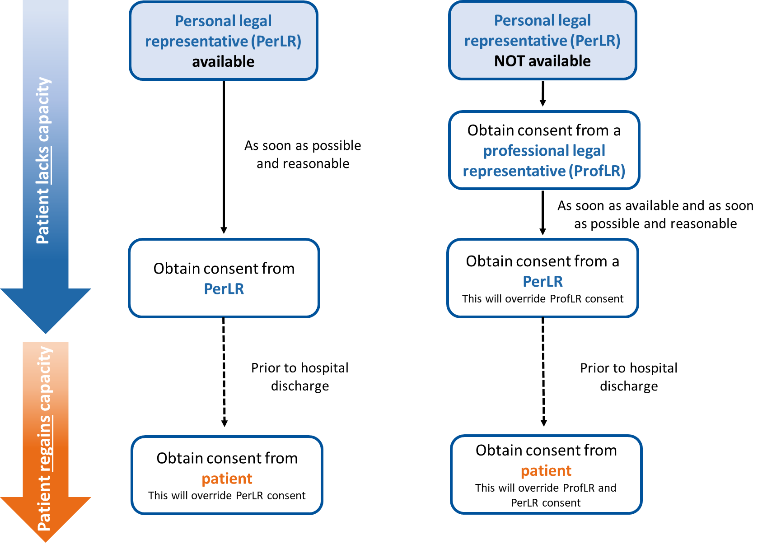
Consent hierarchy
Consent should be sought as soon as is reasonably possible according to the hierarchy detailed below:
Slide 28
Notes:
Hierarchy – always approach PerLR first if available. If no such person, approach ProfLR. If a PerLR later becomes available before the patient regains capacity, they should be informed and consent should be obtained. Their consent or dissent will override that provided by the ProfLR.

Slide 6

Patient Information Sheet
No objection
Document on consent form
Explain trial and provide copy of patient information sheet
Ask personal legal representative to consider the patient’s wishes regarding trial participation
If no objection expressed, complete the consent form.
Ask professional legal representative to consider best interests of the patient
Both legal representative and person receiving consent to sign the form.
Ensure you are using the correct version of the PIS and consent forms – there are different versions depending on who is consenting and whether it is pre- or post-enrolment.
Document in medical notes.

Slide 7
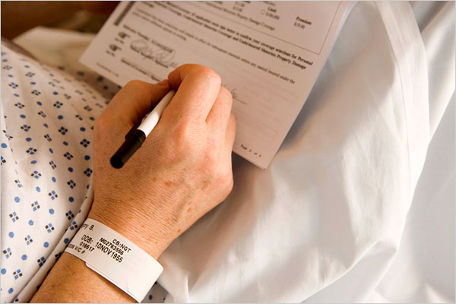
Patient consent
If the patient regains capacity while still in hospital, they should be given the Patient Information Sheet and be given the option to consent/withdraw
Slide 29
Notes:
After hospital discharge it will not be reasonable or practical to assess patient’s capacity and obtain written consent in the event that the patient regains capacity. Questionnaires will therefore be sent to the patient’s legal representative, and return of a completed questionnaire from either the legal representative or the patient will be considered implied consent.
Consent from the legal rep remains valid.

Slide 8
Legal Representative Consent
YES
Is a personal legal representative available?
NO
Is the personal legal representative able to attend the hospital in person to provide consent?
Obtain written informed consent from a professional legal representative
YES
NO
Obtain written informed consent from the personal legal representative
Obtain witnessed verbal consent over the phone from the personal legal representative

Slide 9
Witnessed verbal consent
Only if it is not feasible to obtain written consent from personal legal representatives or patients due to COVID-19:
Personal LR unable to attend hospital to sign form
Patient tests positive for COVID-19
Verbal consent must be obtained in the presence of an impartial witness, who is:
independent of the study
cannot be unfairly influenced by people involved with the study
Slide 30
Notes:
Written informed consent should be obtained if possible. Only in cases where it is not feasible, should witnessed verbal consent be obtained instead, e.g. if the personal legal representative is unable to attend the hospital to sign for themselves due to visiting restrictions, or if the patient tests positive for COVID-19.
Verbal consent must be obtained in the presence of an impartial witness independent to the trial team e.g. doctor or nurse that is not on the delegation log.

Slide 10
Witnessed verbal consent
Patient Information Sheet
Obtain verbal consent
Document on consent form
Explain trial to Personal LR/patient
Send/provide copy of patient information sheet
Read out consent form and ask Personal LR/patient to confirm if they agree verbally.
Person obtaining consent to write their own initials in the boxes to indicate the Personal LR/patient agreed to clause
Both person obtaining consent and witness to sign the consent form
Document in patient medical notes and record how impartial witness was selected.
Witnessed verbal consent can be obtained over the telephone for Personal LR
Slide 31
Notes:
If the personal legal representative is unable to attend the hospital to sign the consent form, verbal consent should be sought over the phone. The witness will need to listen to the conversation so the phone will need to be on loudspeaker.

Slide 11
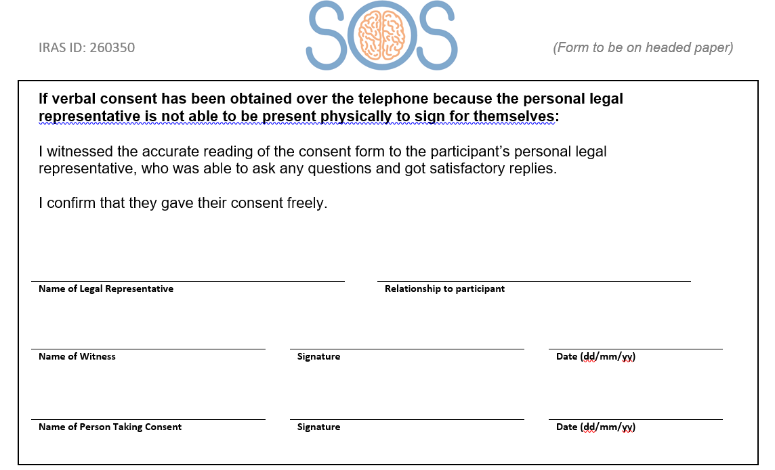
Witnessed verbal consent
Slide 32
Notes:
If witnessed verbal consent has been obtained complete the relevant section on page 2.

Slide 12
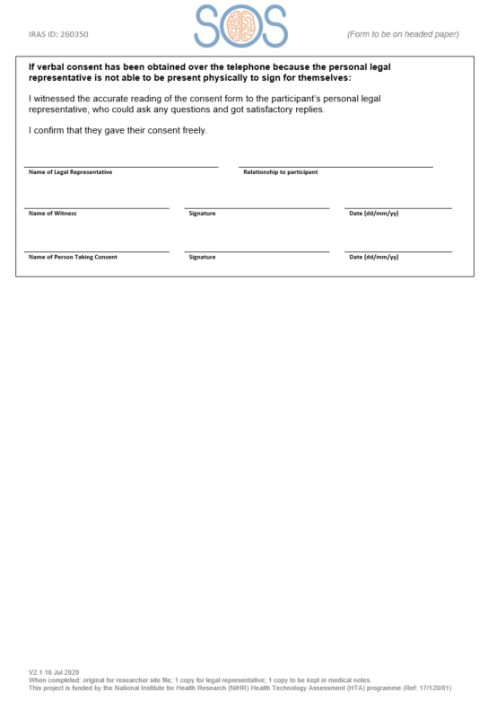
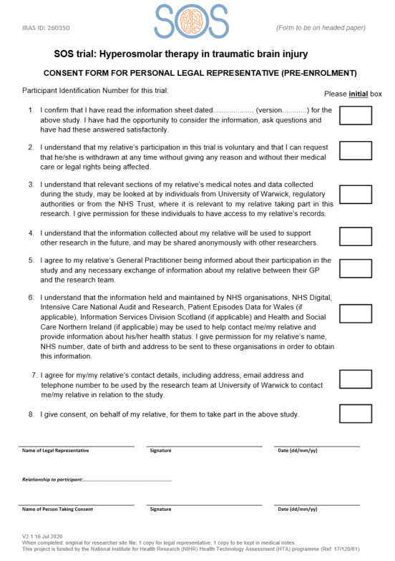
Consent process
Consent should be documented on the trial database and in the patient’s medical notes
Three copies to be signed:
original to be kept at site in ISF
one for LR/patient
one for medical notes
Consent is an ongoing process!
Do not send copies of consent forms to Warwick CTU. They should be stored securely at site
Who can approach patients/LRs for consent at your site?
Slide 33
Notes:
Three signed copies of consent form – original in ISF, copy to patient/legal rep and copy for medical notes. If verbal consent has been obtained over the phone, you will need to send a copy to the personal legal representative.
Ongoing process – confirmation that still happy to be involved in SOS should be sought and documented in patient notes when discussing with LR or patient.
Consent should be sought as soon as possible following the initial emergency i.e. when appropriate to do so. We would expect this to be within 24 hours in most cases.
Different versions of PIS and consent form available depending on who’s consenting and whether it’s pre or post enrolment
Pre-enrolment – consenting to receive trial treatment and ongoing data collection
Post-enrolment – consenting to ongoing data collection only (trial intervention complete at that point)
Question: what are local policies for taking consent - Check whether research nurses at site can take consent for CTIMPs

Slide 13
Withdrawals
Please notify Warwick CTU straight away of any withdrawals by completing the withdrawal form on the online database
Options for withdrawal:
Trial treatment*
Completion of follow-up questionnaires
From remote data collection (from medical notes/other organisations)
* A clinician can only withdraw a patient from trial treatment
If withdrawing from trial treatment, stop allocated treatment immediately and continue with local protocols
If withdrawing from data collection, stop all data collection from the point of withdrawal (data already collected can be retained).
Document in the medical record the date of withdrawal.
Slide 35
Notes:
Important to clarify with the patient/LR what exactly they’re withdrawing from – detail that on withdrawal form.
If insist on all data collected being removed then talk to trial team at WCTU – sites do not have to delete all the data, the trial team will deal with it.

Slide 14
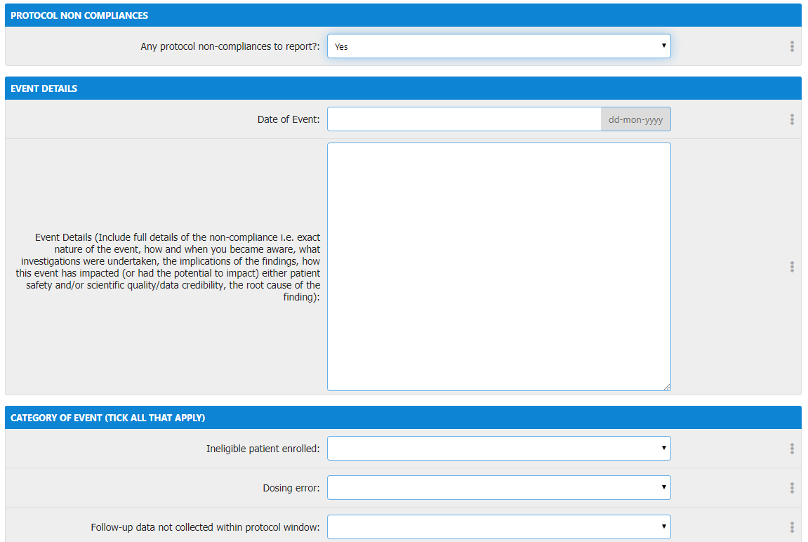
Non-compliance
Report any non-compliances immediately (within 24 hours of becoming aware)
Complete online non-compliance form for non-compliances related to an individual participant.
For general site level non-compliances, please complete the non-compliance form separately and email to WCTU.
Slide 42
Notes:
Complete online non-compliance form for all non-compliances linked to a participant.
For general site level non-compliances (not linked to a particular participant) e.g. lost the ISF – please complete the separate form electronically or by hand and send to WCTU by email.
If you need any help or come across a non-compliance that believe is serious or requires urgent attention, please call or email the WCTU.

Slide 15
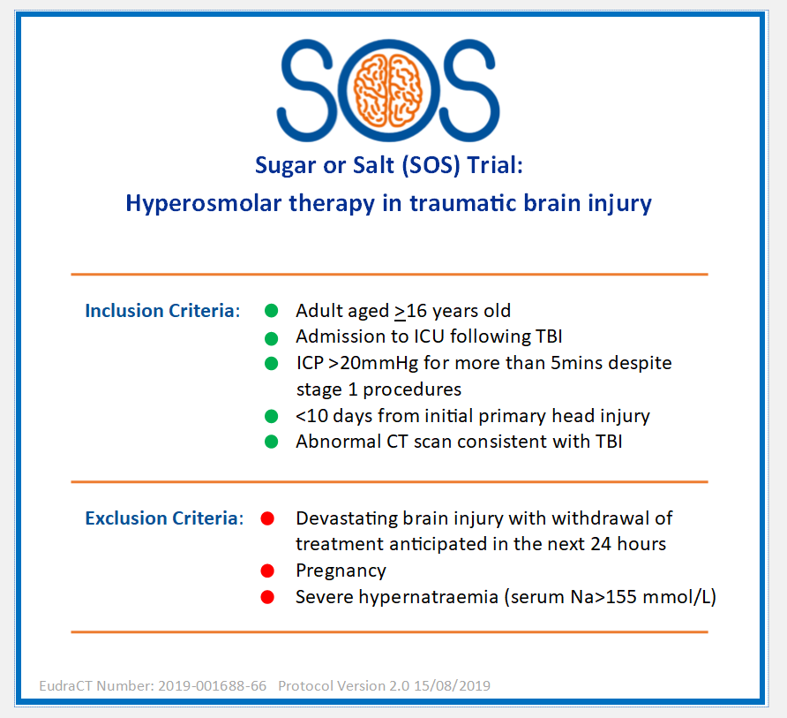
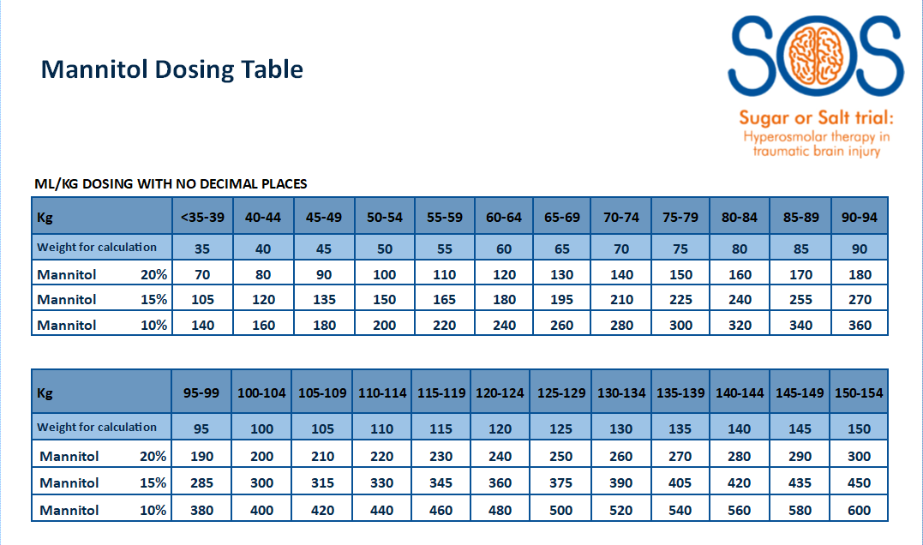
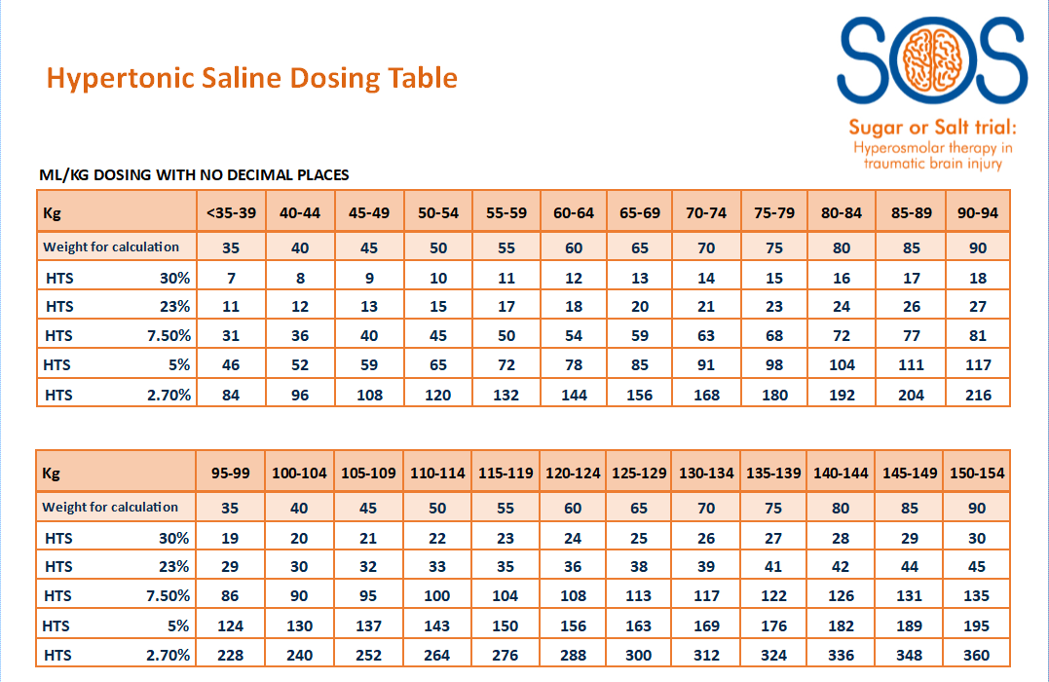
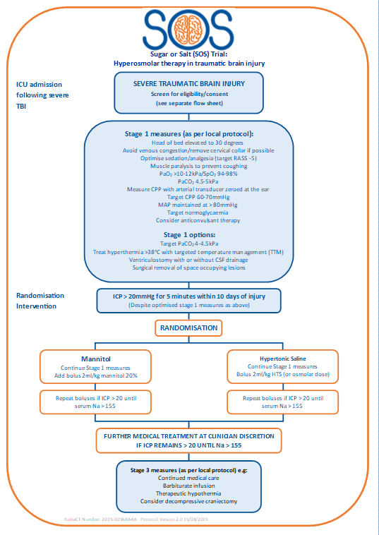
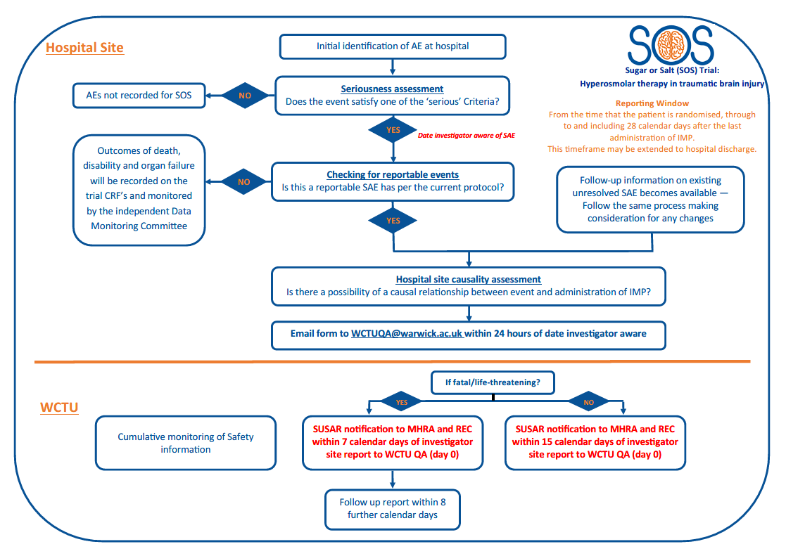
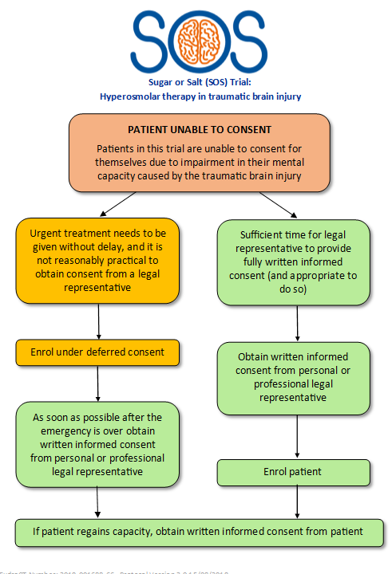
Available tools
Pocket sized/A4 aide memoires available from WCTU:
Eligibility criteria
Dosing conversion
SAE process
Consent process
Treatment intervention flowchart
Slide 47
Notes:
These are examples – let us know if there’s anything else that would be useful!

