Slide 1

Site Training – Randomisation and
Trial Interventions
SIV slide set V4.0

Slide 2
Pocket sized eligibility laminates available from WCTU
Trial Design
Inclusion criteria:
  Adult > 16
  Admission to ICU with TBI
  ICP > 20mmHg for more than 5 mins despite stage 1 measures
  < 10 days from initial TBI
  Abnormal CT scan consistent with TBI
Exclusion criteria:
  Devastating brain injury with withdrawal of treatment anticipated in the next 24 hours
  Pregnancy*
  Severe hypernatraemia (serum Na > 155mmol/L)
  2 or more prior doses of hyperosmolar therapy given on ICU
  *NB Pregnancy is not a contraindication to hyperosmolar therapy, but these patients must be excluded for ethical and regulatory reasons
Notes:
Do not need to specifically test for pregnancy, but confirmed/apparent pregnancy should be excluded
This is a pragmatic trial and therefore will not exclude patients that are given hyperosmolar therapy prior to ICU admission. The rationale is that this trial is addressing the use of hyperosmolar therapy in monitored patients in intensive care. Un-monitored hyperosmolar therapy occurs in practice currently and is likely to continue after this trial. The sub-set of patients (with clinical signs of raised ICP) frequently will go direct to theatre for surgical intervention, which may resolve the raised ICP or indicate that injuries are non-survivable.
Aide memoires are available

Slide 3
Screening process
PI responsibility to make treating teams aware of trial
All patients admitted to ICU with severe TBI should be screened
Screening should be a continuous process
Screening data to be entered on the SOS web application
Slide 17
Notes:
Screening starts when patients are admitted to ICU with a severe TBI.
If ICP raises in a patient to >20mmHg within the 10 day eligibility window a previously screened patient can become eligible for the trial – in this situation we only want one set of screening data. For patients who are only ineligible due to their ICP, screening should continue throughout the 10 day eligibility window, but only screening data from the final screening should be entered online – whether that is that the patient is ineligible at the end of the 10 day period, or at point of randomisation.
There is not a separate screening log on the online database, the same wizard is used for screened patients that is used for randomising a patient into the trial. There is a paper log that should be completed by sites to keep track of which patients have been screened – this should not be sent to the trial office as will contain patient identifiable data, which the trial does not have approval to receive prior to randomisation.

Slide 4
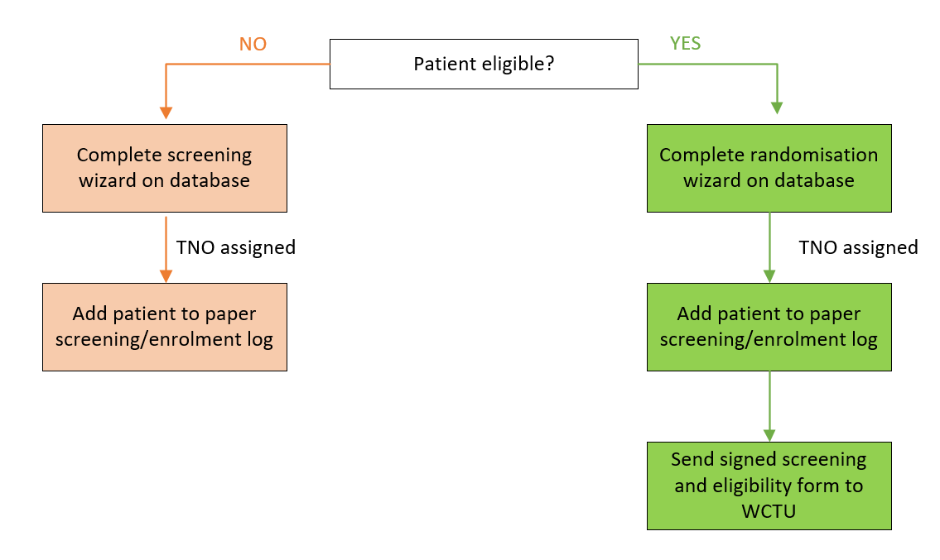
Screening process
Slide 18

Slide 5
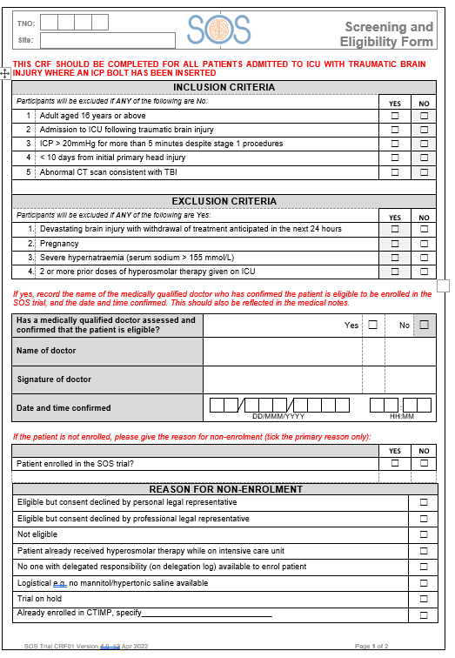
Confirmation of eligibility
Eligibility must be assessed and confirmed by a medically qualified member of staff only, prior to the patient being enrolled
The screening and eligibility form can be signed at the time or as soon as practically possible after enrolment
The justification for the patient meeting all of the eligibility criteria must be clearly documented in the patient’s medical notes for monitoring purposes
Slide 19
Notes:
- Key document -
Along with entering the details onto the database this is a paper form will need to be signed on completion – ideally we would like to receive these forms as quickly as possible; as the trial is taking as pragmatic approach it is understood that there may be some delay. You should only complete one form for each patient screened.
Copy of the screening and eligibility form to be emailed to SOS resource account. For purposes of oversight, signatures will be cross-referenced against training sign off to ensure site staff are correctly trained.
We have sought advice from the MHRA with regard to enrolment in an emergency situation

Slide 6
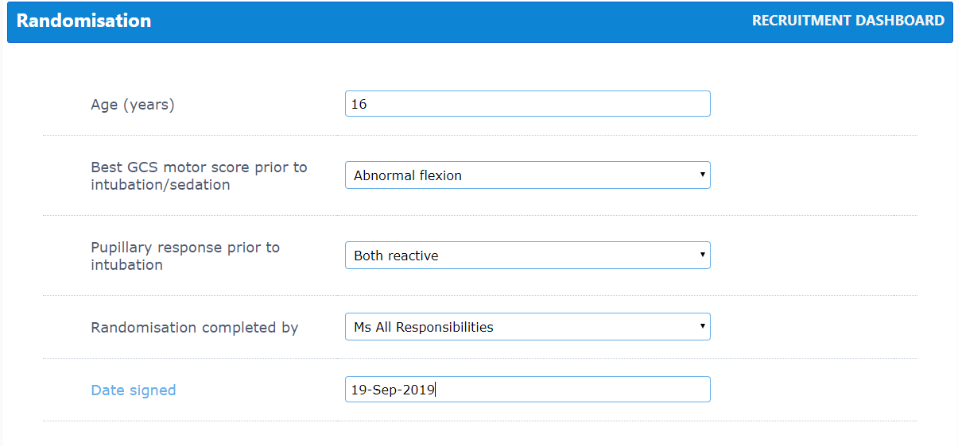
Randomisation
Use online randomisation form
Access to system granted once training complete and ‘green light’ to begin recruitment
Backup = Call WCTU Emergency Randomisation service 02476 150 402 (Mon-Fri 9-5 only)
Slide 20
Notes:
Randomisation wizard will prompt for the information required – will need to confirm patient is eligible and enter age, GCS motor score and pupillary response which is all used to stratify the randomisation and ensure balance of patients across treatment arms (those variables are put into a model to calculate probability of unfavourable outcome at 6 months).
Individual logins issued once training is complete and green light issued
Backup = paper based randomisation system where you will be given a TNO and treatment allocation – the patient can then be added to the database retrospectively

Slide 7
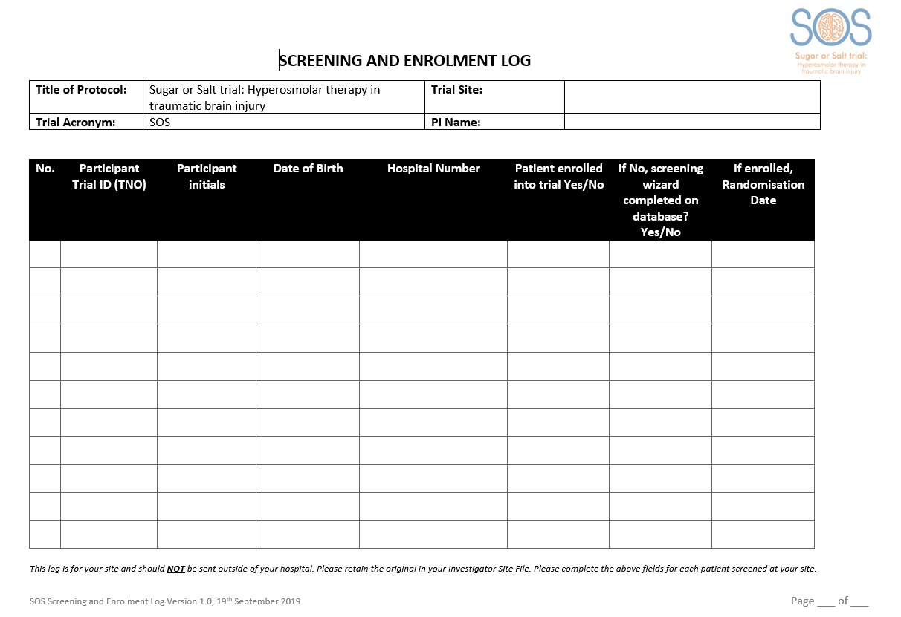
Screening and Enrolment log
Once the patient is randomised, complete the paper Screening and Enrolment Log stored in section 11.1 of your Investigator Site File (could also be completed electronically)
Do NOT send this log to WCTU.
Slide 21
Notes:
Just to complete locally in order to track which patients have been screened and enrolled and match them to patient identifiers. It is important this log is accurate and kept up to date as it is how you will identify patients by their TNO prior to completing patient identifiers form on the database.
DO NOT SEND THIS TO WCTU – this log will contain identifiers of patients not recruited into the SOS trial - the trials unit should not receive this information = breach of GDPR and deviation.
Electronic versions can be kept, please signpost where this is saved in the paper ISF (to be printed and filed when recruitment ends).

Slide 8
Co-enrolment
We are supportive of co-enrolment with both other non-CTIMP trials and other CTIMP trials, provided a co-enrolment agreement is in place
Trials that can co-enrol with SOS can be found on our website
Slide 22
Notes:
For co-enrolling studies, would need to exchange protocols and both Trial Management Groups need to agree co-enrolment
Are there any conflicting trials, or other studies that would be recruiting from a similar patient population running in your ICU?

Slide 9
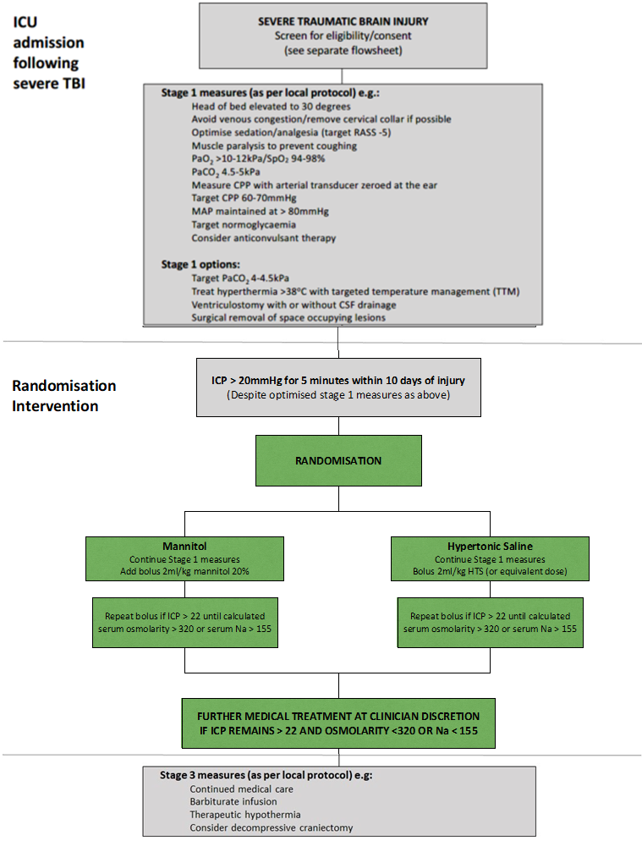
Slide 23

Slide 10
Trial Interventions
Randomisation (web based/allocation concealed) to:
  Equi-osmolar dose of mannitol intravenous bolus
  Equi-osmolar dose of hypertonic saline intravenous bolus
Use dosing table provided to assist with calculating doses.
If ICP remains >20mmHg, boluses of each IMP can be repeated until serum sodium is > 155 mmol/L.
If there is a second spike in ICP to >20mmHg, allocated IMP should continue to be used.
Slide 24

Slide 11
Dosing table – ml/kg
kg | 40-44 | 45-49 | 50-54 | 55-59 | 60-64 | 65-69 | 70-74 | 75-79 | 80-84 | 85-89 | 90-94 | 95-99 | 100-104
Weight for calculation | 40kg | 45kg | 50kg | 55kg | 60kg | 65kg | 70kg | 75kg | 80kg | 85kg | 90kg | 95kg | 100kg
Mannitol 20% | 80 | 90 | 100 | 110 | 120 | 130 | 140 | 150 | 160 | 170 | 180 | 190 | 200
Mannitol 15% | 120 | 135 | 150 | 165 | 180 | 195 | 210 | 225 | 240 | 255 | 270 | 285 | 300
Mannitol 10% | 160 | 180 | 200 | 220 | 240 | 260 | 280 | 300 | 320 | 340 | 360 | 380 | 400
HTS 30% | 8 | 9 | 10 | 11 | 12 | 13 | 14 | 15 | 16 | 17 | 18 | 19 | 20
HTS 23% | 12 | 13 | 15 | 17 | 18 | 20 | 21 | 23 | 24 | 26 | 27 | 29 | 30
HTS 7.50% | 36 | 40 | 45 | 50 | 54 | 59 | 63 | 68 | 72 | 77 | 81 | 86 | 90
HTS 5% | 52 | 59 | 65 | 72 | 78 | 85 | 91 | 98 | 104 | 111 | 117 | 124 | 130
HTS 2.70% | 96 | 108 | 120 | 132 | 144 | 156 | 168 | 180 | 192 | 204 | 216 | 228 | 240
Look in your site file to find laminated dosing tables for use at the bedside
Slide 25
Notes:
Use dosing table to help you calculate equivalent osmolar doses for different concentrations of the trial interventions. The full table can be found in the ISF and also available as an aide memoire.

Slide 12
IMP supply
Use local stock
No trial-specific storage or labelling requirements
IMP should be stored and dispensed as per local protocols
MHRA have confirmed:
  No accountability logs required (CRF will detail what was given and number of doses)
  No destruction certificates required
Slide 36
Notes:
MHRA have confirmed that the drugs become IMP at the point of administration. Local protocols for drug management to be followed in full. Therefore no need for pharmacy file.

Slide 13
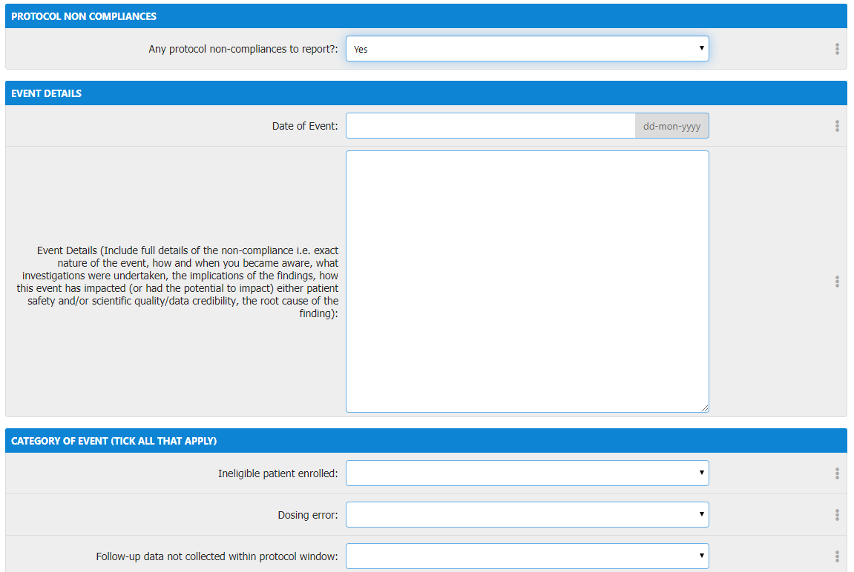
Non-compliance
Report any non-compliances immediately (within 24 hours of becoming aware)
Complete online non-compliance form for non-compliances related to an individual participant.
For general site level non-compliances, please complete the non-compliance form separately and email to WCTU.
Slide 42
Notes:
Complete online non-compliance form for all non-compliances linked to a participant.
For general site level non-compliances (not linked to a particular participant) e.g. lost the ISF – please complete the separate form electronically or by hand and send to WCTU by email.
If you need any help or come across a non-compliance that believe is serious or requires urgent attention, please call or email the WCTU.

Slide 14
Blinding
SOS is a an open label trial, with no requirement for specific labelling of the IMP; therefore it is not possible to blind clinical staff to treatment allocation.
We will not specifically set out to inform participants or their legal representative of the treatment allocation. We recognise however that it may become evident during the course of the participant receiving the treatment. If the participant or legal representative asks which treatment allocation they had received, in the interest of being transparent, there is no requirement for this to be withheld.
If possible the person completing the Hospital Discharge Form should be blinded to treatment allocation to limit bias.
Slide 43

Slide 15
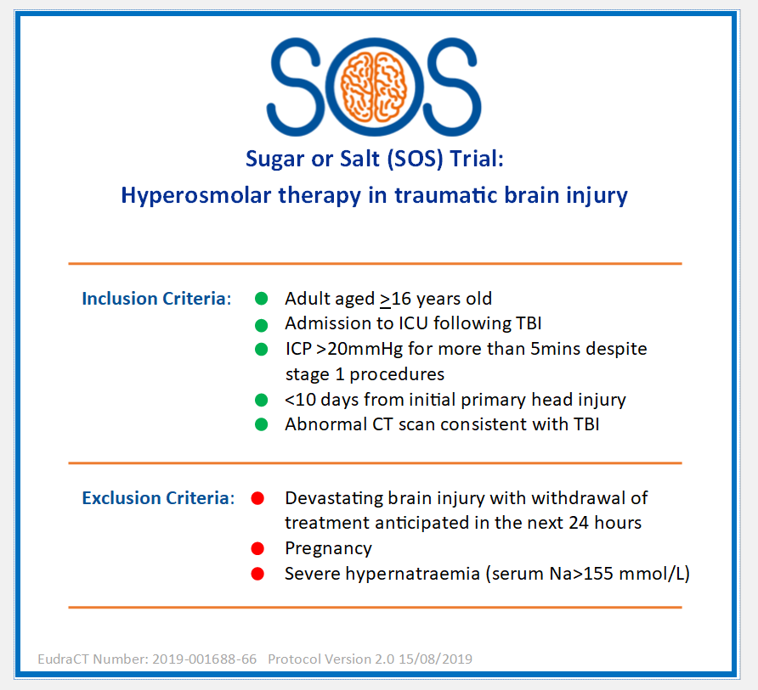
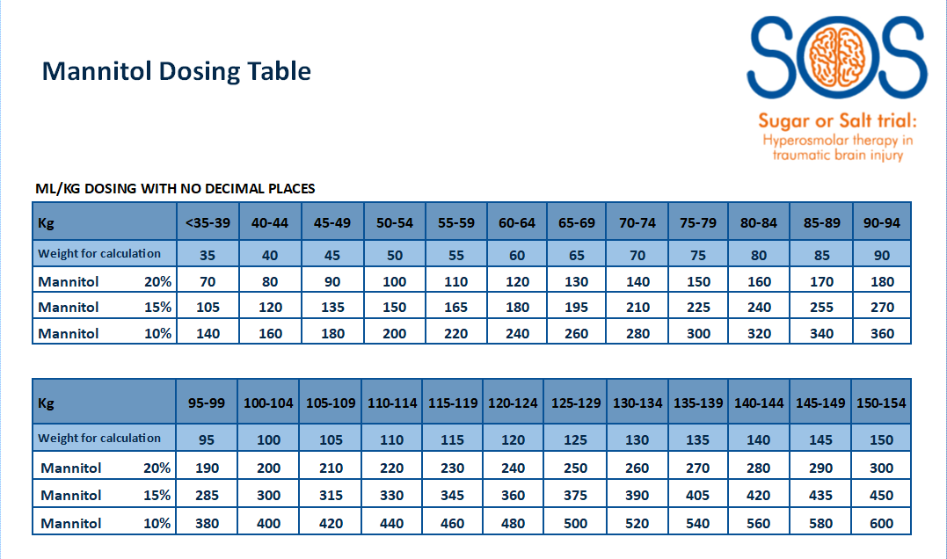
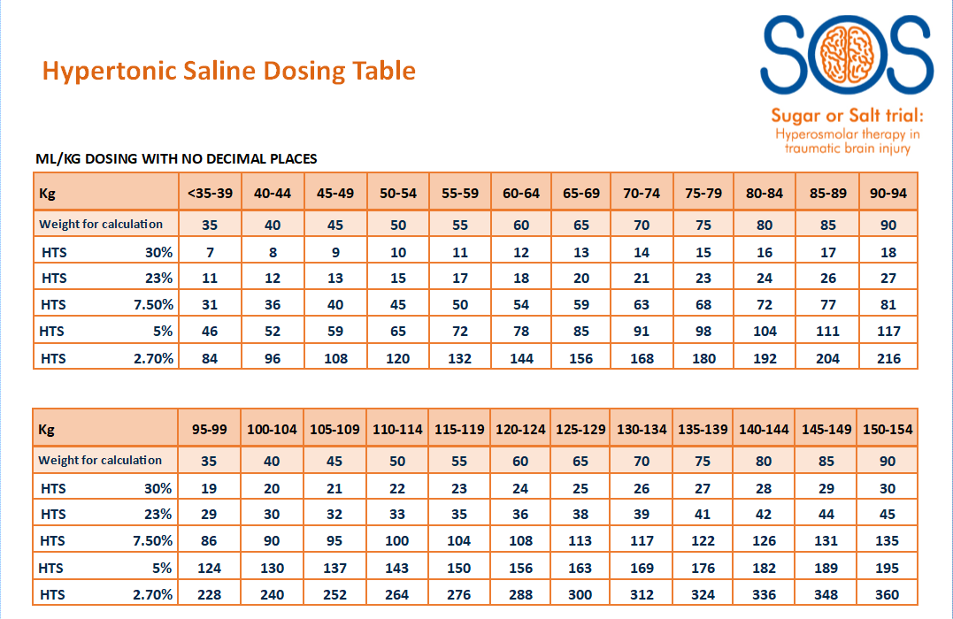
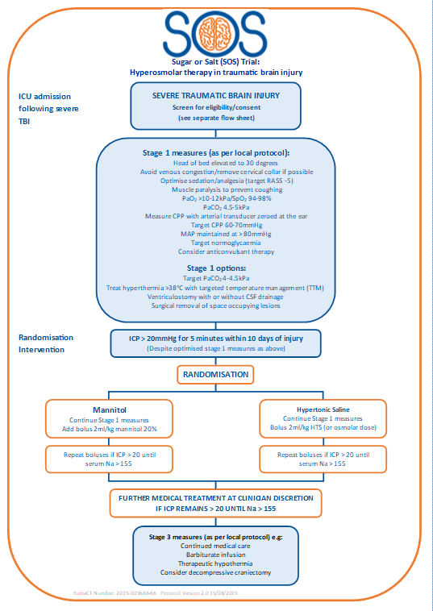
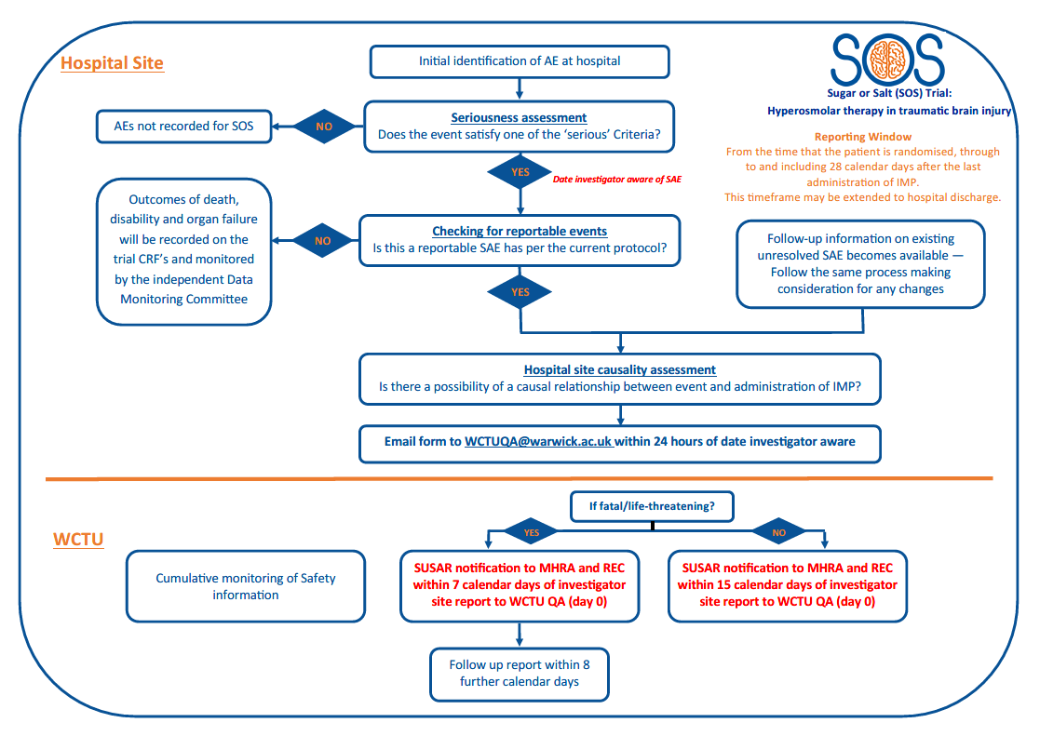
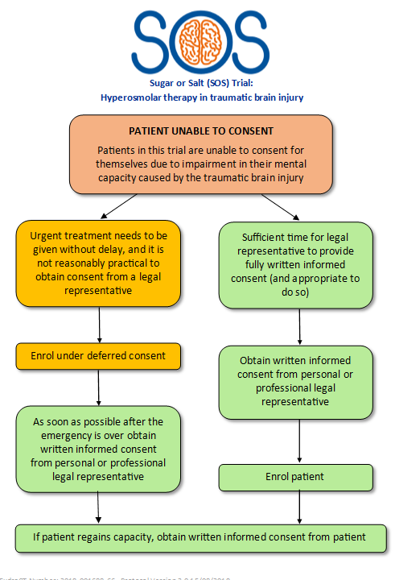
Available tools
Pocket sized/A4 aide memoires available from WCTU:
Eligibility criteria
Dosing conversion
SAE process
Consent process
Treatment intervention flowchart
Slide 47
Notes:
These are examples – let us know if there’s anything else that would be useful!

