Slide 1

Site Initiation Visit
V9.0 11 May 2022

Slide 2

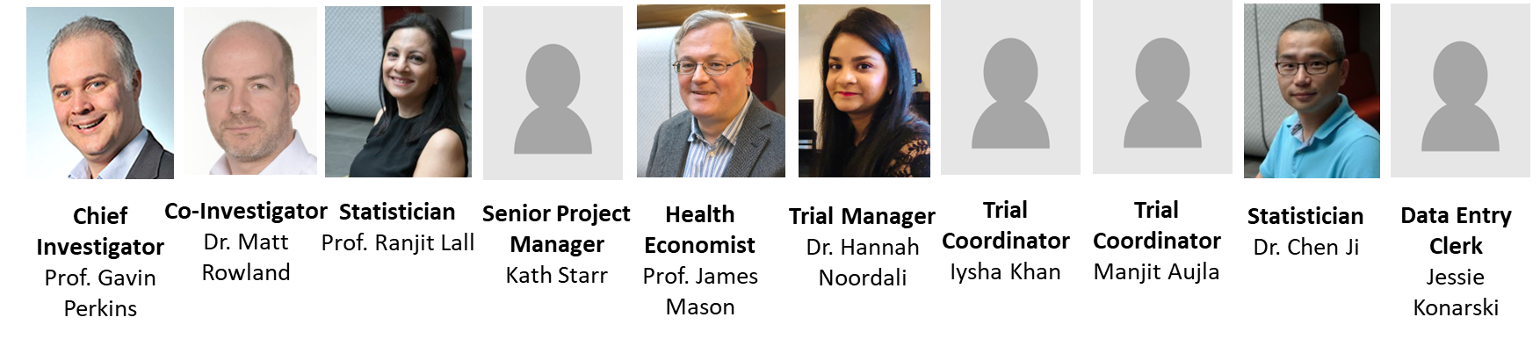
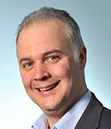
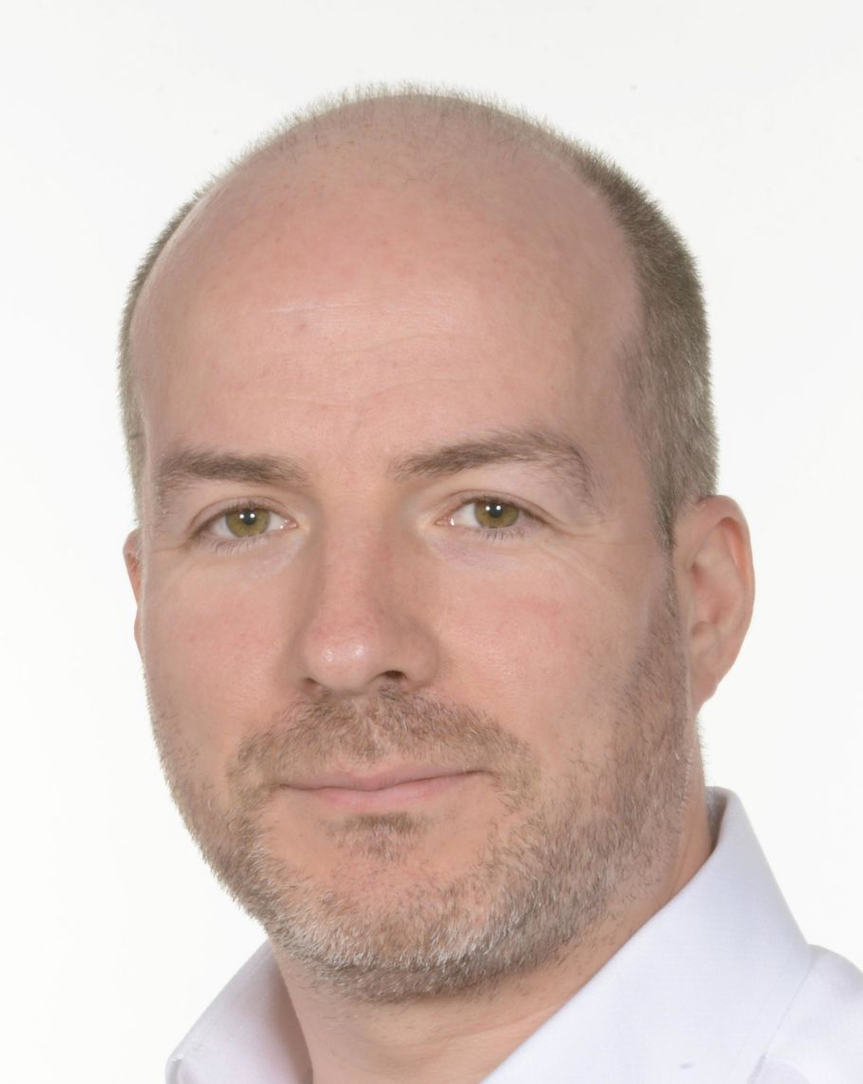


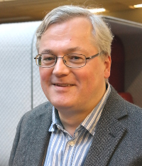
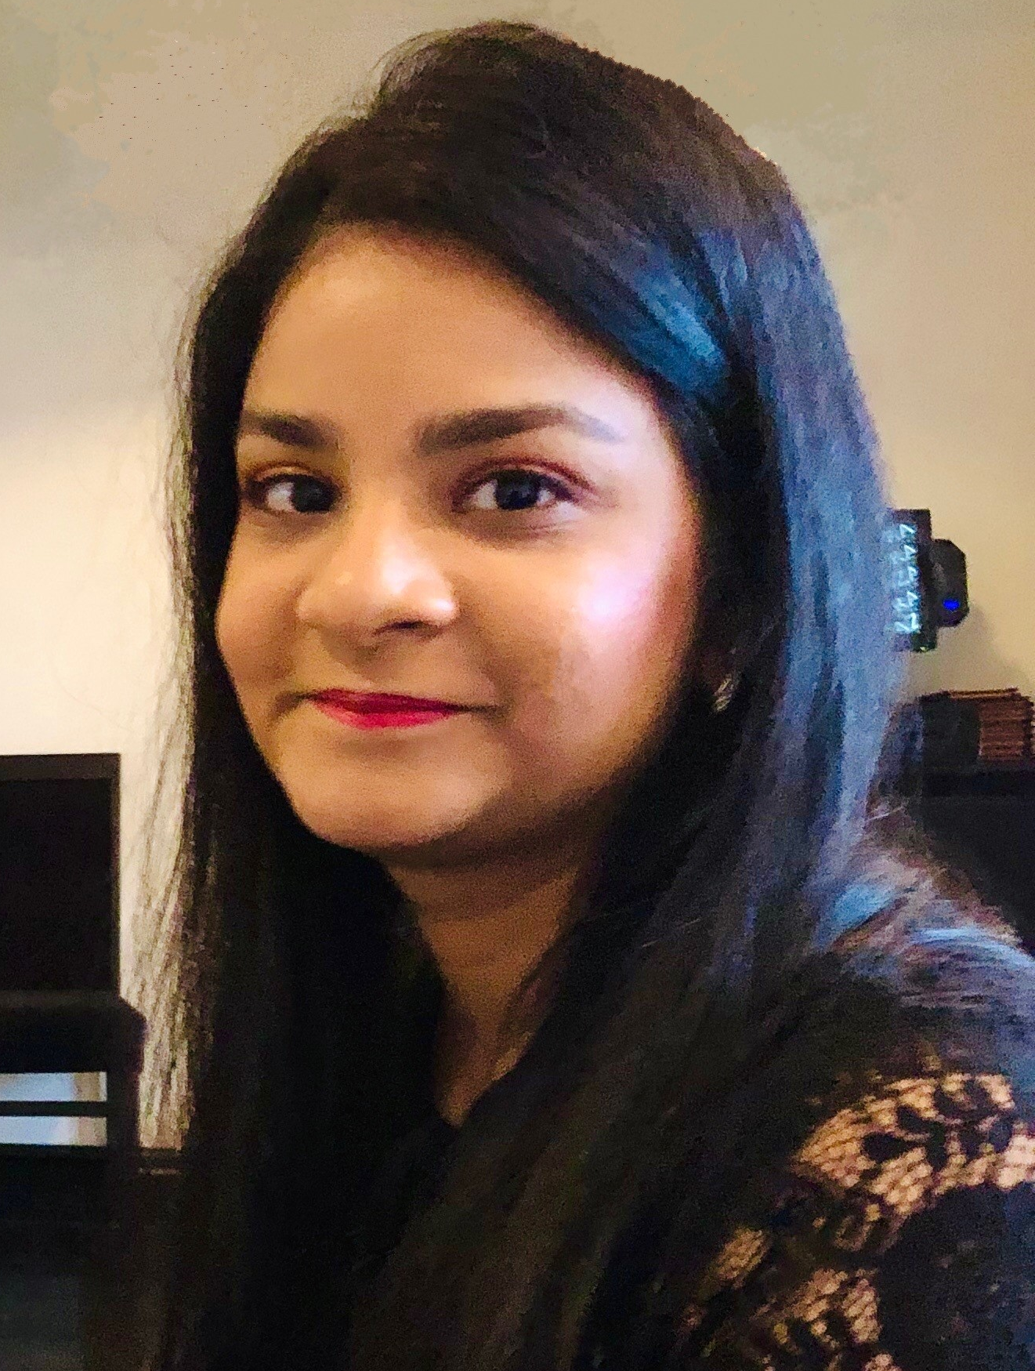
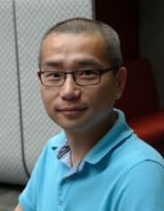
General Study Information
Chief Investigator | Prof. Gavin Perkins
Funder | NIHR Health Technology Assessment Programme (HTA)
Sponsors | University Hospitals Birmingham NHS Foundation Trust University of Warwick
Coordinating Centre | Warwick Clinical Trials Unit
Contact | sostrial@warwick.ac.uk Tel: 024 761 50478
Slide 2
Chief Investigator
Prof. Gavin Perkins
Co-Investigator
Dr. Matt Rowland
Statistician
Prof. Ranjit Lall
Senior Project Manager
Kath Starr
Health Economist
Prof. James Mason
Trial Manager
Dr. Hannah Noordali
Trial Coordinator
Iysha Khan
Trial Coordinator
Manjit Aujla
Statistician
Dr. Chen Ji
Data Entry Clerk
Jessie Konarski

Slide 3
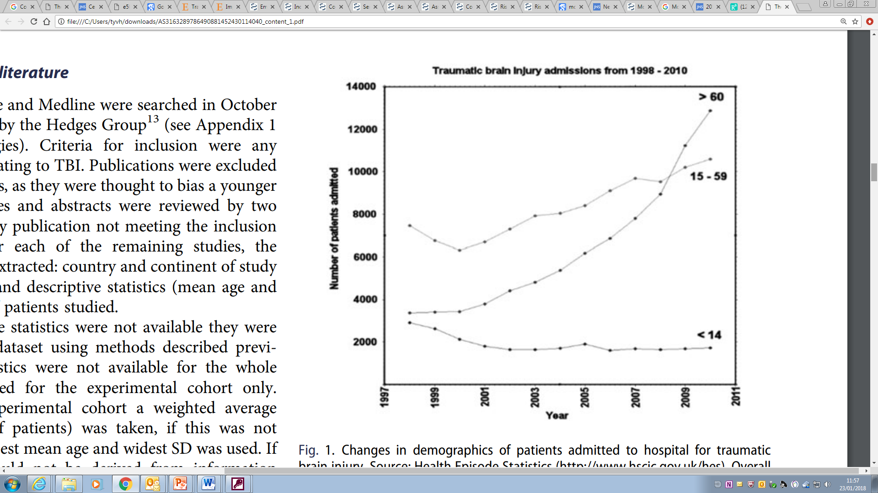
Background
1.4 million patients attend ED with a TBI per year
3500 of these require ICU admission
Overall mortality of 36%
Of those survivors:
  61% of patients had an unfavourable outcome (death or severe disability) at 6 months.
  Between 35-70% of survivors reported problems across the five domains of the EQ-5D at 6 months
Slide 3
Notes:
Matt first slide.

Slide 4
Pathophysiology of injury
Primary neuronal injury
  Focal haematoma, contusions, other diffuse injury
  Leads to hypoxic-ischaemic injury
Exacerbated by secondary physiological insult:
  Hypoxia, hypotension, hypo/hypercarbia, hyperthermia, hypo/hyperglycaemia
Raised intracranial pressure – can result from either primary injury or resulting pathophysiology including cerebral oedema/obstructed CSF flow
Associated with poor neurological outcomes in a number of studies
ICU/surgical treatment of TBI therefore primarily focused on treating raised ICP
Slide 4

Slide 5
Current TBI management
Normally takes a stepwise/protocolised approach:
  Initial treatment of surgical pathology – haematoma removal/hydrocephalus
  Optimisation of ‘stage 1’ interventions e.g. sedation, BP, ventilation, temperature
  Stage 2 measures e.g. hyperosmolar therapy, NM blockade
  Stage 3 measures: e.g. decompressive craniectomy, barbiturate coma
Hyperosmolar therapies - mannitol and hypertonic saline (HTS)
  Both exert osmotic action between plasma/brain cells reducing oedema
  Other actions suggested include:
    Maintenance of BBB integrity
    Modulation of neuroinflammatory response
    Augmenting volume resuscitation
    Microthrombosis
Slide 5

Slide 6
Current evidence for osmotherapy
Seven published SRs based on 18 index trials
Trials limited by:
  Low sample sizes (only 1 trial with > 100 pts)
  Moderate to high risk of bias/inconsistency/imprecision/indirectness
  Range of time scales (spanning over 3 decades)
Low quality evidence that mannitol/HTS effective in reducing ICP
Suggestion of mortality benefit with HTS compared to mannitol but hard to interpret due to quality/bias
Overall insufficient evidence to favour either mannitol or HTS
Slide 6

Slide 7
Need for a trial
Remains unclear if there is a treatment benefit to mannitol/HTS
Many UK centres moving towards HTS as first line osmotherapy:
  2018 UK survey of practice of clinicians in ED/ICU/Neurosurgery
  75% HTS v 25% mannitol for management of ICP
  Little empirical evidence to support this
  Widespread variation in practice – timing/dosing of osmotherapy
Importance highlighted by HTA commissioning brief
Concordance with research gaps identified by:
  Brain Trauma Foundation
  European Society of Intensive Care Medicine
  Recent editorial supporting the publication of the COBI trial protocol
Slide 7

Slide 8
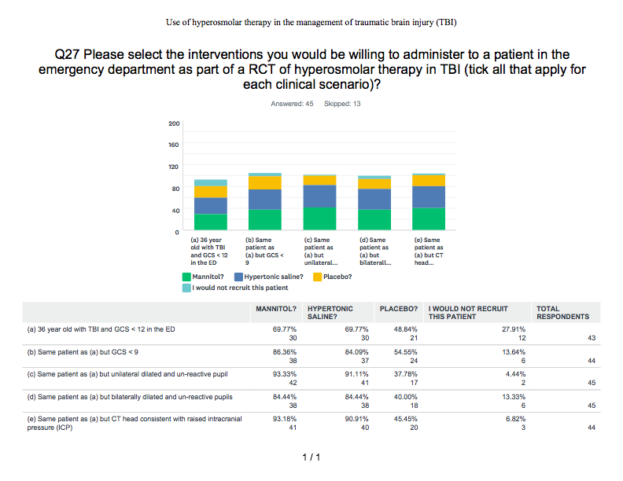
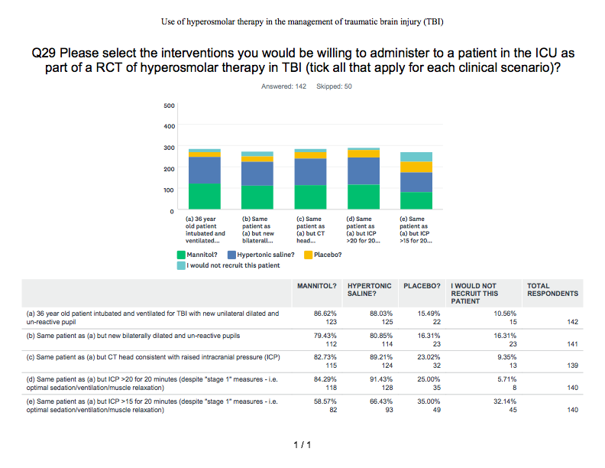
Need for a trial
2018 UK survey of practice:
  Majority support for locating trial in ICU
  Majority of clinicians would not support placebo trial
  90% using bolus osmotherapy first line
  Range of concentrations of HTS used
    5% and 2.7% most common
    Also 30%, 7%, 15% and 23%
COBI Trial
  France
  Continuous v bolus regimes
  There was no significant difference in the 6-month GOS-E score distribution between the 2 groups
  The rates and durations of the other interventions were not significantly different between the groups
Please select the interventions you would be willing to administer to a 30 year old ventilated patient in the ICU as part of a RCT of hyperosmolar therapy in TBI?
Unilateral
pupil
Bilateral
pupils
CT evidence
raised ICP
ICP > 20 despite stage 1
ICP > 15 despite stage 1
Slide 8

Slide 9
Research Aims
To deliver a UK-wide pragmatic phase 3, multi-centre RCT to determine the clinical & cost-effectiveness of hyperosmolar therapy regimes using mannitol/HTS in adult patients with TBI and raised ICP
Hypothesis
Hypertonic saline is more effective than mannitol in the management of raised ICP after severe TBI through improving clinical outcomes/cost-effectiveness
Slide 9

Slide 10
Trial Design
Randomised controlled open label phase III clinical/cost-effectiveness RCT comparing mannitol and hypertonic saline
  Internal pilot (6 months)
  Blinded assessment of primary outcome at 6 months after randomisation
Adult patient >16 with severe TBI and raised ICP requiring ICU
Multi-centre, approx. 28 UK sites
Neurosurgical and NeuroICU leads in each centre to help aid recruitment
Overall recruitment target 638 patients in 36 months (average 1 patient per centre per month)
End of recruitment: November 2022
Slide 10

Slide 11
Outcomes
Primary outcome: GOS-E at 6 months post-TBI
Secondary outcomes:
  Efficacy: ICP control, Progression to stage 3 therapies
  Resource use: Organ support on ICU, ICU LOS, Hospital LOS
  Patient outcomes: mOHS at discharge, GOS-E at 12 months, Survival (discharge, 3/6/12 months), Quality of life – EQ-5D (discharge, 3/6/12 months)
  Serious adverse events
Slide 11

Slide 12
Potential side effects
Renal failure (M>HHS, if sOsm >320)
Central pontine myelinolysis
Rebound increase in ICP after bolus
Metabolic acidosis
Slide 12

Slide 13
OSMOTIC trial
Planned sub-study of the SOS Trial
Aim to investigate the mechanisms behind any potential benefit of either mannitol or HTS
  Likely will be equivalent in reducing ICP
  ?other effects on neuronal injury, neuroinflammation or other pathophysiological pathway on top of osmotic action
Serum samples from recruited patients – markers of:
  Neuronal injury
  Inflammatory pathways
Automated analysis of CT scans
Slide 13

Slide 14
Pilot stop/go criteria
The pilot phase has been successfully completed (May 2021-October 2021).
The recruitment rate is anticipated to be one patient per centre, per month open to recruitment. Success criteria for recruitment was based on the traffic light system:
Go:
Amend:
Stop:
75-100% recruitment = progress to main trial following a review of screening logs and protocol. Any barriers to recruitment will be addressed.
50-75% recruitment = progress to main trial with additional sites being recruited as well as a screening log and protocol review.
<50% recruitment = the decision to progress will be made by the TSC in association with the funder.
Slide 14
Notes:
Pilot will run for 6 months in up to 8 sites, purpose = test processes. Pilot recruitment target is 50.
This will be a seamless recruitment with the main study, so no halt in recruitment will take place
Recruitment rate will be reviewed and will determine whether we can progress to main trial
1 patient per month per site
Decision to progress will be made by funder and TSC

Slide 15
Pocket sized eligibility laminates available from WCTU
Trial Design
Inclusion criteria:
  Adult > 16
  Admission to ICU with TBI
  ICP > 20mmHg for more than 5 mins despite stage 1 measures
  < 10 days from initial TBI
  Abnormal CT scan consistent with TBI
Exclusion criteria:
  Devastating brain injury with withdrawal of treatment anticipated in the next 24 hours
  Pregnancy*
  Severe hypernatraemia (serum Na > 155mmol/L)
  2 or more prior doses of hyperosmolar therapy given on ICU
  *NB Pregnancy is not a contraindication to hyperosmolar therapy, but these patients must be excluded for ethical and regulatory reasons
Slide 15
Notes:
Matt last slide.
Do not need to specifically test for pregnancy, but confirmed/apparent pregnancy should be excluded
This is a pragmatic trial and therefore will not exclude patients that are given hyperosmolar therapy prior to ICU admission. The rationale is that this trial is addressing the use of hyperosmolar therapy in monitored patients in intensive care. Un-monitored hyperosmolar therapy occurs in practice currently and is likely to continue after this trial. The sub-set of patients (with clinical signs of raised ICP) frequently will go direct to theatre for surgical intervention, which may resolve the raised ICP or indicate that injuries are non-survivable.
Aide memoires are available

Slide 16
Screening process
PI responsibility to make treating teams aware of trial
All patients admitted to ICU with severe TBI should be screened
Screening should be a continuous process
Screening data to be entered on the SOS web application – only enter data for each patient once
Slide 16
Notes:
Screening starts when patients are admitted to ICU with a severe TBI.
If ICP raises in a patient to >20mmHg within the 10 day eligibility window a previously screened patient can become eligible for the trial – in this situation we only want one set of screening data. For patients who are only ineligible due to their ICP, screening should continue throughout the 10 day eligibility window, but only screening data from the final screening should be entered online – whether that is that the patient is ineligible at the end of the 10 day period, or at point of randomisation.
There is not a separate screening log on the online database, the same wizard is used for screened patients that is used for randomising a patient into the trial. There is a paper log that should be completed by sites to keep track of which patients have been screened – this should not be sent to the trial office as will contain patient identifiable data, which the trial does not have approval to receive prior to randomisation.

Slide 17
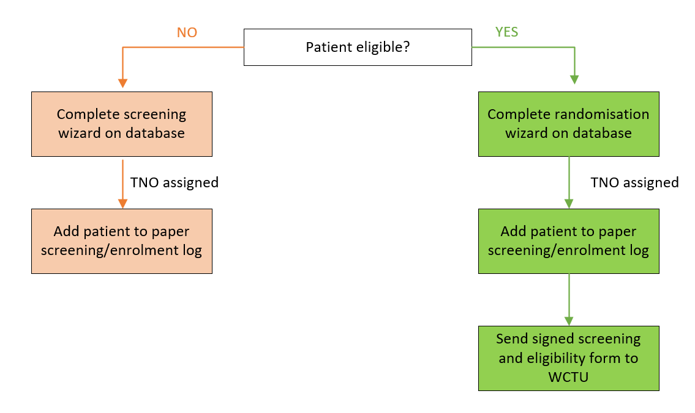
Screening process
Slide 17

Slide 18
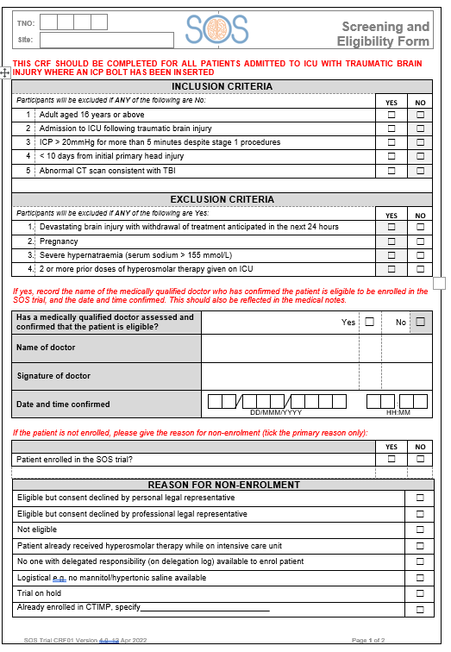
Confirmation of eligibility
Eligibility must be assessed and confirmed by a medically qualified doctor only, prior to the patient being enrolled
The screening and eligibility form can be signed at the time or as soon as practically possible after enrolment
The justification for the patient meeting all of the eligibility criteria must be clearly documented in the patient’s medical notes for monitoring purposes
  This must include ICP and serum Na readings at point of confirming eligibility
Slide 18
Notes:
- Key document -
Along with entering the details onto the database this is a paper form will need to be signed on completion – ideally we would like to receive these forms as quickly as possible; as the trial is taking as pragmatic approach it is understood that there may be some delay. You should only complete one form for each patient screened.
Copy of the screening and eligibility form to be emailed to SOS resource account. For purposes of oversight, signatures will be cross-referenced against training sign off to ensure site staff are correctly trained.
We have sought advice from the MHRA with regard to enrolment in an emergency situation

Slide 19
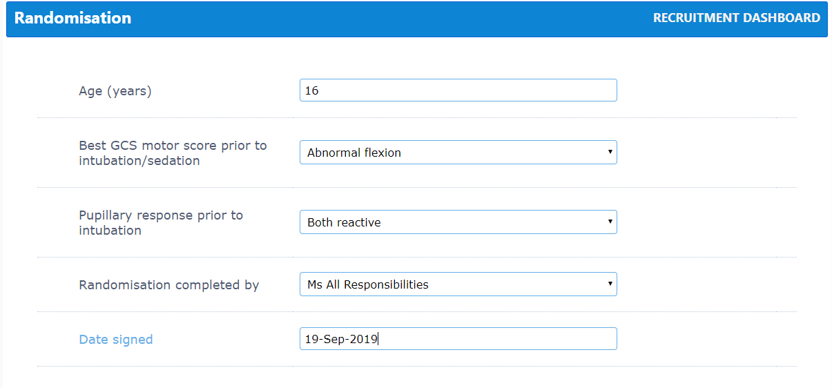
Randomisation
Use online randomisation form
Access to system granted once training complete and ‘green light’ to begin recruitment
Backup = Call WCTU Emergency Randomisation service 02476 150 402 (Mon-Fri 9-5 only)
Slide 19
Notes:
Randomisation wizard will prompt for the information required – will need to confirm patient is eligible and enter age, GCS motor score and pupillary response which is all used to stratify the randomisation and ensure balance of patients across treatment arms (those variables are put into a model to calculate probability of unfavourable outcome at 6 months).
Individual logins issued once training is complete and green light issued
Backup = paper based randomisation system where you will be given a TNO and treatment allocation – the patient can then be added to the database retrospectively

Slide 20
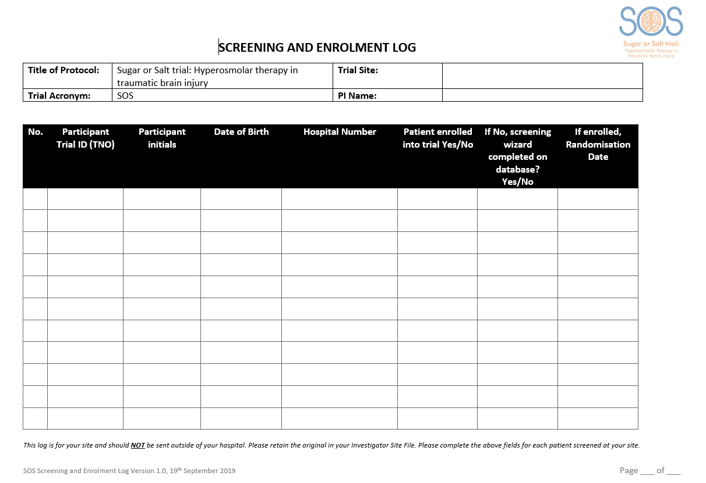
Screening and Enrolment log
Once the patient is randomised, complete the paper Screening and Enrolment Log stored in section 11.1 of your Investigator Site File (could also be completed electronically)
Do NOT send this log to WCTU.
Slide 20
Notes:
Just to complete locally in order to track which patients have been screened and enrolled and match them to patient identifiers. It is important this log is accurate and kept up to date as it is how you will identify patients by their TNO prior to completing patient identifiers form on the database.
DO NOT SEND THIS TO WCTU – this log will contain identifiers of patients not recruited into the SOS trial - the trials unit should not receive this information = breach of GDPR and deviation.
Electronic versions can be kept, please signpost where this is saved in the paper ISF (to be printed and filed when recruitment ends).

Slide 21
Co-enrolment
We are supportive of co-enrolment with both other non-CTIMP trials and other CTIMP trials, provided a co-enrolment agreement is in place
Trials that can co-enrol with SOS can be found on our website
Slide 21
Notes:
For co-enrolling studies, would need to exchange protocols and both Trial Management Groups need to agree co-enrolment
Are there any conflicting trials, or other studies that would be recruiting from a similar patient population running in your ICU?

Slide 22
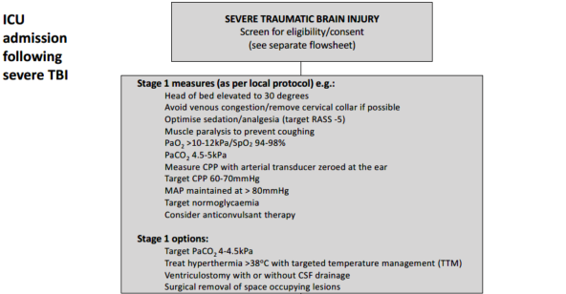
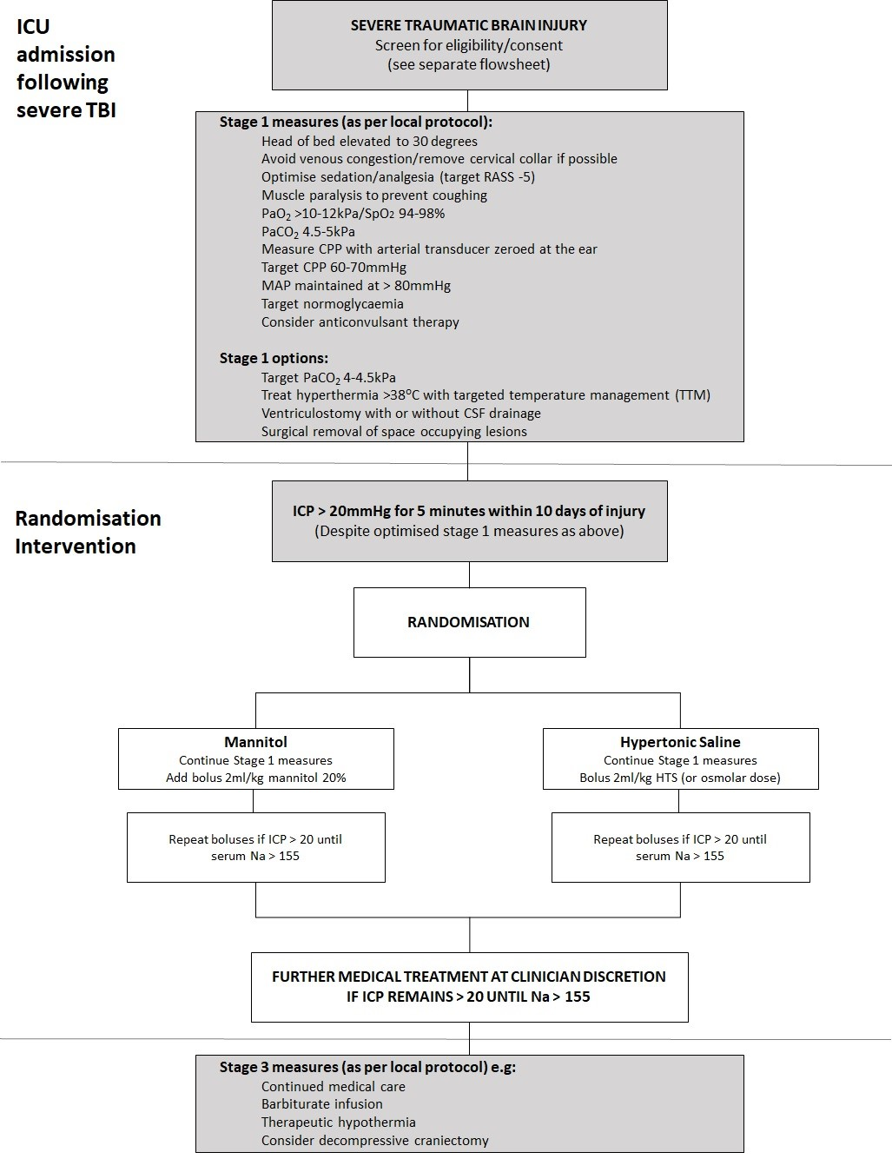
Slide 22
Notes:
Matt to talk through

Slide 23
Trial Interventions
Randomisation (web based/allocation concealed) to:
  Equi-osmolar dose of mannitol intravenous bolus
  Equi-osmolar dose of hypertonic saline intravenous bolus
Use dosing table provided to assist with calculating doses. If estimating weight, use ideal body weight.
If ICP remains >20mmHg, boluses of each IMP can be repeated until serum sodium is > 155 mmol/L.
If there is a second spike in ICP to >20mmHg, allocated IMP should continue to be used.
Slide 23
Notes:
Matt to talk through

Slide 24
Dosing table – ml/kg
kg | 40-44 | 45-49 | 50-54 | 55-59 | 60-64 | 65-69 | 70-74 | 75-79 | 80-84 | 85-89 | 90-94 | 95-99 | 100-104
Weight for calculation | 40kg | 45kg | 50kg | 55kg | 60kg | 65kg | 70kg | 75kg | 80kg | 85kg | 90kg | 95kg | 100kg
Mannitol 20% | 80 | 90 | 100 | 110 | 120 | 130 | 140 | 150 | 160 | 170 | 180 | 190 | 200
Mannitol 15% | 120 | 135 | 150 | 165 | 180 | 195 | 210 | 225 | 240 | 255 | 270 | 285 | 300
Mannitol 10% | 160 | 180 | 200 | 220 | 240 | 260 | 280 | 300 | 320 | 340 | 360 | 380 | 400
HTS 30% | 8 | 9 | 10 | 11 | 12 | 13 | 14 | 15 | 16 | 17 | 18 | 19 | 20
HTS 23% | 12 | 13 | 15 | 17 | 18 | 20 | 21 | 23 | 24 | 26 | 27 | 29 | 30
HTS 7.50% | 36 | 40 | 45 | 50 | 54 | 59 | 63 | 68 | 72 | 77 | 81 | 86 | 90
HTS 5% | 52 | 59 | 65 | 72 | 78 | 85 | 91 | 98 | 104 | 111 | 117 | 124 | 130
HTS 2.70% | 96 | 108 | 120 | 132 | 144 | 156 | 168 | 180 | 192 | 204 | 216 | 228 | 240
Look in your site file to find laminated dosing tables for use at the bedside
Slide 24
Notes:
Matt to talk through.
Use dosing table to help you calculate equivalent osmolar doses for different concentrations of the trial interventions. The full table can be found in the ISF and also available as an aide memoire.

Slide 25
Consent process
PATIENT UNABLE TO CONSENT
Patients in this trial are unable to consent for themselves due to impairment in their mental capacity caused by the traumatic brain injury
Urgent treatment needs to be given without delay, and it is not reasonably practical to obtain consent from a legal representative
Sufficient time for legal representative to provide fully written informed consent (and appropriate to do so)
*Witnessed verbal consent may be obtained if it is not feasible to obtain written consent from personal legal representatives and patients
Enrol under deferred consent
Obtain written informed consent from personal* or professional legal representative
As soon as possible after the emergency is over obtain written informed consent from personal* or professional legal representative
Enrol patient
If patient regains capacity before hospital discharge, obtain written informed consent from patient*
Slide 25
Notes:
Patient will not have capacity to consent for themselves
If urgent treatment needs to be provided, patient can be enrolled under deferred consent – this is permitted with the Medicines for Human Use (Clinical Trials) Regulations 2006 amendment. In this situation consent be obtained as soon as practically possible once the emergency is over. This can be from a legal representative as patient will likely still lack capacity.
Any questions?

Slide 26
Deferred consent
Main route of consent will probably be deferred consent
Pre-enrolment consent from a LR is an option if:
  LR is available
  There is sufficient time to explain the study fully and get written consent
  It is appropriate to speak to the LR e.g. if they are keen to be involved in decision making
Slide 26
Notes:
Consent should be sought as soon as possible following the initial emergency i.e. when appropriate to do so. We would expect this to be within 24 hours of enrolment in most cases.
Different versions of PIS and consent form available depending on who’s consenting and whether it’s pre or post enrolment
Pre-enrolment – consenting to receive trial treatment and ongoing data collection
Post-enrolment – consenting to ongoing data collection only (trial intervention complete at that point)

Slide 27
Legal representative consent
Personal legal representative
The definition of a Personal Legal Representative (PerLR) for England, Wales and Northern Ireland is: “A person not connected with the conduct of the trial who is suitable to act as a legal representative by virtue of their relationship with the adult and available and willing to do so”.
The definition of a PerLR for Scotland is: “Any guardian or welfare attorney who has power to consent to the adult’s participation in research. If there is no such person, the adult’s nearest relative as defined in section 87(1) of the Adults with Incapacity (Scotland) Act 2000”.
Professional legal representative
The definition of a Professional Legal Representative (ProfLR) in England, Wales, Northern Ireland and Scotland is: “A person not connected with the conduct of the trial who is the doctor primarily responsible for the adult’s medical treatment or a person nominated by the relevant health care provider”.
Slide 27

Slide 28
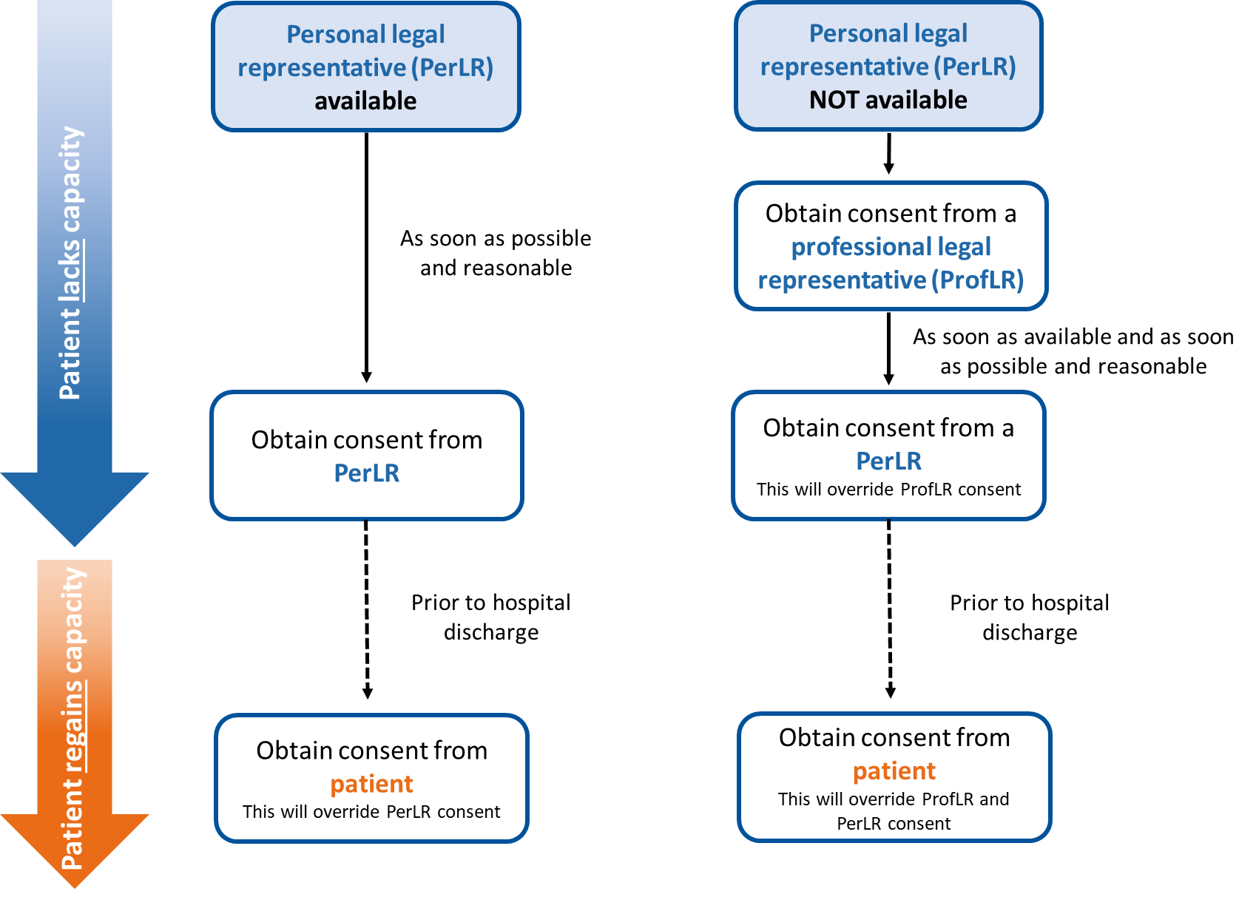
Consent hierarchy
Consent should be sought as soon as is reasonably possible according to the hierarchy detailed below:
Slide 28
Notes:
Hierarchy – always approach PerLR first if available. If no such person, approach ProfLR. If a PerLR later becomes available before the patient regains capacity, they should be informed and consent should be obtained. Their consent or dissent will override that provided by the ProfLR.
Any questions? Is this a familiar process? Are there any specific issues surrounding this consent process?

Slide 29

Patient Information Sheet
No objection
Document on consent form
Explain trial and provide copy of patient information sheet
Ask personal legal representative to consider the patient’s wishes regarding trial participation
If no objection expressed, complete the consent form.
Ask professional legal representative to consider best interests of the patient
Both legal representative and person receiving consent to sign the form.
Ensure you are using the correct version of the PIS and consent forms – there are different versions depending on who is consenting and whether it is pre- or post-enrolment.
Document in medical notes.
Slide 29

Slide 30

Patient consent
If the patient regains capacity while still in hospital, they should be given the Patient Information Sheet and be given the option to consent/withdraw
Slide 30
Notes:
After hospital discharge it will not be reasonable or practical to assess patient’s capacity and obtain written consent in the event that the patient regains capacity. Questionnaires will therefore be sent to the patient’s legal representative, and return of a completed questionnaire from either the legal representative or the patient will be considered implied consent.
[consent from the legal rep remains valid]

Slide 31
Legal Representative Consent
YES
Is a personal legal representative available?
NO
Is the personal legal representative able to attend the hospital in person to provide consent?
Obtain written informed consent from a professional legal representative
YES
NO
Obtain written informed consent from the personal legal representative
Obtain witnessed verbal consent over the phone from the personal legal representative
Slide 31

Slide 32
Witnessed verbal consent
Only if it is not feasible to obtain written consent from personal legal representatives or patients.
For example:
  Personal LR unable to attend hospital to sign form
  Patient tests positive for COVID-19
Verbal consent must be obtained in the presence of an impartial witness, who is:
  independent of the study
  cannot be unfairly influenced by people involved with the study
Slide 32
Notes:
Written informed consent should be obtained if possible. Only in cases where it is not feasible, should witnessed verbal consent be obtained instead, e.g. if the personal legal representative is unable to attend the hospital to sign for themselves due to visiting restrictions, or if the patient tests positive for COVID-19.
Verbal consent must be obtained in the presence of an impartial witness independent to the trial team e.g. doctor or nurse that is not on the delegation log.

Slide 33
Witnessed verbal consent
Patient Information Sheet
Obtain verbal consent
Document on consent form
Explain trial to Personal LR/patient
Send/provide copy of patient information sheet
Read out consent form and ask Personal LR/patient to confirm if they agree verbally.
Person obtaining consent to write their own initials in the boxes to indicate the Personal LR/patient agreed to clause
Both person obtaining consent and witness to sign the consent form
Document in patient medical notes and record how impartial witness was selected.
Witnessed verbal consent can be obtained over the telephone for PerLR
Slide 33
Notes:
If the personal legal representative is unable to attend the hospital to sign the consent form, verbal consent should be sought over the phone. The witness will need to listen to the conversation so the phone will need to be on loudspeaker.

Slide 34
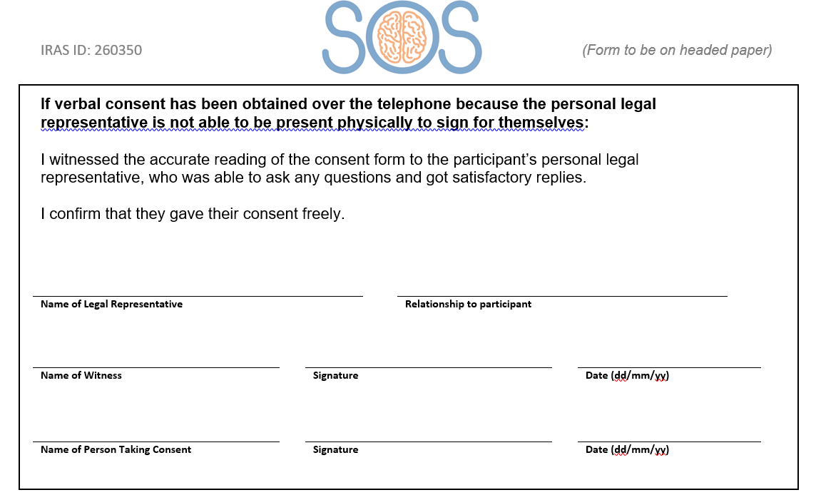
Witnessed verbal consent
Slide 34
Notes:
If witnessed verbal consent has been obtained complete the relevant section on page 2.

Slide 35
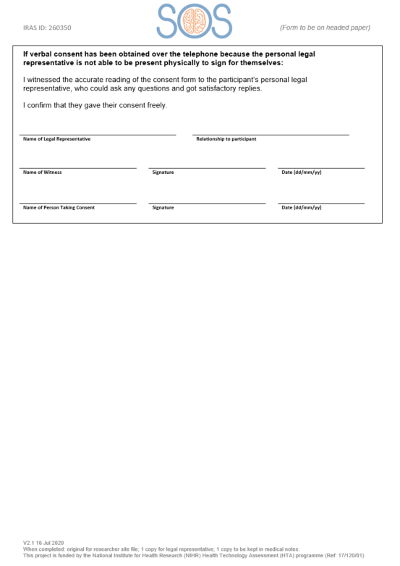
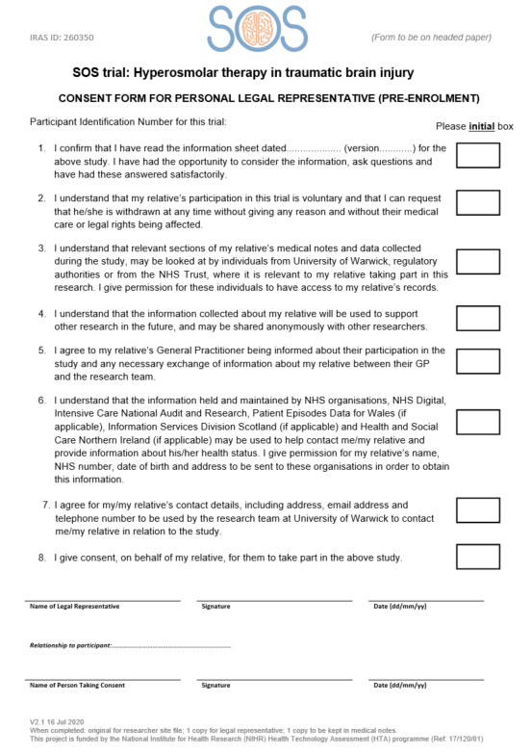
Consent process
Consent should be documented on the trial database and in the patient’s medical notes
Three copies to be signed:
  original to be kept at site in ISF
  one for LR/patient
  one for medical notes
Consent is an ongoing process!
Do not send copies of consent forms to Warwick CTU. They should be stored securely at site
Who can approach patients/LRs for consent at your site?
Slide 35
Notes:
Consent should be sought as soon as possible following the initial emergency i.e. when appropriate to do so. We would expect this to be within 24 hours in most cases.
Different versions of PIS and consent form available depending on who’s consenting and whether it’s pre or post enrolment
Pre-enrolment – consenting to receive trial treatment and ongoing data collection
Post-enrolment – consenting to ongoing data collection only (trial intervention complete at that point)
Three signed copies of consent form – original in ISF, copy to patient/legal rep and copy for medical notes. If verbal consent has been obtained over the phone, you will need to send a copy to the personal legal representative.
Ongoing process – confirmation that still happy to be involved in SOS should be sought and documented in patient notes when discussing with LR or patient.
Question: what are local policies for taking consent - Check whether research nurses at site can take consent for CTIMPs

Slide 36
Follow-up
Where possible follow-up should be done by a blinded member of staff
Daily data collection while ICP monitored/while on ICU
Mortality status at 3/6/12 months (if patient still in hospital)
Critical care discharge info
Hospital discharge info
Modified Oxford Handicap Score and EQ-5D at discharge
3/6/12 month follow-up questionnaires sent by post from Warwick CTU
Slide 36
Notes:
If patient is still in hospital – hospital team to check mortality status. If patient is discharged, WCTU team will check mortality
Ideally we would like follow-up data to be collected from a blinded member of staff i.e. not treating clinician – to eliminate any possibility of bias – Is this something that would be feasible? Are there blinded and non-blinded teams?
On the CRFs it is captured whether the hospital staff member is blinded or not to the treatment allocation and this will be reviewed by the TMG

Slide 37
Withdrawals
Please notify Warwick CTU straight away of any withdrawals by completing the withdrawal form on the online database
Options for withdrawal:
  Trial treatment*
  Completion of follow-up questionnaires
  From remote data collection (from medical notes/other organisations)
  * A clinician can only withdraw a patient from trial treatment
If withdrawing from trial treatment, stop allocated treatment immediately and continue with local protocols
If withdrawing from data collection, stop all data collection from the point of withdrawal (data already collected can be retained).
Document in the medical record the date of withdrawal.
Slide 37
Notes:
Important to clarify with the patient/LR what exactly they’re withdrawing from – detail that on withdrawal form.
If insist on all data collected being removed then talk to us – sites do not have to delete all the data, we will deal with it.

Slide 38
IMP supply
Use local stock
No trial-specific storage or labelling requirements
IMP should be stored and dispensed as per local protocols
MHRA have confirmed:
  No accountability logs required (CRF will detail what was given and number of doses)
  No destruction certificates required
Q) What are local processes for prescribing and dispensing mannitol and hypertonic saline?
Q) How will you ensure sufficient stock of both during the trial?
Slide 38
Notes:
MHRA have confirmed that the drugs become IMP at the point of administration. Local protocols for drug management to be followed in full. Therefore no need for pharmacy file.

Slide 39
Monitoring
Each site will be provided with an Investigator Site File (ISF)
It will be the sites responsibility to maintain the ISF
On-Site Monitoring (x1 visit or remote meeting as a minimum; further monitoring as necessary)
  We will visit you, or arrange a videoconference, to check that the study is being run according to protocol, SOPs, GCP and regulatory requirements
  Key staff should be available during visits
  Source documentation, original consent forms and the site file must be available for review
Close-out (x1 visit or may be done remotely)
  Resolve any outstanding queries
  Collect any outstanding data
  Ongoing responsibilities
  Archive (at least 10 years)
Slide 39
Notes:
ISF/amendment management: Question to site – how would you like to receive updates to documentation?
Monitoring visits:
Question to site - what is source data and where is it held? Need access to source data for monitoring visits to complete source data verification.
A report will be sent after each visit and a response will be required from you within 28 days.
Archive – site to archive all trial documentation for minimum of 10 years.

Slide 40
Safety reporting
Any Serious Adverse Events (SAEs) that occur from the time that the patient is randomised, through to and including 28 calendar days after the last administration of IMP must be reported to WCTU.
Send completed paper SAE forms to WCTUQA@warwick.ac.uk within 24 hours of becoming aware of the event.
Events that do NOT need be reported as SAEs:
  Death
  Persistent or significant disability/incapacity
  Organ failure
  Any other events relating to the underlying illness/injury
SmPCs for Mannitol and HTS can be found in your site file.
Slide 40
Notes:
Reporting window can be extended if investigator site feels it is relevant to the IMP
Event type - what makes it serious?: Clarify reasons for exceptions - **provide examples?** - ask Matt
If patient is randomised, but does not receive IMP - SAEs to reported up to and including 28 calendar days after randomisation.
SmPCs: Mannitol 10% and 15% Baxter Healthcare Ltd, 20% Fresenius Kabi Limited. Hypertonic saline 2.7% and 5% Fresenius Kabi Limited, 30% Torbay and South Devon NHS Foundation Trust, Torbay Pharmaceuticals

Slide 41
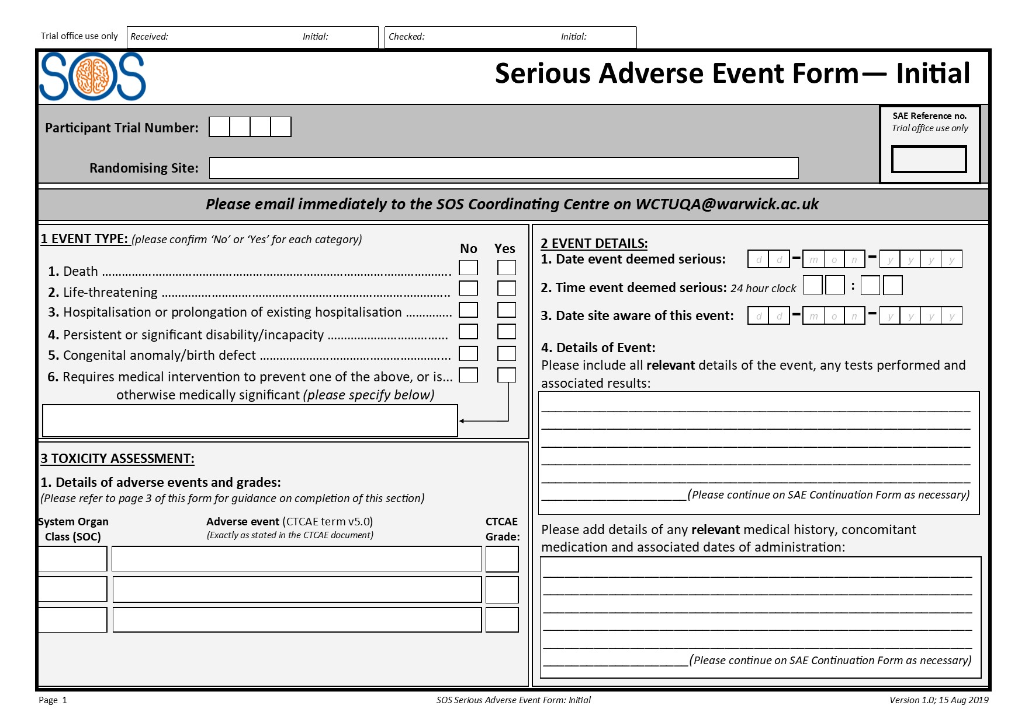
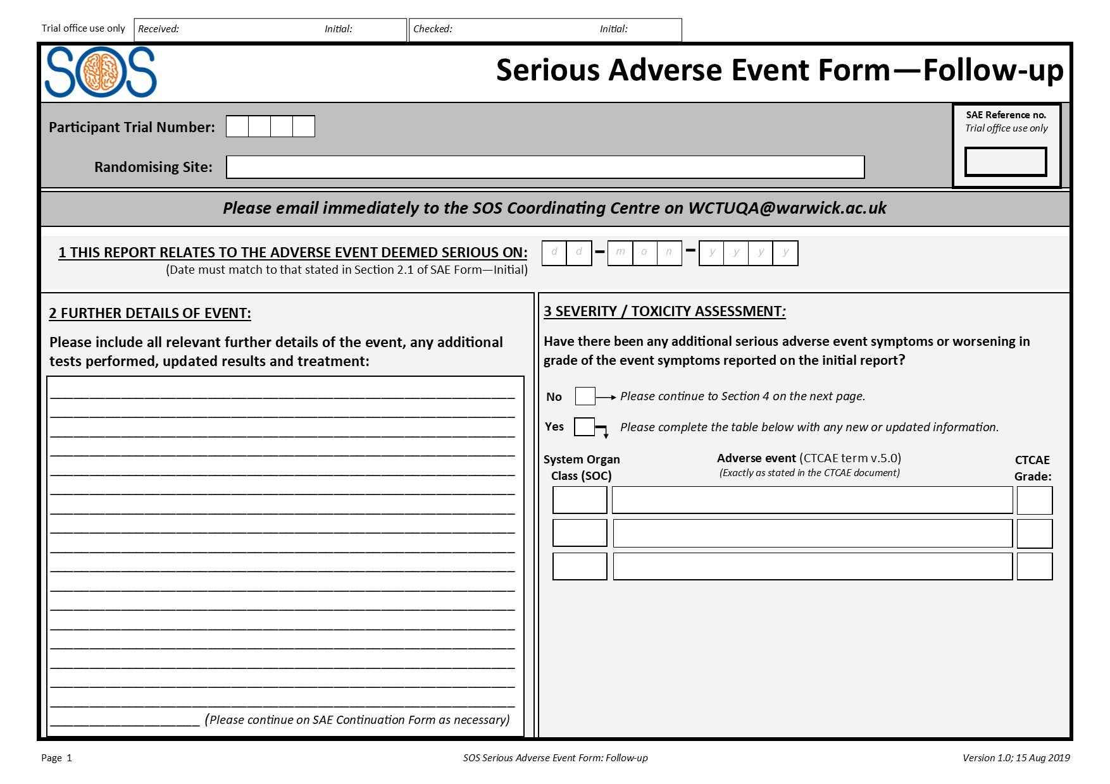
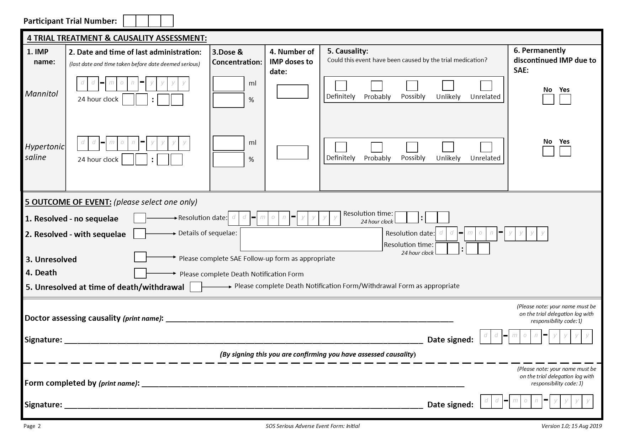
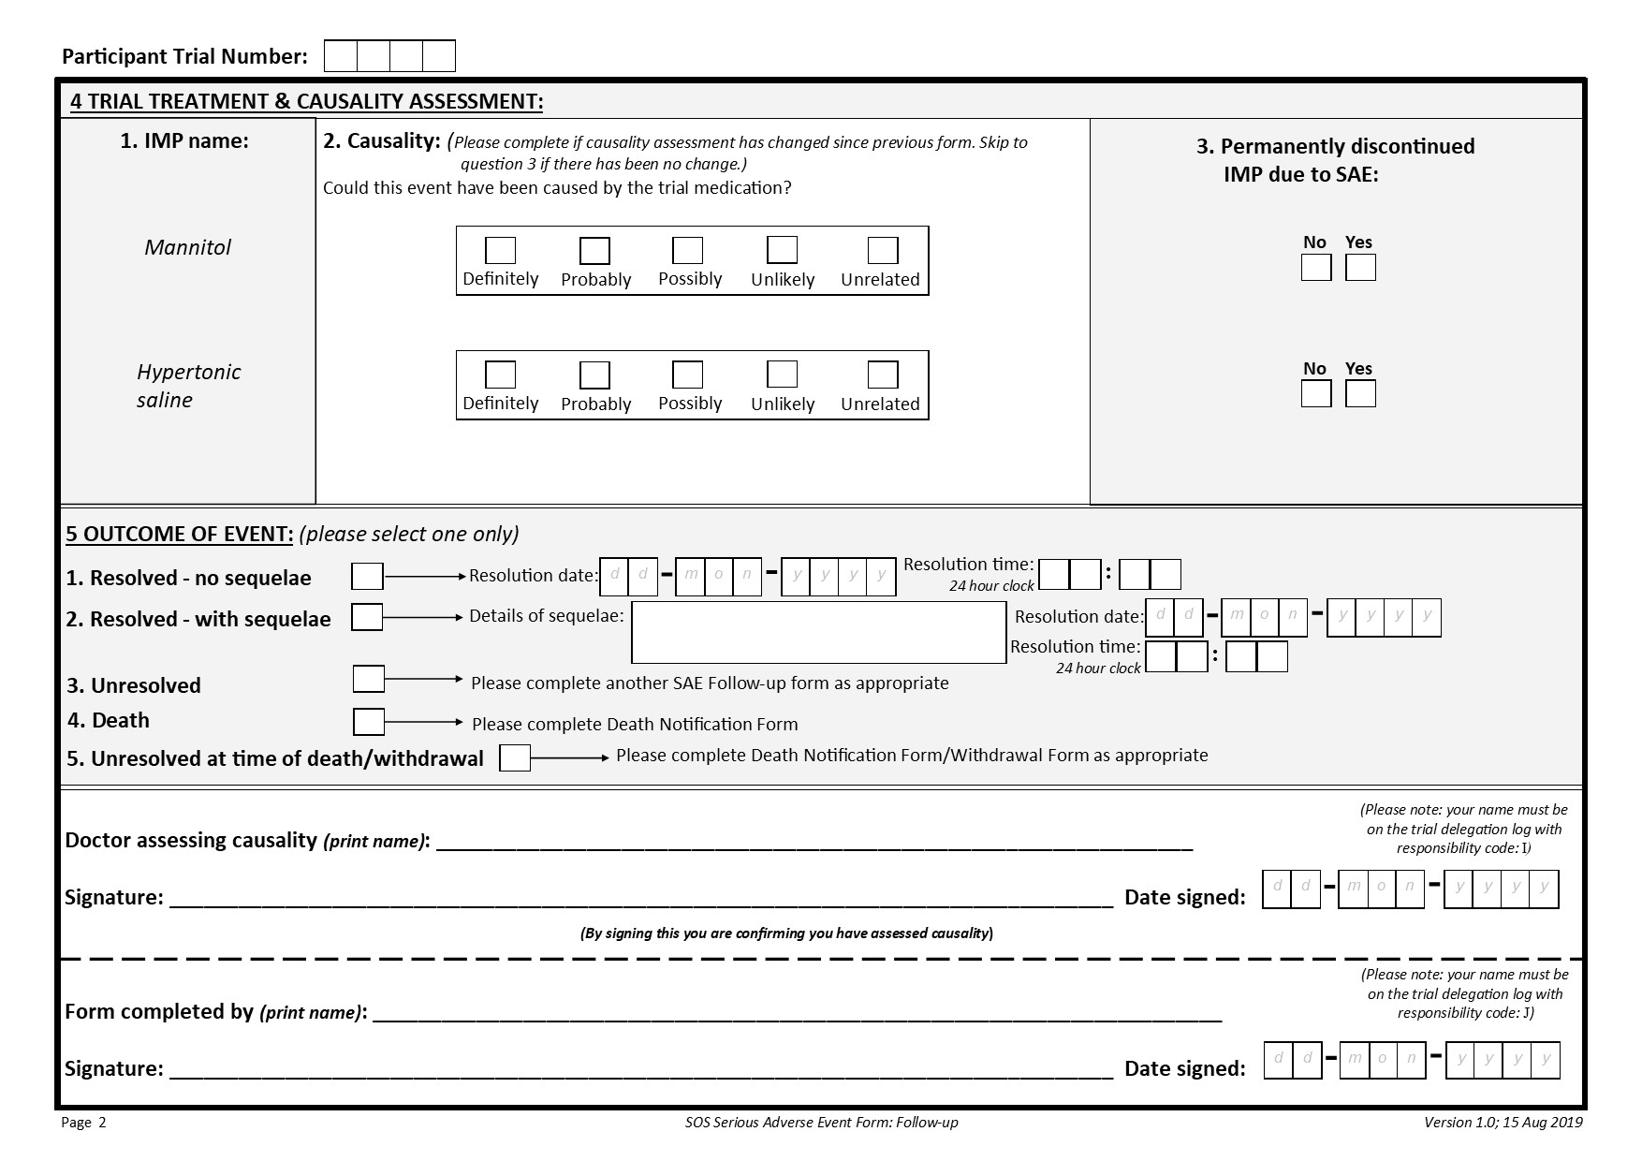
SAE Forms
Signed paper copies should be emailed to WCTU.
Slide 41
Notes:
SAE Continuation Form is available if required
Highlight requirement to be on delegation log for doctor assessing and the person completing the form.

Slide 42
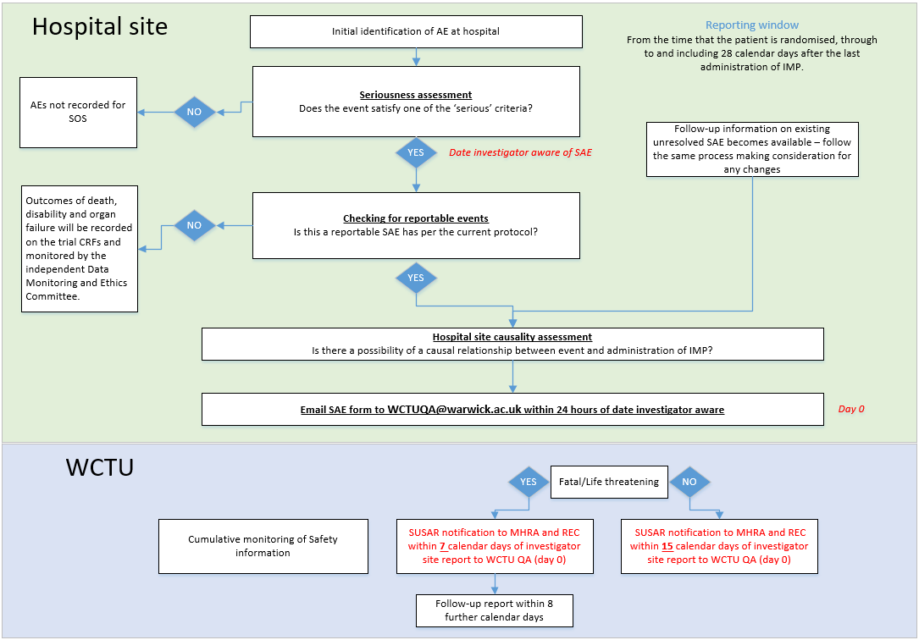
CRFs collect certain AE information.
No separate form required.
If SAE is considered related to IMP and unexpected
Slide 42
Notes:
Certain expected AEs are recorded on CRFs
Expand on what WCTU's role is - Clinician assessing causality and trial team assessing expectedness using RSI

Slide 43
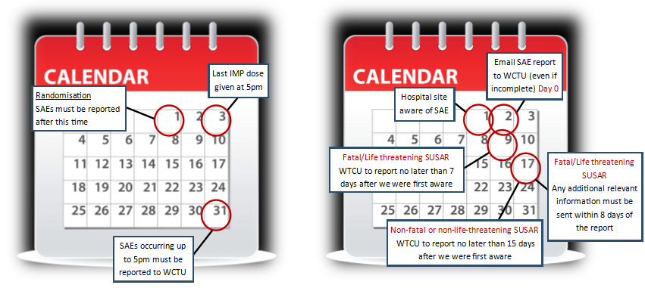
Safety reporting timelines
Slide 43

Slide 44
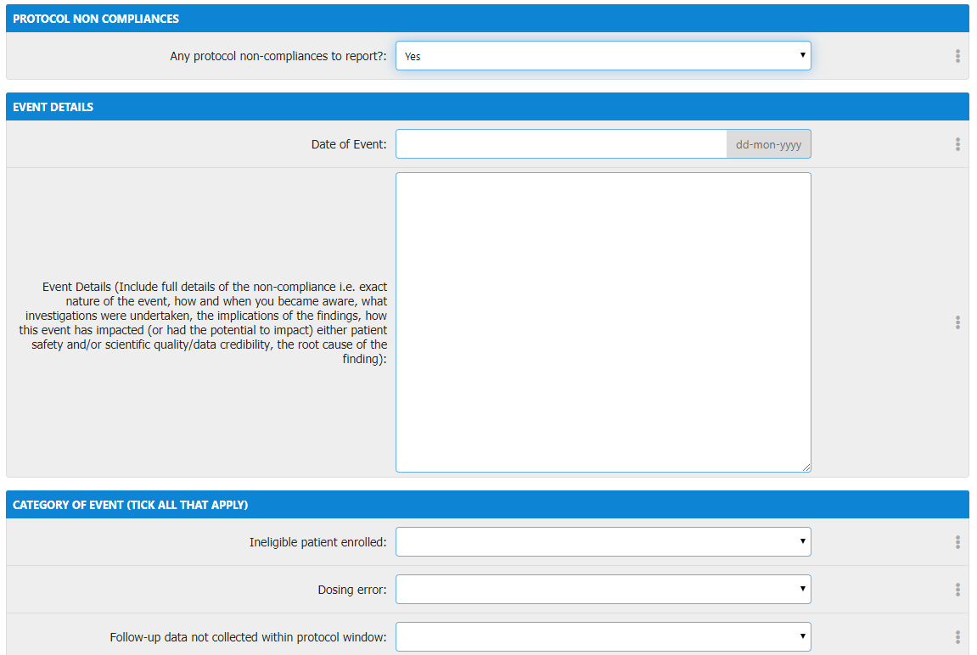
Non-compliance
Report any non-compliances immediately (within 24 hours of becoming aware)
Complete online non-compliance form for non-compliances related to an individual participant.
For general site level non-compliances, please complete the non-compliance form separately and email to WCTU.
Slide 44
Notes:
Complete online non-compliance form for all non-compliances linked to a participant.
For general site level non-compliances (not linked to a particular participant) e.g. lost the ISF – please complete the separate form electronically or by hand and send to WCTU by email.
If you need any help or come across a non-compliance that believe is serious or requires urgent attention, please call or email the WCTU.

Slide 45
Blinding
SOS is a an open label trial, with no requirement for specific labelling of the IMP; therefore it is not possible to blind clinical staff to treatment allocation.
We will not specifically set out to inform participants or their legal representative of the treatment allocation. We recognise however that it may become evident during the course of the participant receiving the treatment. If the participant or legal representative asks which treatment allocation they had received, in the interest of being transparent, there is no requirement for this to be withheld.
If possible the person completing the Hospital Discharge Form should be blinded to treatment allocation to limit bias.
Slide 45

Slide 46
Training and Delegation log sign-off
Trial Role/Responsibility | Who can do this role | On delegation log? | CV required? | Minimum training required | Risk assessment and justification
Screening | Any member of the team who has been trained can assess eligibility. | Do not need to list individuals on the delegation log. | No | Study team contacts Eligibility criteria Targeted screening GCP training | These are standard routine assessments made under a standard of care setting for these patients in this patient population, therefore full protocol training is not required.
Confirming eligibility | Must be a medically-qualified doctor. Ideally this individual should sign the Screening and Eligibility CRF to confirm eligibility prior to the patient being enrolled. If this is not possible, the CRF should be signed as soon as possible after the patient has been enrolled. | Do not need to list individuals on the delegation log. | No | Study team contacts Eligibility criteria Targeted eligibility GCP training | These are standard routine assessments made under a standard of care setting for these patients in this patient population, therefore full protocol training is not required.
Performing randomisation | Any member of the team who has been trained. | Yes | Yes | Data collection guide on how to use randomisation wizard. | Restricted user access to database to randomisation wizard only. Enables greater scope for enrolling patients.
Prescribe mannitol/hypertonic saline | Anyone who would usually prescribe mannitol/hypertonic saline | No | No | Eligibility criteria Targeted drug prescription GCP | The MHRA have confirmed the drug becomes IMP at point of administration
Administer IMP | Anyone who would usually administers mannitol/hypertonic saline | No | No | N/A | No greater risk than standard care; mannitol and hypertonic saline are both routinely administered in this patient population.
Informed consent | Doctor or research nurse (if permitted by Trust policy) | Yes | Yes | Full protocol training Targeted consent GCP training | Targeted GCP training enables greater scope for capturing the patient population.
Data collection | Anyone who has been trained on trial data collection | Yes | Yes | Full protocol training Targeted data collection GCP training | Targeted GCP training enables greater scope for data collection.
SAE causality assessment and sign off | PI or delegate. (Must be a medically-qualified doctor.) | Yes | Yes | Full protocol training Targeted SAE GCP training | Targeted GCP training enables greater scope for SAE causality assessment.
Slide 46
Notes:
Randomising participants – need a log in to the database and need to be on delegation log.
Question to site - how they are going to ensure enough people on the delegation log to allow randomisation to continue out of hours?

Slide 47
Targeted Training
Targeted training materials are available in your site file for the following trial roles:
You do not need to read these if you have completed full protocol and GCP training.
Once you have read the relevant materials, please sign the Investigator Training Log and document which materials you read.
Targeted training materials | Who needs to read the targeted training?
Screening and Eligibility | Medically qualified doctors who may be confirming eligibility but have not completed full protocol training and/or GCP training.
Prescribing Mannitol/Hypertonic Saline | Anyone who will be prescribing Mannitol/Hypertonic Saline but has not completed full protocol training and/or GCP training.
Informed Consent GCP | Has received full protocol training but has not completed full GCP training.
Data Collection GCP | Has received full protocol training but has not completed full GCP training.
SAE assessment GCP | Has received full protocol training but has not completed full GCP training.
Slide 47
Notes:
Training log – this is a rolling document and should be signed by all staff involved to demonstrate that they have been suitably trained in their trial role.

Slide 48
Training
The PI is responsible for ensuring all trial staff are appropriately trained for their delegated roles.
Once relevant training has been completed, all trial staff should sign the Investigator Training Log and Delegation Log (if applicable), and a copy should be sent to the WCTU.
CV and GCP certificate for PI.
New staff members may be trained prior to performing any trial-related activities by someone at site who has already been trained, or by the WCTU. Please contact the WCTU for up-to-date SIV slides.
Further training may be available following substantial amendments or at the request of site
Slide 48
Notes:
Training log – this is a rolling document and should be signed by all staff involved to demonstrate that they have been suitably trained in their trial role.
We are only collecting a copy of CV and GCP cert for the PI but it is expected that CVs & GCP certs will be available for monitoring purposes/on request for all others on del log. Please file these in your site file (just don’t need to send a copy to WCTU).

Slide 49
NIHR Associate PI Scheme
Aims to develop junior doctors, nurses and allied health professionals to become PIs of the future and provides formal recognition of a trainee’s engagement in NIHR Portfolio research studies.
Significant contribution to SOS at your site over a period of at least six months
Completion of the scheme checklist
Trainees that would like to be involved must first register with the scheme by completing the registration form
Slide 49

Slide 50
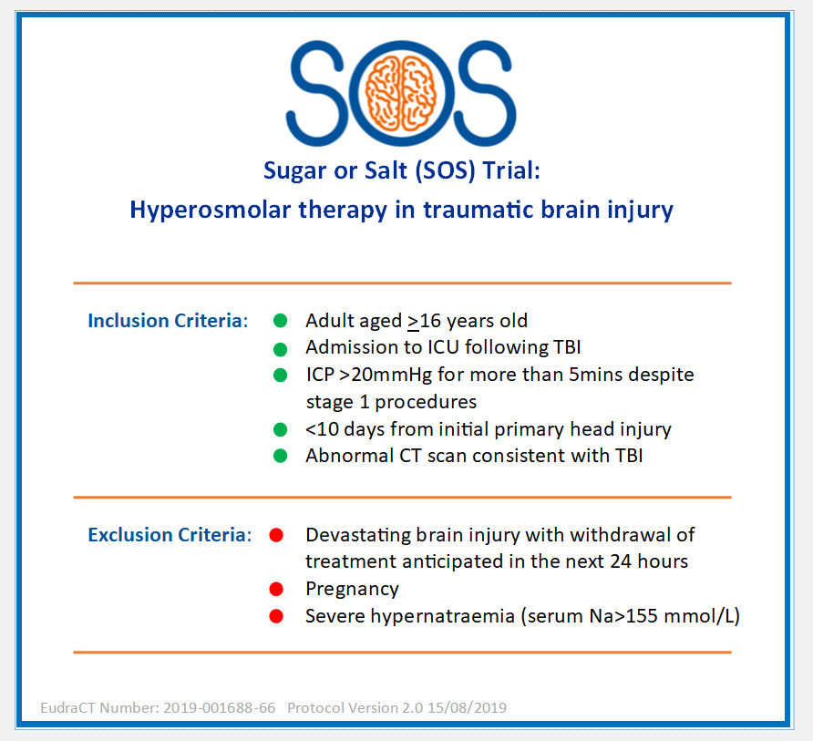
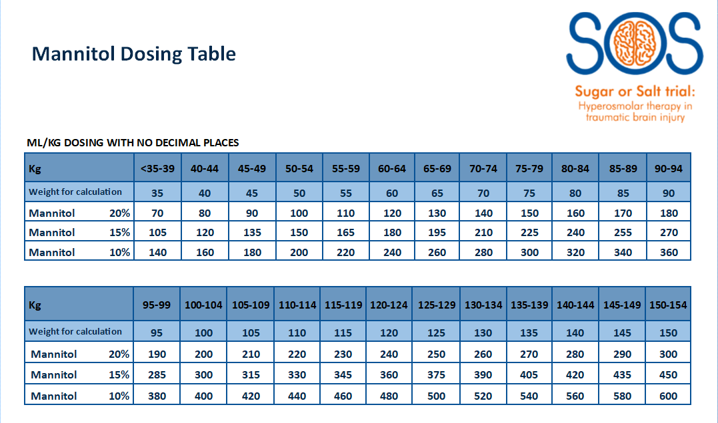
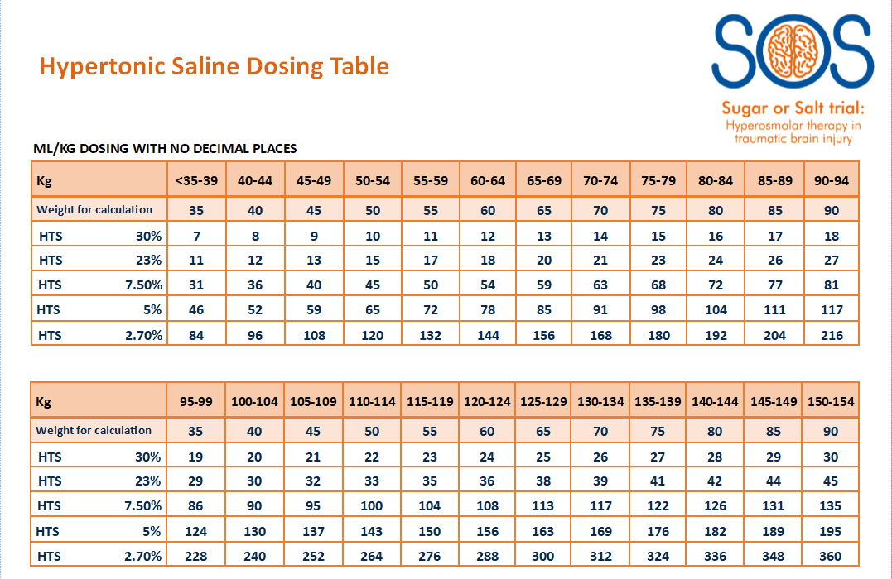
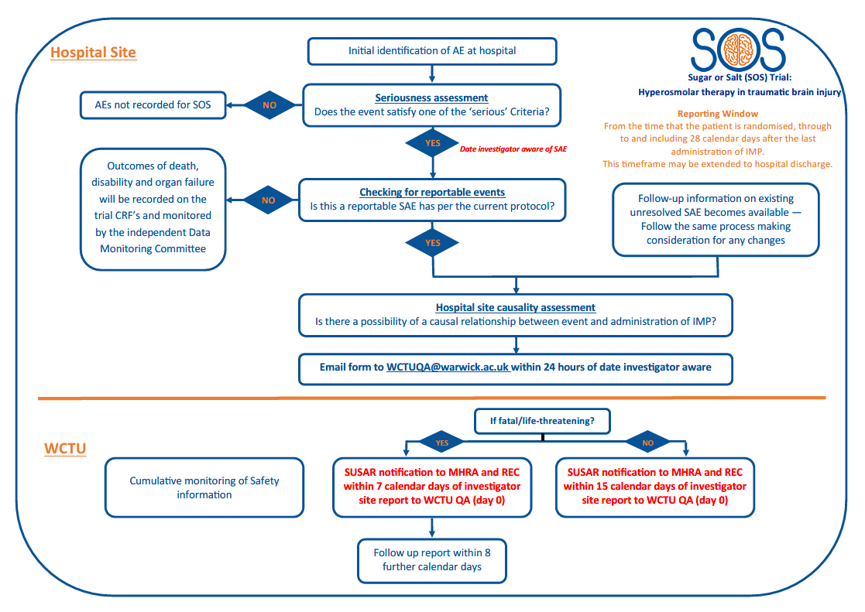
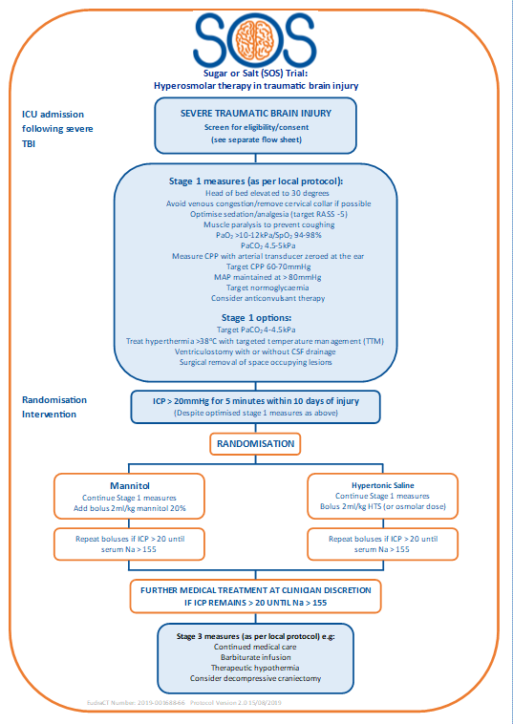
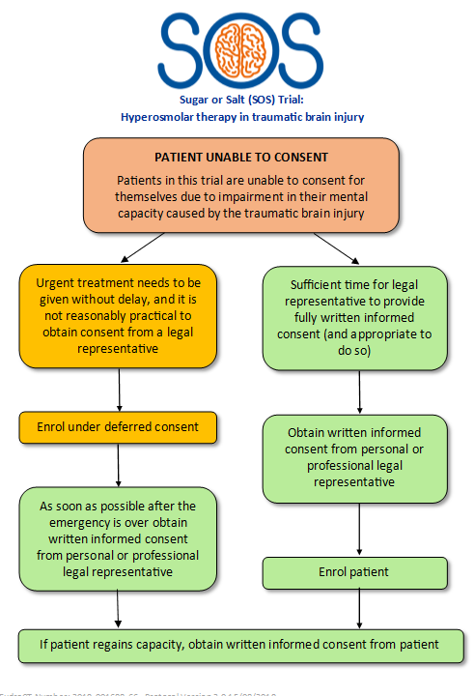
Available tools
Pocket sized/A4 aide memoires available from WCTU:
Eligibility criteria
Dosing conversion
SAE process
Consent process
Treatment intervention flowchart
Slide 50
Notes:
These are examples – let us know if there’s anything else that would be useful!

Slide 51

Questions?
Slide 51

Slide 52
Data Collection
Bespoke online database
Log ins will be provided to individual trial staff once appropriate training has been completed.
User ID to be provided by email following ‘green light’ approval to begin recruitment.
Training version of database to be made available to sites to practice and gain familiarity of the system
Paper CRFs can be used as a back up in cases where there are issues logging in to the online database.
Slide 52
Notes:
Please use browsers Edge or Chrome – this is covered in the Data Collection Guide
Browser Compatibility
Internet Explorer Not compatible
Edge Fully supported (recommended)
Chrome Fully supported (recommended)
Firefox Not supported but usable
Safari Not supported (unknown usability)
Opera Not supported (unknown usability)

Slide 53
Data Collection - CRFs
Case Report Forms | Events
 | Pre Randomisation | Randomisation | Hospital stay | 3 months | 6 months | 12 months | End of Trial
Screening and Eligibility | ●
Informed Consent | ● | ● | ●
Randomisation |  | ●
Patient and Legal Representative Identifiers |  |  | ●
Baseline |  |  | ●
Study Drug Administration |  |  | ●
ICP Monitoring |  |  | ●
Daily Data |  |  | ●
Concomitant Treatments |  |  | ●
Critical Care Discharge |  |  | ●
Hospital Discharge |  |  | ●
Follow-up Day 90-360 (mortality) |  |  |  | ● | ● | ●
Serious Adverse Events
Non-compliances
Withdrawal form
Death Information
3 month follow-up questionnaire |  |  |  | ●
6 month follow-up questionnaire |  |  |  |  | ●
12 month follow-up questionnaire |  |  |  |  |  | ●
End of Trial |  |  |  |  |  |  | ●
Slide 53

Slide 54
Informed Consent eCRF
Informed consent should be obtained as soon as it is appropriate to do so i.e. usually within 24 hours of randomisation.
Informed Consent eCRF should be completed within 3 days of randomisation.
Once the Informed Consent eCRF is completed the Patient and Legal Representative Identifiers eCRF will appear in the ‘Hospital stay’ forms.
Slide 53
Notes:
Recording routine clinical data only

Slide 55
Data collection - eCRFs
Recording routine clinical data
Forms should be completed as soon as possible following randomisation (within 14 days):
  Patient and Legal Representative Identifiers – this form will appear when the Consent eCRF has been entered
  Baseline
  Study drug administration – record doses given
  ICP Monitoring details
  Concomitant treatments – to be completed by discharge from ICU
Slide 54
Notes:
Recording routine clinical data only – nothing above and beyond.
ICP monitoring – when started and stopped, ICP device used, any problems etc.
Concomitant treatments – update as go along but can complete on discharge from ICU.

Slide 56
Baseline eCRF
Routinely collected clinical data to be recorded:
Admission details
Demographics
TBI details – mechanism, details of injury on head and other body systems, craniotomy/craniectomy
Significant medical history
Concomitant medications
Pre-admission function
ICP prior to randomisation
Serum Sodium at randomisation
Hyperosmolar therapy prior to randomisation
CT Scan appearance (routine scan prior to randomisation)
GCS
Pregnancy test (if applicable)
Slide 55
Notes:
Day 0 = day of randomisation

Slide 57
Daily Data Collection
Start on day 0 from time of randomisation (day 0 = day of randomisation)
The following measurements should be collected hourly whilst ICP is being monitored i.e. until bolt removed:
  Intracranial Pressure (ICP),
  Mean Arterial Pressure (MAP)
  Serum Sodium
Organ support recorded daily for duration of patient’s stay on critical care.
Slide 57
Notes:
Daily data should be entered asap.
If not discussed earlier, question to site – what is source data and where is it held?

Slide 58
Other eCRFs
To be completed in the database as and when required:
Critical Care Discharge Form
Hospital Discharge Form
Death Notification Form
Withdrawal form
End of Trial – this should also be completed on paper and emailed to WCTU.
Protocol Non-compliance
SAEs are paper forms – complete and email to WCTU
Slide 58

Slide 59
Data Management
Queries will be sent out to sites on a monthly basis to request missing data and for any data clarifications.
Self-evident corrections:
All forms
Header | In the event of CRFs being sent through the post: If TNO is missing from one or more pages but is present on an attached page or can be worked out through other information, transcribe in green pen onto pages where missing, initial and date. If Site/Randomising Site is missing from the header, check whether it has been received with other information that identifies the site or that it corresponds to the TNO on the online database and write it on in green pen, initial and date. In the event of CRFs being sent via email: If any information is missing from a CRF but sufficient audit trail is in place, e.g. the body of the email specifies the TNO and it is clear which site sent the data, these details can be used when entering information onto the database.
Dates | Particularly at the beginning of a new year sites may record the incorrect year. This can be self-evidently corrected if the date has not yet occurred or you are certain of the year it should say.
Decimal places | If values are supplied to more decimal places than required you may round up or down as appropriate.
Yes/No questions (Not relevant for Screening and Eligibility Form or Randomisation Form) | If a yes/no box is left blank where a question that asks if further information has been provided, this can be amended to ‘yes’ if further information has been provided. If a site or participant has answered ‘no’ and provided further information this should be amended to ‘yes’ and the information added to the database.
Slide 59

Slide 60
Free text boxes | If sites denote an upward or downward arrow you can replace these with the words ‘Increased’, ‘raised’ or ‘decreased’. Recognised medical shorthand can be converted to full text.
Baseline
Was a pregnancy test done? | If the participant’s gender is recorded as male and the question has not been completed, you can tick ‘No’.
Serious Adverse Event Form – Initial
3.1 | If you have queried with the site to ask them to change the SOC number and adverse event term, but they change only one in response, as long as stated in the query which SOC number and adverse event you wanted it changing to, this can be self-evidently corrected.
4.6 | If no answer is selected here you need to query it with site, unless you are aware that the patient is no longer taking the medication (i.e. completed or withdrawn). In this case, please select ‘No’ and write the explanation onto the form. If ‘Yes’ has been ticked incorrectly as the patient had already stopped medication prior to event becoming serious, this can be amended to ‘No’
Serious Adverse Event Form – Follow-up
3.1 | If information is completed below this question, you may select ‘Yes’ if not already ticked but you must check the initial SAE to see if there has actually been a change. If there is no change, you can tick ‘No’. You can also amend any ‘Yes’ that has incorrectly been ticked due to information being the same on checking with initial SAE. If you have queried with the site to ask them to change the SOC number and adverse event term, but they change only one in response, as long as stated in the query which SOC number and adverse event you wanted it changing to, this can be self-evidently corrected.
4.3 | If ‘Yes’ has been ticked incorrectly as the patient had already stopped medication prior to event becoming serious, this can be amended to ‘No’
Slide 60

Slide 61
In the event of a participant’s death numerous data fields, which could easily be missed on the online database, ask for the participant’s mortality status and multiple drop downs will need to be completed on each form. Providing the Death Notification Form has been completed relevant mortality status fields in the below listed forms can be self-evident corrected to dead/deceased as applicable and the date of death completed as required.
Critical Care Discharge Form - If the participant died before discharge from ICU we would want this form to be completed with the details of the participant’s death
Date and time of ICU discharge | For this field we want the date and time of the participant’s death. These details can be copied from the Death Notification Form.
Vital status on discharge | Tick the box labelled ‘Dead’
Discharge destination | Tick the box labelled ‘N/A – patient died’
Hospital Discharge Form (both Trial and Final Hospital sections)- If the participant died before discharge from hospital, but were alive when discharged from critical care, we would want this form to be completed with the details of the participant’s death. If the participant dies at the trial hospital we only require details for the trial hospital, final hospital details can be left blank.
Date and time of discharge from trial/final hospital | For this field on the relevant form we want the date and time of the participant’s death. These details can be copied from the Death Notification Form.
If discharged from hospital, specify location | Tick the box labelled ‘N/A – patient died’
Slide 61

Slide 62
Follow-up information
Date of assessment | The assessment date can be completed as the date the Death Notification Form data was received.
Mortality status at hospital discharge | Tick the box labelled ‘Deceased’
Modified Oxford Handicap Scale at discharge from trial/final hospital | Tick the box labelled ‘Deceased’
Follow up 3 months – 12 months - As appropriate
Date of assessment | If a participant dies before 3 months no follow-up information is required – leave forms blank. If a participant dies after 3 or 6 months the following survival check can be completed following receipt of Death Notification Form. The assessment date can be completed as the date the Death Notification Form data was received. If a participant dies after 3 month only the 6 month survival check is required, the 12 month can be left blank.
Mortality status at day 180/360 | Tick the box labelled ‘Deceased’ on the relevant form.
Slide 62

