Slide 1

Site Training – Generic login access for
randomising
SIV slide set V4.0
V2.0

Slide 2
Overview of this training
These training slides are for site staff who will require access to their site’s generic login for randomisation purposes.
If you have attended an SIV session/completed trial training and are signed off on the delegation log, you do not need to repeat training by completing these slides.
Once you have completed this training, you must complete the online training form as a record of this. We will then inform your PI and you will be provided with the generic login details.
The following material will be reviewed in this training:
  Basic GCP
  Brief background on the trial
  Eligibility criteria
  Randomisation process
  Trial intervention
  IMP dosing table
Slide 4

Slide 3
Good Clinical Practice (GCP)
GCP is an internationally agreed ethical and scientific quality standard for designing, conducting, recording and reporting trials that involve the participation of human subjects
Working to GCP principles provides assurance that:
  The rights, safety and well-being of trial subjects are protected
  We are working ethically and in accordance with the principles that have their origin in the Declaration of Helsinki
  That the clinical trial data is credible
Slide 7

Slide 4
GCP – 13 Principles
You may pause the video as necessary
Clinical trials should be conducted in accordance with have their origin in the Declaration of Helsinki, and that are consistent with GCP and the applicable regulatory requirement(s).
Before a trial is initiated, foreseeable risks and inconveniences should be weighed against the anticipated benefit for the individual trial subject and society. A trial should be initiated and continued only if the anticipated benefits justify the risks.
The rights, safety, and well-being of the trial subjects are the most important considerations and should prevail over interests of science and society.
The available nonclinical and clinical information on an investigational product should be adequate to support the proposed clinical trial.
Clinical trials should be scientifically sound, and described in a clear, detailed protocol.
A trial should be conducted in compliance with the protocol that has received prior institutional review board (IRB)/independent ethics committee (IEC) approval/favourable opinion.
The medical care given to, and medical decisions made on behalf of, subjects should always be the responsibility of a qualified physician or, when appropriate, of a qualified dentist.
Each individual involved in conducting a trial should be qualified by education, training, and experience to perform his or her respective task(s).
Freely given informed consent should be obtained from every subject prior to clinical trial participation.
All clinical trial information should be recorded, handled, and stored in a way that allows its accurate reporting, interpretation and verification.
The confidentiality of records that could identify subjects should be protected, respecting the privacy and confidentiality rules in accordance with the applicable regulatory requirement(s).
Investigational products should be manufactured, handled, and stored in accordance with applicable good manufacturing practice (GMP). They should be used in accordance with the approved protocol.
Systems with procedures that assure the quality of every aspect of the trial should be implemented.
Slide 3

Slide 5
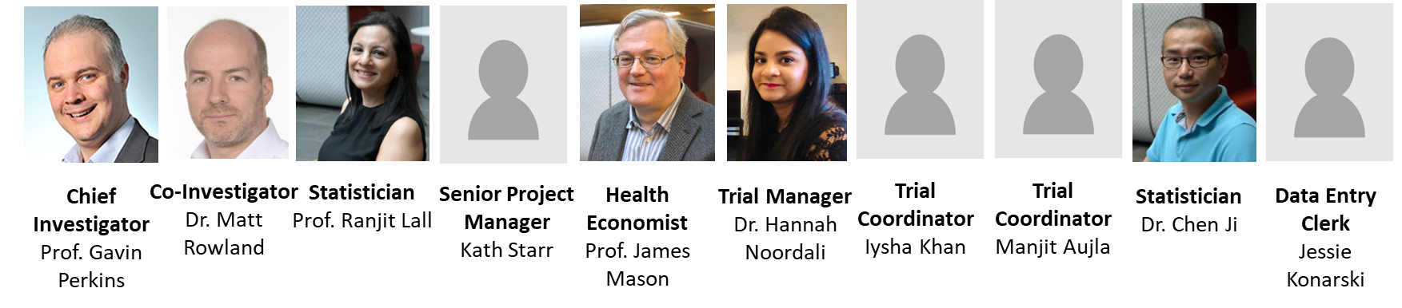

General Study Information
Chief Investigator | Prof. Gavin Perkins
Funder | NIHR Health Technology Assessment Programme (HTA)
Sponsor | University Hospitals Birmingham NHS Foundation Trust University of Warwick
Coordinating Centre | Warwick Clinical Trials Unit
Contact | sostrial@warwick.ac.uk Tel: 024 761 50478

Slide 6
Trial Background
Patients admitted to ICU with a Traumatic Brain Injury (TBI) have an overall mortality rate of 36%
Of those that survive:
  61% of patients have an unfavourable outcome (death or severe disability) at 6 months
  Between 35-70% of survivors report problems across the five domains of the EQ-5D at 6 months
The pathophysiology of TBI includes a raised intracranial pressure (ICP)
ICU/surgical treatment of TBI therefore primarily focused on treating raised ICP
For a more detailed trial background, please view the Background and Training slides available on the SOS trial website: https://warwick.ac.uk/fac/sci/med/research/ctu/trials/sos/health/training/
Slide 3

Slide 7
TBI management
Current TBI management takes a stepwise/protocolised approach:
  Stage 1
    Initial treatment of surgical pathology – haematoma removal/hydrocephalus
    Optimisation of these interventions e.g. sedation, BP, ventilation, temperature
  Stage 2
    e.g. NM blockade, hyperosmolar therapy
  Stage 3
    e.g. decompressive craniectomy, barbiturate coma
Hyperosmolar therapies
  Mannitol and hypertonic saline (HTS) both exert osmotic action between plasma/brain cells reducing oedema
  Other suggested benefits include:
    Maintenance of BBB integrity
    Modulation of neuroinflammatory response
    Augmenting volume resuscitation
    Microthrombosis
Slide 5

Slide 8
Need for a trial
Remains unclear if there is a treatment benefit to mannitol/HTS
Many UK centres moving towards HTS as first line osmotherapy:
  2018 UK survey of practice of clinicians in ED/ICU/Neurosurgery the preference was for HTS (75%) over mannitol (25%) for management of ICP
  Little empirical evidence to support this
  Widespread variation in practice – timing/dosing of osmotherapy
Importance of this research question highlighted in an NIHR HTA commissioning brief
Concordance with research gaps identified by:
  Brain Trauma Foundation
  European Society of Intensive Care Medicine
  Recent editorial supporting the publication of the COBI trial protocol
Slide 7

Slide 9
SOS is a UK-wide pragmatic phase 3, multi-centre RCT to determine the clinical & cost-effectiveness of hyperosmolar therapy regimes using mannitol/HTS in adult patients with TBI and raised ICP
Hypothesis
Hypertonic saline is more effective than mannitol in the management of raised ICP after severe TBI through improving clinical outcomes/cost-effectiveness
Slide 7

Slide 10
Trial Design & Outcomes
Randomised controlled open label phase III clinical/cost-effectiveness trial comparing mannitol and hypertonic saline
Adults >16 with severe TBI and raised ICP requiring ICU
Overall recruitment target 638 patients in 36 months
Outcomes:
Primary outcome: GOS-E at 6 months post-TBI
Secondary outcomes:
  Efficacy: ICP control, Progression to stage 3 therapies
  Resource use: Organ support on ICU, ICU LOS, Hospital LOS
  Participant reported outcomes: mOHS at discharge, GOS-E at 12 months, Survival (discharge, 3/6/12 months), Quality of life – EQ-5D (discharge, 3/6/12 months)
  Serious adverse events
Slide 10

Slide 11
Eligibility criteria
Inclusion criteria:
  Adult > 16 years old
  Admission to ICU with TBI
  ICP > 20mmHg for more than 5 mins despite stage 1 measures
  < 10 days from initial TBI
  Abnormal CT scan consistent with TBI
Exclusion criteria:
  Devastating brain injury with withdrawal of treatment anticipated in the next 24 hours
  Pregnancy*
  Severe hypernatraemia (serum Na > 155mmol/L)
  2 or more prior doses of hyperosmolar therapy given on ICU
  *NB Pregnancy is not a contraindication to hyperosmolar therapy, but these patients must be excluded for ethical and regulatory reasons
Slide 10
Notes:
Do not need to specifically test for pregnancy, but confirmed/apparent pregnancy should be excluded
This is a pragmatic trial and therefore will not exclude patients that are given hyperosmolar therapy prior to ICU admission. The rationale is that this trial is addressing the use of hyperosmolar therapy in monitored patients in intensive care. Un-monitored hyperosmolar therapy occurs in practice currently and is likely to continue after this trial. The sub-set of patients (with clinical signs of raised ICP) frequently will go direct to theatre for surgical intervention, which may resolve the raised ICP or indicate that injuries are non-survivable.
Aide memoires are available

Slide 12

Screening a patient
All patients admitted to ICU with severe TBI and ICP monitored (i.e. bolt inserted) should be screened
Patients must be confirmed for eligibility by a medically qualified doctor who has signed the SOS trial training log
The justification for the patient meeting all the eligibility criteria must be clearly documented in the patient’s medical notes
  Especially the ICP and serum Na levels at the point of becoming eligible

Slide 13
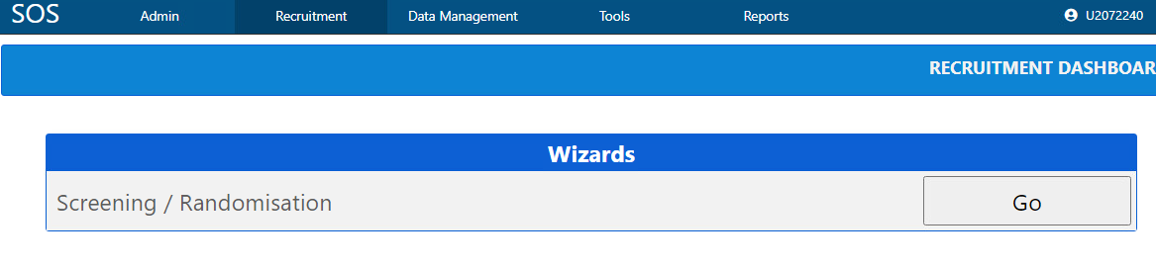
Randomising a patient
Once a patient is deemed eligible they can be randomised by logging onto the SOS trial database https://ctu.warwick.ac.uk/sos
Log on using the generic login details we provide and enter your email address
Click on the ‘Recruitment’ tab
Click ‘Go’ and work through the randomisation wizard
Slide 10

Slide 14
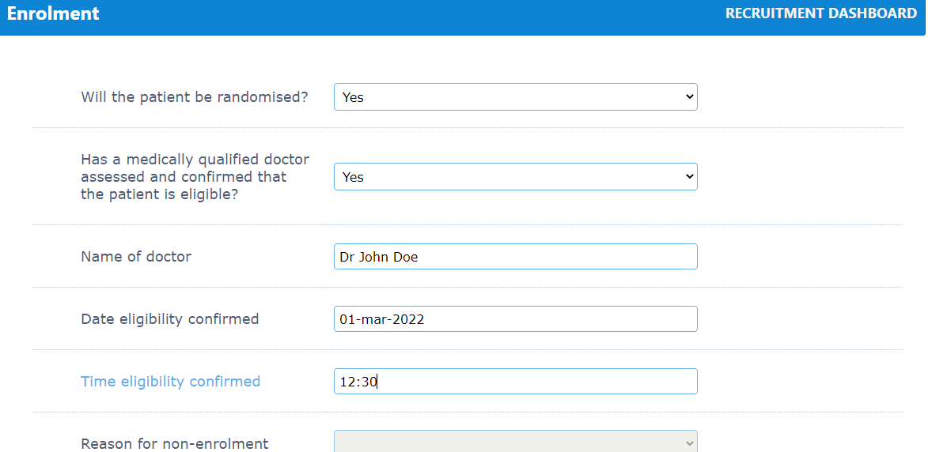
Randomising a patient
Enter your site name to proceed to the inclusion and exclusion criteria checklist
Complete the assessment of eligibility details
Slide 10

Slide 15
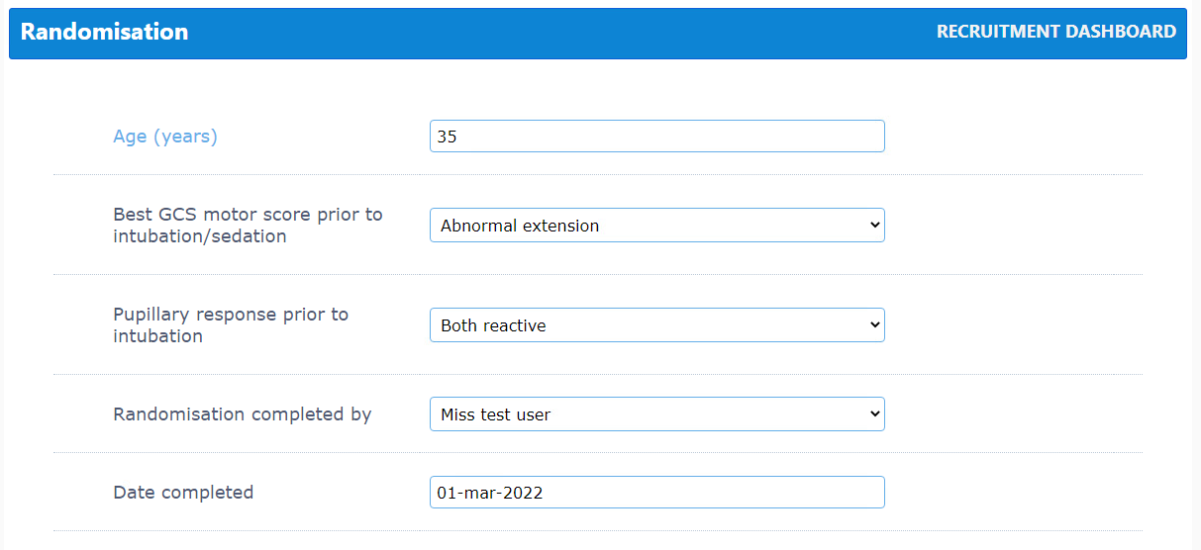
Randomising a patient
Next complete the below information (used to stratify the randomisation and ensure balance of patients across treatment arms)

Slide 16
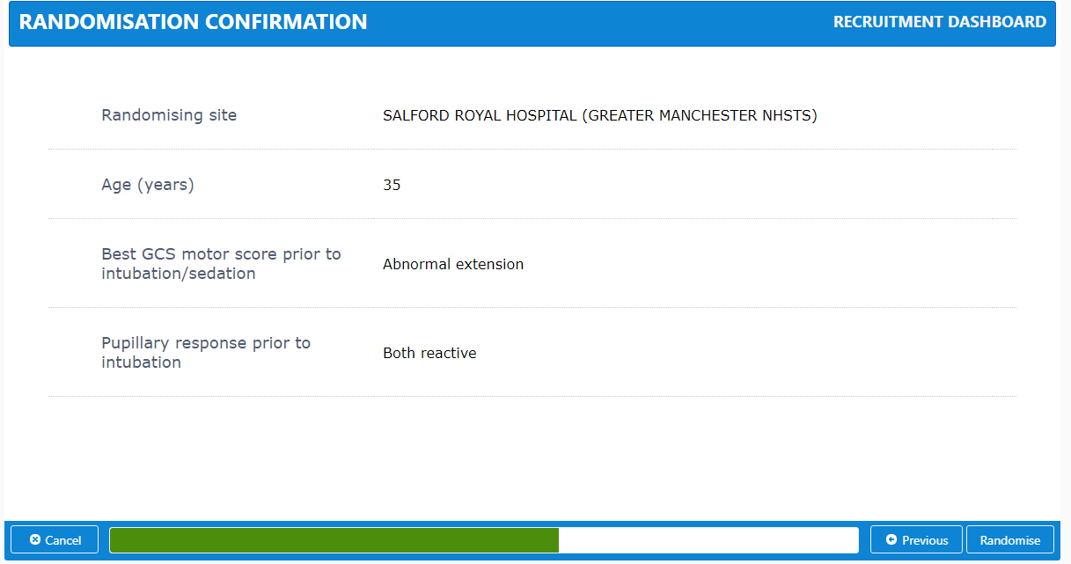
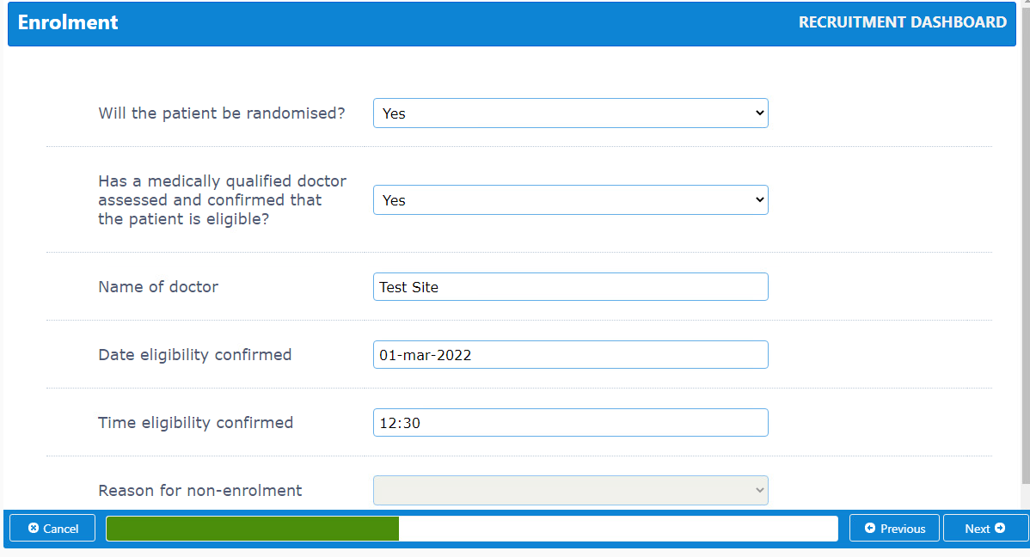
Randomising a patient
Review the entered information
Then click on ‘Randomise’

Slide 17
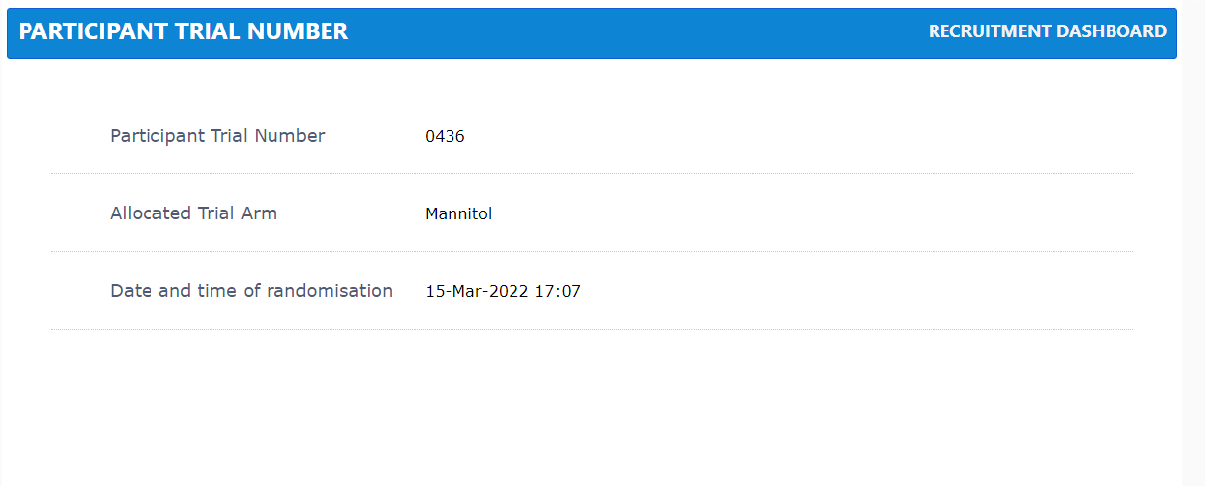
Randomising a patient
Once randomised, the participant trial number and IMP allocation will be displayed
You, your site team and the trial office will receive an automated confirmation email

Slide 18
Trial intervention
Participants are randomised (web based/allocation concealed) to receive:
  Equi-osmolar dose of mannitol intravenous bolus
  OR
  Equi-osmolar dose of hypertonic saline intravenous bolus
Use protocol dosing table (see next slide) to assist with calculating doses. If estimating weight, use ideal body weight
If ICP remains >20mmHg, boluses of each IMP can be repeated until serum sodium is > 155 mmol/L
If there is a second spike in ICP to >20mmHg, allocated IMP should continue to be used
Slide 10

Slide 19
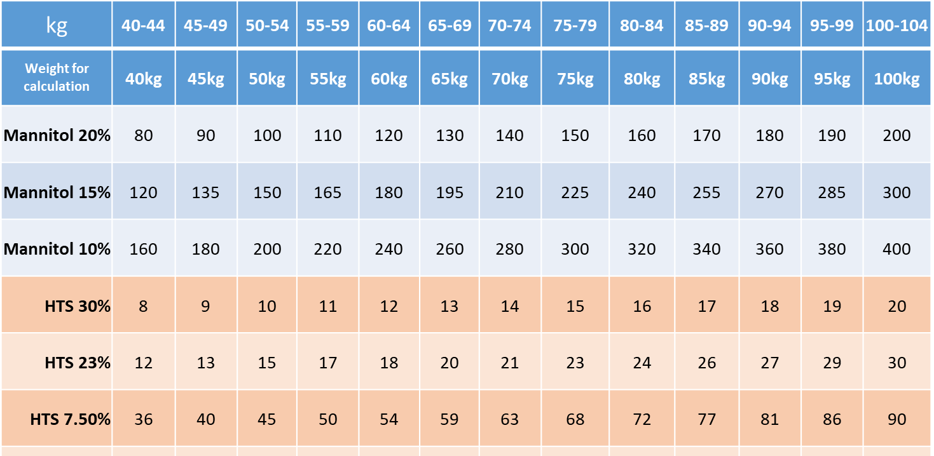
IMP dosing table – ml/kg
Below is a snapshot of the protocol IMP dosing table which can be found in your site file and in the protocol
E.g. if a participant weighing 46kg was randomised to mannitol and your site uses 10%, the allocated dose would be 180
Slide 10
Notes:
Use dosing table to help you calculate equivalent osmolar doses for different concentrations of the trial interventions. The full table can be found in the ISF and also available as an aide memoire.

Slide 20
Thank you for completing this training. Please record this using the online training form at: https://warwick.ac.uk/fac/sci/med/research/ctu/trials/sos/health/training/genericlogin/
SIV slide set V4.0

