Slide 1

STRESS-L Trial: STudy into the REversal of Septic Shock with Landiolol (Beta Blockade)
Site Initiation Visit
Version 8.6 28 July 2021

Slide 2








Slide 2
General Study Information
Chief Investigator: Dr Tony Whitehouse
Funder: NIHR Efficacy and Mechanism Evaluation
(EME) programme
Sponsor: University Hospitals Birmingham NHS
Foundation Trust
Coordination: Warwick Clinical Trials Unit Contact: stress-l@warwick.ac.uk
Warwick Lead SPM Trial Manager Trial Coordinator Anower Hussain Will Bozic
Dr Ranjit Lall Scott Regan Emma Skilton Belinder Ghuman Statistician Data Entry Clerk

Slide 3
Slide 3
STRESS-L SIV
Agenda
Introduction and study overview
Eligibility Criteria
Visit Schedule
Study Medication & Pharmacy
Adverse Events
Roles and Responsibilities

Slide 4
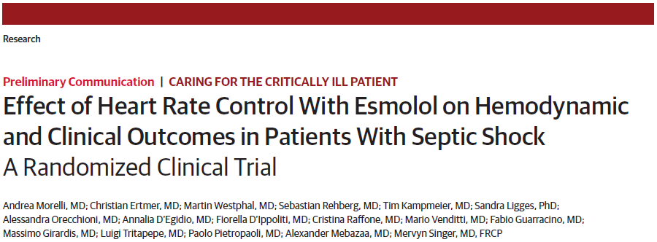
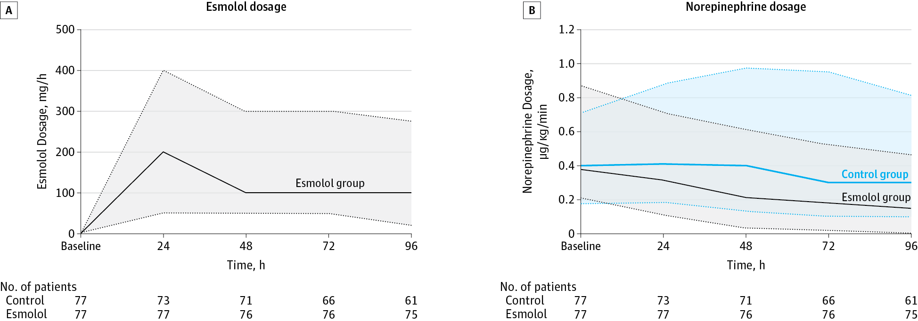
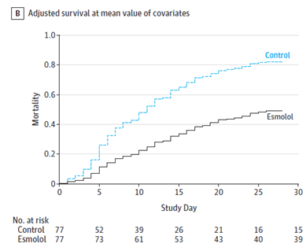
Background
Slide 4
Morelli A et al
JAMA. 2013 Oct 23;310(16):1683-91. doi:10.1001/jama.2013.278477.
PMID: 24108526
Notes:
A group in Italy led by Morelli in 2013 carried out a trial in patients with septic shock and fast heart rates and receiving high doses of noradrenaline.
This subset of patients carries a particularly high mortality (over 60%). Half their patients were randomly allocated to receive a ‘beta-blocking’ drug infusion intravenously named ‘Esmolol’.
The Italian group gave enough drug to reduce, and then maintain, the patients’ heart rate at between 80-94 beats per minute. They found this strategy was not only safe but was associated with big improvements in survival and time in intensive care.
Morelli’s study has been criticised for being a single centre and for the high mortality seen in the control group. It did not provide enough information to make the use of beta blockers a mainstream recommendation. They did not study the way in which the beta blocker was acting in their patients.
Early data using esmolol and landiolol have suggested that beta blockade is possible and safe in this sick and physiologically deranged population.
Need for STRESS-L
Repeat their study in multiple intensive care units throughout the UK to see if we can confirm the safety and benefits found in Rome but also to extend it by taking blood samples to measure effects of the drug on the patient’s immune system, metabolism and heart function.
It is crucial to discover if the safety and efficacy Morelli described can be reproduced in a prospective randomised multicentre study in which mechanisms of action can also be explored.

Slide 5
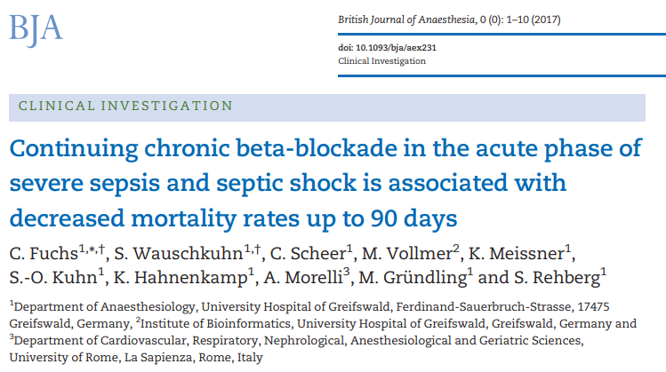
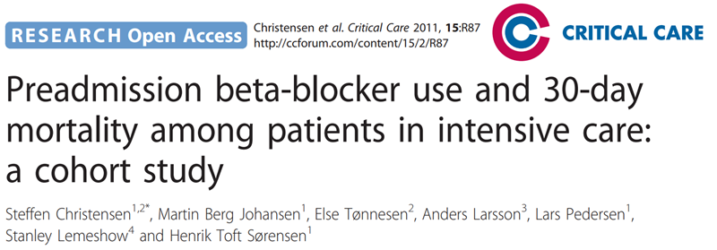
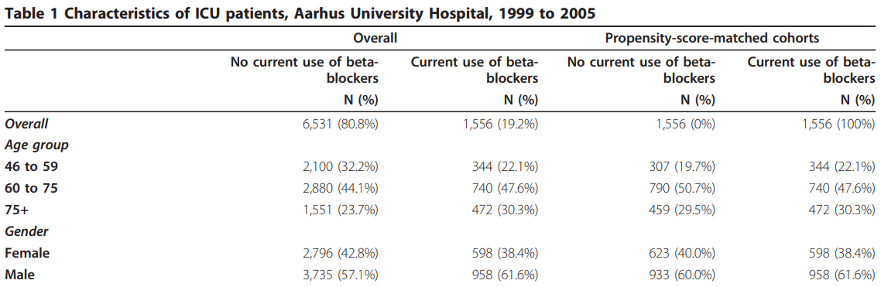
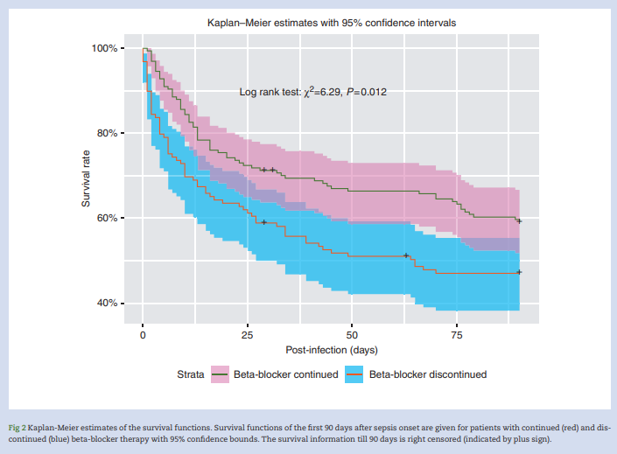
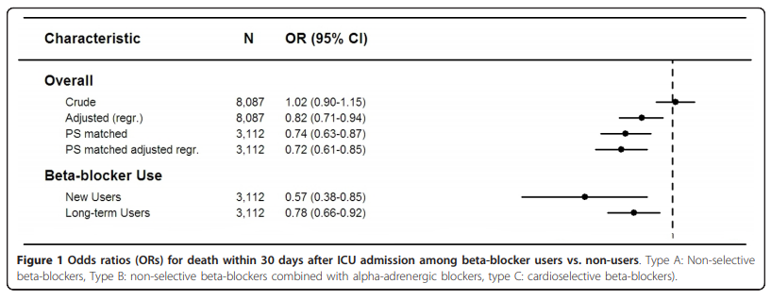
Slide 5
296 patients with severe sepsis or septic shock and pre-existing, chronic oral beta-blocker therapy
Decreased:
Hospital (P=0.03)
28-day (P=0.04)
90-day mortality (40.7% vs 52.7%; P=0.046) in contrast to beta-blocker cessation
Notes:
Growing evidence that beta-blockade may reduce mortality in selected patients with Sepsis.
Left
Study looked at if continuing chronic beta-blockade in the acute phase of severe sepsis and septic shock is associated with decreased mortality rates up to 90 days. Unclear if pre-existing, chronic oral beta-blocker therapy should continue or discontinue during acute phase of severe sepsis or septic shock.
A total of 296 patients with severe sepsis or septic shock and pre-existing, chronic oral beta-blocker therapy were included.
Chronic beta-blocker medication was discontinued during the acute phase of sepsis in 129 patients and continued in 167 patients.
Continuation of beta-blocker therapy was significantly associated with decreased hospital and 90-day mortality rates.
Continuing pre-existing chronic beta-blockade might be associated with decreased mortality rates up to 90 days in septic patients.
Right
Beta-blockers have cardioprotective, metabolic and immunomodulating effects that may be beneficial to patients in intensive care.
Examined association between preadmission beta-blocker use and 30-day mortality following intensive care.
Looked at probability of death within 30 days following ICU admission for beta-blocker users and non-users.
80.8% - no current use of beta-blockers; 19.2% use of beta-blockers.
Looked at odds rations (ORs) for death within 30 days after ICU admission among beta-blocker users vs. non-users.
the 30-day mortality was 25.7% among beta-blocker users and 31.4% among non-users.
Preadmission beta-blocker use is associated with reduced mortality following ICU admission.

Slide 6
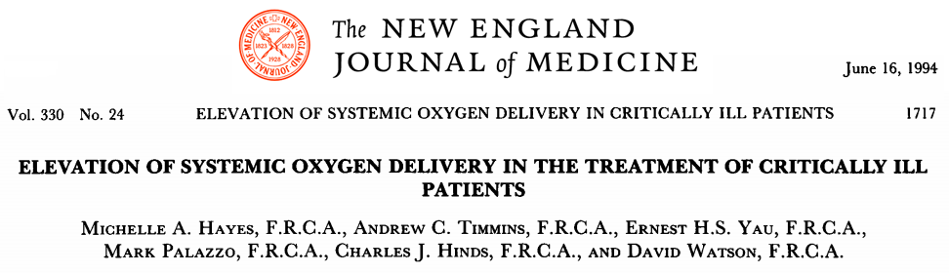
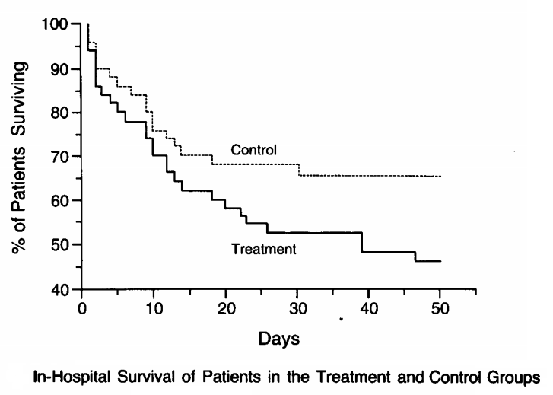
Beta Agonists Bad?
Slide 6
109 Patients Studied
Predicted Risk of Death During Hospitalization:
34% Percent (Both Groups)
In-hospital Mortality:
Control Group (34 Percent)
Treatment Group (54 Percent)
(P = 0.04; 95 % CI 0.9 To 39.1%)
Notes:
Study by Michelle Hayes in 1990s in Charing Cross
Conducted a randomized trial to determine whether boosting oxygen delivery with dobutamine (gold directed therapy) which stimulates beta receptors in the heart to increase the rate and strength at which the heart beats would improve outcomes for critically ill patients.
109 patients – 50 in treatment group and 50 in control group – both same risk of death during hospitalisation (34%) however in-hospital mortality was lower for the control group compared to the treatment group.
Shows increased morality using dobutamine with septic shock, patients do worse with

Slide 7
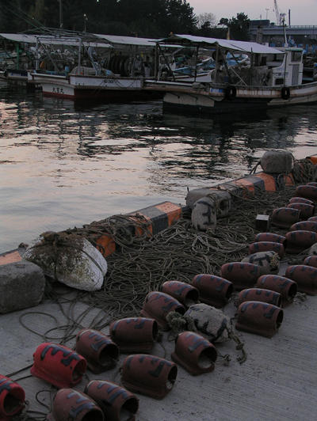
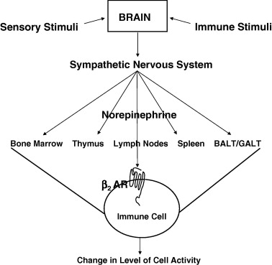
Heart rate control or immune modulation?
Slide 7
Notes:
Initially immune response from Sepsis, targeting infection. Continues causes damage.
Part of this response is tachycardia which is damaging after a certain amount of time. Using Landiolol to bring down the heart rate and counteract.
Takotsubo fishing pots on the left handside – shape of the left ventricle which is weakened with takotsubo cardiomyopathy as a result of severe emotional or physical stress resembles a Japaense octopus trap with a round bottom and narrow neck.
Effects we see in Septic Shock with an over adrenalized heart.
White blood cells have a beta 1 receptor on – don’t need the reason yet – indepth understanding land
Landiolol binds to beta 1 receptors.

Slide 8
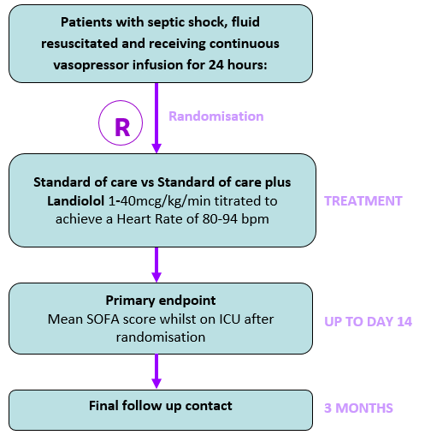
Slide 8
Study Design
Randomised, controlled open label phase IIb trial comparing usual treatment with usual treatment plus landiolol infusion
Multi-centre, approx. 41 UK sites
Identifying participants admitted to ICU, with septic shock, fluid resuscitated and receiving continuous vasopressor infusion for 24 hours
Overall recruitment target: 340 patients
Recruitment target per site: minimum of 4 participants per year (0.36 per centre per month)
End of Recruitment: August 2022 – Pending fully costed extension to extend beyond this date. TBC

Slide 9
Slide 9
Primary Outcome
Mean SOFA score over the first 14 days from entry to the trial and whilst in ICU
Measurement of the SOFA score will cease if the patient dies or is discharged from the ICU

Slide 10
Slide 10
Secondary Outcomes
ICU & Hospital Mortality
Mortality at day 28 & 90
Length of ICU and hospital stay
Reduction in dose and duration of vasopressor treatment
Exploratory Mechanistic Outcomes
Safety: The episodes of bradycardia (HR <50 bpm), bradycardia with haemodynamic compromise requiring intervention, significant hypotension requiring intervention (not including temporarily stopping the infusion), heart block, arrhythmia, arrhythmia with haemodynamic compromise requiring intervention will be reported

Slide 11
Slide 11
Inclusion Criteria
Aged 18 years or above
Being treated on a ICU (Level 2 or 3 facility)
Septic shock according to internationally accepted definitions*
Heart rate ≥95 bpm (at the time of randomisation)
Receiving vasopressor support to maintain a target blood pressure for ≥24 hours
Are being treated with noradrenaline at a rate ≥ 0.1mcg/kg/min

Slide 12
Slide 12
Inclusion Criteria
*Sepsis -3 definitions:
  confirmed or suspected infection requiring antibiotic therapy
  new organ dysfunction, as evidenced by an increase in SOFA score ≥2
  a blood lactate >2 mmol/l at any point during shock resuscitation
  vasopressor therapy to maintain mean arterial pressure (MAP) ≥65 mmHg
In particular the presence of a blood lactate > 2 mmol/l is only necessary for the diagnosis of septic shock and is NOT necessary for randomisation 24 hours later
Remember: Fast Atrial Fibrillation may be an indicator of septic shock; therefore, these patients ARE eligible for the trial.

Slide 13
Slide 13
Exclusion Criteria -1
Tachycardia as a result of pain, discomfort from medical devices (including endotracheal tubes), during interventions or other patient distress
Any form of vasodilatory shock that is not caused by sepsis
Noradrenaline infusion <0.1mcg/kg/min
>72 hours after start of vasopressor therapy
<12 hours since noadrenaline to treat a medical condition other than septic shock stopped
Having pre-existing severe cardiac dysfunction (NYHA grade 4 or more)
Having pre-existing severe pulmonary hypertension (mean PA pressures > 55mmHg)
Acute severe bronchospasm (due to asthma or COPD)
Untreated second or third degree heart block
Untreated phaeochromocytoma
Prinzmetal's angina

Slide 14
Slide 14
Exclusion Criteria -2
A past history of ischaemic stroke or transient ischaemic attack (TIA) or untreated severe carotid stenosis
Advanced Liver Disease with Child-Pugh Score of ≥B
Known sensitivity to beta-blockers
Patient / legal representative unwilling to provide written informed consent
Known to be pregnant
Terminal illness other than septic shock with a life expectancy < 28 days
Participants who have been administered an investigational medicinal product for another research trial in the past 30 days
Patients in whom the clinical team feel are about to finish their noradrenaline therapy
Decision of withdrawal of care is in place or imminently anticipated
Receiving extracorporeal membrane oxygenation (ECMO) treatment

Slide 15

Slide 15
Eligibility
The justification for the patient meeting all of the eligibility criteria must be clearly documented in the patient’s medical notes for monitoring purposes.
At the time of eligibility assessment please document the patients HR, Noradrenaline dose and start of Vasopressor therapy.

Slide 16
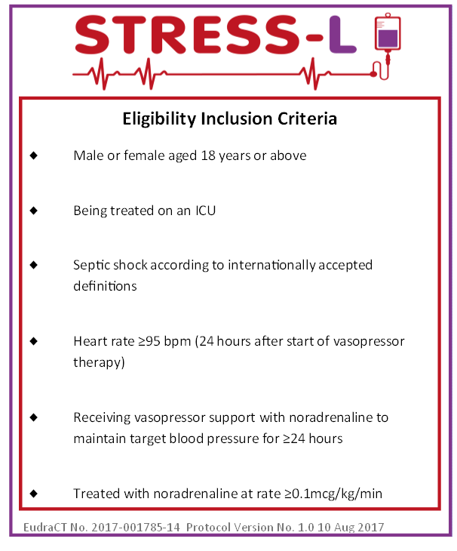
Slide 16
Screening / consent process
PI responsibility to make treating teams aware of trial
Usual care teams to notify research teams of any patients with septic shock commenced on noradrenaline who have received adequate fluid resuscitation
Patients with septic shock not just sepsis are screened
Submit screening data to coordinating centre on a monthly basis
Pocket sized eligibility laminates available from WCTU

Slide 17
Slide 17
Consent
Once eligibility criteria are met there is a 48-hour window for recruitment
Due to this short window, informed consent may be sought during the first 24 hours of vasopressor therapy
It will be made clear to the patient or their legal representative if patient no longer fulfils eligibility criteria at 24 hours they will not be included.
Notes:
24 hours of vasopressor therapy INCLUDING noradrenaline.

Slide 18
Slide 18
Patient consent
Patient provided with information sheet and given adequate time to consider participation.
Consent can be taken on short PIS.
Patient to provide written consent.
Where there are concerns regarding risk of infection transmission (i.e. due to the COVID-19 pandemic ) verbal consent only will be sought from the patient. An impartial witness must countersign the consent form alongside the investigator obtaining consent. Justification for verbal consent must be documented in patient’s notes.
Three signed copies:
- One for ISF
- One for patient
- One for medical notes
Do not send copies of consent forms to Warwick CTU. They should be stored securely at site.
The full consent process should be clearly documented in the patients medical notes including how the impartial witness was selected.

Slide 19
Slide 19
Personal Legal Representative (PerLR) Consent
If patient doesn’t have capacity, Personal Legal Representative consent should be sought in first instance.
PerLR to provide verbal consent due to limitations on visitation of patients in hospital.
Verbal consent obtained via telephone and/or teleconference facilities.
An impartial witness must countersign the consent form alongside the investigator obtaining consent.
Three signed copies:
- One for ISF
- One for PerLR and copy of PIS sent to PerLR also
- One for medical notes
Do not send copies of consent forms to Warwick CTU. They should be stored securely at site.
Consent should be clearly documented in the patients medical notes including how the impartial witness was selected.

Slide 20
Slide 20
Professional Legal Representative (ProLR) Consent
If Professional Legal Representative used, they must not be connected with the conduct of the trial or work under the direction of someone who is on the delegation log.
The Research Ethics Committee have stated the ProLR must be a clinician with expertise within the ICU environment
Three signed copies:
- One for ISF
- One for PerLR
- One for medical notes
Consent should be clearly documented in the patients medical notes.

Slide 21
Slide 21
Randomisation
IVR System (24/7 service)
Randomisation Form
PIN access to be provided following ‘green light’ to begin recruitment
Emergency Randomisation service as back-up (M-F, 9am-5pm only)
RANDOMISATION (IVR SYSTEM QUESTIONS)
Please enter site number:
Does the patient fulfil all of the eligibility criteria? | Yes | ☐ | No | ☐
Has an approved investigator signed the eligibility form? | Yes | ☐ | No | ☐
Has written informed consent been gained? | Yes | ☐ | No | ☐
What is the current noradrenaline dose? | ≤0.3 mcg/kg/min | ☐ | >0.3 mcg/kg/min | ☐

Slide 22
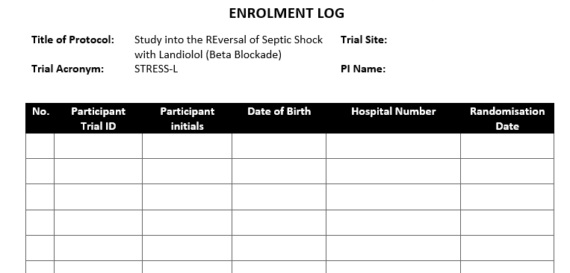
Slide 22
Enrolment Log
Once the patient is randomised, complete the paper Enrolment Log stored in section 10.1 of your Investigator Site File.

Slide 23
Slide 23
Starting Landiolol Treatment
Ideally, study drug should be started within 1 hour of randomisation
Landiolol should start once:
  Treating physician is confident adequate fluid resuscitation has been achieved
  Patient has reached the target MAP pre-defined by the treating clinician overseeing care (suggested target 65-70 mmHg but may vary) using vasopressors
Landiolol can be prescribed up to a maximum of 14 days for the STRESS-L trial

Slide 24
Slide 24
Administering Landiolol Treatment
Participants randomised to receive Landiolol will be started on a dose of 1.0 mcg/kg/min
  Landiolol should be increased every 15 minutes at increments of 1.0 mcg/kg/min, to reach the target heart rate of 80-94 bpm, usually occurring over a period of 6 hours
Elimination half-life of 2.3 to 4 minutes so a loading dose is unnecessary
Landiolol may be administered peripherally or centrally but MUST be on a dedicated line

Slide 25
Slide 25
Administering Landiolol Treatment
Landiolol infusion should be continued to keep pulse rate between 80 and 94. Once the patient is consistently within the target heart rate, the Landiolol Infusion should continue and not be adjusted.
If all vasopressor agents have been discontinued for less than 12 hours, the landiolol infusion will continue as per Appendix E.
The landiolol should be weaned and, if necessary, stopped whilst the HR is below 80 bpm. It may be restarted according to protocol at any point before the End of Noradrenaline Treatment Visit (EONT)

Slide 26
Slide 26
Stopping Landiolol Treatment
Reduce Landiolol infusion once all vasopressors have been stopped for 12 hours and the patient is consistently within target heart rate range.
However, continue Landiolol infusion if the patient remains tachycardic, even when all vasopressors have stopped for 12 hours.
Attempts to wean Landiolol should continue to maintain HR between the target rates of 80-94 bpm.

Slide 27
Slide 27
Stopping Landiolol Treatment
Landiolol infusion should not be stopped during procedures including trips to theatre, percutaneous tracheostomy, central line insertions etc.
Recommend stopping infusion for at least 12 hours before the patient is discharged from the ICU; however ICU stay should not be prolonged for this.
Oral beta blocker use after ICU discharge should be at discretion of the clinicians.

Slide 28
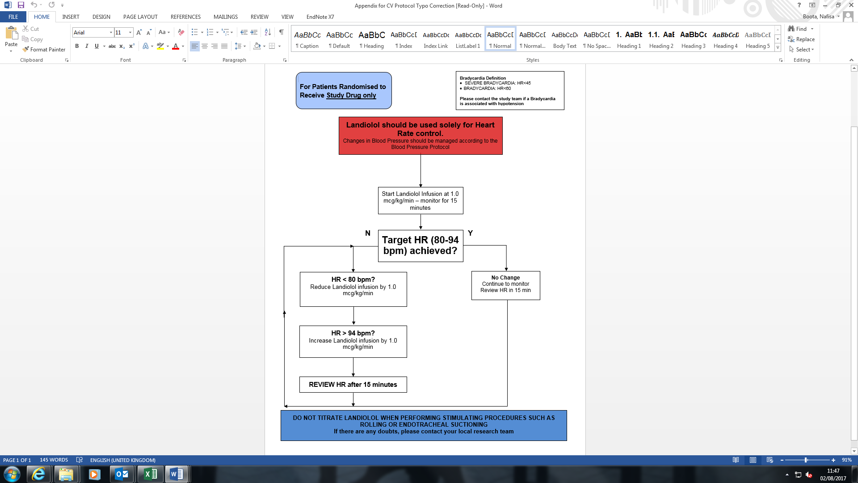
Slide 28
APPENDIX B:
Study Drug Infusion Protocol

Slide 29
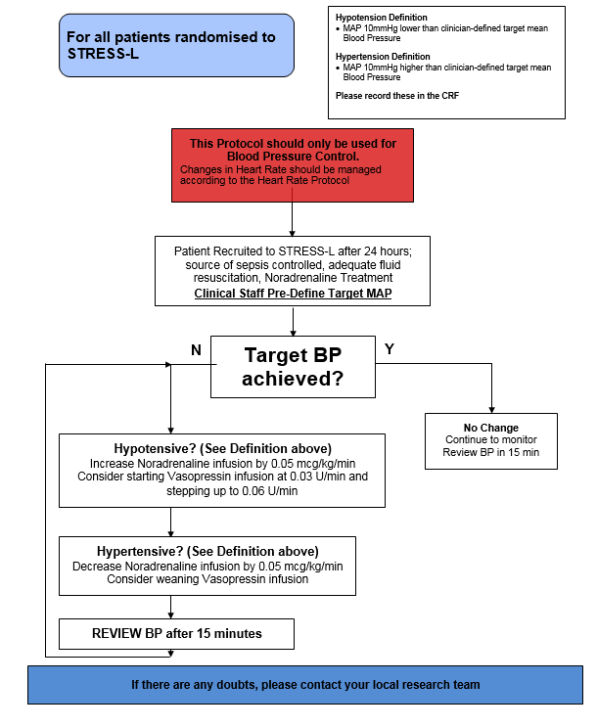
Slide 29
APPENDIX C:
STRESS-L Vasopressor Infusion Protocol

Slide 30
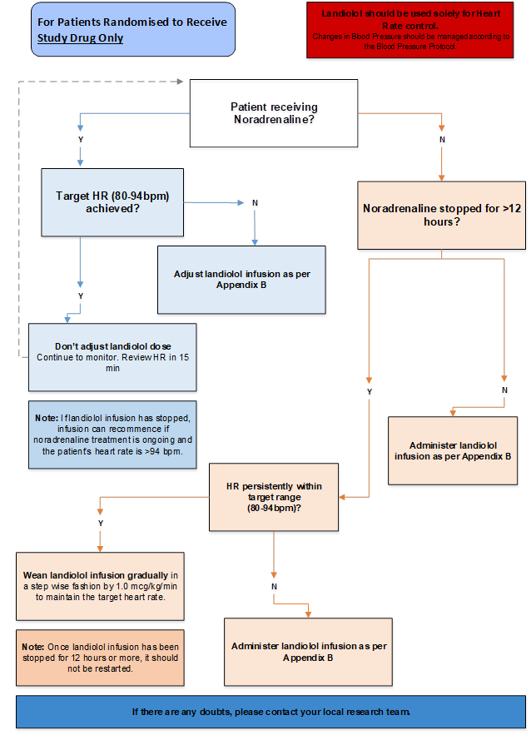
Slide 30
APPENDIX E:
STRESS-L Timing and Weaning of Study Drug

Slide 31
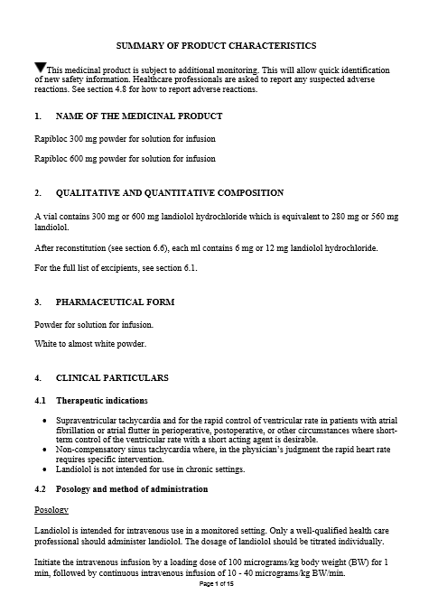
Slide 31
Contraindications, special warnings, and precautions in the context of Septic Shock
See sections 4.3 and 4.4 of SPC and protocol section 3.9.6
SPCs for beta blockers currently reflect the contraindications, precautions and warnings for their common indications of hypertension and tachyarrythmias and not for their use in ICU.
Notes:
Specific ICU population with 1:1 care.

Slide 32
Slide 32
Contraindications, special warnings, and precautions in the context of Septic Shock
Contraindications in the SPC are diametrically opposed to the effects under study in STRESS-L
  Severe Metabolic Acidosis
  Diabetes
  Peripheral Vascular Disease
Notes:
Contraindications in the SPC are diametrically opposed to the effects under study in STRESS-L; for example, conditions such as Severe Metabolic Acidosis (one of the inclusion criteria in STRESS-L) is marked as a contraindication in the SPC
Similarly, diabetic patients are advised not to take beta blocking tablets as these drugs mask the symptoms of hypoglycaemia but they do not interfere with the diabetes per se. Patients in ICU have their glucose controlled by continuous insulin infusion and it is routine to monitor the blood glucose regularly; STRESS-L patients will be managed according to this standard of care
Presence of peripheral vascular disease (PVD) is a risk for increased mortality in septic shock; while the SPC states that beta blockade should be avoided in patients with PVD, the vasodilation induced by sepsis means that any possible adverse effects of landiolol will be reduced and so it will be possible to administer the IMP in these patients

Slide 33
Slide 33
Concomitant illnesses
No additional beta blockers should be prescribed for the duration of the ICU stay.
If the treating clinician deems beta blockade necessary, a protocol deviation form must be completed on the e-CRF.
If a beta blocker has been administered for a pre-exisiting condition regardless of which arm they are randomised to, it can be continued.
However, if a patient is receiving a beta blocker for Atrial Fibrillation in the current episode of septic shock, it should be discontinued.
AF must be treated with Magnesium, Potassium and Amiodarone.
Decision to continue or stop pre-existing blockade remains at the discretion of the treating clinician.

Slide 34
Slide 34
Concomitant medications
Antihypertensive agents used in caution with Landiolol
Verapamil or diltiazem not recommended with atrioventricular conduction abnormalities
Catecholamine-depleting agents or antisympathomimetic agents may have an additive effect when concomitantly administered with landiolol with marked hypotension and bradycardia.
Anaesthetists should be made aware that landiolol enhances the hypotensive effects of anaesthetic agents.
Landiolol is metabolised by plasma esterases; drugs such as suxamethonium may decrease the metabolism of landiolol leading to an enhanced bradycardic effect.
Notes:
Antihypertensive agents should be used with caution in patients treated with landiolol.

Slide 35
Slide 35
What is the IMP?
Name of product: Landiolol hydrochloride 300 mg lyophilised powder
Formulation: 300 mg powder for solution for injection and infusion
Maximum Dosage: 40µg/kg/min
Indication: Landiolol is a beta blocker used for supraventricular tachycardia and for the rapid control of ventricular rate in patients with atrial fibrillation or atrial flutter in perioperative, postoperative, or other circumstances where short-term control of the ventricular rate with a short acting agent is desirable. Landiolol is also indicated in non-compensatory sinus tachycardia where, in the physician’s judgment the rapid heart rate requires specific intervention.
Licensing status: Approved for use in Europe, not currently licensed in the UK

Slide 36




Slide 36
Where does the IMP come from?
AOP Orphan
(Austria)
Supply the study drug for STRESS-L free of charge for the duration of the trial
Reig Jofré
(Spain)
Study drug manufacturer
CSM Germany
(Germany)
Carry out final IMP labelling and packaging
Mawdsleys
(England)
Store and distribute landiolol to trial sites

Slide 37
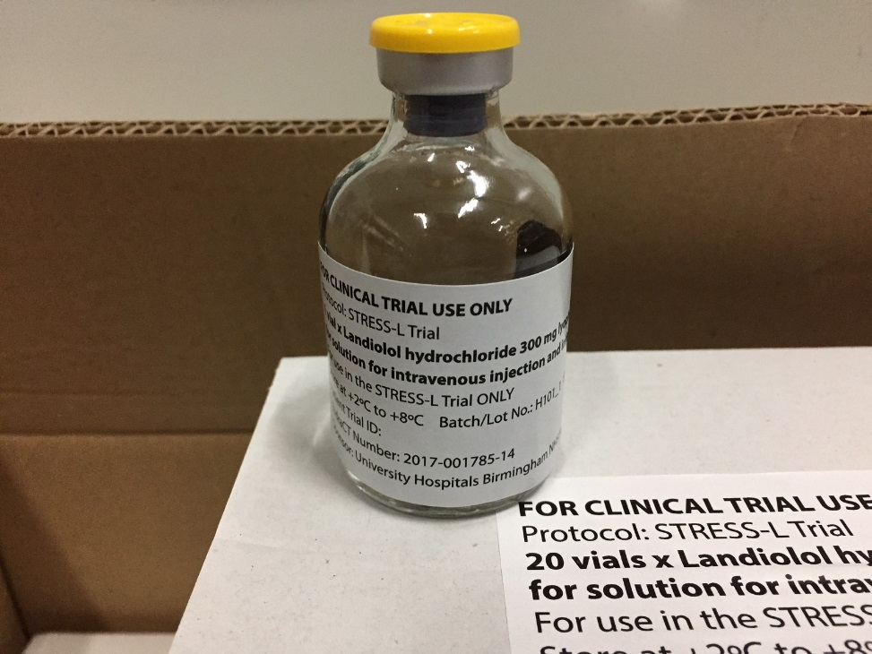
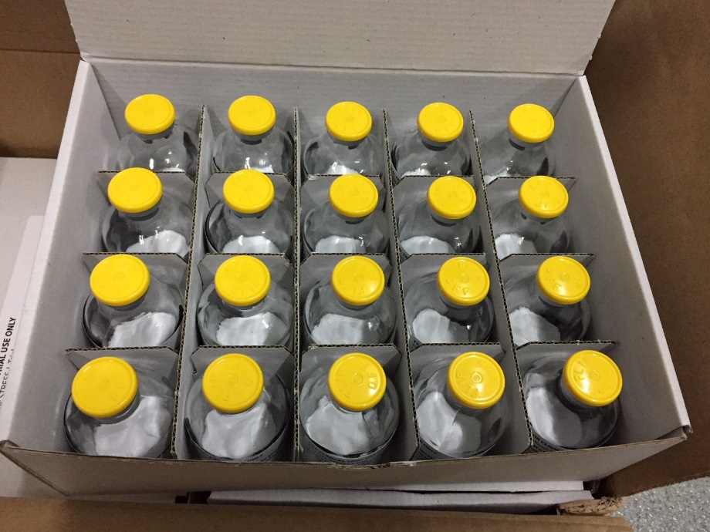
Slide 37
What does the IMP look like?

Slide 38
Slide 38
How is the IMP being used?
Refer to IMP Management Manual and Trial Protocol for full details.
IMP is refrigerated (must be stored between 2°C and 8°C)
Reconstituted drug must not be frozen.
A calibrated thermometer must be used on ICU and in pharmacy to monitor IMP stock as per MHRA guidance
Ensure calibration certificates are sent to WCTU and filed in investigator site file.

Slide 39
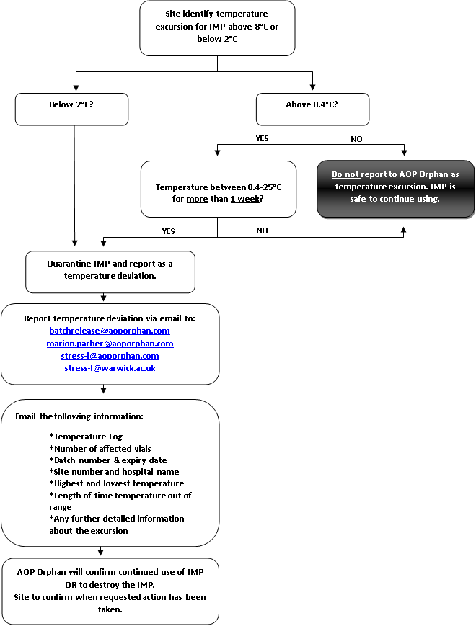
Slide 39
Reporting temperature excursions

Slide 40
Slide 40
How is the IMP being used?
Supplied as lyophilisate in vials with a nominal filling volume of 50 ml containing 300mg landiolol hydrochloride. The IMP is a white to almost white powder for solution for infusion.
Inactive ingredients Mannitol E421 and Sodium hydroxide (for pH adjustment)
After reconstitution, each ml contains 6 mg landiolol hydrochloride
Reconstitute 1 vial with 50 ml of one of the following solutions:
NaCl 9 mg/ml (0.9%) solution
Glucose 50 mg/ml (5%) solution
Ringer’s solution
Ringer-lactate solution

Slide 41
Slide 41
How is the IMP being used?
Conversion table for continuous intravenous infusion: micrograms/kg/min to
ml/h (Landiolol hydrocholoride 300 mg/50 ml = 6 mg/ml strength):
Body weight (kg) | 1 mcg/kg/min | 2 mcg/kg/min | 3 mcg/kg/min | 4 mcg/kg/min | 5 mcg/kg/min | 6 mcg/kg/min | 7 mcg/kg/min | 8 mcg/kg/min | 9 mcg/kg/min | 10 mcg/kg/min | 11 mcg/kg/min | 12 mcg/kg/min | 13 mcg/kg/min | 14 mcg/kg/min | 15 mcg/kg/min | 16 mcg/kg/min | 17 mcg/kg/min | 18 mcg/kg/min | 19 mcg/kg/min | 20 mcg/kg/min | 30 mcg/kg/min | 40 mcg/kg/min
40 | 0.4 | 0.8 | 1.2 | 1.6 | 2.0 | 2.4 | 2.8 | 3.2 | 3.6 | 4.0 | 4.4 | 4.8 | 5.2 | 5.6 | 6.0 | 6.4 | 6.8 | 7.2 | 7.6 | 8.0 | 12.0 | 16.0 | ml/h
45 | 0.5 | 0.9 | 1.4 | 1.8 | 2.3 | 2.7 | 3.2 | 3.6 | 4.1 | 4.5 | 5.0 | 5.4 | 5.9 | 6.3 | 6.8 | 7.2 | 7.7 | 8.1 | 8.6 | 9.0 | 13.5 | 18.0 | ml/h
50 | 0.5 | 1.0 | 1.5 | 2.0 | 2.5 | 3.0 | 3.5 | 4.0 | 4.5 | 5.0 | 5.5 | 6.0 | 6.5 | 7.0 | 7.5 | 8.0 | 8.5 | 9.0 | 9.5 | 10.0 | 15.0 | 20.0 | ml/h
55 | 0.6 | 1.1 | 1.7 | 2.2 | 2.8 | 3.3 | 3.9 | 4.4 | 5.0 | 5.5 | 6.1 | 6.6 | 7.2 | 7.7 | 8.3 | 8.8 | 9.4 | 9.9 | 10.5 | 11.0 | 16.5 | 22.0 | ml/h
60 | 0.6 | 1.2 | 1.8 | 2.4 | 3.0 | 3.6 | 4.2 | 4.8 | 5.4 | 6.0 | 6.6 | 7.2 | 7.8 | 8.4 | 9.0 | 9.6 | 10.2 | 10.8 | 11.4 | 12.0 | 18.0 | 24.0 | ml/h
65 | 0.7 | 1.3 | 2.0 | 2.6 | 3.3 | 3.9 | 4.6 | 5.2 | 5.9 | 6.5 | 7.2 | 7.8 | 8.5 | 9.1 | 9.8 | 10.4 | 11.1 | 11.7 | 12.4 | 13.0 | 19.5 | 26.0 | ml/h
70 | 0.7 | 1.4 | 2.1 | 2.8 | 3.5 | 4.2 | 4.9 | 5.6 | 6.3 | 7.0 | 7.7 | 8.4 | 9.1 | 9.8 | 10.5 | 11.2 | 11.9 | 12.6 | 13.3 | 14.0 | 21.0 | 28.0 | ml/h
75 | 0.8 | 1.5 | 2.3 | 3.0 | 3.8 | 4.5 | 5.3 | 6.0 | 6.8 | 7.5 | 8.3 | 9.0 | 10.8 | 10.5 | 11.3 | 12.0 | 12.8 | 13.5 | 14.3 | 15.0 | 22.5 | 30.0 | ml/h
80 | 0.8 | 1.6 | 2.4 | 3.2 | 4.0 | 4.8 | 5.6 | 6.4 | 7.2 | 8.0 | 8.8 | 9.6 | 10.4 | 11.2 | 12.0 | 12.8 | 13.6 | 14.4 | 15.2 | 16.0 | 24.0 | 32.0 | ml/h
85 | 0.9 | 1.7 | 2.6 | 3.4 | 4.3 | 5.1 | 6.0 | 6.8 | 7.7 | 8.5 | 9.4 | 10.2 | 11.1 | 11.9 | 12.8 | 13.6 | 14.5 | 15.3 | 16.2 | 17.0 | 25.5 | 34.0 | ml/h
90 | 0.9 | 1.8 | 2.7 | 3.6 | 4.5 | 5.4 | 6.3 | 7.2 | 8.1 | 9.0 | 9.9 | 10.8 | 11.7 | 12.6 | 13.5 | 14.4 | 15.3 | 16.2 | 17.1 | 18.0 | 27.0 | 36.0 | ml/h
95 | 1.0 | 1.9 | 2.9 | 3.8 | 4.8 | 5.7 | 6.7 | 7.6 | 8.6 | 9.5 | 10.5 | 11.4 | 12.4 | 13.3 | 14.3 | 15.2 | 16.2 | 17.1 | 18.1 | 19.0 | 28.5 | 38.0 | ml/h
100 | 1.0 | 2.0 | 3.0 | 4.0 | 5.0 | 6.0 | 7.0 | 8.0 | 9.0 | 10.0 | 11.0 | 12.0 | 13.0 | 14.0 | 15.0 | 16.0 | 17.0 | 18.0 | 19.0 | 20.0 | 30.0 | 40.0 | ml/h
Look in your site file to find laminated dosing charts for use at the bedside

Slide 42
Slide 42
How is the IMP being used?
Prepared syringes have a maximum expiry of 24 hours. Must be labelled and checked by second nurse.
Ideally the infusion should not be prepared in advance, but can be for availability overnight. Number of syringes prepared would be based on average requirements over previous 24 hours.
There is not a body weight limit for the Landiolol calculation. Use ideal body weight for patients below 40kg and above 100kg.
Do not exceed max dose of 40 mcg/kg/min
Be aware of units of measurement – ensure ml/hr is converted to mcg/kg/min

Slide 43
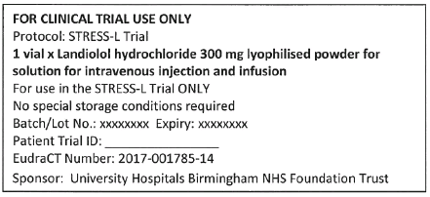
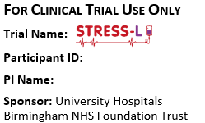
Slide 43
Prescribing and dispensing
The prescription must be signed by an authorised prescriber named on the trial delegation log. Known allergies should be completed with details of any allergies or ‘none’. When prescribing the following details will be added to the patient’s inpatient chart:
For clinical trial use only
STRESS-L Trial
Landiolol hydrochloride 300mg
The ICU research team will add the Patient Trial ID to the label on the vial (primary packaging) when issued and prior to reconstitution of IMP. Please see below example:
Following reconstitution the syringes will have a label added to identify the drug and patient details as per standard local medicines policies. The following information should also be included on the label prior to administration;
For Clinical Trial Use Only Trial Name: STRESS-L Participant ID: PI Name: Sponsor: University Hospitals Birmingham NHS Foundation Trust
Pharmacy, syringe and drug line labels can be provided upon request to the coordinating centre.

Slide 44
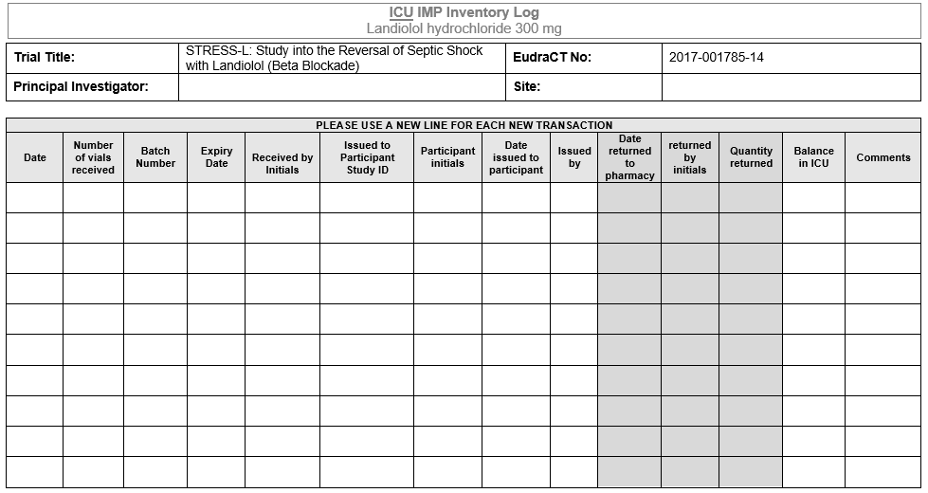
Slide 44
ICU IMP Inventory Log

Slide 45
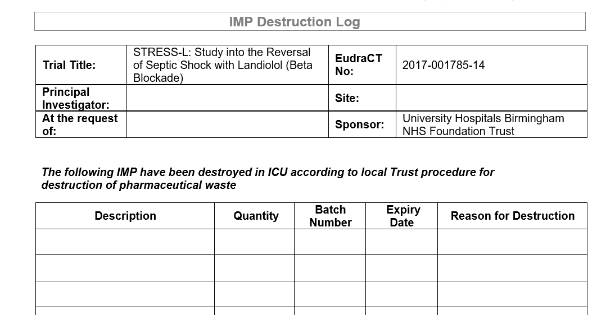
Slide 45
IMP destruction log
Unused or expired IMP will be destroyed by local pharmacy.
Reconstituted infusion in syringes can be destroyed by the ICU research team.

Slide 46
Slide 46
Protocol Compliance (section 4.3)
Protocol Compliance
Use Landiolol / vasopressor infusion protocols (Appendices B and C of protocol) and encourage use with clinical team
Review heart rate data daily from the ICU charts and feedback to clinical team where target heart rate is achieved.
Support clinical team in changing rate of Landiolol infusion but have no input into management of blood pressure
Discontinue Landiolol according to Appendix B.

Slide 47
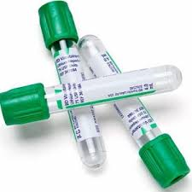
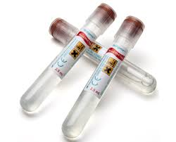
Slide 47
Blood samples
Mandatory research blood samples = Days 0, 1, 2, 4, 6 and EONT
Green Lithium Heparin Vacutainers (4ml). 3 tubes to be taken on each sampling day.
Spin bloods, extract plasma and store in provided cryovials inside of plastic storage boxes in -80ºC or -70ºC freezer.
Voluntary Biobank blood samples = Days 0, 1 and EONT.
x1 PaxGene RNA on Day 0, 1 & EONT and x1 DNA tubes on Day 0 (2.5ml)
If tubes to be kept at temperatures below -20ºC, freeze at -20ºC for 24 hours and then transfer to -80ºC or -70ºC for longer term storage.
Freezer and lab accreditation certificates must be filed in site file
Freezers must be alarmed and research team informed if temperature falls outside of range
Refer to lab manual for full details
To protect staff safety and reduce risk of viral transmission, blood samples should not be taken for confirmed COVID-19 positive patients.

Slide 48
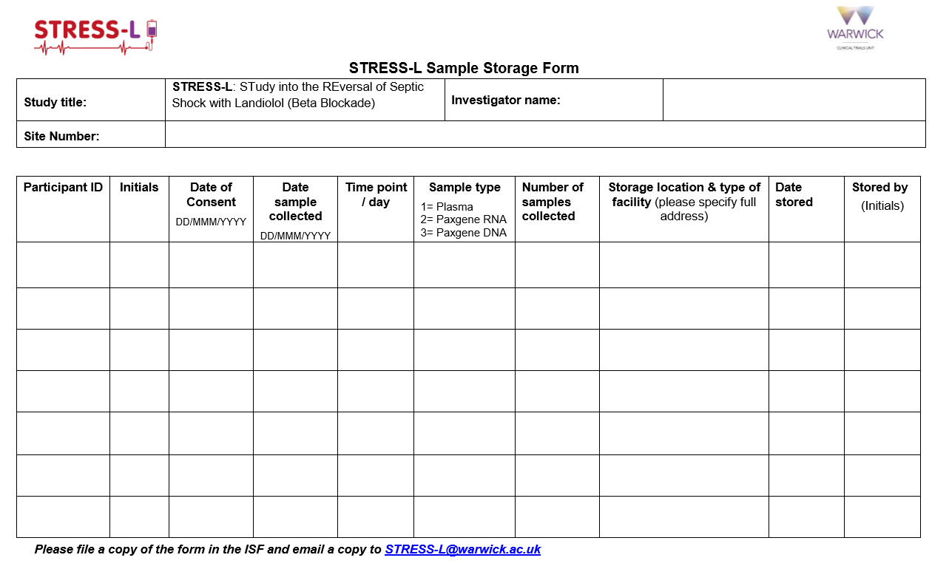
Slide 48
Blood Sample Storage Form

Slide 49
Slide 49
Data entry / eCRF
Bespoke online database
User ID to be provided by email following ‘green light’ approval to begin recruitment. Password will be provided over the telephone
Training version of database to be made available to sites to practice and gain familiarity of the system
Optional whether paper CRF’s are used prior to entry.

Slide 50
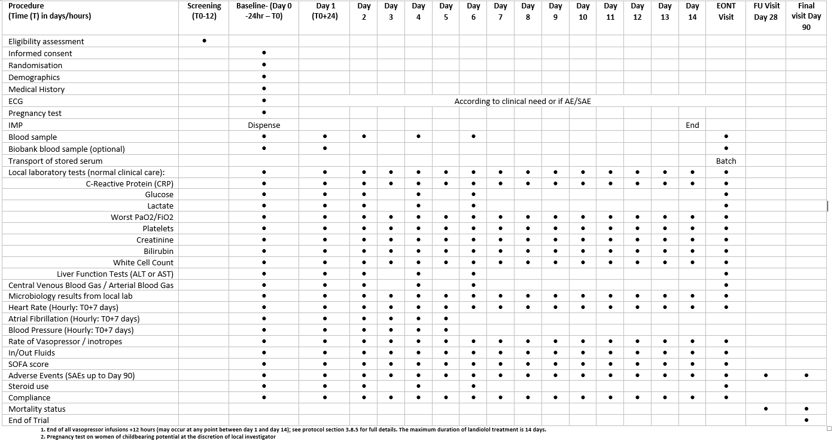
Slide 50
Study Schedule / Data Collection
Notes:
Data collection points - Only recording routine clinical data, nothing above and beyond.

Slide 51
Slide 51
Baseline Visit / Day 0 – 24 hours prior and
up to the time of randomisation
Eligibility and Randomisation
Confirmation of eligibility and informed consent will be taken at (or leading up to) Day 0
Randomisation (via IVR)
Baseline Assessments
Baseline characteristics/demographic data
Medical history
Electrocardiogram (ECG)
Pregnancy test on women of childbearing potential at discretion of the local investigator
Weight
ACTIONS
Reconstitute, dispense & start IMP infusion if allocated to landiolol arm (ICU Inventory Log)
Record landiolol infusion details (number of vials used etc.)
Record AEs/report SAEs following randomisation

Slide 52
Slide 52
Baseline Visit / Day 0 – 24 hours prior and
up to the time of randomisation
Record steroid use
Results for elements of the SOFA score will be recorded.
Rates of noradrenaline infusion
Microbiology Assessments - site & types of pathogens isolated following admission
Other routinely collected clinical data to be recorded:
  Central Venous Blood Gas
  Arterial Blood Gas
  Cardiac Output and Stroke Volume (optional)
  Glucose
  Highest Lactate (last 48 hours)
  Liver Function Tests (ALT/AST)
  IN/OUT Fluids
  Inotrope dosages

Slide 53
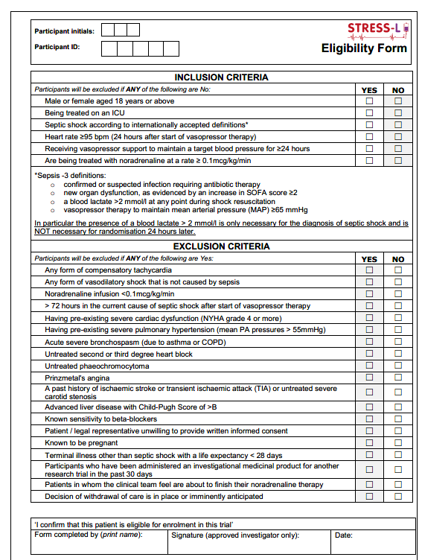
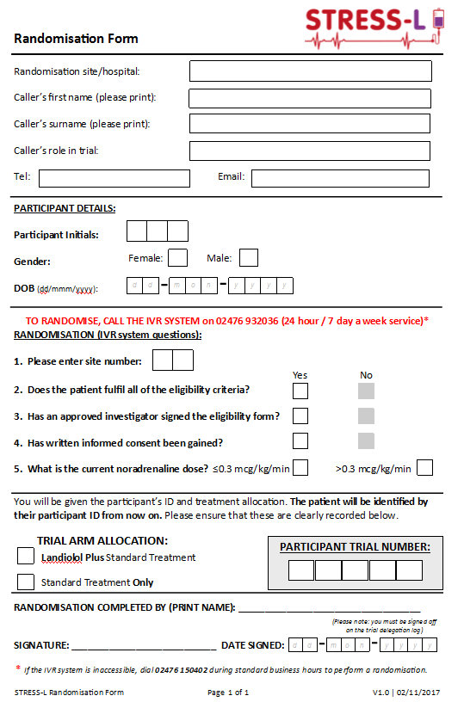
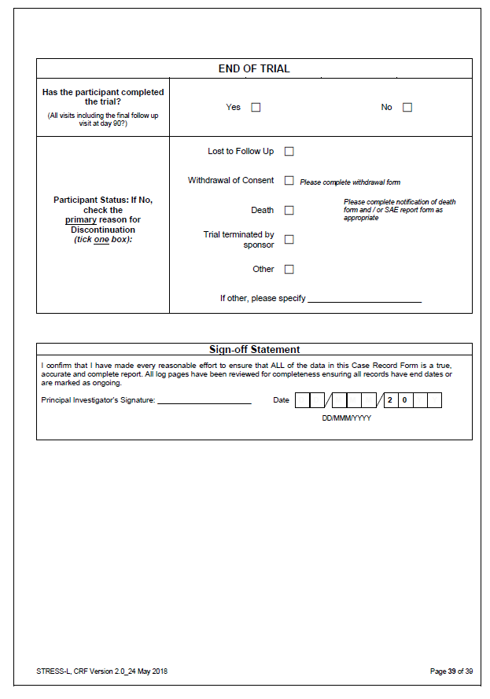
Slide 53
Eligibility Form Randomisation Form
PI sign off
Paper copies sent to WCTU via NHS Encryption Service.
Notes:
These forms must be completed on paper.
Medically qualified physician listed on the trial delegation log will confirm eligibility by completing and signing this form provided by the research team.
Unlicensed drug, document PI oversight, train clinical colleagues. We have designed a set of slides for non-research staff. PI can delegate to clinical colleagues -> E: review eligibility and sign form, F: medical care and supervision of trial participants, K: prescribe medication and treatment. Don’t have to have GCP training but slides incorporate key tasks and trial activities and couple of slides on GCP training. Sign the training log and delegation log.

Slide 54
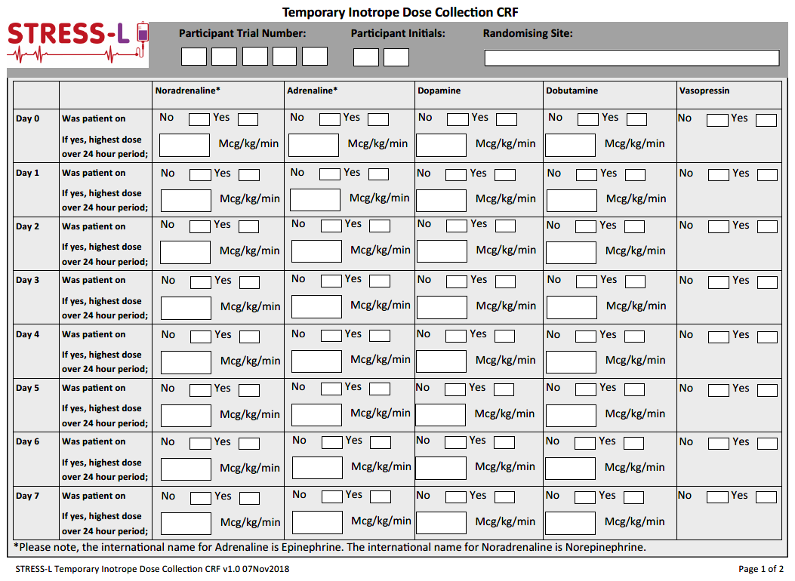
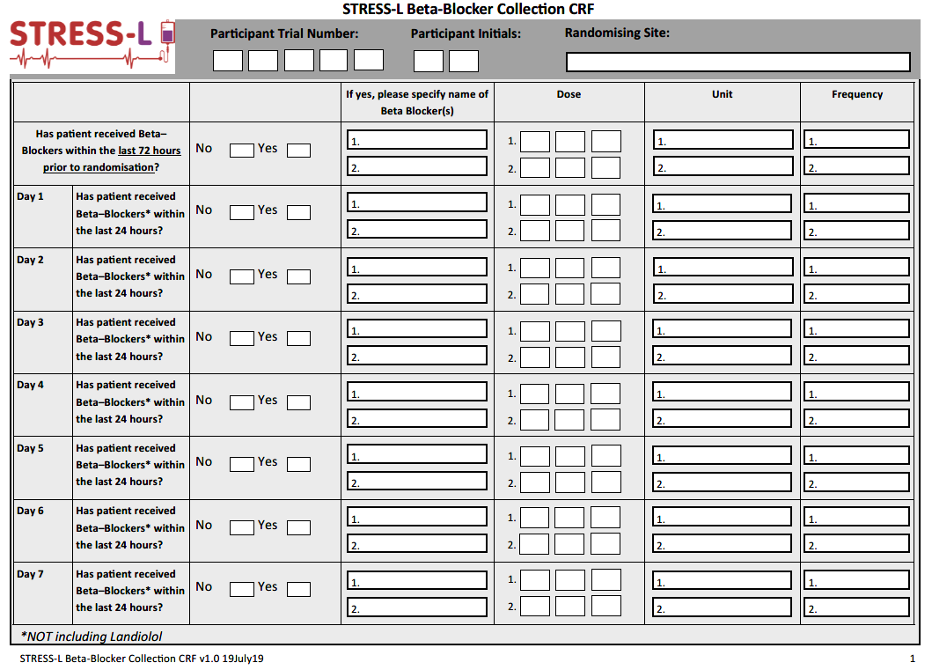
Slide 54
Temporary paper CRFs
Inotrope Dose Collection Beta-blocker Collection

Slide 55
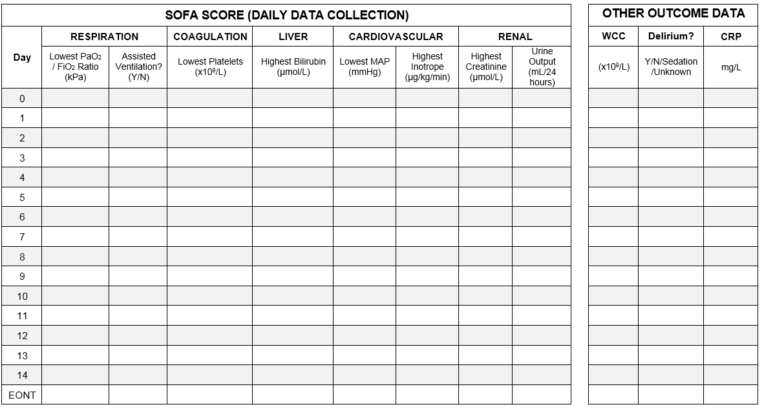
Slide 55
SOFA SCORE (DAY 0-14)
Notes:
Highest or lowest values over the 24 hour period will be collected – therefore the ‘worst’ score is collected and not the value closest to 24 hour mark.
An exception to this is for the Other Outcome Data i.e. WCC, Delirium & CRP where the value will be as close as possible to the 24 hour mark at the end of the data collection day.
Certain variables such as lowest platelets and highest bilirubin, will only one value may be available as this is reliant on when a blood test is taken. If blood tests are not routinely taken every day on ICU and therefore, lowest platelets, highest bilirubin, highest creatinine, WCC and CRP cannot be obtained for that day, please leave this field blank.
Similarly, Urine Output will refer to a cumulative number across the 24 hour period.

Slide 56
Slide 56
DAYS 1, 2, 4 and 6 (day 1 = time of
randomisation plus 24 hours)
  Rates of noradrenaline infusion and/or landiolol infusion; HR, MAP and other vasopressors will be recorded hourly up to end of day 2 and then 6 hourly from day 3
  Research blood sample (+ biobank sample 2 on day 1 if consented). No set time frame.
  Steroid Use
  Central Venous Blood Gas
  Arterial Blood Gas
  Cardiac Output and Stroke Volume (optional) – won’t be queried if left blank.
  Glucose
  Highest Lactate
  Liver Function Tests (ALT/AST) – Only one is required.

Slide 57
Slide 57
Daily data collection (up to day 14 whilst
patient is on ICU)
Landiolol administration (if allocated to this arm)
Landiolol infusion details (number of vials used)
Results for elements of the SOFA score
Rates of noradrenaline infusion and/or landiolol infusion
Heart Rate
IN/OUT Fluids
Cardiovascular Safety Data
Record AEs/report SAEs following randomisation
Post EONT and end of Landiolol, data collection for additional assessments (inc blood samples) is not required.

Slide 58
Slide 58
EONT Visit –
(once noradrenaline has been stopped for 12 hours)
Stop date and time of noradrenaline
Results for elements of the SOFA score
Steroid Use
Central Venous Blood Gas
Arterial Blood Gas
Cardiac Output and Stroke Volume (optional)
Glucose
Highest Lactate
Liver Function Tests (ALT/AST)
Research and biobank blood sample

Slide 59
Slide 59
Day 28 follow up
Mortality status
SAEs
Please leave Day 28 SOFA score data blank. Update to database is pending
Day 90 follow up
Mortality status
SAEs

Slide 60
Slide 60
Other ‘unscheduled’ e-CRF Forms
ICU Discharge
Hospital Discharge
AE Log
Microbiology Assessments – capture positive COVID-19 result
Protocol Deviations
Withdrawal Form
Death Notification Form
End of Trial Form

Slide 61
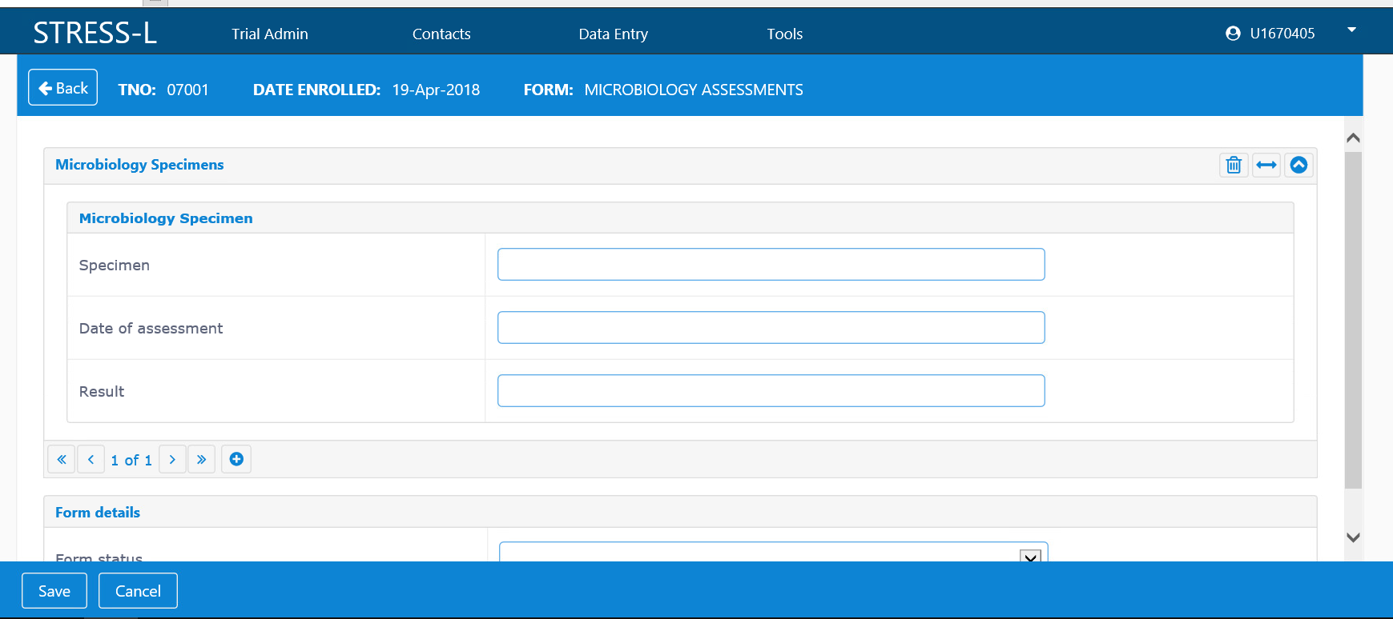
Slide 61
COVID-19 positive patient
Enter positive COVID-19 result

Slide 62
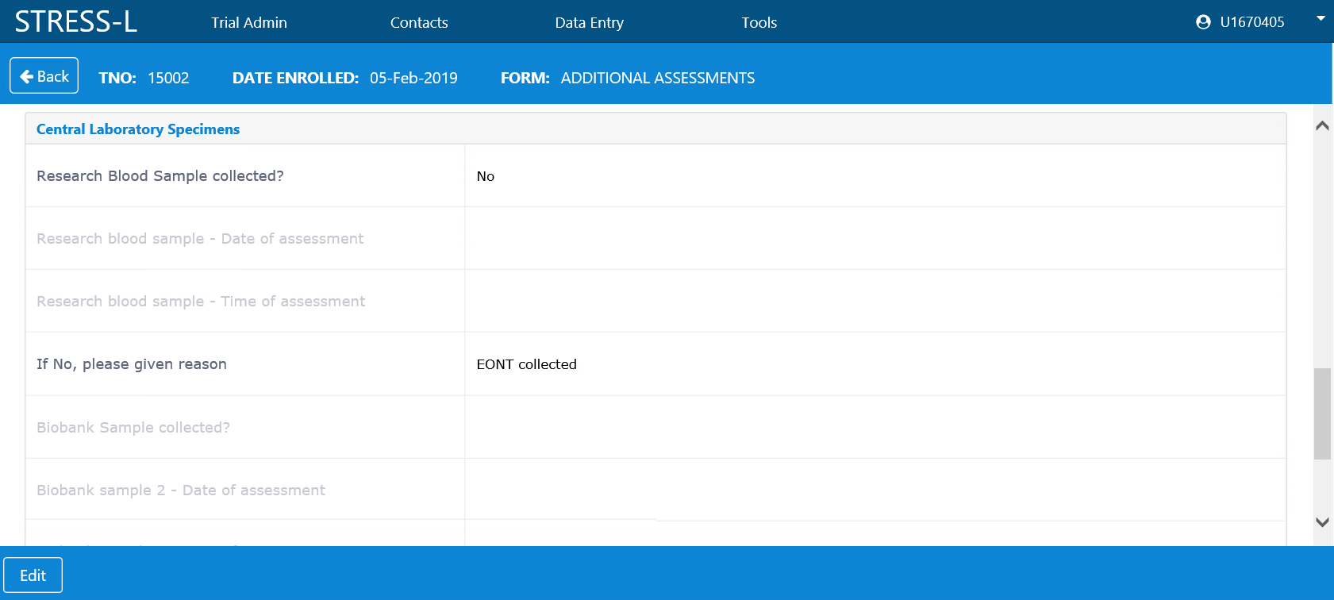
Slide 62
COVID-19 positive patient
Enter here blood sample could not be taken as COVID-19 positive patient

Slide 63
Slide 63
Withdrawal from therapy or assessments
Intention-to-treat protocol for all randomised patients up until day 90.
GP letter sent informing them patient is enrolled in trial and will be contacted on days 28 & 90.
If patient unavailable via telephone on day 28 & 90, every effort will be made to contact GP to ensure collection of safety data.
If participant withdraws from trial treatment but remains on follow up this will be documented on withdrawal eCRF.
If the participant has withdrawn from the trial entirely/withdrawn consent
  document in medical record the date of withdrawal of consent
  complete Withdrawal and End of Trial eCRFs

Slide 64
Slide 64
Adverse Events
For the purposes of this study:
Adverse Events will be documented in the eCRF following randomisation, up to day 14 (end of landiolol infusion)
Serious Adverse Events will be reported and documented following randomisation up to and including the 3 month follow-up visit
Notes:
All SAE’s/SUSAR’s occurring from time of randomisation to the final follow up visit at day 90 must be recorded on the STRESS-L SAE report form and faxed to the coordinating centre within 24 hours of the research staff becoming aware of the vent.

Slide 65
Slide 65
Serious Adverse Events
A Serious Adverse Event (SAE) is any adverse event occurring following study mandated procedures, having received the IMP or placebo that results in any of the following outcomes:
Death
A life-threatening adverse event
Inpatient hospitalisation or prolongation of existing hospitalisation
A disability / incapacity
A congenital anomaly in the offspring of a participant
Other medical events may be considered to be a SAE if they require medical or surgical intervention to prevent one of the outcomes listed in this definition
SAR / SUSAR definitions:
SAR - Serious, and at least possibly related to IMP
SUSAR - A SAR which is unexpected in nature, severity or frequency
Events must be reported for patients in the interventional AND control arm

Slide 66
Slide 66
Serious Adverse Event Reporting
Common Terminology Criteria for Adverse Events (CTCAE) version 4.0.
SAEs/SARs/SUSARs reported within 24 hours to Warwick CTU of becoming aware of event.
Events followed up until the event is resolved or a final outcome has been reached up until final visit at Day 90.

Slide 67
Slide 67
Serious Adverse Event Reporting exemptions
Exclusions from reporting (these outcomes will be recorded on eCRF):
  Death related to sepsis
  Cardiovascular failure, the need for vasopressors, inotropic support, including dobutamine, adrenaline and phosphodiesterase inhibitors
  Respiratory failure, including mechanical ventilation and acute lung injury
  Hepatic impairment as measured by Transaminases <1000 IU/L
  Renal failure, including the need for renal replacement therapy
  Haematological / Coagulation failure, including thrombocytopaenia and Disseminated Intravascular Coagulopathy
  Delirium / confusion

Slide 68
Slide 68
Serious Adverse Event Reporting
Episodes of bradycardia (HR <50 bpm), bradycardia (HR <50 bpm) with haemodynamic compromise requiring intervention, heart block, significant hypotension requiring intervention, arrhythmia with haemodynamic compromise requiring intervention should be recorded
These events must be reported as a Serious Adverse Event if the delegated treating clinician deems this event fulfils the serious criteria or is related to the drug.
If the event is not deemed to fulfil the serious criteria or is unrelated to the drug this should be reported on the Cardiovascular Safety Outcomes CRF.

Slide 69
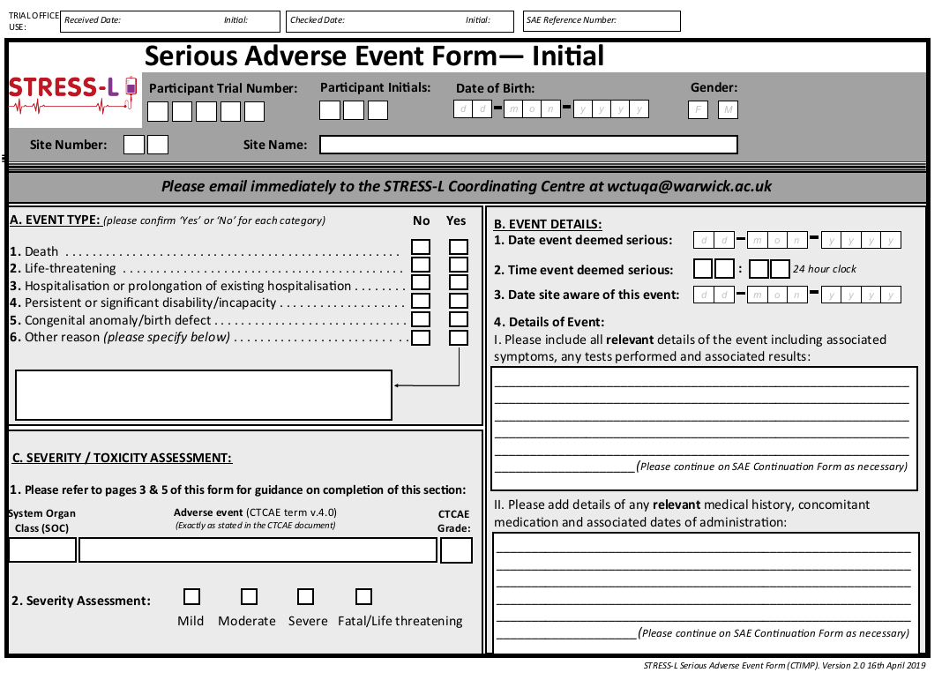
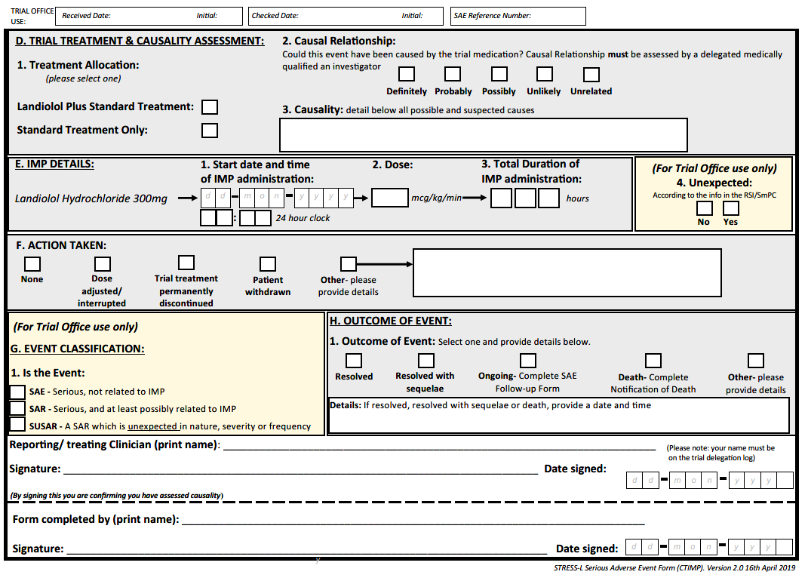
Slide 69
STRESS-L SAE Report Form
Completed SAE report forms should be emailed to wctuqa@warwick.ac.uk
Notes:
Completed SAE report forms should be faxed or emailed to 02476 150549 / wctuqa@warwick.ac.uk

Slide 70
Slide 70
Reference Safety Information – Section 4.8 SmPC
Tabulated summary of adverse reactions for landiolol hydrochloride
Infections and infestations | uncommon: Pneumonia rare: Mediastinitis
Blood and lymphatic system disorders | rare: Thrombocytopenia, platelet disorder
Metabolism and nutrition disorders | uncommon: Hyponatraemia rare: Hyperglycaemia
Nervous system disorders | uncommon: Cerebral ischemia, headache rare: Cerebral infarction, cerebrovascular accident, seizure
Cardiac disorders | common: Bradycardia uncommon: Cardiac arrest, sinus arrest, tachycardia rare: Myocardial infarction, ventricular tachycardia, atrial fibrillation, low cardiac output syndrome, atrioventricular block, bundle branch block right, supraventricular extrasystole, ventricular extrasystole
Vascular disorders | common: Hypotension uncommon: Hypertension rare: Shock, hot flush
Respiratory, thoracic and mediastinal disorders | uncommon: Pulmonary oedema rare: Asthma, respiratory distress, respiratory disorder, bronchospasm, dyspnoea, hypoxia
Gastrointestinal disorders | uncommon: Vomiting, nausea rare: Abdominal discomfort, oral discharge, breath odour
Hepatobiliary disorders | uncommon: Liver disorder rare: Hyperbilirubinemia
Skin and subcutaneous tissue disorders | rare: Erythema, cold sweat
Musculoskeletal and connective tissue disorders | rare: Muscle spasms
Renal and urinary disorders | rare: Renal failure, acute kidney injury, oliguria
General disorders and administration site conditions | rare: Pyrexia, chills, chest discomfort, administration site pain not known: Application site pain, injection site reaction, sensation of Pressure
Investigations | common: Blood pressure decreased uncommon: Electrocardiogram ST segment depression, cardiac index abnormal, alanine aminotransferase (ALT /GPT) abnormal, aspartate aminotransferase (AST /GOT) abnormal, blood bilirubin abnormal, white blood cell count abnormal, red blood cell count abnormal, haemoglobin abnormal, haematocrit abnormal, platelet count abnormal, blood lactate dehydrogenase abnormal, blood urea abnormal, blood creatinine increased, blood creatine phosphokinase abnormal, protein total abnormal, blood albumin abnormal, blood sodium abnormal, blood potassium abnormal, blood cholesterol abnormal, blood triglycerides abnormal, protein urine present rare: Blood pressure increased, electrocardiogram T wave inversion, electrocardiogram: prolonged QRS complex, heart rate decreased, pulmonary arterial pressure increased, PO2 decreased, neutrophil count abnormal, blood alkaline phosphatase abnormal, leukocyte alkaline phosphatase, free fatty acids abnormal, blood chloride abnormal, glucose urine
Notes:
Used when assessing causality of SAE’s.

Slide 71
Slide 71
Study Oversight
Investigator Site File (ISF) & Pharmacy Site File (PSF) will be available to download from trial website.
All trial staff should be appropriately trained and listed on the Investigator Training Log and Delegation Log.
Monitoring Visits (x1 minimum; further visits as necessary)
Until further notice, monitoring visits will be held remotely to check the trial is being run according to protocol, SOPs, GCP and regulatory requirements.
Timeframe and feasibility for remote monitoring to be agreed in advance with the site to reduce burden on trial team.
Reduced remote self-monitoring checklist to be used followed by video teleconference with QA monitor – Emily Dight.
Close-out Visits (x1 or may be done remotely)
  Resolve any outstanding queries
  Collect any outstanding data
  Final drug accountability
  Ongoing responsibilities
  Archive

Slide 72

Slide 72
Questions?

