Slide 1
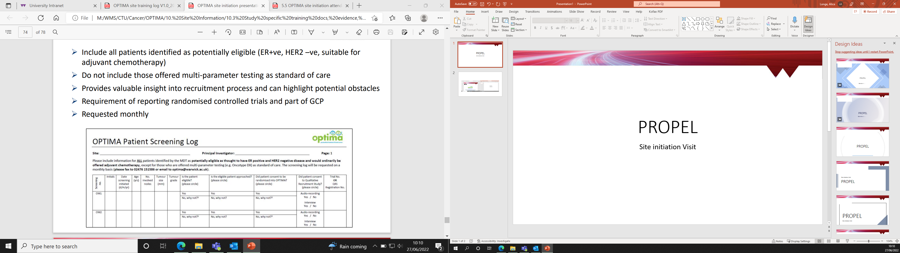

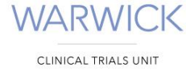


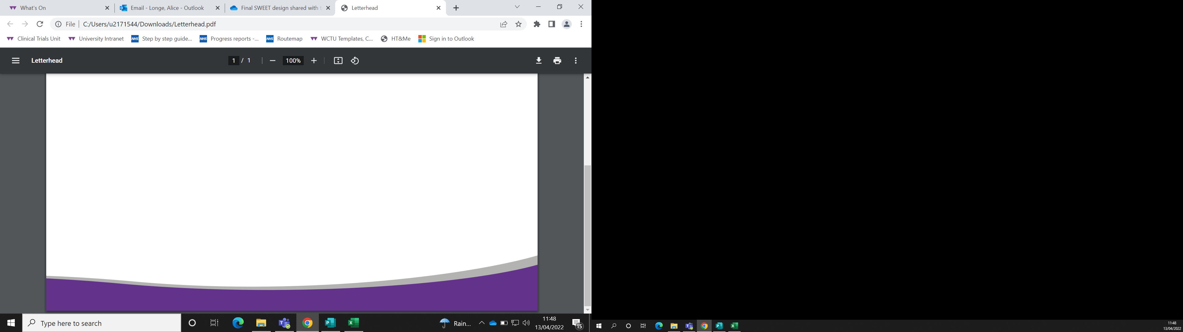



SWEET: Improving outcomes for women diagnosed with early breast cancer through adherence to adjuvant endocrine therapy
Database Training Slides
Notes:
Introductions.
Welcome to the database training session for the SWEET study.
Todays session will be a very brief overview of the database and shouldn’t be longer than 10 minutes.

Slide 2
Agenda
1. CDMS
2. Access
3. Registration
4. Randomisation
5. Data Management
6. Participant Management
7. Queries
8. Top Tips
9. Q&A

Slide 3
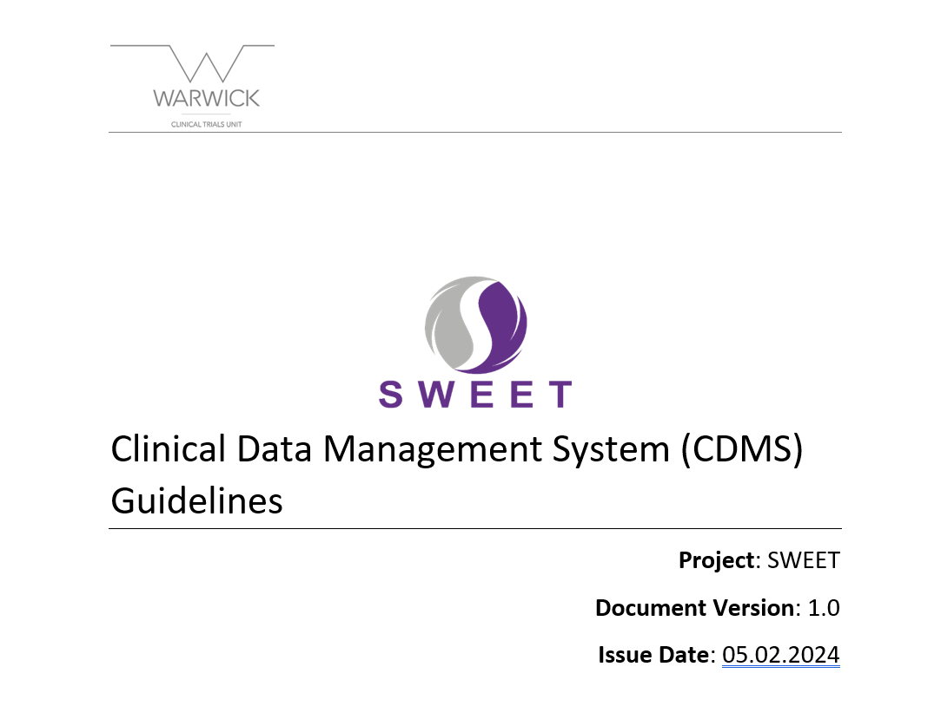
Clinical Data Management System
CDMS
Registration
AKA ‘The SWEET Database’
In depth Instructions can be found in Folder 9 of your ISF.
This presentation covers the main sections from the guidance document.
URL: https://ctu.warwick.ac.uk/SWEET
Randomisation
Data
Management
Participant Management
Queries
Top Tips
Q&A
Notes:
The Clinical Data Management System is the official name for the trial database.
Comprehensive guidelines can be found in folder 9 of your ISF.
This presentation covers the main sections in these guidelines.
If you have worked on a Warwick Clinical Trials Unit trial previously, the database will look and function in the same way.
You can access the database by the URL on screen.

Slide 4
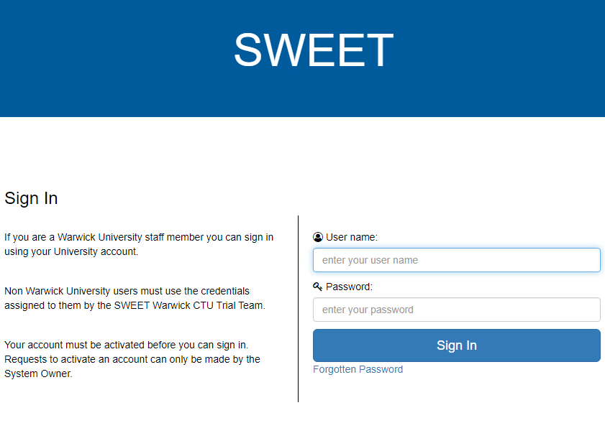
Access
(Section 4 CDMS Guidelines)
CDMS
Registration
Compatible with Google Chrome & Microsoft Edge.
You will be provided with a username & temporary password
First Login: Prompted to change Password
If you forget your password: Forgotten Password
5 wrong attempts you will be locked out!
Randomisation
Data
Management
Participant Management
Queries
Top Tips
Q&A
Notes:
The database is compatible with google chrome and Microsoft edge browsers.
Once we have received your delegation log, we will arrange your access and you will be provided with a username and temporary password.
The first time you log in you will be prompted to change the temporary password to your preferred password.
There is a Forgotten password link if you need it.
If you do get locked out for any reason, please get in touch and we can restore your access.

Slide 5
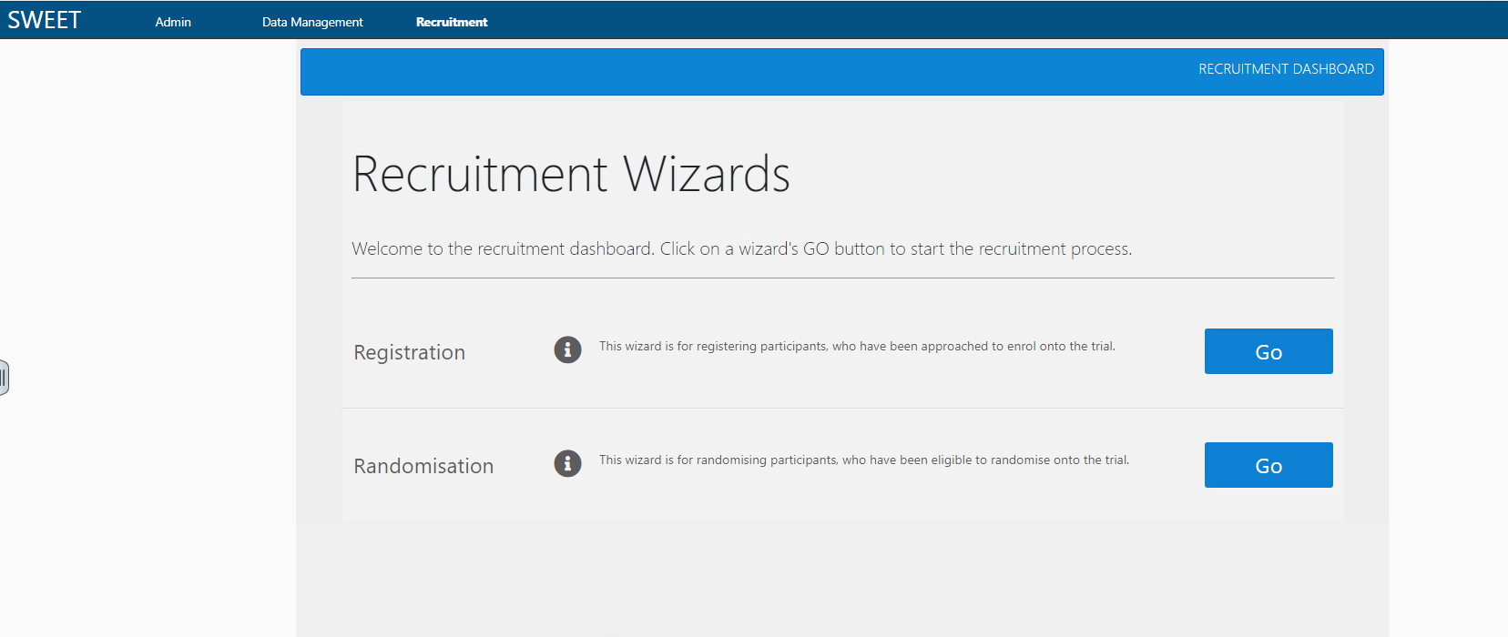
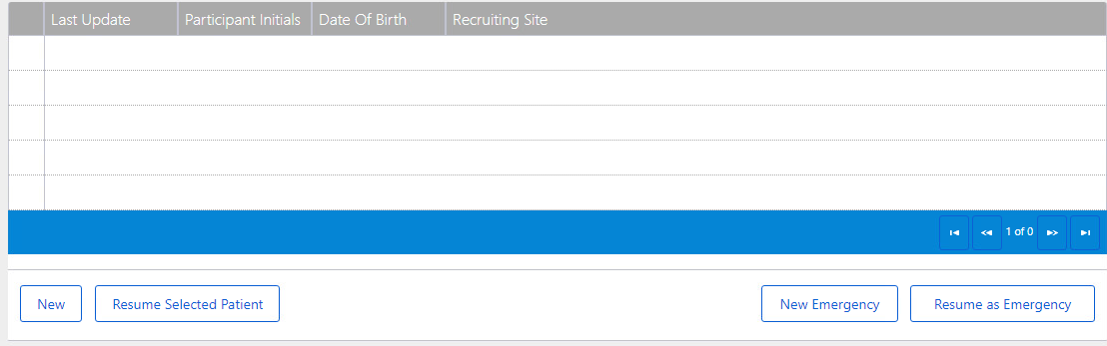
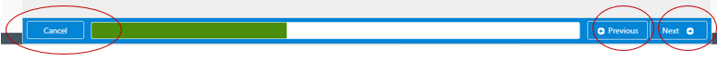
Participant Registration
(Section 4.5 CDMS Guidelines)
CDMS
Registration
Select Recruitment (top tab)
Select ‘Go’ on the Registration Dashboard
You either start a ‘New’ registration or ‘Resume Selected Patient’ if already started
You will continue through the Dashboard entering the appropriate data selecting ‘Next’
Upon Completion you will be asked to ‘Confirm’ the information you’ve put in the database
Once registered you will receive the participants trial number and can complete the baseline pre-randomisation pack which contains the Eligibility CRF & Contact Details CRF
Randomisation
Data
Management
Participant Management
Queries
Top Tips
Q&A
Notes:
As you will know from your SIV the SWEET study uses a register then randomize process of recruitment.
In order to register a participant, select the recruitment tab circled in red.
On the recruitment wizard page then select the ‘go’ button next the registration.
You can either start a new registration or resume a patient if already started.
Fill in all the on-screen questions.
Along the bottom of the screen there are ‘cancel’, ‘previous’ & ‘next’ buttons to navigate through the pages.
Upon completion of the questions the database will ask you to confirm all the provided information is accurate.
Then following confirmation your participant will be registered and will be allocated their TNO.
After successful registration you can then go onto complete the baseline pre-randomisation pack.

Slide 6
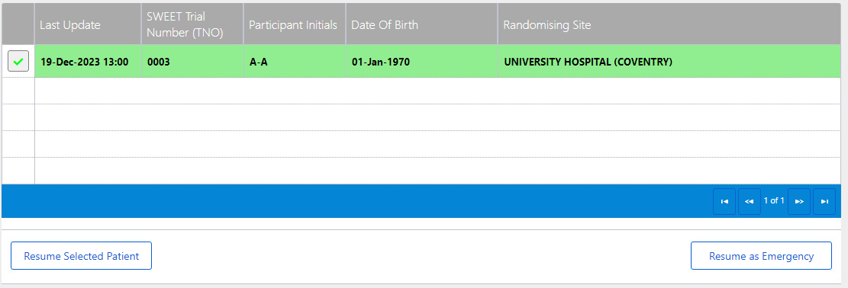
Participant Randomisation
(Section 4.6 CDMS Guidelines)
CDMS
Registration
Select Recruitment (top tab)
Select ‘Go’ on the Randomisation Dashboard
Find the TNO of the patient and ‘Resume Selected Patient’
You will continue through the Dashboard entering the appropriate data selecting ‘Next’
Upon Completion you will be asked to ‘Confirm’ the information you’ve put in the database
One randomised you will receive the participants Treatment Allocation.
Randomisation
Data
Management
Participant Management
Queries
Top Tips
Q&A
Notes:
Once the participant has completed their baseline questionnaire then they can go on to be randomised.
Randomisation is similar to the registration process via the recruitment tab.
Select the ‘Go’ button next to randomization.
A list of all registered patients at your site will then appear.
Select the appropriate TNO, then click ‘Resume Selected Patient’
As before you will be asked to enter the appropriate data, using the next button to navigate through.
Upon completion the database will ask you to confirm all the provided information is accurate.
Then following confirmation your participant will be randomized and you will receive their treatment allocation.
An automated email will also be distributed to your team.

Slide 7
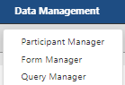
Data Management
(Section 5 CDMS Guidelines)
CDMS
Registration
Three Main Views:
Participant Manager: shows a list of all the participants that have been enrolled at your site and will show an ‘at a glance’ view of their form status.
Form Manager: shows a list of all forms for all participants at your site and show the status of completion.
Query Manager: shows all the data items with a query associated.
Randomisation
Data
Management
Participant Management
Queries
Top Tips
Q&A
Notes:
To view/enter & edit your data you can do this via the data management tab.
There are 3 different views found under this tab:
Participant Manager: will show you a list of all your participants and an ‘at a glance’ view of their form statues.
Form Manager: will show you a list of all forms for your participants and their completion status.
Query Manager: will show you all data items with a query attached.

Slide 8
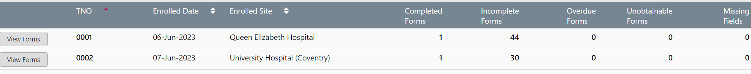
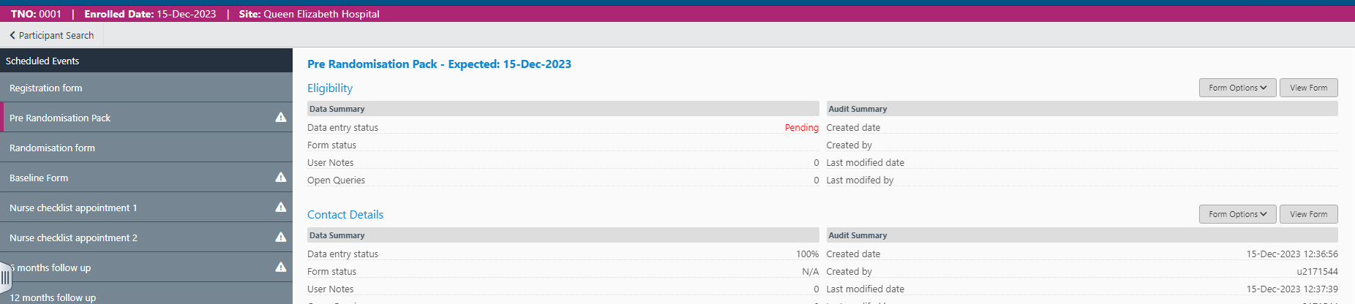
Participant Management
(Section 5.1 CDMS Guidelines)
CDMS
Registration
Navigate to patient details via participant manager, a list of your TNOs will appear:
Randomisation
Data
Management
Clicking ‘View forms’ next to a TNO will take you to the patient profile where you can view and edit the CRFs associated with the patient:
Participant Management
Queries
Top Tips
Q&A
Left Hand Panel Shows the Form Type.
Right Hand Grey section shows the CRF.
Notes:
Under the data management tab you will find the participant manager.
This is the simplest way to navigate to a participants details/CRFs.
There will be a list of all your participants.
Click on ‘view forms’ next to the listed TNO to view/enter or edit their forms.
Once in a participant forms, the grey panel on the left lists all the form types.
When you then click on one of these, they will appear on the right hand side of the screen.
On the right hand side you will see a summary of the forms, the options for this form and the ability to view the form (from where you can enter/edit data).
For unscheduled ad-hoc forms – there will be an option to start a new form when required on the right hand side.

Slide 9
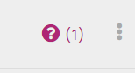
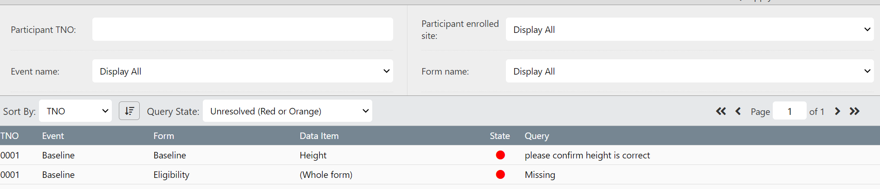
Query Management
(Section 5.4 CDMS Guidelines)
CDMS
Registration
Queries will be raised on the database by the SWEET team here at WCTU.
If a Data field has a query, you will see a burgundy question mark by the field. Click the three dots to view the query.
If a form has a query, it'll be noted next to ‘Open Queries’ on the View Form page.
Under the data management tab you can view and update all your queries. The query manager uses a traffic light system:
Red – query requires a response from site.
Orange – site has responded, WCTU will review.
Green – query is resolved and no further action is required.
Randomisation
Data
Management
Participant Management
Queries
Top Tips
Q&A
Notes:
Queries will be raised by us at the WCTU, we will send email prompts if queries have been raised for your site.
The red/pink question mark indicates a query on a data item, you can view the query by clicking the three dots next to the question mark.
If a whole form has a query, this will be indicated in the data summary when you view a participants forms.
The easiest way to see queries is via the Query Manager, found under the data management tab.
The query manager will list all queries raised for your site.
There is a traffic light system, you will need to address any queries are ‘Red’.
Once addressed these will then be orange for us here at the ctu to review. We will then either confirm as resolved and change the state to green or re-query these and turn back to red.

Slide 10
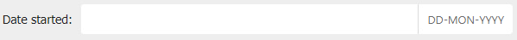

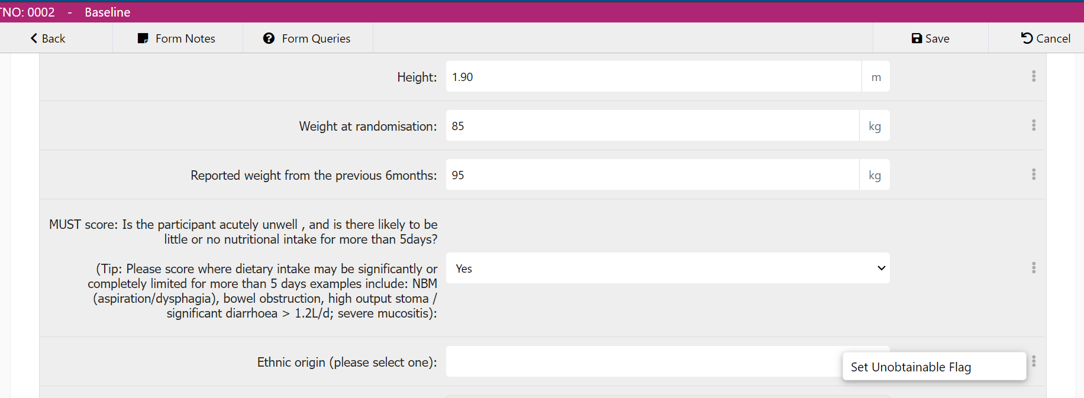
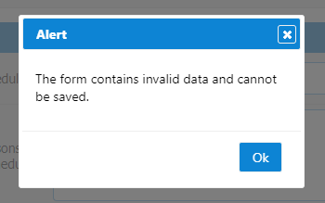
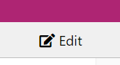
Top Tips
CDMS
Registration
Dates: dd-mmm-yyyy e.g. 01-feb-2024
Required fields must be completed
You must save a form on completion.
If a form has invalid data it wont allow you to save.
You can edit a field, but not all fields are editable.
Setting an Unobtainable flag: if a data item is truly unobtainable you can mark this using the three dots next to an item.
Set the correct form status at the end of each CRF: Complete, Complete with unobtainable missing data, Query in progress & Data entry in progress.
Randomisation
Data
Management
Participant Management
Queries
Top Tips
Q&A
Notes:
The database is relatively straight forward and the guidelines are much more in-depth than this whistle stop tour.
A few tips include:
All dates are in the form dd-mmm-yyyy
Required field must be completed before you can save a form
You must click the Save button before leaving a form or it will not be saved
If a data item is unobtainable, then you can set an unobtainable flag. This is only to be used when truly unobtainable, leave blank and return to an item if the data will be available at a later date.
At the end of each form there is a ‘form status’ that has to be set, choose the most appropriate option so that we are aware of the status of the form.

Slide 11
CDMS
Registration
Randomisation
Any Questions?
Please feel free to contact us at SWEET@warwick.ac.uk.
Data
Management
Participant Management
Queries
Top Tips
Q&A

