Slide 1


SWEET Drop In
11Aug2026
Please Use QR Code to log your attendance!
https://forms.gle/3TtUQQSaGw4eGtGn8

Slide 2
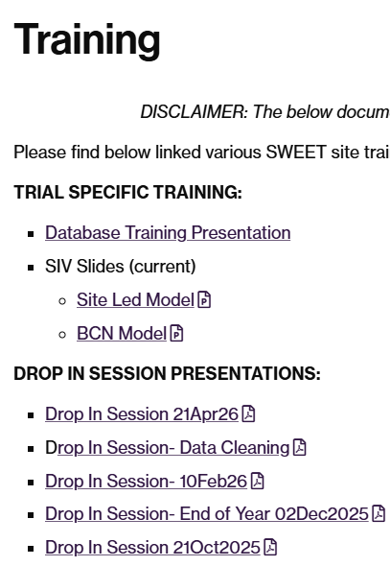
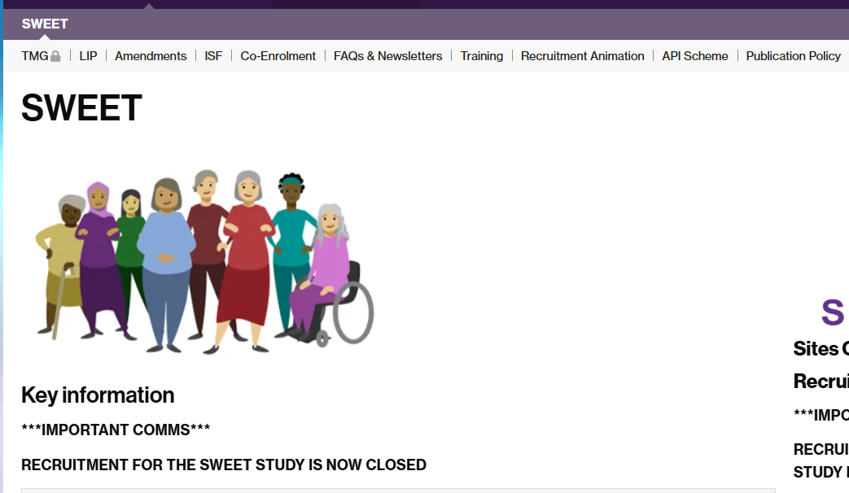
Topic 1: Accessing Information
https://warwick.ac.uk/fac/sci/med/research/ctu/trials/sweet

Slide 3
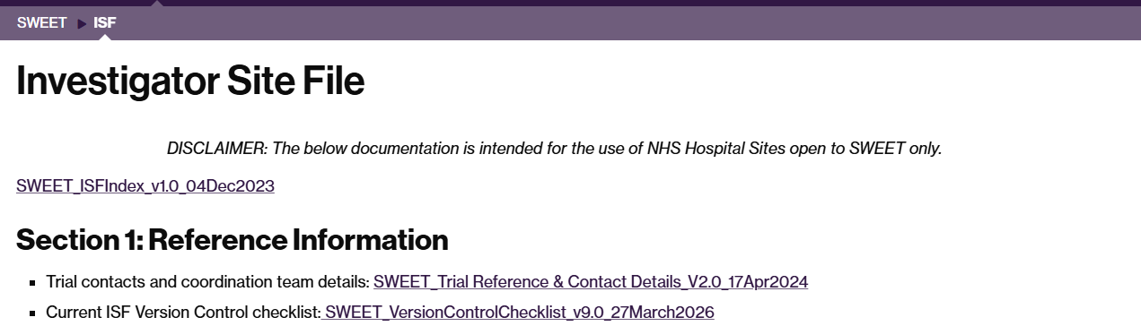

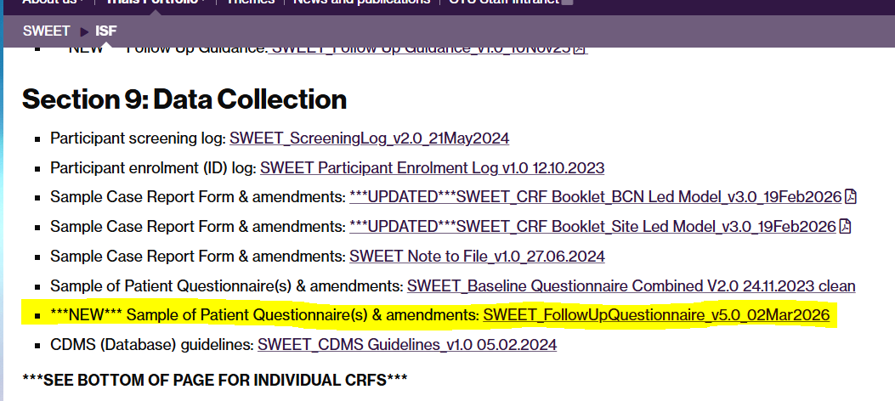
Topic 2: Version Control
Follow Up Questionnaire - V5.0
Double Check ISF/ Folders and dispose of any v4.0s
Remember to still send
  Cover Letter
  Postcard
  Questionnaire
  Pen
  Freepost Envelope

Slide 4
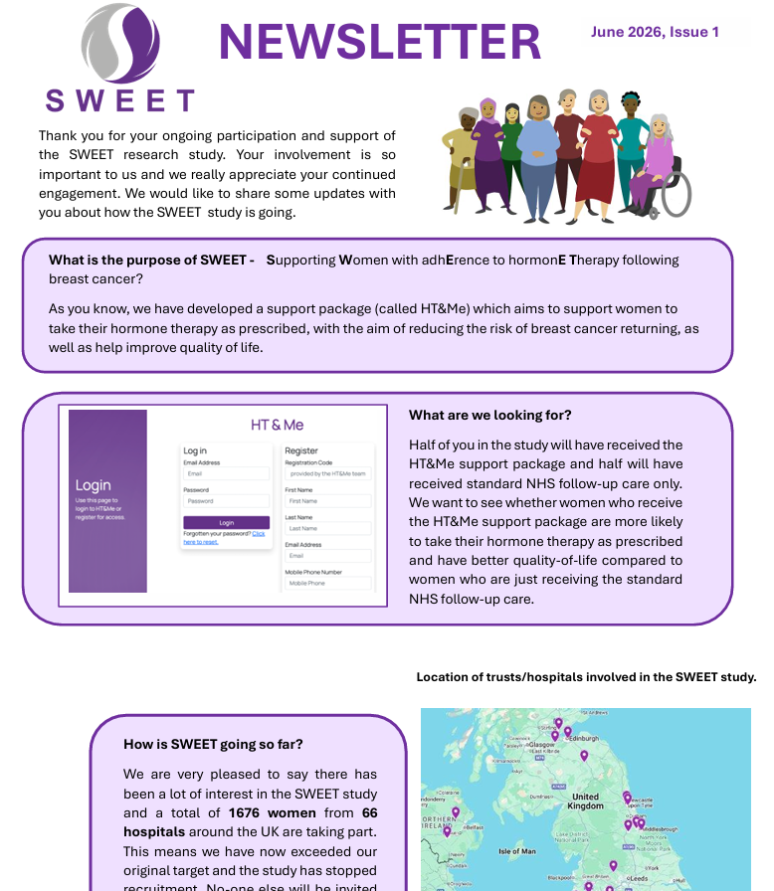
Topic 3: Participant Newsletter
Should now be with all participants who were listed in the initial email 18th June
Sent to participants via Email (or) Post
Public Facing and can be found on the SWEET website
Pending Confirmation that this has been actioned
  Deadline of 30th June
All confirmations to be received by 18th Aug please ☺

Slide 5
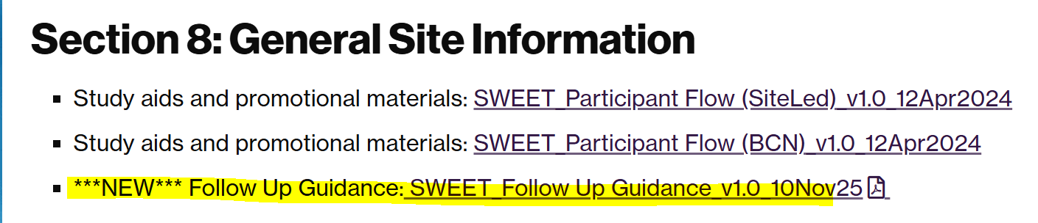
Topic 4: Follow Up
  Please follow the guidance provided in the ‘Follow Up Guidance’ document
    Section 8 of ISF
1202 /1551
532 /739
  Time Point X, - 4 weeks
  Start of Follow Up Window
  You will receive an Email from SWEET prompting you to send the Questionnaire and complete the CRF
  Time Point X, + 2 weeks
  Receive an Email from SWEET IF we have still not yet received the questionnaire, prompting the site to follow up with the participant and encourage completion
  Time Point X,
  Official Due Date
  Receive an Email from SWEET IF we have not yet received the questionnaire, prompting the site to follow up with the participant and encourage completion
  Time Point X, + 4 weeks
  End of Window
  We will still collect and use received data but will not chase

Slide 6
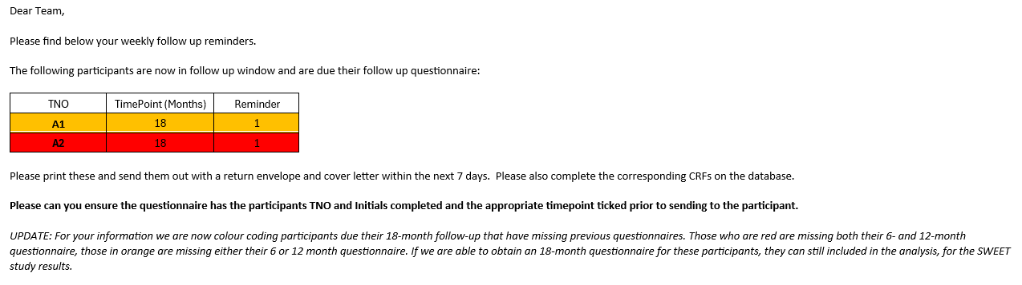
Topic 5: Follow Up cont.
12 MONTHS/ 18 MONTHS
  Both 12- and 18-month return rates are 73%
  (70% = under powered!!)
  Small Window
HOW ARE WE TRYING TO HELP?
  Highlighting where sites have many participants who are missing follow up- investigate/review process- visibility is key!
  Highlighting in the reminder emails participants who are showing concern using a traffic light system
    Red Missing 6 & 12
    Orange Missing 6 or 12
    Hoping this provides context and means sites can focus on those at higher risk of L.T.F.U
PLEASE REMEMBER:
  FOCUS RECRUITMENT = FOCUS FOLLOW UP…Follow the reminder schedule!! This is important for successful return rates
  If you are lacking capacity, please highlight to R&D and us. 18M is the absolute critical time point!
1202 /1551
532 /739

Slide 7
Topic 6: Other Business
Please remember finance is based in NuTH- all invoices need to be sent to nuth.projectmanagement@nhs.net
  If you are having any issues please let us know
Envelopes
  Requested if you have any surplus to send them back to us so we can redistribute them. We have placed another order and will send out on Wednesdays when/if requested
Systematic Data Cleaning of Baseline
  Statistician will be pulling queries in Sept
  Expect Queries w/c 21st Sept

Slide 8
Q & A
Please Use QR Code to log your attendance!
https://forms.gle/3TtUQQSaGw4eGtGn8

