Slide 1
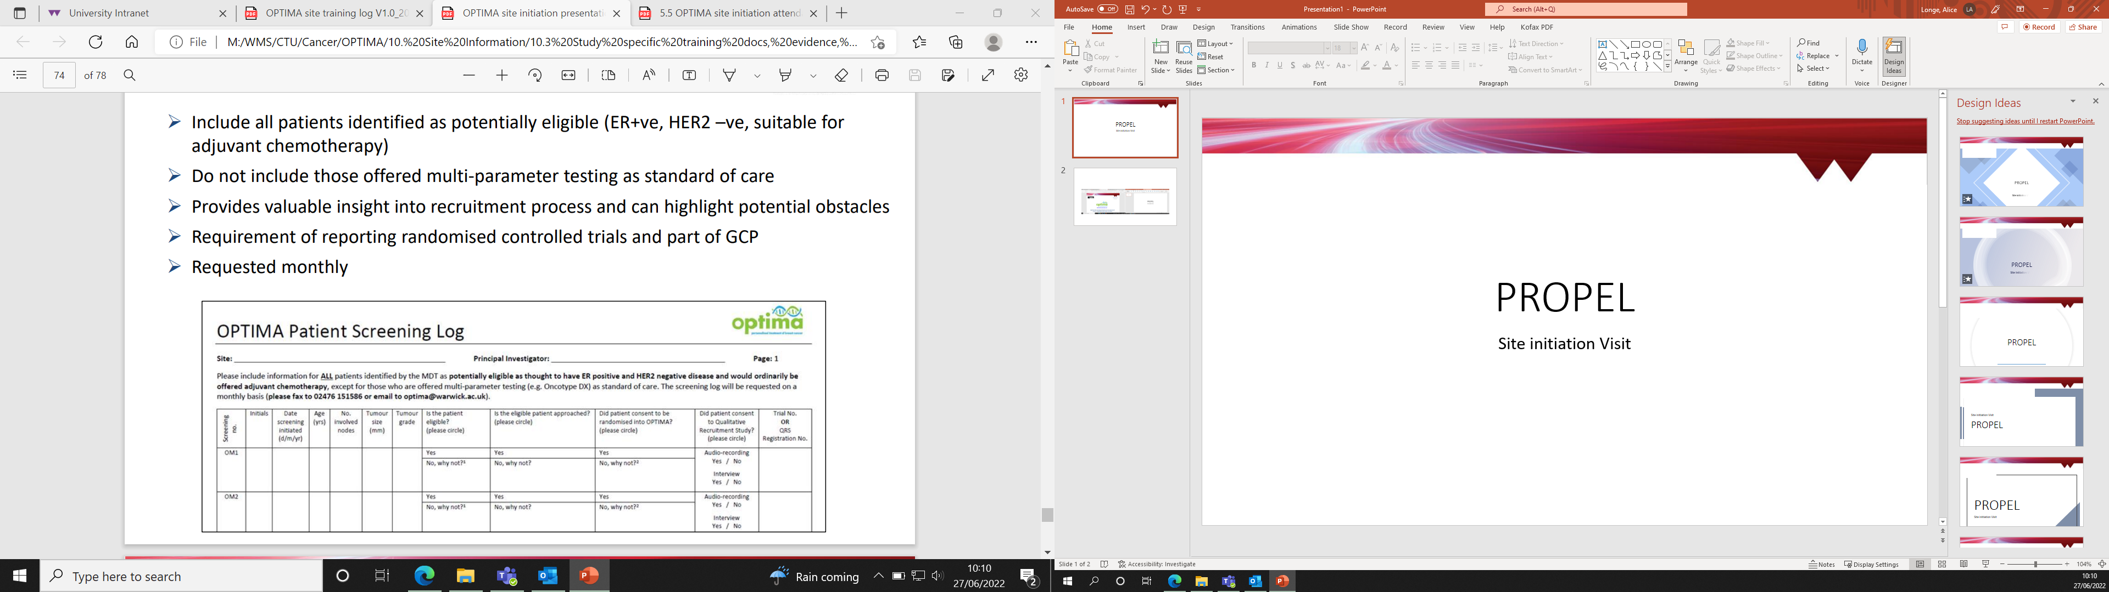





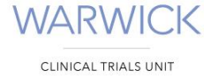


Improving outcomes for women diagnosed with early breast cancer through adherence to adjuvant endocrine therapy
Chief Investigators: Professor Linda Sharp (Newcastle University) & Professor Eila Watson (Oxford Brookes University)

Slide 2

SWEET Trial Infrastructure
Funder: National Institute for Health Research (NIHR) Programme Grant for Applied Research (PGfAR)
Sponsor: The Newcastle upon Tyne Hospitals NHS Foundation Trust
Trial Co-ordination: Warwick Clinical Trials Unit (WCTU), University of Warwick

Slide 3
Agenda
Trial overview
Rationale
Patient eligibility
Patient pathway
Intervention
Follow up
Data collection
Investigator responsibilities
Site activation requirements
Questions

Slide 4
Terminology
Local research team:
Research team at site responsible for the conduct of the study at site (ie PI, research nurses, trial
coordinators)
SWEET BCN nurse:
Practitioners from the BCN charity are responsible for delivering the intervention and conducting the consultations.
Central research team:
Team based in Warwick, and other organisations (i.e. Newcastle/Oxford/UCL). Oversee the overall delivery of the study

Slide 5
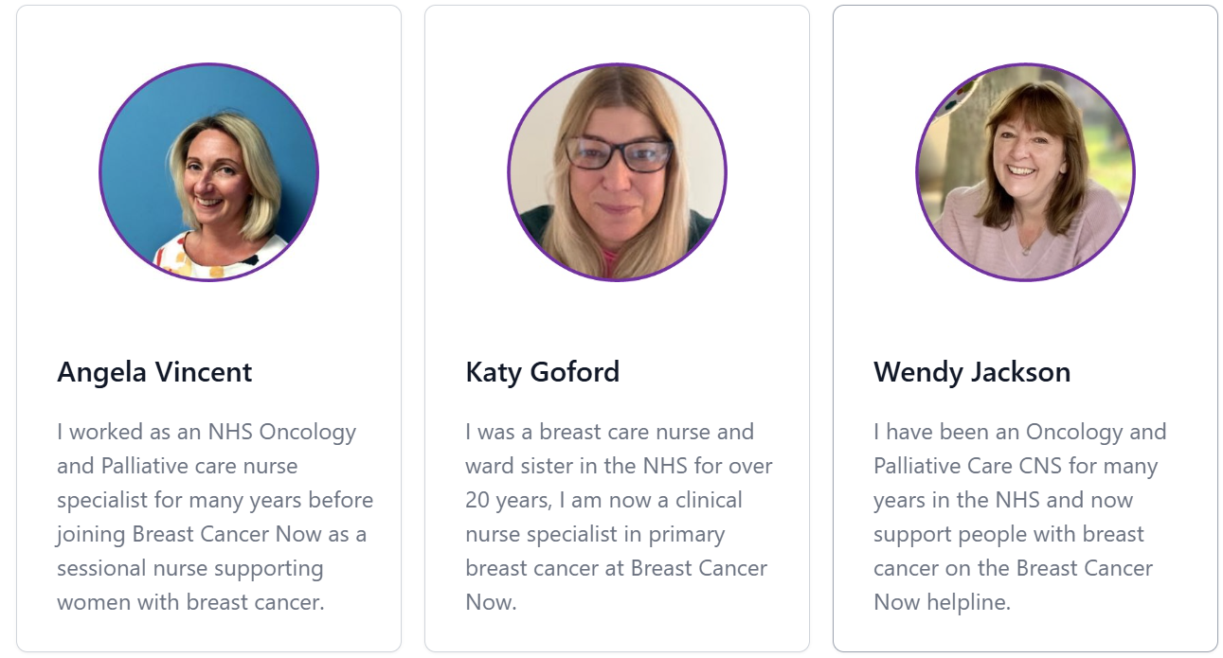
Meet the BCN Team
SWEET BCN nurse:
Practitioners from the BCN charity are responsible for delivering the intervention and conducting the consultations.

Slide 6
Background and Rationale
Adherence to endocrine therapy (ET) is a significant problem. At least 20% of women have poor adherence after two years and around 50% by five years.
When women discontinue ET early, or don’t take it as prescribed known as “poor adherence”. These women have up to a three times higher chance of cancer recurrence and mortality.
There is uncertainty on how best to improve ET adherence
The first phase of the SWEET study has developed an evidence based, theoretically informed and patient centred intervention to support adherence - the HT&Me intervention.

Slide 7

Aims & Primary Outcomes
Aim: To determine the clinical effectiveness of the trial intervention (HT&Me) in reducing poor adherence to Adjuvant Endocrine Therapy (AET) and improving cancer specific Health Related Quality of Life (HRQoL).
Primary Outcomes:
Adherence using combined self-report (Medical Adherence Report Scale (MARS-5) and community prescribing records (e.g. Medication Possession Ratio (MPR))
Cancer-specific HRQoL: Functional Assessment of Cancer Therapy scale- General (FACT-G)

Slide 8
Secondary Outcomes
To compare between arms:
AET-specific HRQoL: Breast Cancer Trialist Prevention checklist (BCPT)
Cost-effectiveness: Within trial cost per quality-adjusted life year (QALY); and EQ-5D

Slide 9
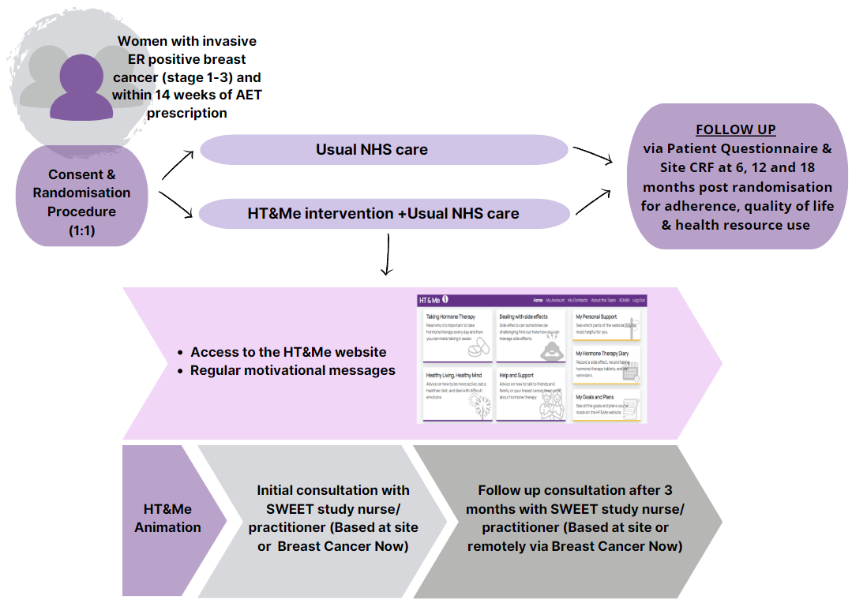
Trial Design
Multi-centre, unblinded, pragmatic randomised controlled trial (RCT) of HT&Me intervention + usual care Vs usual care alone
Sample size of 1460 patients across up to 80 NHS sites, recruited over a period of 24 months, and followed up for 18 months

Slide 10
Inclusion & Exclusion Criteria
Inclusion Criteria:
Aged 18+
Female
Diagnosis of ER positive invasive breast cancer, stages 1-3 and treated with curative intent
Completed surgery for breast cancer
Within 14 weeks of first oral Adjuvant ET prescription (tamoxifen or aromatase inhibitor) post breast cancer completion surgery
Completed chemotherapy (if applicable)
Able to access the internet
Has access to an email address
Willing to use a support package with a web-based component
The following women will also be eligible providing they fulfil the above criteria:
Women undergoing, or planned to receive radiotherapy,
Women receiving anti-HER2 therapies,
Women receiving ovarian suppression drugs,
Women receiving, or planned to receive an adjuvant CDK4/6i (e.g. abemaciclib)
Women who received neo-adjuvant ET
Women who have had a previous primary breast cancer (as long as they did not have AET to treat that first cancer).

Slide 11
Inclusion & Exclusion Criteria
Exclusion criteria
Male
Evidence of metastatic disease i.e. stage 4 disease (M1 regardless of T and N status)
Previous AET for another previous breast cancer
Have cognitive impairment sufficient to preclude participation, as judged by the clinical team
Unable to read and understand English

Slide 12
Usual Care Alone
Participants randomised to usual care alone will continue to access AET as per institutional guidelines and will continue to be followed up (either at site or through their GP) as per institutional guidelines and follow up processes.

Slide 13
Intervention- HT&Me Support Package
Early stages of the SWEET research programme have developed the HT&Me support package which involves:
Animation
Tailored consultation with BCN nurse
HT&Me website
1
2
3
4
3-month follow-up consultation with BCN nurse
5
Brief, monthly messages
Clear description of:
-How AET works
-Why it's important
-How to manage side effects. https://welcome.htandme.co.uk/
-Ensure understanding of AET
-Motivate to take regularly and long term
-Address any concerns
-Introduce & register onto website
-Personalised information
-Coping strategies and behavior change techniques
-Support
-Reinforce the importance of taking AET
-Address emerging concerns or problems
-Motivational reminders
-Nudges to website

Slide 14
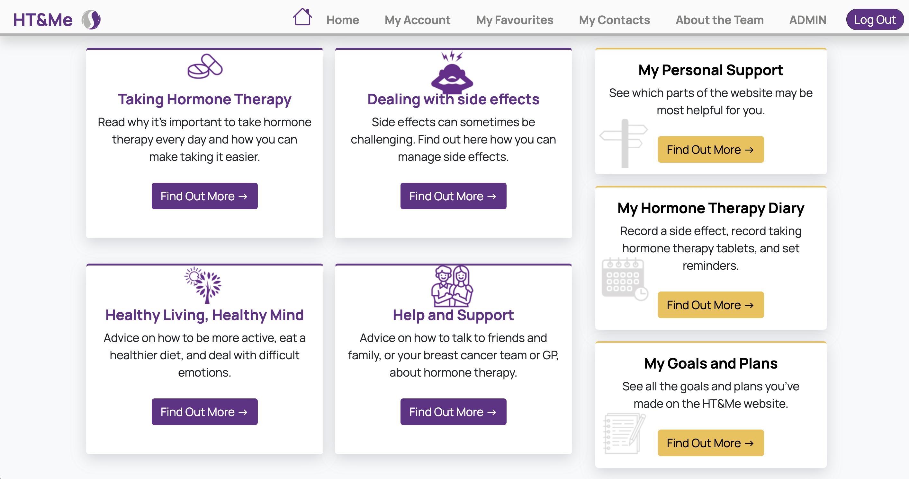
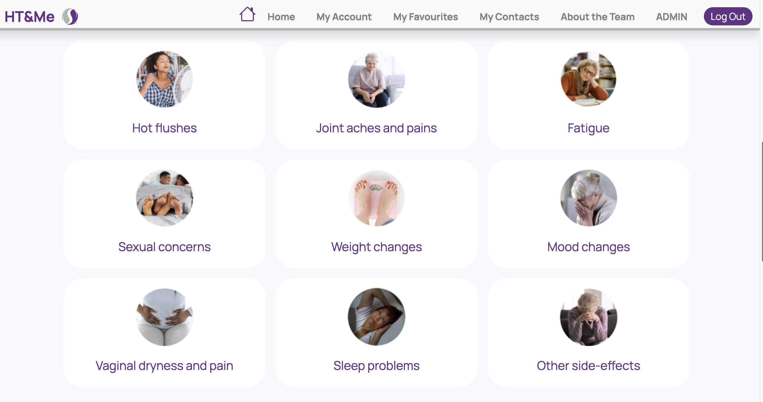
Intervention- HT&Me Support Package
HT&Me website features:
interactive
tailored support
information on the importance of taking AET
facility to set daily reminders to take AET and reminders to order repeat prescriptions
facility to record side effects & coping strategies for dealing with them
signposting to further support

Slide 15

Patient pathway

Slide 16


Patient Pathway: Identify & Approach
Identify & Approach
Patients could be identified through:
hospital records/ clinic lists
MDT records
*It is important to approach women from all treatment pathways i.e. surgery only, surgery and radiotherapy or surgery, chemo and radiotherapy.
Patients can be approached:
If a patient fully understands the study, what is expected of them and is happy to be consented immediately you do not have to wait 24hrs to take consent.
See invitation letter (signed by the patient's consultant)
Please add details of all potentially eligible patients approached for the study to the Screening log.
Informed Consent & Registration
Baseline
Approached remotely with a PIS and signed letter of invitation
With a PIS at a routine clinic appointment
Randomisation
Post randomisation

Slide 17


Patient Pathway: Informed consent and registration
Identify & Approach
Remote verbal consent:
Signed by designated researcher (as per delegation log) and countersigned by a witness
In person consent:
Signed by patient and countersigned by designated researcher (as per delegation log)
Informed Consent & Registration
The original copy of the informed consent form must be filed in the ISF, a copy provided to the patient and a copy to be kept in the patient's medical records. Consent forms should not be returned to WCTU.
Baseline
The patient can then be registered on the database, using the registration CRF. Please confirm the patient’s preference for completion of questionnaires (i.e. paper or electronic).
You will then be provided with a 4-digit TNO.
Randomisation
Post randomisation

Slide 18

Patient Pathway: Baseline
Identify & Approach
Complete and enter the following CRFs:
Eligibility CRF- signed by someone delegated this responsibility on the delegation log- it does not have to be someone medically trained
Participant contact details CRF
Questionnaire completion: A questionnaire must be completed before the participant is randomised; validation will not allow you randomise a participant until you have confirmed these are completed.
Electronic: If patient opts for electronic questionnaire completion, WCTU will organise these to be distributed through the database. *Not yet live*
Paper: Local research team to provide patient with a baseline questionnaire. Sites should return these to WCTU for data entry. If these are returned directly to WCTU we will notify you on receipt.
Up to two reminders can be sent to complete the questionnaire
Informed Consent & Registration
Baseline
Randomisation
Post randomisation

Slide 19
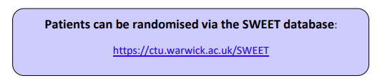

Patient Pathway: Randomisation
Participants should be randomised via the database, and will be stratified based on the following factors:
1. Age
2. Current AET
3. Treatment complexity
The site PI, randomising practitioner, SWEET study nurse/practitioner and main site contact will receive a notification by email to confirm which arm the participant has been randomised to.
A GP letter should be sent to participants GP, specific on their trial allocation.
Identify & Approach
Informed Consent & Registration
Baseline
Randomisation
Post randomisation

Slide 20
Patient Pathway: Post randomisation (Intervention)
Pre consultation:
BCN nurse will contact the patient and organise Consultation 1 within 4 weeks of randomisation. The planned consultation date must be entered on the database.
Once the consultation has been booked with BCN, the site must send the patient their Initial Consultation Appointment Letter – this contains a link to and QR code to the HT&Me animation which is a core part of the HT&Me intervention.
If a consultation is cancelled or rescheduled for any reason, please let SWEET@warwick.ac.uk know urgently for transparency between BCN & your site.
Identify & Approach
Informed Consent & Registration
Baseline & Randomisation
Pre- Consultation
Consultation 1
Consultation 2

Slide 21
Patient Pathway: Consultation 1
BCN nurse will conduct 30min consultation with patients via video call. This will follow the consultation guide found in the HT&Me study nurse manual, and include registering the participant on the HT&Me website.
Participants will begin to receive motivational, nudge messages by text or email from the HT&Me website, and receive a text message asking for brief feedback on their consultation.
BCN nurse will complete consultation 1 checklist alongside this consultation and enter onto the SWEET database.
Identify & Approach
Informed Consent & Registration
Baseline & Randomisation
Pre-Consultation
Consultation 1
Consultation 2

Slide 22

Patient Pathway: Consultation 2
Identify & Approach
BCN nurses to organise and conduct 15 minute follow up consultation (consultation 2) with patients either by telephone or by video call (approximately 12 weeks after Consultation 1). This will follow the consultation guide found in the HT&Me study nurse manual.
Site must send out confirmation of appointment letter to participant prior to their appointment.
BCN nurse to complete consultation 2 checklist and enter onto the SWEET database.
Patient will receive text message asking for brief feedback on their consultation.
Informed Consent & Registration
Baseline & Randomisation
Pre-Consultation
Audio Recording Consultations
Consultation 1
A sample of consultations will be audio recorded to assess fidelity.
We will contact the BCN nurse directly to request for them to record any consultations delivered during a set time frame.
Consultation 2

Slide 23

Follow Up
Participants will be followed up at 6 months, 12 months and 18 months by means of questionnaires (completed online or on paper, dependant on participants preference) and using the Follow up CRF.
If participants opt to complete their questionnaire online, completion of the relevant follow up CRF will trigger WCTU to send the follow up questionnaire.
Longer term follow up (up to 15 years) for recurrence, survival and adherence will be subject to additional funding.

Slide 24
Prescription Encashment Data*
We will link participants details with NHS England (or equivalent) records to obtain data on prescriptions in the community. This is to assess:
AET adherence
Other related therapies
If we are unable to obtain this data through NHS England (or equivalent), we will try to obtain this data from participants GP.
*This is included in the main consent form, and nothing additional is required by sites

Slide 25
Promoting digital inclusion
Promoting digital inclusion is key to ensuring this isn’t a barrier to recruitment:
HT&Me Website: Extensive user testing for optimisation for all users
Provision of tablets with data bundles for women where needed
Email addresses are provided in the event of any technology support issues
Paper 'How to Guide' for users to refer to
Print screen options for women who prefer to print material and have hard copies
Reassure the women that they will be supported with any digital needs
Avoid making assumptions that women will struggle with digital access
Monitoring digital exclusion through screening logs

Slide 26

Hints & Tips for recruitment
Share the study with all the relevant departments to identify and recruit women across all treatment pathway (i.e surgery only, and surgery and oncology pathways)
The study is for all women taking hormone therapy, not just those struggling. There are relevant web pages for all women, and women can develop side effects at any point in their treatment.
BCN nurse consultations will be delivered remotely via video consultation
Approach all eligible women and avoid assumptions that some women will not want to or will be unable to take part. Flexibility should be used to accommodate the needs of different women.
Use clear, language: Feedback has shown technical language such as trial, or arms or WebApp can intimidate women
Discuss the overall benefits of research- many women find taking part in research, and having the opportunity to “give back”, very rewarding
Any questions, please just ask

Slide 27

Data Collection

Slide 28
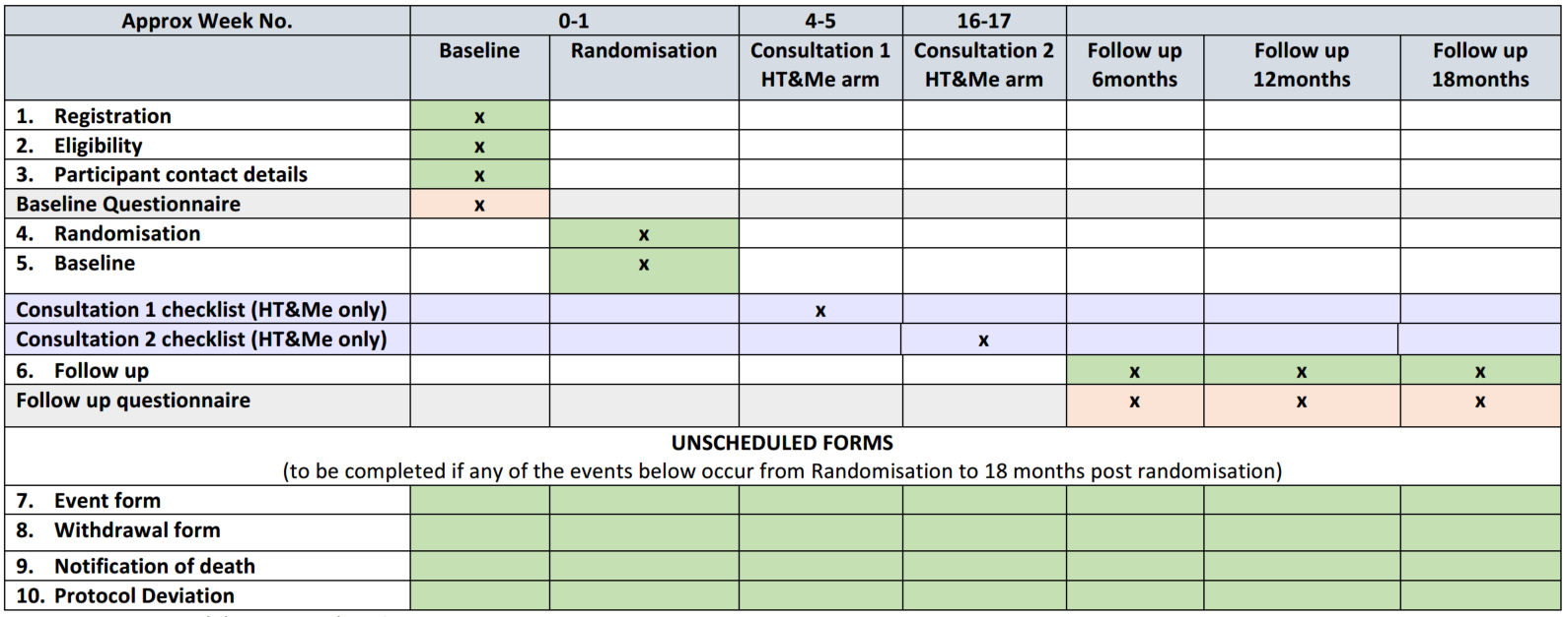
Schedule of Events:
Green = Site responsibility to complete & enter onto CDMS.
Orange = Site to facilitate provision to patient (unless electronic), WCTU responsibility to enter onto CDMS.
Purple = Intervention: BCN responsibility to complete & enter onto CDMS.

Slide 29
Electronic CRF Completion
This trial will use an electronic remote data capture (eRDC) system for registration, randomisation and completion of CRFs.
All trial data should be completed online
Only forms to remain ‘paper’ based are questionnaires where the participant prefers paper questionnaire completion.
Database access will be granted based on assigned delegation log duties
Database user manual is available for guidance
Optional Database Training Drop In Sessions will be held if required
Consent forms should not be returned to WCTU trials office
https://ctu.warwick.ac.uk/SWEET

Slide 30

eCRF Completion and Data Queries
CDMS = Clinical Data Management System = the SWEET database
We ask for eCRFs to completed in real time where possible.
If any data within database is unknown, mark it as unobtainable using the flag.
Queries will be generated on the database.
If a data manager on leave etc. please just let us know.
We usually request a response to data queries within 2-3 weeks.
Comprehensive CDMS Guidelines can be found section 9 of the ISF.
A list of permitted self-evident corrections (SECs) can be found in the CDMS guidelines.

Slide 31
Patient Interviews
Audio recorded, semi-structured interviews will be conducted by the central research team with participants (Intervention n=25-30, Usual Care n=-10-15), via telephone, or video call.
Identify key issues relating to patient experience of the study and HT&Me.
Participants will be selected to ensure a range of characteristics.
Participants will be asked as part of the main ICF if they are interested and consent to taking part in an interview.
Participants will be contacted by our central research team to conduct the interview
Expected duration of 60-90 minutes.
We will be requesting letters of access to facilitate these interviews.

Slide 32
Healthcare Professional Interviews
Audio recorded, semi-structured interviews with a total of up to 20-25 SWEET study nurses/ HCPs
Remote via phone call or video call depending on interviewee preference
Conducted by a member of the central research team
Views and experiences of the trial, intervention, and Behaviour Change Techniques (BCTs) (as appropriate)
Intervention fidelity and quality
Potential contamination
Contextual factors
Eligible staff members will be contacted and undergo a consent process with our central research team
Interviews will last approximately 60 minutes

Slide 33
Patient Withdrawal
Patients can withdraw from the trial at any time
Levels of withdrawal
Withdrawal from randomised trial allocation
Withdrawal of consent to be contacted re: follow-up
Withdrawal from questionnaire completion
Overall withdrawal
It may not be necessary to withdraw patient from entire trial – consider all options
Withdrawal of patients should be communicated to the SWEET Trial Office as soon as possible and a Withdrawal CRF completed.
Withdrawal decisions (including level of withdrawal) should be documented within the patients’ medical records.
Data until the point of withdrawal will be retained

Slide 34
Lost to follow-up
Participants who are deemed as lost to follow up or have moved out of region should not be automatically withdrawn from the trial
Where possible any follow up data should be collected from:
GP records
Hospitals records

Slide 35

Screening logs
Sites are required to maintain a Screening Log of all potential study candidates that are identified as potentially eligible and approached
Screening Logs should be stored as a soft copy (excel spreadsheet)
Logs will include limited information about the potential candidate:
Age
Ethnicity (as per medical records, if possible, to obtain)
Date and outcome of the screening process
Important to help identify and assess potential recruitment issues
To be provided to trial office on a quarterly basis.
Screening logs should be sent to SWEET@warwick.ac.uk on request

Slide 36

Protocol and/or GCP non-compliances
Non-compliances identified at site should be reported to the Trials Office immediately
These should be reported on the ‘Protocol Deviation CRF’
Non-compliances will be documented and reviewed regularly by the trial management group to identify any trends
Corrective and preventative actions will be identified and discussed with the site

Slide 37
Co-enrolment With Other Studies
As a non-CTIMP, co-enrolment into SWEET is expected to be permitted
Trials will be reviewed on a case-by-case basis by the SWEET Trial Management Group (TMG) and the CIs of involved studies to ensure study outcomes will not be affected
A rolling list of studies permitted for co-enrolment will be kept by the SWEET trials office
Email SWEET@warwick.ac.uk for more information
Current approved studies for participant co-enrolment: Co-Enrolment

Slide 38
Investigator Site File (ISF)
Contains all documents required for study. A paper or electronic folder provided as part of set-up
Must be kept updated with latest documentation – including all local approvals
Initial HRA & Ethics documents are supplied
Approvals for any amendments will be sent to site via email and must be filed in the ISF. Amended documents should be acknowledged, filed in the ISF and confirmation of receipt returned to SWEET@warwick.ac.uk. Old versions of documents must be kept but marked as superseded
A copy of the PI CV & GCP will be requested, however other site team members are requested to keep an up to date CV/ GCP filed in the ISF for monitoring purposes
If there is a change in staff Delegation Log must be updated and sent to the trials office
Screening/Enrolment Log must also be kept up to date
Store copies of all CRFs (if paper based) and Patient ICFs (or note to file of secure location)
Store all other relevant communications (e.g. with Trust, Trial Office)

Slide 39
Monitoring
Trials are monitored to ensure that rights & well-being of patients are protected, Trial data are
accurate, complete & verifiable and that trial conduct is in compliance with the protocol, GCP
& applicable regulatory requirements.
Monitoring in SWEET:
Risk-based proportionate monitoring approach.
Monitoring activity will be predominantly central and remote.
On-site visits arranged to support sites if necessary or if triggered by a specific issue.
SWEET trial team and/or research team will conduct any on-site visits.
Ensure trial activities are clearly and consistently recorded in source documents – source documents may be reviewed against submitted data
Source data
Information in original records/certified copies of clinical findings, observations and/or activities necessary for the reconstruction and evaluation of the trial. This may be electronic and/or paper and will vary across sites. Questionnaires and in some instances, paper Case Report Forms will be considered to be source data for SWEET

Slide 40
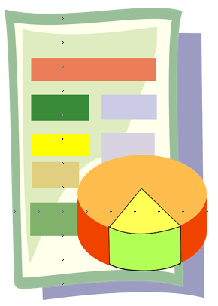


Central Monitoring:
At WCTU
In-built trial management activities
No/limited input form sites
Examples (not exhaustive!):
Validation within the trial database
Review of Delegation logs, consent form data, eligibility data, safety data
Remote Monitoring:
At CTU or sponsor office
Input from sites
Recreate elements of an on-site visit
On-site Monitoring:
At Participating site
Input and availability from sites
Format:
Discuss trial procedures with local team
Review will depend upon the scope of the visit: review of ISF, consent procedure, eligibility, outcome data
If an on-site visit is needed, sites will be guided through the process, requirements and timelines
For remote visits, IT requirements will be discussed prior to the visit

Slide 41
Storage & Archiving
Investigator Site File should be stored in a secure location
Study documentation not stored in ISF should be stored in a secure location (e.g. patient notes, secure filing cabinet) with a note to file stating the location in ISF
All study documentation (including electronic documents) must be archived in secure location for 10 years after publication of study report
WCTU will flag to you when the retention period is over and ISFs can be destroyed
Check with the SWEET Trial Office before disposing of any documents

Slide 42
Training requirements
All staff involved in trial activities should be trained in GCP (this does not include clinical staff only performing duties as per their normal clinical role)
All staff are advised to undertake self-directed training via the protocol and SIV slides
All training should be documented on the training log
(please note the SWEET nurse/practitioner tick box in the role column is only for individuals delivering the intervention)
Additional training will be required for the SWEET study nurse(s)/practitioner(s) undertaking the consultations

Slide 43
Investigator Responsibilities and GCP
The PI has overall responsibility and must:
Maintain appropriate qualifications
Sign agreements
Ensure local resources available
Comply with ethics
Comply with the protocol
Adhere to Informed Consent procedure
Maintain accurate data, reports & records
Ensure that all persons assisting with the trial are adequately informed (and on delegation log)
Have oversight of ISF maintenance
However:
All staff must comply with GCP
Staff should not commence study procedures until informed consent has been received
Staff should only perform tasks delegated to them
Staff should ensure that their details are available to the Investigator
Staff should maintain appropriate confidentiality at all times to avoid any data breaches

Slide 44
Associate PI Scheme
Six month in-work training opportunity, providing practical experience for healthcare professionals starting their research career.
People who would not normally have the opportunity to take part in clinical research in their day-to-day role have the chance to experience what it means to work on and deliver a trial under the mentorship of a local PI.
Benefits to the study:
Local understanding of patient pathways
More opportunities for patients
Improved Engagement with the study
Dedicated point of contact
How (Associate Principal Investigator (PI) Scheme | NIHR) :
Search on ODP> Gain Local PI Approval> Complete Application form for NIHR approval.
Increased Capacity
Increased Recruitment
Improved data completion
Resilience for future studies.

Slide 45
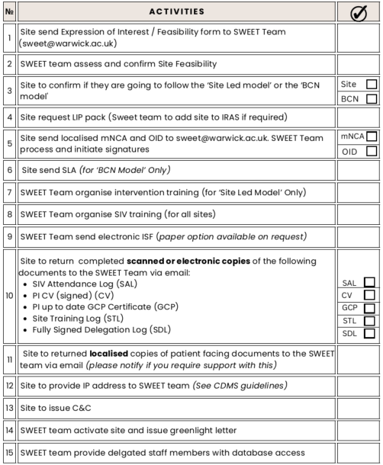

Site activation requirements:

Slide 46
Thank you!
Any Questions?

