Slide 1



MILES TO GO
Improving transitional mental health care for young people across Europe
Dr Giulia Signorini
Next Presenter: Dr Giulia Signorini
@Milestone_UoW #MILESTOGO
http://milestone-transitionstudy.eu/

Slide 2

What is the state of CAMHS provision across Europe?
Giulia Signorini, Giovanni de Girolamo
IRCCS Fatebenefratelli, Brescia
London, April 29th 2019

Slide 3




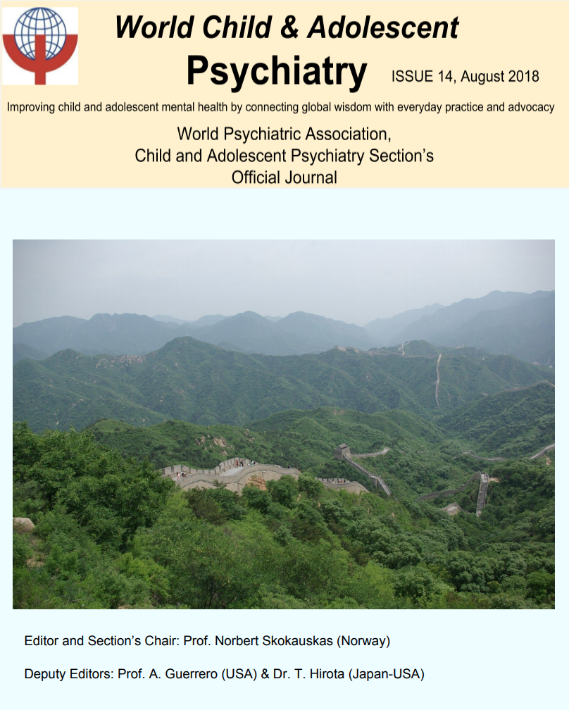

MILESTONE WP 1 tasks and outputs
Notes:
WP1 was conceived to make a point on the actual state of CAMHS architecture and functioning across EU, including the way they interface with AMHS transition wise.
We delivered this task by different intitiatives, including an expert consultation meeting with many C&A psychiatry experts in EU which took place in Madrid in 2014 (dame Sue Bailey was there as well) and by developing two tools which were administered through an on line mapping survey.
Most of the outputs of our activities are already published…

Slide 4

European CAMHS Mapping Questionnaire
(ECM-Q)
Standardized Assessment Tool for Mental Health Transition (SATMeHT)
Online survey
100% response rate
Data collection:
October 1st 2014 March 31st 2015
Notes:
ECMQ sections included info on
1. C&A Policy and Legislation
2. CAMHS Financing, Human Resources, Collaboration with Other Services, Activity Data, Medications and Other Treatment Modalities
We identified child psychiatrists and representatives of national child-psychiatry associations within each of the 28 EU member states. Each respondent was sent login credentials to complete the online questionnaires.
Data were collected between October 1st 2014 and March 31st 2015.
We approached a total of 34 individuals, and obtained responses from one respondent in all 28 EU countries.
Over 95% of survey items were completed.

Slide 5
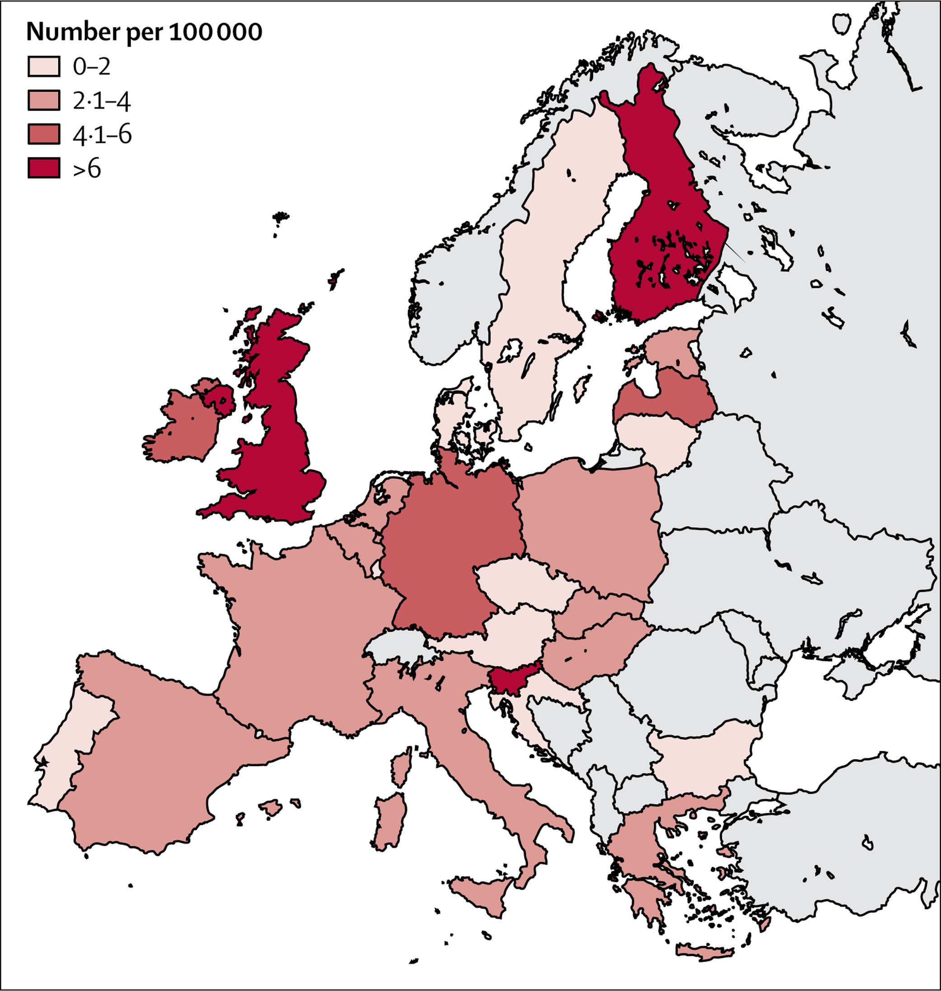
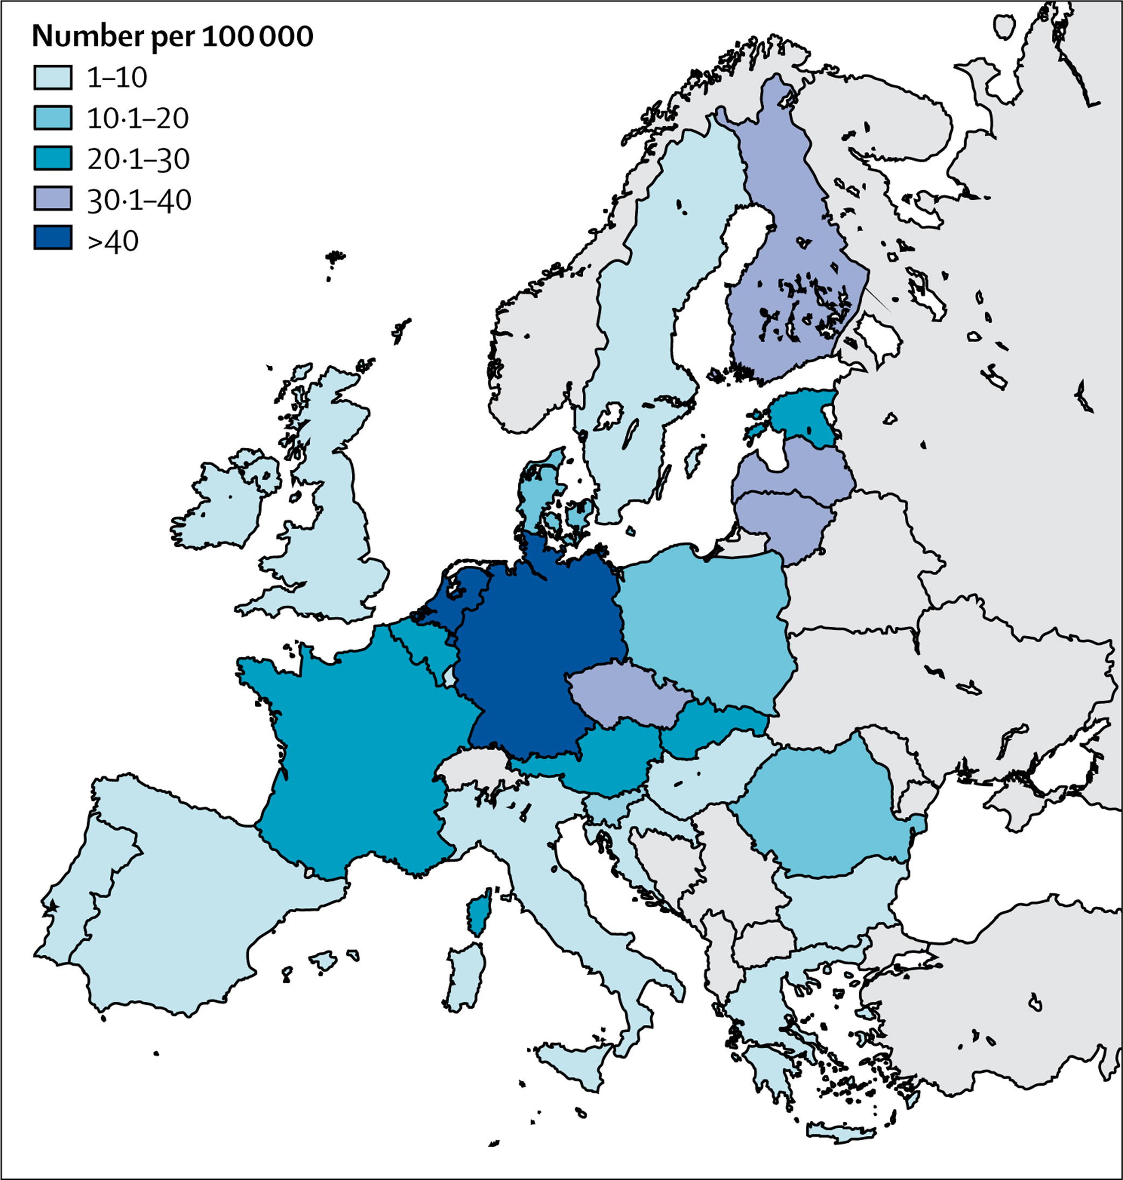

BEDS AVAILABILITY
26:1 ratio!
CAMHS AVAILABILITY
49:1 ratio!
The Lancet Psychiatry DOI: (10.1016/S2215-0366(17)30127-X)
Copyright © 2017 Elsevier Ltd Terms and Conditions
Notes:
Here a selection of data collected:
On the left you see the number of CAMHS per 100 000 young people in European Union countries; which ranged from 12.9 per 100.000 young people (Finland) to 0.5 (Bulgaria), with a 26:1 ratio in the availability of CAMHS!
On the right you see the number of inpatient beds per 100 000 young people in European Union countries. Again, there is marked heterogeneity in terms of inpatient beds…..in this case the ratio raises up to 49:1.
We did not collect information on how a service is delineated, so a service might be made up of many teams and work across a diverse range of settings

Slide 6
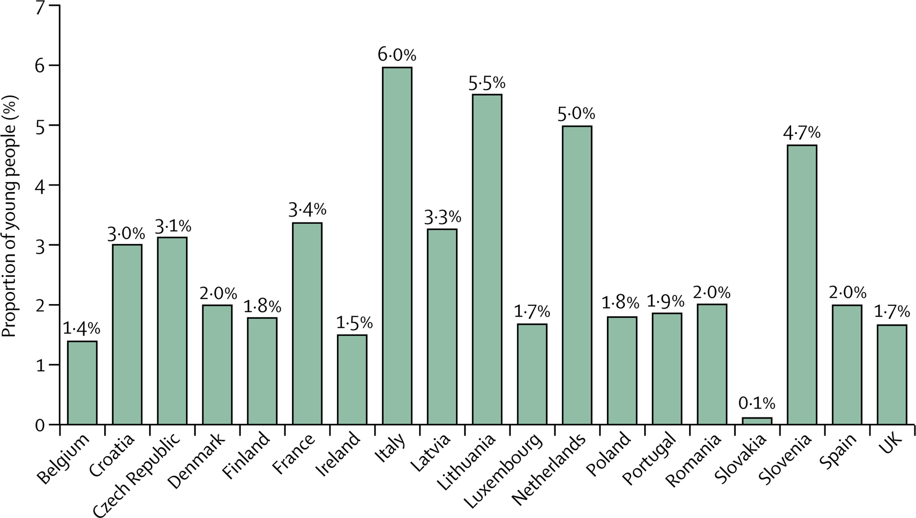
PROPORTION OF YOUNG PEOPLE (%) BELOW TRANSITION BOUNDARY IN TREATMENT AT CAMHS IN THE LAST 12 MONTHS
NEW CASES:
0,2-2% young population
The Lancet Psychiatry DOI: (10.1016/S2215-0366(17)30127-X)
Copyright © 2017 Elsevier Ltd Terms and Conditions
Notes:
These bars are showing you the proportion of young people beneath the transition boundary age treated in child and adolescent mental health services in the latest year available (2013–14)
The percentage of young people treated in CAMHS in the past 12 months was 3,6% in 7 of 19 countries, 1,3% in 11 countries, and less than 1% in one country (Slovakia).
The number of recorded new cases, for the last year available was provided by 13/28 (46%) countries, and generally ranged between 0·2% and 2% of the young population.
--------------
Despite a periodic activity report of CAMHS is obligatory in 86% (N=24/28) of countries, activity data were not available for 32% (N=9/28) of the responding countries, mainly due to the lack of national registries (presently available in 18 countries), or lack of access to such sources of information.
DIAGNOSES:
Less than half of the countries (46%, N=13) could provide complete data for every diagnostic category, DSM-5 or ICD-10 based.
In all these countries, neurodevelopmental disorders are the most frequent diagnostic group for those receiving treatment from CAMHS.

Slide 7
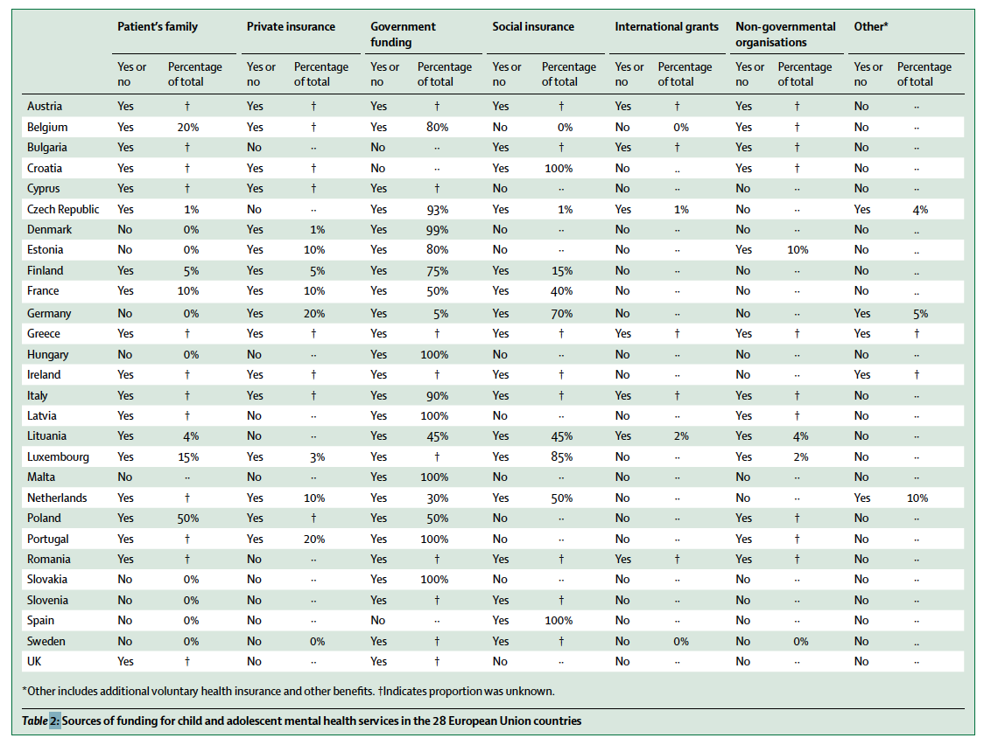
SOURCES OF CAMHS FUNDING
Notes:
How CAMHS are funded?
The most common source is government taxes (25/28 countries, 89%): in ten countries, this accounts for the majority (80-100%) of funding.
Two other important sources of funding are service user families (68%, N=19/28) and social insurance, (61%, N=17/28) of countries.
In about half of the countries, private insurance (57%, N=16/28) and NGOs (46%, N=13/28) play an important role in funding; international grants fund services in 6/28 (21%) countries.
Marked differences were observed: in some countries all CAMHS activities are entirely publicly funded (i.e. Croatia, Italy, Spain), while in others, like Poland, a high proportion of CAMHS activity is funded through private sources.
In eighteen countries, at least three quarters of CAMHS funding is provided by the government or social insurance.

Slide 8
CAMHS-AMHS INTERFACE
2/28 countries (Denmark and UK) = written national or regional policies or guidelines for the management of individual service user transition from CAMHS to AMHS available
4/28 countries (Cyprus, Denmark, Spain and the UK) = written national or regional policies or guidelines to manage the interface between the services.
17/28 countries (60%) = no specialized transition planning available

Slide 9
Estimated % of CAMHS users anticipated to need transition to AMHS care by estimated % of AMHS users with previous contact with CAMHS [under 30 years of age]
 | Estimated % of CAMHS users with AMHS care needs as they age
 |  | 0-24% | 25-49% | 50-74% | 75-100%
Estimated % of AMHS users under 30 years of age with previous history of CAMHS service use | 10% | Greece, Poland | Portugal |  |  | 3
 | 20% | Cyprus, Italy, Slovenia, | Austria, Ireland, Romania | Malta | Netherlands | 8
 | 30% |  | Bulgaria, Croatia, Germany, Latvia, Luxembourg |  |  | 5
 | 40% | Hungary | Sweden |  |  | 2
 | 50% | Denmark | Finland | France, Lithuania |  | 4
 | 60% | Estonia |  | Spain |  | 2
 | 70% | Slovakia |  |  |  | 1
 | Not Available |  | Czech Republic | Belgium, UK |  | 3
 |  | 9 | 12 | 6 | 1 | 28
Notes:
This table shows the percentages of CAMHS service users anticipated to need adult mental health care, contrasted with the percentages of AHMS patients under 30 years of age who have had previous contact with CAMHS.
Most country experts estimated that between 25% and 49% of CAMHS service users will need transition to AMHS and 20% to 30%of AMHS service user had been already seen in CAMHS. As you can see continuity of psychopathology is manifest in a substantial proportion of service users in CAMHS will need to continue their treatment AND in young service users at AMHS, with up to a third having previously accessed CAMHS.
It is important to note, that ‘previous contact’ in CAMHS may not necessary imply ‘transition’: an unspecified portion of these AMHS users might have received treatment in CAMHS for instance at the age of 12 until the age of 14, and again when 24 years old at AMHS. It is reasonable to conclude that experts indicate discontinuation of care as something happening much earlier before the transition boundary

Slide 10

STAKEHOLDERS’ INVOLVEMENT
NEEDS
ASSESSMENT
(at least)
one service user association (86%, N=24/28)
one family or caregivers’ association (96%, N=27/28)
39%-46% “NOT ROUTINELY INVOLVED” in the formulation or implementation of mental health policies at national level
3/28 countries (11%) =routinely conducted standardized assessment of the needs of young people approaching the TB.
8/28 (29%) = AMHS address the transition needs of incoming CAMHS service users
Notes:
The degree of involvement of such organizations in the past two years in the formulation or implementation of mental health policies at national level (ie, participation in meetings dedicated to this purpose) differed considerably across countries, ranging from “rarely” (18% for users and 11 % for family associations, N=5-3/28) and “not routinely” (39% for users, n=11/28, and 46% for family associations, N=13/28), to “frequently” (29%, N=8/28).
Three countries (11%) reported that a standardized assessment of the needs of young people approaching the transition boundary is routinely conducted. In Lithuania and Sweden, this is implemented at the local level, and in Ireland as a countrywide initiative. Only 29% (N=8) of respondents felt that AMHS address the transition needs of incoming CAMHS service users.
Involvement of parents and other actors in transition planning
In almost half the countries (N=13, 46%), parents/carers are involved in transition decisions, although sometimes only to the extent of being informed about the procedures and characteristics of the transition. In five countries (18%) the degree of involvement is limited by agreements reached between the young person and his/her parents (i.e. they might get involved only when requested by the service user), whereas in seven countries (25%) parents are able to choose the service they would like their adolescent child to be referred to, and in a few countries (N=3, 11%) they can even decide the treating clinician in the new service.

Slide 11

What sorts of difficulties are children or young people, who need transitional care and have mental disorders, most frequently personally experiencing?
Lack of connection between CAMHS and AMHS 82%
Lack of specific competencies in AMHS 64% Full AMHS caseload 21% Eligibility differences 36% Lack of specific destination 36% System culture differences 46% Territoriality 14% Ignorance of other systems 14%

Slide 12
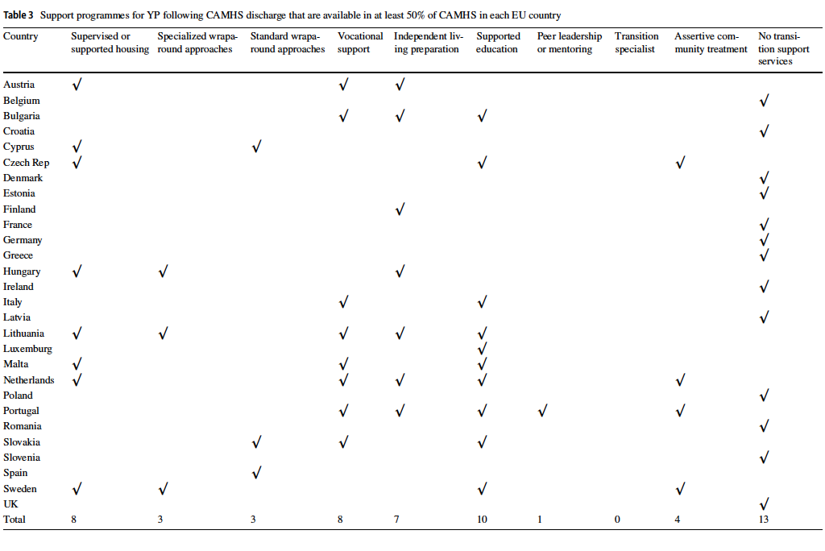
Notes:
This table shows the support programmes available when YP are discharged from CAMHS
Country variability in the provision of transition programmes mirrors the heterogeneity already observed in the configuration of CAMHS across Europe [21], and suggests that differing sociocultural and political beliefs have influenced the development of services in each county, together with national income, as limiting factor in general
Almost half of interviewed countries indicated no transition support services available

Slide 13

DISCUSSION
Marked heterogeneity in terms of:
(i) service distribution (beds, professionals, opening hours, dedicated facilities or educational services),
(ii) CAMHS financing (public vs private sources), and
(iii) users access (including new cases).
Despite 68% of the EU countries has a an official national child and adolescent mental health policy and up to 49% of CAMHS service users need specialist adult mental health services, as they get older, only four out of 28 countries have a written policy for managing the interface between these two services and only two countries have a policy dedicated to transition.
Lack of connection between CAMHS and AMHS is reported as the major (82%) difficulty experienced by young service users.
Notes:
1) Resource distribution does not match epidemiological prevalence estimates of child and adolescent mental disorders.
Such differences are likely to be dependent on policy issues, distribution of financial resources, social, cultural and ethical attitudes, and the general architecture of mental health care in each country. For instance, the very low number of inpatient beds for children and adolescents in Italy reflects the very small number of psychiatric beds in general, ^{20,21} after the law leading to the closure of all mental hospitals and to a radical decrease in the provision of inpatient and residential care. Other countries, such as Germany, have a high number of inpatient beds across all types of psychiatric care (child and adolescent, adult, psychogeriatric, forensic).²² Some countries have other services such as intensive home treatment teams, psychotherapeutic facilities, or Flexible Assertive Community Teams,²³ delivering almost comparable care in an outreach fashion.
2) The need to use private resources (private insurance or paid directly by patient/family) to obtain access to mental healthcare may have, in our opinion, important societal implications for at least two reasons. First, having to pay for care may affect the socioeconomic wellbeing of patients’ families, by reducing their expenditure capacity on other essential goods and services. Secondly, accessing care only through private, and costly, pathways, may discourage families from seeking clinical support as soon as their child may need it, thereby removing any opportunities for early intervention. Families play an important role in the continuity of young patients’ healthcare. Governments should therefore consider how they might further support families and minimize any burden on them since this may result in better care for young patients, with a consequent saving on the public purse.
3) The percentage of young people under the age of majority assisted by CAMHS varies substantially between different countries, without being justified neither by CAMHS availability, nor by differences in transition age
Despite the overall (86%) mandatory requirement of periodic CAMHS activity reports, data on service activities were available only from 19/28 countries, furtherly reduced to 13/28 for diagnostic group information, with neurodevelopmental disorders indicated as most frequent

Slide 14
CONCLUSIONS
discrepancies in equipment across countries
general lack of any kind of outcome assessments
clearer national/regional policies of services delivery and structure,
measure of treatment offered, taken up, and effectiveness
limited involvement of service users and their families
better identification of the young people’s needs and the assessment of their satisfaction toward services
Service GAP
Scarce transition planning
No transition specialists available
umbrella management overseeing both AMHS and CAMHS
CAMHS/AMHS professional training
reconfiguration of current service provision
harmonization of data collection systems
share of knowledge about transitional care issues
Notes:
Young people are too often excluded from the process of making transition decisions, and the majority of surveyed countries do not undertake an established standardized assessment of their needs. As transitioning youth have very specific psychosocial needs, generic care provision is destined to be ineffective, if not detrimental, and is likely to lead to treatment withdrawal
Individuals affected by ADHD or Autism spectrum disorders, as they become adults, may not find any suitable mental health service for their care needs; ²⁶ the exception being those who have psychiatric comorbidities. Since mental health professionals dealing with adult patients are generally not trained in child and adolescent psychopathology, the appropriateness of the clinical treatment provided in AMHS may be questioned Equally, CAMHS professionals may benefit of specific training on severe adult mental disorders having their onset in adolescence or young adulthood [e.g. severe personality disorders, psychotic disorders, severe depression or bipolar disorder]. Clinical training and services policies should be reviewed
reconfiguration of current service provision, in order to arrive to a unified, appropriate and timely configuration of services for children and adolescents in the 28 European countries. This includes a more efficient resource planning
A starting point may be to look at the few countries where these issues have already been tackled through the establishment of dedicated transition policies and practices, and adopting their example

Slide 15

Acknowledgements
MILESTONE team
Country experts
Thank you for your attention!

