Slide 1
“Making Transitions Work”
Professor Dame Sue Bailey, Chair
Children and Young People’s Mental Health Coalition
@CentreforMH
@CYPMentalHealth
29th April 2019

Slide 2


Slide 3
Children and Young People’s Mental Health Coalition
We work with over 180 organisations to campaign and influence policy, with and on behalf of children and young people in relation to their mental health and wellbeing.
Proud to be hosted by Centre for Mental Health

Slide 4





Centre for Mental Health
The Centre for Mental Health are a charity with over 30 years’ experience in providing life changing research, economic analysis and policy influence in mental health.
www.centreformentalhealth.org.uk
Follow us on social @CentreforMH

Slide 5
Our Vision
For all infants, children and young people to grow up in a society that prioritises, invests, listens and attends to their mental health and wellbeing.

Slide 6

Listen to, and learn from members, supporters, children, young people and families
What We Do
Influence and shape policy, systems and practice
Advocate a whole-system approach underpinned by core principles

Slide 7
Prevention of MH problems: universal & targeted approaches for those living with and in the most challenging circumstances
Our Priorities
Bolder approaches to investment in high quality, person-centred early intervention provision in community/education settings
Everyone has the skills and confidence to recognise and address the mental health needs of infants, children and young people

Slide 8
Transition: a period of heightened vulnerability and opportunity?
The transition from children’s to adult services is an issue across the whole of healthcare
It is well established that the brain does not fully mature until about age 25, and so a young person may not be developmentally ready to move to adult mental health services at 18.
Lifelong consequences associated with poorly managed transitions for young people with mental health needs
Half of mental health problems emerge before the age of 14 and around three quarters are established by the age of 24.
Source: Blakemore, S-J. (2013) https://www.edge.org/response-detail/23798

Slide 9
National CAMHS Review (2008) concluded “…chronological age is not the best determinant for appropriate service provision.”
Transition based on need not age
Future in Mind (2015) reaffirmed “…transitions from children’s services based on the needs of the young person, rather than a particular age.”

Slide 10
There are also well established and pioneering voluntary sector services that are aimed at 16-25 year olds.
Youth, Information, Advice and Counselling Services (YIACS) for instance, are available across the country and provide easy, community based access to a range of support under one roof.
Future in Mind recommends that these one-stop-shops be a key part of the universal local offer and build on the existing network of YIACS.
Learning from the voluntary and community sector

Slide 11
We have been are calling for:
Invest in support for young people aged 16-25, who require support in the transition to adult mental health services, and into adulthood generally.
Greater coordination, is also needed between mental health service providers and key agencies such as education, social care and substance misuse services.
Evaluating and evidencing what works, There are a few service models which have been set up to address issues surrounding transitions. These services need to be evaluated to ensure that they are effective for all children and young people.
Improving the mental health and wellbeing of young people during transition

Slide 12
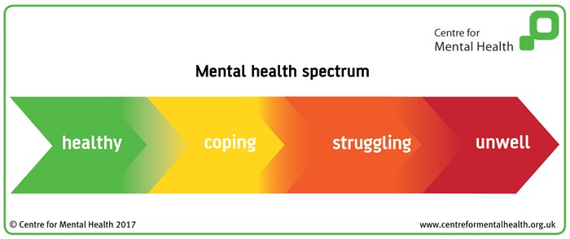
Mental health spectrum
‘We all have mental health’

Slide 13
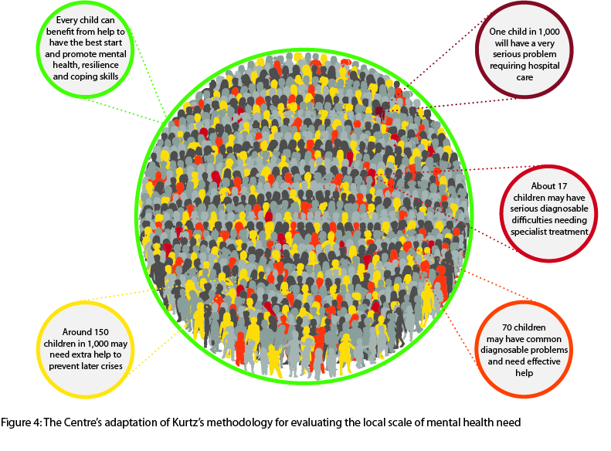
For every 1,000 children…

Slide 14

Supporting young people transitioning in education
What we did:
Literature review
Interviews and focus groups
Survey
Involving students and staff at:
Comprehensive school
Special school
Independent school
FE college

Slide 15
School is a place of reliable, informal and personalised support
Moving onto university as an important ‘rite of passage’ towards adulthood
Young people are worried about transitions, but feel pressure to do it on their own

Slide 16

Romantic relationships
Having a good social life
Living independently
Easy access to drugs and alcohol
Identity issues
Managing finances
Keeping safe
Academic pressures

Slide 17
Continuity of MH care is important
Practical factors which support a positive transition
Teachers and university/ FE college - more communication about students
Extended transitions
Better data to compare universities
NHS England and CCGs should ensure continuity of care for young people in CAMHS throughout their education, including the transition to university / FE college
Our report welcomes the NHS Long Term Plan’s commitment ‘to extend current service models to create a comprehensive offer for 0-25 year olds’

Slide 18
Reflections: ‘Nothing about me without me’
Transitions truly matter if we want healthy health creating societies
Transitions are everybody's business stretching across health, social care, education, world of work leisure and justice
Key is equipping the whole workforce to be able to support young people whatever their state of health or social context
Transitions are embedded in a developmental understanding of human beings where young people have the right to fairness, protection and autonomy
Listen to the experts young people themselves, utilise all the evidence base
Deliver on values based practice through shared decision making with young people. "Nothing about me without me"

