Slide 1

Compassionate
Birmingham

Slide 2

Compassionate City
Birmingham was the first City to be endorsed as a Compassionate City by Compassionate Communities UK
The award recognises the acts of kindness and compassion across the City
It has senior sign up by health, care and council leaders to continue to improve experiences relating to palliative, end of life care and loss and reduce loneliness and isolation

Slide 3

What is Compassionate Birmingham
creating caring, connected & supportive communities in Birmingham and beyond
A network of organisations
Following the broad aspirations of the Compassionate City Charter which was endorsed by the United Nations
Field of Public Health Palliative and End of Life Care – serious illness, death, dying, loss, caregiving
Paying attention to social morbidities including loneliness

Slide 4
Areas of the Compassionate City Charter
Schools and Young People
Workplaces and Trade Unions
Places of Worship
Health and Care
Arts and Culture
Memorials
Neighbourhoods
Prisons
Homelessness
Diversity and Inclusion
Incentives and Rewards
Visibility via media, signage etc

Slide 5
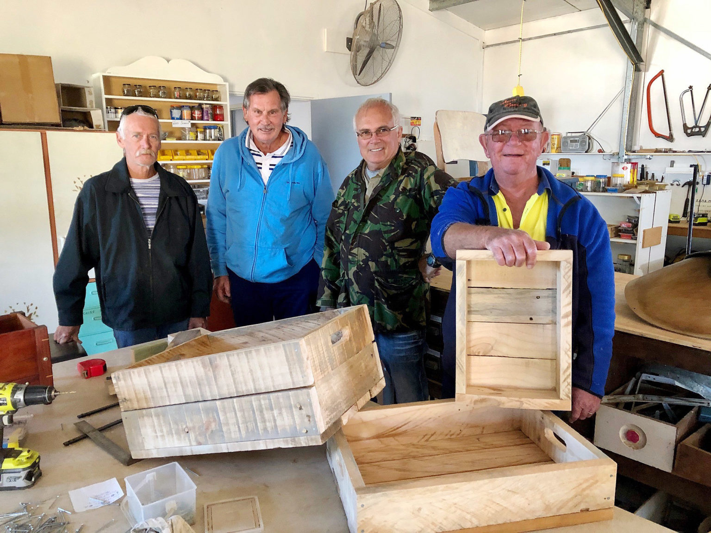

Social connections are essential to our health and wellbeing
Where do you connect with others in your community?
ThePhoto by PhotoAuthor is licensed under CCYYSA.

Slide 6
1. Comparison of odds (lnOR) of decreased mortality across
several conditions associated with mortality.
Social Relationships:
Social Relationships:
Social Relationships:
Drug Treatment for Hypertension
Holt-Lunstad J, Smith TB, Layton JB (2010) Social Relationships and Mortality Risk: A Meta-analytic Review. PLOS Medicine 7(7): e1000316. https://doi.org/10.1371/journal.pmed.1000316
https://journals.plos.org/plosmedicine/article?id=10.1371/journal.pmed.1000316

Slide 7
Just three things!
Learn more about issues relating to palliative and end of life care – we call this death literacy
Get your affairs in order – this can make a big difference to those left behind
Be a connector – we can all do this. If you are interested in getting involved email info@compassionate-communitiesuk.co.uk

Slide 8
Death Literacy - or health literacy for serious illness, death, dying and loss

Slide 9
