Slide 1
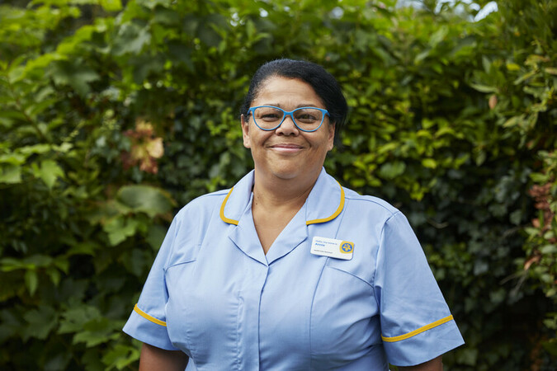
Hospice and End-of-Life Care

Slide 2
Our Vision:
A better end of life for all.
Everything we do, everything we fund, the reasons our teams go to work is to drive fundamental change in end-of-life care so that everyone can have the best possible quality of life to the end.

Slide 3
Our Mission:
To close the gap in end-of-life care.
One in four people dying in the UK don’t get the care and support they need, and the problem is getting worse as our population ages. By 2048, the need for end-of-life care will have increased by up to 25%. We need to close this gap.

Slide 4
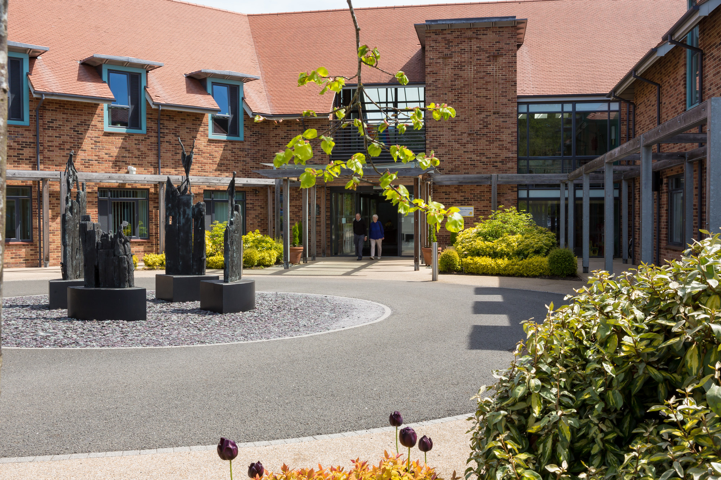
Hospice Care
Our hospices help people with any illness they’re likely to die from, and the people close to them, receive the support they need.
From medical and physical support to psychological and emotional care, whatever your illness, at whatever stage of the journey, we help you to live the best life possible – right to the end.
West Midlands Hospice is in Solihull and supports people from across the entire Midlands including Coventry and Warwickshire.
Notes:
Located in Solihull
Support all conditions not just cancer
Take patients from across midlands

Slide 5
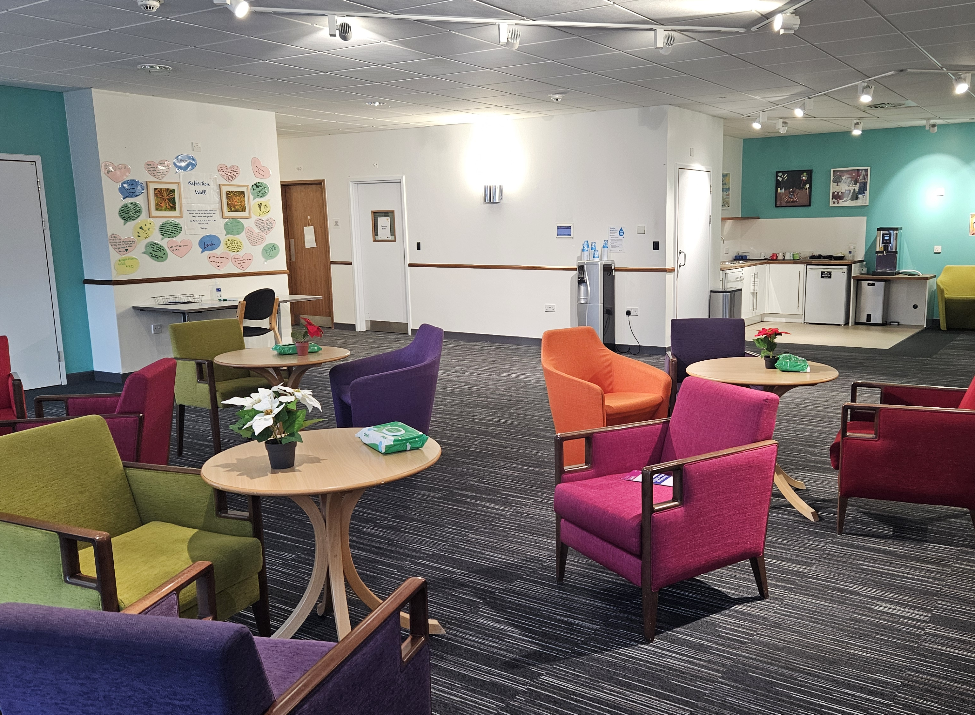
Support & Wellbeing Hub
Monday Book Club
Tuesday Pet Therapy
Men's Shed
Daff Café
F.A.B (Fatigue, Anxiety and Breathlessness)
Hairdressing
Wednesday Complementary Therapy
Motor Neurones Disease Support
Hand Massage
Thursday Complementary Therapy
Friday Motivate Exercise Group
Complementary Therapy
Horticulture Group
Saturday Walk & Talk Social Group
Notes:
Carers groups
Therapy led groups
Open to patients, carers and bereaved carers

Slide 6
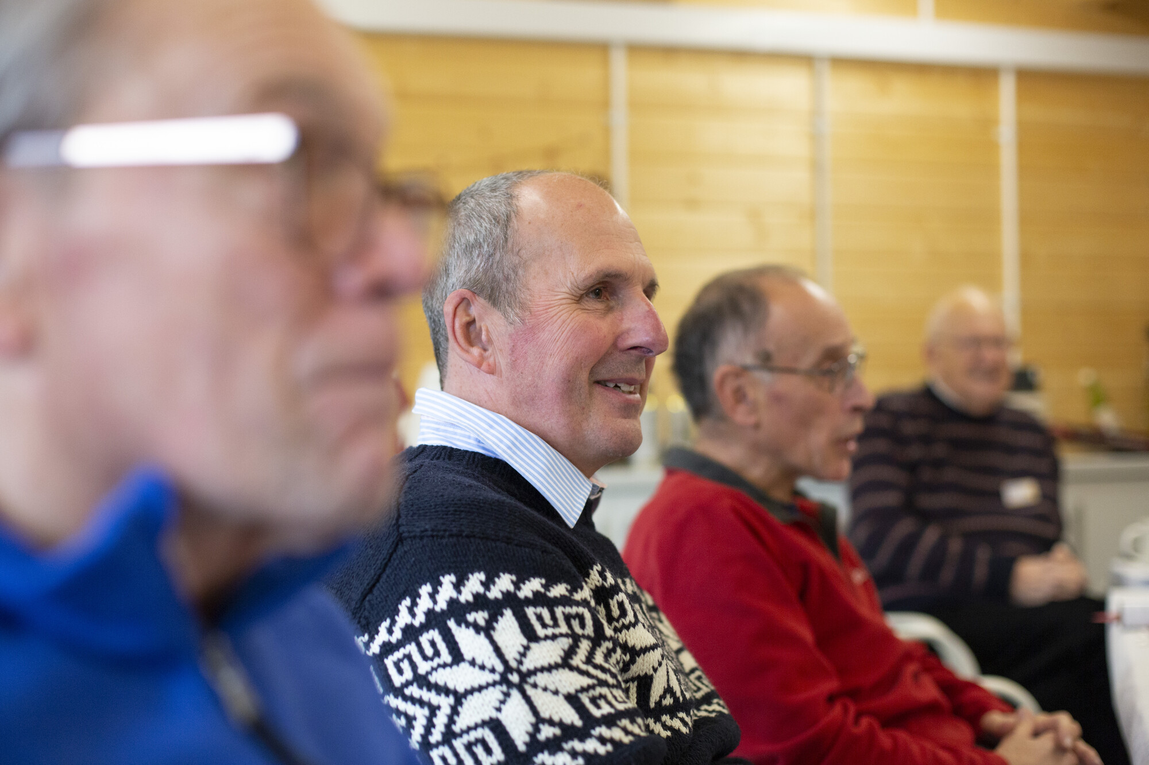
Dealing with grief and loss
The Family Support team at Marie Curie Hospice West Midlands works holistically with people, their family, and friends of all ages, to provide, emotional and spiritual support.
The team consists of Counsellors, a Spiritual Care Coordinator, Art Therapist, and specialist Emotional support volunteers.
All our services aim to support patients, family members and care givers to navigate their way through emotional issues that may arise during the Palliative care Journey.
Notes:
We offer 1 to 1 counselling (in person and telephone) as well as bereavement support groups
Children & Young Person service can be done in school or at hospice
Range of booklets – free to order or download

Slide 7
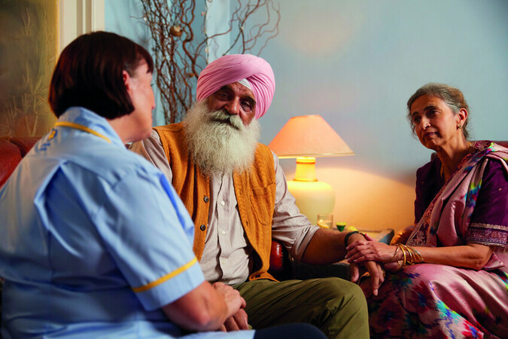
Hospice Care at Home
Hospice care at home provides expert, hands-on care to anyone with an illness they're likely to die from, and those close to them.
Our nurses, healthcare assistants and other healthcare professionals bring the clinical, practical and emotional help you need to you, in the comfort of your own home.
And we offer support to the people close to you too – from reassurance and practical information to letting them take a break.
Notes:
Provide end of life care to those that wish to stay in their own homes

Slide 8

Companions
Companion volunteers focus on what’s important to you and those close to you. It might be accompanying you to appointments, being there to listen to how you’re feeling without judgment or stepping in so family or carers can take a break.
Companions at home provide practical and emotional support to anyone living with a terminal illness in the comfort of their home.
Hospital Companions support patients in hospital in the last days or hours of life by providing emotional support and comfort. They can also provide support to families.
Notes:
Free volunteer support at home
Non-clinical support
Purely companionship and befriending
Support for patient or carer
Can take self referrals

Slide 9
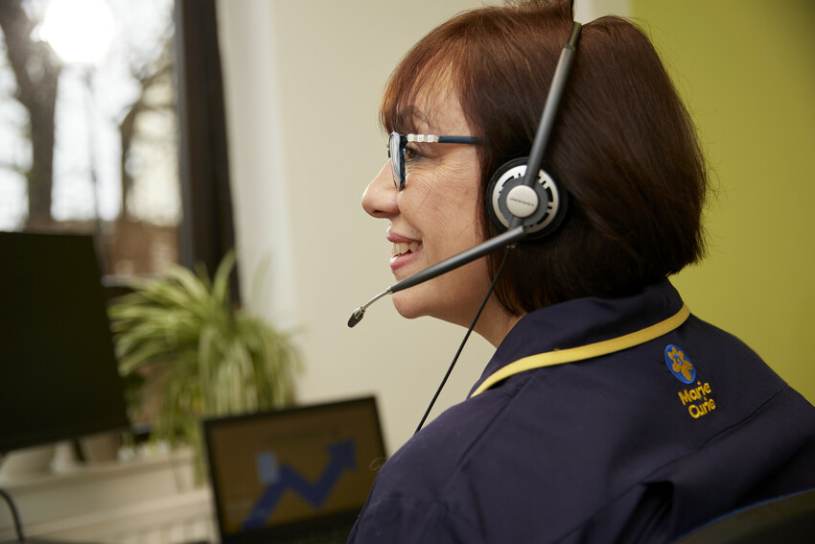
Information and Support
Marie Curie provides free support over the phone in over 200 languages, and via webchat, to anyone with an illness they’re likely to die from and those close to them.
Our team offers practical and emotional support on everything from symptom management and day-to-day care to financial information and bereavement support.
Call our free Support Line on 0800 090 2309. Calls are free from landlines and mobile phones.
Notes:
I&S can be split into 2 sections – content which is our website and booklets and PCKNZ. Our website has an amazing 235 information pages!
The other area is our I&S services

Slide 10
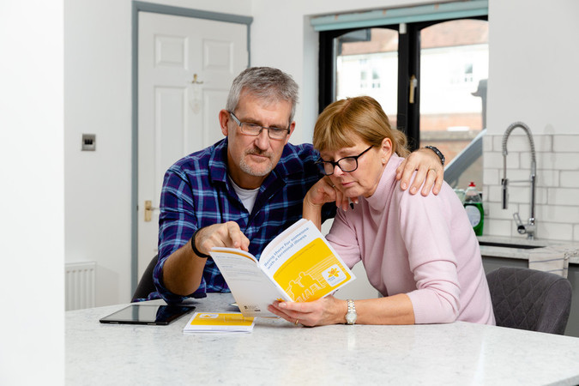
Trusted Information
Our free, trusted information is available to all. From first questions after a terminal diagnosis, or information about accessing services, to experiences shared by carers, guidance on planning for death, and support for grief.
We have information on palliative care for healthcare professionals, too.
You can access this information and support for free online, in print and by talking to us over the phone.

Slide 11
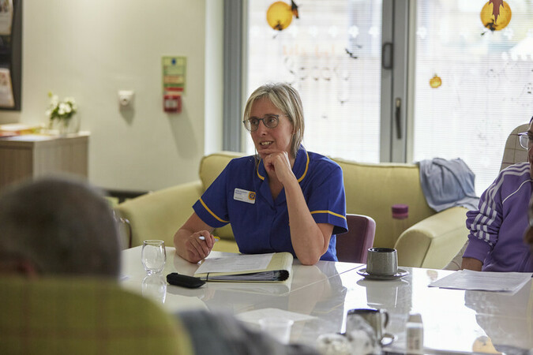
Research
Marie Curie is the UK’s largest charitable funder of palliative care research.
Our work deepens our understanding of what makes a good end of life, highlighting challenges and gaps in care, and improving support for everyone with an illness they’re likely to die from, and those close to them.
Our research helps us give the best care and improve the care system so that more people have the best possible experience at the end of life

Slide 12

Policy & Campaigns
Marie Curie campaigns for a world where everyone gets the best experience possible at the end of their life.
We raise public awareness and influence decision-makers across the UK on the issues affecting dying people and those close to them, so more people can access high quality care and support when and where they need it most.
Current campaigns:
Make “sadmin” simple
The Cost of Dying crisis

Slide 13
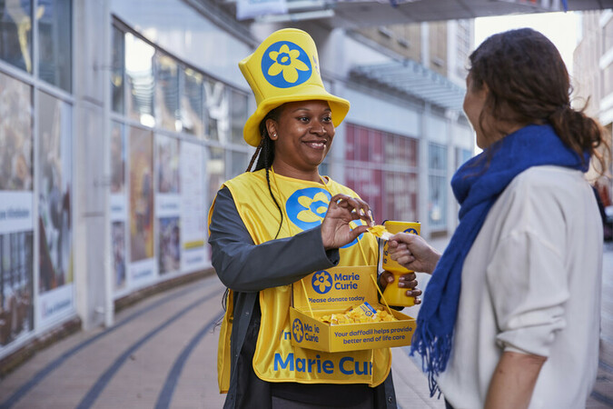
How we are funded
All our services are free for people to access.
On average the NHS only funds 26% of our Hospice care and 40% of our Hospice at Home care. Our Information and Support service, Research and Companions are 100% funded by voluntary contributions.
People fundraise for us because someone they know has received our care or as part of their bereavement journey.
It may also be because a loved one was supported by Marie Curie or they read an inspiring story about our work.
Notes:
Small % funding from NHS but only about 30% of overall costs
Rest is funded through general public donations and retail
All our services are free for people to access

Slide 14
Socials
Local
Facebook: www.facebook.com/MarieCurieHospiceWestMidlands/
Twitter: @MarieCurieWM
National
Facebook: www.facebook.com/MarieCurieUK
Twitter (X): @mariecurieuk
Instagram: www.instagram.com/mariecurieuk
Tiktok: @mariecurieuk

Slide 15
Thank you Hannah Nolan Community Engagement & Development Manager 0121 703 3600 Hannah.Nolan@mariecurie.org.uk

