Slide 1
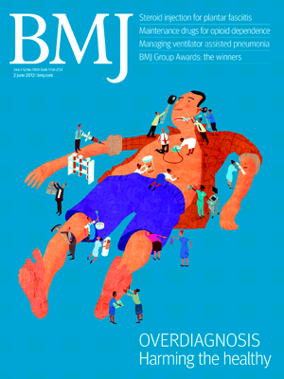
GPs and “Too Much Medicine”
Dr. Julian Treadwell RCGP Midland Faculty Symposium 18th May 2017
Declarations of Interest
Salaried GP, Hindon Surgery, Wiltshire.
NIHR In-Practice fellow. Dept PrimHCSci, Oxford.
Vice-Chair RCGP Standing Group on Overdiagnosis.
Occasional GP Education work on Overdiagnosis
GP Appraiser.
Choosing Wisely UK Steering Committee
Editorial Board Member,Drugs & Therapeutics Bulletin.
juliantreadwell@nhs.net www.whopaysthisdoctor.org

Slide 2
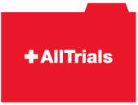



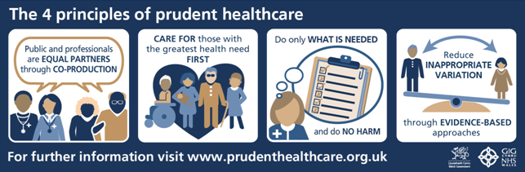


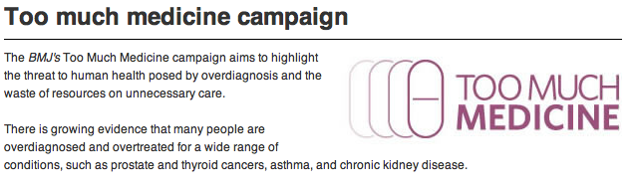
#realEBM

Slide 3
What is Overdiagnosis?
Overdiagnosis occurs when people without symptoms are diagnosed with a disease that ultimately will not cause them to experience symptoms or early death.
More broadly defined, overdiagnosis refers to the related problems of overmedicalisation and subsequent overtreatment, diagnosis creep,
shifting thresholds and disease mongering.
Moynihan et al. BMJ 2012
Notes:
Ref : Ray M article BMJ May 2012

Slide 4
Drivers of Overdiagnosis. Moynihan et al. BMJ 2012
Advancing technology and research.
Commercial and professional vested interests.
Conflicted expert panels tending to expand disease definitions and
encourage overtreatment (Indication Creep).
Legal pressure : Underdiagnosis punished, overdiagnosis not (yet).
Patient pressure groups – genuine grass roots and “astroturf”.
Guidelines and targets, QOF
Cultural beliefs : More = better, faith in early detection
Notes:
Good “Progress” comes hand in hand with problems
Comments about guideline panel research
Cultural = politicians, patients, doctors, media

Slide 5
More drivers of Overdiagnosis
Over simplification, poor translation, “spin” of evidence. STORIES.
Extrapolations of benefit from severe end of clinical spectrum to mild.
Medical pseudo-solutions/wishful thinking/political bright ideas.
Fast uptake of new interventions, slow to stop/do less.
Population goals trump person centred goals.
Specialist view trumps generalist view.

Slide 6
“Red Flags” for Overdiagnosis Moynihan et al. BMJ 2012
Increasing incidence , static mortality.
A risk factor or biomarker becomes a disease
Changing diagnostic or treatment thresholds.
A large proportion of the population gets a label or treatment.
(mine) If the explanation for a disease definition or an intervention is really difficult to understand!
Notes:
So we all know this
PO not theraputic nihilism – we need to separate the useful from the not
Let’s get going..

Slide 7
How is Overdiagnosis Harmful?
Disease Labeling : Psychological burden
From CKD3 to Dementia to Cancer
Treatment Harms: “Mild” e.g. drug side effects
Severe or Fatal – drugs, surgery, chemo/DXT
Waste: NHS - Money, staff time, mental energy.
Public- Time, work, money, family and carers.
Diversion of Resources
What are we not doing instead? Opportunity cost.

Slide 8
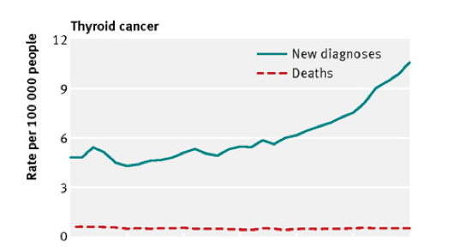
Overdiagnosis in Cancer (screening)
75 80 85 90 95 00 05
Thyroid Cancer Deaths and New Diagnoses 1975 - 2005
Notes:
Histology – poor definition between indolent dysplasia and mailignancy
UK radiologists- don’t report on thyroid in head/neck scans

Slide 9
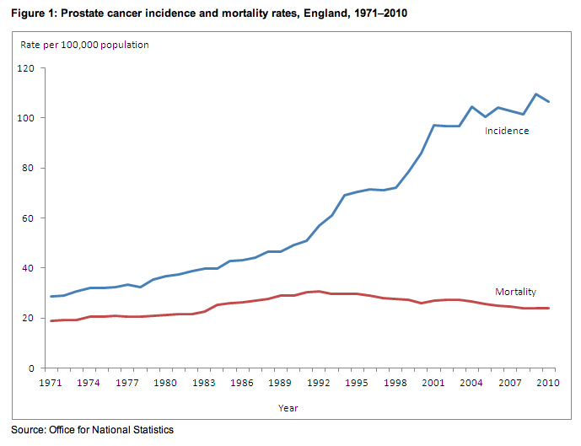

Slide 10
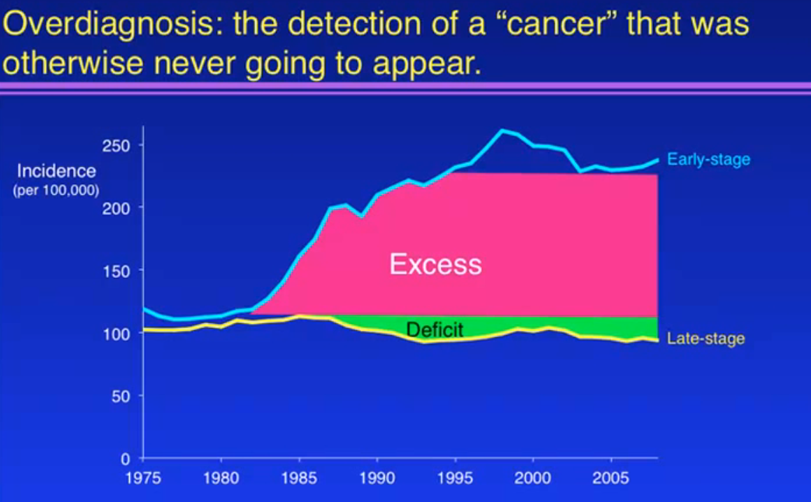
Early vs. Late Stage Breast Cancer USA
Bleyer+Welch NEJM 2012
1.3 million women
Notes:
1.3 million: diagnoses, anxiety, surgery, DXT…..
Of the 1.3 mill, about 1/3 DCIS, 2/3 Local invasive

Slide 11
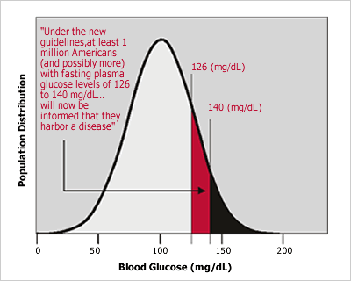
Reducing diabetes diagnostic threshold from 7.8 – 7.0mmol/L (USA)
1.7m
Notes:
Why was this criteria accepted? Retinopathy only ? Long term outcomes?
Screening for diabetes = no benefit, so……
Head of panel was paid consultant to Aventis, BMS, EliLily, GSK, Novartis, Merk, Pfizer (all make DM drugs)

Slide 12
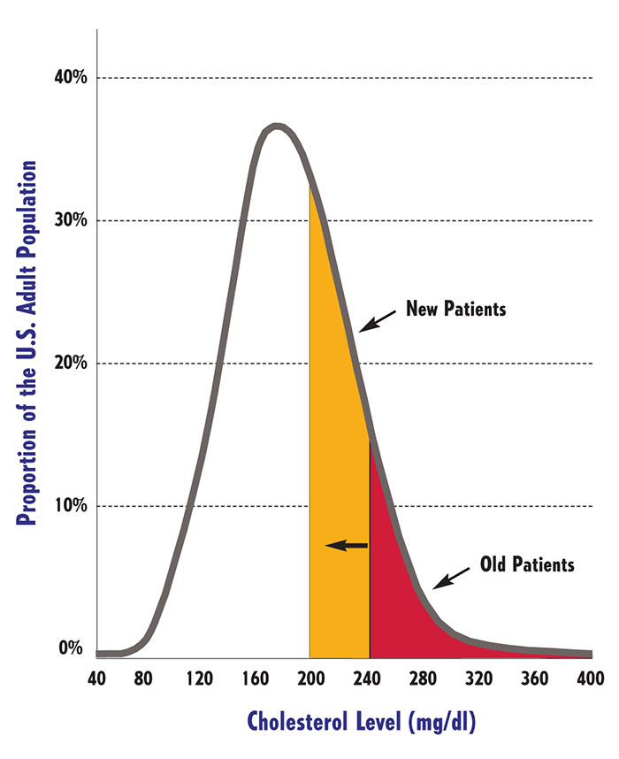
Reducing TC threshold
6.2 – 5.18 mmol/L
42.6m
New “patients”
Notes:
8 of 9 panel members paid consultants to drug companies

Slide 13
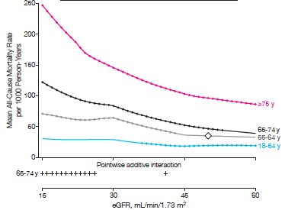
All cause mortality vs eGFR From Chronic Kidney Disease Prognosis Consortium

Slide 14
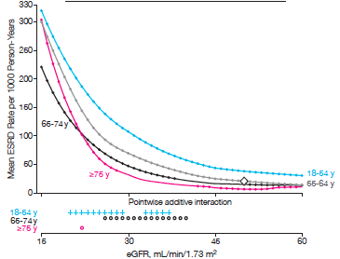
ESRD vs eGFR From Chronic Kidney Disease Prognosis Consortium

Slide 15
ACEi/A2RAs in CKD (NICE)
1.6.3 Offer a low‑cost renin–angiotensin system antagonist to people with CKD and:
diabetes and an ACR of 3 mg/mmol or more (ACR category A2 or A3)
hypertension and an ACR of 30 mg/mmol or more (ACR category A3)
an ACR of 70 mg/mmol or more (irrespective of hypertension or cardiovascular disease)

Slide 16
Where ACE/A2RAs ARE valuable
RENAAL Trial : Type 2 diabetes, nephropathy.
Mean Creatinine 168umol/L, Mean ACR 1200mg/g
No clear evidence on diabetics without proteinuria
(i.e. most of our T2DM patients).
^{RENAAL}
Outcome at 3.5 yrs. | Placebo | Losartan
Progression to ESRD | 25.5% | 19.6%
Doubling of creatinine | 26% | 21.6%

Slide 17
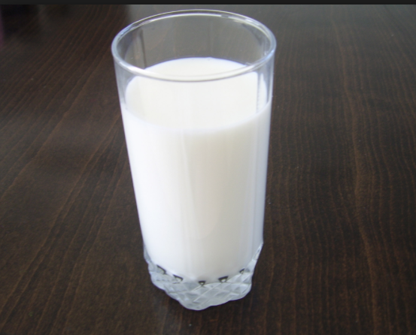
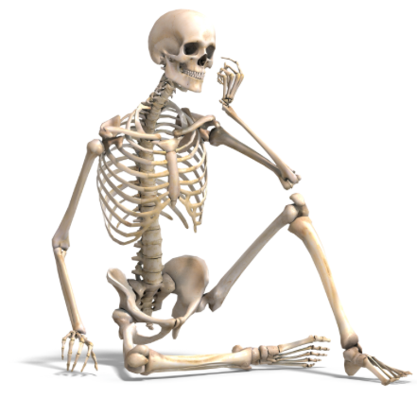
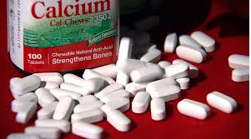
Calcium is good for your bones…

Slide 18
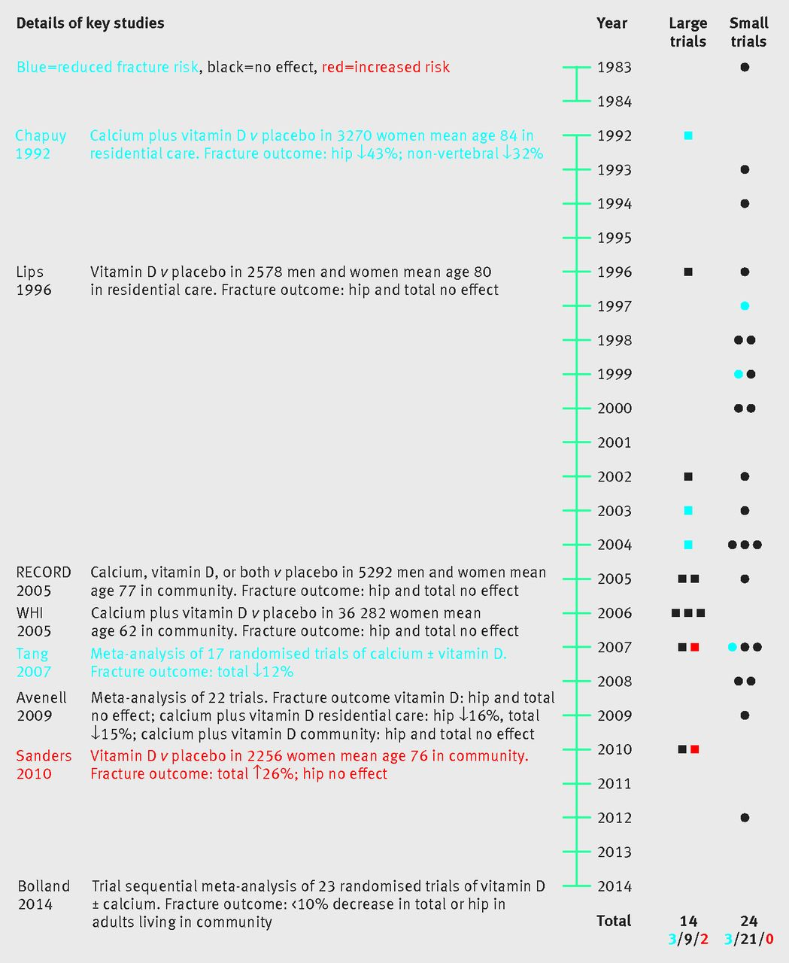
Calcium and Vitamin D
For fracture prevention
Any effect?
BMJ 2015;351:h3170 doi: 10.1136/bmj.h3170 (Published 21 July 2015)

Slide 19


 | Alendronate | Placebo
Hip/Wrist | 1 in 100 | 2 in 100
Vertebral | 6 in 100 | 12 in 100
Other | 7 in 100 | 9 in 100
“Secondary” prevention. 3-4 years treatment. (2008)

Slide 20
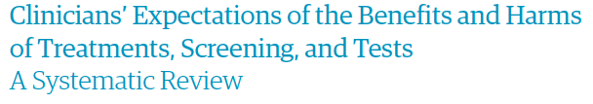
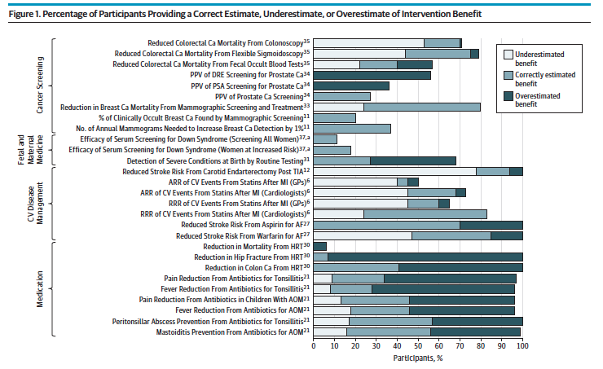
Notes:
Lots of radiology, surgical, less on treatments

Slide 21
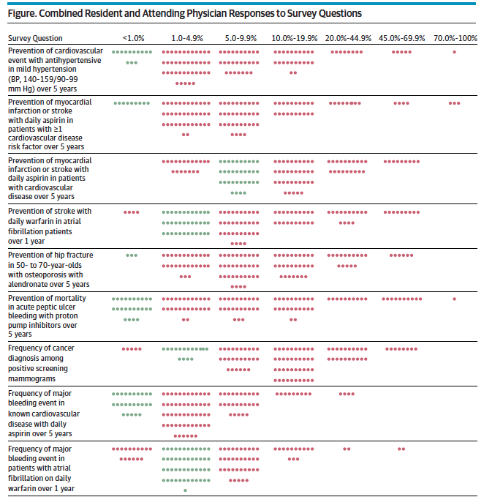
Questionnaire survey of 132 Residents and Attending Physicians at 2 academic health centres in USA.
BP meds, aspirin, warfarin, alendronate, PPIs,mammography

Slide 22
Bright ideas and pseudosolutions
Dementia Screening
Difficult problem, no easy solution.
Political agenda
Nationally driven “case – finding” exercise, financial incentives
Non-evidence based screening , NSC recommended against, harms.
Consultation hijacking
See also….depression screening, Diabetes prevention programme?

Slide 23
An important caveat
None of this is simple: overdiagnosis and overtreatment arise as consequences of activities that have a degree of benefit to some. Difficult questions arise about how harms and benefits are weighed or perceived, and how to offer real choice to patients.
The Prevention Paradox - Geoffrey Rose 1981
The majority of cases of a disease come from a population at low or moderate risk , and only a minority come from a population at high risk.

Slide 24
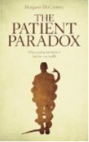
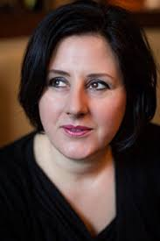
The Patient Paradox
“That’s the paradox that I keep finding within the NHS: if you are ill, you may have to be persistent and determined to get help…Yet if you are well, you are at risk of being screened and checked into patienthood, given preventive medication for something you’ll never get, or treated for something you haven’t got.
Too much testing of well people and not enough care for the sick worsens health inequalities and drains professionalism, harming both those who need treatment and those who don’t.”
Margaret McCartney

Slide 25
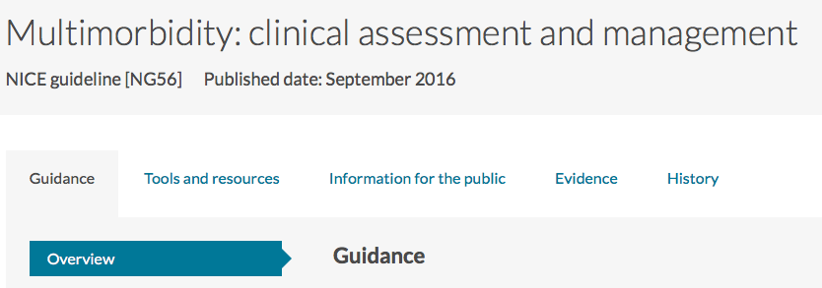
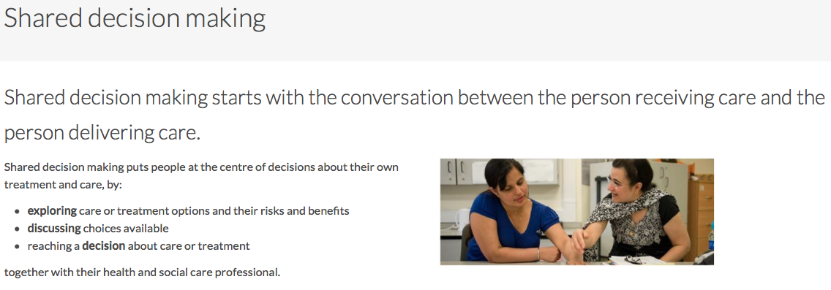
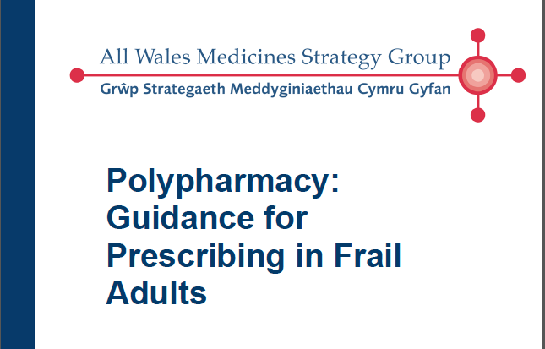

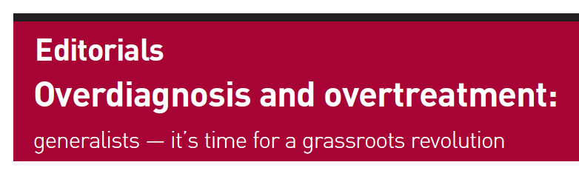
Reasons to be cheerful

Slide 26
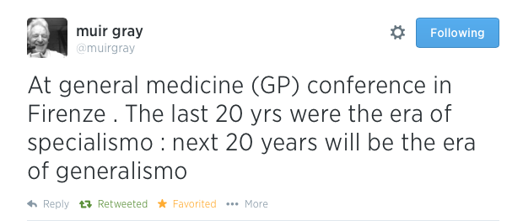
When we rule the world…

Slide 27
Websites
http://www.lessismoremedicine.com
Evidently Cochrane Blog
BMJ Too Much Medicine Timeline Easily accessible article collection
Check out the rapid responses
USPSTF Some good evidence summaries and patient decision aids
Preventing Overdiagnosis Home Conference info
and especially worth looking at the videos.

Slide 28
Books
The Patient Paradox: Why Sexed Up Medicine is Bad for Your Health [Paperback]
Margaret McCartney (Author)
Overdiagnosed: Making People Sick in the Pursuit of Health [Paperback]
H. Gilbert Welch (Author), Lisa Schwartz (Author), Steve Woloshin (Author)
Bad Pharma. Ben Goldacre

Slide 29
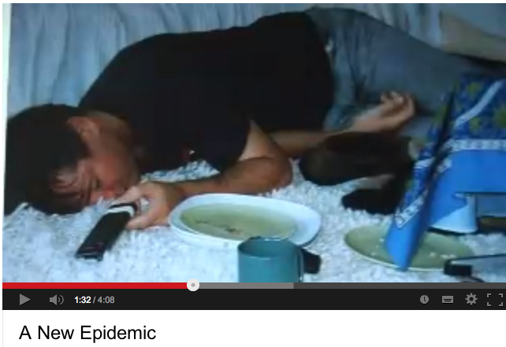
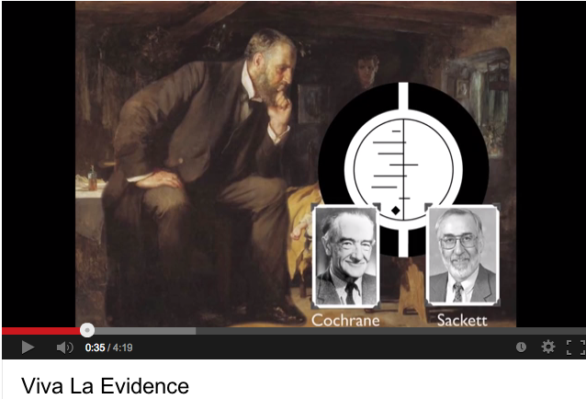
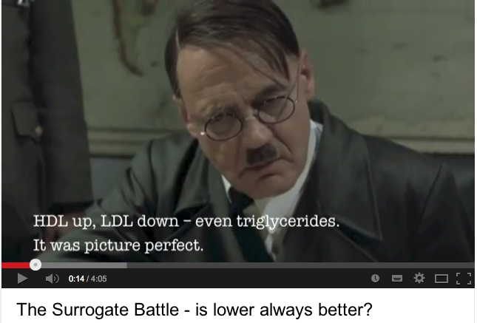
Fun
Motivational Deficiency Disorder
Ray Moynihan’s well known spoof
on disease mongering.
..and the original BMJ article from 2006
Viva La Evidence
Refresh your memory about the principles of EBM with help from Coldplay (sort of).
From James McCormick (Prof Pharm Sci at UBC)
The Surrogate Battle
Hitler discovers the problems of surrogate
end-points.

Slide 30
Shared Decision Making Tools
http://sdm.rightcare.nhs.uk
NHS Shared Decision making site : For people to use at home rather than in consult.
Leads people through the decision process, though a little short on data/stats.
http://www.optiongrid.org
A Welsh/US (!) project. They’ve produced one sided “grids” to print off and aid decision
making. Worth a look – I think perhaps best for secondary care “big decisions”
http://shareddecisions.mayoclinic.org/decision-aid-information/decision-aids-for-chronic-disease/
Mayo Clinic Shared Decision Aids. Really good – in consultation tools. Needs time to explore-
watch videos on site to see.
http://www.nice.org.uk/guidance/cg181/resources/cg181-lipid-modification-update-patient-decision-aid2
NICE Statin decision aid. Good quality – long though…

Slide 31
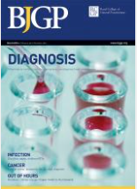
Link

