Slide 1
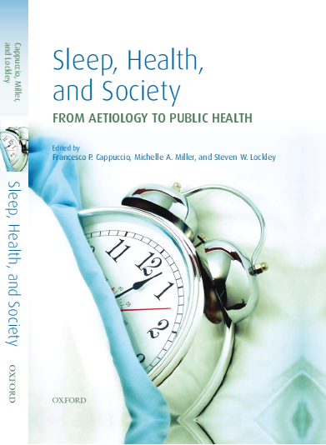
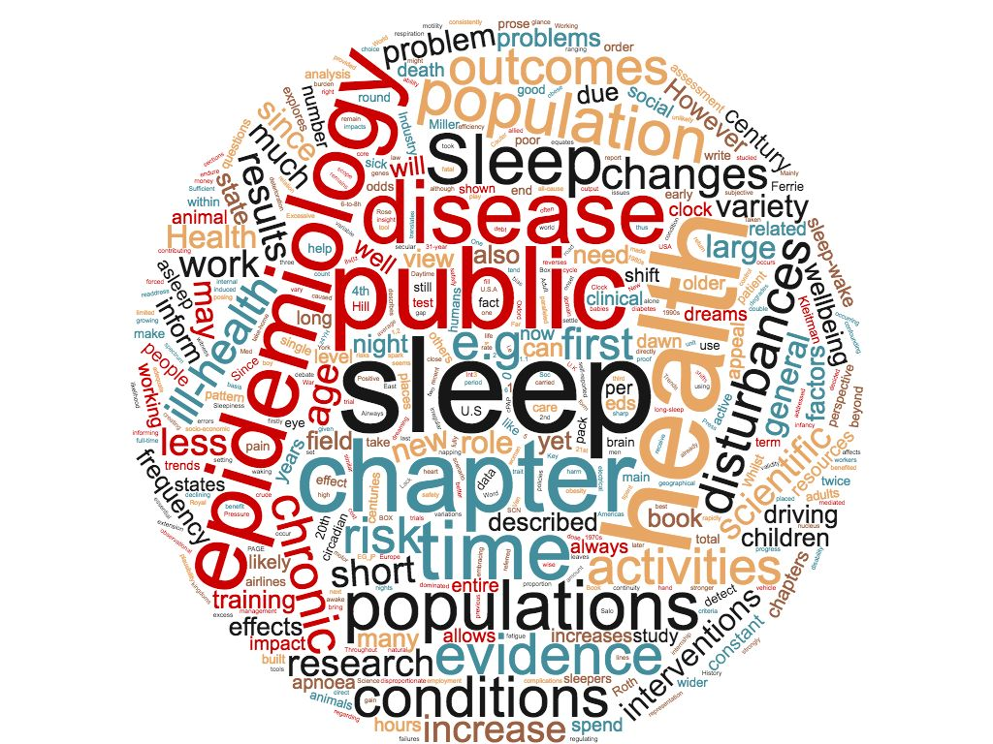
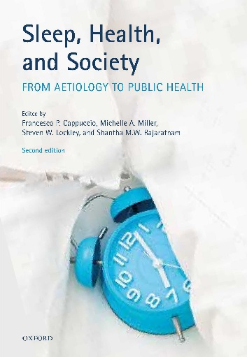
Dream environment
2010
Francesco P. Cappuccio
MB BS, MD, MSc, DSc, FRCP, FFPH, FBIHS, FESC, FAHA
Professor of Cardiovascular Medicine & Epidemiology
Head:“Sleep Health & Society Programme”
Warwick Medical School, University of Warwick
Consultant Physician
University Hospitals Coventry & Warwickshire NHS Trust
Coventry, UK
www2.warwick.ac.uk/go/sleep
2018
Notes:
Sleep is foundational to our health and wellbeing. When we get the sleep our body needs, we can be and feel at our best. But in spite of the sleep’s importance, our society and culture still favour busyness and sleep deprivation over quality rest and recovery.
Sure, getting a good night’s sleep increases wellbeing, but is sleep a business issue? Research shows when we get a good night’s sleep, it can also boost productivity, creativity and help foster innovation, leading to greater impact.

Slide 2

Why do we sleep?
How much sleep do we need?
Sleep, health and wellbeing.
The environment and good sleep.
What to do ?
  Individuals
  Society

Slide 3

The 2017 Nobel Prize in Physiology and Medicine
In 2017 Hall, Rosbash and Young were awarded the Nobel Prize in Physiology and Medicine “for their discoveries of molecular mechanisms controlling the circadian rhythm” bringing to the fore this ‘new’ dimension of science – the study of human sleep.
Notes:
In 2017 these three scientists (Hall, Rosbash and Young) were awarded the Nobel Prize in Physiology and Medicine “for their discoveries of molecular mechanisms controlling the circadian rhythm” bringing to the fore this ‘new’ dimension of science – the study of human sleep. The Nobel prize was just rubber stamping the exponential speed of development of the science of circadian rhythm and of sleep medicine.

Slide 4
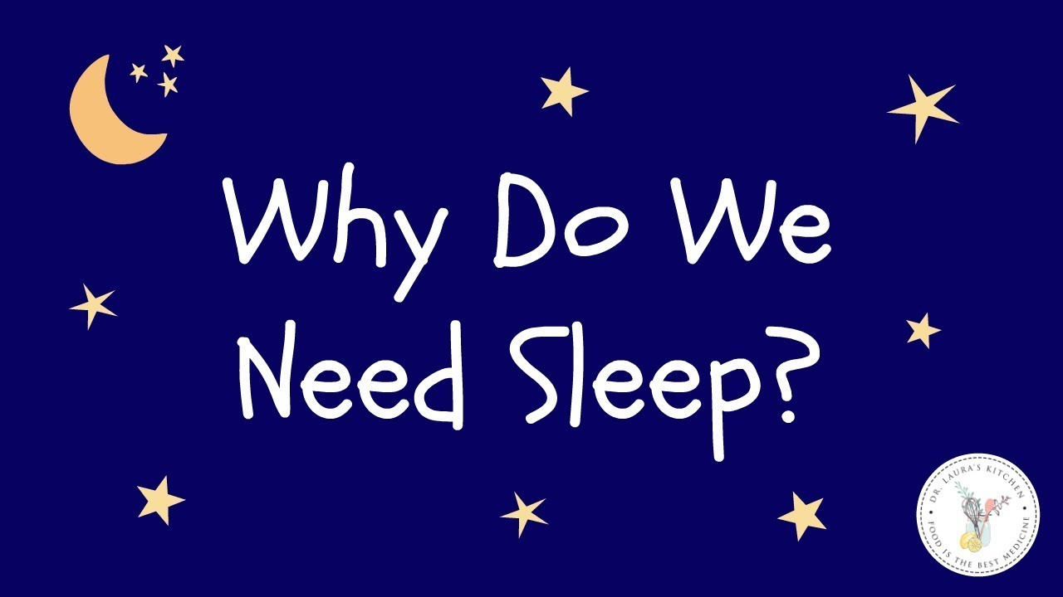
Basic functions
Restorative functions
  Rest and recovery
  Attention, reaction time, performance
Memory consolidation
  Learning, Remembering
Brain plasticity
  Problem solving, Creativity
Energy conservation
Biological regulations
  Metabolic, cardiovascular, mental, immune, developmental, ….
Cell repair & Tissue regeneration
Basic facts
Sleep is a universal phenomenon
Everybody and every creature sleeps
No sleep = death
A state of vulnerability

Slide 5
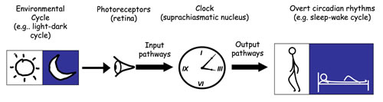
The master clock that regulates all circadian rhythms is located within the brain. All other peripheral clocks oscillate in a self-sustained manner maintaining biological rhythms. The clocks, in turn, are synchronized to the solar day. Synchronization to the light-dark cycle is through direct neuronal projections from the eye (retina) to the brain (hypothalamus).

Slide 6


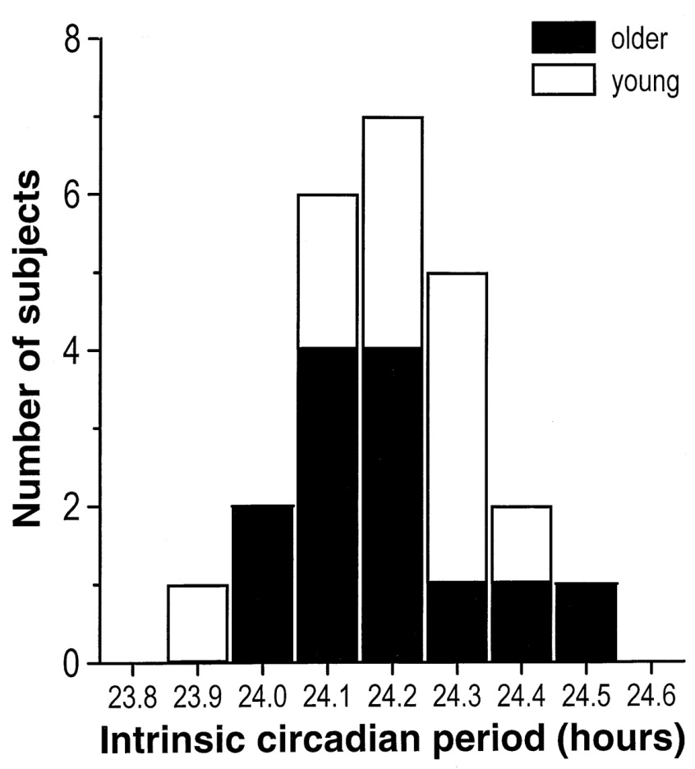
  Fundamental properties of circadian rhythms
  Rhythm with a period of “about a day”
    Average ~24.2 h (23.6-25.0 h)
  Can be reset by time cues (zeitgebers)
    light, temperature, drugs, activity, social cues
  Persists in the absence of external time cues
  Can be phase-shifted to a different time
  Genetic basis, inheritable
Larks……….………….Owls
Morning chrono-type…Evening chrono-type

Slide 7
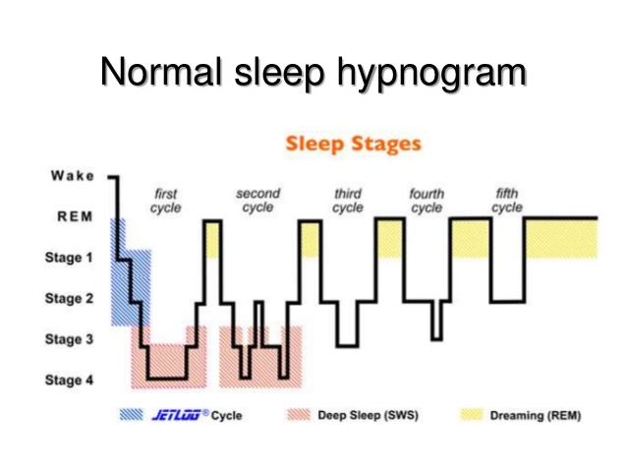
Sleep architecture
Wakefulness
REM (rapid eye movement; light sleep; dreams)
Stage 1 - 2 (light sleep)
Stage 3 - 4 (deep SWS; restorative; consolidation)
Several cycles per night
Hypnogram: graph that represents the stages of sleep as a function of time

Slide 8
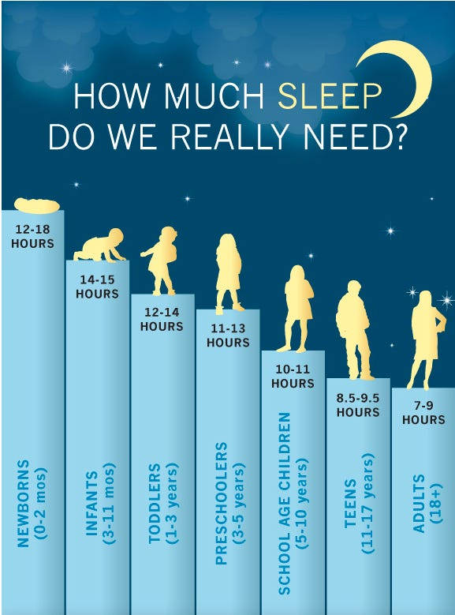
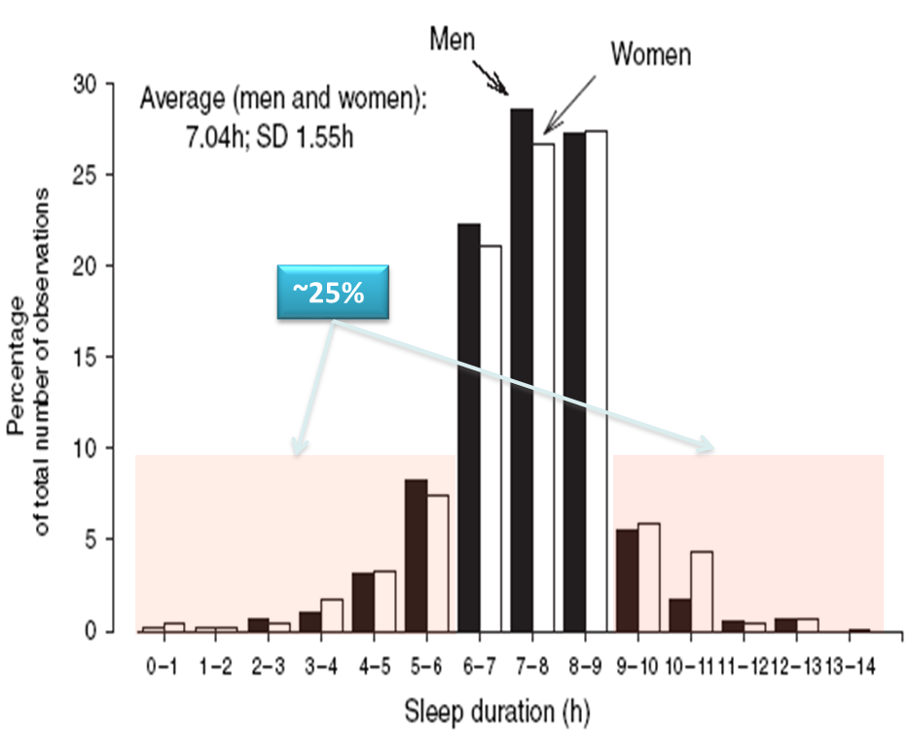
Short
Long
JA Groeger et al. J Sleep Res 2004; 13: 359-71

Slide 9
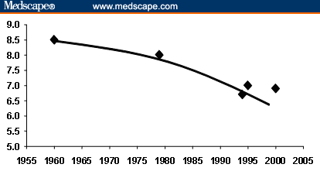
Sleep duration in the last 50 years
Hours per night
Steady decline in total sleep time attributed to lifestyle changes
increased shift-work
longer working hours
less physically demanding jobs
increased sedentary leisure time
extended use of devices / social media
24/7 work-life patterns
Kripke D et al (1979) Arch Gen Psychiatry. 36: 103-116
National Sleep Foundation. Sleep in America Poll, 2001-2002

Slide 10
Why do we sleep less?
Reduced sleep duration is
associated with delayed bedtime (B)
not with early wake time (A)
On-line data submission via app (n=5,450)
Walch OJ et al. Sci Adv 2016; 2: e1501705

Slide 11
‘Quantity’ of sleep
Short duration of sleep and risk of ‘incident’ chronic disease
Obesity¹
High BP²
High TC³
T2DM⁴
CHD⁵
Stroke^{5,6}
Death⁷
Relative Risk
vs. 5h per night
+58%
+21%
+10%
+28%
+48%
+15%
+12%
¹Miller MA et al. Sleep 2018; 41(4): zsy018
²Meng L et al. Hypertens Res 2013; 36: 985-95
³Kruisbrink M et al. BMJ Open 2017;7:e0185585
⁴Cappuccio FP et al. Diab Care; 2010; 33: 414-20
Notes:
This slide reports the summary of the epidemiological evidence in prospective studies showing that sustained sleep deprivation leads to increased morbidity and mortality for cardiometabolic causes.
We have seen already that sleep deprivation predicts the incidence of obesity, hypertension and type 2 diabetes.
In additional meta-analyses we also reported an increased risk of developing fatal and non-fatal coronary heart disease and stroke and – surprisingly – premature death within 12 years of observation.
For the latter, there was debate on whether a single assessment of sleep duration by self reporting would be a tool reliable enough to imply that the sleep deprivation was ‘sustained’ during the follow up period. In fact, sleep duration is a behavioural characteristic that can change substantially through the life-time.

Slide 12
‘Quantity’ of sleep
Short duration of sleep and risk of ‘incident’ events
Obesity¹
High BP²
High TC³
T2DM⁴
CHD⁵
Stroke^{5,6}
Death⁷
Relative Risk
vs. 5h per night
+58%
+21%
+10%
+28%
+48%
+15%
+12%
⁵Cappuccio FP et al. Eur Heart J 2011; 32: 1484-92
⁶Leng Y et al. Neurology 2015; 84: 1072-9
⁷Cappuccio FP et al. Sleep 2010; 33:585-9
Notes:
This slide reports the summary of the epidemiological evidence in prospective studies showing that sustained sleep deprivation leads to increased morbidity and mortality for cardiometabolic causes.
We have seen already that sleep deprivation predicts the incidence of obesity, hypertension and type 2 diabetes.
In additional meta-analyses we also reported an increased risk of developing fatal and non-fatal coronary heart disease and stroke and – surprisingly – premature death within 12 years of observation.
For the latter, there was debate on whether a single assessment of sleep duration by self reporting would be a tool reliable enough to imply that the sleep deprivation was ‘sustained’ during the follow up period. In fact, sleep duration is a behavioural characteristic that can change substantially through the life-time.

Slide 13
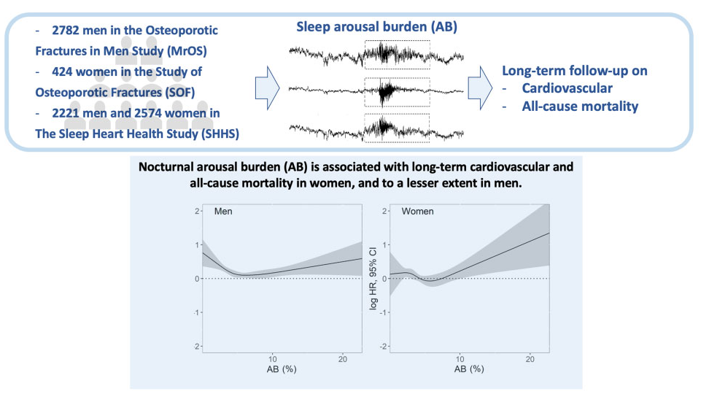
‘Quality’ of sleep
Sleep arousals and CVD
Shahrbabaki SS et al. Eur Heart J 2021; 42: 2088-99

Slide 14
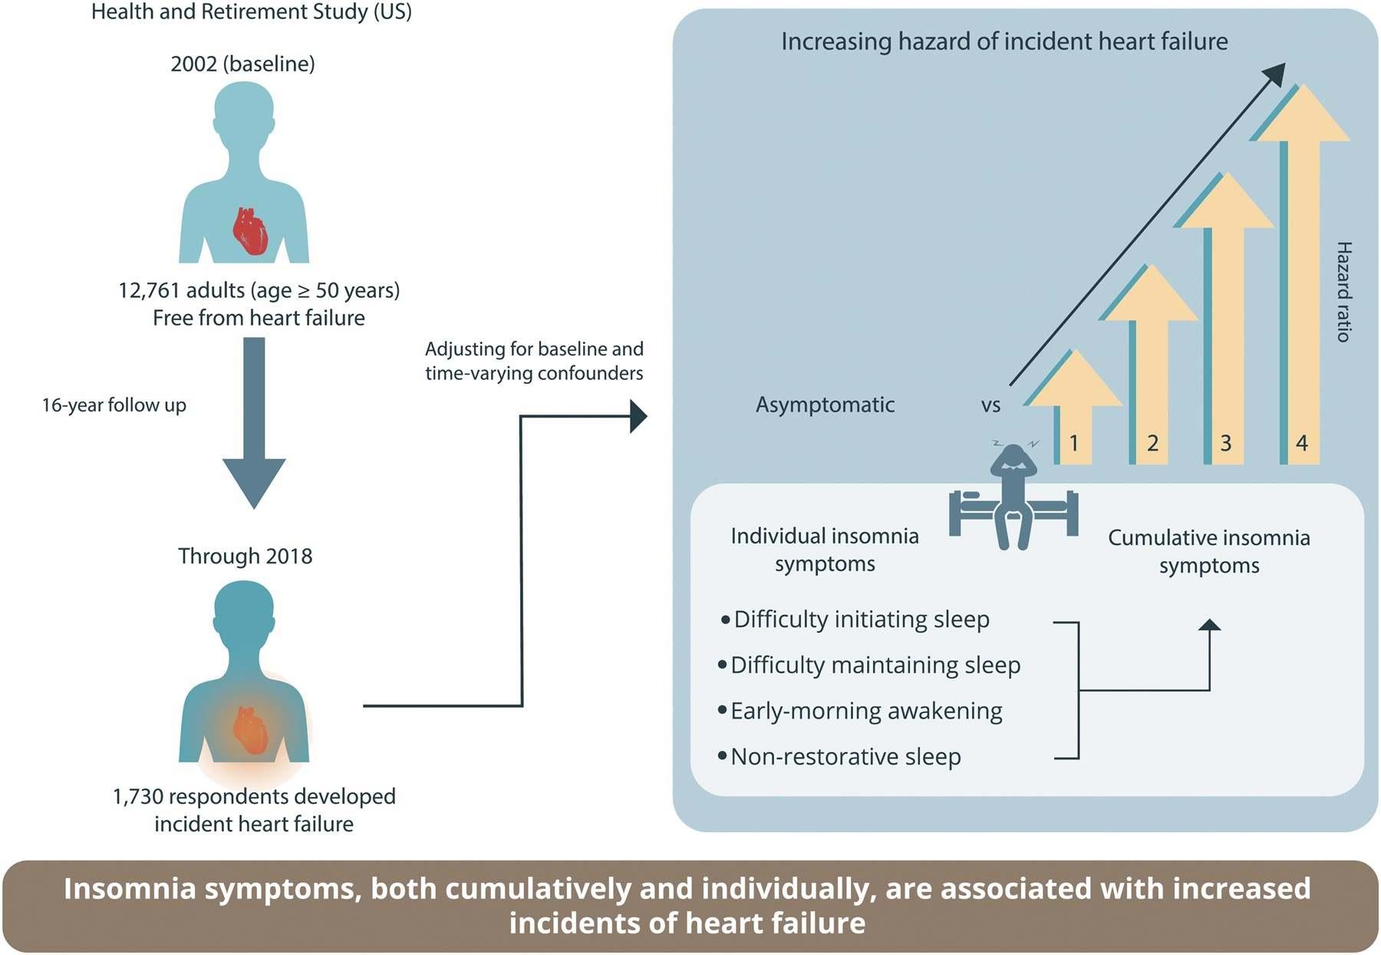
‘Quality’ of sleep
Insomnia, heart failure and CVD
Mahmood A, et al. Eur Heart J 2021; 42: 4169-76
Berger M, et al. Eur Heart J 2021; 42: 4177-9
Notes:
Also, Insomnia symptoms, both cumulatively and individually, are associated with incident HF. They are qualitative sleep disturbances defined as difficulty initiating sleep, difficulty maintaining sleep, early-morning awakening and non-restorative sleep all gathered through questionnaires.
The effects of poor quality sleep are independent and additive to those reported in relation to short quantity of sleep.
Public health awareness and screening for insomnia symptoms in at-risk populations should be encouraged to reduce HF incidence.

Slide 15
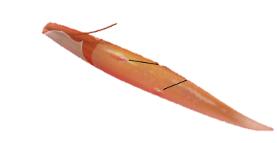
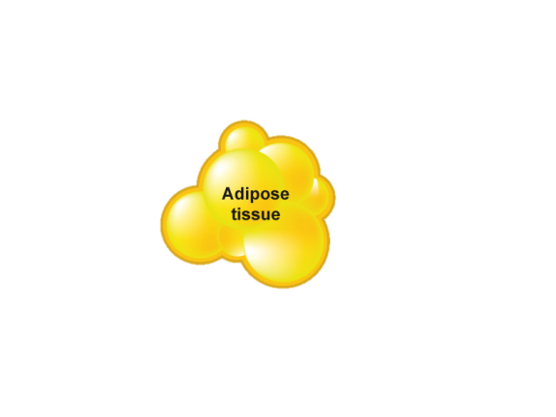
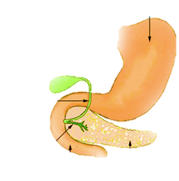
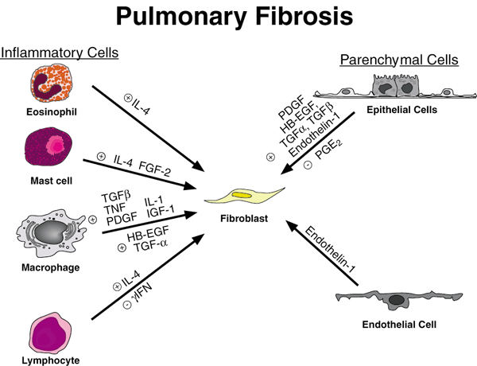

Environment (physical, social, work)
Genetics
Sleep loss or disturbance
⬇energy metabolism
⬆SNS
Altered circadian rhythms
⬇ SWS
HPA axis
STROKE
Orexin ➔ NPY
BP & HR variability
⬇Cognitive function
⬆Appetite
Food intake
OBESITY
Na⁺ retention
Evening cortisol
⬆ Ghrelin
⬇ Leptin
⬇ Glucose tolerance
⬆ Insulin resistance
⬆ Inflammation
CHD
HEART FAILURE
Coronary
calcification
DIABETES
HYPERTENSION
Hyperlipidaemia
Atherosclerosis
Miller MA & Cappuccio FP. J Hum Hypert 2013; 27: 583-8
Cappuccio FP & Miller MA. Curr Cardiol Reports 2017; 19: 110
Notes:
15
This scheme summarises the wealth of evidence accumulated in the past 20 years extending the concept that sleep disturbances are not only a problem for the brain and confined to the nervous system. Sleep disturbances involve almost every system and organ of the body with far reaching consequences in the short and longer term.

Slide 16
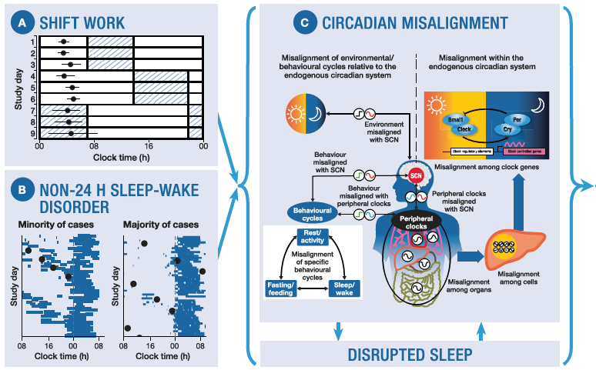
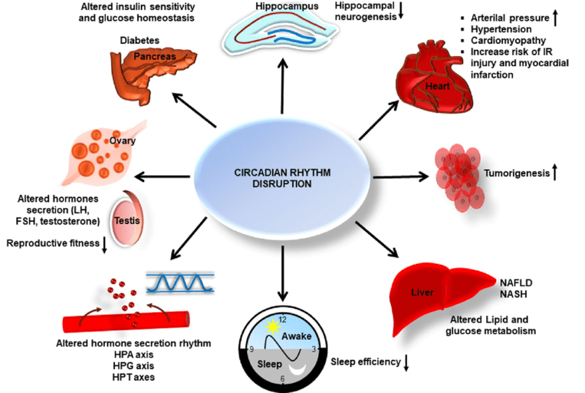
Relationship between sleep disruption, circadian misalignment
and health outcomes
Sletten TL et al. Sleep 2020; 43(1): zsz194

Slide 17

Kecklund G & Axelsson J. Br Med J 2016; 355: i5210

Slide 18
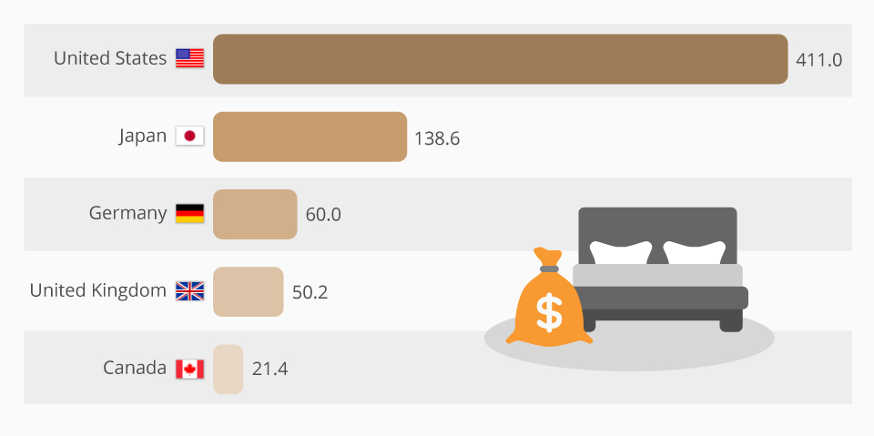
Cost of sleep deprivation
Sleep deprivation
Loss of productivity
Increased sickness leave
Cost to GDP
Estimated annual cost of insufficient sleep in GDP terms (billion US $). Source: RAND

Slide 19

Regular Bedtime waketime
No Alcohol
No Caffeine or
Stimulants
Light dinner
No late Exercise
Books not screens!
Dim down lights
No Smoking
If wake up, relax, not too active
Check Bedroom temperature

Slide 20
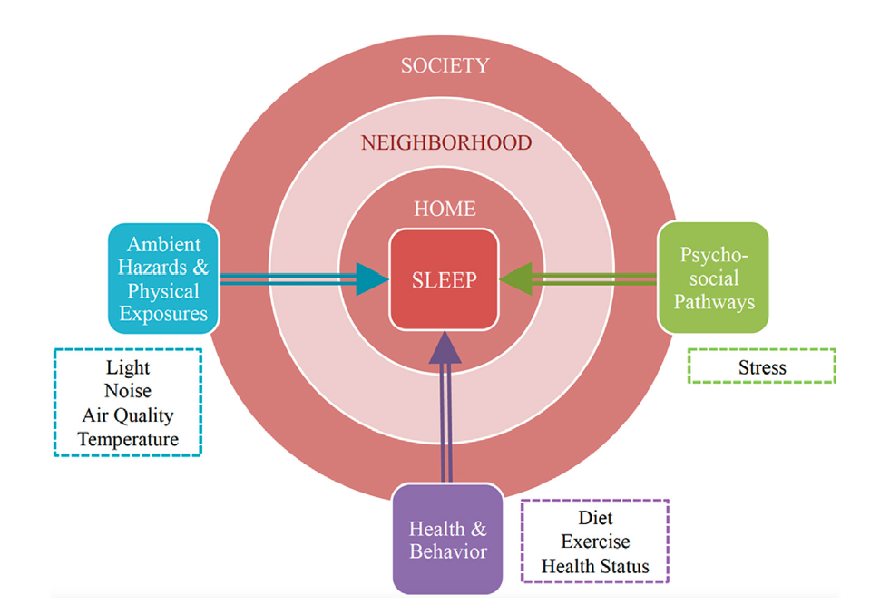
Create an enabling environment
Simonelli G & Hale S. Chapter 12 in Foundations of Sleep Health. 2022; 265-78.

Slide 21

Light and sleep
Light strongest environmental cue for synchronizing human circadian rhythms.
Lighting standards historically focused on ‘visual performance’.
‘Non-visual’ effects should now be a focus.
General principle: mimic stable 24-h light-dark cycle (daytime=high-intensity blue-enriched light: evening=low-intensity short WL light; night=darkness).
Short-term effects: alertness, melatonin suppression.
Longer-term effects: alertness, concentration, productivity, performance, cognition.
Use of electronic devices near bedtime cause of circadian disruption.
Cedeño Laurent JG et al. Chapter 23.
In: Sleep, Health & Society; eds. Cappuccio FP et al. OUP (2018); pp. 206-14.

Slide 22

Noise and sleep
Noise measured by sound intensity and frequency.
Auditory health effects (e.g. noise-induced hearing loss).
Non-auditory health effects (e.g. sleep disturbances).
Noise-induced sleep disturbances first cause of disability in urban settings (WHO Report).
Noise sensitivity depend on sleep phase (responses lower but vasoconstriction higher in REM compared to SWS).
Night-time noise worse effect on CVD than day-time noise.
Opportunities (energy efficient e-cars, acoustical dampening technologies in buildings).
Challenges (alarms/notifications from smartphones; indoors gadgets; wind turbines).
Cedeño Laurent JG et al. Chapter 23.
In: Sleep, Health & Society; eds. Cappuccio FP et al. OUP (2018); pp. 206-14.

Slide 23
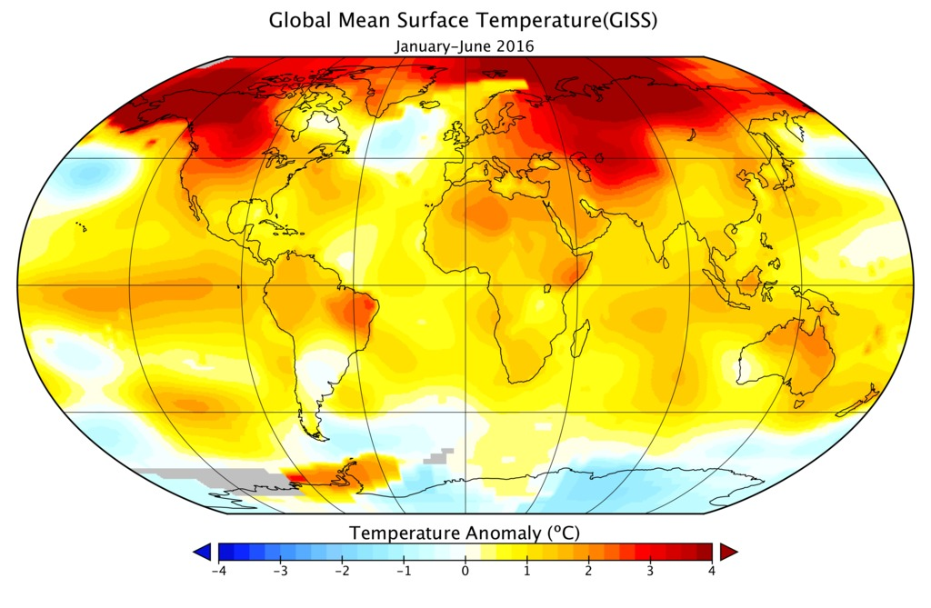
Temperature and sleep
Temperature strong environmental factor affecting sleep.
Loss of heat during sleep; hence need to have adequate thermal conditions for optimal sleep.
Thermoregulation follows a homeostatic control and a circadian rhythm.
Too cold (<20ºC) or too hot (>29ºC), or high humidity in hot climates (reduced capacity to lose heat via sweat) affect sleep quality and quantity.
Cedeño Laurent JG et al. Chapter 23.
In: Sleep, Health & Society; eds. Cappuccio FP et al. OUP (2018); pp. 206-14.

Slide 24

Air quality and sleep
Hazards due to climate change and urbanization.
Indoor and outdoor air quality impact on high-quality sleep.
Particulate matter (PM_{2.5}), carbon monoxide (CO₂), barometric pressure, temperature, humidity, noise.
Sleep efficiency reduced with increasing levels of PM_{2.5}, CO₂, temperature and noise in bedroom.
Air pollution associated with respiratory sleep problems in children and adolescents and with sleep disordered breathing in adults.
Basner M et al. Sleep Health 2023; 9: 253-63
Liu J et al. Environ Pollution 2020; 262: 114263

Slide 25
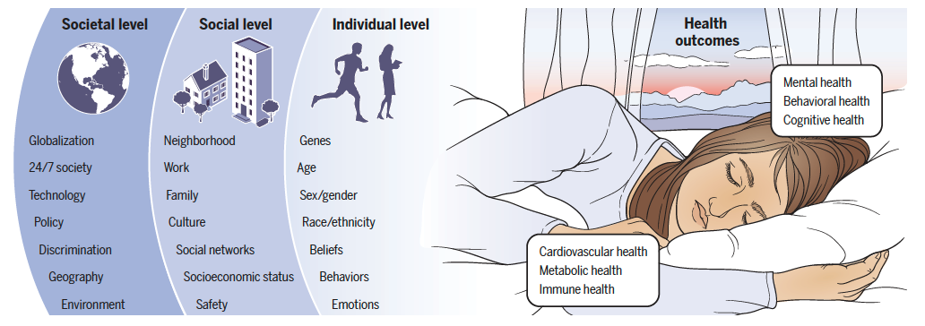
Sleep health in context: individual, social and societal
Sleep deprivation is a public health issue!
Grandner MA & Fernandez F-X. Science 2021; 374: 568-73
Notes:
Sleep health in context
There are several dimensions to sleep health, such as regularity, satisfaction, alertness, timing, efficiency, and duration.
Alone and in combination, these dimensions interact with many aspects of our general health, including cardiovascular, metabolic, immune, mental, behavioral, and cognitive health. Interactions between sleep and health are further shaped by individual- and social-level factors operating within larger societal factors. All occur in the context of the day-night cycle.
Fig. 1. Social-ecological model of sleep health. The right side of the image, which depicts a sleeping person, reinforces the importance of situational context in sleep physiology. The external environment is shown as a dawn-to-dusk transition, reinforcing the importance of day-night circadian context in sleep physiology. Health outcomes associated with sleep—cardiovascular health, metabolic health, immune health, mental health, behavioural health, and cognitive health—are listed. On the left side of the image, the levels of the social-ecological model are depicted. Individual-level factors that influence sleep include age, genetics, sex and gender, beliefs, feelings and attitudes, race and ethnicity, and behaviors. These are embedded within social-level factors, which include neighborhood, work and occupation, family and home, culture, social networks, socioeconomics, and safety and security. These factors are further embedded within those at the societal level, such as such as technology, globalization, racism and discrimination, public policy, geography, the physical environment, and “24/7” society.

Slide 26

Thank you!
Notes:
26

