Slide 1

Scientific evidence and non-scientific threats of population sodium intake reduction to prevent CVD: a case study
Francesco P Cappuccio MBBS MD MSc DSc DLSHTM FRCP FFPH FBHS FAOP FESC FAHA
Professor of Cardiovascular Medicine & Epidemiology & Consultant Physician
University of Warwick and UHCW NHS Trust, Coventry, UK
Head, WHO Collaborating Center for Nutrition (2008-2023) and WHO Scientific Advisor
https://www2.warwick.ac.uk/go/cappuccio/who
European Salt Action Network
8-9 July, 2024
Bern, Switzerland

Slide 2
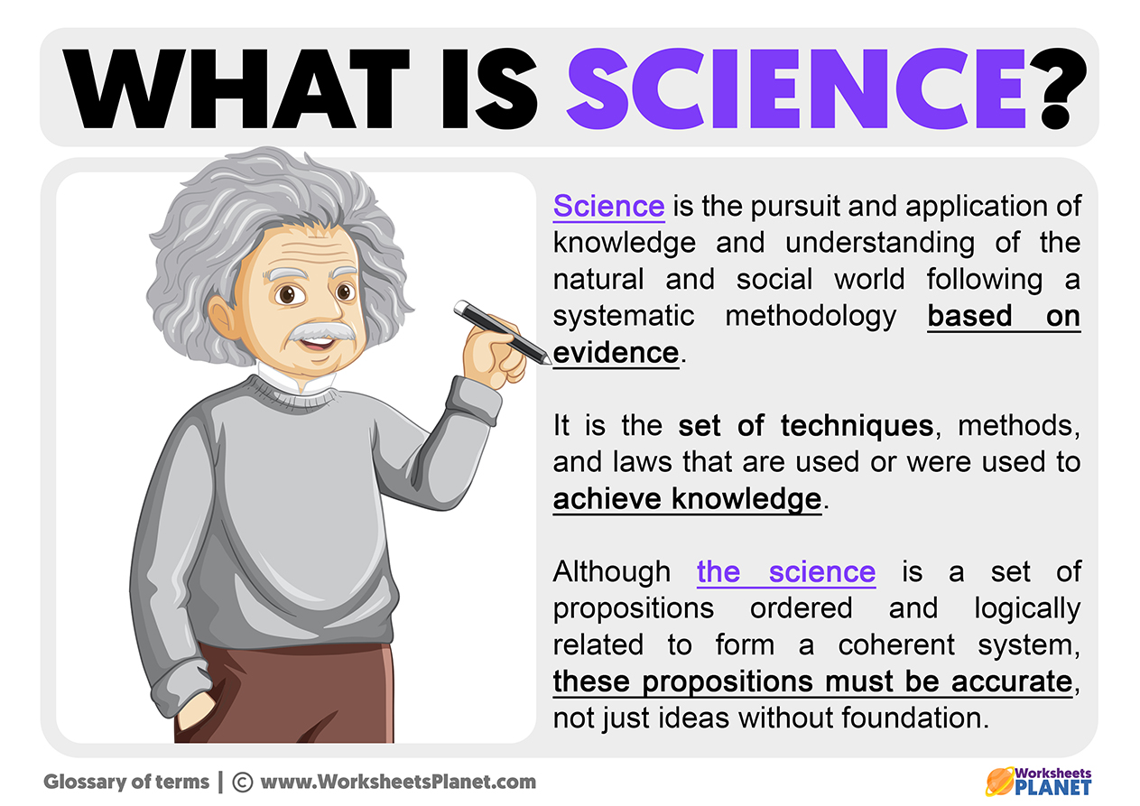

WHAT IS THIS PITCH ABOUT ?
It is about Research Integrity and
Credibility of Science
Pillars to support Translational
Medicine and Applied Research
Evidence-Based Medicine
Evidence-Based Policy
Using case-study: sodium (salt) intake and CVD
Scope

Slide 3
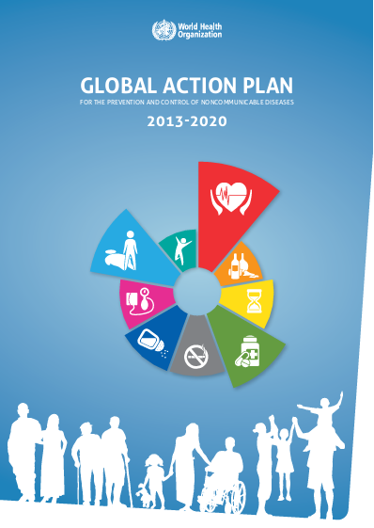
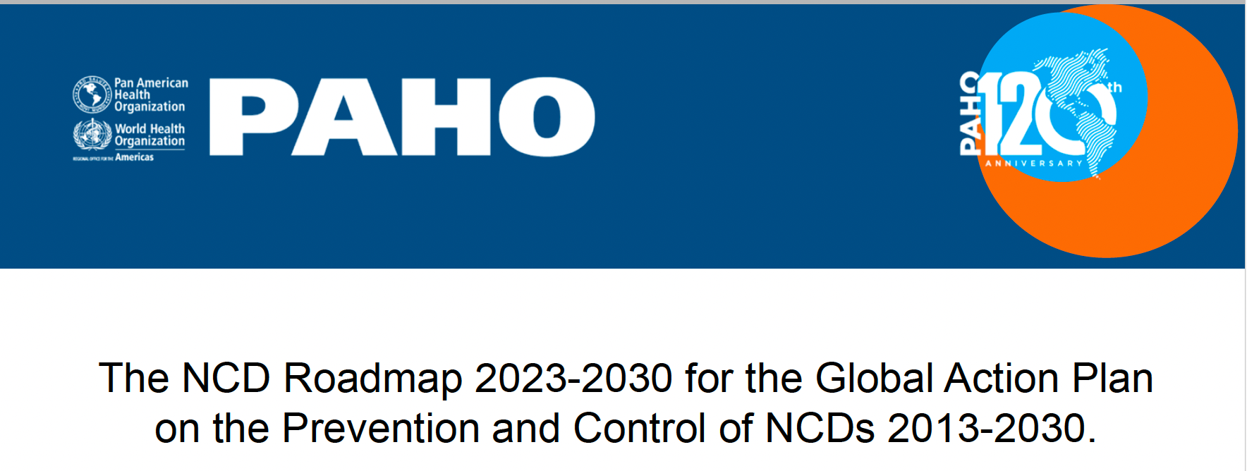
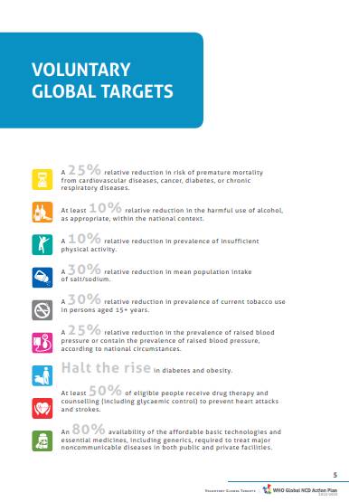
World Health Organization Global Action Plan for NCD
CVD reduction
Salt reduction
BP reduction
Public Health Policies

Slide 4
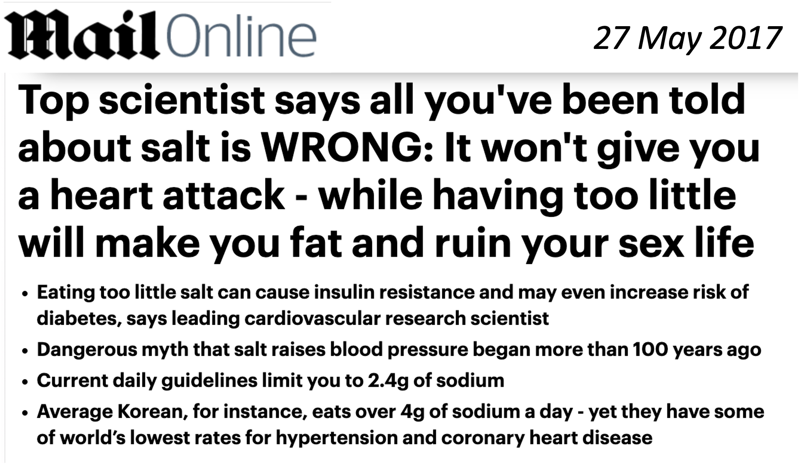
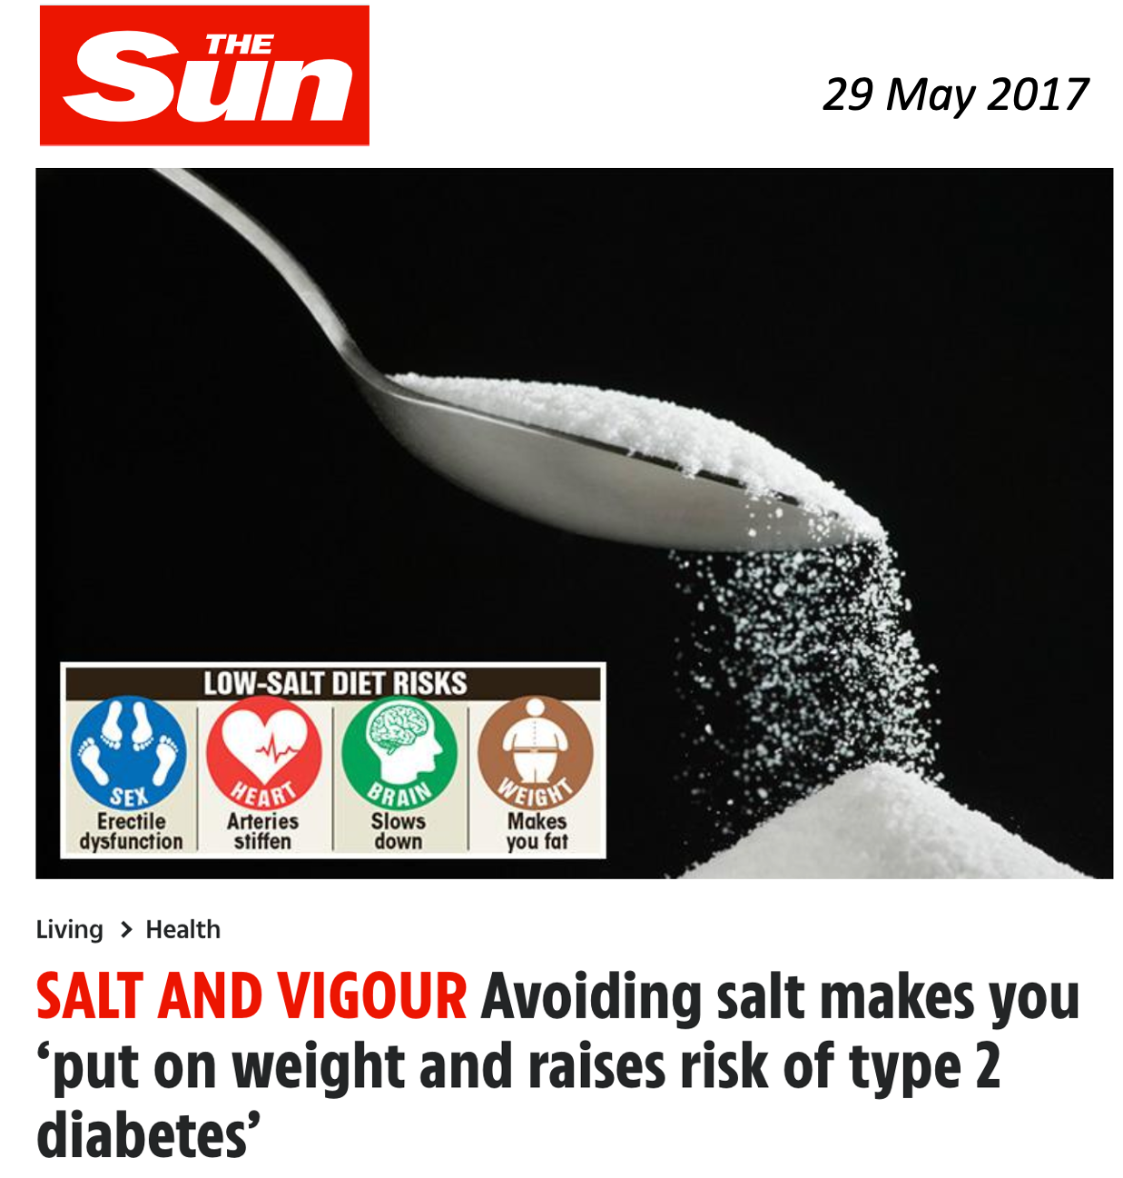
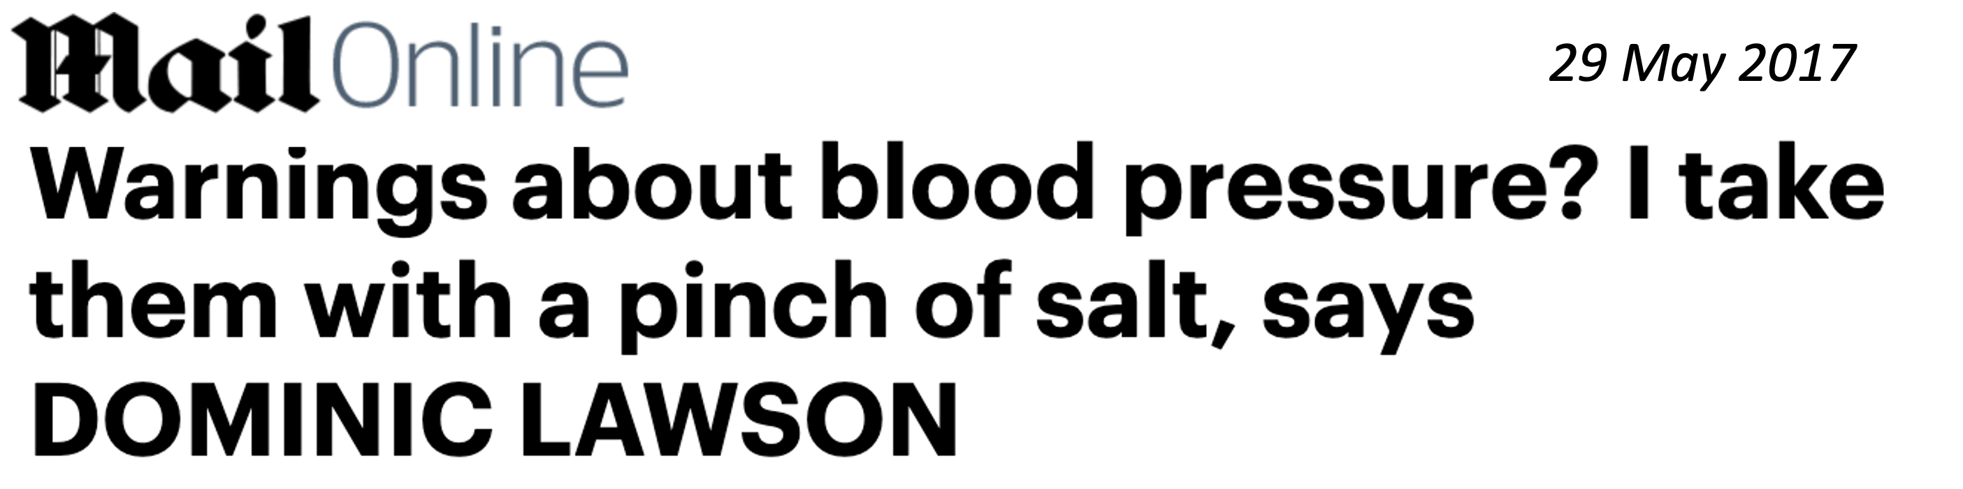
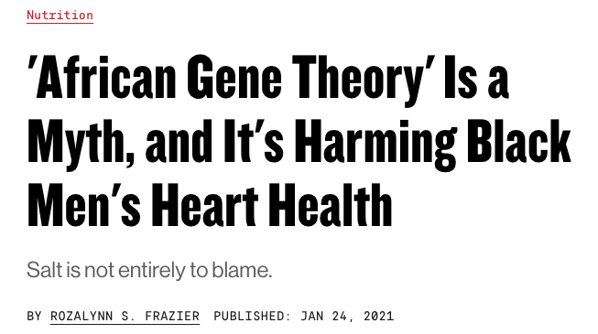
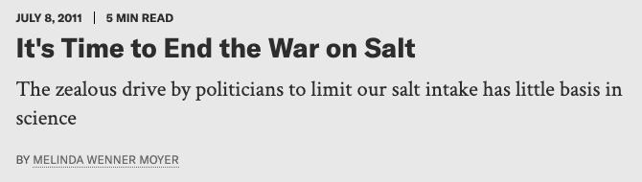
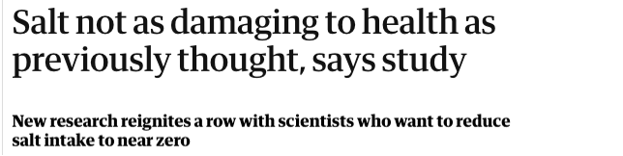
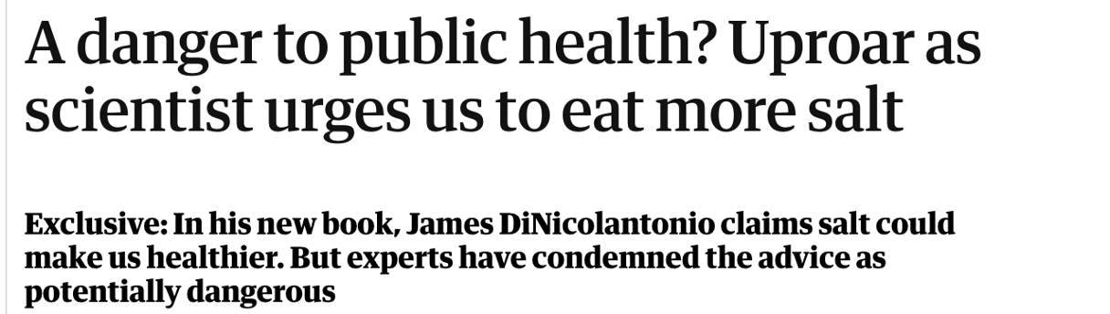
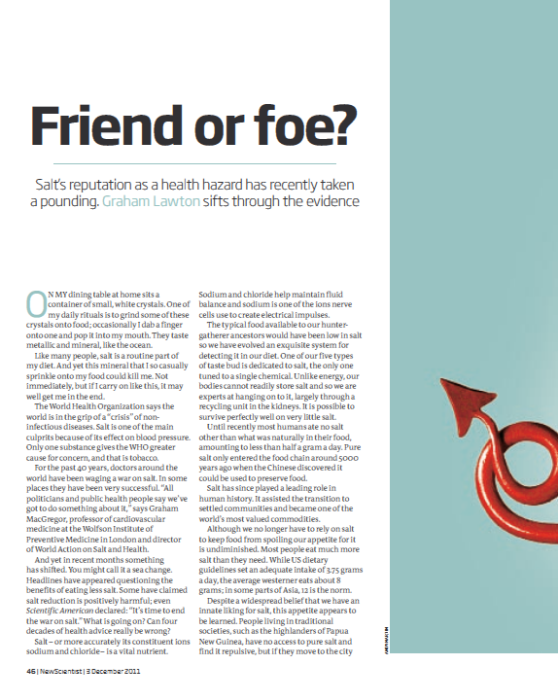
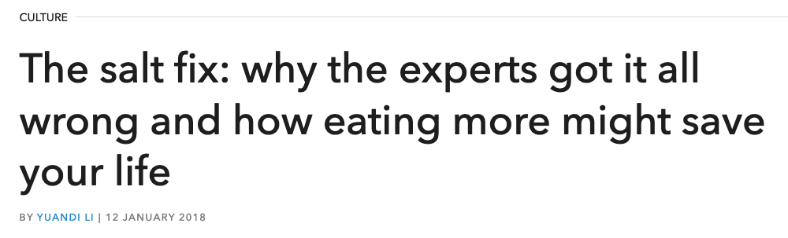
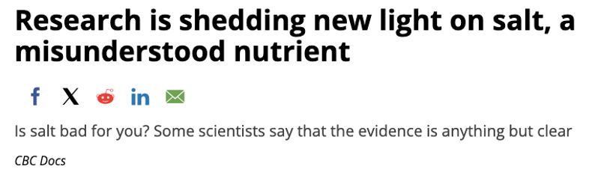
New Scientist, 3 December 2011
Myths

Slide 5
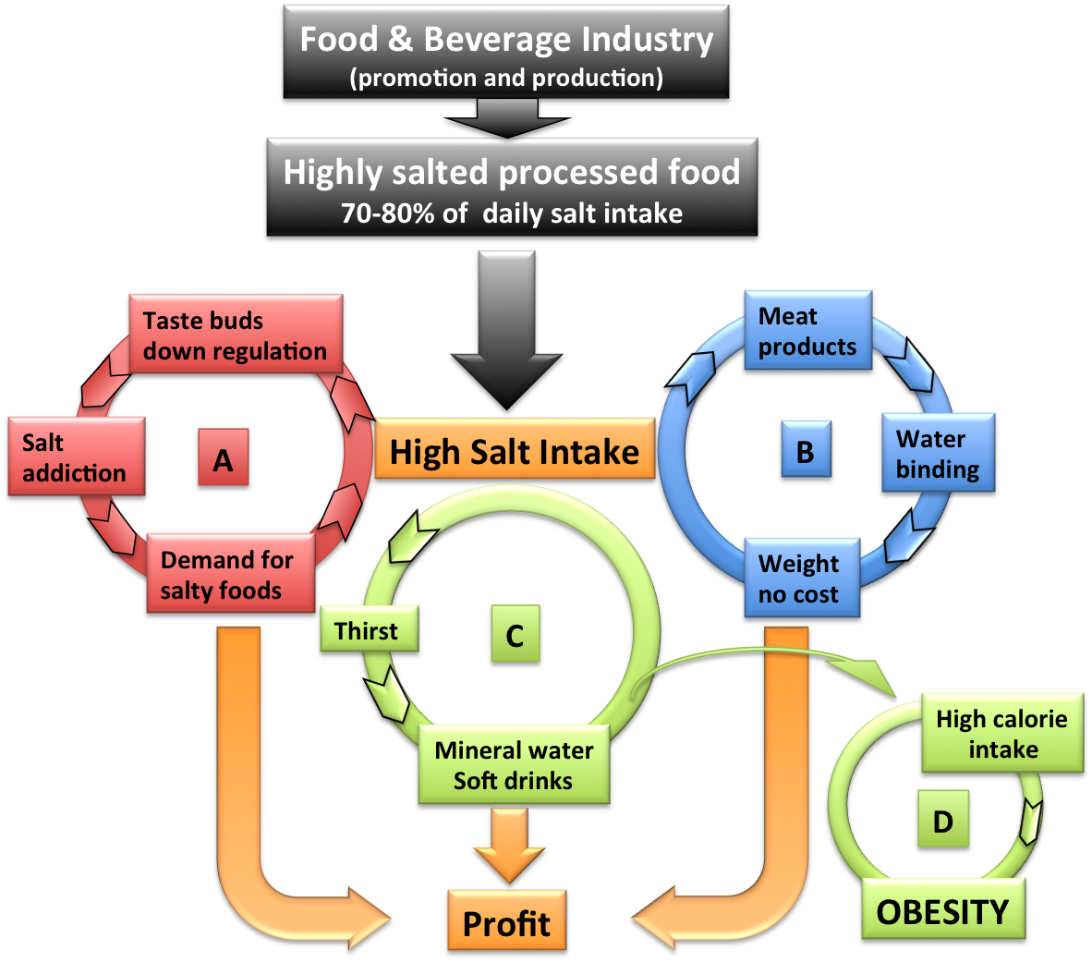
Profit vs Public benefit
High salt in processed and manufactured food leads to profit to industry, not to health benefits!
A. Palatability – bad food edible
A. Taste addiction – demand
B. Hygroscopic properties – weight at extra cost
C. Thirst - drinks (sugary, carbonated, alcoholic)
D. Obesity
Cycles of profit for industry
Cappuccio FP, Capewell S. Functional Food Reviews 2015; 7(1): 41-61.

Slide 6
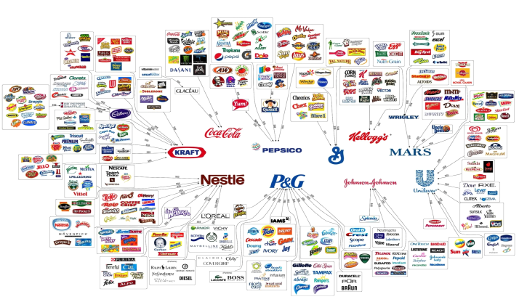
Who owns what in the food industry?
Source: Fritz Kreiss/Occupy Monsanto
“The world’s 10 largest food and non-alcoholic beverage companies feed daily an estimated global population of several hundred million in >200 countries, generating a combined annual revenue of >$422b” (Source: IFBA, 2012)
Cycles of profit for industry

Slide 7
Industry vs Public Health priorities
Industry
Salt contributes to food safety
Salt increases shelf-life
Salt makes unpalatable food edible at virtually no cost
Habituation to high salt foods increases demand – Profit on these foods tends to be greater
Increasing salt concentration in meat products increases water binding capacity by up to 20%
Salt intake is the main drive to thirst and thereby increases soft drinks, beer, wine and mineral water consumption
Public health
Lower salt intake reduces ill-health and prevents diseases (CV and non-CV)
Lower salt intake reduces the consumption of sugar-containing drinks, alcohol, hence calories
Lower salt intake is highly cost-effective for society (reduced healthcare costs)
Lower salt intake reduces salt addiction
Moderate population reduction in salt intake is feasible, efficacious, cost-effective
Profit vs Health gains

Slide 8
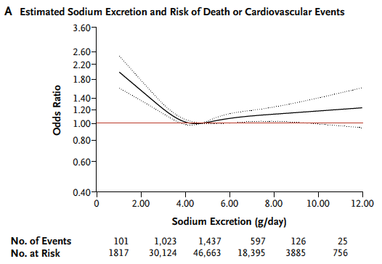


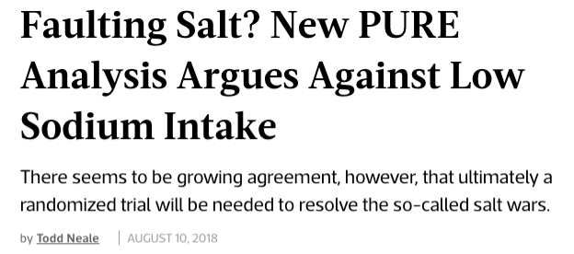
Controversy: reducing sodium intake will increase risk of death !
5-10g salt/day
Using ‘spot’ urine collections and applying different formulas to ‘estimate’ daily intake
Controversy
O’Donnell M et al. et al. NEJM 2014:371:612-23

Slide 9
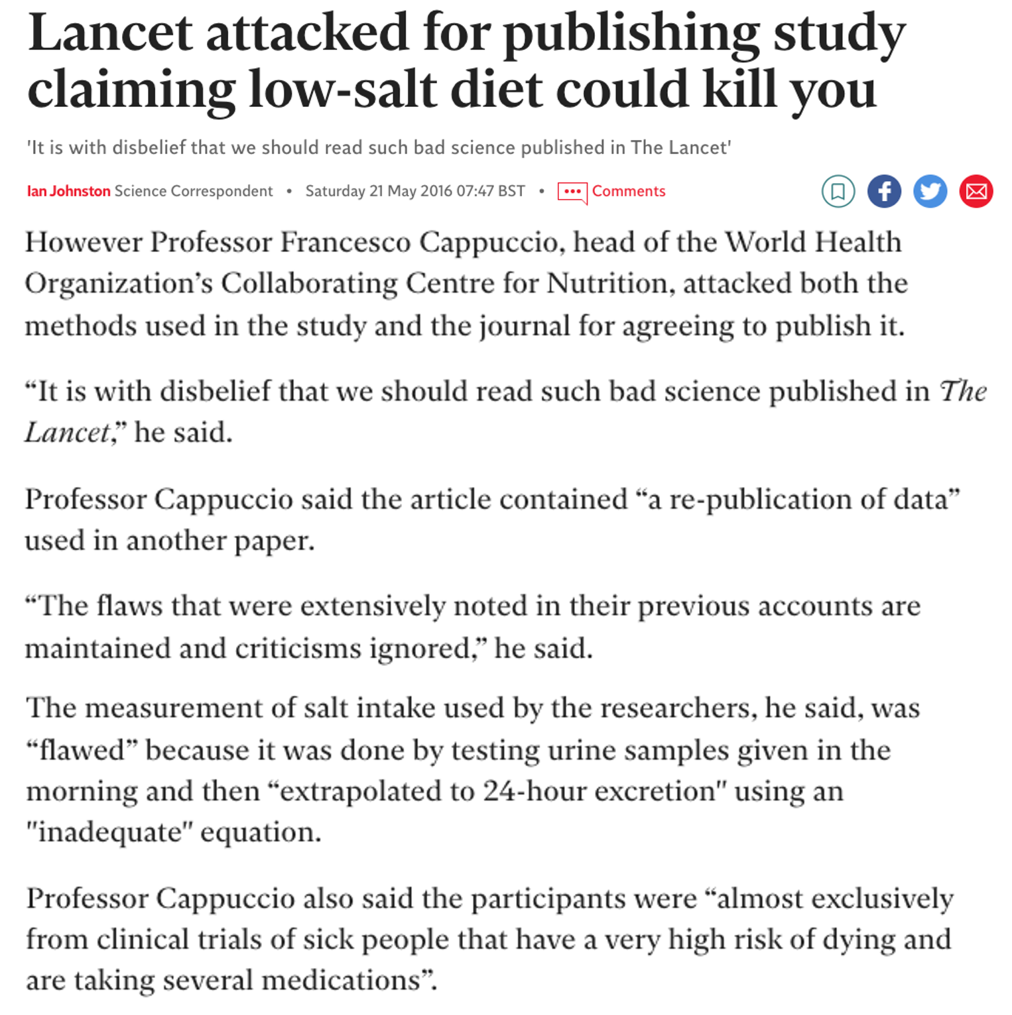
Role of science
Debunk misperceptions about risks
Replicate and reanalyse
Achieve scientific consensus upon which to make clinical and public health recommendations
Analogies: tobacco; MMR; climate change;
Failing
peer
review
Professional
malpractice
Denial of collective evidence
Lack of rigour
in research
methods; lack of policies to protect public interest
Role of science

Slide 10
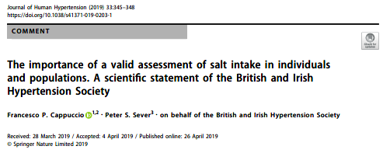
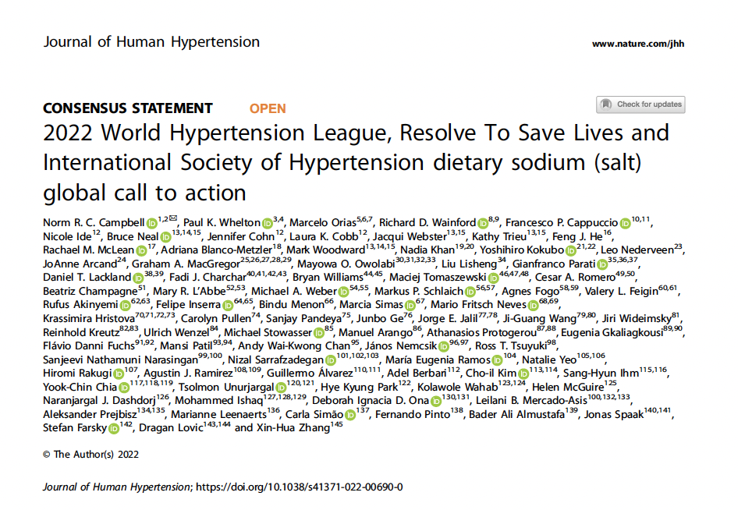

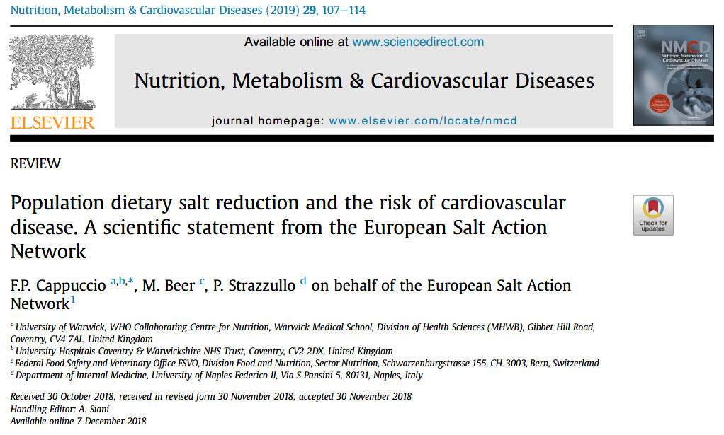
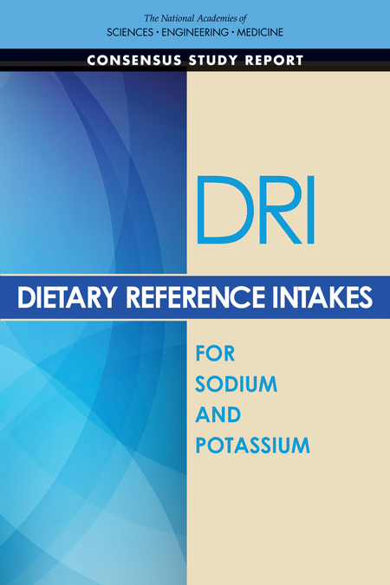
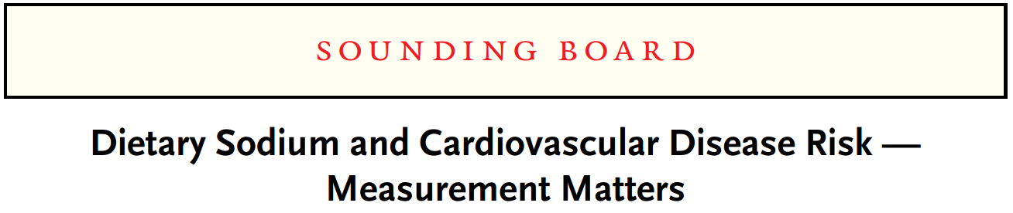
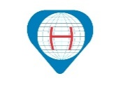
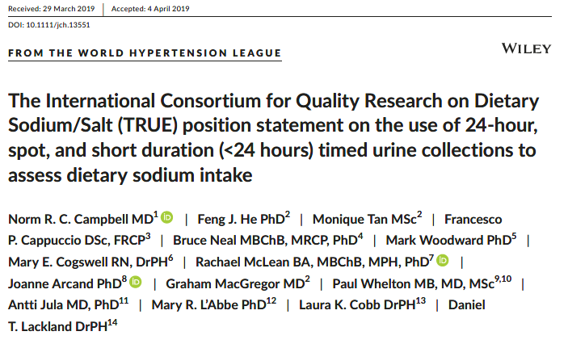
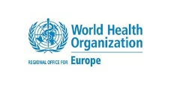
Consensus on position statements
J Hum Hypertens 2023; 37: 428-437
J Hum Hypertens 2023; 37: 428-437
J Clin Hypertens 2019;21:700-709
“The application of Bradford Hill’s criteria to the putative association between low sodium intake and increased CVD risk indicates that the association is not causal”.
“Undue emphasis on observational studies with large numbers of participants but invalid measurement of sodium intake and other methodological limitations (see Cobb) can lead to erroneous conclusions and delay effective public health action to reduce blood pressure and to save lives”.
E.S.A.N.
Cogswell ME et al. NEJM 2016; 375: 580-6
2019
Role of science

Slide 11
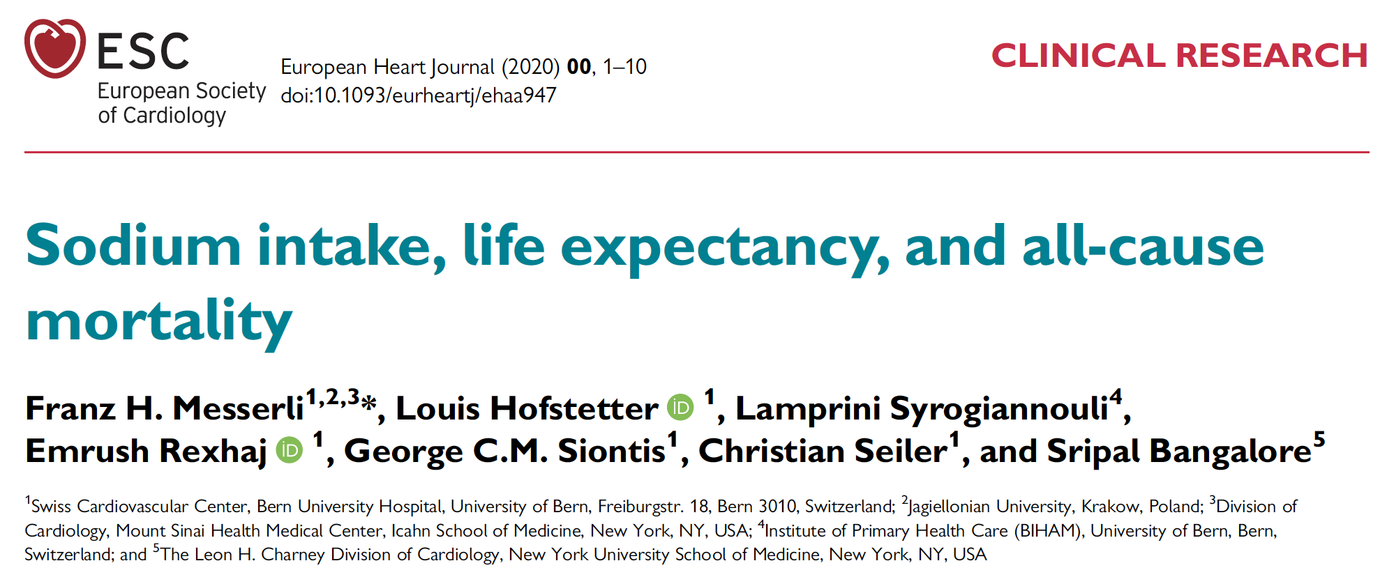
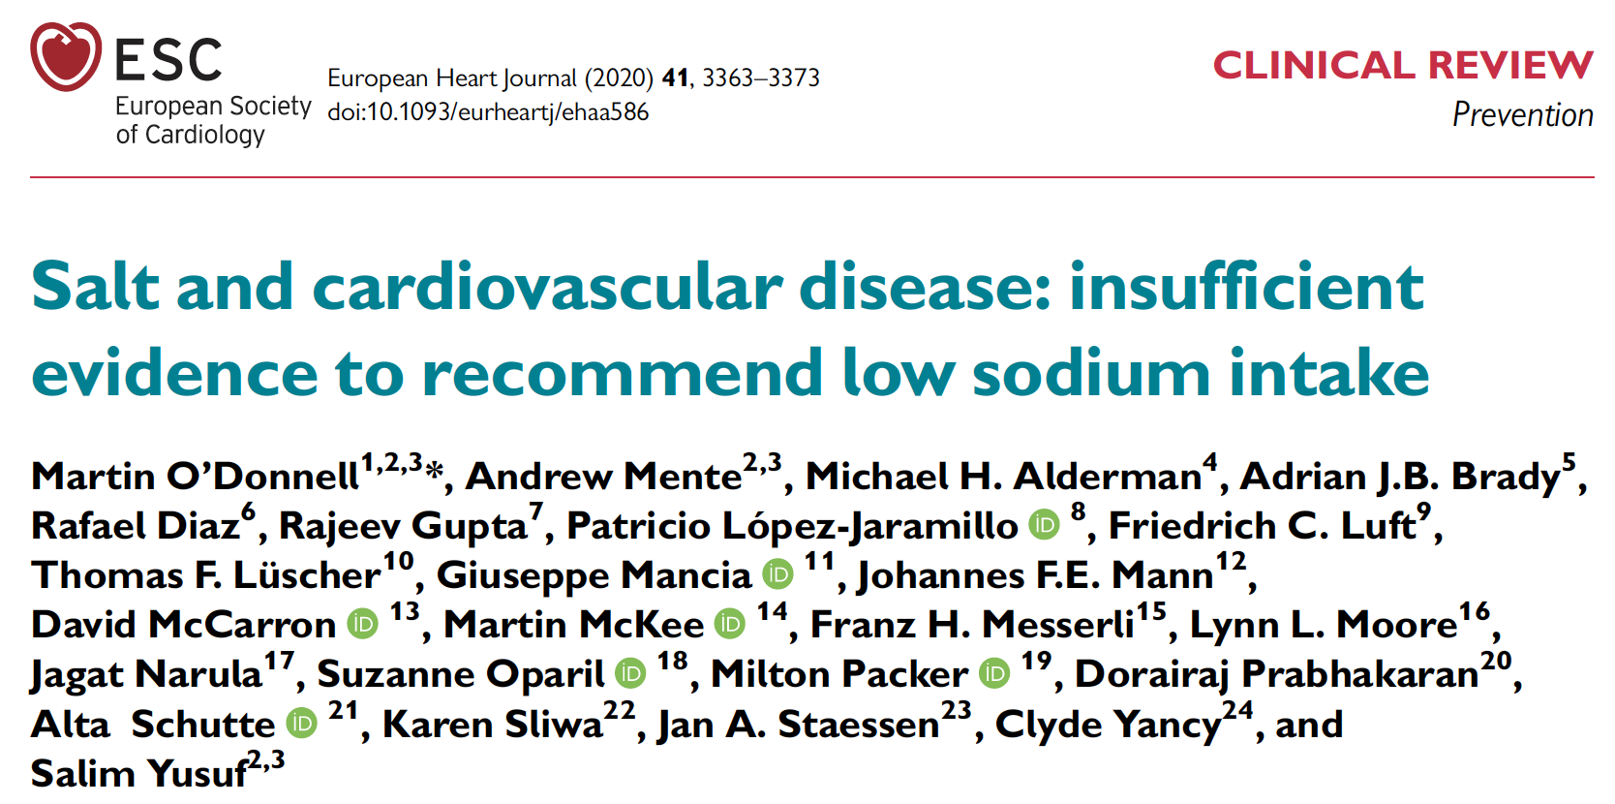
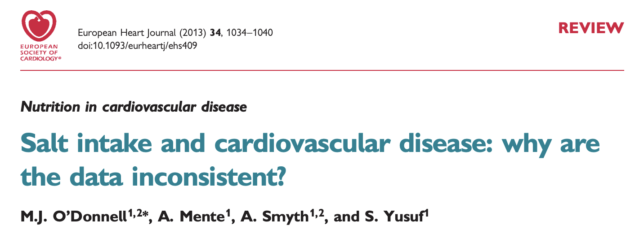
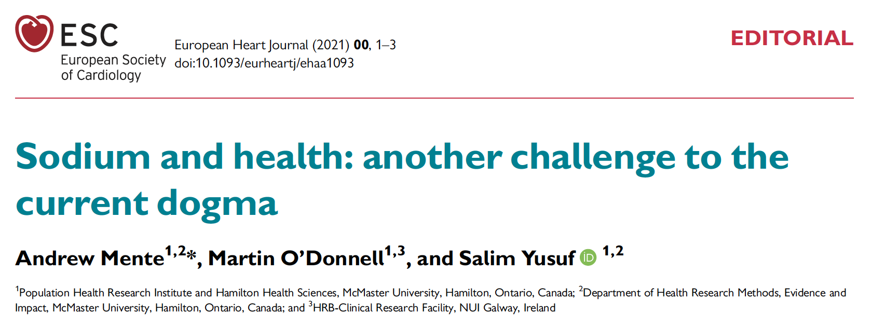
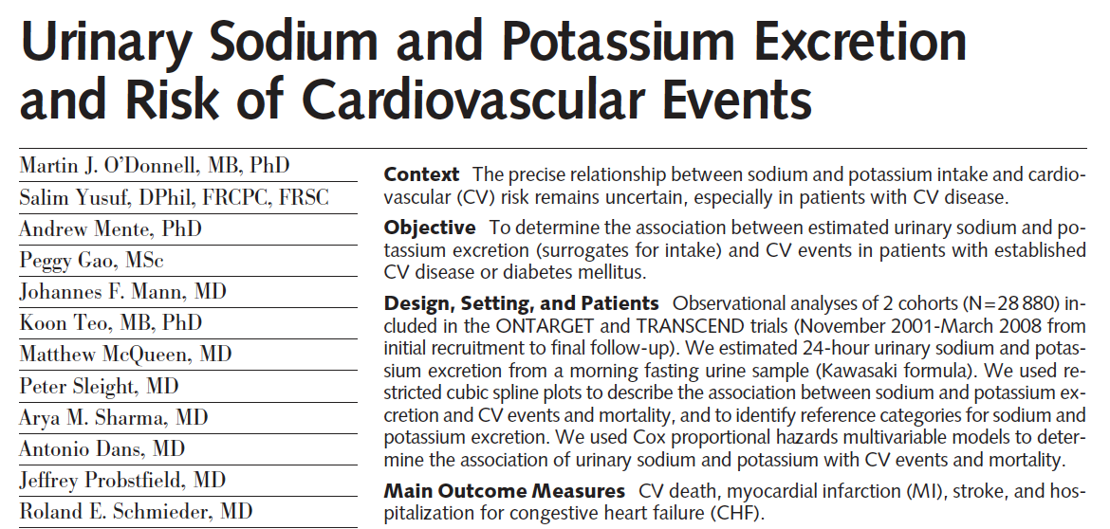
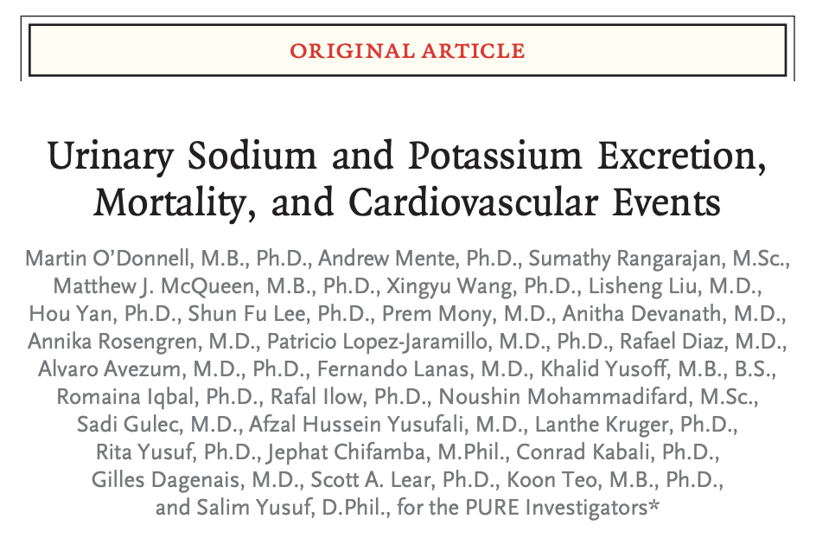
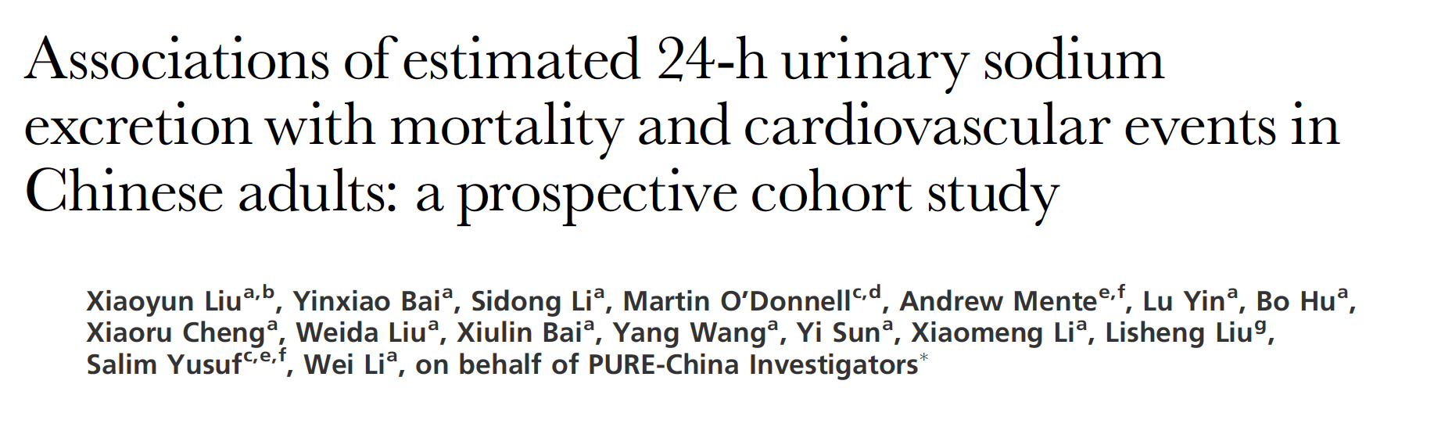
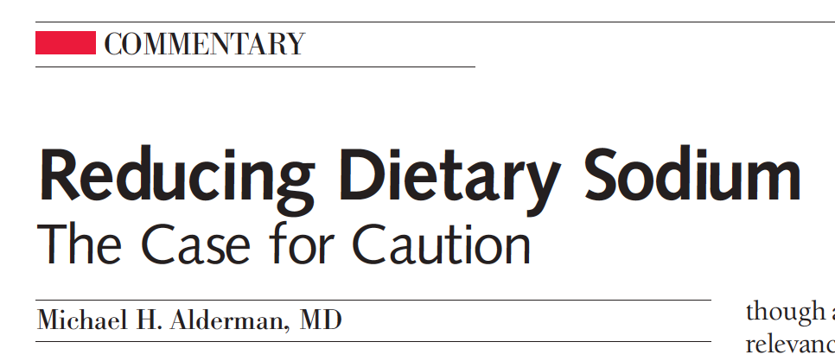

Concerns about advocacy ‘against’ reducing dietary sodium intake
CASE STUDY: Studies of low quality are numerous and often in high-impact journals, bypassing critical reviews, even featuring Editorials by dissenting scientists with known (often undeclared) Conflicts of Interest.
Journal of Hypertension 2021, 39:484–493
JAMA, Feb 3, 2010 – vol.303, No.5, 448-9
JAMA, November 23/30, 2011—Vol 306, No. 20
N Engl J Med 2014;371:612-23
What are the non-scientific threats to public health policies?
Campbell NRC et al. Curr Nutr Rep 2021; 10; 188-99
Cappuccio FP et al. Curr Nutr Rep 2022; 11: 172-84
Effect -> confusion

Slide 12
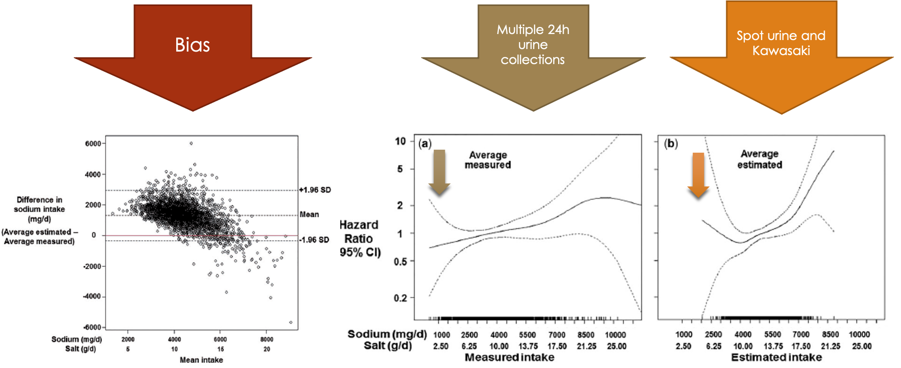
Concerns about advocacy ‘against’ reducing dietary sodium intake
Use of inappropriate research methods and lack of rigor in research
  Low-quality, inappropriate methods and research designs prone to spurious results.
  Example: the use of formulas to estimate sodium excretion (as measure of intake) from spot urine collections produces biased estimates that alter the relation between sodium and outcomes
  He FJ et al. Int J Epidemiol 2018; 47: 1784-95
Flawed methodology

Slide 13
De-bunking the fake science by re-analysis of data.
MacLean RM, Song J, Wang C, He FJ, Cappuccio FP, Campbell NRC, MacGregor GA. Examination of formula-led methods using first morning fasting spot urine to assess usual salt intake: a secondary analysis of PURE study data. J Hypertension 2024; in press.
First study¹ based on an independent analysis of a PURE data set previously published² that demonstrates that a single fasting morning spot urine sample is unsuitable for estimating usual salt intake in individuals due to a high level of error.
Accuracy
  lower average estimate than 24h collections
  lower average estimates by quartile of 24h collections
  large relative and absolute errors
  high proportion of misclassification of individuals into quartiles of 24h collections
  All formulae systematically over-estimate 24h salt intake by up to 13.09 g at low levels of measured excretion, and under-estimate it by up to 10.94 g at high levels of measured excretion.
Role of science
¹ MacLean RM et al. J Hypertens 2024; in press – ² Peng Y et al. PLoS ONE 2016; 11(2): e0149655

Slide 14
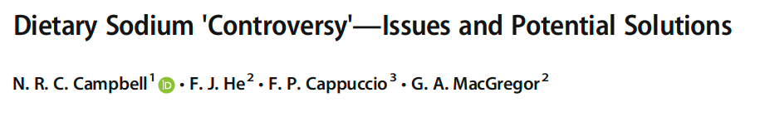

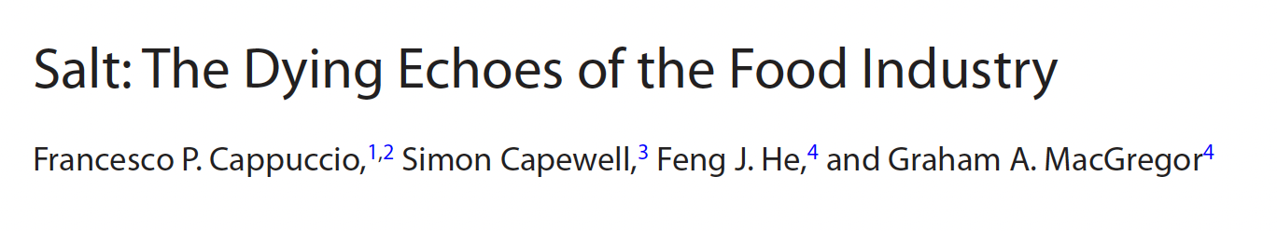
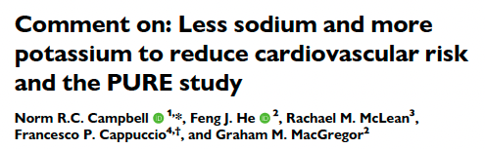
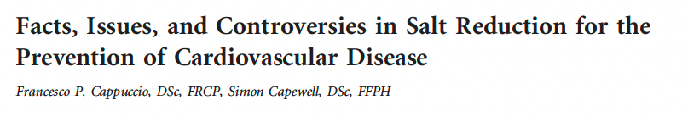
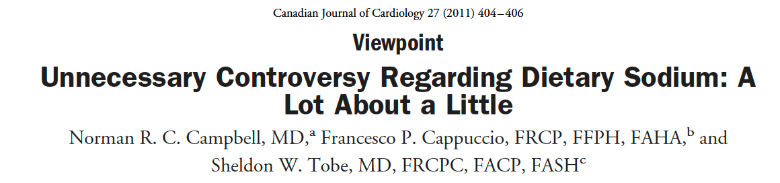
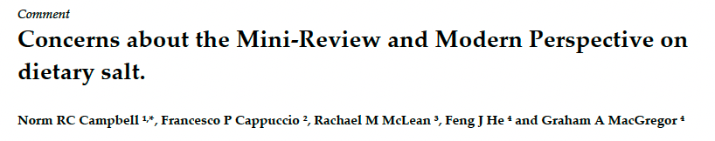
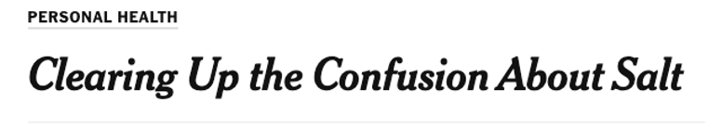
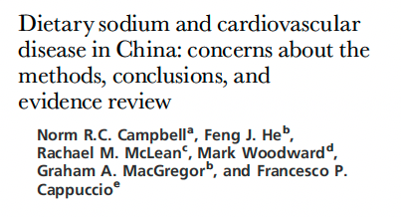
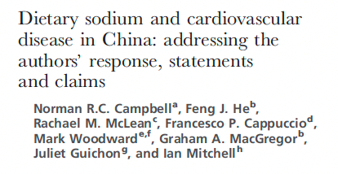
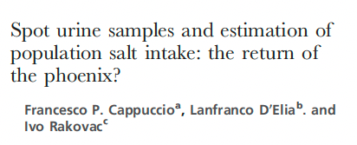
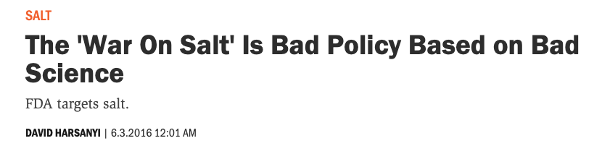
Traditional media
Scientific critique
Misleading claims | Objections and Reasons

Slide 15
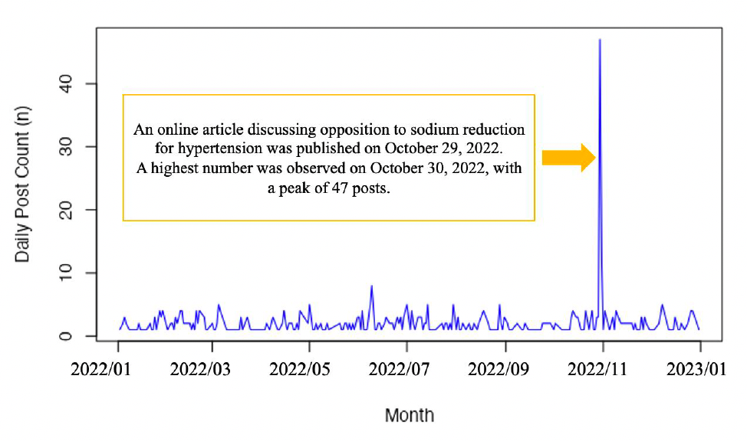
The misinformation echo-chambers of social media (SM)
Systemic bias in research funded by food and drinks industry¹
SM platforms have become conduits for health-related misinformation²
The use of SM as information source is associated with conspiracy beliefs and less health protective measures³
Lack of regulation of SM, coupled with promotions to boost company profits contradicting evidence by non-professionals, lead to the spread of misinformation amplifying health concerns⁴
X (former Tweeter) is one of the most common sources of health-related misinformation²
Daily Post Count related to sodium-related misinformation on X in Japan (01/01/2022 – 31/12/2022).
Terada M, et al. Health Promotion Int. 2024; in press
¹Lesser LI et al. PLoS Med 2007;4:e5
²Wang Y et al. Soc Sci Med 2019;240:112552
³Allinvgton D et al. Psychol Med 2021;51:1763-9
⁴Zenone M et al. Int J Health Policy Manag 2022;1
Misleading claims | Objections and Reasons

Slide 16
Reasons for advocacy ‘against’ reducing dietary sodium intake
Conflicts of Interest and Commercial Bias
Lack of public access to raw data
Scientific and Professional misconduct
Journal, Granting Agencies, Research and Ethics Committees
Media, Health and Scientific Organizations
  Platforms for low-quality research.
  False sense of equipoise and credibility for dissenting scientists, creating an aura of controversy.
  By allowing “equal representation” these debates “…only succeed in creating false equivalence” between two sides of an issue (polarization) even when there is only one credible side¹.
  Dissenting scientists achieve high-level positions in these organizations
Governments
  Complacent and subject to industry lobbying
Reasons
Campbell NRC et al. Curr Nutr Rep 2021; 10; 188-99
Cappuccio FP et al. Curr Nutr Rep 2022; 11: 172-84
¹McIntyre L. Post-Truth. MTP Press 2018

Slide 17
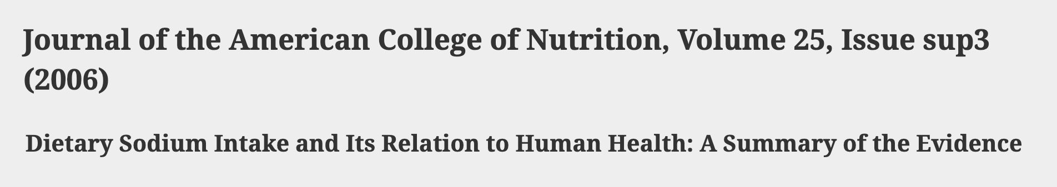
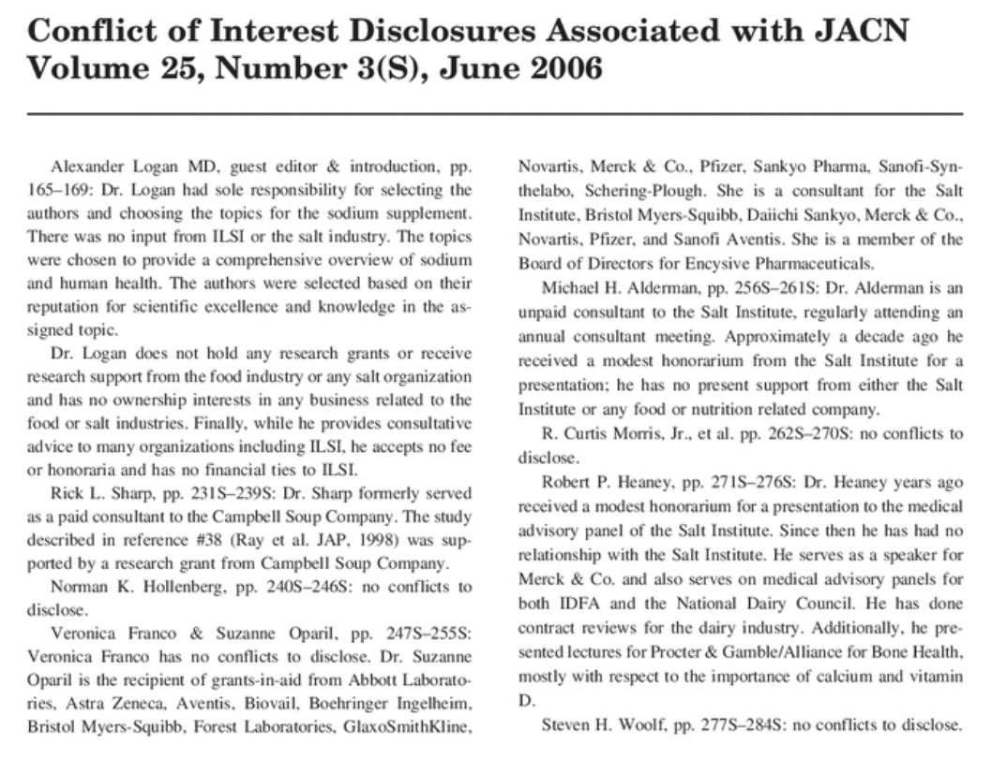
Reasons about advocacy ‘against’ reducing dietary sodium intake
Conflicts of Interest and Commercial Bias
  Example: JACN supplement 2006; 25(3) funded by industry, participants advisors and consultants for food industry, no disclosures provided.
  Although omissions violated journal policies, identified and notified to Editor, no corrective action by the journal other than post-hoc disclosure by the publisher in 2013 (!).
Lack of public access to raw data
  Databases from studies claiming adverse effects of sodium reduction are not publicly available, although mostly publicly funded, hence results cannot be independently verified (e.g. recent refusal from the PURE Study).
  Where independent verification was carried out, the original spurious result was identified^{1,2}
  Standard formula to assess urine completeness was altered inflating the proportion of complete samples and data on validation not disclosed even after request³
Reasons
¹ J Gen Int Med 2008;23:1297 - ² Arch Int Med 2011;171:1183 - ³ Int J Epidemiol 2016; 46: 362, 367 and 2018; 47: 670, 673.

Slide 18

Reasons about advocacy ‘against’ reducing dietary sodium intake
Scientific and Professional conduct
  Granting agencies and scientific and ethics reviews approving weak and inappropriate research designs (e.g. post-hoc secondary analyses not originally planned).
  Journals delay in investigating, and where needed, retracting papers based on dubious or fabricated data. Once retracted, cited even after retraction date (e.g. Sodium intake in heart failure¹). Failure of peer-review system, lack of scientific rigor and professional conduct of authors and journals.
Journal, Granting Agencies, Research and Ethics Committees
  Outright rejection of correspondence to Editor pointing to serious methodological flaws and false statements in published manuscripts.
  Flawed evidence used in introductions, reviews and presentations, supporting the aura of controversy and encouraging polarizations.
  In one case, we were unable to confirm or refute if a grant agency had received, reviewed and approved plans for specific secondary analyses.
Reasons
¹ Heart 2013; 99: 820

Slide 19

Reasons about advocacy ‘against’ reducing dietary sodium intake.
Health and Scientific Organizations
  Debates on dietary sodium as platforms for low-quality research and erroneous and misleading statements.
  False sense of equipoise and credibility for dissenting scientists, creating an aura of controversy.
  By allowing “equal representation” these debates “…only succeed in creating false equivalence” between two sides of an issue (polarization) even when there is only one credible side¹. Dissenting scientists achieve high-level positions in these organizations, some using them as platforms to advocate against dietary sodium.
Governments
  Complacent about threats to evidence-based public policy.
  Industry lobbying delays or deters policy implementations, despite clear evidence to the contrary.
Reasons
¹ McIntyre L. Post-Truth. MTP Press 2018

Slide 20
Actions to support evidence-based dietary sodium public policies
In nutritional science, long-standing lack of ethical guidance for all stakeholders.
Many millions of lives at stake -> guidance on standards of acceptable and unacceptable conduct needed.
Academic organizations: strict guidelines on
research funding
personal financial gain from those opposing important public policies (e.g. tobacco, sodium)
Funding bodies
Editors: sometimes negligent in publishing low-quality research on dietary sodium. Update and Enforce guidelines on Publication Ethics (see COPE and Individual Journals’ policies).
rigorous designs and methods
accessible databases in areas of research impacting public
invest in scientific impact of financial interests, low research quality, misinformation, professional conduct.
Actions
Campbell NRC et al. Curr Nutr Rep 2021; 10; 188-99
Cappuccio FP et al. Curr Nutr Rep 2022; 11: 172-84

Slide 21
Summary
We discussed experiences and observations that relate to undermining the evidence supporting a moderate reduction in dietary sodium as a public health policy to reduce the burden of CVD, first killer in the world.
We reported concerns that plague science even outside the health field (e.g. vaping, vaccines, climate change).
We raised issues critical for society to address, to maintain public trust.
We share with many scientists the desire to discover the true relationship between sodium intake and health outcome, particularly given that millions of lives are at risk.
We all play a role in safeguarding science.
We need to collaborate with ethics groups to develop, implement and enforce higher standards to safeguard public policy.
Summary
Campbell NRC et al. Curr Nutr Rep 2021; 10; 188-99
Cappuccio FP et al. Curr Nutr Rep 2022; 11: 172-84

Slide 22

Evidence-Based Medicine = Evidence-Based Policy
The conscientious explicit and judicious use of current best evidence in making decisions about the care of individual patients
Conscientious – being careful, and thorough, in what you do
Explicit – being “up-front”, open, clear and transparent
Judicious – using good judgement and common sense
“We should not refrain from implementing public health policies based on the judicious use of the best available evidence”
Iain Chalmers

Slide 23
Evidence-based imperatives supporting policy
Salt consumption is much higher than needed
A reduction in salt consumption causes a dose-dependent reduction in BP
Lower salt intake is associated with lower morbidity and mortality from CVD
Population salt reduction programmes are
  feasible and effective (preventive imperative)
  cost-saving in all settings (economic imperative)
  powerful, rapid, equitable (political imperative)
  life saving (moral imperative)
Reduction in salt recommended for the prevention of CVD (WHO 30% reduction by 2025, aim <5g per day)
Preventive
Political
Moral
Economic
Cappuccio FP. Arterial Hypertension 2021; 30(1): 13-19

Slide 24

Thank you!
Any question?
Notes:
24

Slide 25
















2.5 g of salt (NaCl) =
1.0 g of sodium (Na)
Sodium or Salt?
All types of salt contain >97% sodium chloride¹.
Black salt
(Kala namak)
Celtic salt
Coarse salt
Flake salt
Fleur de Sel
French Sea salt
Grey salt
Grinder salt
Hawaiian Sea salt
(Alaea)
Himalayan Pink salt
Italian Sea salt
Kosher salt
Organic salt
Sea salt
Smoked Sea salt
¹Federal Food Safety and Veterinary Office, Switzerland (2016)
Notes:
To start the conversation let us agree on the terminology to avoid confusions. We shall refer to sodium and salt – however they are not the same thing. Sodium is a cation and it is what we want to reduce for its health effects. It is mainly consumed as a component of the Sodium Chloride salt or Salt in our conversation. 1 g of sodium is contained in 2.5 g of salt.
Salt is not just the ‘white stuff’ we often find on our table, but can be found in nature in a variety of appearances – all containing >97% sodium chloride. None of them is healthy and none of them have any magic effects!

Slide 26


First double-blind RCT of three sodium intakes and long-term effect of sodium reduction in essential hypertension
Sodium excretion in 24h urines bio-marker of daily intake (~94%)
MacGregor GA et al. Lancet 1989; ii:1244-7
Notes:
We know from observational studies that high salt intake is associated with high blood pressure. The association is not a proof that eating more salt causes the blood pressure to rise, and more importantly, does not prove that if we reduce the amount of salt we eat, we would reduce blood pressure.
[TAB]
The first randomized trial to confirm the cause-effect is shown here.
Hypertensive patients were randomised to three different levels of salt intake, ~3, ~6 and ~10 grams of salt per day, each to be sustained for a month (LEFT PANEL). The bars indicate 24h urinary sodium excretion, marker of salt intake. The top represent systolic and diastolic blood pressure at the end of each monthly period. The lower the salt intake the lower the blood pressure, suggesting a powerful and natural way of lowering blood pressure in hypertensive patients without the use of drugs.
[TAB]
The indication of a sustained effect was given by the evidence (RIGHT PANEL) that if salt reduction was sustained over a year, the blood pressure would stay lower.

Slide 27

A reduction in dietary salt (sodium) reduces blood pressure
Cappuccio FP . Nephrol Dial Transplant 2016; 31: 1392-6
Notes:
Since the first trial, more than 100 clinical trials have been carried out and many meta-analyses published, as listed here. Their results, irrespective of different inclusion or exclusion criteria, showed a consistent message: reducing salt intake lowers both systolic and diastolic blood pressure.

Slide 28

The greater the reduction in salt (sodium) intake,
the greater the reduction in blood pressure
Mozaffarian D et al. N Engl J Med 2014: 371: 624-34
Notes:
The effect of reducing salt intake on blood pressure is dose-dependent: the more you reduce salt, the more the blood pressure falls.

Slide 29

‘Graded and linear’ association between sodium intake and outcomes
Urinary sodium measured with repeated 24h urine collections
Cardiovascular disease
All-cause mortality
Cook NR et al. Circulation 2014; 129: 981-9
Cook NR et al. J Am Coll Cardiol; 2016; 68: 1609-17
Notes:
In prospective studies, the relationship between salt consumption, measured by multiple 24h urine collections for sodium determination, and both cardiovascular outcomes (LEFT PANEL) and all-cause mortality (RIGHT PANEL) proved to be graded and linear across the range of salt consumption seen in most populations.

Slide 30

Salt reduction lowers cardiovascular risk: meta-analyses of outcome trials
Intake-response meta-analysis for CVD risk in the range of sodium intake 2,300-4,100 mg/day (5.75-10.25 g salt/day)
He FJ, MacGregor GA. Lancet 2011: 378: 380-2
DRI for sodium and potassium. US National Academy of Sciences (2019)
Notes:
Finally, few randomized clinical trials where it was possible to measure the effect of a period of salt reduction on vital cardiovascular outcomes, clearly indicate a statistically significant 20% reduction in total cardiovascular events, as predicted from observational studies.

Slide 31
Evidence: Sodium – Blood Pressure – CVD Model
Natural
Japan (1956 - 1980)
Finland (1972 - 2002)
United Kingdom (2003 - 2018)
X-sectional
~1,000 worldwide (using 24h urine collections)
Prospective
>500 worldwide (using 24h urine collections)
RCT
>200 on BP
~10 on CVD outcomes
Evidence
Drawn from: Cappuccio FP. Chapter 44.6. ESC Textbook of Cardiovascular Medicine. 3rd ed. 2018

Slide 32
Global deaths and disabilities (lost DALYs) attributable to dietary risk factors (2017)
High sodium intake
3 m deaths
70 m DALYs
Low intake of whole grains
3 m deaths
82 m DALYs
Low intake of fruits
2 m deaths
65 m DALYs
Population impact
GBD 2017 Diet Collaborators. Lancet 2019; 393: 1958-72

Slide 33


Global estimates of salt intake
WHO target
<5g per day
2023
Targets

Slide 34
World Health Organization Global Action Plan for NCD
CVD reduction
Salt reduction
BP reduction

Slide 35
Components of a strategy to reduce population salt intake
Communication
Public Awareness Campaigns
Food industry
Reformulation
Setting Targets
Monitoring & Surveillance
Population salt intake
Reformulation progress
Decision makers
Media
Health Professionals
Motivation
Costs & Benefits
Consumer awareness
Wider support
Corporate responsibility
Labelling
Effectiveness of communication and intervention
Urinary sodium
Dietary surveys
Salt content of foods (databanks; self-reporting by industry; market surveys)
Benchmarking food categories
Consumers
Measuring ….
Attitudes and behaviour changes
Research
Epidemiology
Nutrition
Public Health
Food technology
Behavioural
Voluntary vs Regulatory
Evaluation
Policy
[…]
Industry Engagement
Reformulation
Minimum standards in common foods
Advocacy
Economics
[…]
Effectiveness
Sociology
Awareness of campaigns
Changes in population salt intake
Street vendors
Three-pillar
(pronged)
approach
Cappuccio FP et al. Br. Med. J. 2010; 343: 402-405

Slide 36
Hierarchy of effectiveness of dietary salt reduction policies
DOWNSTEAM (Agentic) UPSTREAM (Structural)
  reliance on individual choice – e.g. social marketing, awareness, health promotion, behavioural – politically more likely but fewer benefits and potentially widen inequalities.
  affecting food environment – e.g. legislative and fiscal changes, mandatory reformulation – effective and reducing inequalities
Hyseni L et al. PLoS ONE 2017; 12(5): e0177535

Slide 37

Policy forecast for England (2025): effectiveness and health equity
UPSTREAM (Structural) DOWNSTREAM (Agentic)
Greater reduction in low SES
Gillespie DOS et al. PLoS ONE 2015; 10: e0127927

Slide 38

Cost-effectiveness of government supported policy strategy to lower sodium intake
Affordability of a national policy intervention to reduce sodium consumption by 10% in the world’s 20 most populous countries.
Each point is CE of intervention.
Colour lines represent CE ratios, as measure of affordability.
WHO benchmark for CE <3xGDP per capita and highly CE <1xGDP per capita.
Webb M et al. BMJ 2017; 356: i6699
Notes:
Each point represents the cost effectiveness of the intervention (I$/disability adjusted life year (DALY)) for a given country against that country’s gross domestic product (GDP) per capita (I$), adjusted for purchasing power. The lines represent 0.01×, 0.05×, and 0.1×GDP per capita, selected as reasonable fractions against which to compare our estimates of affordability. Notably, each of these thresholds is substantially lower than the World Health Organization benchmarks for an intervention being cost effective (<3.0×GDP per capita) or highly cost effective (<1.0×GDP per capita). For example, Nigeria and Bangladesh, being to the right of the blue line and to the left of the red dotted line, have a cost effectiveness ratio less than 0.1×GDP per capita but greater than 0.05×GDP per capita

Slide 39

The new salt debate and the spread of myths
Lancet 2016; 388: 438
New Scientist, 3 December 2011
Q1: Is there a J-shape relationship between sodium intake and CV events?
Q2: Is there any harm in reducing salt intake towards recommended targets?

Slide 40



Common methodological problems
Systematic errors in sodium assessment
    Single or incomplete 24h urine collection
    Spot urine collections
    Dietary assessment
Random error in sodium assessment
Reverse causality
  Sick populations in low sodium group
Potential for residual confounding
    Incomplete adjustment for confounding
    Incomplete follow-up
Insufficient statistical power
Inconsistent results with same datasets
Cobb LK et al. Circulation 2014; 129: 1173-86

Slide 41
Spot urine collections inadequate to monitor changes in population salt reduction programmes
24h
Tanaka
Kawasaki
Gold-standard
Average population salt reduction (g/day)
Spot-urines
Huang L et al. Int J Epidemiol 2018; 47: 1811-20
Cappuccio FP et al. Nutr Metab Cardiovasc Dis 2019; 29: 107-14
Notes:
Furthermore, the use of a spot urine collection would not have the same power to detect small but important changes in average sodium excretion over time in repeated population surveys. Spot urines would fail to detect important effects of salt reduction strategies (RED) compared to 24h urines (GREEN). This would have negative implications in supporting further actions to strengthen public health policies.

Slide 42





Slide 43
Campbell NRC et al. Curr Nutr Rep 2021; 10; 188-99
Cappuccio FP et al. Curr Nutr Rep 2022; 11: 172-84

Slide 44


Salt intake, blood pressure and CVD mortality in England
Song J et al. J Hypertension 2023; 10: : August 24, 2023; doi: 10.1097/HJH.0000000000003521

Slide 45
Policy forecast for England (2025): effectiveness and health equity
UPSTREAM (Structural) DOWNSTREAM (Agentic)
Greater reduction in low SES
Gillespie DOS et al. PLoS ONE 2015; 10: e0127927

Slide 46
Notes:
85 authors

