Slide 1
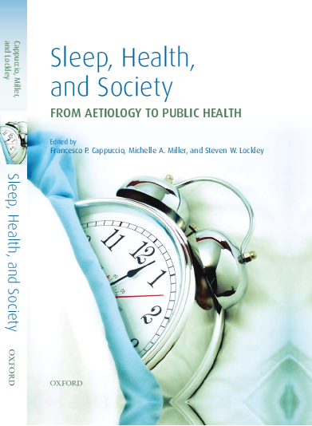
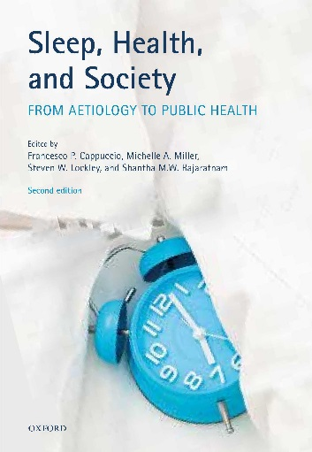

Sleep disturbances and cardio-metabolic risk
2010
Francesco P. Cappuccio
MB BS, MD, MSc, DSc, FRCP, FFPH, FBIHS, FESC, FAHA
Professor of Cardiovascular Medicine & Epidemiology
“Sleep Health & Society Programme”
Warwick Medical School, University of Warwick
Consultant Physician
University Hospitals Coventry & Warwickshire NHS Trust
Coventry, UK
President, British and Irish Hypertension Society
www2.warwick.ac.uk/go/sleep
2018

Slide 2

The 2017 Nobel Prize in Physiology or Medicine
The Nobel Prize in Physiology or Medicine 2017 was awarded jointly to Jeffrey C. Hall, Michael Rosbash and Michael W. Young "for their discoveries of molecular mechanisms controlling the circadian rhythm".

Slide 3
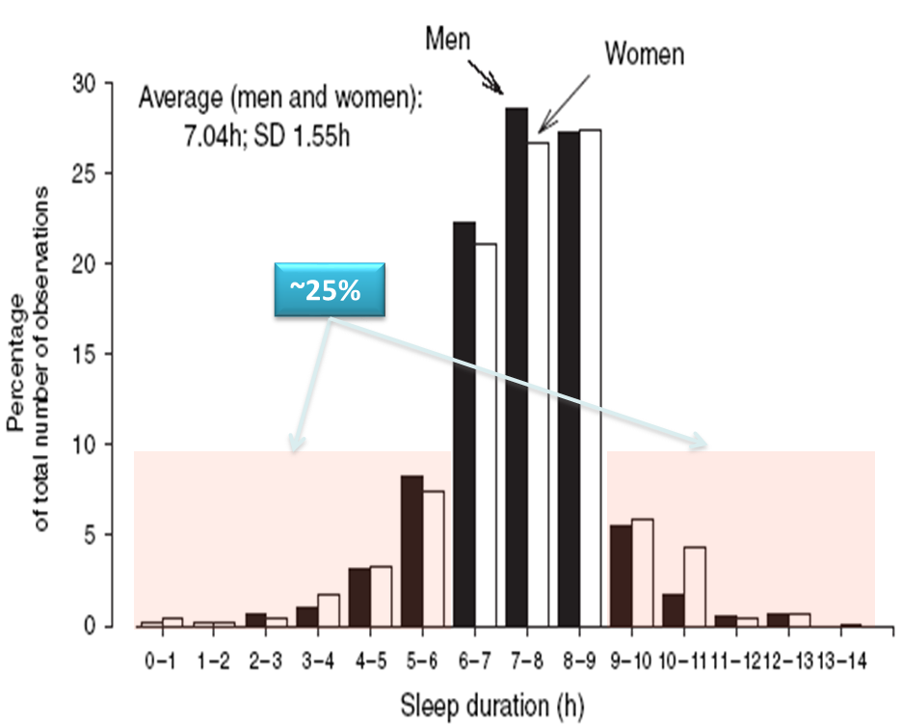
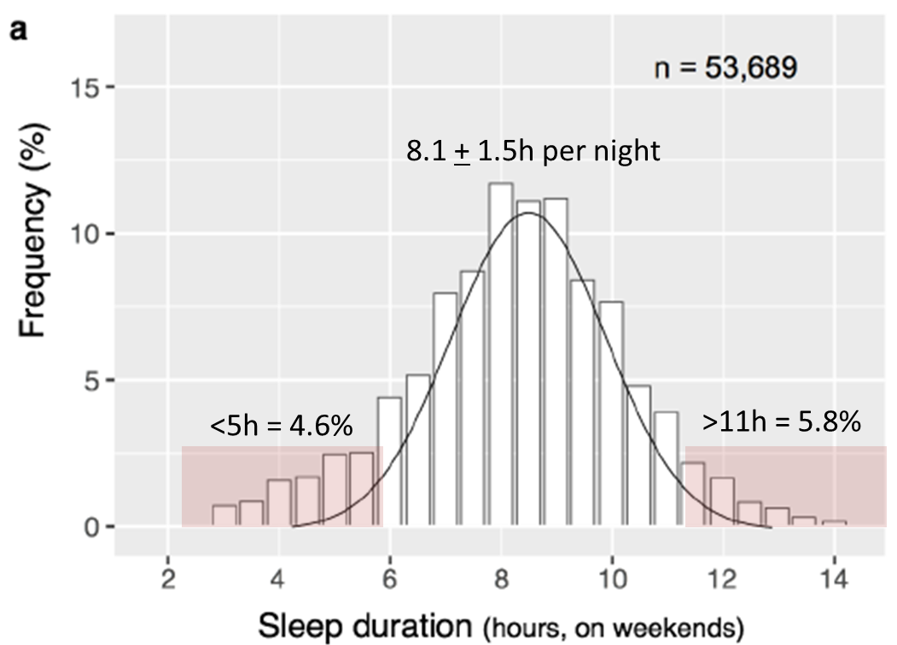
U.K.
941 men and 1,056 women
How much sleep do we need?
U.S.A.
American Time Use Survey (n=53,689)
JA Groeger et al. J Sleep Res 2004; 13: 359-71
Fischer D et al. PLoS ONE 2017; 12(6): e0178782

Slide 4
Sleep duration and self-rated health problems
Japan
Korea
Thailand
Taiwan
Steptoe A et al. Arch Int Med 2006;166:1689-92

Slide 5
Questions to address
Cause, consequence or symptom?
Short vs long term effects?
Time in bed vs time asleep vs naps?
Self-report vs direct sleep assessment?
Sleep vs phase of sleep?
Age and Gender effect?
Genetic determinants?
Reversibility of effect?

Slide 6

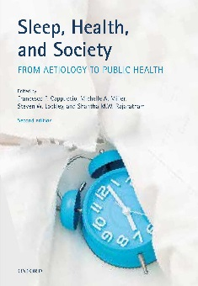
Focusing on sleep deprivation (short sleep)
Short sleep
Mechanisms
Inflammation
Appetite
Neuro
Endocrine
Molecular
Genetic
Risk factors
Hypertension
Diabetes
Obesity
High cholesterol
High trigs
Low HDL-chol
Metabolic synd.
Outcomes
Death
CHD
Stroke
Heart failure
Cancer
© Cappuccio FP & Miller MA (2010).

Slide 7
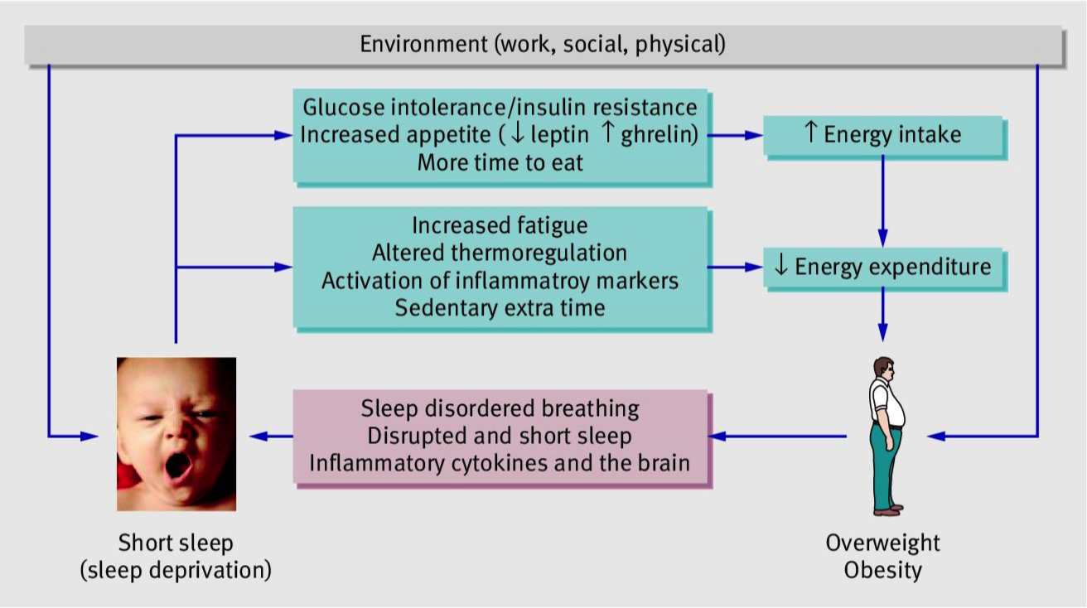
Is prolonged lack of sleep associated with obesity?
Bi-directional model of the sleep deprivation-obesity association¹
Children: OR = 1.89 (1.46, 2.43)²
Adults: OR = 1.55 (1.43, 1.68)²
¹ Cappuccio FP & Miller MA. Br Med J 2011; 342: d3306
² Cappuccio FP et al. Sleep 2008; 31: 619-26

Slide 8
Is prolonged lack of sleep associated with obesity?
Bi-directional model of the sleep deprivation-obesity association¹
Children: OR = 1.89 (1.46, 2.43)²
Adults: OR = 1.55 (1.43, 1.68)²
Children: RR = 1.57 (1.34, 1.85) ³
¹ Cappuccio FP & Miller MA. Br Med J 2011; 342: d3306
³ Miller MA et al. Sleep 2018; 41(4): zsy018
² Cappuccio FP et al. Sleep 2008; 31: 619-26

Slide 9
Effects of sleep reduction on cardio-metabolic mechanisms: evidence in healthy volunteers
two days of 4h sleep vs 10h sleep cause a reduction in serum leptin and an increase in serum ghrelin, increasing hunger and appetite. The effect is dose-dependent and reversible (Spiegel K et al. Nat Rev Endocrinol 2009;5:253-61)
Five nights of 4h sleep vs 10h sleep cause an increase in all indices of glucose intolerance and insulin resistance (ibidem)
3 weeks of sleep restriction (5.6h pn) and concurrent circadian disruption increases post-prandial glucose response due to reduced pancreatic insulin secretion (Buxton OM et al. Sci Trans Med 2012; 4: 129ra43)
4 days of 4.5h vs 8.5h sleep reduces insulin sensitivity due to impaired pAKT phosphorylation and reduced insulin-receptor transduction (Broussanrd JL et al. Ann Intern Med 2012; 157: 549-57)
One week of 5.7h sleep v 8.5h sleep causes up- and down-regulation of 711 genes associated with circadian rhythms, sleep haemostasis, oxidative stress and metabolism (Möller-Levet CS et al. PNAS 2013; 110: E1132-41)
Children and adolescents who exhibit late sleep timing are more likely to make poorer dietary choices (more sugary/caffeinated beverages and high-energy-dense, nutrient-poor foods and more food throughout the day and into the nighttime hours (Thellman KE et al. Sleep Health 2017; 3: 269-75)

Slide 10
Short sleep and metabolic consequences?
Energy expenditure
Appetite
Insulin resistance
Glucose tolerance
Obesity
Type-2 diabetes?

Slide 11
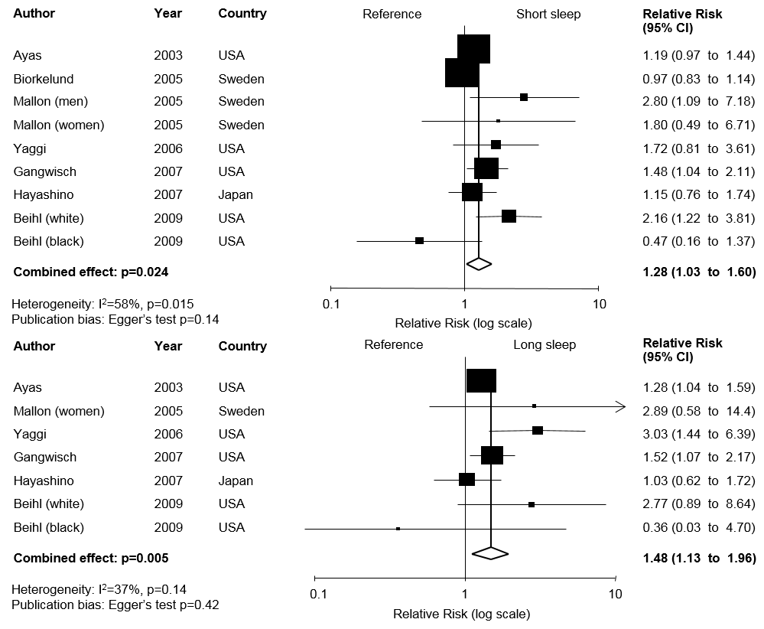
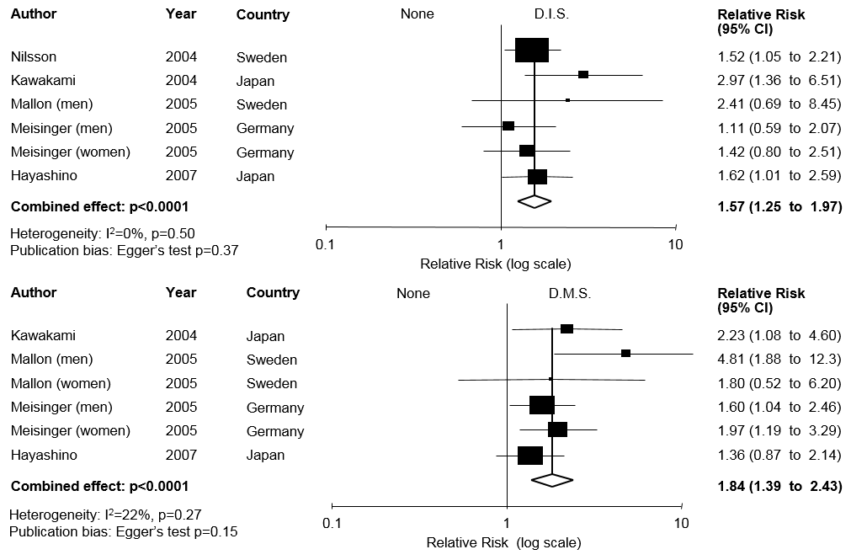
Short duration of sleep and incidence of type-2 diabetes
Exposure
Short sleep duration
Difficulty in initiating sleep
Difficulty in maintaining sleep
Cappuccio FP et al. Diabetes Care; 2010; 33: 414-20

Slide 12
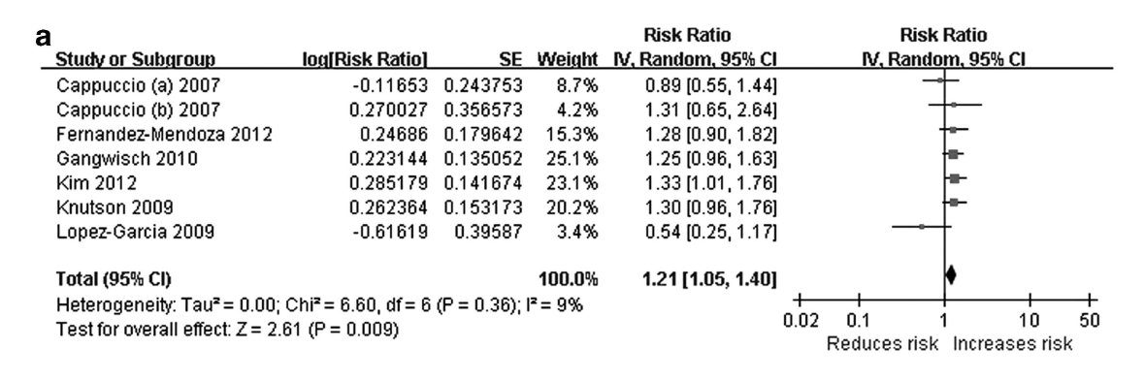
Sleep duration and incidence of hypertension
Effect of variations in sleep duration on 24h blood pressure is reversible (Haack M et al J Sleep Res 2013; 22: 295-304)
Effect on incidence of hypertension associated mainly with a reduction in Slow Wave Sleep (Fung MM et al. Hypertension 2012; 169: 1055-61)
Meng L et al. Hypertens Res 2013; 36: 985-95

Slide 13
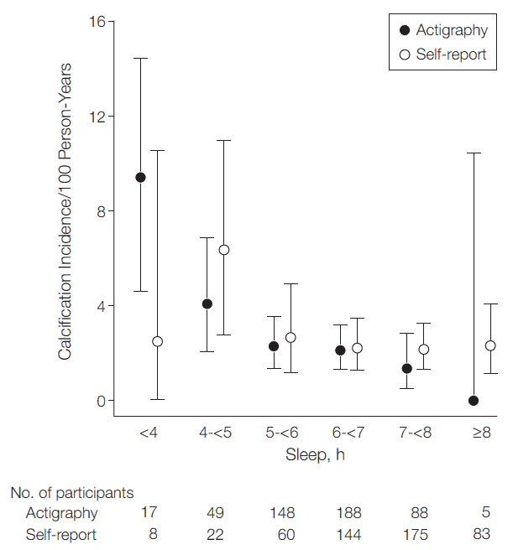
Incidence of Coronary Calcifications by sleep duration
(The Chicago CARDIA Cohort Study)
OR=0.67 (0.49-0.91) per h
P=0.01
Effect stronger in women
Women (n=291)
0.48 (0.27- 0.85)
Men (n=203)
0.76 (0.52 -1.10)
King CR et al. JAMA 2008; 300(24): 2859-66

Slide 14
Short sleep
Mechanisms
Inflammation
Risk Factors
Hypertension
Outcomes
CHD
Metabolic
Vascular
Hormonal
Obesity
Diabetes
Stroke
Death
High cholesterol
CVD
Vascular calcifications
Molecular
Genetic
Modified from: Cappuccio FP & Miller MA. Sleep 2011; 34(11): 1457-8

Slide 15
Short duration of sleep is associated with higher risk of …..
POLICY IMPLICATIONS
1. Understand how sleep disturbances contribute to chronic disease
2. Increase the awareness of the importance of sleep
3. How to improve sleep for health and wellbeing
a) behaviour
b) environment/society
Diabetes (28%)³
C.H.D.
(48%)⁴
Stroke
(15%)^{4,5}
Premature death (12%)⁶
Obesity
(57%)¹
Hypertension (21%)²
¹Miller MA et al. Sleep 2018; 41(4): zsy018; ²Meng L et al. Hypertens Res 2013; 36: 985-95; ³Cappuccio FP et al. Diabetes Care; 2010; 33: 414-20; ⁴Cappuccio FP et al. Eur Heart J 2011; 32: 1484-92; ⁵Leng Y et al. Neurology 2015; 84: 1072-9^{; 6}Cappuccio FP et al. Sleep 2010; 33:585-92

Slide 16



Benefits of napping ?
‘Power’ naps (20min) improve alertness and motor learning skills
SHORT TERM
30m ‘siesta’ associated
with 30% lower CHD
Trichopoulos D et al. 1988
LONG TERM
Is ‘day-time napping’ always healthy and free from hidden risk?

Slide 17
Day-time napping and risk in EPIC-Norfolk
Is ‘day-time napping’ always healthy and free from hidden risk?
Increased risk of diabetes²
Napping: HR 2.57 (95% CI: 1.74 – 3.78)
No napping: HR 1.42 (95% CI: 0.95 – 2.15)
Increased risk of premature death³
<1h nap: HR 1.14 (95% CI: 1.02 – 1.27)
>1h nap: HR 1.32 (95% CI: 1.04 – 1.68)
Increased risk of respiratory disease¹
<1h nap: HR 1.32 (95% CI: 1.15 – 1.52)
>1h nap: HR 1.54 (95% CI: 1.14 – 2.09)
¹ Leng Y et al. Sleep Med 2016; 23: 12-15
² Leng Y et al. NMCD 2016; 26: 996-1003
³ Leng Y et al. Am J Epidemiol 2014; 179: 1115-24

Slide 18
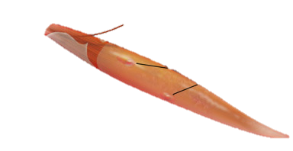
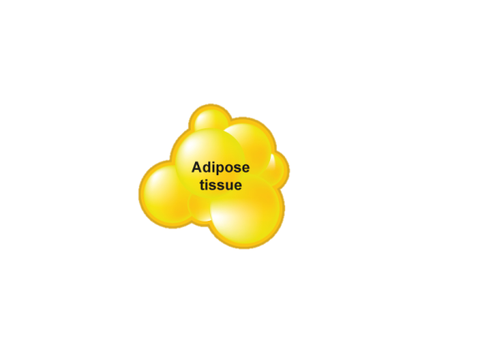
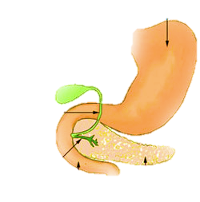
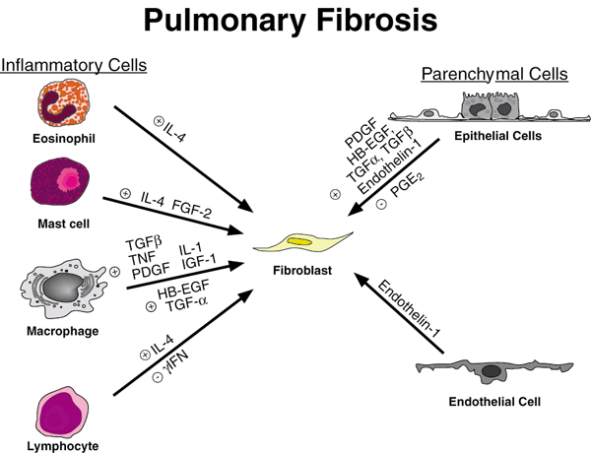

Environment (physical, social, work)
Genetics
Sleep loss or disturbance
⬇energy metabolism
⬆SNS
Altered circadian rhythms
⬇ SWS
HPA axis
STROKE
Orexin ➔ NPY
BP & HR variability
⬇Cognitive function
⬆Appetite
Food intake
OBESITY
Na⁺ retention
Evening cortisol
⬆ Ghrelin
⬇ Leptin
⬇ Glucose tolerance
⬆ Insulin resistance
⬆ Inflammation
CHD
Coronary
calcification
DIABETES
HYPERTENSION
Hyperlipidaemia
Atherosclerosis
Miller MA & Cappuccio FP. J Hum Hypert 2013; 27: 583-8
Cappuccio FP & Miller MA. Curr Cardiol Reports 2017; 19: 110
Notes:
18

Slide 19
Why do we sleep less?
Reduced sleep duration is associated with delayed bedtime (B) but not with early wake time (A)
On-line data submission via app (n=5,450)
Walch OJ et al. Sci Adv 2016; 2: e1501705

Slide 20
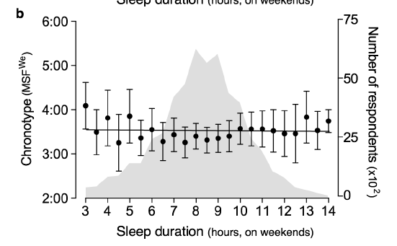


Can we sleep anytime?
Sleep is not a biological constant but a universal necessity.
Pre-industrial sleep in Western history was segmented (two intervals at night bridged by an hour or more of wakefulness) and of poor quality
Industrial Revolution confined sleep to a single interval for ‘efficiency’
Artificial lighting led to later bedtimes
Short and long sleepers are equally frequent among early and late chronotypes
American Time Use Survey (n=53,689)
Ekirch AR. Sleep 2016; 39: 715-6
Fischer D et al. PLoS ONE 2017; 12(6): e0178782

Slide 21
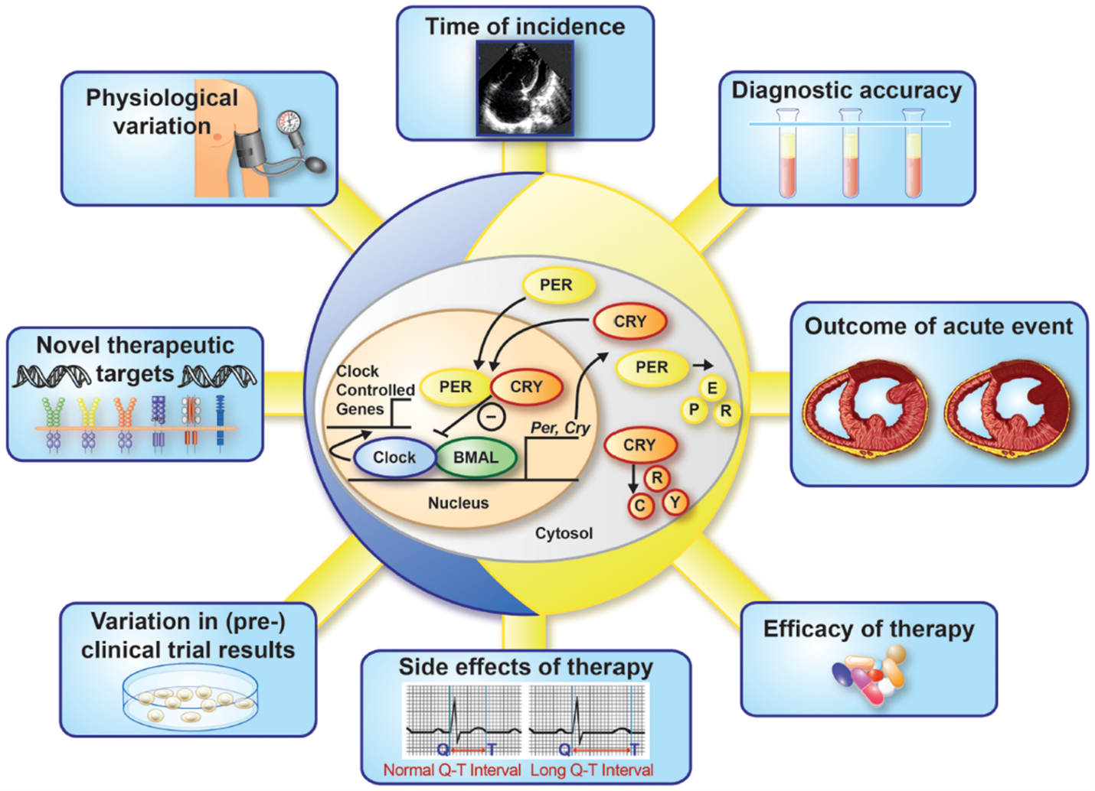
The molecular circadian clock (centre) sustains a 24-h rhythm of several cardiological functions
Van Laake LW et al. Eur Heart J. 2017; 39(24): 2326-2329
Notes:
Figure 2 The molecular circadian clock and cardiology. The molecular circadian clock, of which a simplified version is schematically depicted in the centre, sustains a 24-h rhythm that has impact on several facets of cardiology.
21

Slide 22
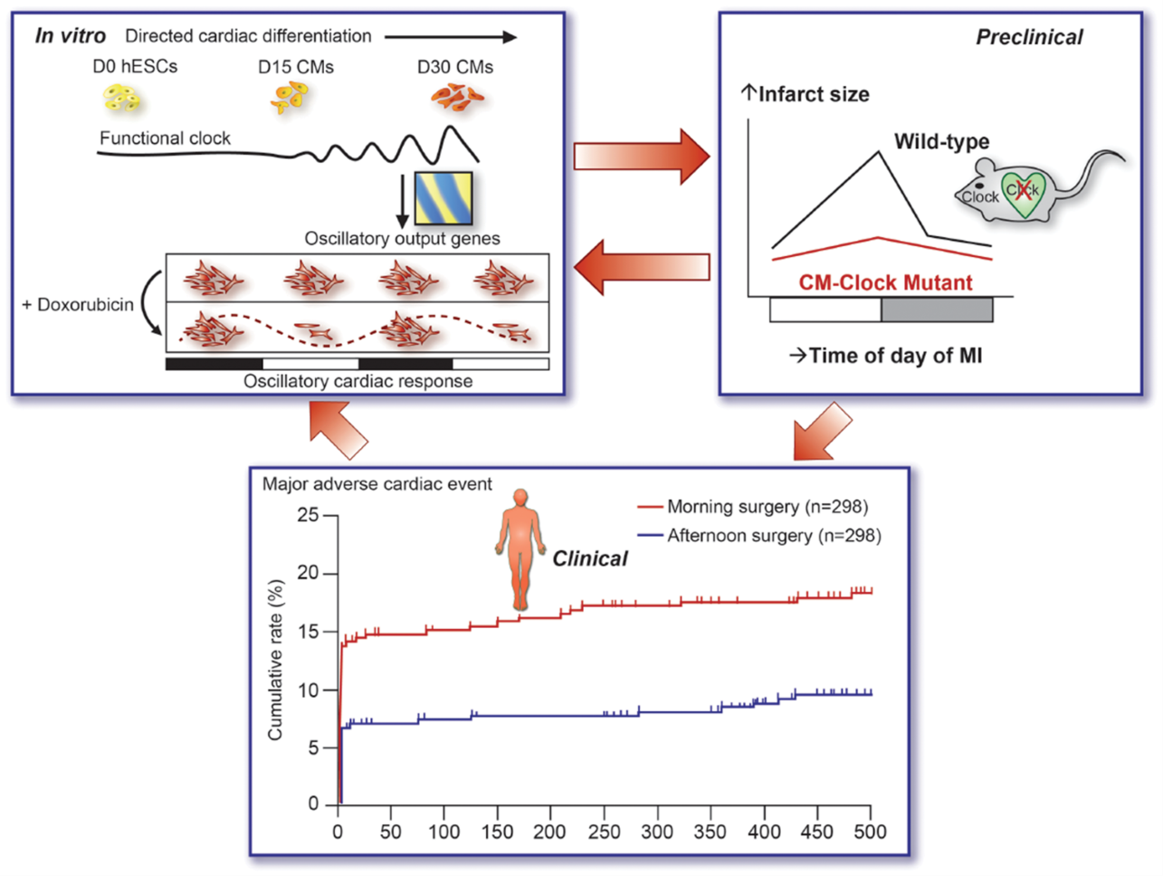
The circadian clock affects stress tolerance in human stem cell-derived cardiomyocytes and progenitor cells, mouse cardiomyocytes in an ischaemia-reperfusion model, and human cardiomyocytes in aortic valve replacement surgery with impact on clinical outcome
Van Laake LW et al. Eur Heart J. 2017; 39(24): 2326-2329
Notes:
Figure 3 Crucial impact of circadian rhythms on cardiology: a translational vision. The circadian clock crucially affects stress tolerance in human stem cell-derived cardiomyocytes and progenitor cells (mechanistic platform; figure modified from Dierickx et al.<sup>8</sup>), mouse cardiomyocytes in an ischaemia-reperfusion model<sup>9</sup> (bridging translational step), and human cardiomyocytes in aortic valve replacement surgery<sup>10</sup> with impact on clinical outcome (clinical application). MI, myocardial infarction.
22

Slide 23
Summary
The association between short duration of sleep and cardio-metabolic risk factors and outcomes may reflect causality as
The effects are strong: large relative risks
They are consistent: confirmed in different populations for several end-points
They show a temporal sequence: short sleep preceding end-points
Dose – response: consistent threshold effects
Biological plausibility: there are several potential mechanisms involved (genetic, molecular, cellular, physiological, …)
Reversibility: confirmed when tested in controlled trial conditions (at least short-term)
Bradford Hill criteria for causation: Hill AB. Proc Royal Soc Med 1965; 58(5): 295-300

