Slide 1
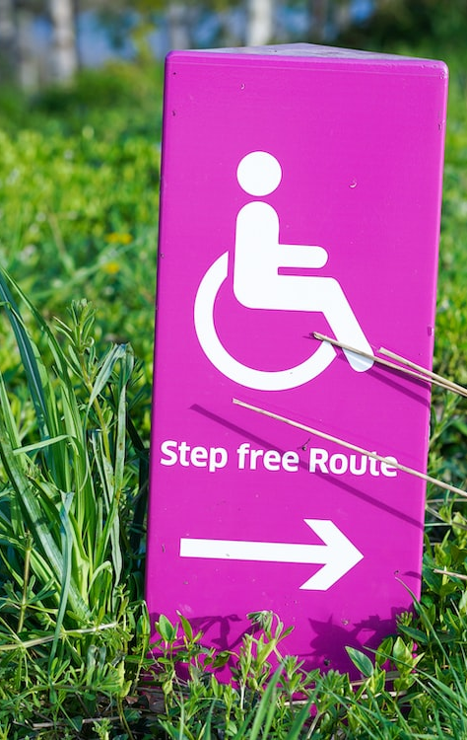
Disability Services
Offering advice, guidance and support to students
with disabilities at the University
Sarah Corbett – Head of Disability Service

Slide 2
Diversity of disability
Neurodevelopmental, Social, Communication differences, Autism Spectrum, Asperger’s
Blind or a serious visual condition uncorrected by glasses
D/deaf, other hearing issues or conditions
A long-standing physical illness or health condition (such as ME/chronic fatigue, epilepsy, diabetes, digestive conditions, or HIV)
A mental health condition, such as depression, anxiety, OCD, or schizophrenia
Neurodiverse, specific learning differences (such as dyslexia, dyspraxia, or ADHD)
A physical or mobility issue, use of mobility aids or difficulty using arms
A disability or medical condition that is not listed above, such as speech difficulties/stammer
You’re disabled under the Equality Act 2010 if you have a physical or mental impairment that has a ‘substantial’ and ‘long-term’ negative effect on your ability to do normal daily activities.

Slide 3

Who are the Disability Team?
We are made up of:
Heads of Disability Services
Disability Advisers
Specialist Study Skills Tutors
Autism Mentors
Mental Health Mentors

Slide 4


Who do we support?
All students, including:
Two plus two
Foundation
Undergraduate
PGCE
Degree apprenticeships
Postgraduate Taught
Postgraduate Research

Slide 5

What support do we offer?
Guidance, support and advice to disabled students
Transition programme offered to autistic students
Supporting with accommodation requirements
Putting in place reasonable adjustments, including exam arrangements, informed by supporting evidence
Advice about the Disabled Student Allowances and other available funding
Specialist study skills support, specialist (AS and MH) mentoring and other enabling support
Neurodivergence Advice Discussion
Advice on assistive technology and productivity tools

Slide 6


Student groups
Wellbeing and Disability Services Groups:
ADHD Support Group
Face-to-face individual therapy
Compassion-Focused Therapy (CFT) for Perfectionism Groups
Interpersonal Relations Groups
Beyond Trauma Group
Societies at Warwick:
Autism@Warwick
Warwick Enable
ADHD Society

Slide 7
Wellbeing Support Services- The Student Journey
Disability adviser appointment, study skills or mentoring
Referral to relevant team(s) for appropriate support
Department signposting or student self referring to WSS
Wellbeing portal - single point of entry with daily initial consultations
Self-help resources
Ongoing support, follow up, liaising with Dep and other services
(Disability, MH Nurses, CAPIT, Statutory Services, sexual and domestic violence adviser, student funding etc. )

Slide 8
Students are encouraged to
Be open and share information about a disability at an early stage
Consider in advance and reflect early on the impact any difficulties might have on their academic and clinical performance
Engage with the Disability team and the WMS support team to explore support options suitable to their needs
Communicate any concerns and discuss any issues as promptly as possible

Slide 9
Other support services
WMS support team
Wellbeing Support Services
Library Services
SU Disabled students’ officer and advice centre
Student Societies and Networks
Student Funding
International Office
Residential Community team
Community Safety team

Slide 10
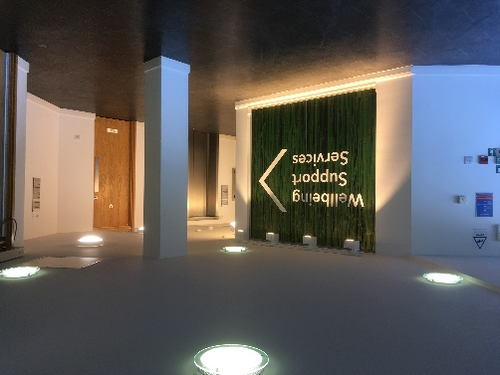
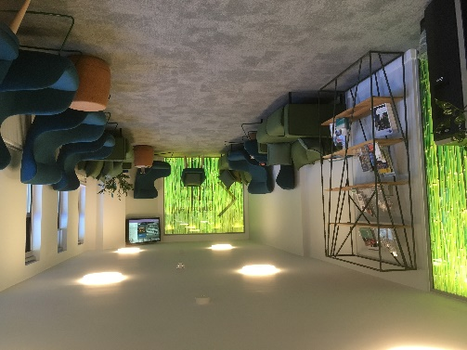
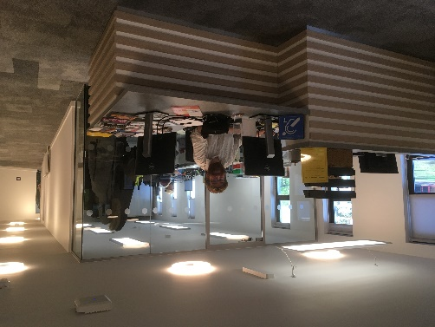
Further information on accessing our services
 024 7657 5570
disability@warwick.ac.uk
https://warwick.ac.uk/services/disability
Wellbeing Support Reception is based at Senate House

