Slide 1
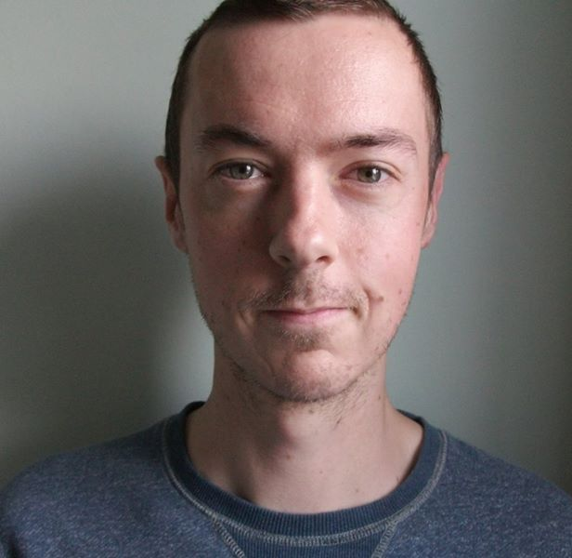
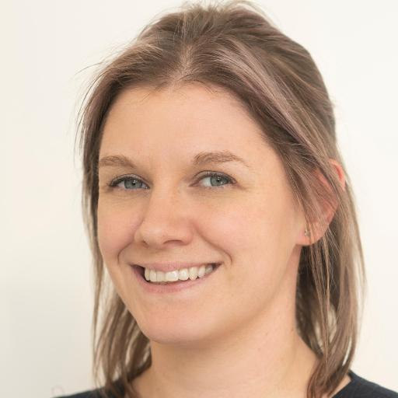
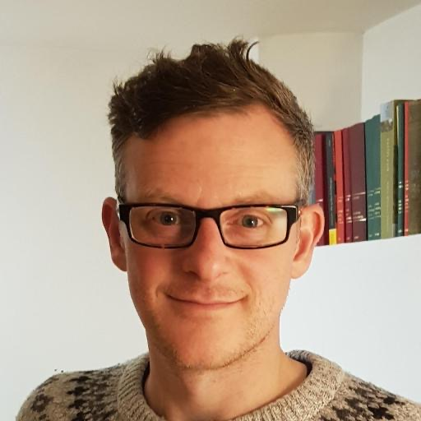

Phase 1 Curriculum
Studying for a medical degree at WMS
Dr Greg Moorlock – Phase 1 Academic Lead
Dr Helen Poulton & Dr Mark Richards – Phase 1 Academic Deputies | Phase 1 Deputy Senior Tutor
Warwick Medical School
March 2026

Slide 2
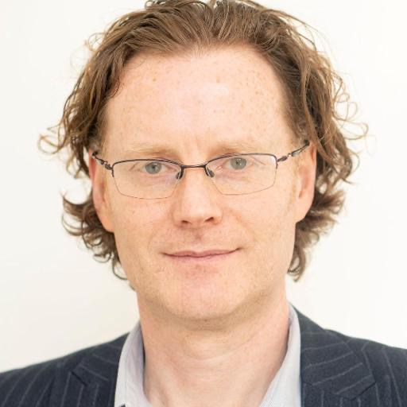
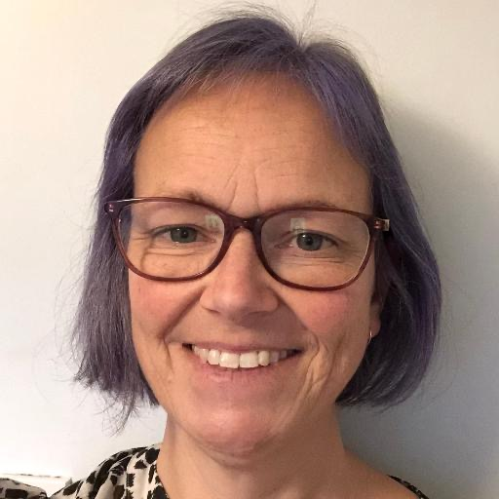


MBChB Team
Associate Dean (Medical Education)
Prof Colin Macdougall
Email: colin.macdougall@warwick.ac.uk
Director of Medical Studies
Prof Kate Owen
Email: katherine.owen@warwick.ac.uk
Phase 1 Programme Manager
Laura Cranshaw
Email: L.Cranshaw@warwick.ac.uk
Phase 1 Programme Co-ordinator
Anjula Kang
Email: A.Kang@warwick.ac.uk

Slide 3
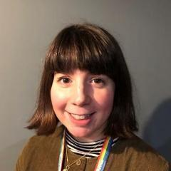
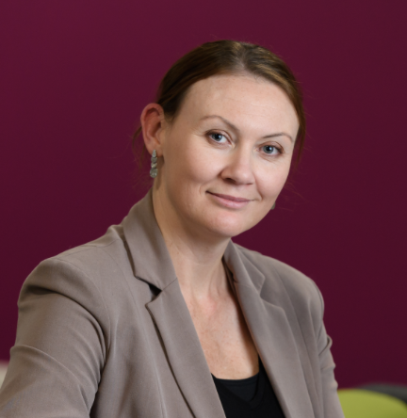
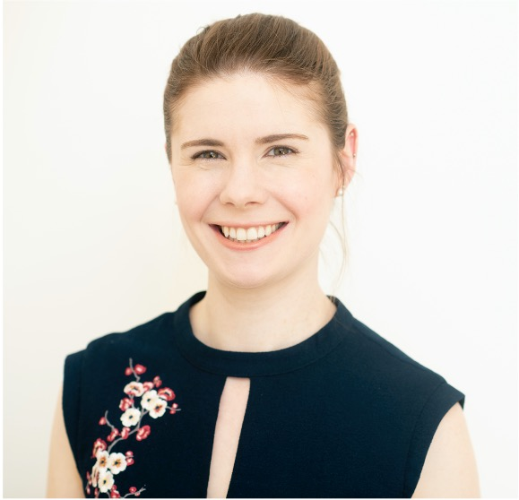
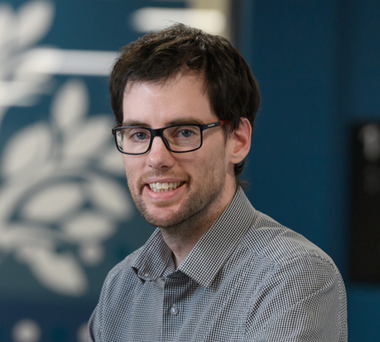
MBChB Phase 1 – Academic Block Leads
Block 1 Lead
Dr Clare Garcin
Block 2 Lead
Dr Helen Strachan Jones
Block 3 Lead
Dr Crispin Wiles
Block 4 Lead (CAI co-lead)
Dr Natalie Keough
Block 5 Lead (Deputy Phase 1 Lead)
Dr Helen Poulton

Slide 4

How will I learn medicine???
Accelerated 4-year course
CBL curriculum
Synchronous & asynchronous learning
Early patient contact
Clinical placements across Coventry & Warwickshire, and beyond
Assessment across every Phase
Notes:
Challenges:
“there’s so much to learn”
“there’s not enough time to do everything”
“how can we discuss things in CBL if we haven’t had a lecture on it yet?”
“not efficient way for me to learn”
“too far to travel…takes too long to travel…cost of parking…”
“we need more time to revise”
Accelerated – yes, there is a lot to learn. You have opted for an accelerated graduate entry medicine course.
There is a compressed “pre-clinical” phase, with heavy amounts of fundamental sciences.
Please engage in the information given to you in advance, particularly those coming from a non-science background, to make sure you are up to speed with what to expect.
Synchronous & asynchronous learning
Face to face – CBL, group work, workshops, clinical placements
Asynchronous – recordings, interactive workbooks, SDL tasks, quizzes etc
Varied methods of delivery – there will be some things that suit you better than others. You need to engage with everything, and find out what is the best way for you to learn.

Slide 5
Phase 1 Overview
3 terms
September – December
January – March
April – June
Please note:
MB ChB course operates outside the University term dates
Notes:
Welcome week 2026 = Monday 21st September

Slide 6
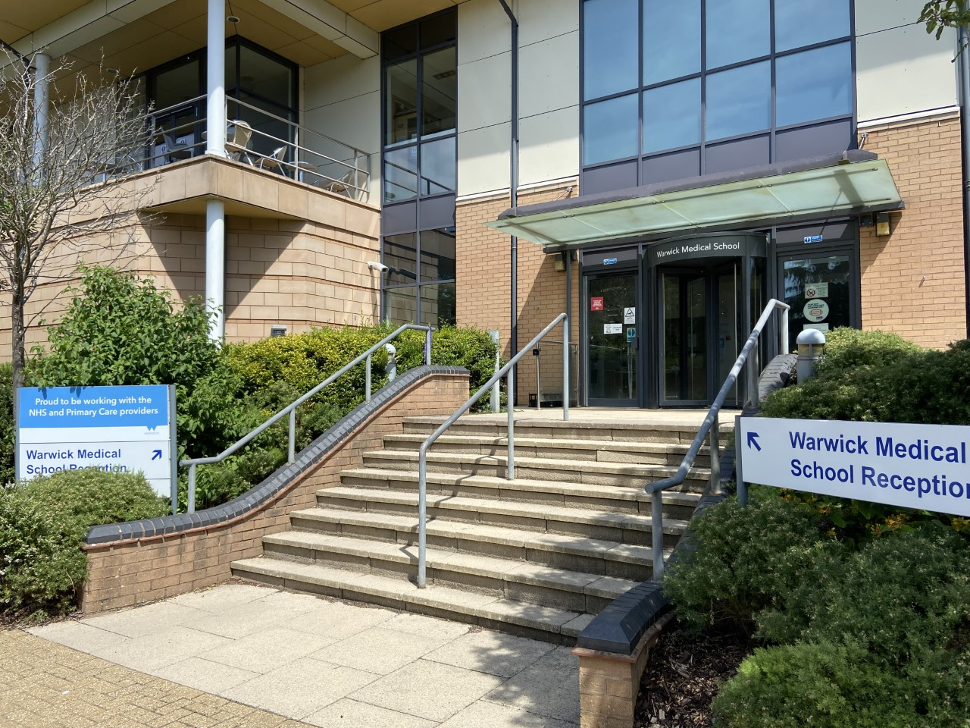

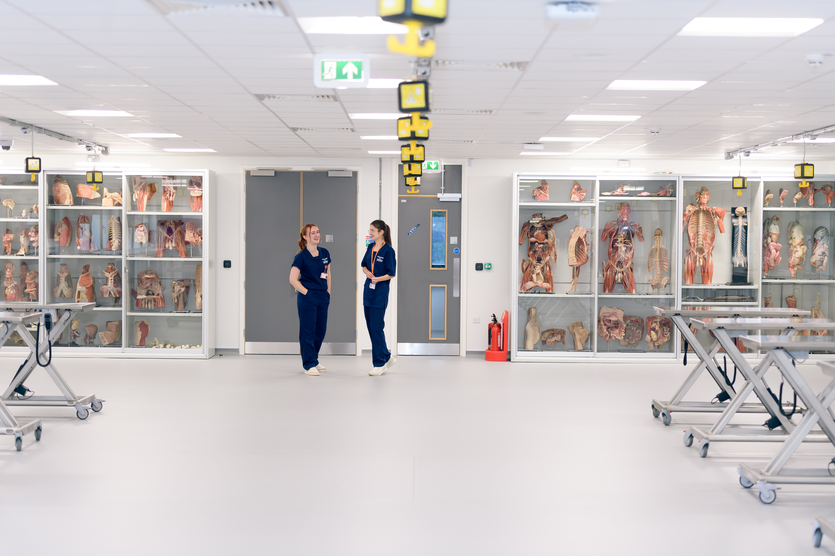
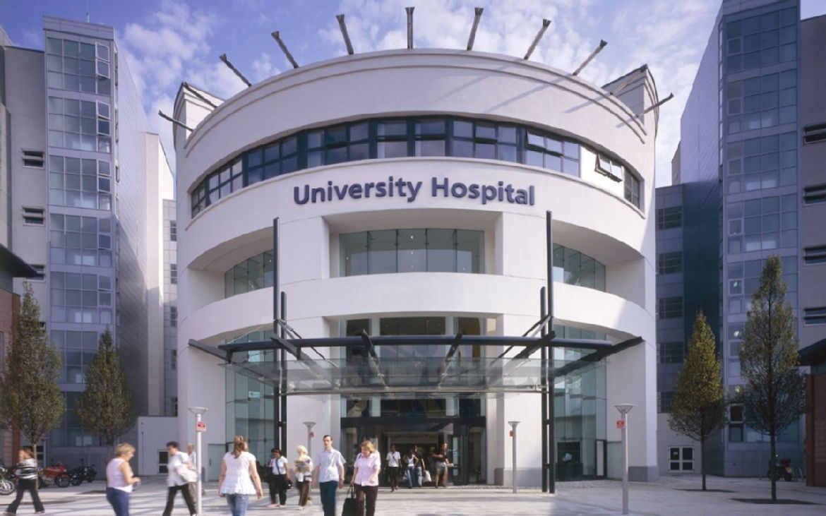

Where will I study?
University of Warwick - Gibbet Hill Campus
Medical Teaching Centre (MTC)
Medical School Building (MSB)
Interdisciplinary Biomedical Research Building (IBRB)
University of Warwick - Clinical Education Hub
Clinical Anatomy
Clinical Skills
Clinical Placements
Community
Hospital trusts

Slide 7
Phase 1 Overview
Foundations of science and medicine
Blended learning
Early interaction with patients
Preparation and foundation for clinical Phases 2/3

Slide 8
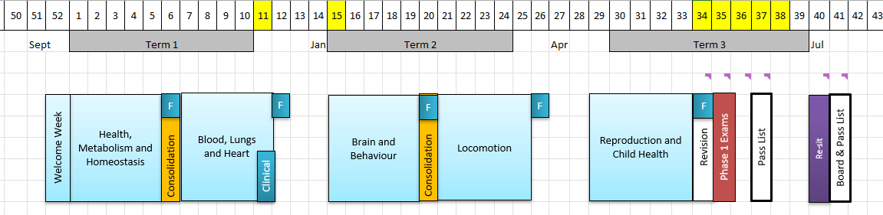
Phase 1 Structure

Slide 9

Welcome Week 2026
Monday 21st September - Friday 25th September
Learn about what the next 4 years will hold in store for you through an exciting range of introductory activities:
Welcome to MBChB and Phase 1
Opportunities to meet current students and staff
Meet your personal tutor and tutor group
Introduction to Case Based Learning and your first case
Drop-in sessions to support your asynchronous learning
Introduction to the core values of WMS and the Warwick Doctor

Slide 10
Phase 1 Structure: Blocks and Themes
Led by WMS academic staff
Blocks:
Welcome Week
Health, Metabolism and Homeostasis
Blood, Lungs and Heart
Brain and Behaviour
Locomotion
Reproduction and Child Health
Integrated Themes:
Cell and Tissue Biomedicine
Clinical Anatomy and Imaging
Clinical Skills
Communication and Lived Experience
Community Learning
Personal and Professional Development
Pharmacology, Prescribing and Therapeutics
Social and Population Perspectives
Values, Law and Ethics

Slide 11
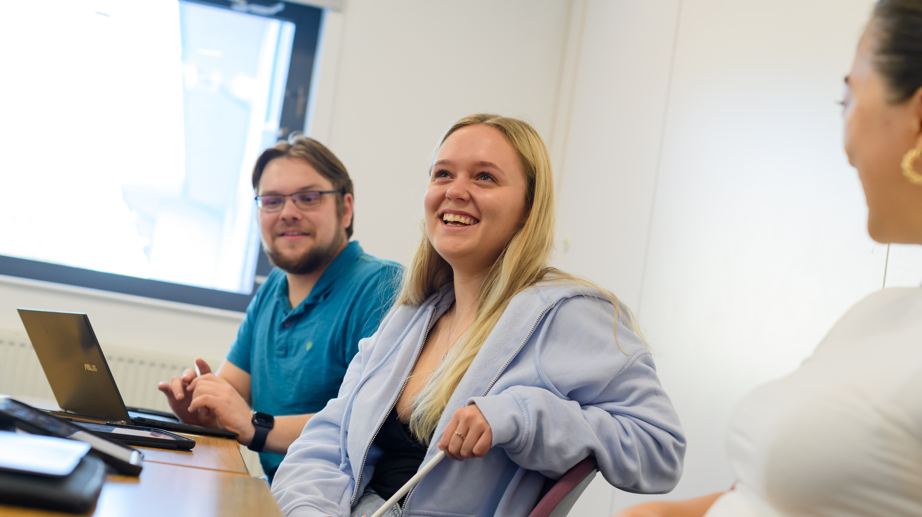
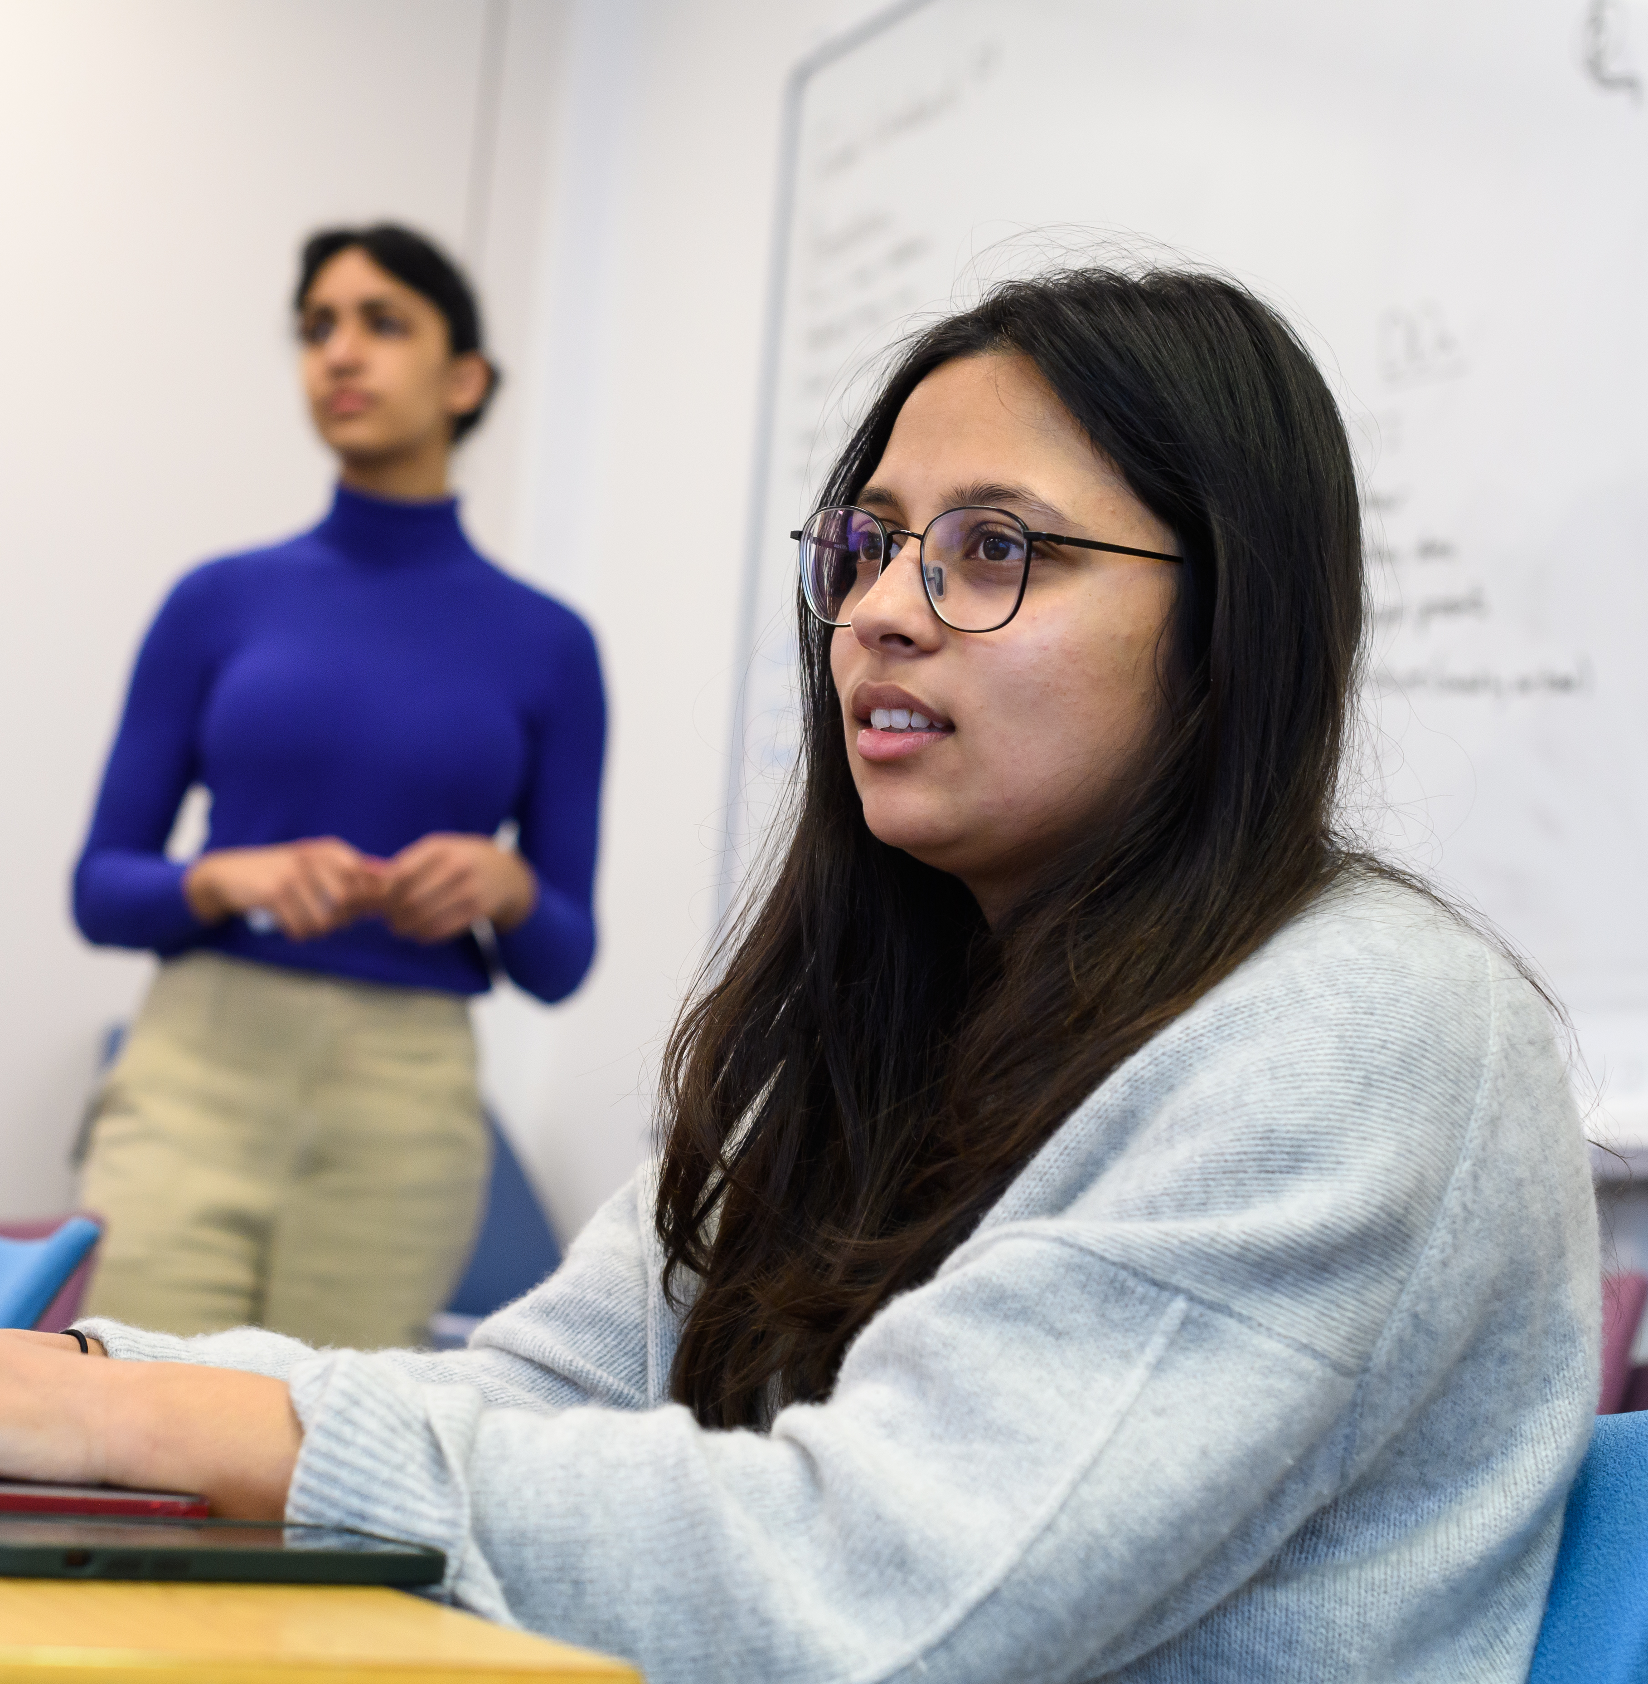

Case Based Learning

Slide 12


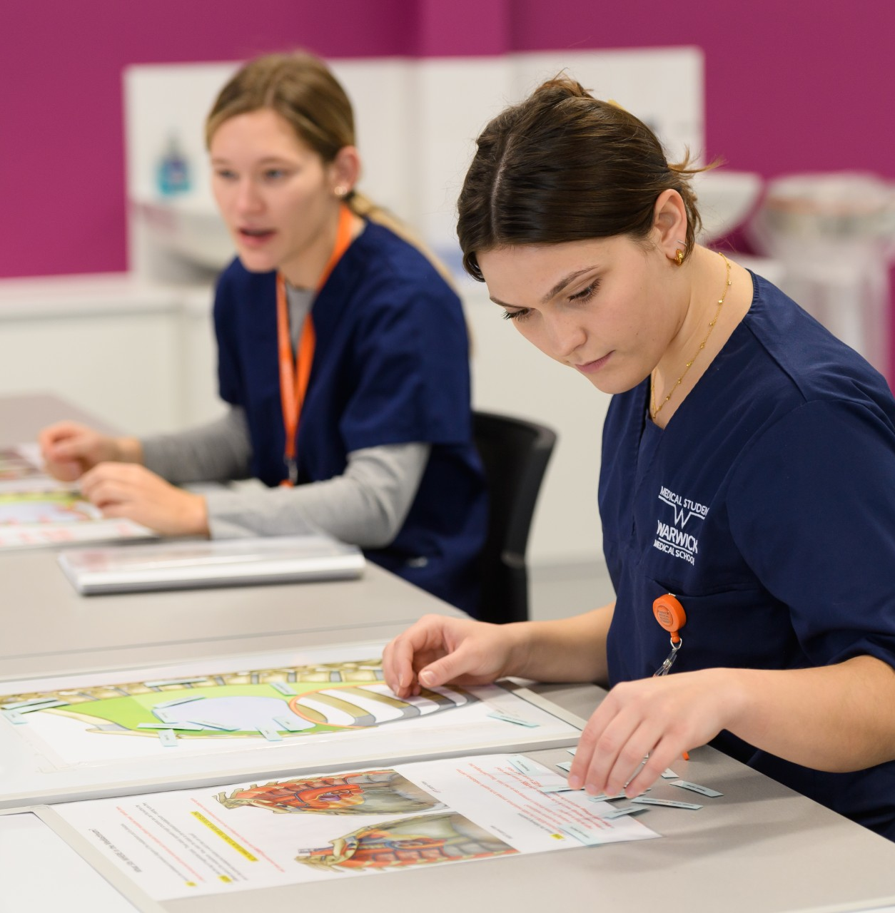
Synchronous & Asynchronous Learning
Notes:
SYNCHRONOUS – THEORY (or practical)

Slide 13
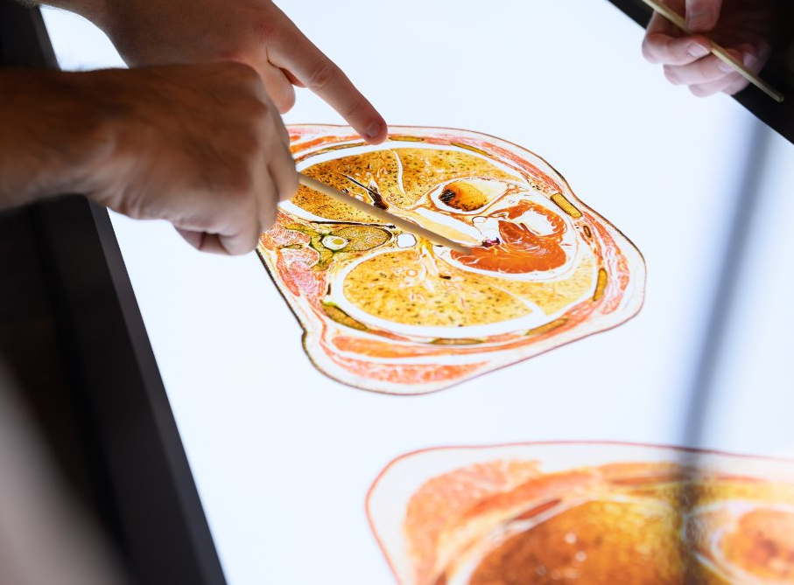
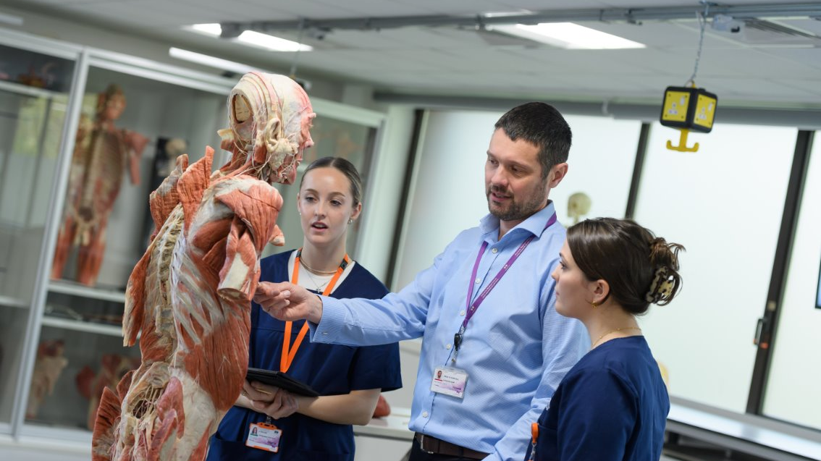
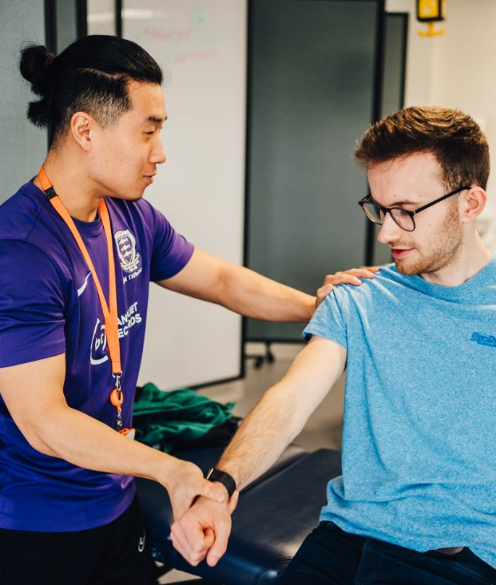
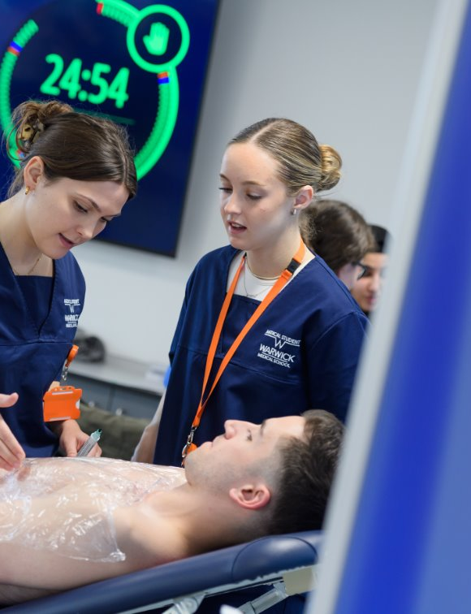
Synchronous & Asynchronous Learning
Notes:
SYNCHRONOUS – (theory) or PRACTICAL
Varied methods of delivery – there will be some things that suit you better than others. You need to engage with everything, and find out what is the best way for you to learn.

Slide 14
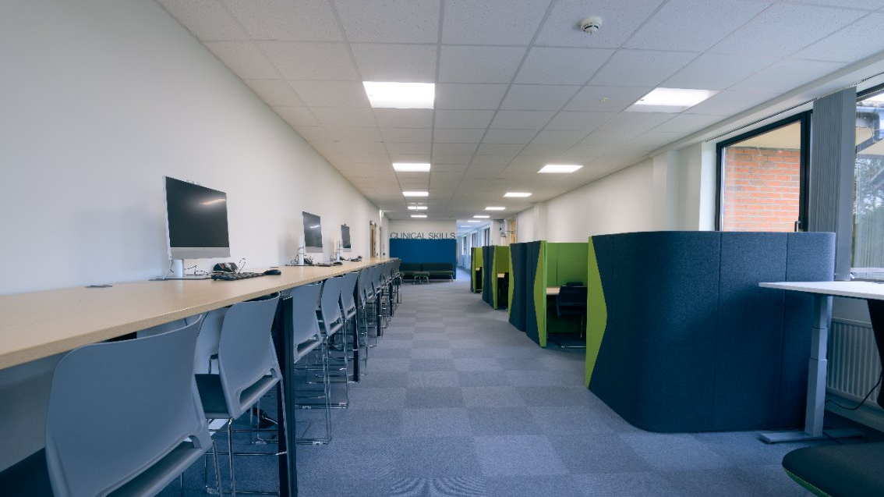

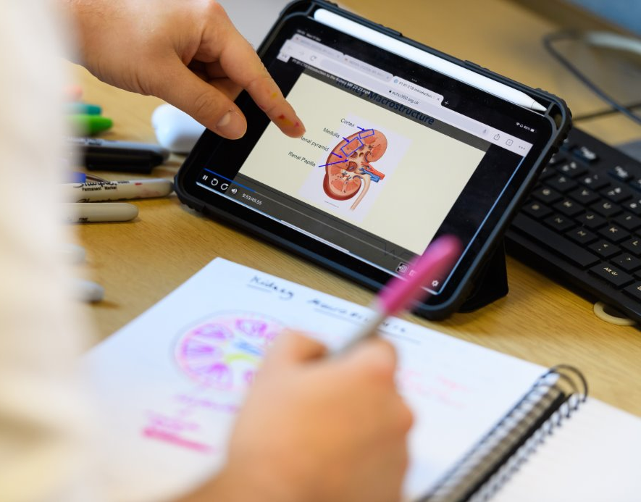
Synchronous & Asynchronous Learning
Notes:
Synchronous & asynchronous learning
Face to face – CBL, group work, workshops, clinical placements
Asynchronous – recordings, interactive workbooks, SDL tasks, quizzes etc
Varied methods of delivery – there will be some things that suit you better than others. You need to engage with everything, and find out what is the best way for you to learn.

Slide 15
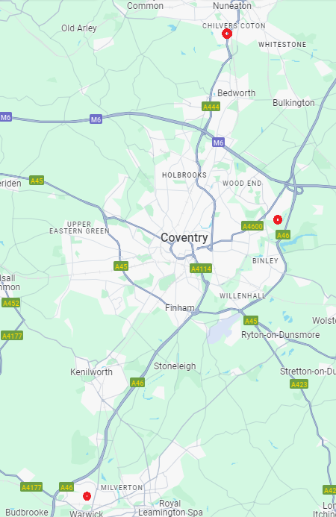
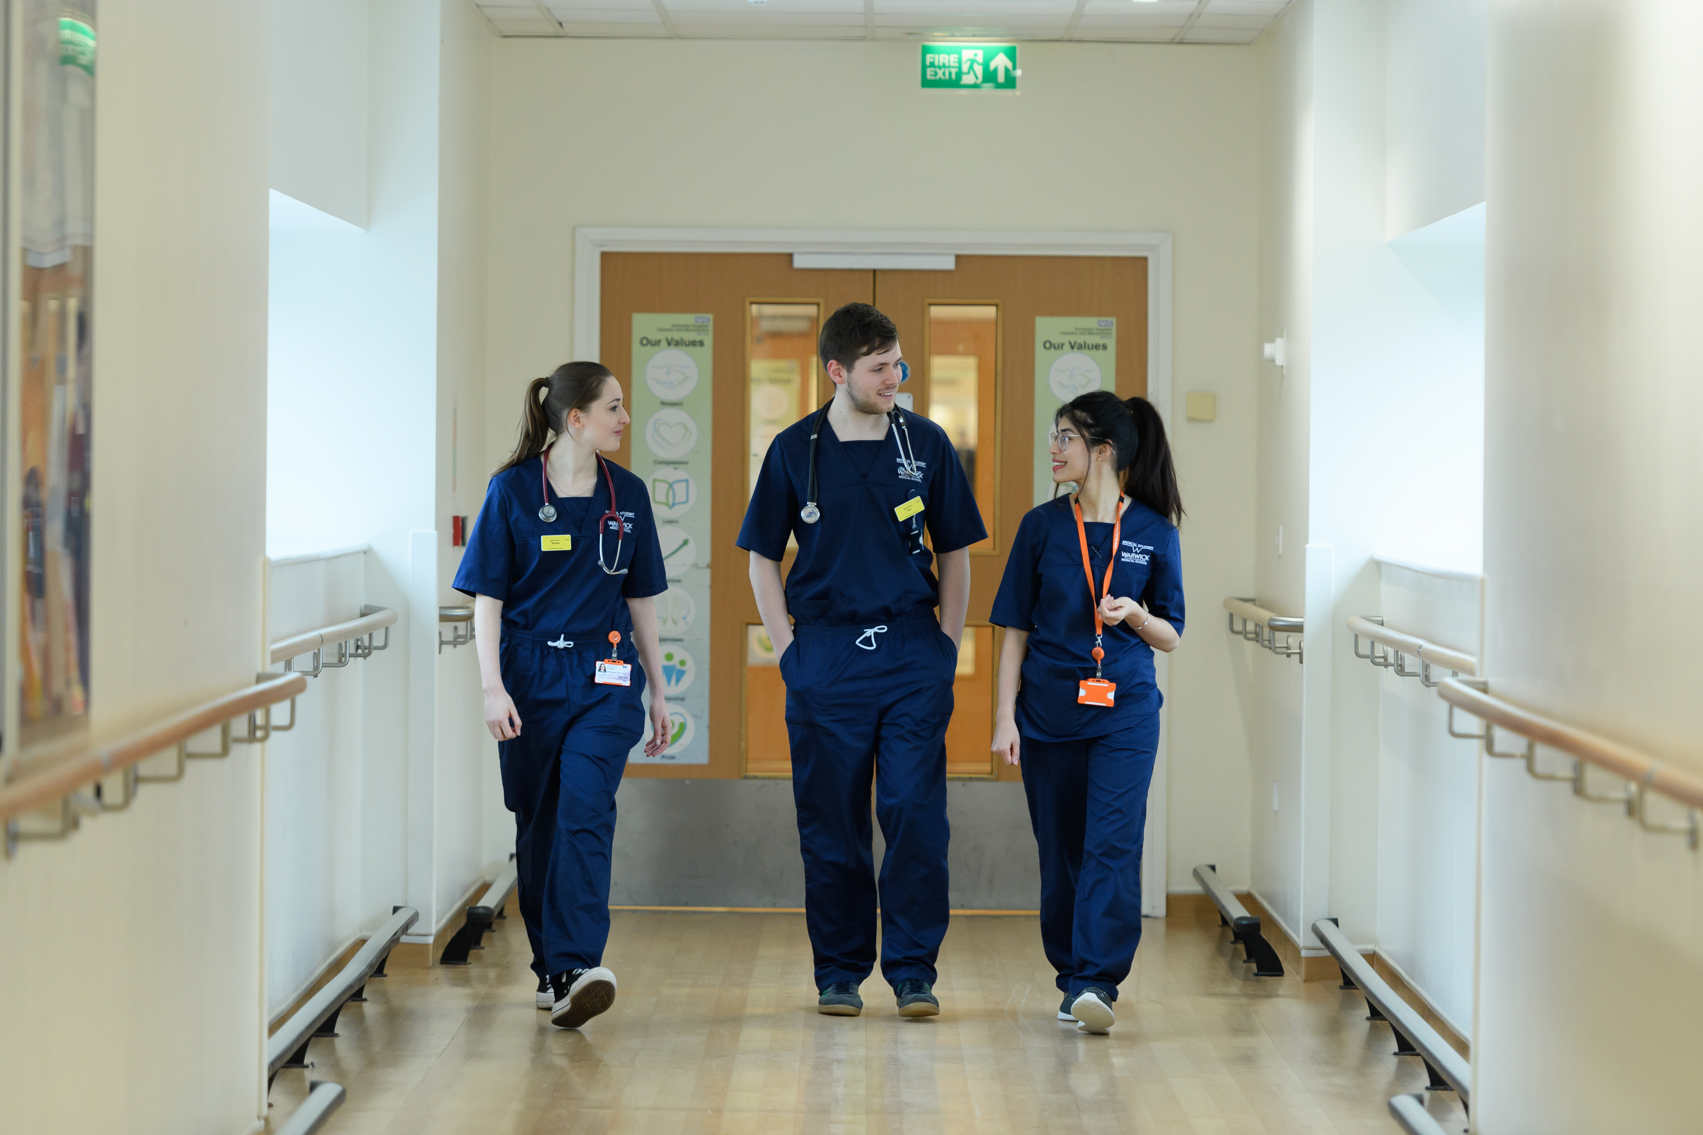
Clinical Placements
GEH
UHCW
WMS
Warwick
Notes:
Add WMS location marker
​
Main hospital placements, across 3 sites Warwick (7.2m), UHCW (9.3m), GEH (16.9m)​
​
Compare to other Midland Medical Schools UoB/Leic: 7-8 hospitals, Wolverhampton (19.6m) Worcester (26.3m), Hereford (55.8m); Helen Boston (65.9m)​
​
Cardiff – placements in north wales Bangor~175m​
​
​
SCRUBS: ​
You will notice the students wearing their navy blue WMS scrubs. ​
These are required for lab based teaching (e.g. CAI in the Beehive) and clinical/bedside teaching.​

Slide 16
Blending learning
Benefits
  Varied schedule
  (some) flexibility
    Control over your day/week schedule
    Reduced travelling time/cost
    Time for wellbeing – sleep/exercise/socialising
  Self-paced learning
  Value of F2F sessions
Challenges
  Varied schedule
  Lack of structure
    Need for self-regulation
    Attending for partial days
    Gaps between sessions
  Perceived value of attending F2F
Think about how you will manage different approaches to learning

Slide 17
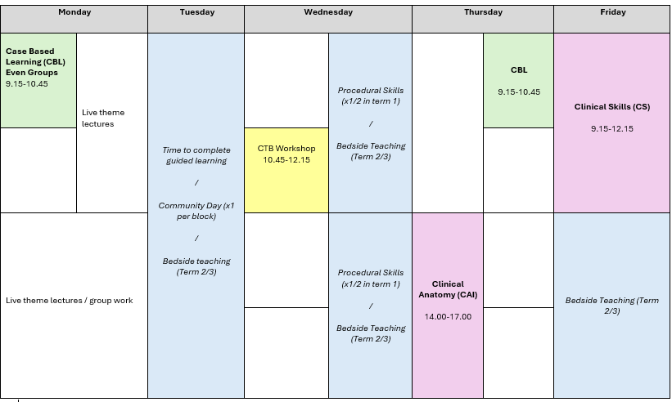
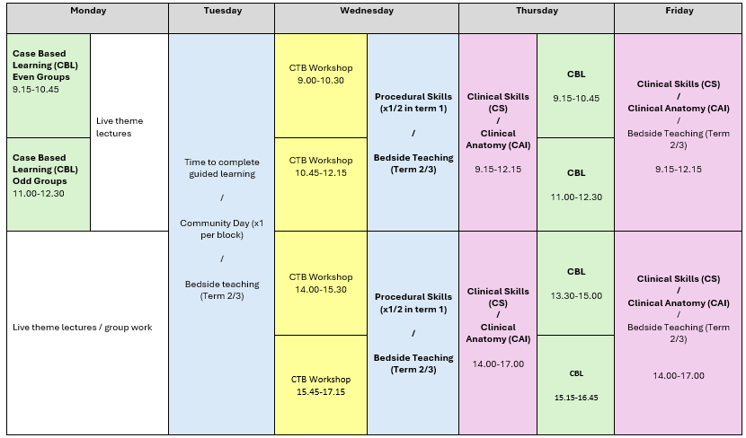
A typical week…

Slide 18

Things to think about…
Treat this like your full-time job!
Timetable changes
Proximity to University
Transport whilst at University
Working whilst attending a full-time* course
Professionalism on the course
Learning to learn again
Notes:
Things to think about – realistic expectations…
We expect you to be available for timetabled activities during normal working hours on weekdays (Monday-Friday 9-6pm). There may be occasions where there are short notice timetable changes, you need to be available to attend timetabled sessions.
We expect you to live within a reasonable commuting distance to University Campus/local clinical placement sites. From experience, we know that students commuting >1 hour can struggle with maintaining attendance & punctuality to sessions. (please be wary of advice from higher year students, as they may have had a different balance of teaching (with more on-line sessions during previous covid adjustments, which may have made commuting easier))
Travelling by car: Please note that car parking spaces are limited at Gibbett Hill Campus. A parking permit does not guarantee a space (this applies to all users, students and staff). If you are driving to campus, please allow plenty of time to arrive for your sessions to allow you to locate an appropriate parking space - during busy periods this may mean parking on MAIN CAMPUS and walking up to Gibbet Hill. A lot of students will choose to car share if living in similar locations, and there are good public transport options available if living in the local area. Campus accommodation is available, within walking distance to Gibbett Hill Campus and Clinical Education Hub
Full time course. We expect you to be spending ~40 hours a week (contact hours + self-directed learning) *link to next slide with hours graph
There are some students/situations where you might find that you need to spend more time than this…e.g. non-science background, time out of studying, learning differences (e.g. dyslexia, ADHD)
We advise you should not work more than 16hrs or two ordinary length shifts per week.
Professionalism: GMC says: Medical students must engage fully with course by attending all educational activities and by completing coursework.
Treat this like a job. Attendance is not optional. Complete absence forms honestly, and in a timely manner.
Learning to learn again – how, where, what resources? who to help?

Slide 19

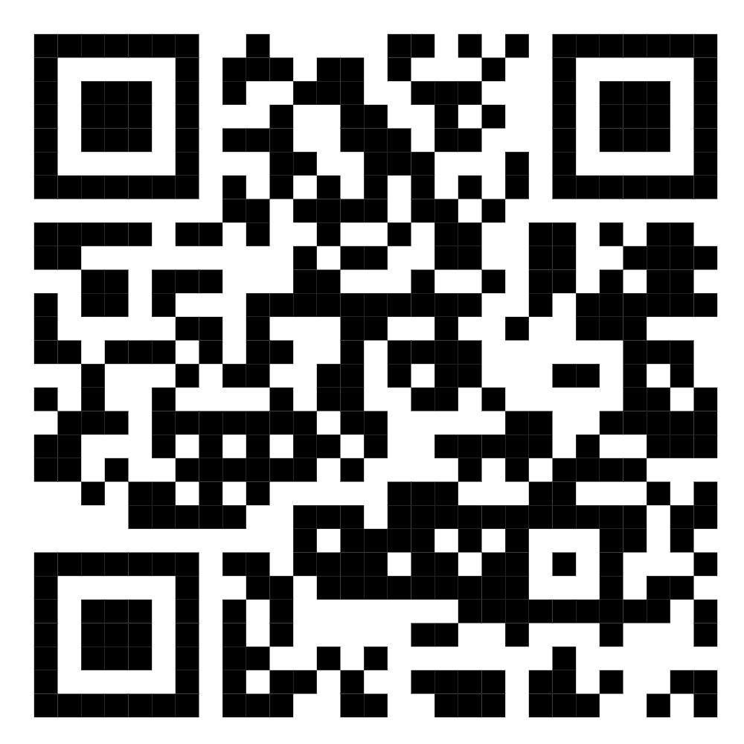
Re-learning how you learn
Reflect on your previous learning and assessment
  How did you study?
  How did you optimise learning?
  How do you process information to learn?
How will you learn medicine?
  Didactic vs Enquiry- based learning
  Be open to different formats of resources, and learning opportunities
  Dissonance
Welcome Week Session: "Learning to Learn"
Multiple theories model of learning (Taylor and Hamdy 2013)
Notes:
Sessions in welcome week “Learning to Learn”
Multiple theories model of learning (Taylor and Hamdy 2013). https://www.tandfonline.com/doi/full/10.3109/0142159X.2013.828153
“Each of our students will have their own individual constraints, experiences and preferences. The educator's task is to provide an environment and the resources in which each learner can flourish.”
“learning” includes the acquisition of three domains: knowledge, skills and attitudes
“The process of learning new things is not just about acquiring knowledge (surface learning), it includes being able to make sense of it, and hopefully making use of it.”
Deep learning is not easy, can cause uncertainty/upset…it requires effort on your part
You need to ACTIVELY PROCESS information…takes time and effort
Be careful of quick wins, e.g. inherited flash card decks. Recall=learning.

Slide 20
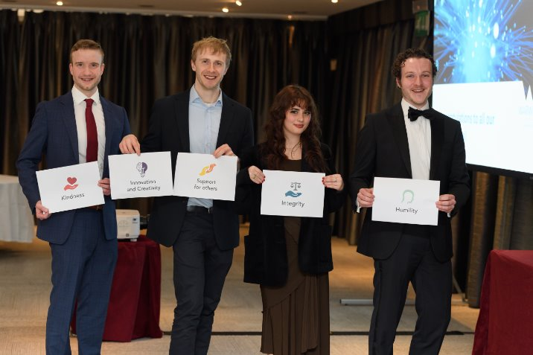
Re-learning how you learn
Learning medicine
vs
Learning to be a doctor
Notes:
Learning medicine for exams vs learning to be a doctor
Knowledge is not enough…need to understand, and apply/analyse…perform & do (Blooms taxonomy/Millers pyramid)
You also need to “learn” (develop) the appropriate skills and professional attitudes it takes to become a doctor

Slide 21
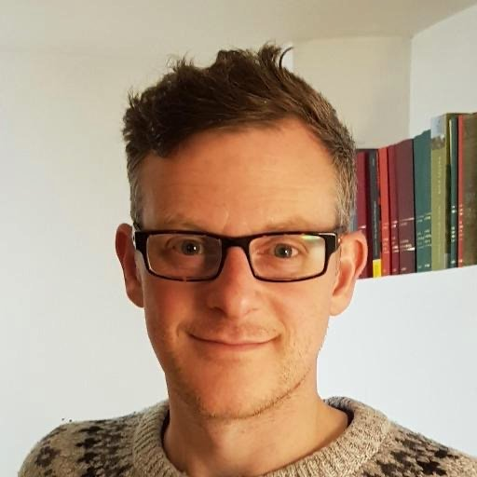
Student support at WMS
Aim: to help you maintain good wellbeing, and support current and arising needs so you can:
“be well, study well”
Dr Mark Richards
Deputy Senior Tutor (Phase 1)

Slide 22

Declaration of Geneva
“I will attend to my own health, well-being, and abilities, in order to provide care of the highest standard”

Slide 23
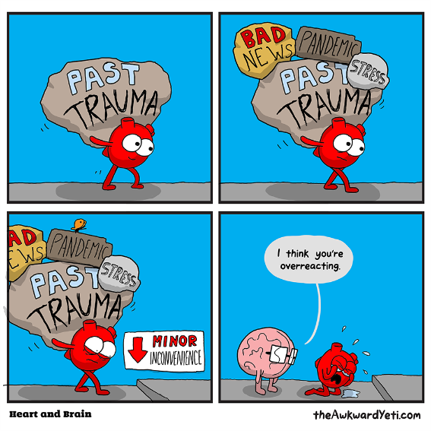
Be well, study well
Why would you need support?
Intensive course
  Vast subject
  Constantly changing
  Multiple dimensions
Graduate students
  Financial pressures
  Different life stages

Slide 24
Help you achieve your potential
What Support is for…
Foster habits for lifelong learning
Ensure patient and student/doctor safety
Ensure you’re at your best

Slide 25
Seek support early
Student Support Team
Administrative Team
Core Teaching Staff
University Wellbeing Services
Student Union
Peers

Slide 26
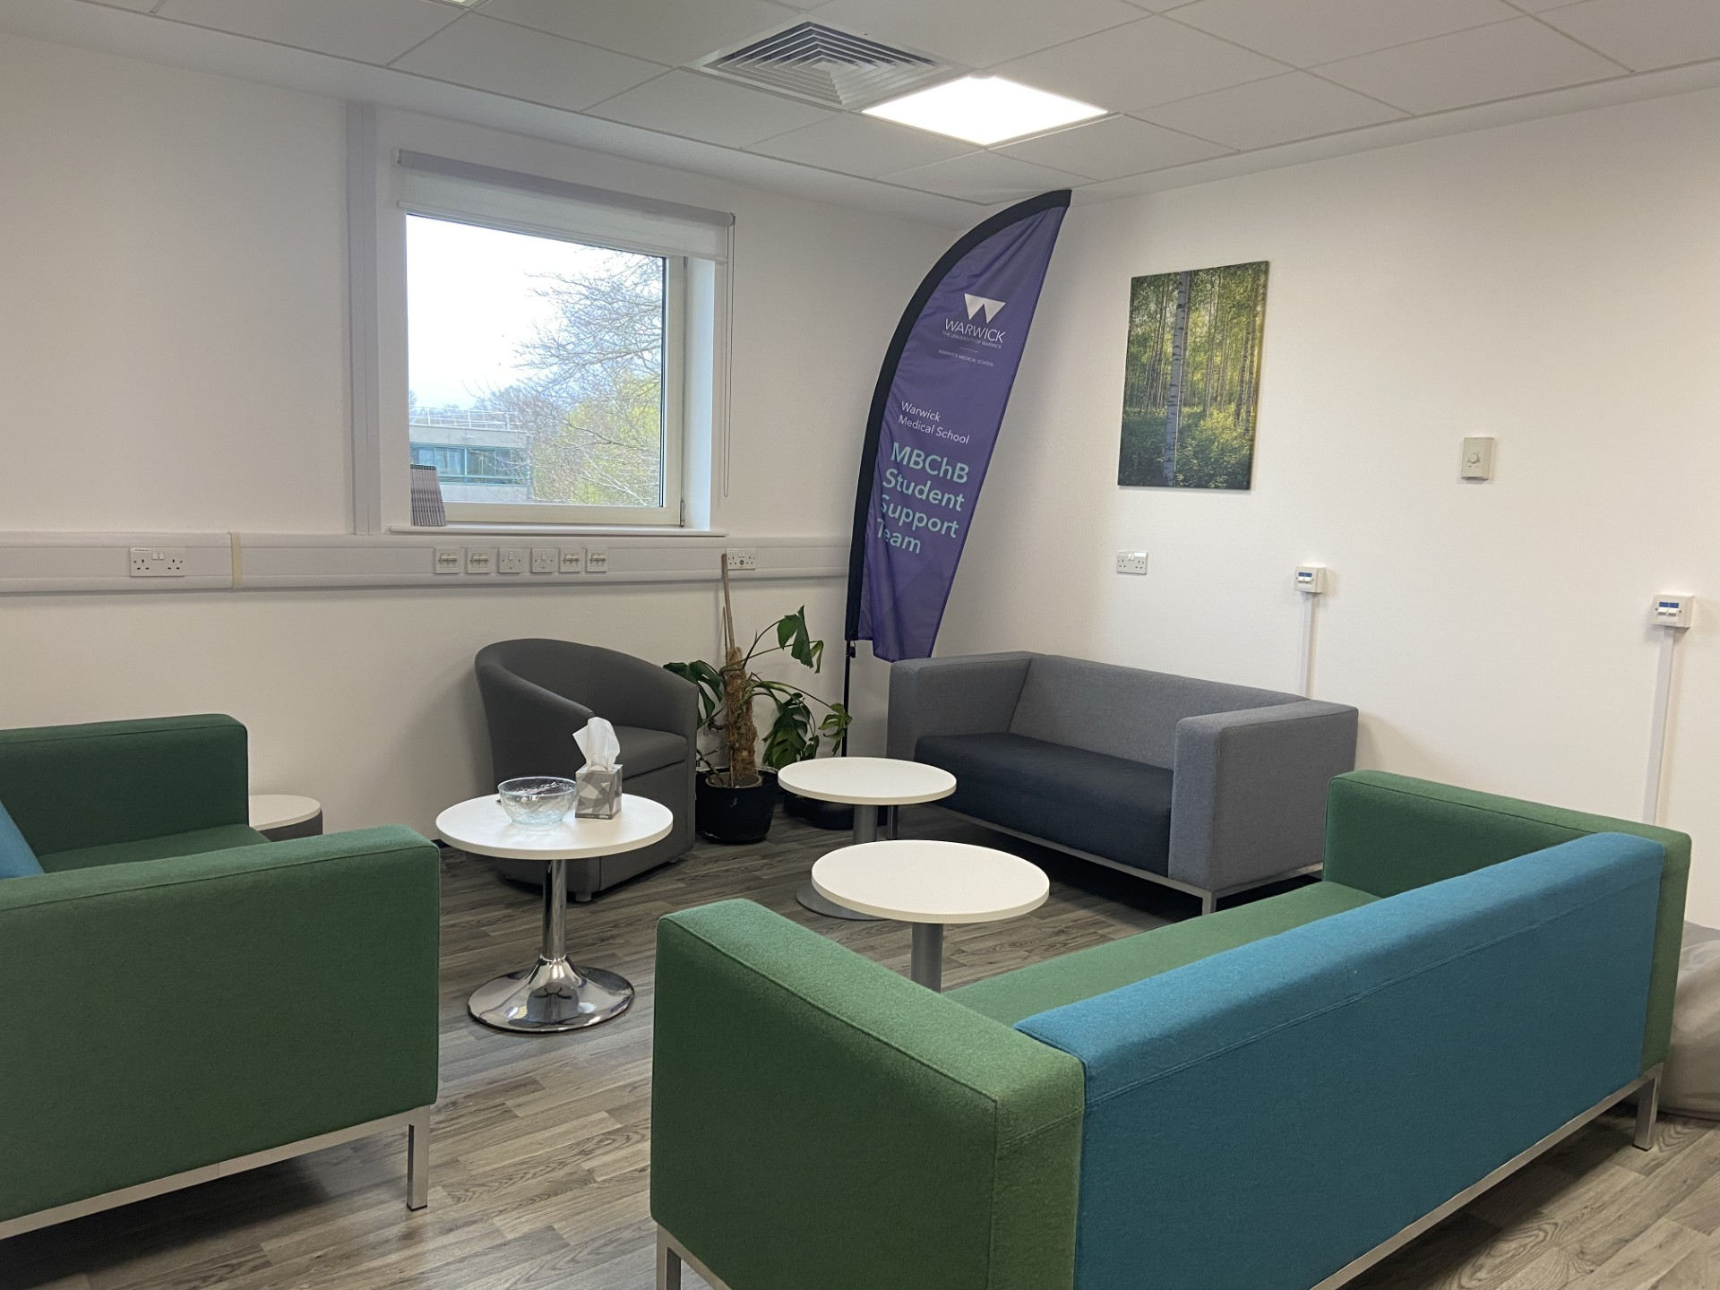
Student Support Team
Personal Tutor
A member of academic staff
Volunteered and trained for role
Your first point of contact for support
MBChB Core Student Support Team
Student Support Officer
Senior Tutor
Deputy Senior Tutor for each year group
Disability Champions
MTC Student Support Hub MTC 1.13

Slide 27
Managing health, and specific learning differences (SpLD)
Disability Services
Existing diagnoses of physical health, mental health issues or learning differences and neurodiversity
New diagnoses at medical school
Importance of managing these alongside studies
Access to reasonable adjustments, and extra support from the University (e.g. study skills support, Disabled Student Allowance)
DECLARE
HWP
Disability Services
Personal tutor
ACCESS
Support
Reasonable adjustments

Slide 28
Some key take home messages…
This is a full-time course – you may need to be on campus/placement Mon - Fri
Professional course - Attendance expectations
We value the expertise that you all bring to the course
We are all here to support you
2026/27 will be the best year yet.

Slide 29


Have fun!

Slide 30
Thank you
Contact
Dr Greg Moorlock: G.Moorlock@warwick.ac.uk
Dr Helen Poulton: helen.poulton@warwick.ac.uk
Dr Mark Richards: mark.richards.1@warwick.ac.uk
General Phase 1 queries: mbchbphase1@warwick.ac.uk

