Slide 1

Accommodation
1st Year MBChB
27 March 2026
Notes:
CO to welcome

Slide 2
Agenda
Your accommodation options campus?
Living on campus
Living off campus
Warwick Studentpad
Advice, guidance and support
Thanks
Notes:
We’ll be giving you an overview of Warwick Accommodation, who we are and the services we provide.
We’ll take you through our allocation principles which is essentially how we allocate accommodation.
Our University-Allocated Accommodation Guarantee and what that means for our students.
We’ll share with a bit about priority groups – who and why we have these.
And we’ll just share with you some top tips about messaging so you can confidently speak to students about accommodation at Warwick.
And you’ll have the opportunity to ask us any questions.

Slide 3
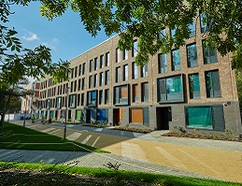
Accommodation Options
Overview:
During your first year MBChB, you can explore living on campus or off campus in the local area.
Around 7,000 rooms on campus owned and managed by the University.
Majority of these rooms are held for first year undergraduate students
We also house a small number of returning undergraduate students and postgraduate students on campus each year
Off campus we offer a property search platform for our students called Warwick Studentpad.
Notes:
We are Warwick Accommodation, we are the University's dedicated accommodation department.
We have around 7,000 rooms on campus currently.
The majority of those rooms will house first-year undergraduate students to help them transition to University life and likely, living away from home for the first time.
We also house some returning undergraduate students and postgraduate students. A lot of these will be students supported by wellbeing to live on campus but there is then a small pot of rooms that are available for returning undergraduates and postgraduates to book through our portal once they go live.
We also have a property search platform, Warwick Studentpad, for students to find accommodation off campus. We have a Student Lettings Manager that works with the landlords advertising on the platform to ensure they have the legal documentation to let their property to students - so we do some of the background checks for the students to ensure the landlords are legitimate and we recommend students use Warwick Studentpad to look for accommodation off campus in the first instance.

Slide 4
Living On Campus
Tocil Residences
£136 per week
45 week contract (arrival from Saturday 19 September)
Flats shared with up to 12 students
Bathrooms shared between 4 students on average
Short walk from Gibbet Hill
Booking a room
Bookings usually open in late April/May time
Instant booking platform
Need to have unconditional firm offer of study to book
First-come first-served, subject to availability
We aim to house MBChB students together
No deposit payment required
If you have a health/medical condition and specific accommodation requirements, you will need to get supported by 17:00 on 7 August 2026 – Wellbeing and Student Support can assess your needs and we can then support you for a suitable room on campus
Notes:
On campus we offer MBChB students rooms in our Tocil residence on a first come, first served basis through our bookings portal

Slide 5

Living Off Campus
Notes:
CO slide

Slide 6
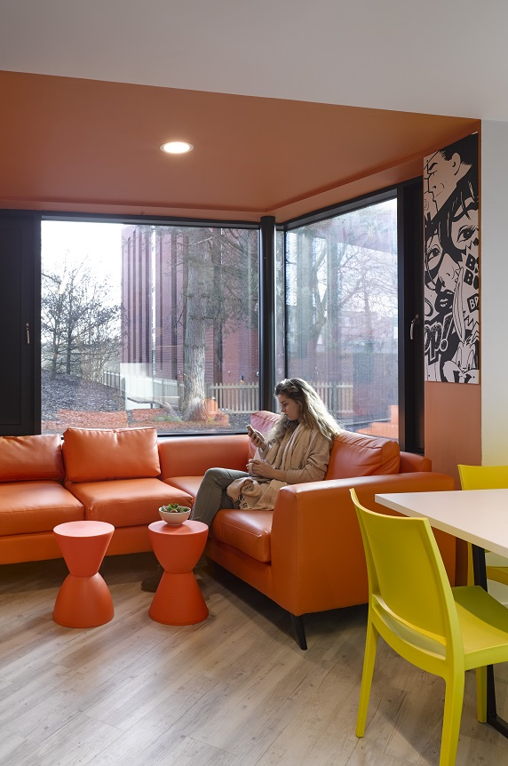
Private Accommodation
Most students live off campus in the local area
Get advice and support from Warwick SU Advice Centre – they can check your contract and help you in the event you need housing advice before or after you sign a contract
Visit the University’s off campus living advice and guidance website: https://warwick.ac.uk/students/life-at-warwick/living-off-campus/
Information on location, types of accommodation, where to search, things to look out for, etc
Notes:
CO slide.
Mention not signed off yet! Will confirm once approved but expectation is this.

Slide 7

Warwick Studentpad
Exclusively for University of Warwick students
We offer a property search platform to help you look for suitable properties
Need to have unconditional firm offer of study to start searching
Talk with landlords and use the message board function to find housemates
We actively recruit landlords to list their properties which include PBSA, shared houses and flats
Notes:
CO slide

Slide 8

Advice and Guidance
Next steps
Think about the location of where you might like to live – do some research and make an informed decision
Speak with previous students about their experience – Unibuddy blogs
Once you have a ‘UF’ offer of study – you can check campus room availability and book a room, or start using Warwick Studentpad to search for suitable properties.
Make sure to reach out to Warwick SU Advice Centre for guidance before signing a contract
We encourage you to read the University’s off campus living guidance website
Notes:
CO slide

Slide 9
Thanks!
We’re here to help
Join us for a 121 live chat in the summer (visit the ‘contact us’ section of website)
5 days a week from July to September
Email us if you need help
Always feel free to contact the team accommodation@warwick.ac.uk
Notes:
Our job is to ensure you understand the accommodation offering for students at Warwick, that you can relay the right messaging and are confident to accurately inform the students – that's what today is about. And if at any point you want clarification, please do reach out to myself, I’m happy to provide any further support.
Please visit our website and read our allocation principles so you understand:
What the different accommodation options are for the various student groups
What our accommodation guarantee to prospective UGs is and what it means for them
How we allocate accommodation to the different student groups
Our allocation principles do change slightly every year – they are dictated by the market and the Universities recruitment targets. It's a careful balance every year to ensure we are supporting the right number of students from the various student groups each year.
Please encourage students and their families to read our allocation principles and accommodation guarantee too when you're speaking to them and ensure they fully understand the process of applying for accommodation and how we allocate.
We offer weekly live chats throughout the summer that allow students to speak to a member of the accommodation team 1-2-1 and get the answers to any questions they may have, so encourage them to join those. And we have a dedicated allocation team – they’re amazing, friendly and really helpful - they are available 5 days a week, Mon-Fri, 9-5 to take calls and respond to email queries so that students feel supported through the process. They are there to help our students so do direct students to them – they are in good hands with the team.

