Slide 1
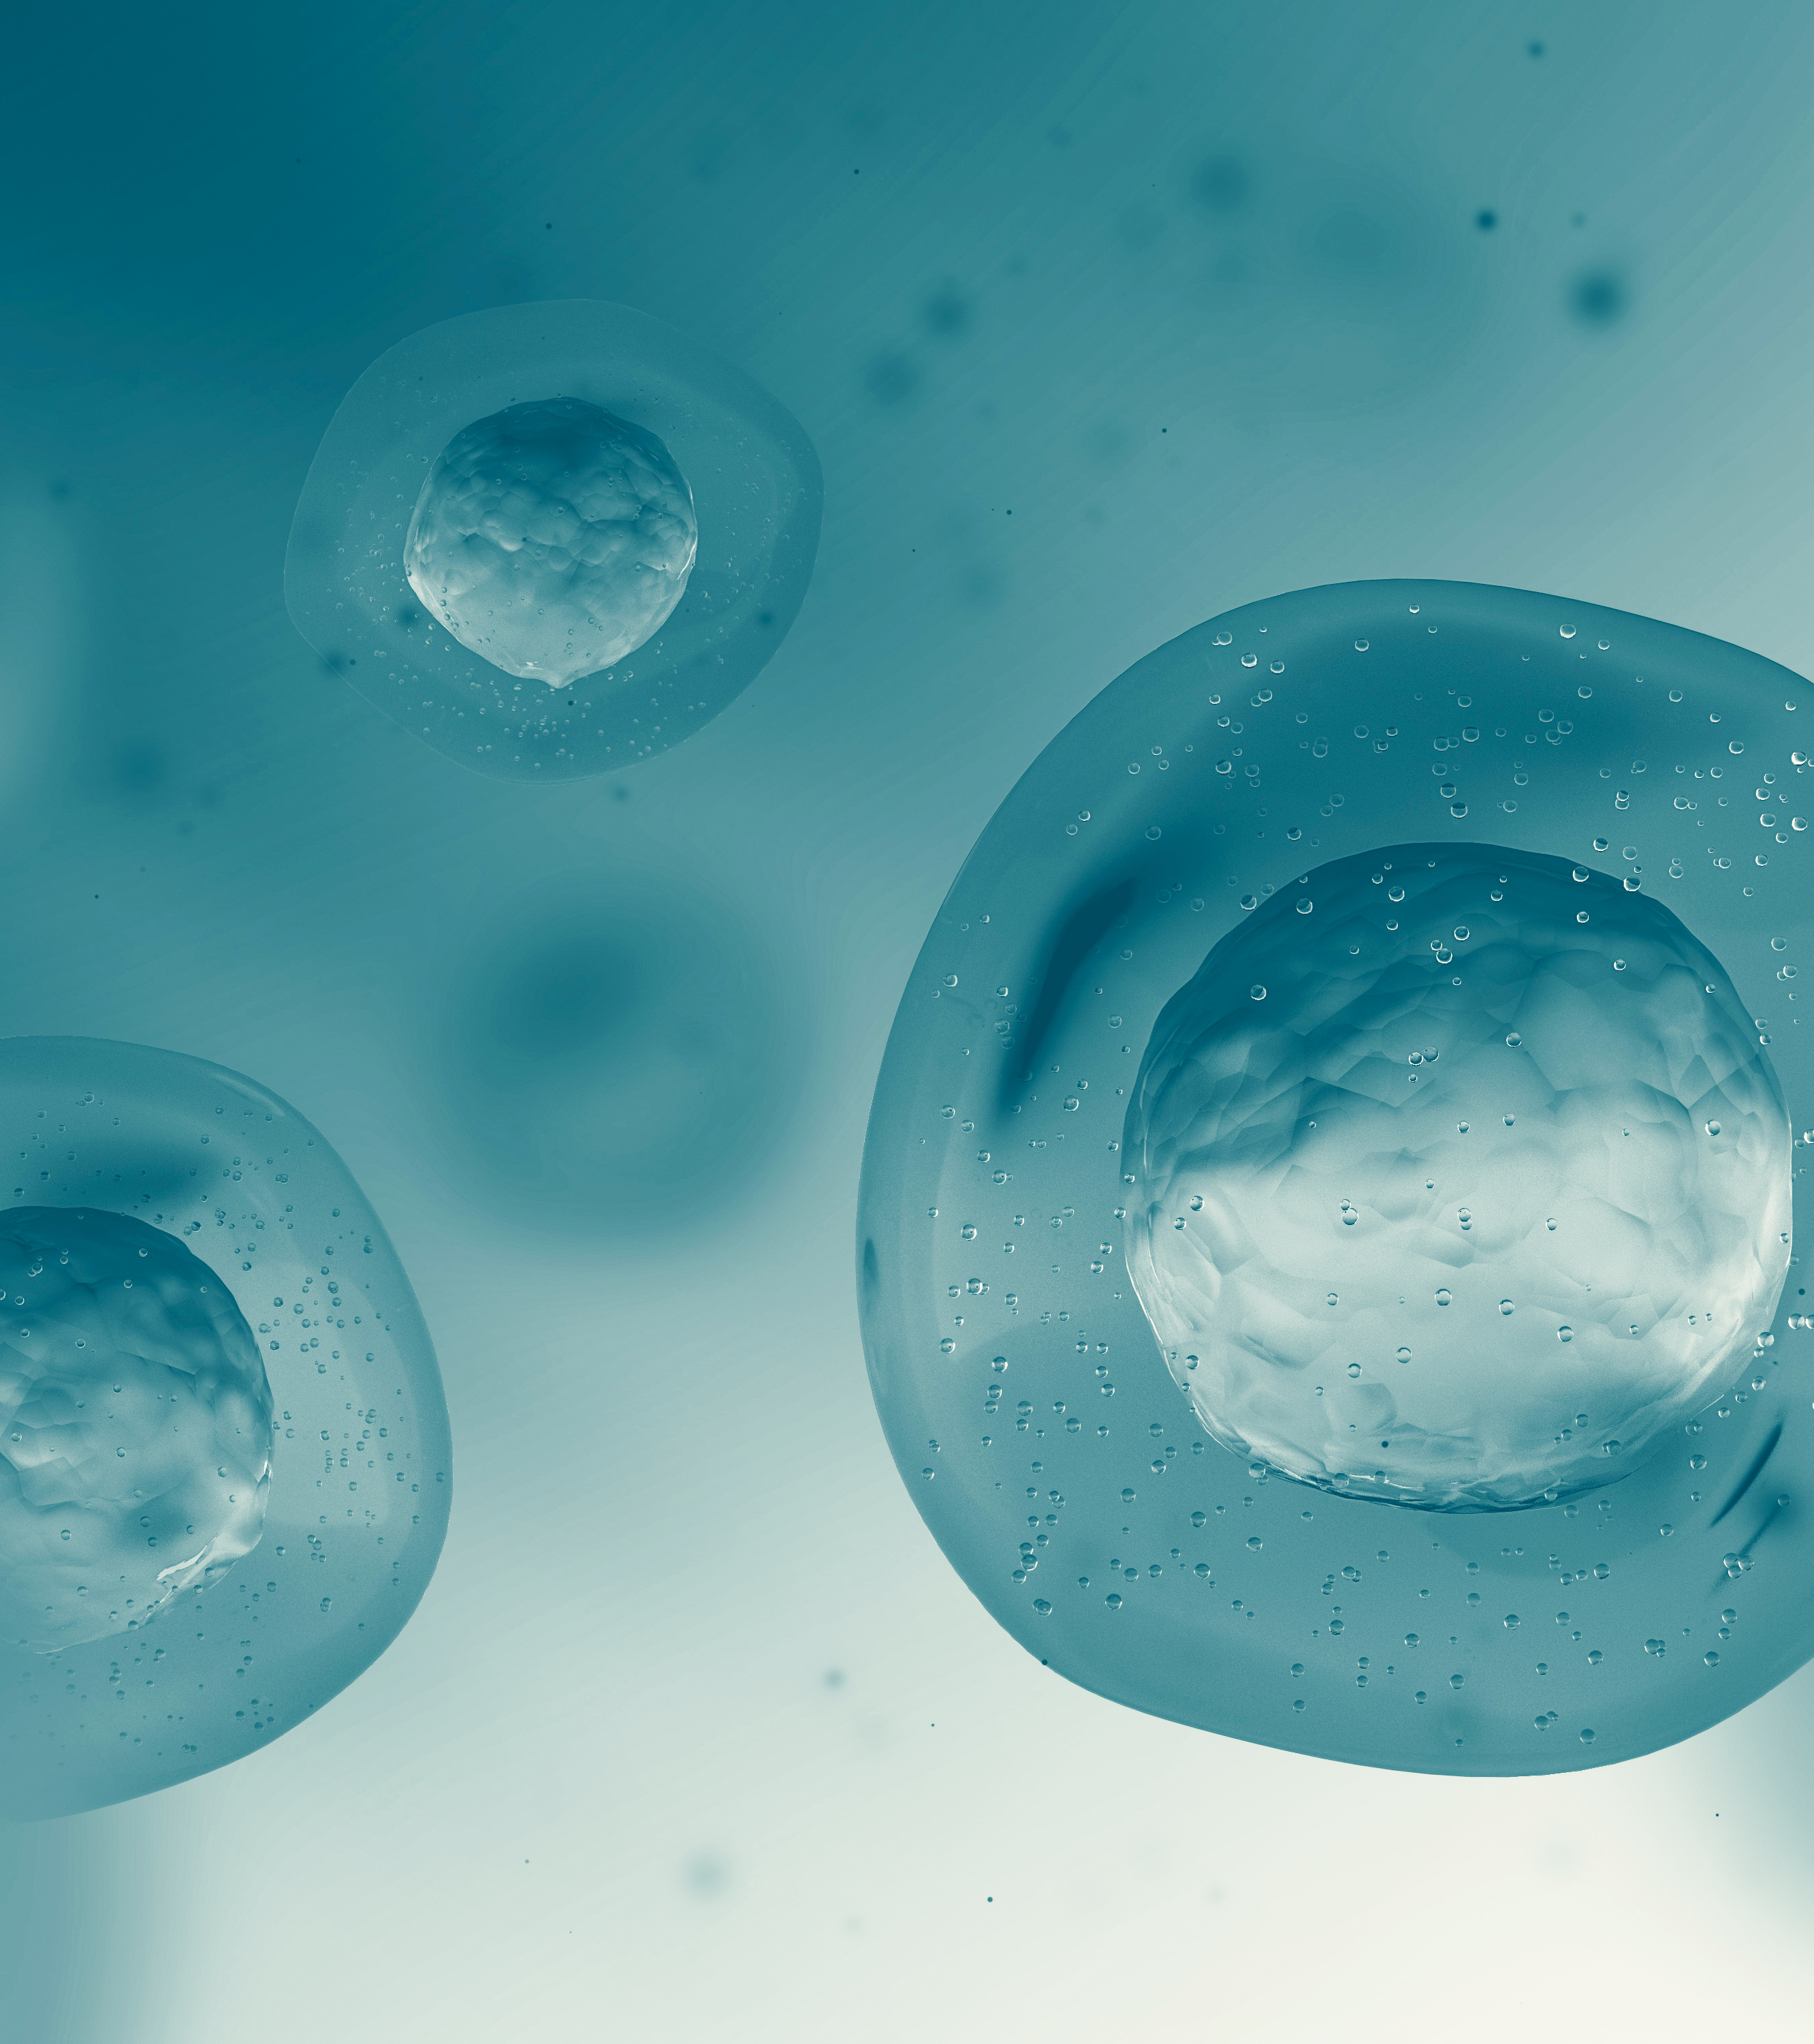
Basic Cell Structure
Dr Clare Garcin
c.garcin@warwick.ac.uk

Slide 2
Learning Outcomes
Distinguish between eukaryotic cells and prokaryotic cells
Define the terms cytoplasm and cytosol
Describe the main constituents and features of the plasma membrane
List the main organelles found in the cytoplasm of human cells and describe their function

Slide 3
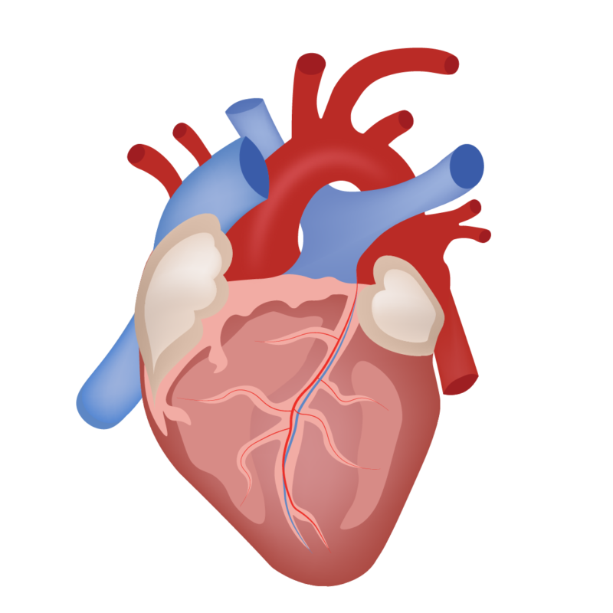
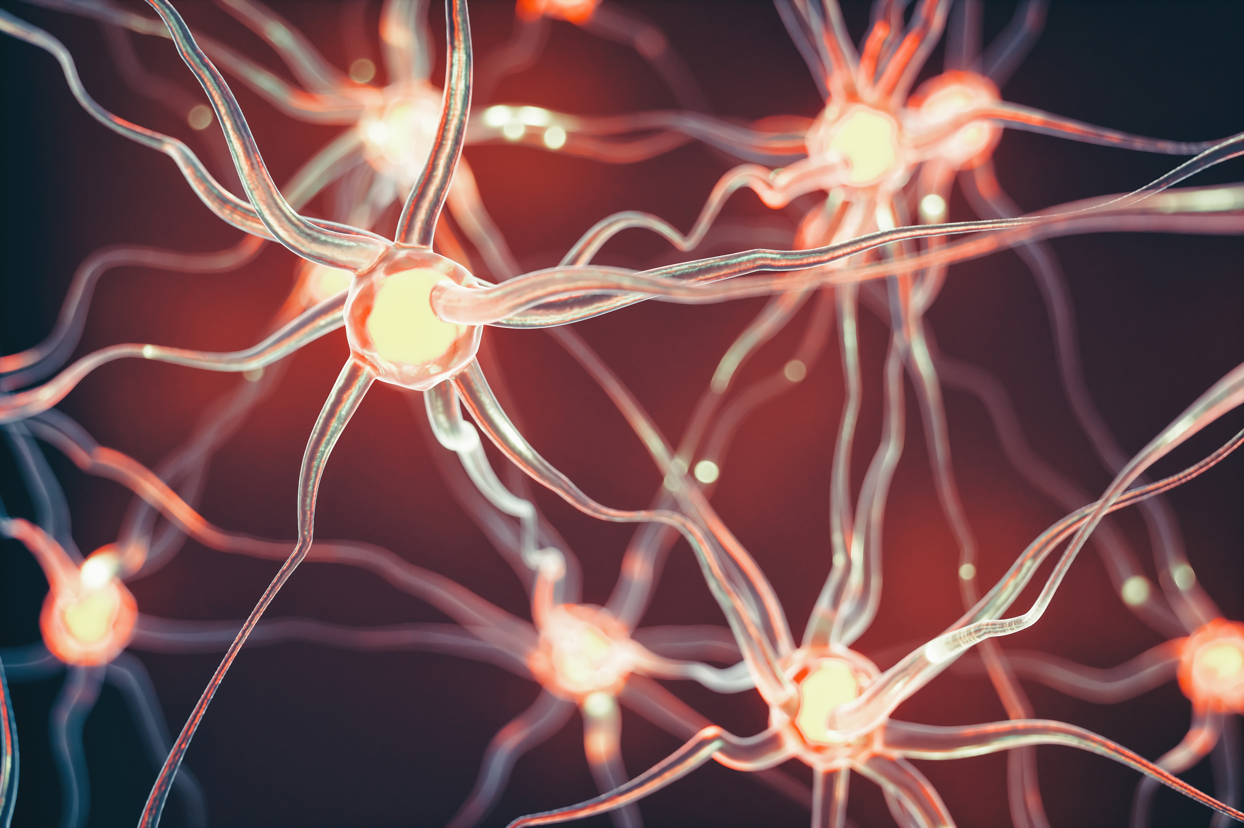

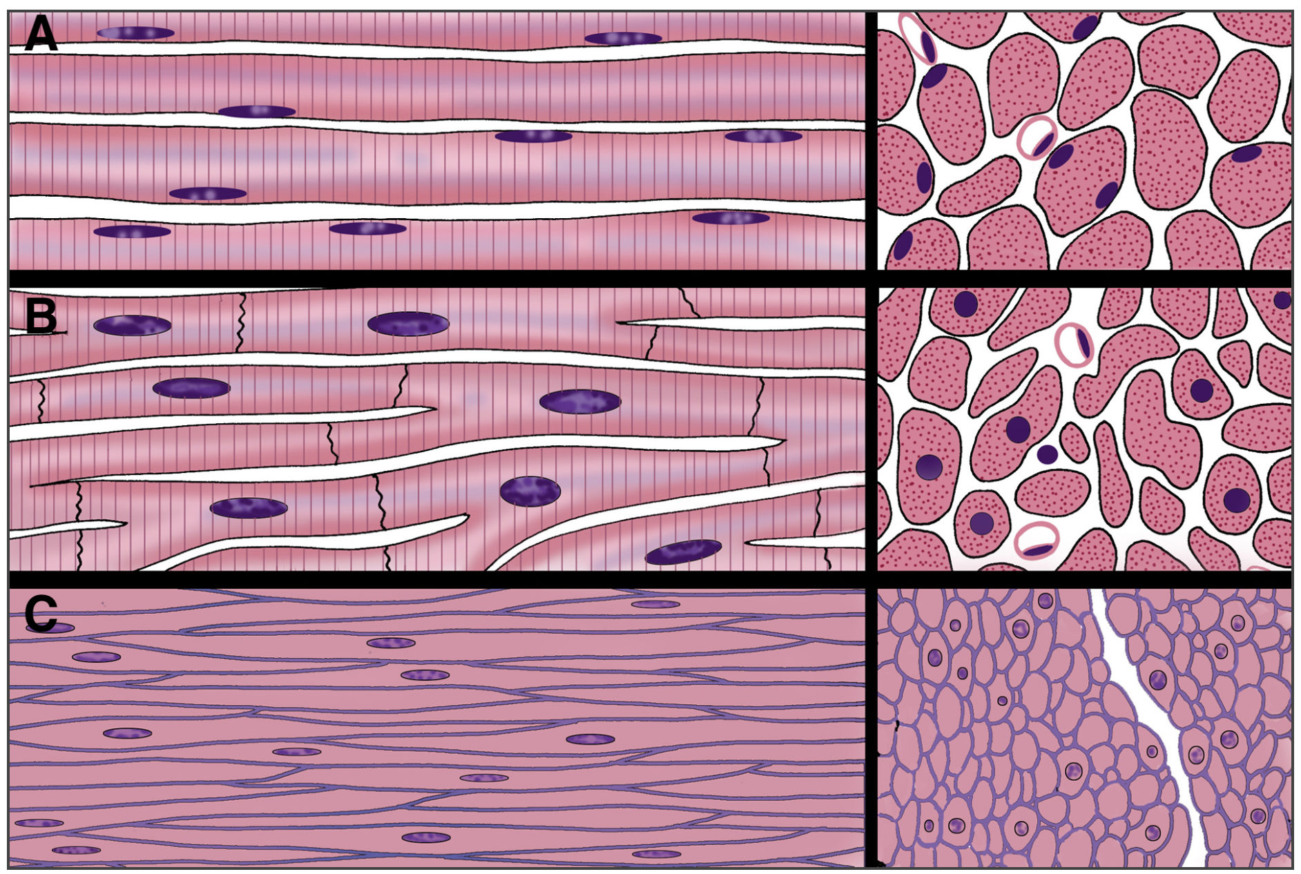
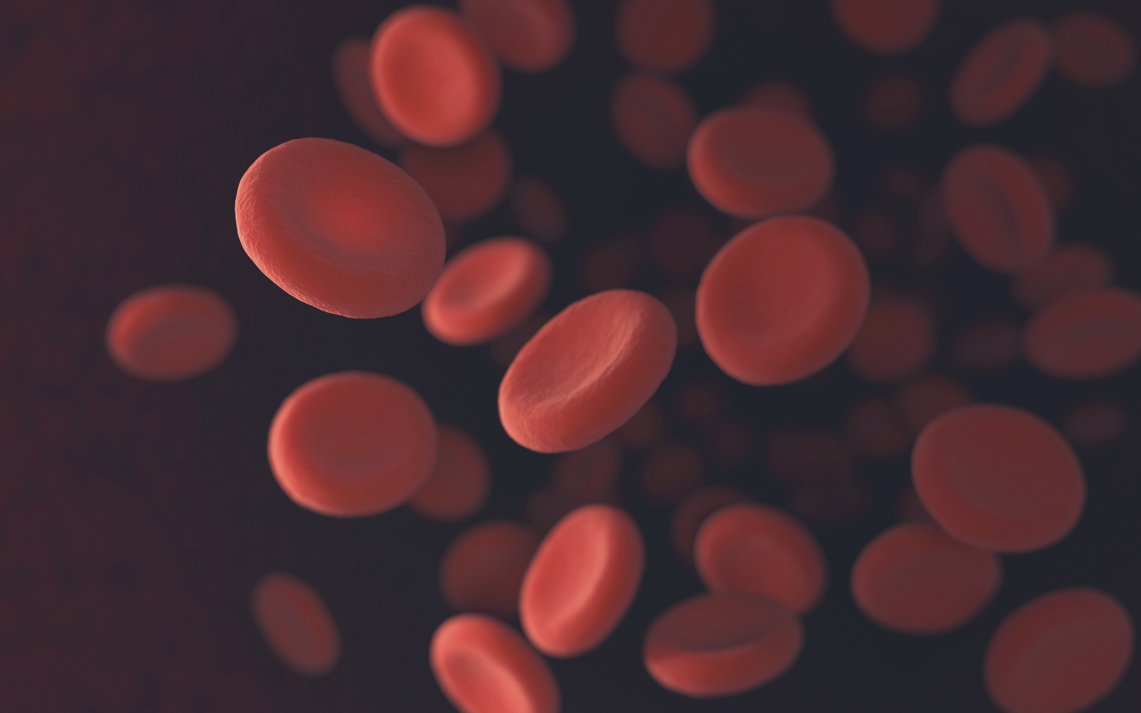
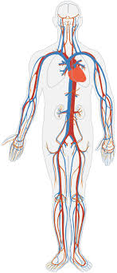
Cells are building blocks

Slide 4
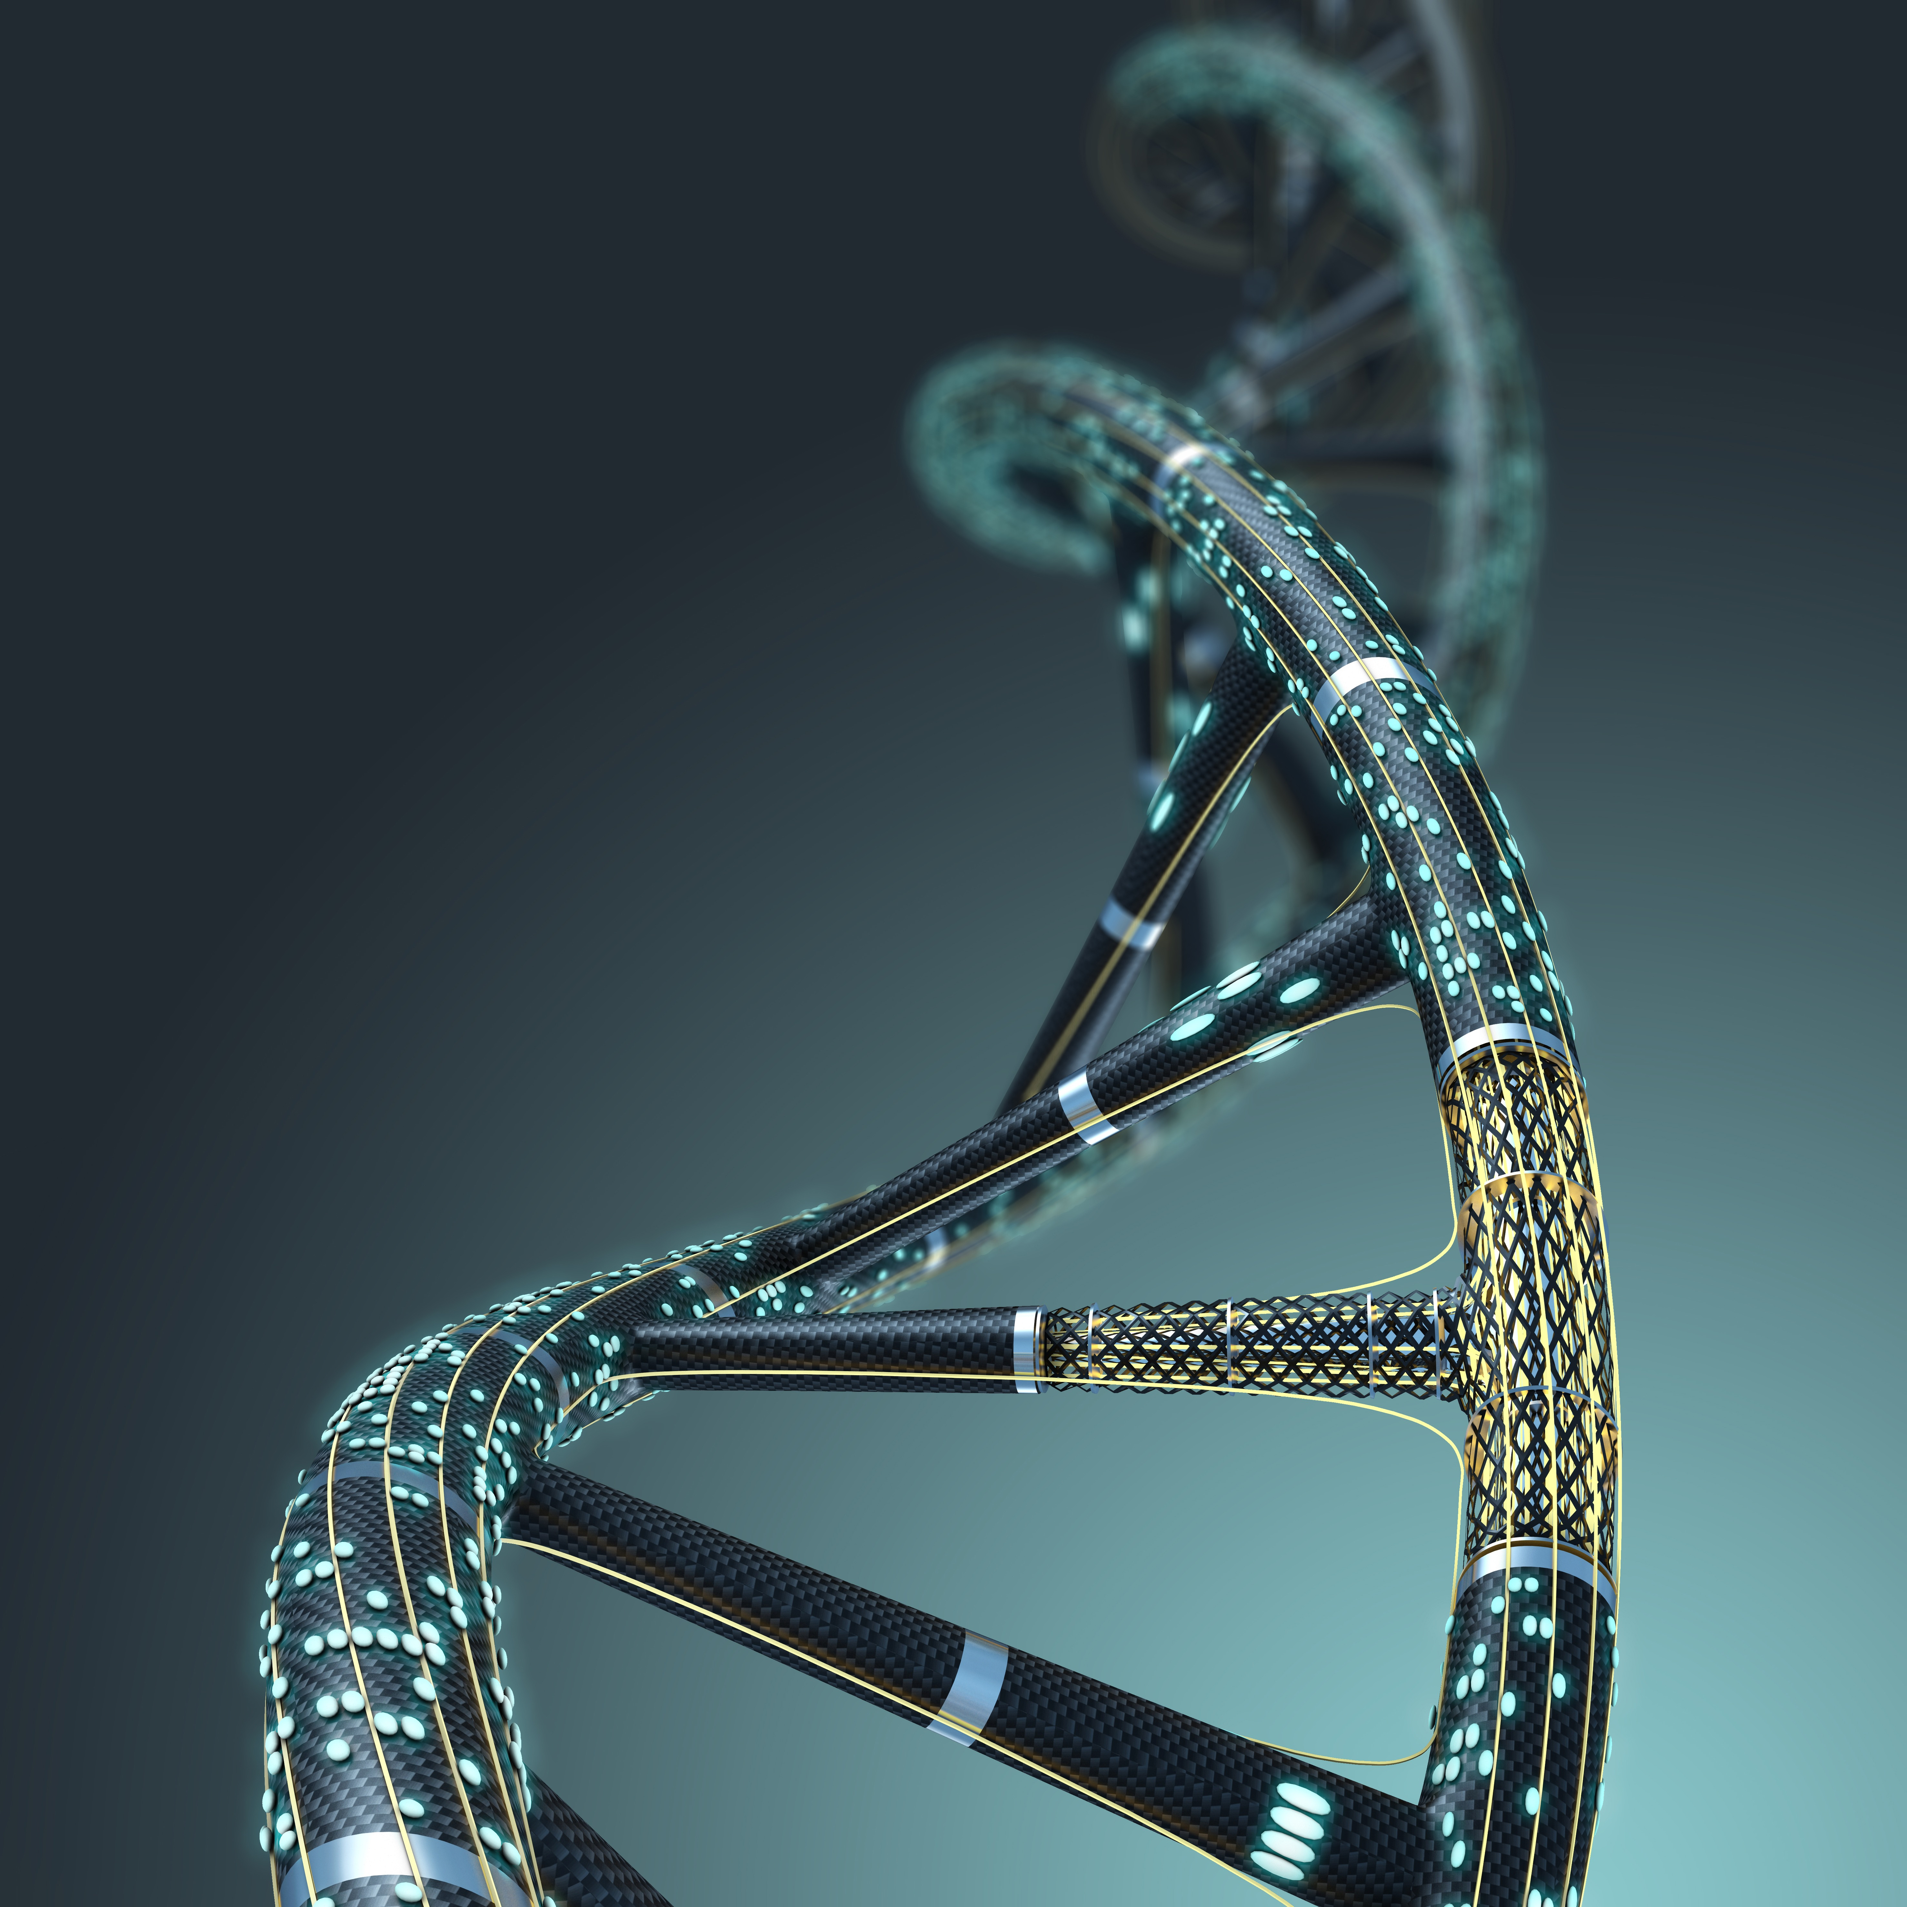
Prokaryotic versus eukaryotic
All cells have certain things in common
A plasma membrane to separate intracellular and extracellular environment
Cytoplasm (containing cellular components)
Genetic material (DNA)
Ribosomes

Slide 5
The plasma membrane
The walls – with doors and windows
Cell membrane
‘The factory walls’
Gives the cell shape
intracellular
Controls the passage of substances across
extracellular

Slide 6
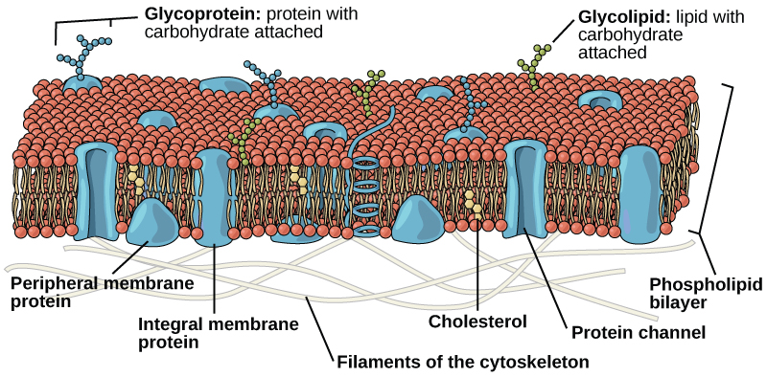
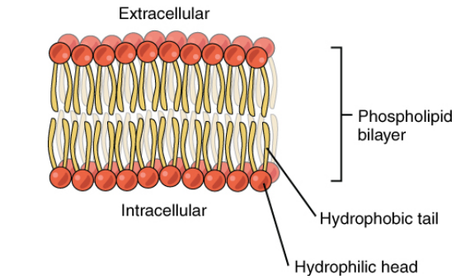
The plasma membrane
A phospholipid bilayer
Phospholipids are amphipathic and arrange themselves ‘tail to tail’
The phospholipid bilayer is selectively permeable
Embedded within the membrane are proteins that form channels or transporters, and glycoproteins and glycolipids, which are important for cell recognition.

Slide 7
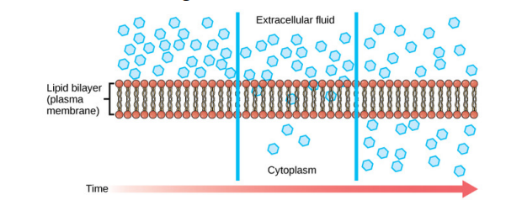
Crossing the cell membrane
Passive versus active transport
Passive transport is the movement of molecules down a concentration gradient, i.e. from an area of high concentration to an area of low concentration.
Small, non-polar, or hydrophobic molecules such as steroids can diffuse into the cell across the plasma membrane.

Slide 8
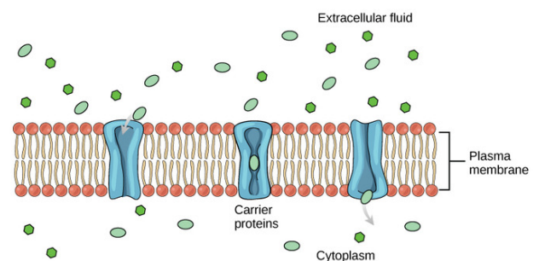
Crossing the cell membrane
Passive versus active transport
Facilitated diffusion is where molecules cannot cross the plasma membrane by simple diffusion, so travel through channels or via carrier proteins.

Slide 9
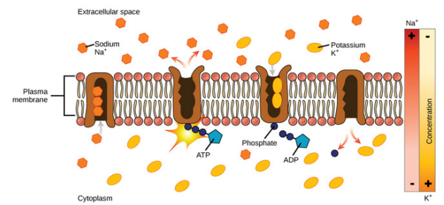
Crossing the cell membrane
Passive versus active transport
Active transport requires energy expenditure (in the form of ATP) to move material, often against a concentration gradient.

Slide 10
Once inside the cell
The cytoplasm/cytosol
The cytoplasm is the term given to the inside of the cell.
Cytoplasm
The fluid component is called the cytosol.
The cytoplasm is packed with cellular components, and is where many cellular reactions take place.

Slide 11
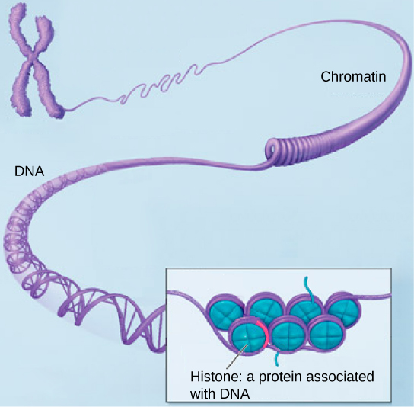
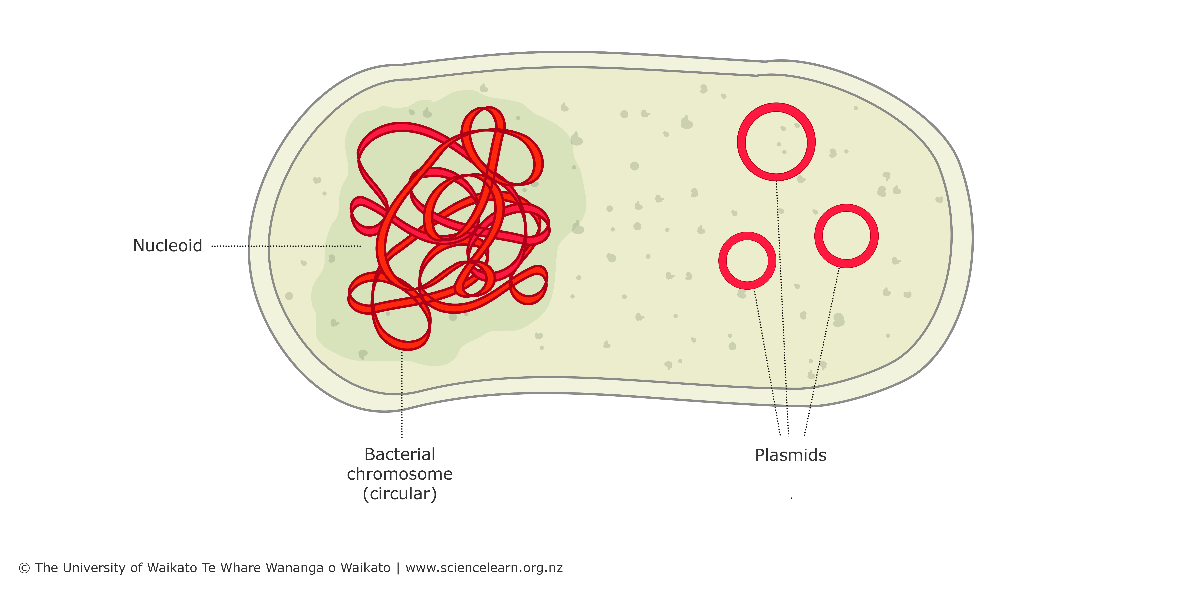
Genetic material
The instruction manual
In prokaryotic cells, genetic material is found as a circular strand in the cytoplasm, or within the ‘nucleoid’
In eukaryotic cells, genetic material is stored as chromosomes within a true nucleus.

Slide 12
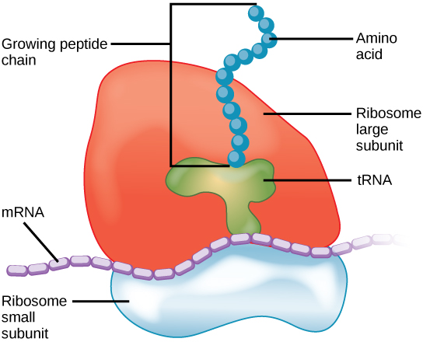
Ribosomes
The assembly room
Ribosomes ‘read’ the genetic material and ‘translate’ it into a string of amino acids
Ribosomes consist of a small subunit and a large subunit.

Slide 13
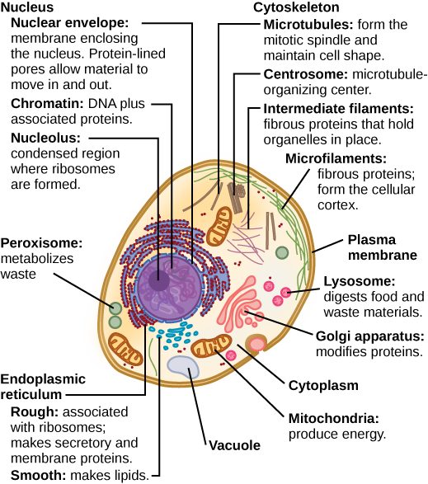
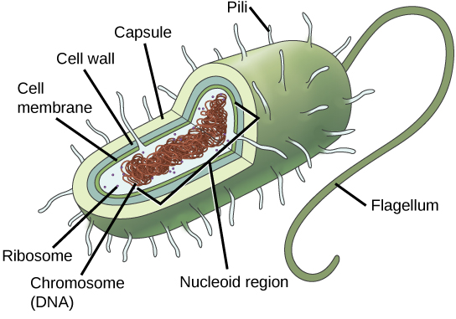
Prokaryotic versus eukaryotic cells
What are the differences?

Slide 14
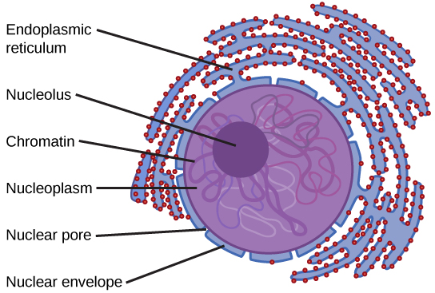
The Nucleus
Houses the instruction manual
The nucleus is surrounded by a double membrane called the nuclear envelope.
The nuclear envelope contains pores, to allow the exchange of molecules between the nucleoplasm and the cytoplasm.

Slide 15
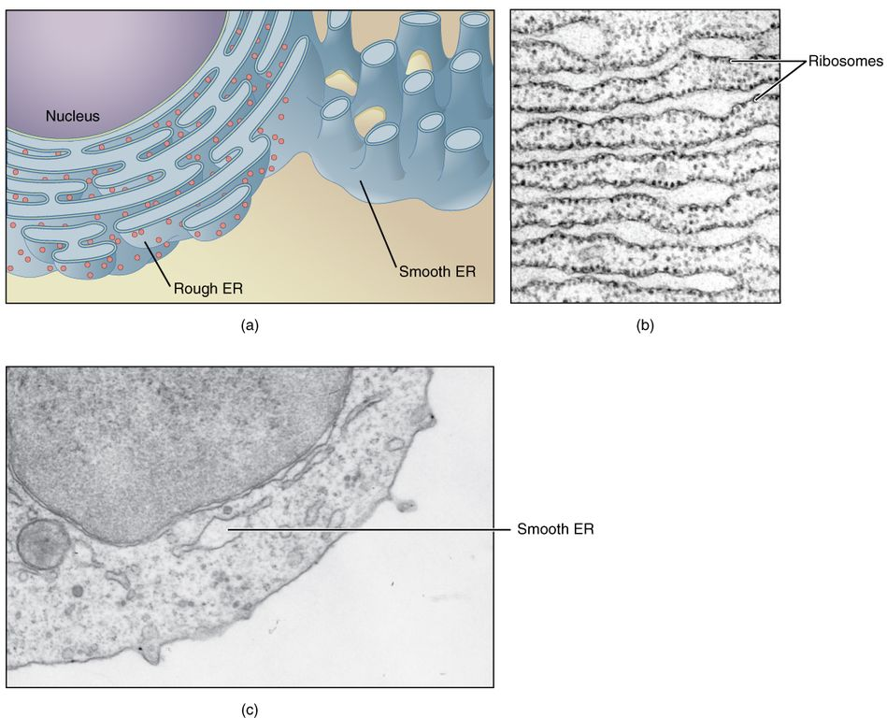
Endoplasmic Reticulum
The wrapping station
The endoplasmic reticulum is often continuous with the nuclear envelope.
Here, proteins are modified, and new phospholipids are made in the endoplasmic reticulum.

Slide 16
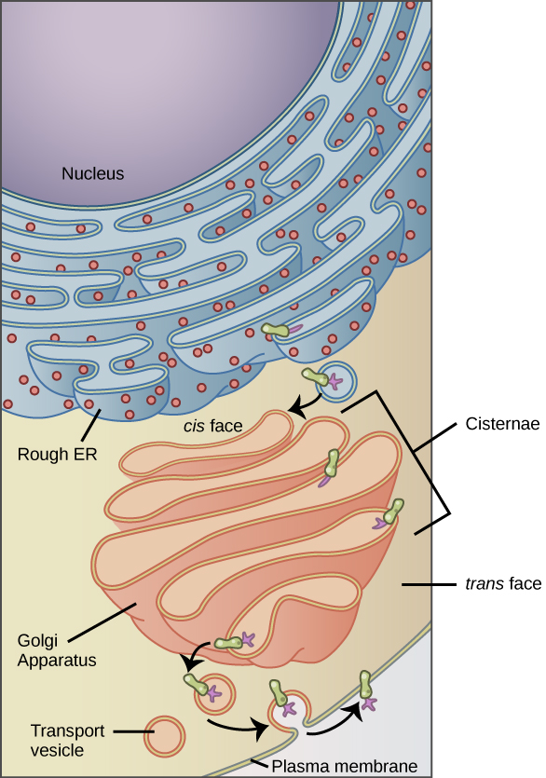
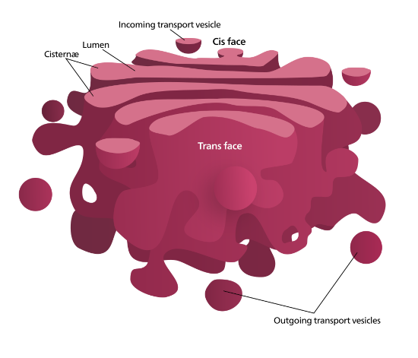
The Golgi Apparatus
The sorting office
The golgi apparatus ‘packages’ and ‘tags’ newly synthesised proteins to ensure they arrive at the correct destination.

Slide 17
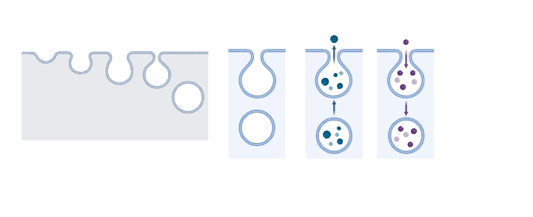
Vesicles and Lysosomes
Transport and Rubbish Disposal
Vesicles are sacs surrounded by lipid bilayers, meaning they can fuse with the cell membrane either to expel products, in exocytosis, or take substances into the cell, in endocytosis.
Lysosomes are specialised vesicles that contain digestive enzymes.

Slide 18
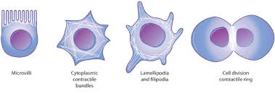
The cytoskeleton
The conveyor belts and steel girders
Microtubule
Intermediate
Filament
Actin
https://www.youtube.com/watch?v=y-uuk4Pr2i8

Slide 19
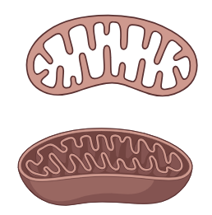
Mitochondria
The engine room
Cristae
Outer membrane
Inner membrane
Matrix

Slide 20
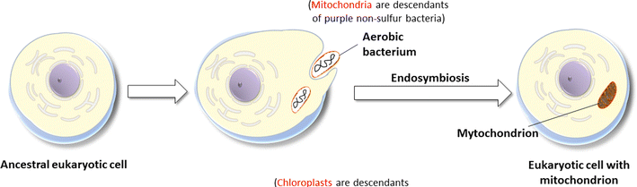
Endosymbiotic theory
The evolution of complex cells

Slide 21
Basic Cell Structure
Learning outcomes
Distinguish between eukaryotic cells and prokaryotic cells
Define the terms cytoplasm and cytosol
Describe the main constituents and features of the plasma membrane
List the main organelles found in the cytoplasm of human cells and describe their function
5.1 – Video and transcript
5.2 – Accompanying reading
5.3 - Worksheet

Slide 22
Images references
Slide 2 – Image ‘Red Blood Cell Cytoskeleton’ by David Goodsell free for use under CC-BY-4.0 license. https://pdb101.rcsb.org/sci-art/goodsell-gallery
Slide 3 – Medicine Libre Texts – Image credit: ‘Muscle Tissue Overview’ by Virginia Commonwealth University licensed under CC BY-NC-SA 4.0
Slides 5-8, 10-15 – Images shared under hared under a CC BY-SA 4.0 license and were authored, remixed, and/or curated by Boundless
Slide 9 – Image ‘Biosites: Cytoplasm’ by David Goodsell free for use under CC-BY-4.0 License
Slide 16 – Images created in Biorender
Slide 17 - Image ‘Biosites: Cytoplasm’ by David Goodsell free for use under CC-BY-4.0 License and cells image: https://www.nature.com/scitable/topicpage/microtubules-and-filaments-14052932/
Slide 18 – Image created in Biorender
Slide 19 – Image from Reiter et al. Cell Mol Life Sci. 2017; 74(21):3863-3881 – 10.1007/s00018-017-2609-7

