Slide 1
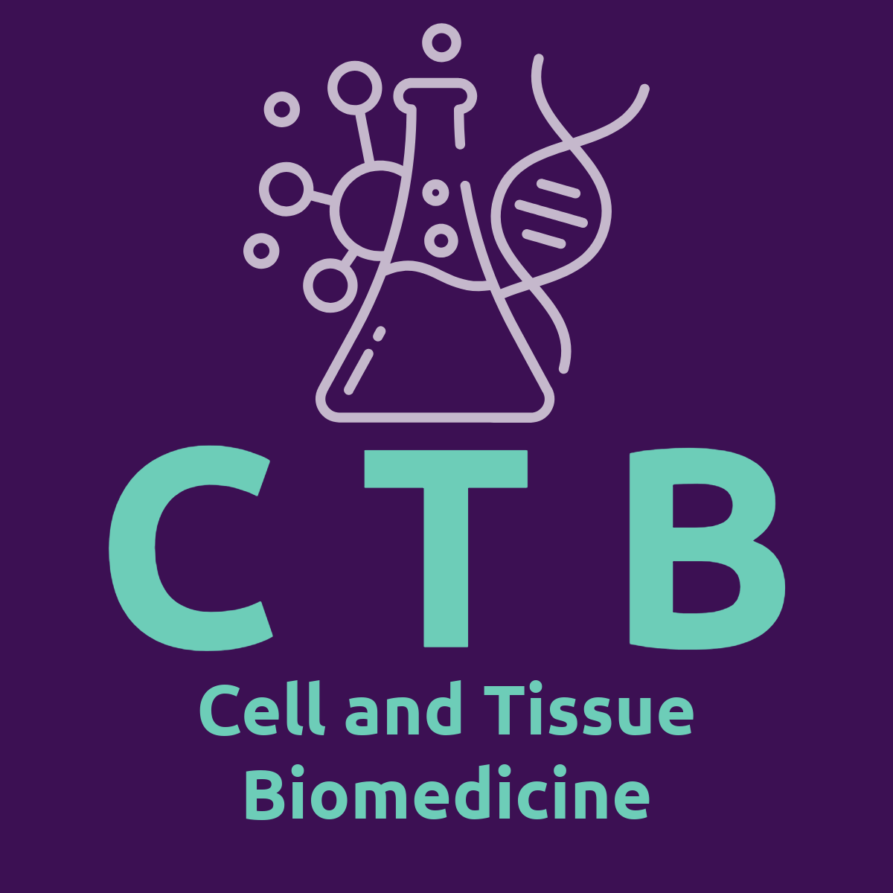

Cell Signalling
Dr Mark Richards
mark.richards.1@warwick.ac.uk

Slide 2
Learning Outcomes
Outline the functions of cell signalling
Define the terms autocrine, paracrine and endocrine signalling
Define the terms ligand, receptor, agonist, antagonist, and second messenger
Describe the mechanisms of the main types of receptors
Explain the role of second messengers in cellular signalling and the role of signalling cascades
Describe the role of Ca²⁺ in cell signalling

Slide 3
Outline the functions of cell signalling

Slide 4
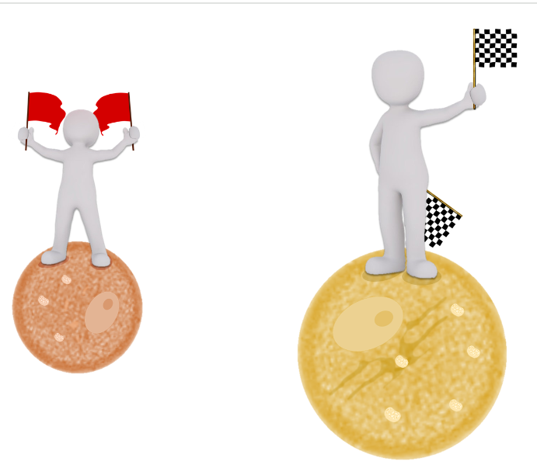
Cell-to-cell communication
Cell-to-cell communication is essential for multicellular organisms
Cells have developed complex mechanisms of communication that can receive a message appropriate responses to that message
Cell signalling mechanisms allow the various cell types to send, receive and integrate biological information
Dysfunctional signalling provides the mechanism for many pathologies

Slide 5

Types of cell signalling
Most signalling between cells occurs via the use of secreted chemicals termed signalling molecules.
This process of cell communication aims to induce a physiological response in a target cell.
There are three main signalling pathways classified by the spatial relationships between the sending and receiving cells.
  Autocrine
  Endocrine
  Paracrine
What is the definition of a target cell?

Slide 6
Define the terms autocrine, paracrine and endocrine signalling

Slide 7
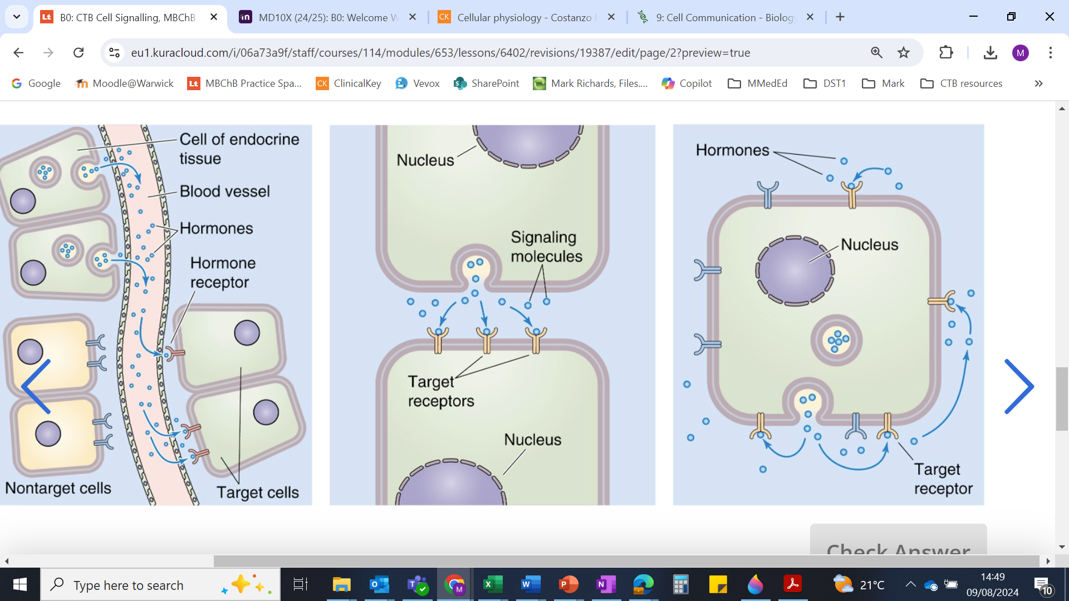
Autocrine signalling
Signalling molecules
The prefix ‘Auto’ means ‘self’
Autocrine signals act on the same cells that produce the secreted extracellular signalling molecules
Examples:
  Embryological development
  Inflammation

Slide 8
Paracrine signalling
Signalling between cells that are closely situated
Signals are quick but short-lived
Signals are terminated by removing the signalling molecules rapidly
Example: neurotransmission - the communication between nerve cells via the release of neurotransmitters

Slide 9
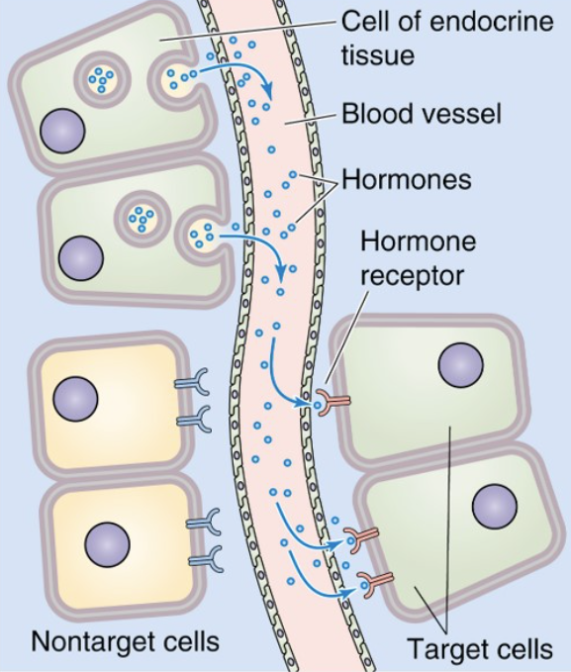
Endocrine signalling
Endocrine signalling produces physiological responses in distant tissues
Endocrine cells secrete signalling molecules that travel through the bloodstream to reach target cells – hormones
Slow response, but longer-lasting
Example: systemic effects of adrenaline

Slide 10
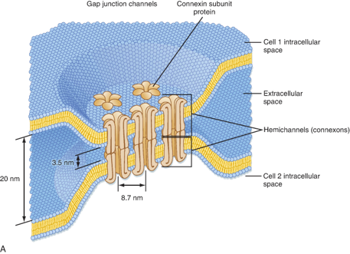


Juxtacrine signalling
Cell signals transmitted between physically connected cells
Neighbouring cells can be electrically and metabolically coupled by means of gap junctions.
Signals can be transferred from cell to cell without leaving the cytoplasmic compartments.
Example: electrical signal propagation through cardiac muscle
Movement across the cell membrane

Slide 11
Define the terms: ligand, receptor, agonist, antagonist and second messenger

Slide 12
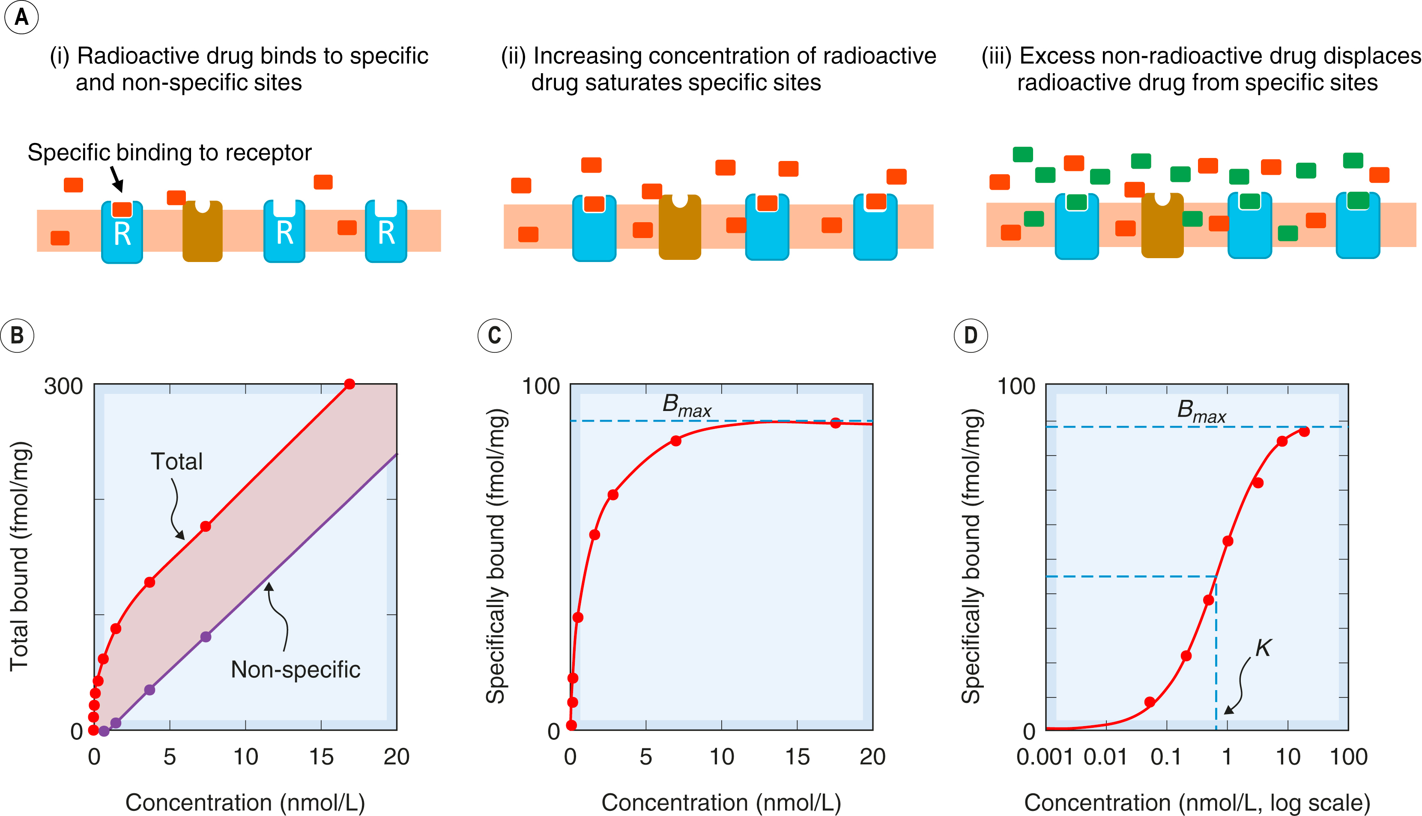
Ligands and receptors
Ligands are signalling molecules that bind to a receptor
Ligands are hugely varied, from small proteins to small molecules to Ca²⁺ ions.
Receptors are proteins of the target cell that selectively bind specific ligands
Ligands bind to receptors in a specific manner due to complementary binding
Receptors are most often found on the cell membrane but can also exist in the cytoplasm of the target cell

Slide 13
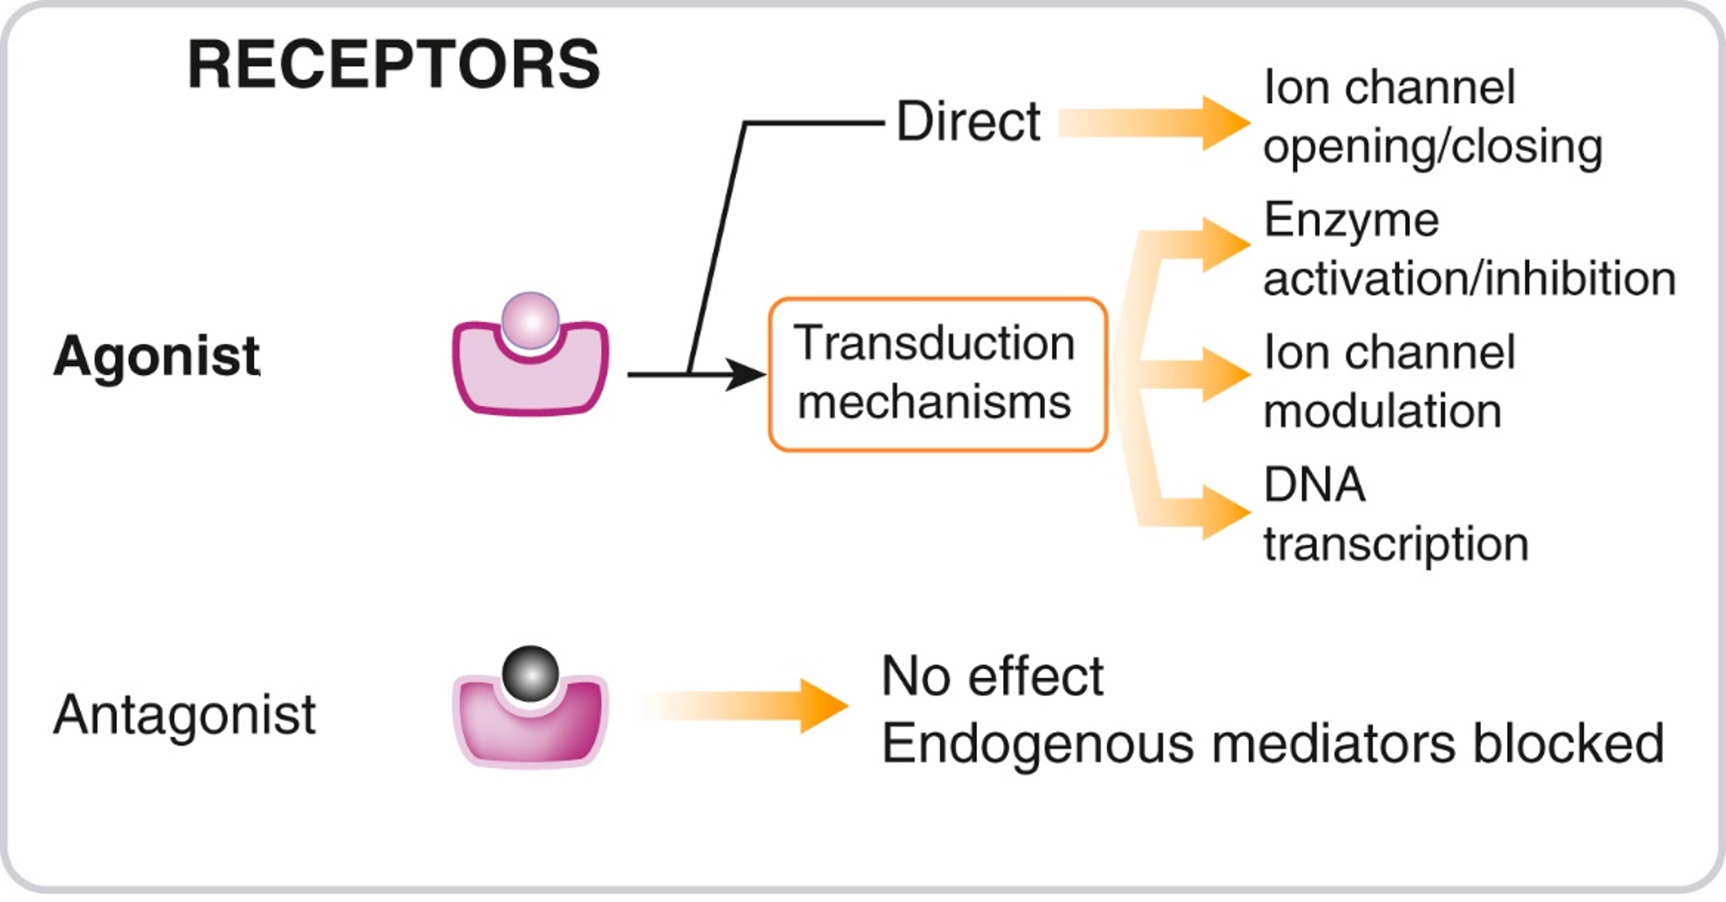
Agonists and antagonists
Ligands can be agonists or antagonists to a receptor
Agonists elicit a response in the target cell by activating the receptor
Antagonists do not elicit a response but can prevent an agonist binding to the receptor

Slide 14
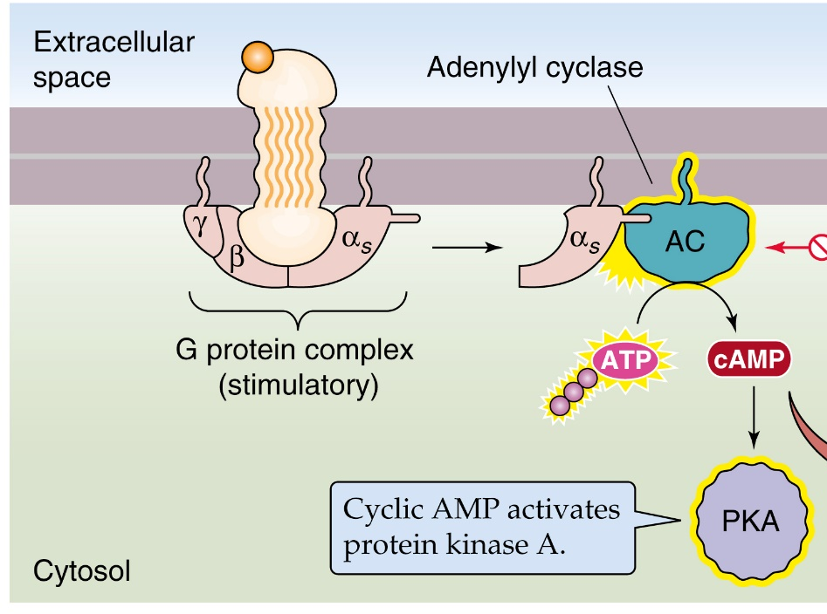
Second messengers
Receptor activation by a ligand can activate intracellular enzymes which synthesise second messengers
Second messengers are soluble small molecules that move through the cytoplasm of a cell to propagate a signal
Second messengers are typically present at low concentrations in resting cells and can be rapidly produced or released when cells are stimulated

Slide 15
Describe the mechanisms of the main types of receptors

Slide 16
Receptor classification
The majority of receptors involved in cell signalling are transmembrane proteins, as most ligands are water-soluble and do not cross cell membranes.
Cellular receptors are grouped into several types based on the signalling mechanisms they use and the intracellular biochemical pathways they activate.
There are 4 main superfamilies of receptor:
  Ionotropic receptors
  G-protein coupled receptors
  Enzyme-linked receptors
  Nuclear receptors

Slide 17
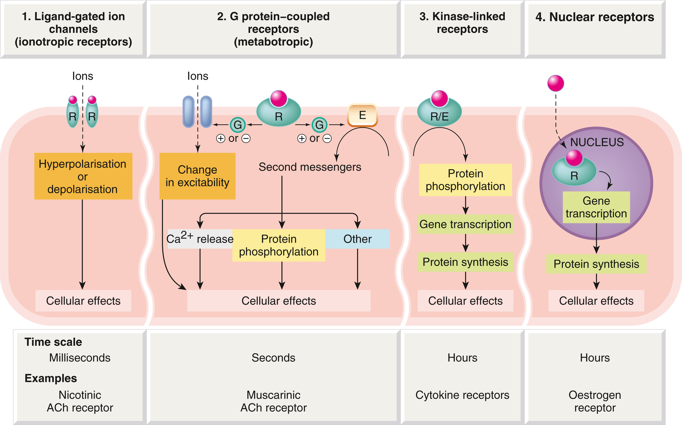
Ionotropic receptors
Movement across the cell membrane
Ionotropic receptors are ligand-gated ion channels
Leads to movement of ions across the cell membrane
Response is extremely fast
Most often involved in electrical activity of excitable cells
Electrochemical equilibrium and action potentials

Slide 18
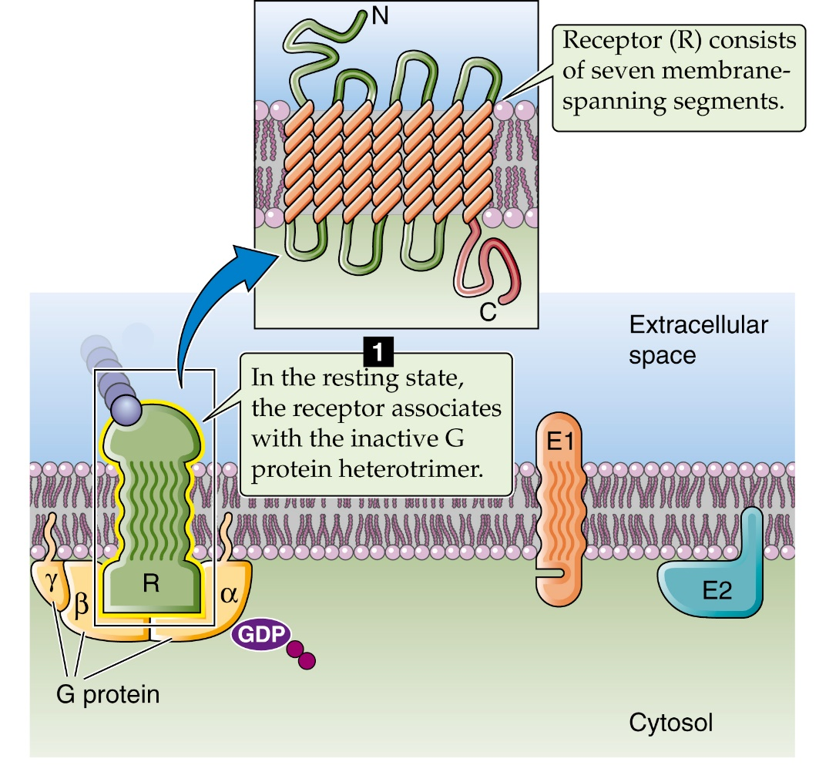
G protein-coupled receptors 1
Also known as metabotropic receptors
Use a second messenger system via activation of a G protein
G protein-coupled receptors can activate one or several intracellular enzymes that synthesize or activate second messengers to produce a diversity of responses to a specific ligand
Signalling is slow, but can be long-lasting

Slide 19

G protein-coupled receptors 2
When an agonist binds it causes a conformational change in the receptor which activates the G-protein.
The signalling sequence follows a cycle as long as the agonist is bound.

Slide 20
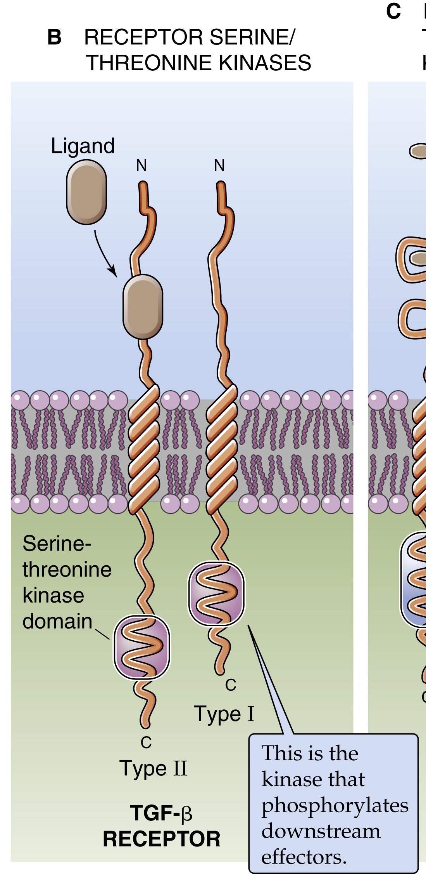
Enzyme-linked receptors
Transmembrane receptor linked to intracellular enzyme activation
Linked enzymes are often kinases
Kinases phosphorylate other intracellular proteins to elicit a physiological response
Responses are slow but long-lasting

Slide 21
Intracellular receptors
Ligands are lipid-soluble and can cross the cell membrane
Receptors are located in the cytoplasm or the nucleus of target cells
Many intracellular receptors are transcription factors that interact with DNA in the nucleus and regulate gene expression.
Very slow response, but very long-lasting

Slide 22
Explain the role of second messengers in cellular signalling and the role of signalling cascades

Slide 23
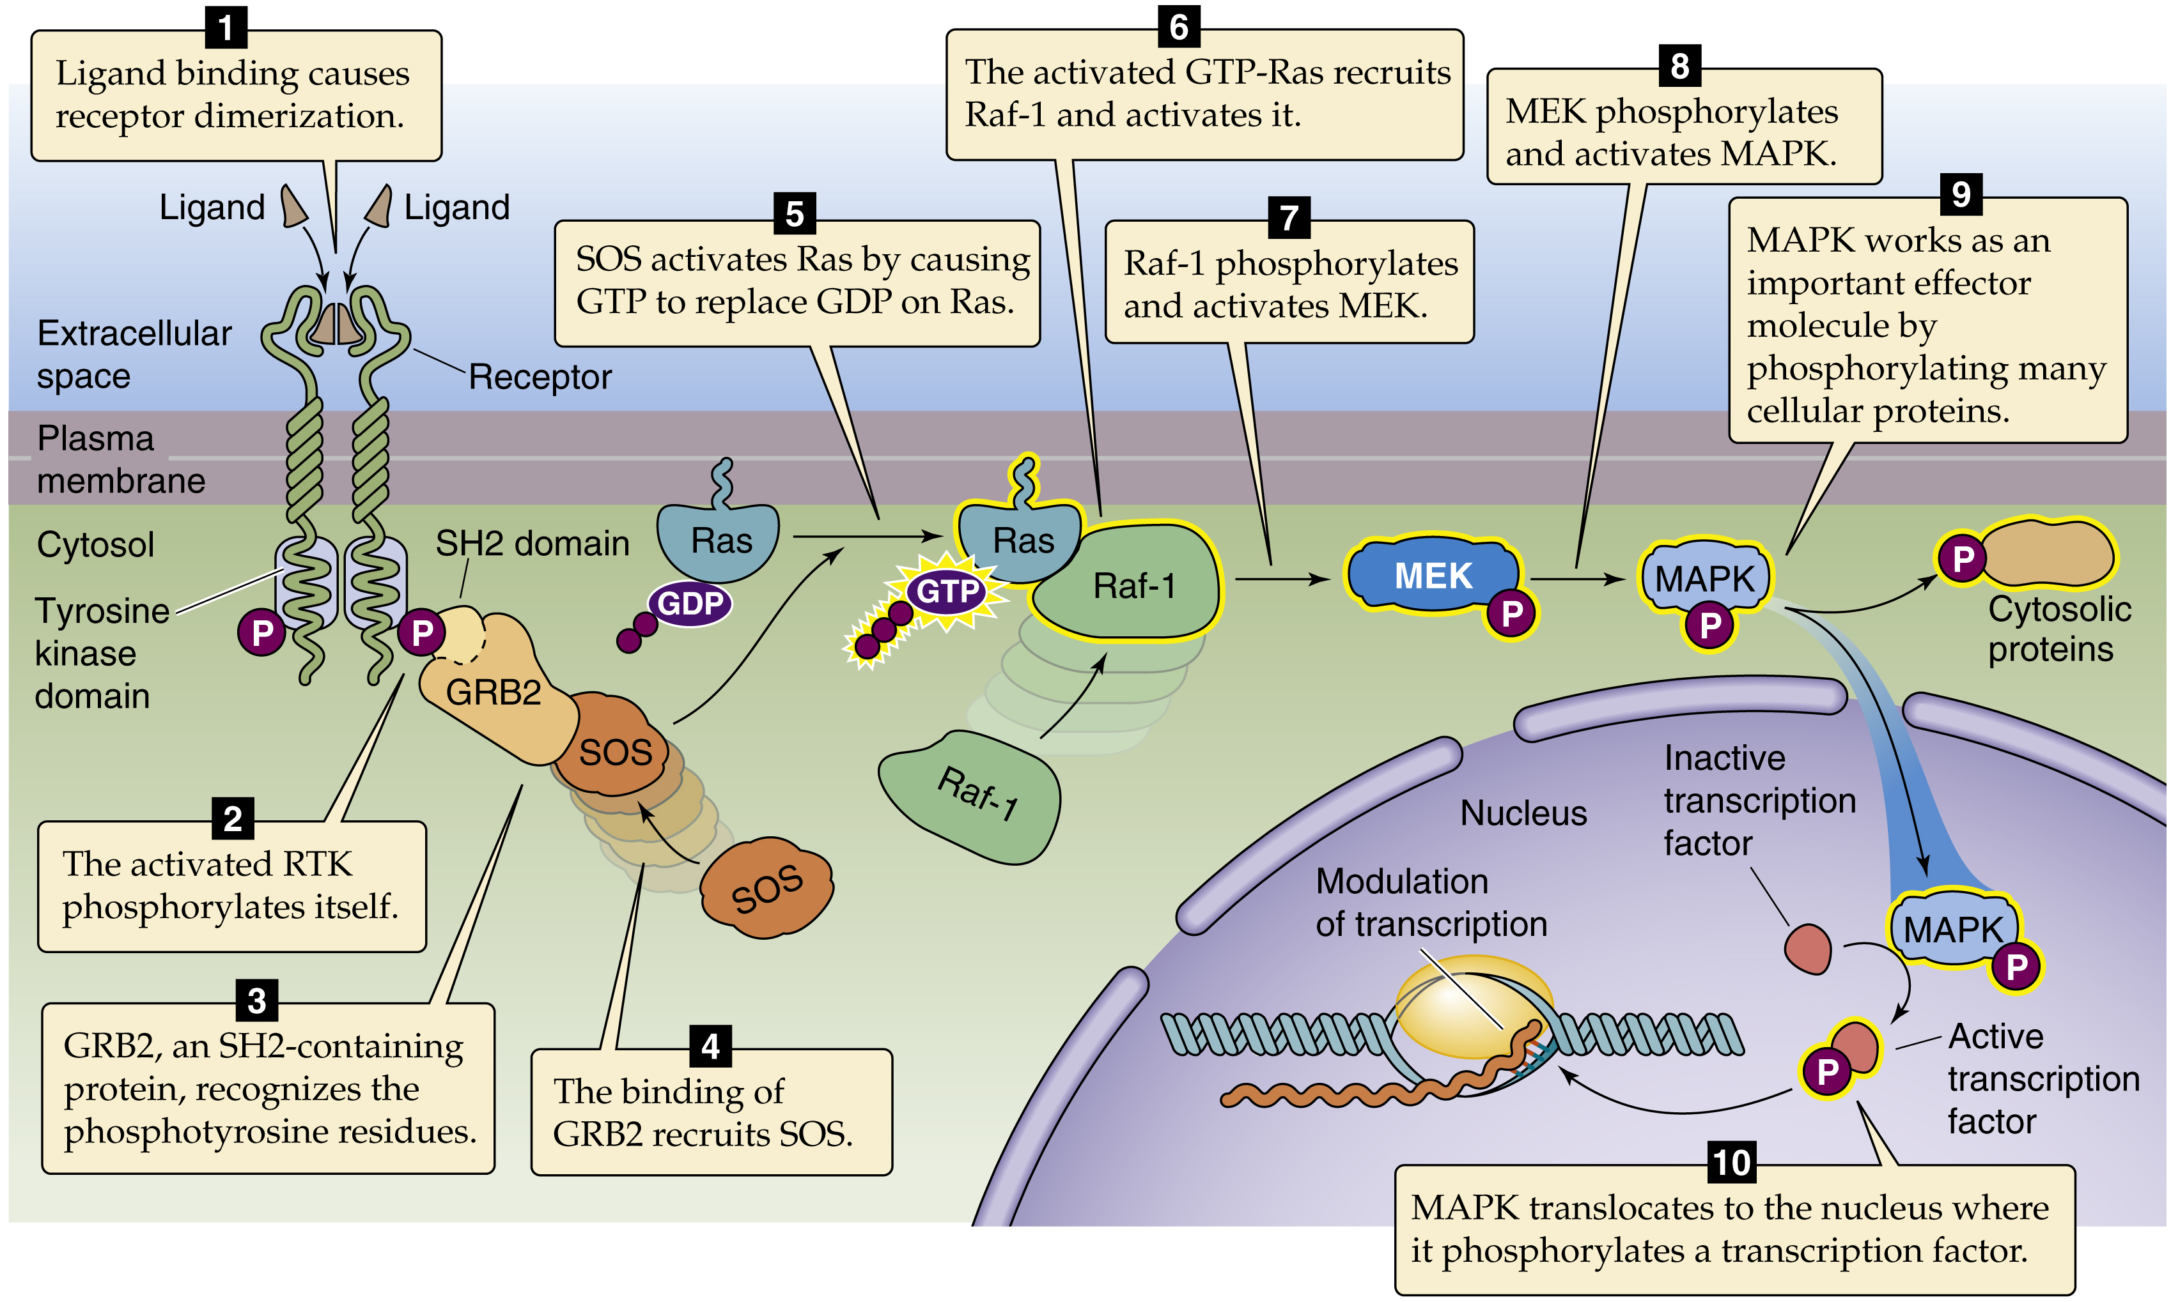
Signalling cascades
Advantages of signalling cascades:
  amplification of the signal
  the ability to adapt the response at each step by modulating the effector protein activity via mediators outside the cascade
  The ability to provide negative or positive feedback into the system via several mediators within the cascade
  The ability to terminate the signalling process at several points in the cascade

Slide 24
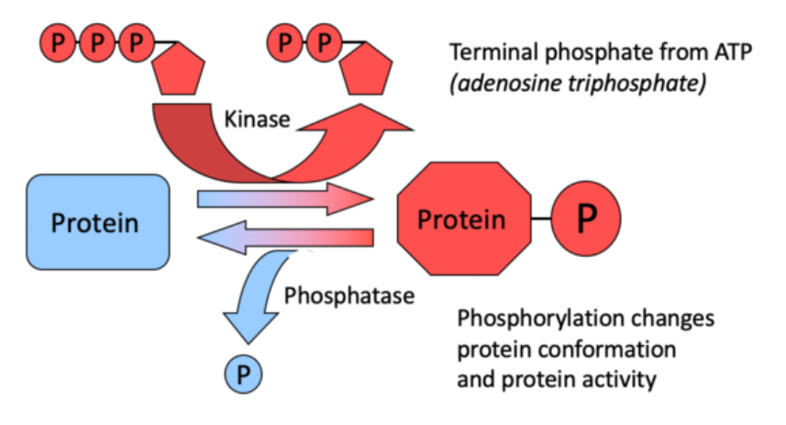
Phosphorylation
Kinase
  add phosphate group – phosphorylation
Phosphatase
  remove phosphate group – dephosphorylation
It happens quickly
It’s quickly reversible
It can cause a lasting effect
It allows for signal amplification: one kinase can phosphorylate, or a phosphatase dephosphorylate, many copies of a target protein.
It allows for signal integration: one kinase can phosphorylate, or a phosphatase dephosphorylate, many different target proteins

Slide 25
Describe the role of Ca²⁺ in cell signalling

Slide 26
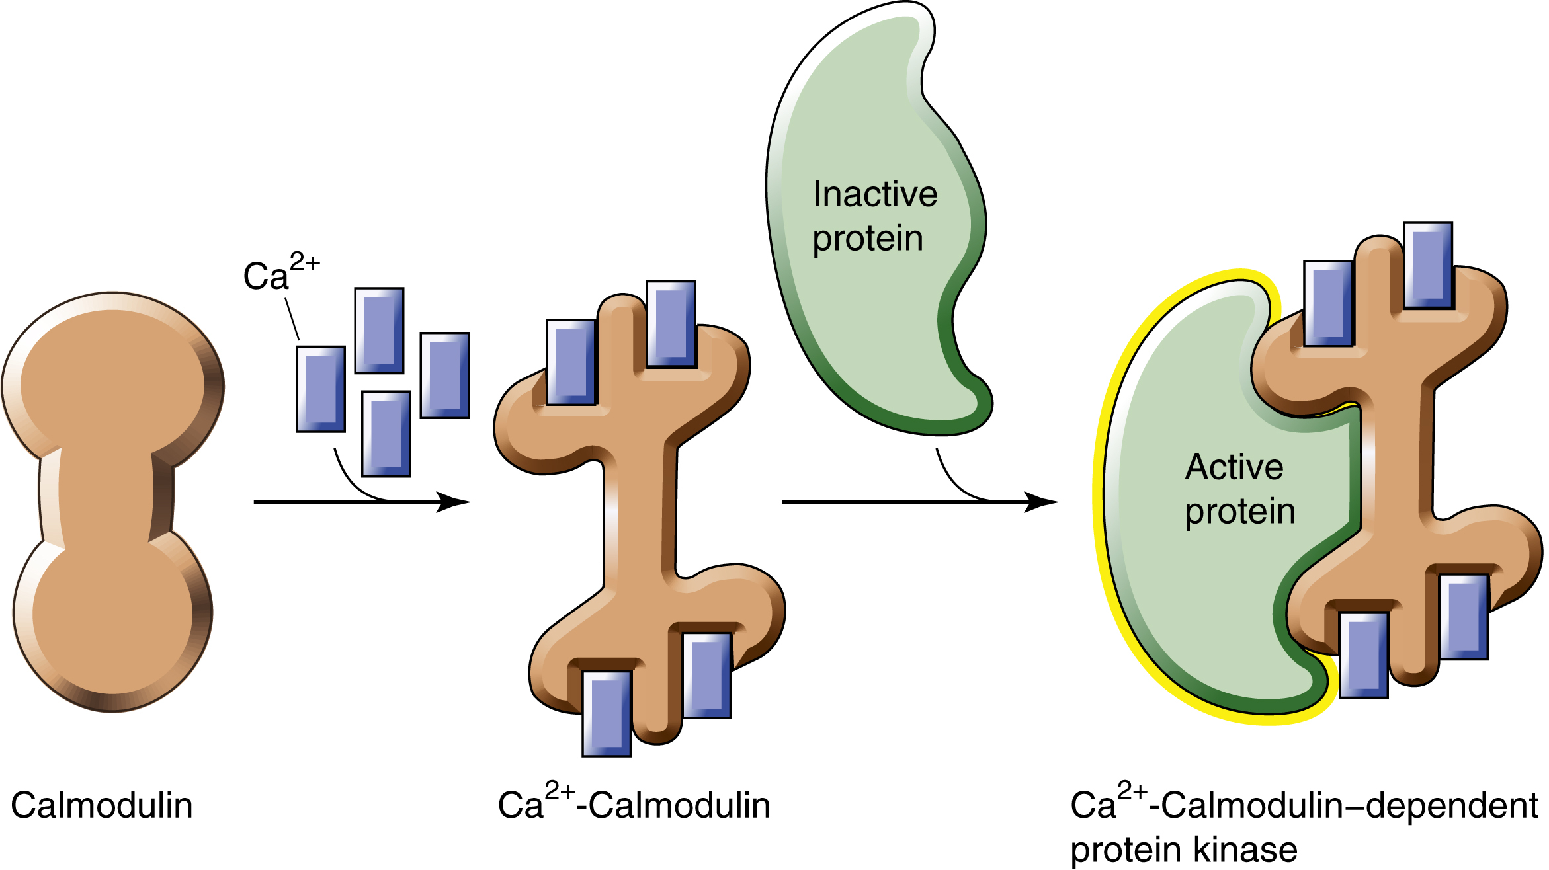
Ca²⁺ signalling
Free Ca²⁺ in the cytoplasm is involved in the regulation of many intracellular enzymes and effector proteins
Ca²⁺ is usually maintained at very low concentrations in the cytoplasm
Effects of changes in intracellular Ca²⁺ are mediated by Ca²⁺-binding proteins

Slide 27
Extracellular signalling
Sequence of events
Step 1: Recognition of the signal ligand by its receptor.
Step 2: Transduction of the extracellular stimulus into an intracellular signal by receptor activation.
Step 3: Transmission of an intracellular second messenger signal to the appropriate effector.
Step 4: Modulation of the expression or activity of effectors such as enzymes, ion channels, cytoskeletal components, and transcription factors.
Step 5: Response of the cell to the initial stimulus via the effectors.
Step 6: Termination of the response by removal or degradation of the signalling molecules.

Slide 28
Key points
Cells can receive a message, transfer the information across the plasma membrane, and then produce a response to the message.
There are three main types of signalling: Autocrine, endocrine and paracrine
There are 4 main superfamilies of receptor that provide mechanisms to produce different types of response to a ligand
Signalling cascades use second messengers to amplify and produce a variety of responses to a ligand
Phosphorylation is a key mechanism to produce intracellular responses
Ca²⁺ is an important intracellular signalling mediator

Slide 29
End of session questions 1
Can you match the signalling events to the correct mode of signalling?
The signal enters the circulation and acts on a distant tissue
Autocrine
The signal acts on a neighbouring cell in the same tissue
Endocrine
The signal stimulates the same cell that released the chemical
Paracrine

Slide 30
End of session questions 2
What is the definition of a target cell?
G-protein signalling uses the hydrolysis of which molecule as an energy source?
Why are steroid hormones ideal signalling molecules for targeting nuclear receptors?
What do the receptors with associated kinase activity do to downstream targets?

Slide 31
Contact
Dr Mark Richards
mark.richards.1@warwick.ac.uk

Slide 32
End of session questions: Answers
Can you match the signalling events to the correct mode of signalling?
The signal enters the circulation and acts on a distant tissue
Autocrine
The signal acts on a neighbouring cell in the same tissue
Endocrine
The signal stimulates the same cell that released the chemical
Paracrine

Slide 33
End of session questions: Answers
What is the definition of a target cell?
  The target cell is the cell that produces the physiological response to the secreted signalling molecules.
G-protein signalling uses the hydrolysis of which molecule as an energy source?
  G proteins utilise the hydrolysis of GTP to produce energy for the transduction process

Slide 34
End of session questions: Answers
Why are steroid hormones ideal signalling molecules for targeting nuclear receptors?
  Steroid ligands such as oestrogens, androgens, and glucocorticoids are highly hydrophobic molecules that can diffuse through the lipid bilayer of the cell membrane and directly interact with intracellular receptors.
What do the receptors with associated kinase activity do to downstream targets?
  Receptors with kinase activity activate the kinase when activated by an agonist. Kinases are enzymes that phosphorylate (add a phosphate group (PO₄) to target proteins. This generally activates proteins to elicit a physiological response.

