Slide 1


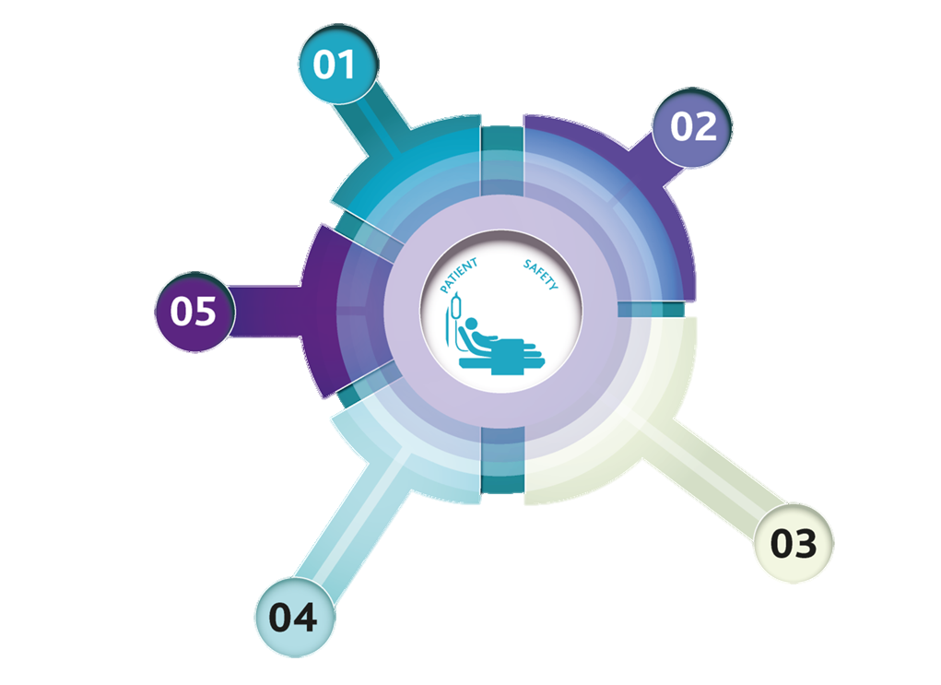



Selected actions in relation to GMC Excellence Framework
Anti-Racism in Medicine Module
Active Bystander training
Raising awareness in student
body
Attainment Gap working group (Senior Leadership)
University Social Inclusion Committee / Race Equality Charter
BMA Charter for Medical Schools
Raising concerns process
Diversity data collection
BME Student Network
BME Mentoring Scheme
Training: Melanin Medics, Communication training on challenging inappropriate behaviour
Financial support: Covid fund
Reflection writing
Decolonising the Curriculum: Content analysis of the curriculum – audit of teaching to assess content for diversity.
CBL review of cases / ethnic stereotyping
Collect and analyse assessment data annually.
Survey of all students on inclusion and intercultural diversity within MB ChB
Working and Teaching with Active Racial Awareness workshops
Challenging Racism: Improving medical students' experiences in the clinical learning environment. IATL/WMS joint funded film project

