Slide 1

1 Fundamental Mathematical Concepts
Dr Helen Strachan-Jones
helen.strachan-jones@warwick.ac.uk

Slide 2

Learning outcomes
Part 1:
Perform calculations following the BIDMAS order of mathematical operations.
Describe the role of powers in describing small and large and express numbers in standard form.
Describe standard ways of approximating numbers.
Distinguish between exponential and logarithmic equations.
Describe the role of the negative logarithmic scale in measuring pH.
Part 2:
Distinguish between directly proportional and indirectly proportional relationships.
Rearrange equations to change the subject.
Distinguish between independent and dependent variables and be able to plot them on a two-dimensional graph.
Calculate the gradient of a straight-line graph.

Slide 3
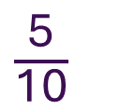

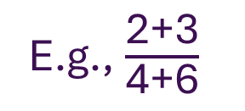
The order of calculations in a mathematical expression should follow BIDMAS
Contents of brackets are always worked out first.
E.g., $\frac{\text{2}\text{+3}}{\text{4}\text{+6}}$
E.g., 9 + 6 - 8(7 + 5) ÷ 4
Brackets
Indices
Division and multiplication
Addition and subtraction
$\frac{\text{(2}\text{+3)}}{\text{(4}\text{+6)}}$
9 + 6 - 8(12) ÷ 4
9 + 6 - 96 ÷ 4
$\frac{\text{5}}{\text{10}}$
9 + 6 - 24
15 - 24
= -9
= 0.5

Slide 4
Powers is shorthand way of writing repeated multiplication using the same number.
Index or exponent- how many times a value has been multiplied by itself
2 x 2
2 x 2 x 2
2 x 2 x 2 x 2
2 x 2 x 2 x 2 x 2 x 2 x 2 x 2
2²
= 2² = “2 squared” or “2 to the power of 2”
= 2³ = “2 cubed” or “2 to the power of 3”
= 2⁴ = “2 to the power of 4”
= 2⁸ = “2 to the power of 8”
Base – the number being multiplied by itself.
10¹ = 10
10² = 10 x 10 = 100 (one hundred)
10³ = 10 x 10 x 10 = 1000 (one thousand)
10⁴ = 10 x 10 x 10 x 10 = 10 000 (ten thousand)
10⁵ = 10 x 10 x 10 x 10 x 10 = 100 000 (one hundred thousand)
10⁶ = 10 x 10 x 10 x 10 x 10 x 10 = 1 000 000 (one million)

Slide 5
In science, we use the power of 10 to describe very large or very small numbers
For each move of the decimal point to the left, the power of 10 increases by 1. And for each move to the right, the power of 10 decreases by 1.
Ordinary form
E.g., 2 380 000
E.g., 0.0056
Standard form
One (non-zero) digit before the decimal point
2.38 x 10⁶
“2.38 times 10 to the power of 6”
5.6 x 10⁻³
“5.6 times 10 to the power of -3”
Power | Prefix | Symbol | Example
10³ | kilo- | k | 1 km = 1000 m or 1 x 10³ m
10⁻² | centi- | c | 1 cm = 0.01 m or 1 x 10⁻² m
10⁻³ | milli- | m | 1 mg = 0.001 g or 1 x 10⁻³ g
10⁻⁶ | micro- | µ or mc | 1 µg = 0.000001 g or 1 x 10⁻⁶ g

Slide 6
Numbers can be approximated (rounded) to the nearest whole number, the number of decimal places or the number of significant figures
In significant figures, 0s within a number or after a decimal number are significant; 0s at the end of a whole number or before a decimal number are not.
E.g., All these numbers are to four significant figures:
10.54
0.8760
6754000
0.0004832
E.g., 3.141592
Nearest whole number
3
Number of decimal places
3.14 to two decimal places
Number of significant figures
3.14 to three significant figures

Slide 7


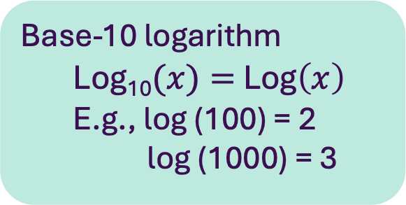
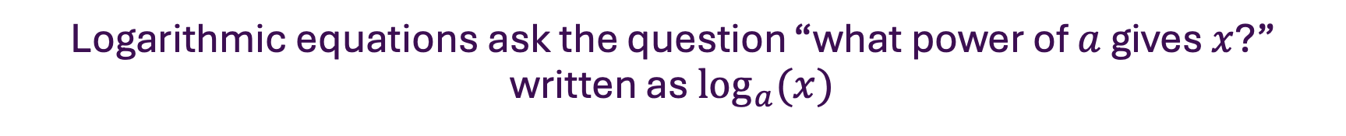
Logarithmic equations ask the question “what power of $a$ gives $x$?” written as $\log_{a}{(x)}$
Exponential equations isolate the power. Logarithmic equations isolate the exponent.
Base
Exponent
Exponential equation
2⁴ = 16
“Two to the power of four equals sixteen”
Logarithmic equation
Log₂(16) = 4
“Log base two of sixteen is four”
Base
Exponent
Base-10 logarithm
Log₁₀$(x)=$ Log$\left(x\right)$
E.g., log (100) = 2
log (1000) = 3
$$\log_{a}{(x)=y}$$
$$x=a^{y}$$

Slide 8
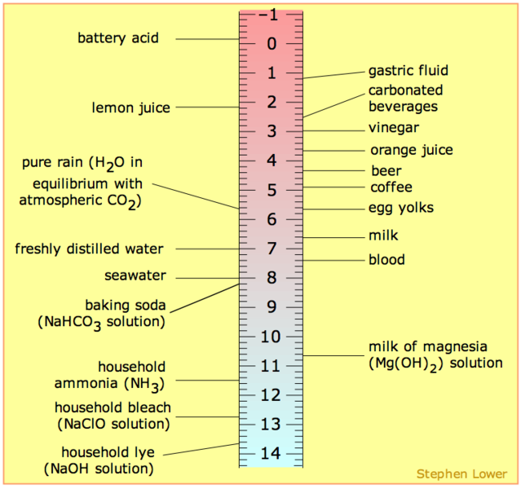
The pH scale is a negative logarithmic scale of hydrogen ion concentration.
The normal range for physiological pH is 7.35-7.45
- log [H⁺] = pH
More hydrogen ions
Each whole number increase or decrease represents a 10-fold change in hydrogen ion concentration
There is an inverse relationship between pH and hydrogen ion concentration
pH <7 is acidic
pH 7 is neutral
pH >7 is basic
Less hydrogen ions
Notes:
The pH scale. Acidic solutions have pH values less than 7, and basic solutions have pH values greater than 7. Image from UCDavis ChemWiki, CC BY-NC-SA 3.0 US(Opens in a new window).

Slide 9
Learning outcomes
Part 1:
Perform calculations following the BIDMAS order of mathematical operations.
Describe the role of powers in describing small and large and express numbers in standard form.
Describe standard ways of approximating numbers.
Distinguish between exponential and logarithmic equations.
Describe the role of the negative logarithmic scale in measuring pH.
Part 2:
Distinguish between directly proportional and indirectly proportional relationships.
Rearrange equations to change the subject.
Distinguish between independent and dependent variables and be able to plot them on a two-dimensional graph.
Calculate the gradient of a straight-line graph.

Slide 10


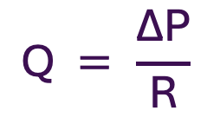
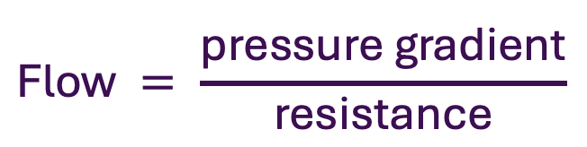
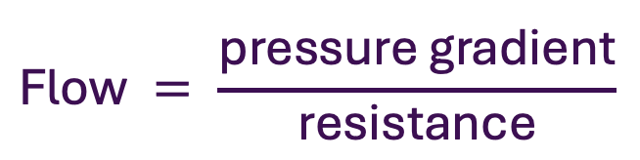
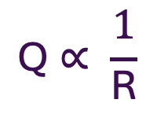

Algebra is the branch of mathematics which uses symbols to represent numbers. It helps us represent relationships between different physiological variables.
$$\text{F}\text{low} = \frac{\text{pressure} \text{gradient}}{\text{resistance}}$$
$$\text{Q} = \frac{\text{∆}\text{P}}{\text{R}}$$
Directly proportional - as one quantity increases, the other quantity also increases at the same rate.
$$\text{Flow}∝\text{pressure} \text{gradient}$$
$$\text{Q}∝∆P$$
Inversely proportional – as one quantity increases, the other quantity decreases at the same rate
$$\text{F}\text{low}∝ \frac{1}{\text{resistance}}$$
$$\text{Q}∝ \frac{1}{\text{R}}$$
If pressure gradient and resistance change in opposite directions at the same rate, flow will stay the same.
$$\text{Flow} = \frac{\text{pressure} \text{gradient}}{\text{resistance}}$$

Slide 11
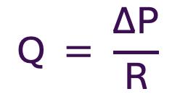
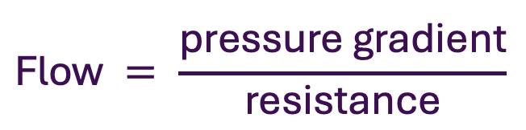



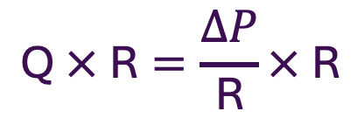
Rearranging an equation can change the subject of the equation.
Whatever is done to one side of the equation (add, subtract, multiply, or divide) must be done to the whole of the other side.
$$\text{F}\text{low} = \frac{\text{pressure} \text{gradient}}{\text{resistance}}$$
$$\text{Q} = \frac{\text{∆}\text{P}}{\text{R}}$$
$$\text{f}\text{low} × \text{resistance}=\frac{\text{pressure} \text{gradient}}{\text{resistance}}× \text{resistance}$$
$$\text{Q} × \text{R}=\frac{∆P}{\text{R}}× \text{R}$$
$$\text{P}\text{ressure} \text{gradient}= \text{flow} × \text{resistance}$$
$$∆\text{P}= \text{Q} × \text{R}$$

Slide 12




Rearranging equations can help us explain physiological relationships in the most logical way
$${\dot{\text{V}}}_{\text{A}}\text{=}\frac{\left(\dot{\text{V}}{\text{CO}}_{\text{2}} \text{×} \text{K}\right)}{{\text{P}}_{\text{A}}{\text{CO}}_{\text{2}}}$$
$${\dot{\text{V}}}_{\text{A}} × {\text{P}}_{\text{A}}{\text{CO}}_{\text{2}}\text{=}\frac{\left(\dot{\text{V}}{\text{CO}}_{\text{2}} \text{×} \text{K}\right)}{{\text{P}}_{\text{A}}{\text{CO}}_{\text{2}}}× {\text{P}}_{\text{A}}{\text{CO}}_{\text{2}}$$
$$\frac{{\dot{\text{V}}}_{\text{A}} ×{ \text{P}}_{\text{A}}{\text{CO}}_{\text{2}}}{{\dot{\text{V}}}_{\text{A}}}\text{=}\frac{\left(\dot{\text{V}}{\text{CO}}_{\text{2}} \text{×} \text{K}\right)}{{\dot{\text{V}}}_{\text{A}}}$$
Reference box
V̇_{A}: Alveolar ventilation
V̇CO₂: Rate of CO₂ production
K: A constant
P_{A}CO₂: Partial pressure of CO₂ in alveolar air
$${\text{P}}_{\text{A}}{\text{CO}}_{\text{2}} \text{=}\frac{\left(\dot{\text{V}}{\text{CO}}_{\text{2}} \text{×} \text{K}\right)}{{\dot{\text{V}}}_{\text{A}}}$$

Slide 13
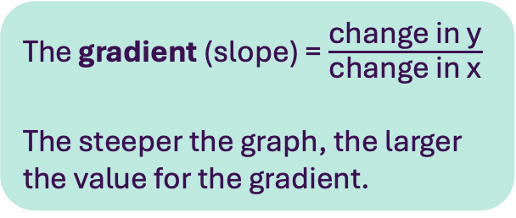
A graph with two axes can be used to compare to variables.
The independent variable is plotted on the x axis. The dependent variable is plotted on the y axis.
Variables are directly proportional if:
When one variable is zero, the other is also zero
When on variable changes, the other changes in the same ratio
4
y axis
+
3
+
2
Change in y
+
1
+
Change in x
0
-4
-3
-2
+
2
3
4
-1
1
-1
x axis
The gradient (slope) = $\frac{\text{change} \text{in} \text{y}}{\text{change} \text{in} \text{x}}$
The steeper the graph, the larger the value for the gradient.
Table of x and y values
Value for x | 0 | 1 | 2 | 3 | 4
Value for y | 0 | 1 | 2 | 3 | 4
-2
-3
-4

Slide 14
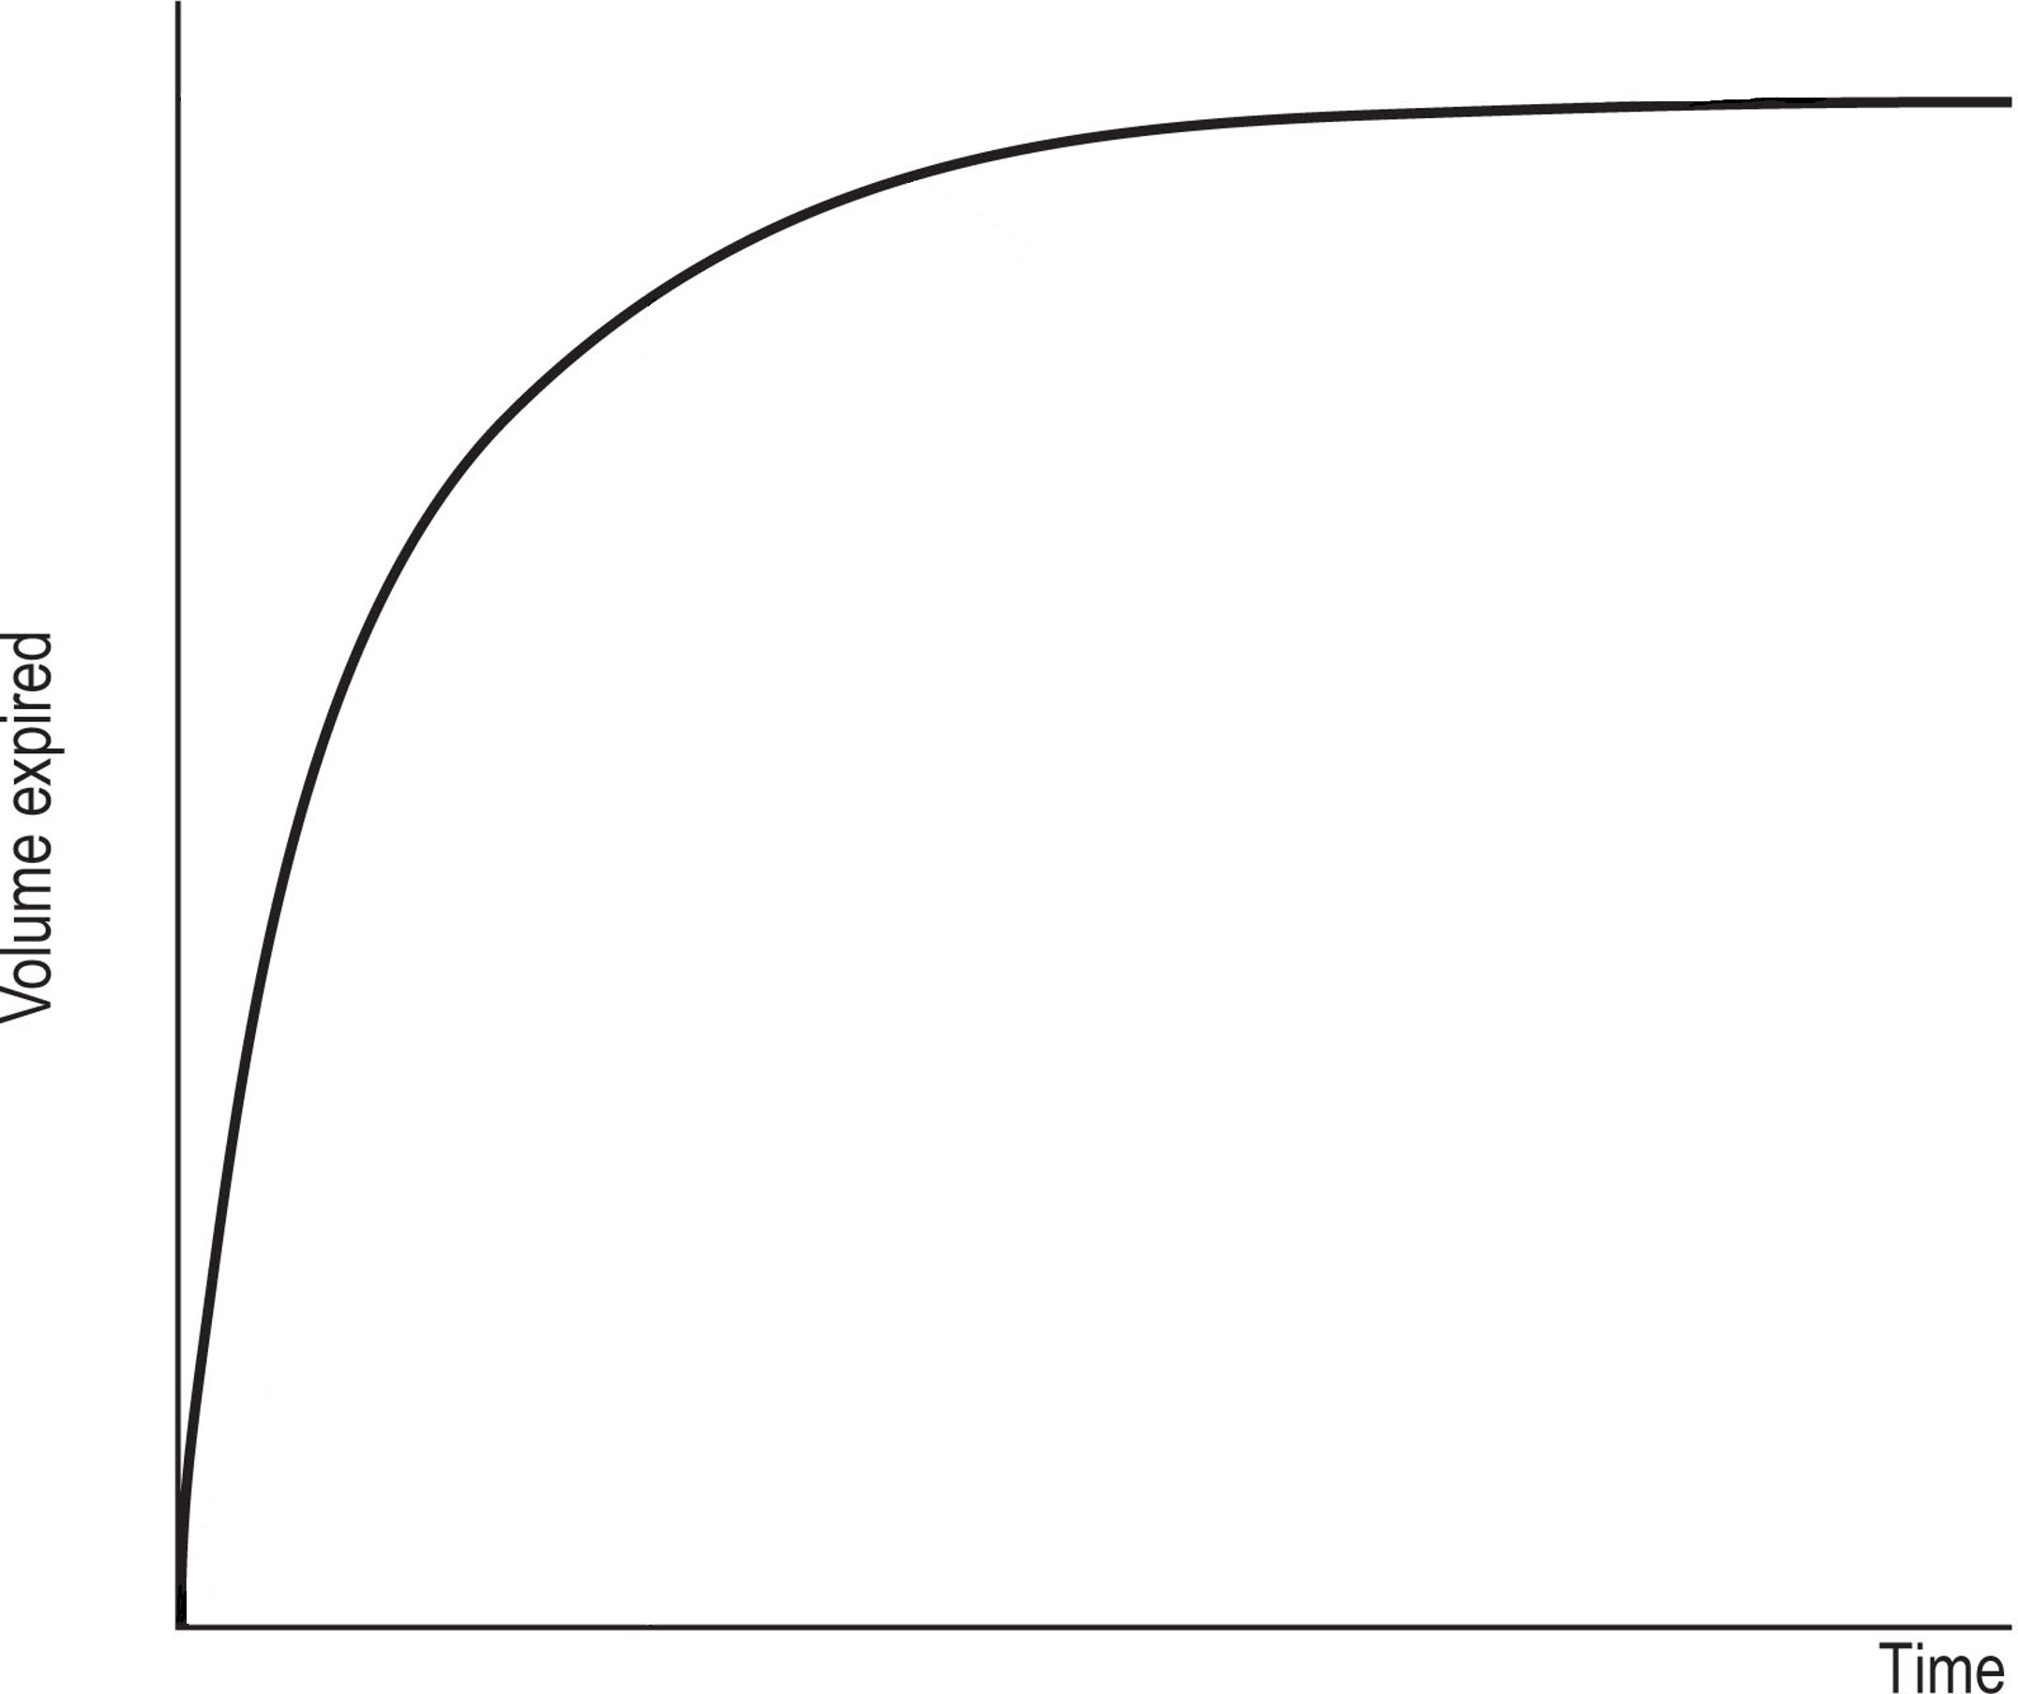
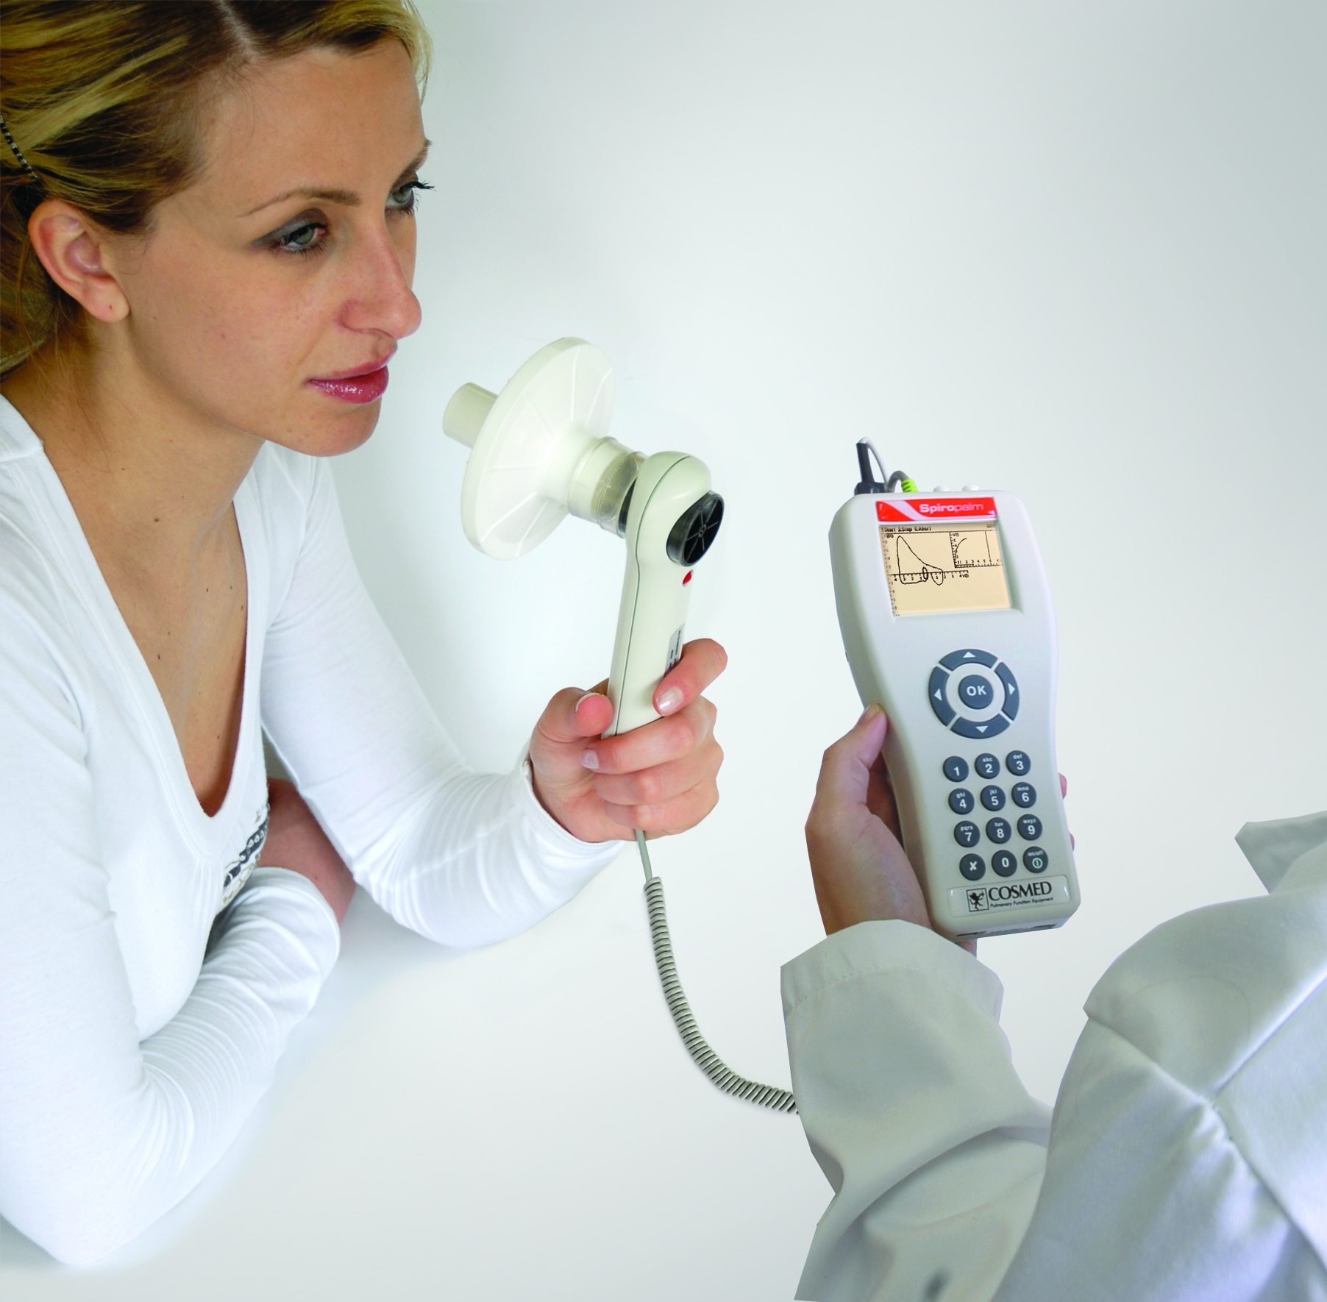
Graphs are used to depict physiological relationships, represent pathological patterns, and display patient results.
Calculating a value for the gradient of a curve requires a different equation, but the shape gives us information about the physiological variables being measured.
Notes:
Cosmed, CC BY-SA 3.0 <https://creativecommons.org/licenses/by-sa/3.0>, via Wikimedia Commons
Adapted from: Kasfiki, Eirini V., 250 Cases in Clinical Medicine, Chapter 1, 2-5. Typical spirometry. FEV1, forced expiratory volume in 1 s; FVC, forced vital capacity. Copyright © 2024 © 2024, Elsevier Limited. All rights reserved

Slide 15
Fundamental mathematical concepts
Learning outcomes
Video part 1:
Perform calculations following the BIDMAS order of mathematical operations.
Describe the role of powers in describing small and large and express numbers in standard form.
Describe standard ways of approximating numbers.
Distinguish between exponential and logarithmic equations.
Describe the role of the negative logarithmic scale in measuring pH.
Video part 2:
Distinguish between directly proportional and indirectly proportional relationships.
Rearrange equations to change the subject.
Distinguish between independent and dependent variables and be able to plot them on a two-dimensional graph.
Calculate the gradient of a straight-line graph.
1.1: Video and transcript
1.2: Accompanying reading
1.3: Worksheet

Slide 16
Image references
Slide 8: UCDavis ChemWiki, CC BY-NC-SA 3.0 US
Slide 14:
Cosmed, CC BY-SA 3.0 <https://creativecommons.org/licenses/by-sa/3.0>, via Wikimedia Commons
Adapted from: Kasfiki, Eirini V., 250 Cases in Clinical Medicine, Chapter 1, 2-5. Typical spirometry. FEV1, forced expiratory volume in 1 s; FVC, forced vital capacity. Copyright © 2024 © 2024, Elsevier Limited. All rights reserved

