Slide 1
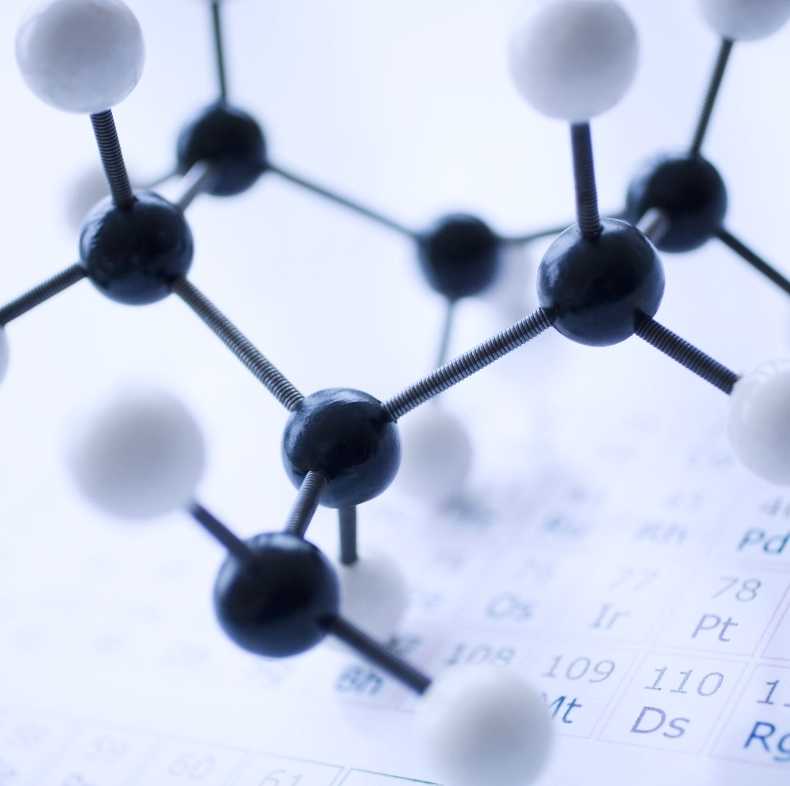

2.1: Atoms and Ions
Dr Helen Strachan-Jones
helen.strachan-jones@warwick.ac.uk

Slide 2

Learning outcomes
Define the terms atom and element.
Describe the basic structure of atoms including the arrangement of protons, neutrons, and electrons.
Describe the charge on protons, neutrons and electrons.
Define the term isotope.
Define the term ion and describe how atoms can become positively or negatively charged.
Define the terms cation and anion.
Identify common elements used in biological processes in the body.

Slide 3
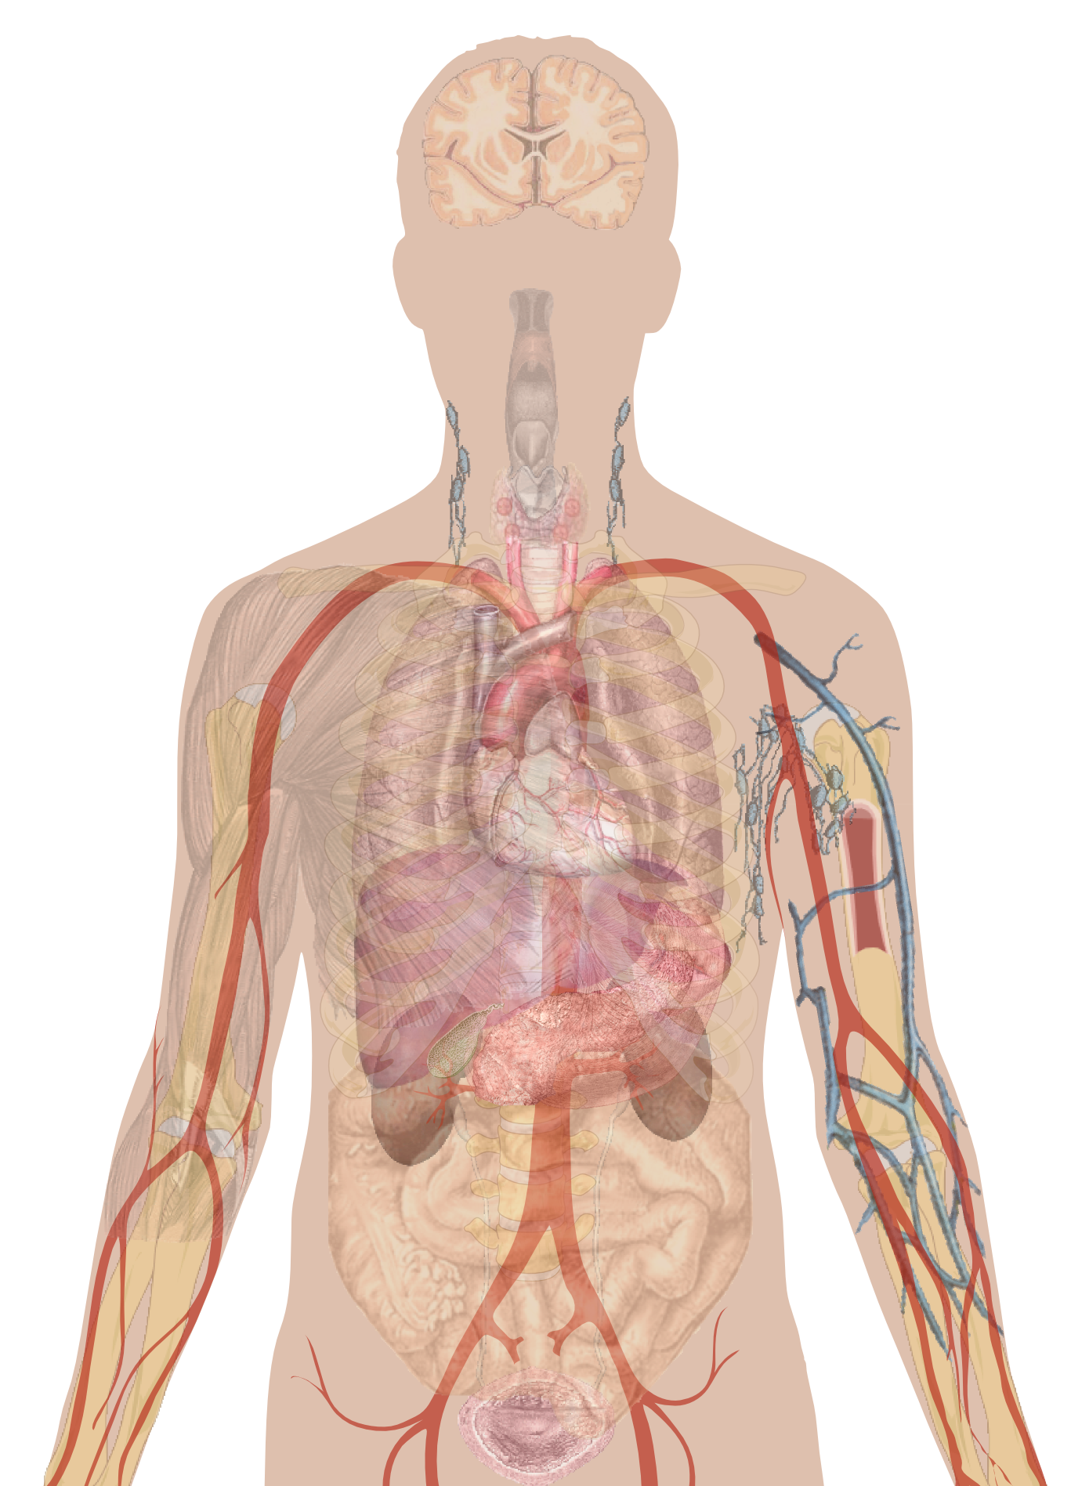
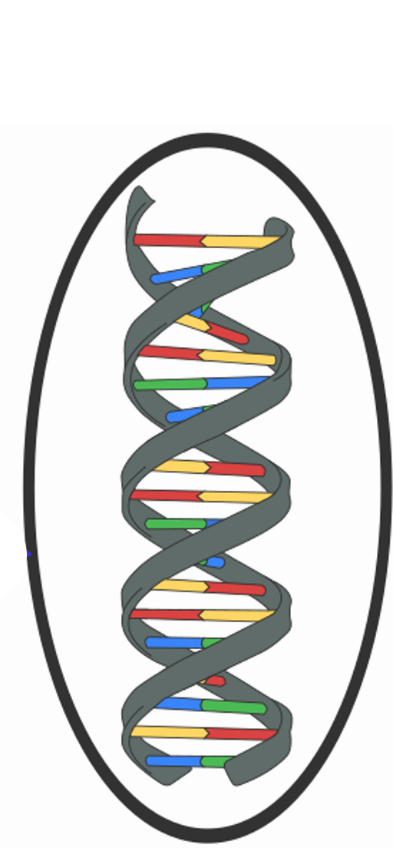
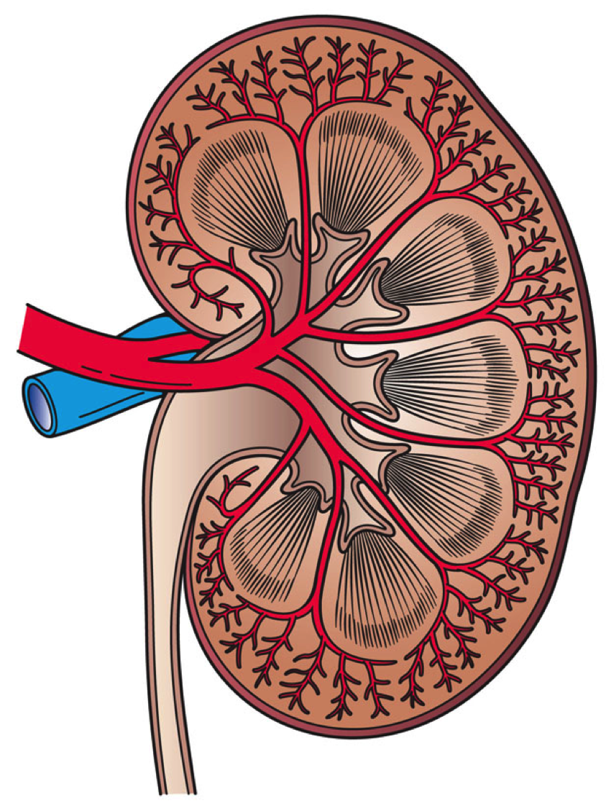
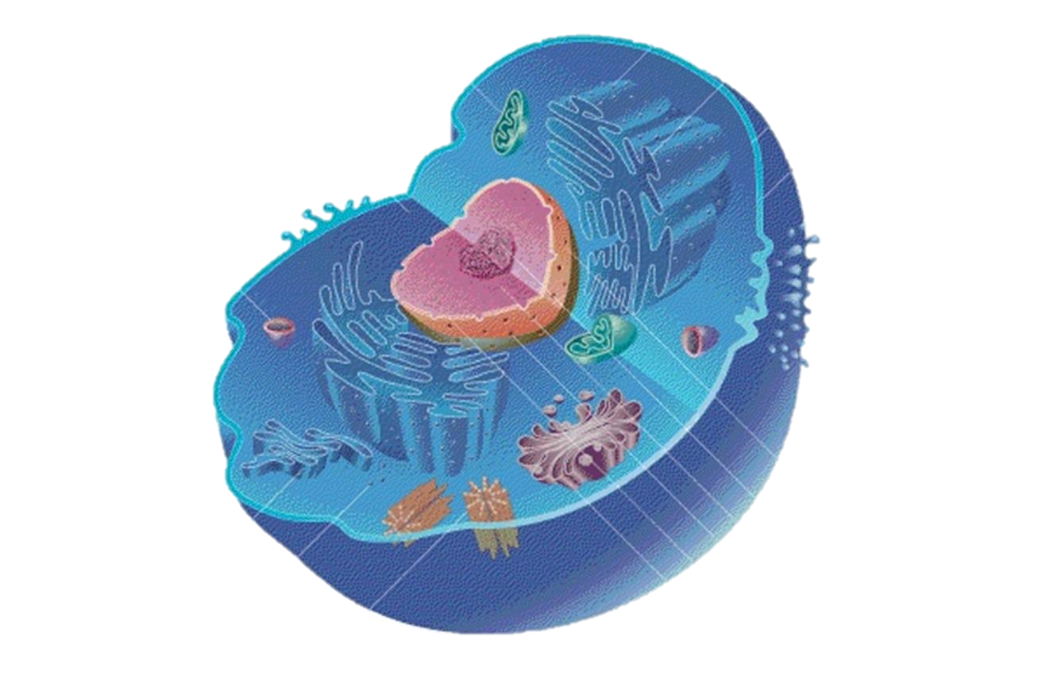

Notes:
Image 1: Mikael Häggström, CC0, via Wikimedia Commons
Image 2: Artwork by Holly Fischer, CC BY 3.0 <https://creativecommons.org/licenses/by/3.0>, via Wikimedia Commons
Image 3: Mediran, CC BY-SA 3.0 <https://creativecommons.org/licenses/by-sa/3.0>, via Wikimedia Commons
Image 4: Adapted from: Sponk, Tryphon, Magnus Manske, User:Dietzel65, LadyofHats (Mariana Ruiz), Radio89, CC BY-SA 3.0 <https://creativecommons.org/licenses/by-sa/3.0>, via Wikimedia Commons
Image 5: Gorkhs on pixabay, CC0, via Wikimedia Commons

Slide 4
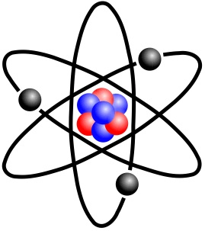
Atoms are formed from subatomic particles: protons, neutrons, and electrons.
Electron
Negative charge
Proton
Positive charge
Nucleus
Neutron
Neutral (no charge)
Atomic number – number of protons
One atomic mass unit (amu) – mass of one proton or one neutron
Atomic mass number – total number of protons and neutrons
E.g., oxygen
8 protons and 8 neutrons
Atomic number = 8
Atomic mass number = 16
Notes:
Image: nshepheard, CC BY-SA 2.0 DEED, via https://www.flickr.com/photos/sn1cks/3631728569

Slide 5
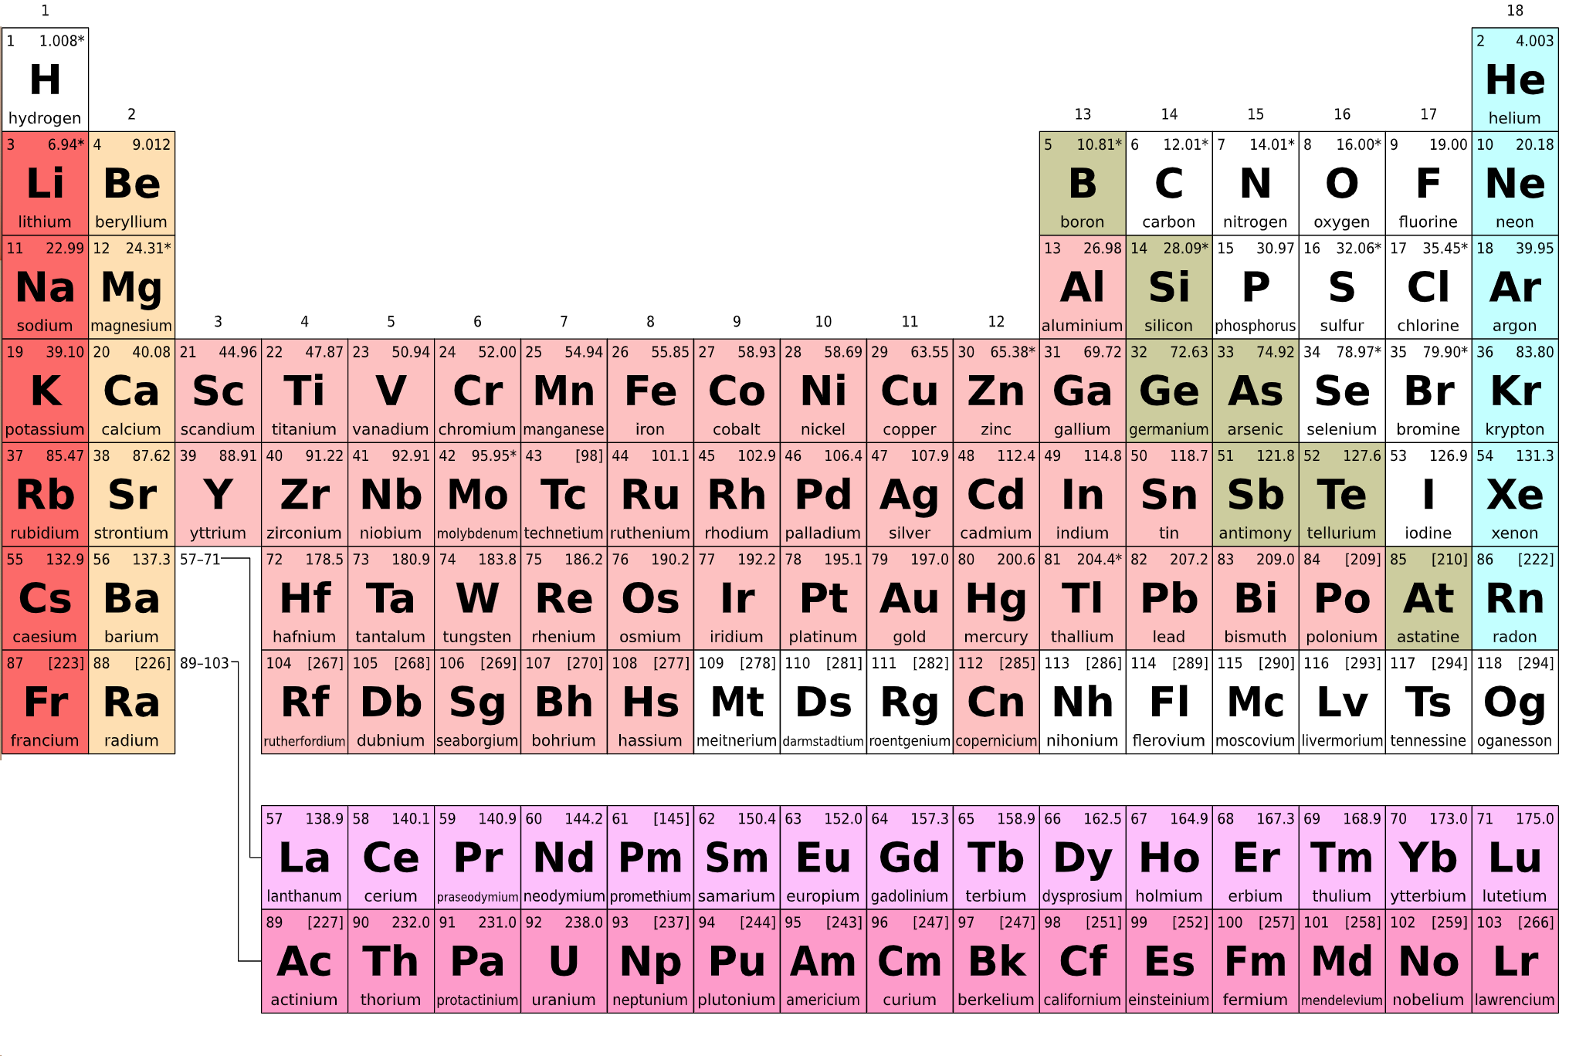
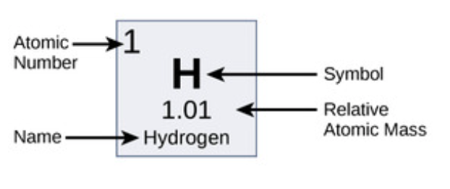
An element is a substance that is made up of only one kind of atom and cannot be broken down into any other simpler substance.
Elements are arranged in the periodic table in order of increasing atomic number.
Notes:
Periodic table image: László Németh, CC0, via Wikimedia Commons
Hydrogen image: Boundless, CC BY-SA 4.0, via https://bio.libretexts.org/

Slide 6
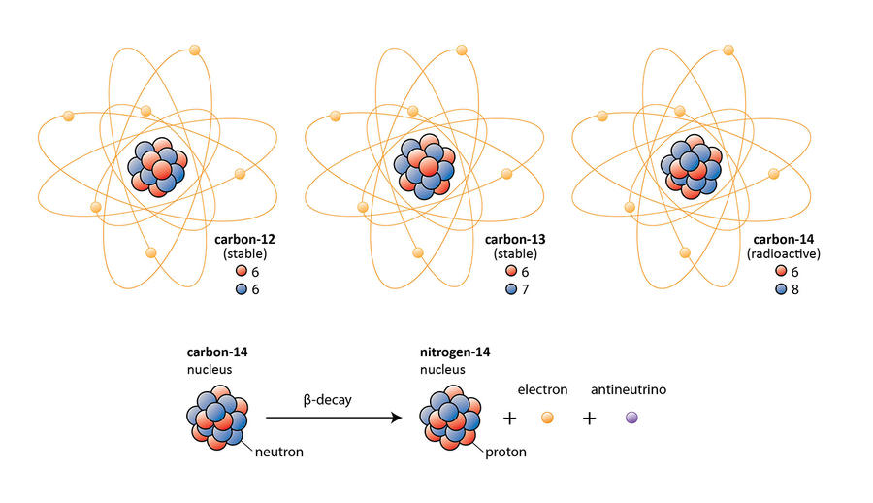
Isotopes are elements with different numbers of neutrons.
Atomic mass number = 12
Atomic mass number = 14
7 protons, 7 neutrons
Atomic mass number = 14
Notes:
Image: Creator: tesskou | Credit: tesskou on DeviantArt, CC BY-NC-ND 3.0 DEED, via https://www.deviantart.com/tesskou/art/Carbon-Isotopes-and-Beta-decay-351064306

Slide 7
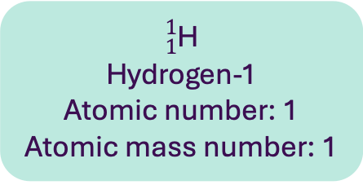
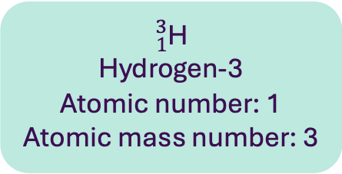
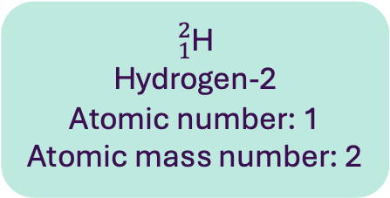
The masses of atoms are measured relative to the mass of a carbon-12 (C-12) atom which is 12 atomic mass units.
The relative atomic mass (Ar) of an element in the weighted average masses of the isotopes compared to the mass of a carbon-12 atom.
1 Neutron
1 Proton
$${}_{1}^{1}{\text{H}}$$
Hydrogen-1
Atomic number: 1
Atomic mass number: 1
$${}_{1}^{2}{\text{H}}$$
Hydrogen-2
Atomic number: 1
Atomic mass number: 2
$${}_{1}^{3}{\text{H}}$$
Hydrogen-3
Atomic number: 1
Atomic mass number: 3
Notes:
Image: Boundless, CC BY-SA 4.0, via https://bio.libretexts.org/

Slide 8
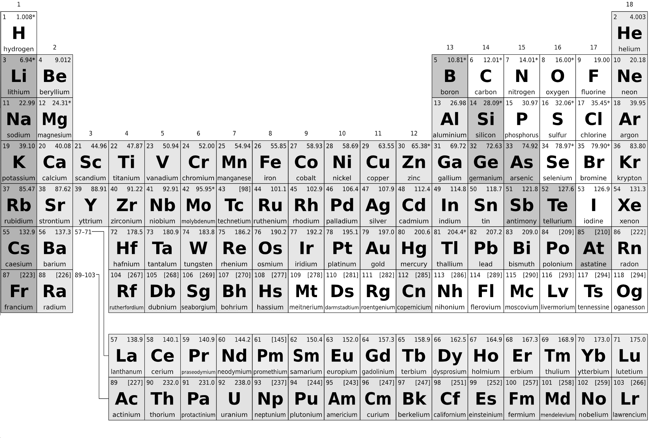
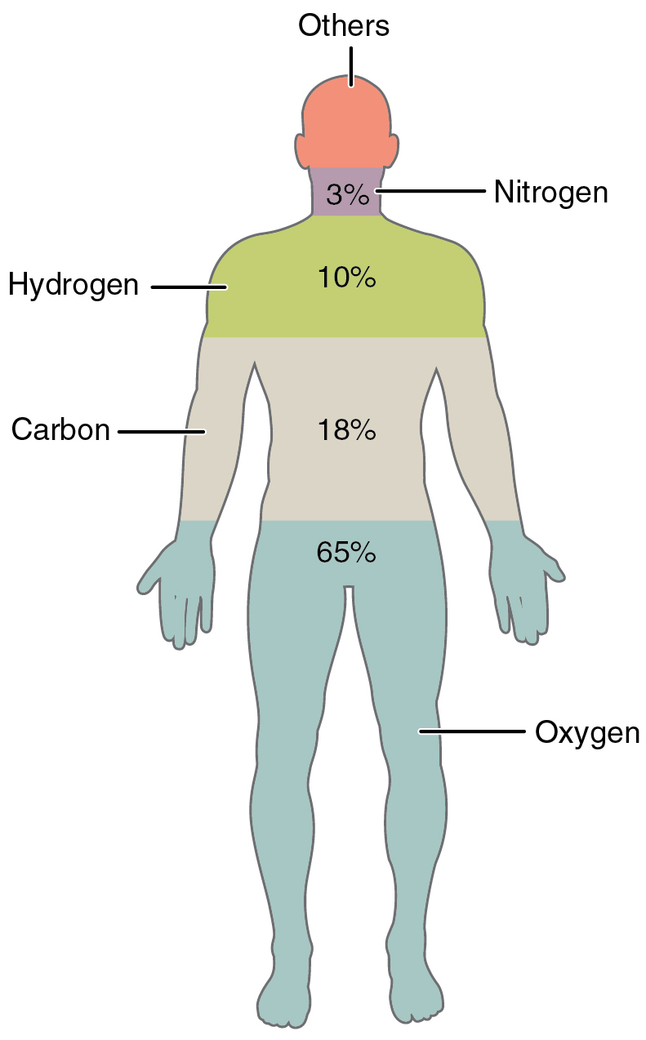
Hydrogen – pH.
Carbon – basic building block of all proteins, carbohydrates and fats.
Nitrogen – proteins, DNA and RNA.
Oxygen – cellular respiration.
Sodium and potassium – cellular communication; regulate fluid levels.
Calcium – cellular communication; bones and teeth.
Magnesium – chemical reactions.
Phosphorus – DNA and RNA; cell membranes; teeth and bones; storing and transporting energy.
Chlorine – regulate fluid levels; activity if other elements; stomach acid.
Iron – haemoglobin.
Notes:
Images:
Image 1: CNX Anatomy & Physiology, CC BY-SA 4.0 <https://creativecommons.org/licenses/by-sa/4.0>, via Wikimedia Commons
Periodic table image: Adapted from: László Németh, CC0, via Wikimedia Commons

Slide 9
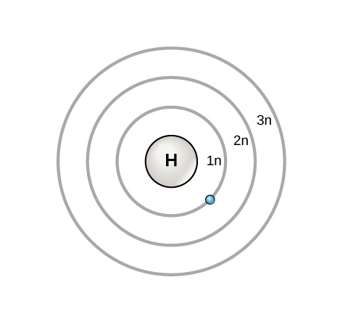
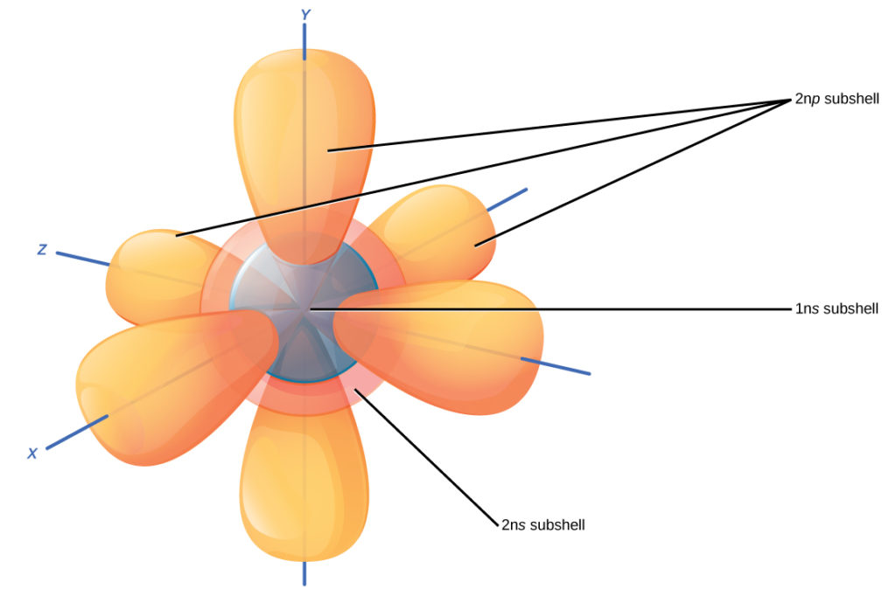
Electrons exist in shells (energy levels) around the nucleus.
The innermost shall (1n) can hold 2 electrons (1 pair), and other shells (2n etc.) can hold 8 electrons (4 pairs)
Ne
Octet rule – 8 electrons in the outmost shell makes the atom more stable.
Notes:
Top left image: Boundless, CC BY-SA 4.0, via https://bio.libretexts.org/
Bottom left image: Biology. Provided by: OpenStax CNX. Located at: http://cnx.org/contents/185cbf87-c72e-48f5-b51e-f14f21b5eabd@10.8. License: CC BY: Attribution. License Terms: Download for free at http://cnx.org/contents/185cbf87-c72...f21b5eabd@10.8

Slide 10
An ion is an atom or group of atoms with a net negative or positive charge
Cl
Na
Na⁺
Sodium ion
Cl⁻
Chloride ion
Cation – ion with a positive charge
Anion – ion with a negative charge

Slide 11
H⁺
Na⁺
K⁺
Ca
Ca²⁺
Calcium ion
Notes:
Image: Adapted from László Németh, CC0, via Wikimedia Commons

Slide 12
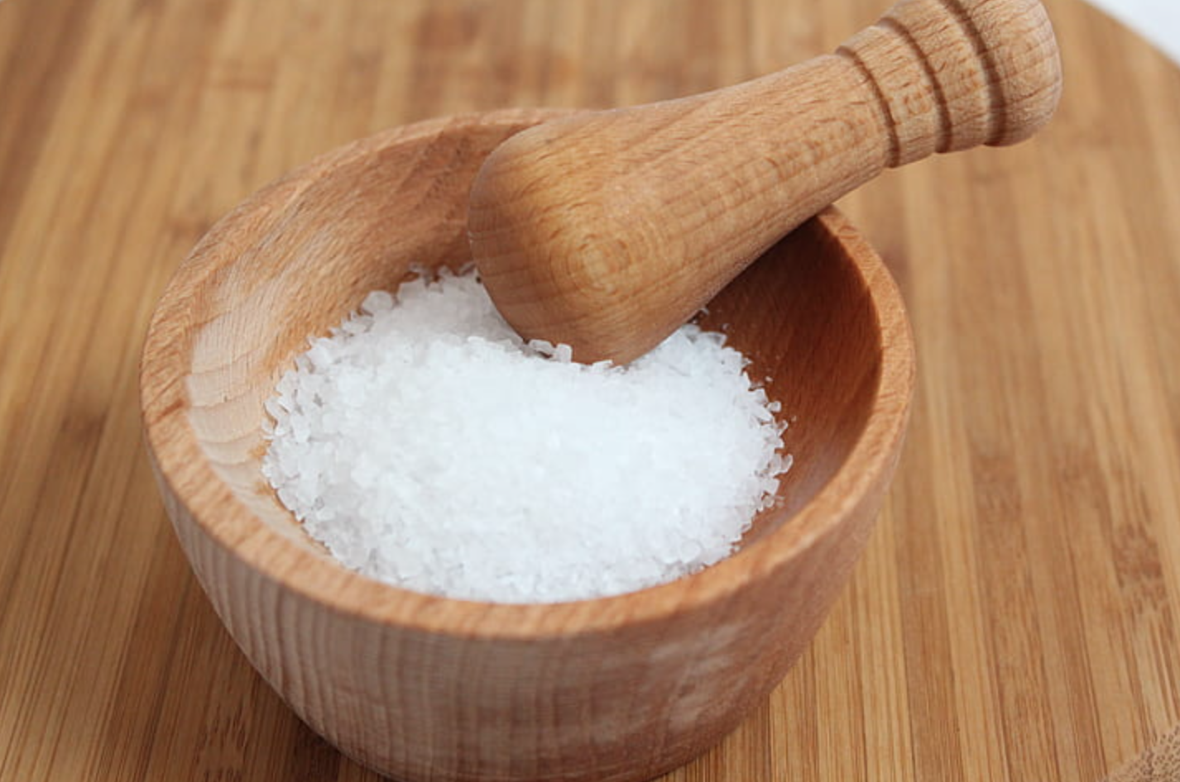
Na
Cl
NaCl
Sodium chloride
Notes:
Image: https://www.pickpik.com/salt-nature-eat-food-spice-white-43357

Slide 13
Atoms and Ions
Learning outcomes
Define the terms atom and element.
Describe the basic structure of atoms including the arrangement of protons, neutrons, and electrons.
Describe the charge on protons, neutrons and electrons.
Define the term isotope.
Define the term ion and describe how atoms can become positively or negatively charged.
Define the terms cation and anion.
Identify common elements used in biological processes in the body.
2.1: Video and transcript
2.2: Accompanying reading
2.3: Worksheet

Slide 14
Image references
Slide 3 (left to right):
Mikael Häggström, CC0, via Wikimedia Commons
Artwork by Holly Fischer, CC BY 3.0 <https://creativecommons.org/licenses/by/3.0>, via Wikimedia Commons
Mediran, CC BY-SA 3.0 <https://creativecommons.org/licenses/by-sa/3.0>, via Wikimedia Commons
Adapted from: Sponk, Tryphon, Magnus Manske, User:Dietzel65, LadyofHats (Mariana Ruiz), Radio89, CC BY-SA 3.0 <https://creativecommons.org/licenses/by-sa/3.0>, via Wikimedia Commons
Gorkhs on pixabay, CC0, via Wikimedia Commons
Slide 4: nshepheard, CC BY-SA 2.0 DEED, via https://www.flickr.com/photos/sn1cks/3631728569
Slide 5:
László Németh, CC0, via Wikimedia Commons
Boundless, CC BY-SA 4.0, via https://bio.libretexts.org/
Slide 6: Creator: tesskou | Credit: tesskou on DeviantArt, CC BY-NC-ND 3.0 DEED, via https://www.deviantart.com/tesskou/art/Carbon-Isotopes-and-Beta-decay-351064306
Slide 7: Boundless, CC BY-SA 4.0, via https://bio.libretexts.org/
Slide 8:
CNX Anatomy & Physiology, CC BY-SA 4.0 <https://creativecommons.org/licenses/by-sa/4.0>, via Wikimedia Commons
Adapted from: László Németh, CC0, via Wikimedia Commons
Slide 9:
Biology. Provided by: OpenStax CNX. Located at: http://cnx.org/contents/185cbf87-c72e-48f5-b51e-f14f21b5eabd@10.8. License: CC BY: Attribution. License Terms: Download for free at http://cnx.org/contents/185cbf87-c72...f21b5eabd@10.8
Boundless, CC BY-SA 4.0, via https://bio.libretexts.org/
Slide 11: Adapted from: László Németh, CC0, via Wikimedia Commons
Slide 12: https://www.pickpik.com/salt-nature-eat-food-spice-white-43357

