Slide 1
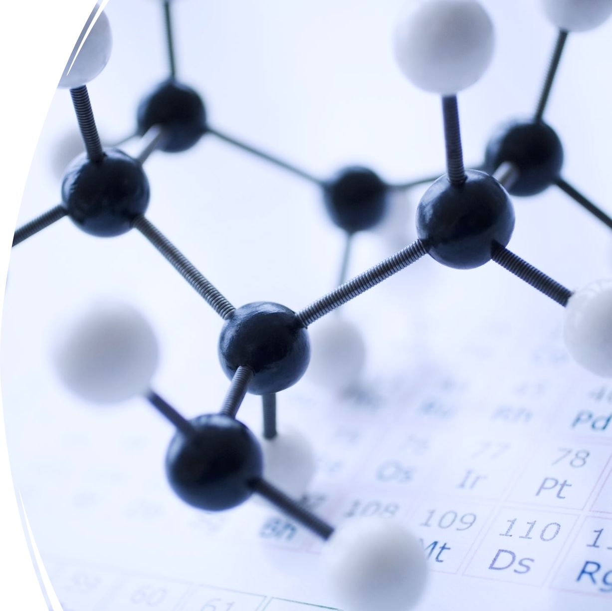
3.1: Molecules and Chemical Bonds

Slide 2
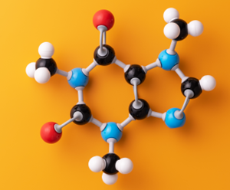
Learning outcomes
Define the terms molecule and compound.
Describe the basic structure of ionic bonds.
Describe the basic structure of covalent bonds.
Distinguish between polar and nonpolar covalent bonds.
Describe the basic structure, formation and function of hydrogen bonding.
List and draw some common functional groups that participate in hydrogen bonding.
Describe van der Waals forces.

Slide 3
Molecule – chemical structure formed when two or more atoms form covalent bonds.
Compound – chemical structure formed when two or more elements form chemical bonds.
E.g., H₂O
NaCl
E.g., O₂
H₂O
Formula unit – one unit of an ionic compound.
E.g., NaCl

Slide 4

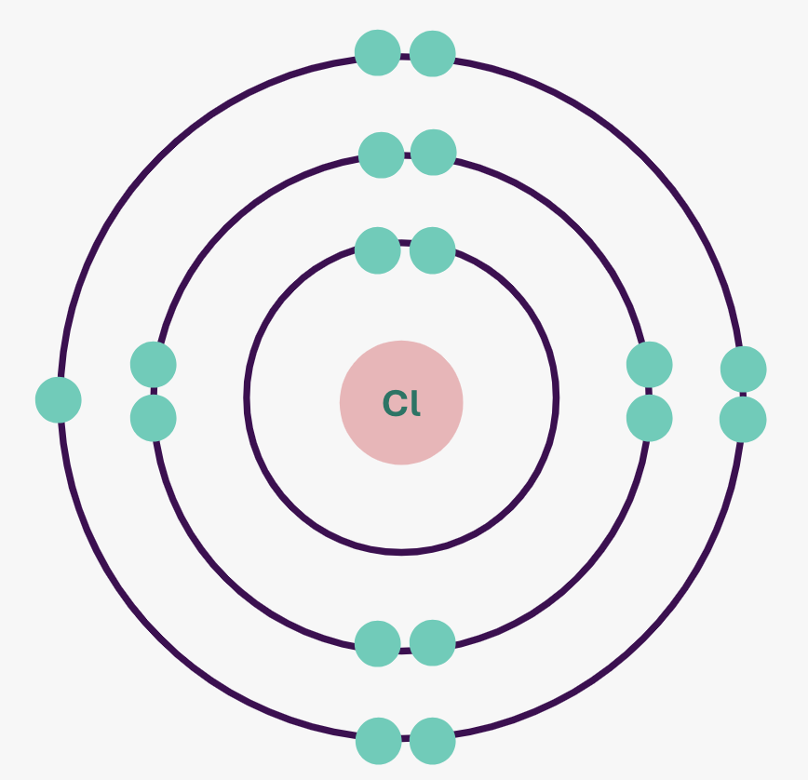
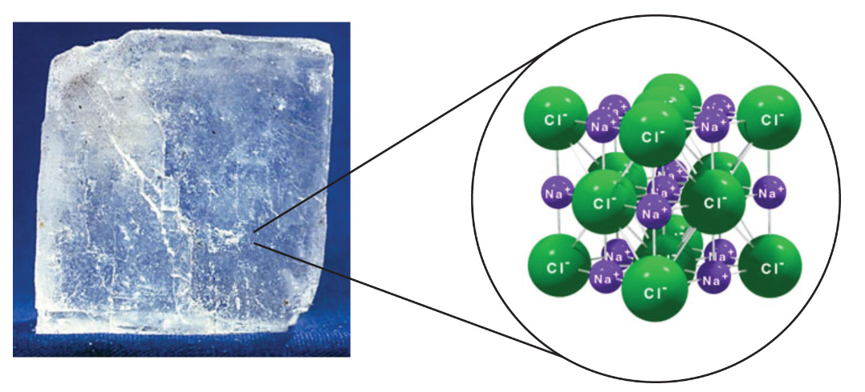
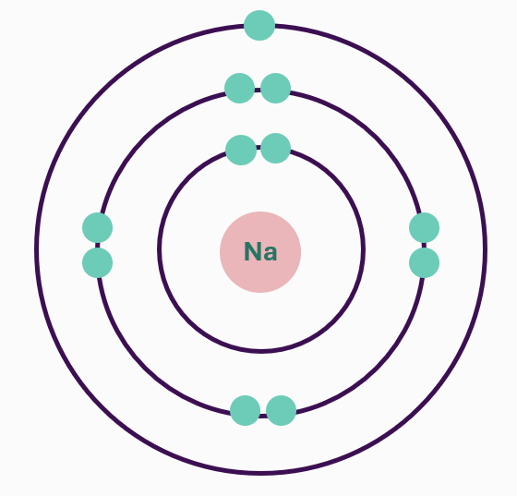
Ionic bond – chemical bond formed by caused by the electrostatic attraction between two oppositely charged ions.
◦ Octet rule – 8 electrons in the outmost shell makes the atom stable
◦ When atoms lose or gain electrons, they become ions
Sodium and chloride ions form a crystal lattice structure due to shared electrostatic attractions between them.
Electron transfer – the movement of electrons from one element to another.
Notes:
Image: Introduction to Chemistry: General, Organic, and Biological, CC BY-NC-SA 3.0

Slide 5
Covalent bond – chemical bond formed by atoms sharing of two or more electrons.
Stronger and more common than ionic bonds in living organisms.
H
O
O
H
H
H
H₂O – water

Slide 6
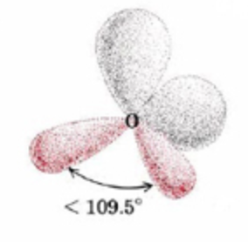
Lone pairs – electrons in an atom’s outer shell that are not involved in bonding.
Repulsive effect of lone pairs is greater than that of bonded pairs, which affects the shape of the molecule.
Lone pairs
H
O
H
H
H
O
··
··
Single covalent bond – one pair of shared electrons
H₂O – water
Notes:
7.4: Molecules with Lone Pairs is shared under a CC BY-NC-SA 4.0 license and was authored, remixed, and/or curated by Ed Vitz, John W. Moore, Justin Shorb, Xavier Prat-Resina, Tim Wendorff, & Adam Hahn.

Slide 7
Generally, the more pairs of electrons shared, the stronger the bonding between atoms.
Double covalent bond – two pairs of shared electrons
Triple covalent bond – three pairs of shared electrons
O
O
N
N
··
··
=
N
O
··
N
··
O
··
=
··
O₂
N₂

Slide 8
Dative (or coordinate) covalent bond – where both electrons come from the same atom.
H
H
+
N
H
N
H
N
H⁺
H
H
H
NH₃ - ammonia
NH₄⁺ - ammonium ion

Slide 9
Nonpolar covalent bond – equal distribution of electrons between atoms
Polar covalent bond – unequal distribution of electrons between atoms
E.g., O₂ - oxygen
E.g., H₂O - water
··
··
δ+
δ+
O
O
··
=
··
H
H
CH₄ - methane
O
H
··
··
δ-
C
Electronegativity – the ability of atoms to attract electrons within a bond.
Dipole – a pair of equal but opposite electrical charges separated by a small distance.
H
H
H

Slide 10
Hydrogen bonding – attraction between a partially positively-charged hydrogen atom attached to a highly negatively charged atom and another nearby electronegative atom.
H
H
H
H
O
O
Individual hydrogen bonds are relatively weak but collectively strong.
Polar covalent bonds and hydrogen bonding give water its particular properties, e.g., the ability to dissolve certain substances, and surface tension.
··
··
··
··
δ+
H
H
δ+
δ-
O
··
··
Hydrogen bond
H
H
H
H
O
O
··
··
··
··

Slide 11
There are many polar functional groups that interact via hydrogen bonding.
A functional group is defined as an atom or group of atoms within a molecule that has similar chemical properties whenever it appears in various compounds.
δ-
δ+
H
O
δ-
δ+
O
H
δ+
δ-
=
N
C
Hydroxyl group – found in alcohols, carbohydrates, proteins and nucleotides
Carbonyl group –
found in organic acids, carbohydrates, proteins and nucleotides
Amino group –
found in proteins and nucleotides

Slide 12
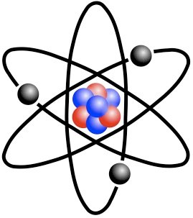
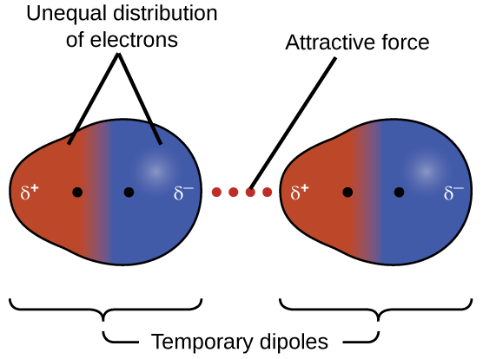
Van der Waals forces - a weak force of attraction or repulsion between between atoms or molecules at close range.
Temporary dipoles can form due to fluctuations in electron density around atoms.
Van der Waals forces and hydrogen bonding contribute to 3D structure of proteins.
Notes:
Left image: nshepheard, CC BY-SA 2.0 DEED, via https://www.flickr.com/photos/sn1cks/3631728569
Right image: OpenStax, CC BY 4.0 <https://creativecommons.org/licenses/by/4.0>, via Wikimedia Commons

Slide 13
Molecules and Chemical Bonds
Learning outcomes
Define the terms molecule and compound.
Describe the basic structure of ionic bonds.
Describe the basic structure of covalent bonds.
Distinguish between polar and nonpolar covalent bonds.
Describe the basic structure, formation and function of hydrogen bonding.
List and draw some common functional groups that participate in hydrogen bonding.
Describe van der Waals forces.
3.1: Video and transcript
3.2: Accompanying reading
3.3: Worksheet

Slide 14
Image references
Slide 3: Introduction to Chemistry: General, Organic, and Biological, CC BY-NC-SA 3.0
Slide 6: 7.4: Molecules with Lone Pairs is shared under a CC BY-NC-SA 4.0 license and was authored, remixed, and/or curated by Ed Vitz, John W. Moore, Justin Shorb, Xavier Prat-Resina, Tim Wendorff, & Adam Hahn.
Slide 12:
nshepheard, CC BY-SA 2.0 DEED, via https://www.flickr.com/photos/sn1cks/3631728569
OpenStax, CC BY 4.0 <https://creativecommons.org/licenses/by/4.0>, via Wikimedia Commons
Cursor: Icons8, CC0, via Wikimedia Commons

