Slide 1
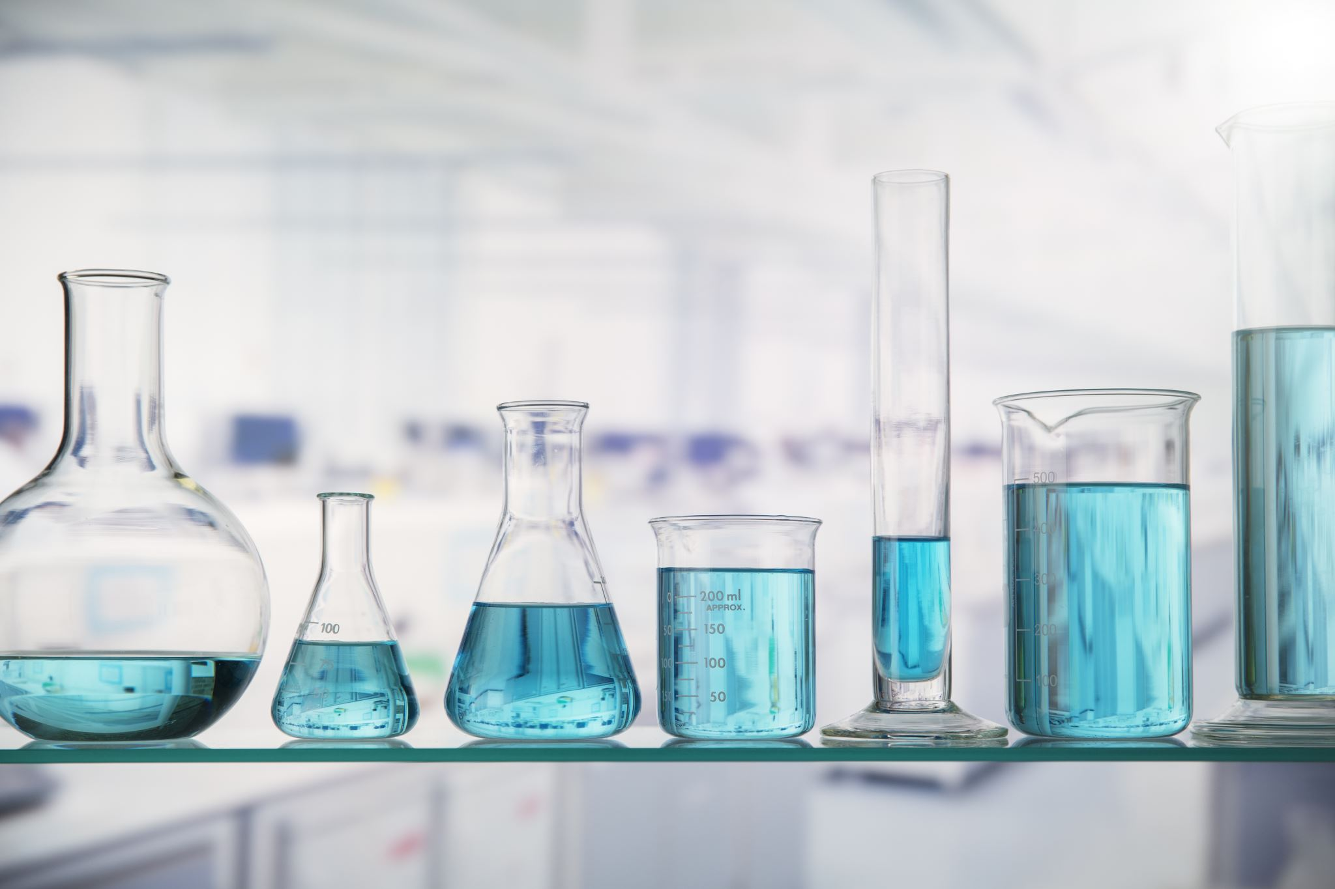
4.1 Solutions and Concentration

Slide 2
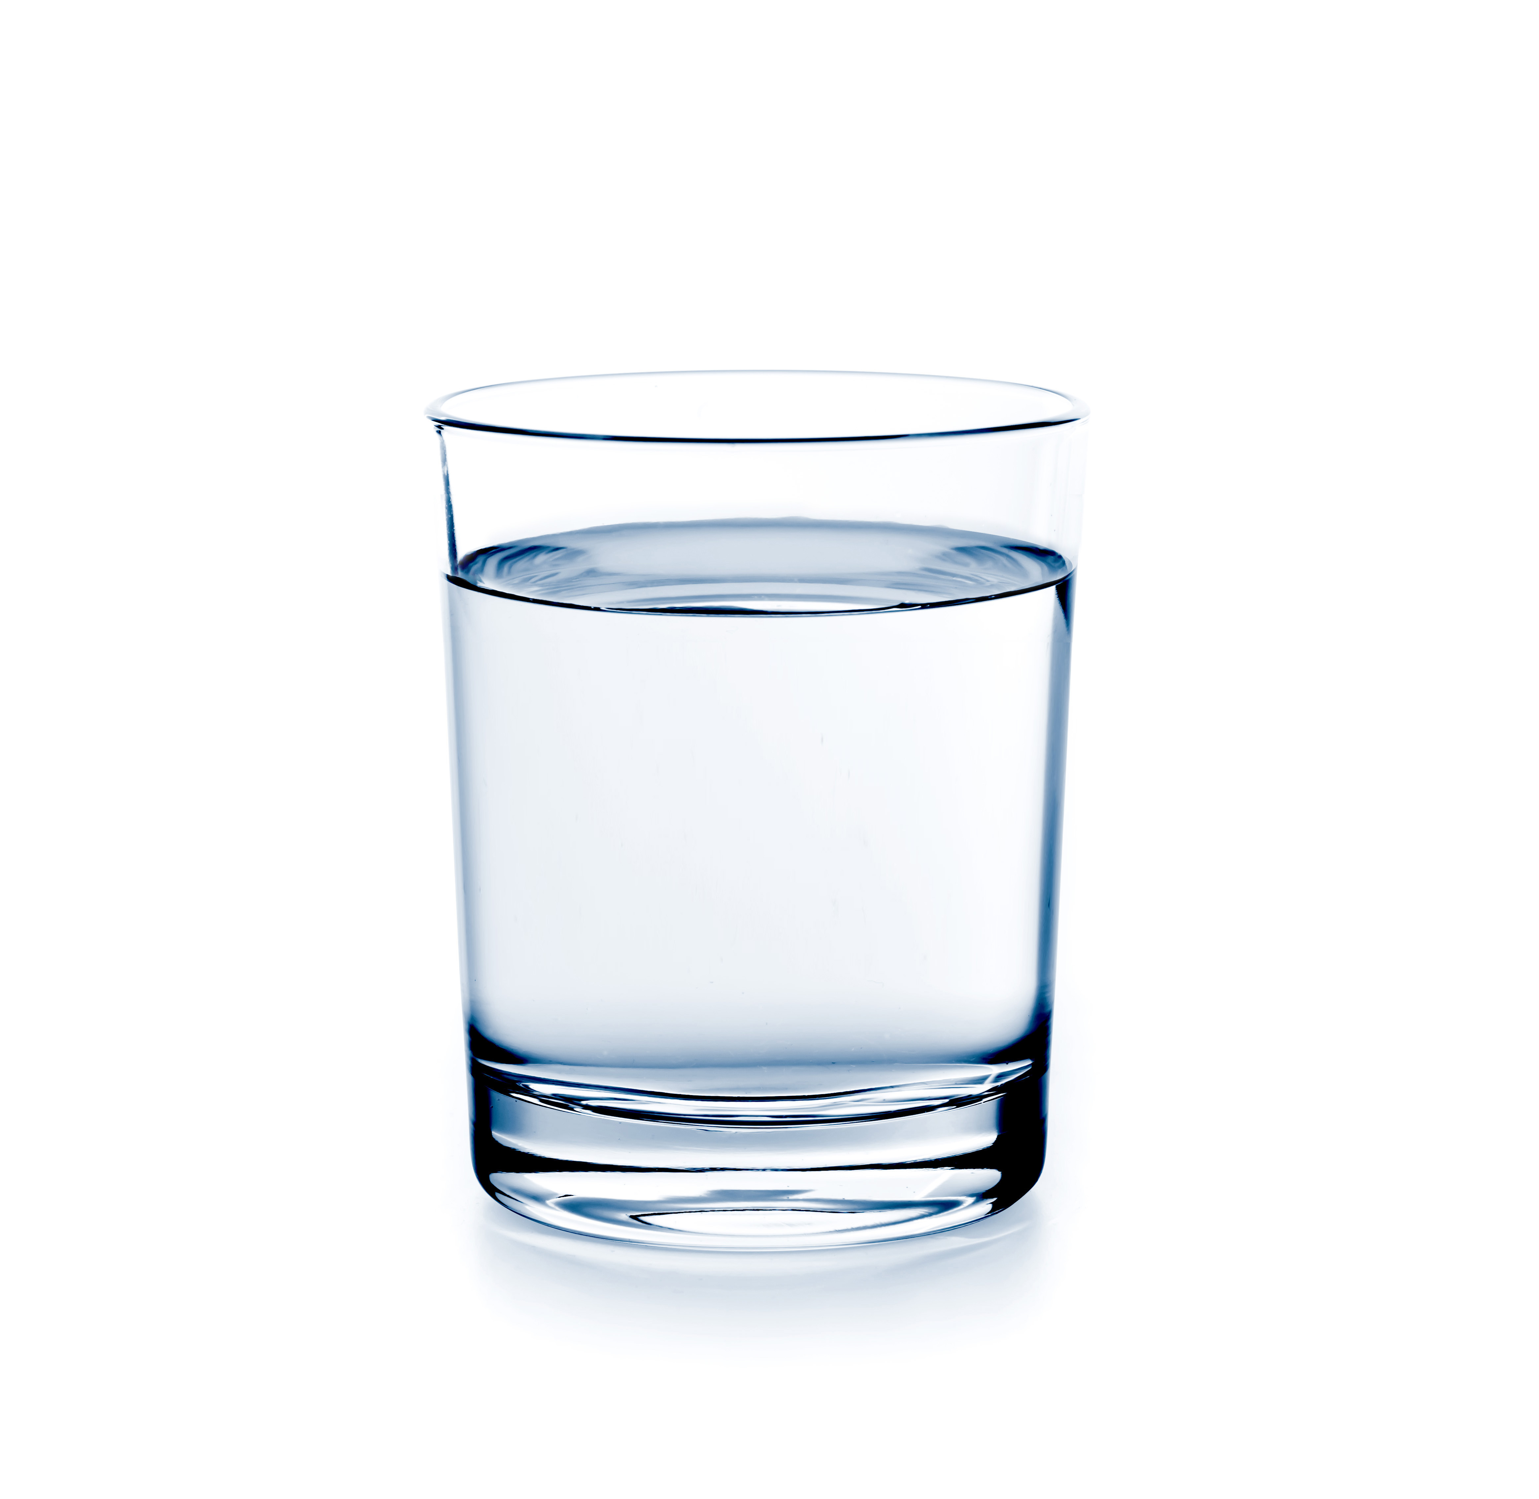
Learning outcomes
Define the terms solute, solvent, and solution.
Describe how substances can interact with water.
Distinguish between hydrophilic and hydrophobic substances.
Describe the meaning of the term mole in the context of atoms, ions and molecules.
Define the term concentration.
Describe how moles, molar mass, and molarity are related.

Slide 3

Water is essential for biological life.
Water makes up about 60-75% of our body weight.

Slide 4
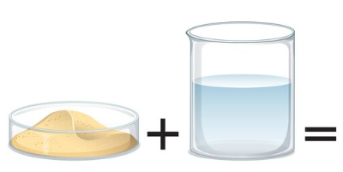
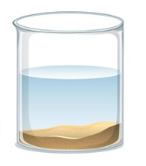
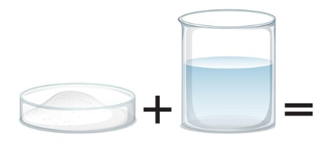
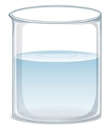
If a substance is soluble in water, it can dissolve in water.
A solution is a homogeneous mixture of two or more substances.
Solutions are formed from:
Solute – the substances dissolved into a solution
Solvent – the substance in which the solute has dissolved
Sand
Water
Heterogeneous mixture
Salt
Water
Homogeneous solution
Notes:
Image: brgfx on Freepik <a href="https://www.freepik.com/free-vector/dissolving-science-experiment-with-sand-water_25592847.htm">Image by brgfx</a> on Freepik

Slide 5
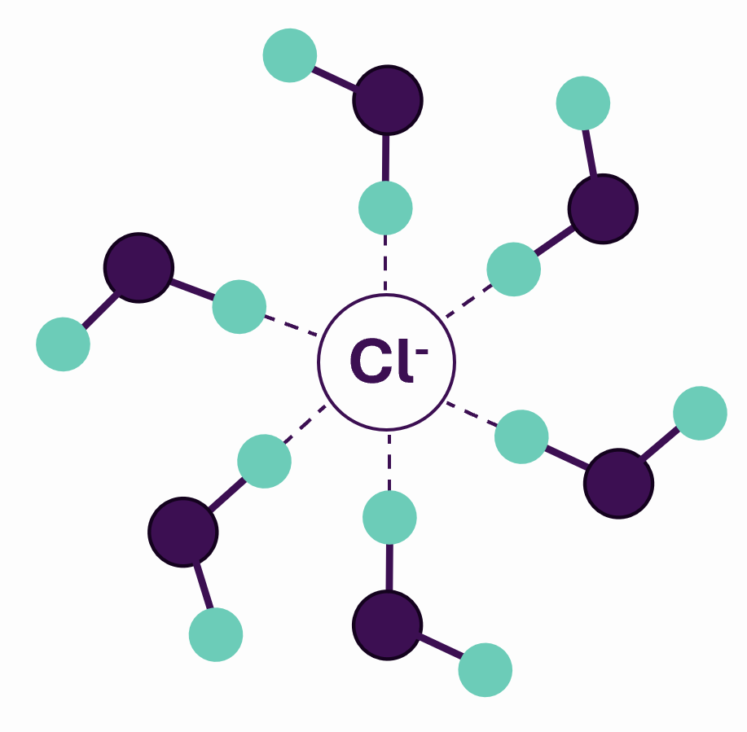
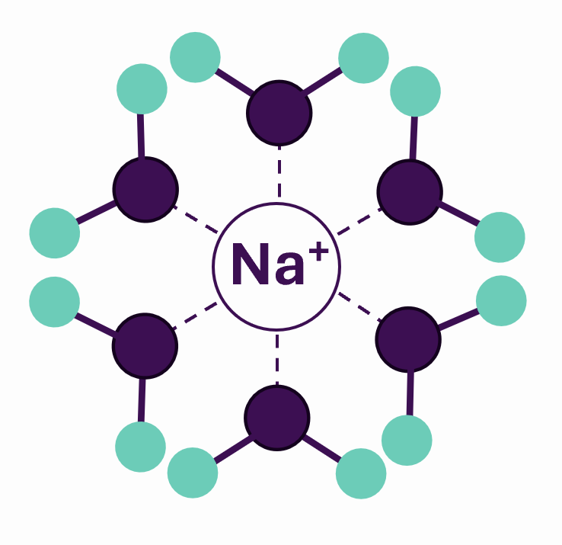
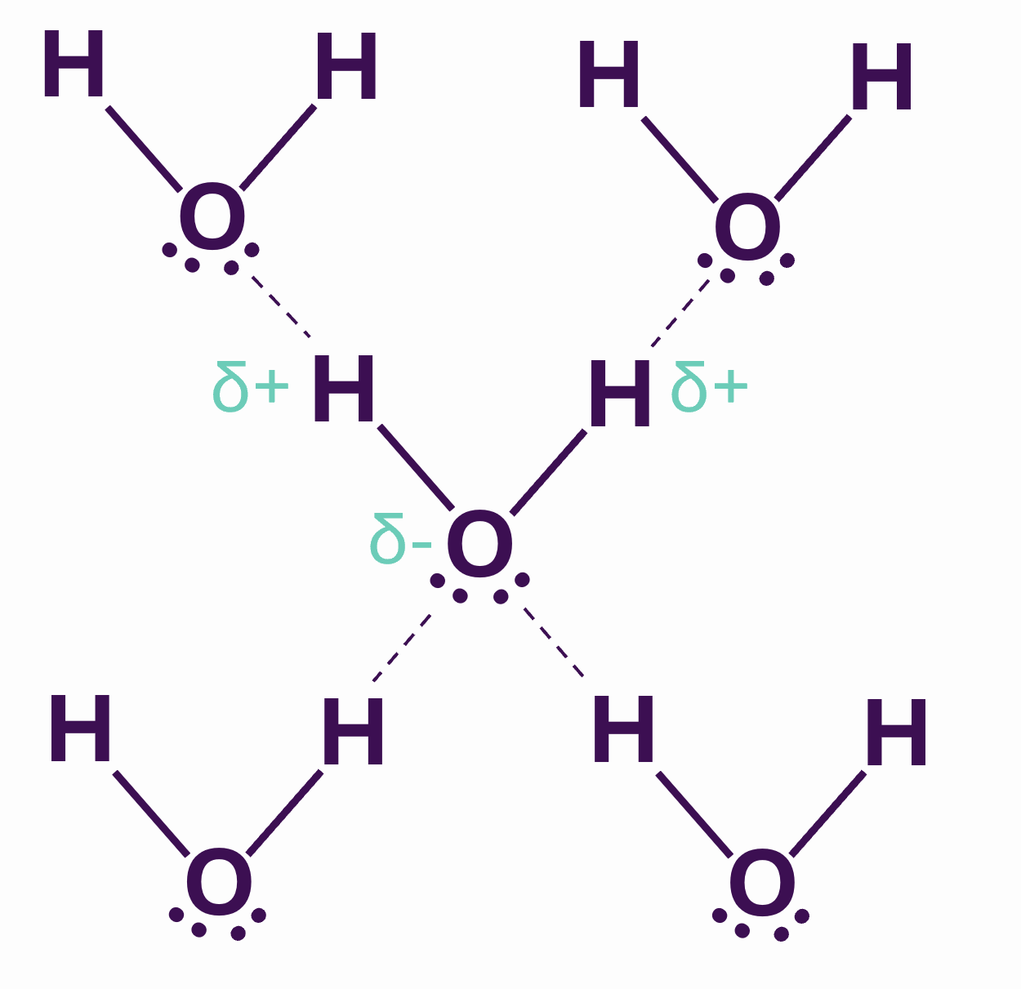
Hydrogen bonding means water has a very ordered structure.
To dissolve substances, room must be made within this structure.
Note: not drawn to scale
NaCl dissociates in water into Na⁺ and Cl⁻ ions.
Water molecules form a hydration sphere around the ions.
Ionic compounds that dissolve in water to form ions are called electrolytes (e.g., Na⁺, Cl⁻, K⁺)

Slide 6
Polar groups can form hydrogen bonds with water.
Substances which interact with water are hydrophilic (‘water-loving’).
Generally, the more polar groups a molecule has, and the smaller the molecule, the more soluble it is in water.
δ+
H
H
δ+
δ+
H
H
δ+
δ+
H
H
δ+
O
··
O
O
··
δ-
··
··
δ-
··
δ-
··
R
··
··
··
δ-
··
··
δ-
δ-
N
O
H
O
C
δ+
H
H
δ+
R
R
δ+
δ+
Hydroxyl group –
found in alcohols, carbohydrates, proteins and nucleotides
Carbonyl group –
found in organic acids, carbohydrates, proteins and nucleotides
Amino group –
found in proteins and nucleotides

Slide 7
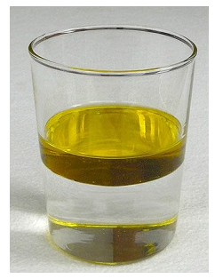
Substances which don’t interact with water are hydrophobic (‘water-hating’).
Apolar molecules contain atoms with approximately equal electronegativities and an equal distribution of electrons.
Apolar molecules can’t form hydrogen bonds with water.
Water will exclude hydrophobic molecules and they will coalescence.
Hydrophobic groups within molecules are important for forming barriers and for folding of proteins.
H
C
H
H
Methyl group –
found in proteins and fat
Polar molecules of water and nonpolar molecules of oil do not form liquid solutions.
Notes:
Image: CC BY-SA 1.0 Generic; Victor Blacus. This page is shared under a CK-12 license and was authored, remixed, and/or curated by StackExchange (thomij), Melissa Alviar-Agnew, Henry Agnew, Lance S. Lund (Anoka-Ramsey Community College), and Vicki MacMurdo (Anoka-Ramsey Community College). Original source: https://www.ck12.org/c/chemistry/.

Slide 8
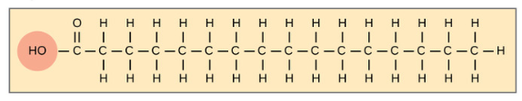
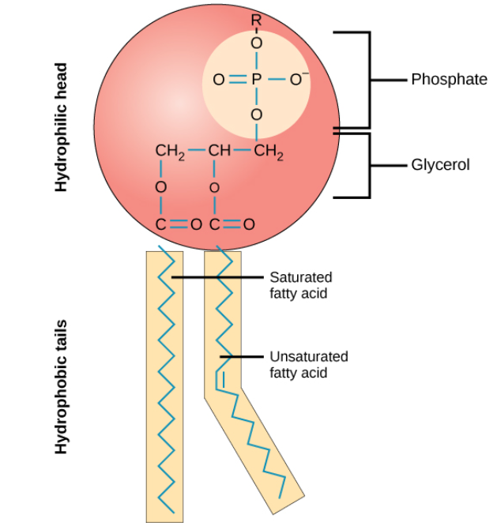
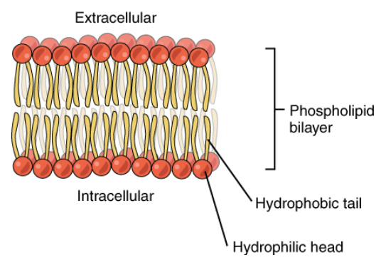
Amphipathic molecules have both polar and apolar parts.
In cell membranes, phospholipids form a bilayer with their polar hydrophilic heads pointing outwards and apolar hydrophobic tails pointing inwards.
Carboxyl group (polar)
Long hydrocarbon chain (apolar)
Fatty acid
Phospholipid membranes compartmentalise cells and restrict movement of substances.
Phospholipid
Notes:
Images:
This page titled 2.5.2: Lipid Molecules is shared under a CC BY-SA 4.0 license and was authored, remixed, and/or curated by Boundless.
This page titled 3.5: Lipid Molecules - Phospholipids is shared under a CC BY-SA 4.0 license and was authored, remixed, and/or curated by Boundless.

Slide 9
In medicine, we often want to know how many atoms, ions or molecules are present in certain places, e.g. in the blood.
Atoms and molecules vary in size.
Looking at the mass of a substance doesn’t easily tell us how many atoms or molecules there actually are.
1 g of NaCl (salt)
Water
Solution A
(salt solution)
1 g of C₆H₁₂O₆ (glucose)
Water
Solution B
(sugar solution)
Notes:
Image: Adapted from: brgfx on Freepik <a href="https://www.freepik.com/free-vector/dissolving-science-experiment-with-sand-water_25592847.htm">Image by brgfx</a> on Freepik.

Slide 10
One mole (abbreviation: mol) of a substance contains approximately 6 x 10²³ ‘particles’ (atoms, ions, or molecules) of the substance. 6 x 10²³ is Avogadro's number.
A mole is the amount of a substance equivalent to the formula mass expressed in grams.
Number of ‘particles’ in 1 mole
Number of atoms or ions in 1 mole
Molecular, formula or atomic mass of 1 ‘particle’ (amu)
Molar mass – mass in grams of 1 mole (g/mol)
Carbon-12
6 x 10²³ atoms of carbon
6 x 10²³ atoms of carbon
12 amu
12 g/mol
NaCl
(Sodium chloride)
6 x 10²³ Na⁺ ions
6 x 10²³ Cl⁻ ions
6 x 10²³ formula units of NaCl
58.44 amu
58.44 g/mol
C₆H₁₂O₆
(Glucose)
6 x 10²³ molecules of C₆H₁₂O₆
6 x 6 x 10²³ atoms of carbon
12 x 6 x 10²³ atoms of hydrogen
6 x 6 x 10²³ atoms of oxygen
180 amu
180 g/mol

Slide 11
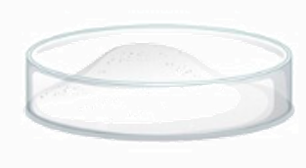

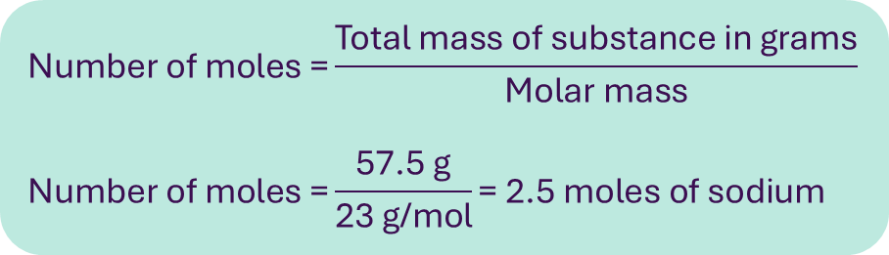
Molar mass of a substance in grams per mole is numerically equal to the mass of that substance expressed in atomic mass units.
We can calculate the number of moles in a sample based on the total mass divided by the molar mass
1 mole of sodium would weigh 23 g
Molar mass of sodium = 23 g/mol
57.5 g of sodium
Atomic mass of sodium = 23 amu
$$\text{Number} \text{of} \text{moles}\text{ =}\frac{\text{Total} \text{mass} \text{of} \text{substance} \text{in} \text{grams}}{\text{Molar} \text{mass}}$$
$$\text{Number} \text{of} \text{moles}\text{ =}\frac{\text{57.5 }\text{g}}{\text{23 }\text{g}\text{/}\text{mol}}\text{= 2.5 }\text{moles} \text{of} \text{sodium}$$
Notes:
Left image: Adapted from: brgfx on Freepik <a href="https://www.freepik.com/free-vector/dissolving-science-experiment-with-sand-water_25592847.htm">Image by brgfx</a> on Freepik.
Right image: László Németh, CC0, via Wikimedia Commons

Slide 12

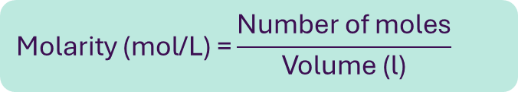
Concentration is the amount of substance (solute) present in a specific volume or mass of solution.
Molarity is a measure of concentration. It is the number of moles of a substance in a certain volume.
$$\text{M}\text{olarity}\text{ (}\text{mol}\text{/}\text{L}\text{) =}\frac{\text{Number} \text{of} \text{moles}}{\text{Volume}\text{ (}\text{l}\text{)}}$$
Millimole (mmol) = 1000th (one thousandth)
of a mole
Micromole (µmol) = 1000000th (one millionth) of a mole
1 mole of NaCl (salt)
1 litre of water
Solution A
Sodium: 135-146 mmol/L
Potassium: 3.5-5.3 mmol/L
1 mole of NaCl (salt)
1 millilitre of water
Solution B
Notes:
Left image: Adapted from: brgfx on Freepik <a href="https://www.freepik.com/free-vector/dissolving-science-experiment-with-sand-water_25592847.htm">Image by brgfx</a> on Freepik.
Right image: The use of the laboratory. Murphy, Michael, MA MD FRCP FRCPath, Clinical Biochemistry: An Illustrated Colour Text, 2, 4-5. Blood specimen tubes for specific biochemical tests. The colour-coded tubes are the Vacutainers in use in the authors’ hospital laboratories. Copyright © 2024 © 2024, Elsevier Limited. All rights reserved.

Slide 13
Solutions and Concentration
Learning outcomes
Define the terms solute, solvent, and solution.
Describe how substances can interact with water.
Distinguish between hydrophilic and hydrophobic substances.
Describe the meaning of the term mole in the context of atoms, ions and molecules.
Define the term concentration.
Describe how moles, molar mass, and molarity are related.
4.1: Video and transcript
4.2: Accompanying reading
4.3: Worksheet

Slide 14
Images references
Slide 4, 9, 11, 12: Image by brgfx on Freepik <a href="https://www.freepik.com/free-vector/dissolving-science-experiment-with-sand-water_25592847.htm">Image by brgfx</a> on Freepik
Slide 7: Image: CC BY-SA 1.0 Generic; Victor Blacus. This page is shared under a CK-12 license and was authored, remixed, and/or curated by StackExchange (thomij), Melissa Alviar-Agnew, Henry Agnew, Lance S. Lund (Anoka-Ramsey Community College), and Vicki MacMurdo (Anoka-Ramsey Community College). Original source: https://www.ck12.org/c/chemistry/.
Slide 8:
This page titled 2.5.2: Lipid Molecules is shared under a CC BY-SA 4.0 license and was authored, remixed, and/or curated by Boundless.
This page titled 3.5: Lipid Molecules - Phospholipids is shared under a CC BY-SA 4.0 license and was authored, remixed, and/or curated by Boundless.
Slide 11: László Németh, CC0, via Wikimedia Commons
Slide 12: The use of the laboratory. Murphy, Michael, MA MD FRCP FRCPath, Clinical Biochemistry: An Illustrated Colour Text, 2, 4-5. Blood specimen tubes for specific biochemical tests. The colour-coded tubes are the Vacutainers in use in the authors’ hospital laboratories. Copyright © 2024 © 2024, Elsevier Limited. All rights reserved.

