Slide 1
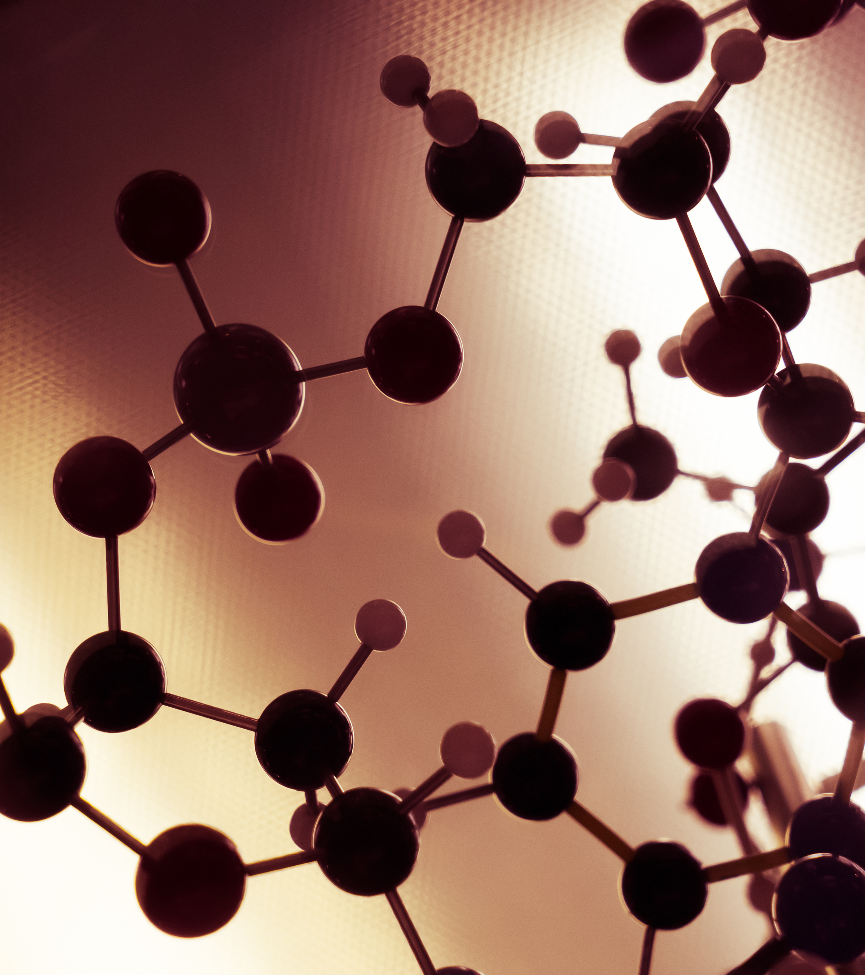
Macromolecules
Dr Clare Garcin
c.garcin@warwick.ac.uk

Slide 2
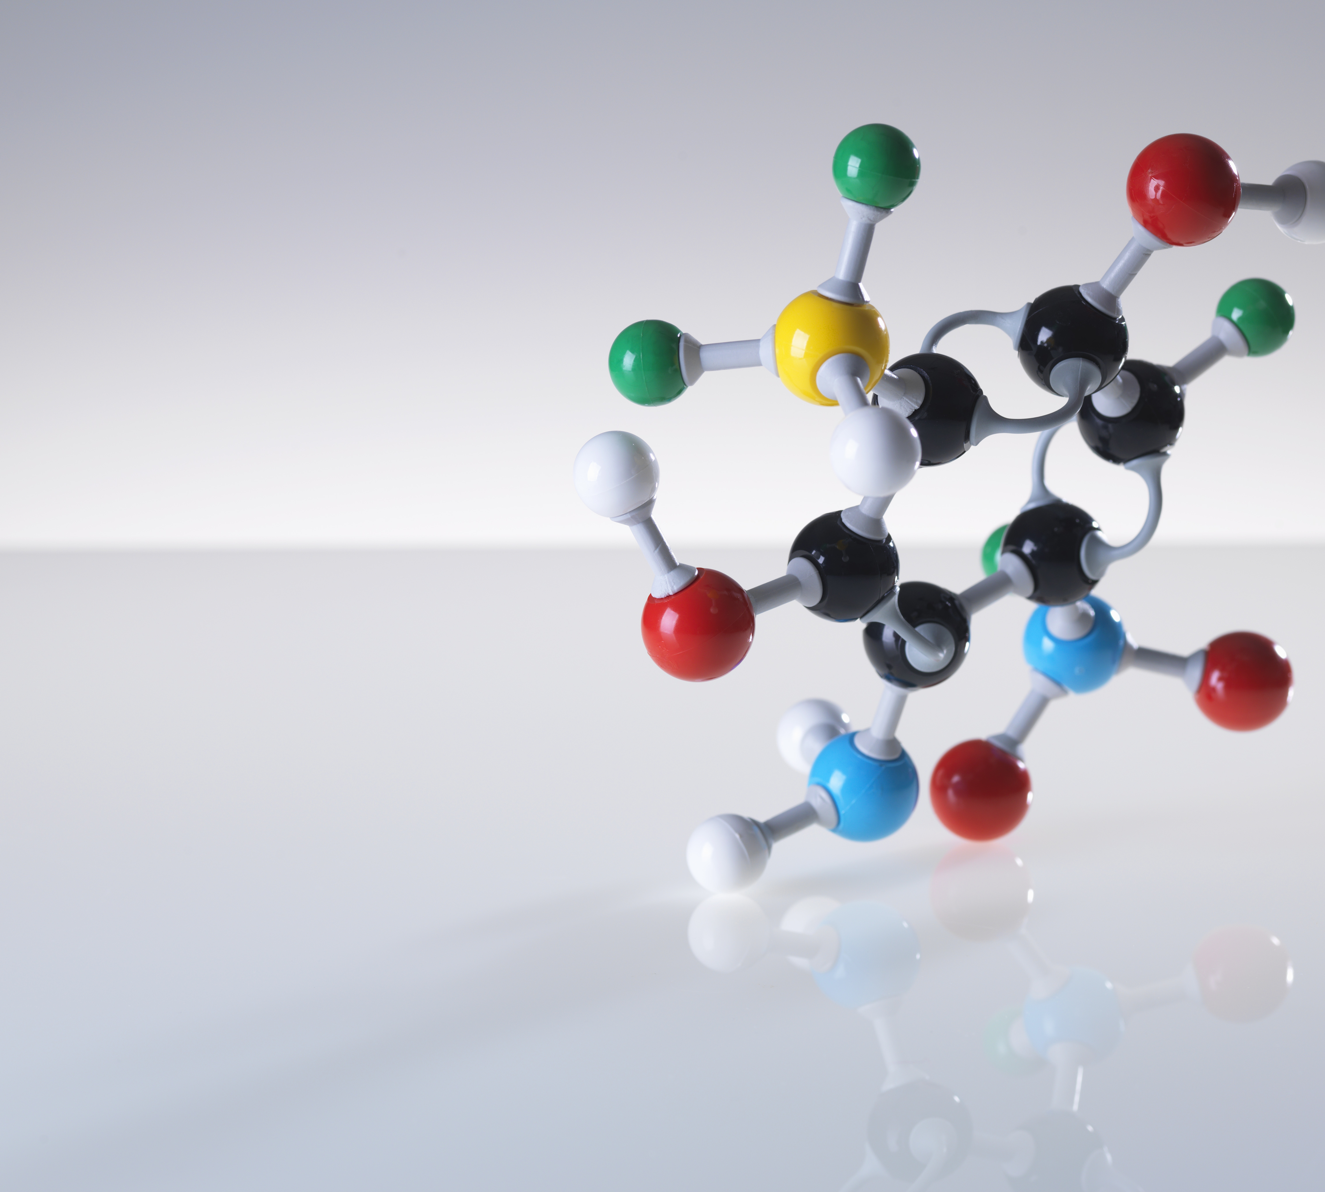
Learning Outcomes
Define the following terms: monomer, polymer, and macromolecules.
Distinguish between sugars and carbohydrates.
Distinguish between amino acids and proteins.
Describe the function of sugars, carbohydrates, amino acids, proteins and fatty acids in the body

Slide 3
Carbon
Carbon is the fourth most abundant element in the universe.
Key to life
H
H
H
H
H
C
C
C
C
C
H
H
H
H
H
H
H
H
H
Organic compounds contain carbon.
Inorganic compounds do not contain carbon.

Slide 4
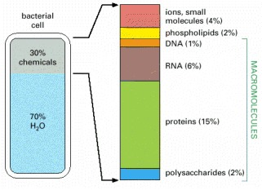
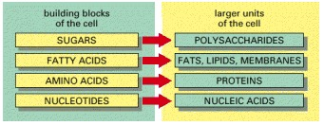
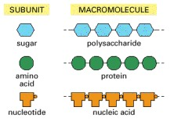
Macromolecules
Polymers constructed by covalently linking small organic monomers into long chains
Macromolecules are the most abundant carbon-containing molecules in a living cell.

Slide 5
Monosaccharides
Sugars as subunits of polysaccharides
Oxygen
CH₂OH
H
H
Hydrogen
CH₂OH
CH₂OH
C
O
O
CH₂OH
CH₂OH
O
O
C
H
H
C
OH
O
OH
O
OH
OH
O
O
OH
C
C
O
HO
OH
OH
OH
H
OH
OH
OH
Carbon
Monosaccharides have the general formula (CH₂O)_{n}

Slide 6
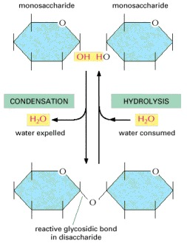
Disaccharides
Formed through condensation reactions
Condensation reactions result in the loss of a water molecule.
Hydrolysis reactions consume a molecule of water.
The bond formed by a condensation reaction between two monosaccharides is called a glycosidic bond.

Slide 7
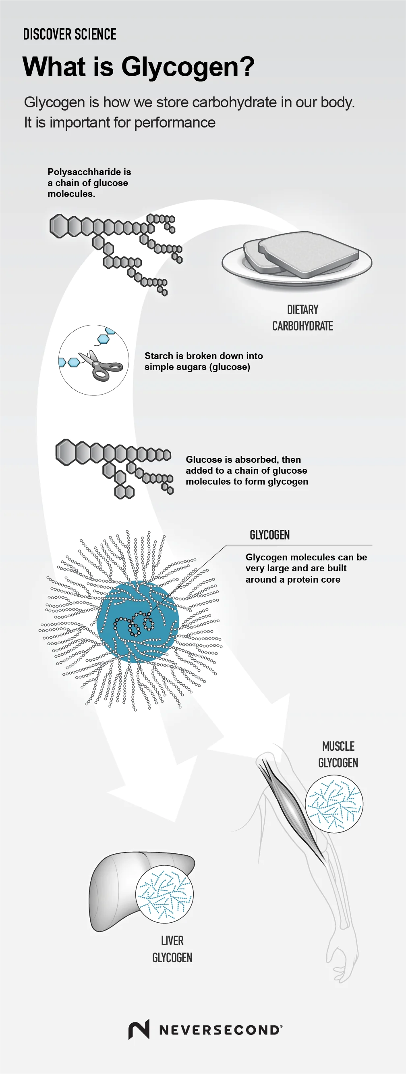
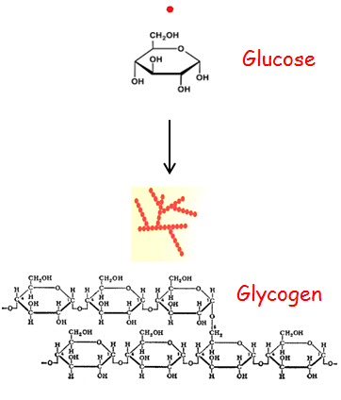
Polysaccharides
Chains of monosaccharides used for energy storage
Glucose is a key energy source for cells.
Glycogen is a polysaccharide composed only of glucose subunits and is used as an energy store.
Break down of glycogen is called glycogenolysis.

Slide 8
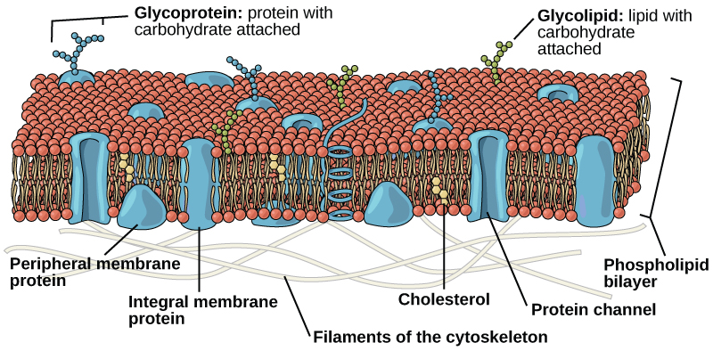
Glycoproteins and Glycolipids
Oligosaccharides covalently linked to proteins or lipids
Oligosaccharides are chains of monosaccharides less than 20 in length.
Glycoprotein
Glycolipid

Slide 9
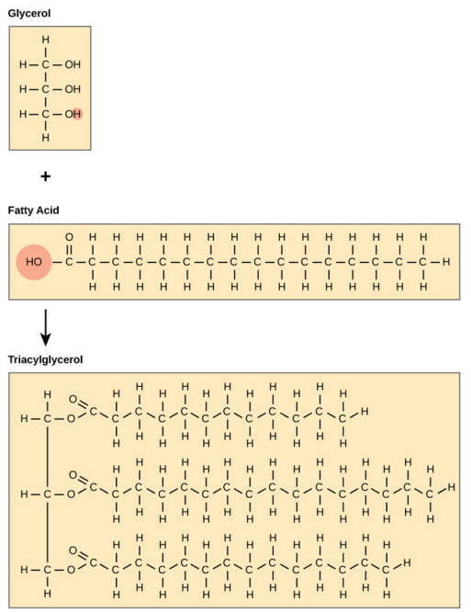
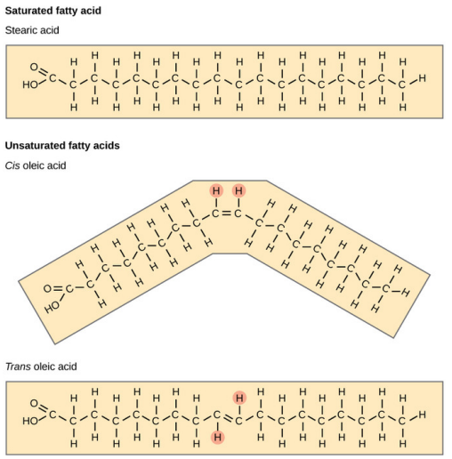
Fatty acids
The building blocks of lipids
Carboxyl group
Hydrophilic, reactive
Hydrophobic, chemically unreactive
Hydrocarbon tail

Slide 10
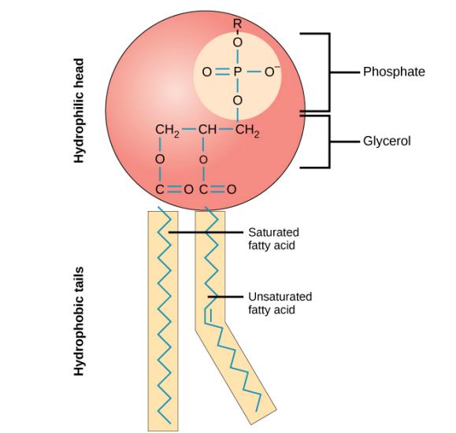
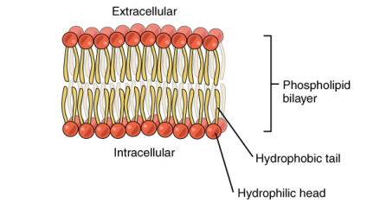
Phospholipids
Constituents of cell membranes
Phospholipids are amphipathic.
Phospholipids self-arrange into a bilayer.

Slide 11
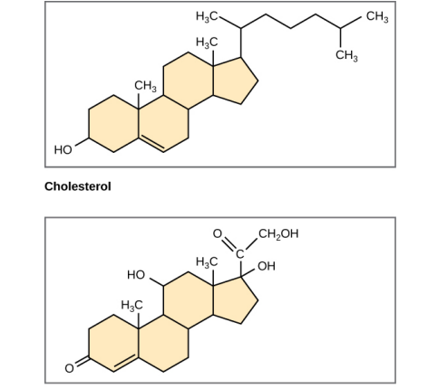
Steroids
Fused ring structures
Cholesterol is the most common steroid and is the precursor to many important steroid hormones, including testosterone, oestrogen and progesterone.
Cortisol
Steroids are hydrophobic and insoluble in water. They are able to diffuse across the lipid bilayer.

Slide 12
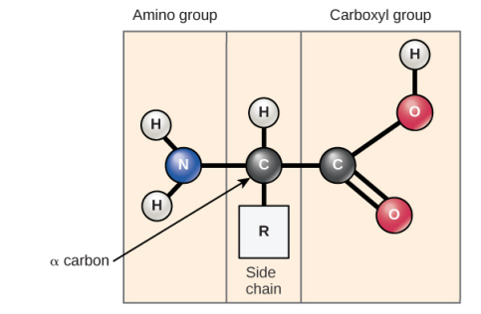
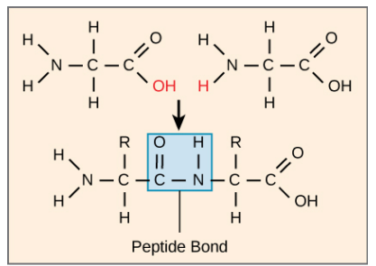
Amino acids
Building blocks of proteins
Proteins have essential roles in the body, including:
Reaction catalysis
DNA
Synthesis and repair Transport of materials across the cell
Chemical signalling
Response to stimuli
Structural support
The amino group is written NH₂
The carboxyl group is written COOH
Peptide bonds are also formed by condensation reactions.

Slide 13
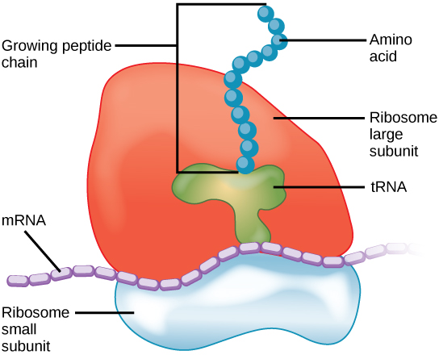
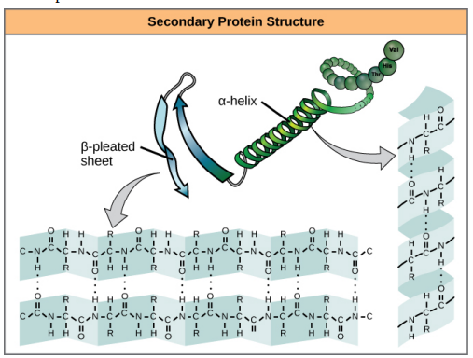
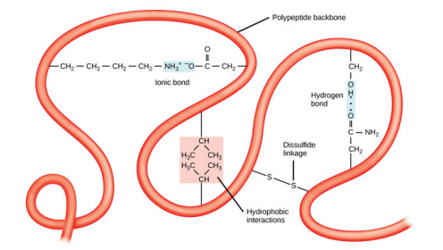
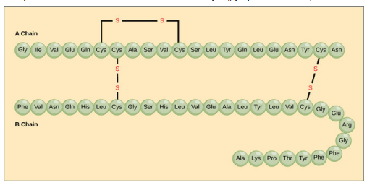
Proteins
Primary – Secondary – Tertiary structures
The tertiary structure is the 3D shape of the protein.
Polypeptide chains form the primary structure of a protein.

Slide 14
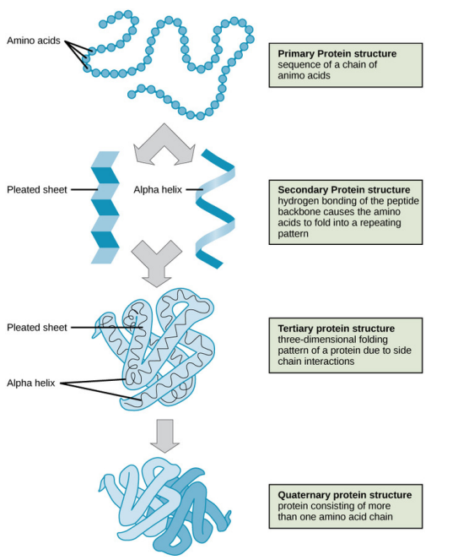
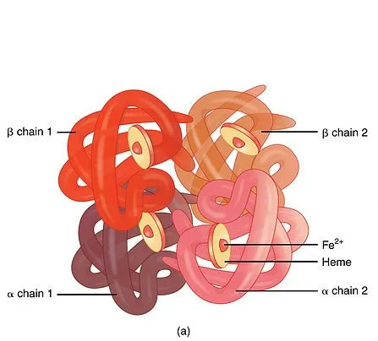
Proteins
Quaternary Structure

Slide 15
Conclusions
Learning outcomes
Define the following terms: monomer, polymer, and macromolecules.
Distinguish between sugars and carbohydrates.
Distinguish between amino acids and proteins.
Describe the function of sugars, carbohydrates, amino acids, proteins and fatty acids in the body
6.1 Video and transcript
6.2 Accompanying Reading
6.3 Worksheet

Slide 16
Images References
Slide 4, 6, – Molecular Biology of the Cell, 4th Edition: Bruce Albers, Alexander Johnson, Julian Lewis, Martin Raff, Keith Roberts and Peter Walter. 2002. Copyright © 2002, Bruce Alberts, Alexander Johnson, Julian Lewis, Martin Radd, Keith Roberts, and Peter Walter; Copyright © 1983, 1989, 1994, Bruce Alberts, Dennis Bray, Julian Lewis, Martin Raff, Keith Roberts, and James D. Watson.
Slide 7 – https://never2.com/blogs/science/what-is-glycogen and https://homework.study.com/explanation/answer-of-the-following-question-what-are-the-elements-in-glycogen.html
Slide 8-14 - Images shared under hared under a CC BY-SA 4.0 license and were authored, remixed, and/or curated by Boundless
Slide 14 - https://alevelbiology.co.uk/notes/hemoglobin/

