Slide 1
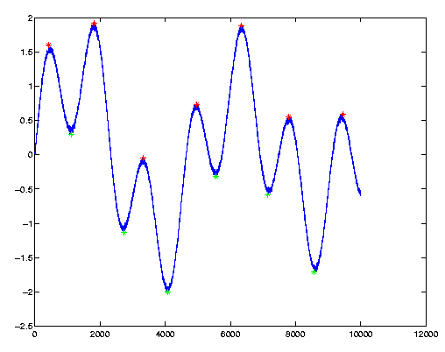
Matrix Manipulation and
2D Plotting

Slide 2
Review
Command Line
Semi Colon to suppress output
    X = 3;
Entering a Matrix
    Square brackets
      X = [1,2,3,4,5]
Generate arrays (1D matrices)
    X = Start:Step:End
      X = 1:3:13

Slide 3
Matrix Manipulation
The basic unit of data storage
Extract a part of a matrix use round brackets
  third entry in a 1D matrix
    X(3)
  last Entry
    X(end)
  fourth to ninth entries
    X(4:9)
A 2D matrix
  Entry at the third row, second column
    A(3,2)
  All of the third row
    A(3,:)

Slide 4
Examples
Create a 5 by 5 magic square
    There is a inbuilt function
Extract the value at the third row, fourth column
Extract the last value of the third column
Extract all of the fifth row
Replace the value at row 2, column 4 with 100
Replace all of the first column with zeros
Delete all of the fourth row
A =
0 24 1 8 15
0 5 7 100 16
0 6 13 20 22
0 18 25 2 9

Slide 5
Questions
What do the following command do?
      If A is a 2D matrix
  A'
  B = [A';A']
  A(:)

Slide 6
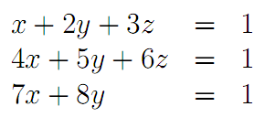
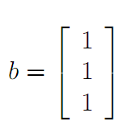
Solving linear Systems
Represent in matrix form
Use backslash operator
  Inv(A)*b
  A/b

Slide 7
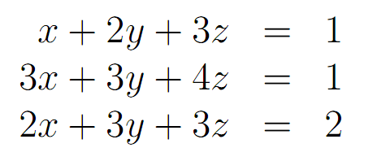
Solve

Slide 8
Data Loading
Navigate to appropriate directory
Right click on file and select importdata
If in plain text format
  A = Load(‘file name.???’);
If a other formats (eg. Excel files)
  A = importdata(‘file name.xls’);

Slide 9
Data Loading Tasks
Download and then load data file
https://files.warwick.ac.uk/kimmckelvey/files/CVBulk.tsv

Slide 10
2D Plotting
Various, flexible, plotting routines.
The basic command is
    plot(x,y)
      This plots the vector of x coordinates against the vector of y coordinates
      X and y must be the same size
    plot(y)
      Plots the vector y against its indecies

Slide 11
Plotting
Plot the function y = sin(x) +x^2 -2
  for x = [-2,9]
Load CVBulk.tsv data
Create a plot of this data

Slide 12
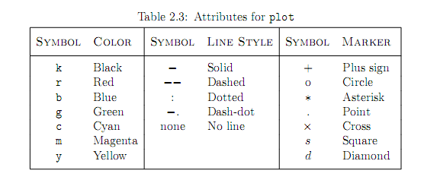
Changing Attributes
Basic usage: plot(x, y, ’Attributes’)
  To plot a green dashed line
    plot(x, y, ’g--’)
  To plot yellow circle at the data points
    plot(x, y, ‘yo’)

Slide 13
Titles etc
Adding a title
  Title(‘whoop whoop’)
Axes labels
  xlabel(‘Peanuts’)
  ylabel(‘Vanilla’)
Legend
  legend('222','33')

Slide 14
Multiple
To plot multiple line of the same plot
  plot(X,Y,'y-',X1,Y1,'go')
Or use the ‘hold on’ function
  plot(x, y, ’b.’)
  hold on
  plot(v, u, ‘r’)

Slide 15
Subplot
Used to plot multiple graphs in the same frame
Try:
  Plot sine and cosine between 0 and 10 on two separate axes in the same frame
>> subplot(2,1,1)
>> plot(x, y)
>> subplot(2,1,2)
>> plot(u, v)

Slide 16
More attributes:
Plots are fully editable from the figure window. Once you have a plot, you can click Tools->Edit plot to edit anything.
plot(X1,Y1,LineSpec,'PropertyName',PropertyValue)
  Plot(x, y, ’r’, ‘LineWidth’, 3, ‘MarkerSize',10)
But all this can also be done from the command line
  set(gca,'XTick',-pi:pi/2:pi)

Slide 17
More types of plots
Histograms
Bar
Pie Charts
Create a bar plot of the CVBulk data

Slide 18
Task
Plot the following equations on the same graph (different colours)
Solve the system of equations
Plot the solution on the same graph
Add appropriate titles, labels and legend

