Slide 1
Introduction to Matlab

Slide 2
An overview of Matlab, giving a introduction to
  Plotting (2D and 3D)
  Scripts
  M-files
  Basic Programming
  Matrices
  etc

Slide 3
Matlab
Matrix Labritory
Computation, visualisation and programming environment.
Additional toolboxes
  Bioinformatics
  etc

Slide 4
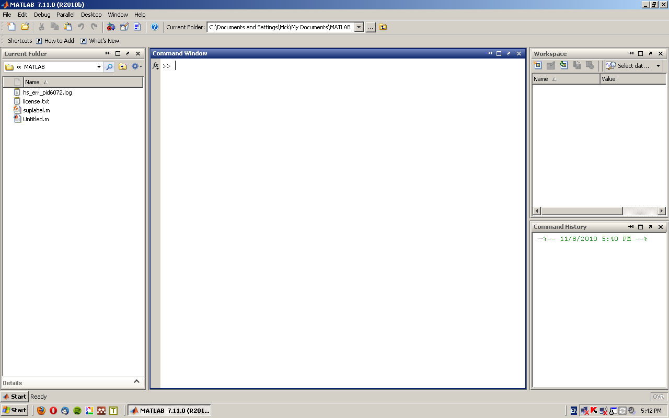
Layout
3
2
1
4

Slide 5
Basic Maths
Basic arithmetic
  Addition +
  Subtraction –
  Multiplication *
  Division /
  Exponential ^
Enter into the command window

Slide 6
Examples
Enter into the command line (and press enter to evaluate)
  2 +3*4
  123/345 +783
  (1+3)*4
  1+3*4
  What is the difference between the last two?

Slide 7
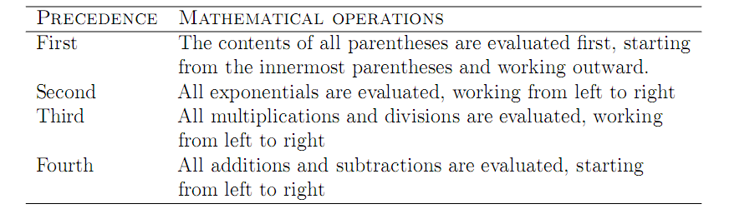
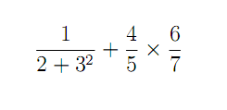
Enter the following:

Slide 8
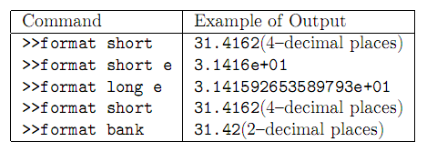
Display format
Try the different formats (enter the above command into the command windows, then enter a number)

Slide 9
Built in Functions
Matlab has lots of predefined functions.
These can be useful.

Slide 10
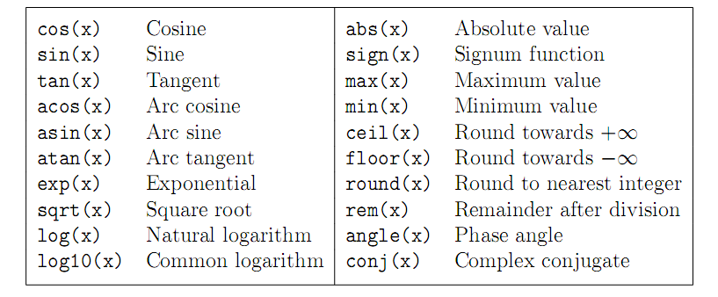
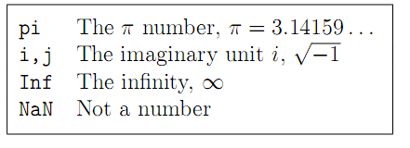

Slide 11




Enter into the command line:
What is the difference between the last two?

Slide 12
Variables
Variables can be assigned values.
  For instance to assign x the value of 5 enter:
  x = 5
  The number of will now be substituted where ever the variable x is.
  What does the following give?
    x^2 +3x +4
  Note defined variables appear in the Workspace

Slide 13




Try:
What does the semi colon in the first line do?

Slide 14
Help
To get help
  Look in the help function browser ( or product help)
  Type help followed by the function you want help with. Eg: help sin
  Google is also your friend

Slide 15
Arrays/Matricies
Data can be entered into 1D arrays
  x = [1,2,3,4,7,2,56]
Or 2D arrays
  y = [1,3;2,5]
Or any dimension

Slide 16
What does the following give?
  x = [1,2,3,4,7,2,56]; x + 6
  Why does x*x return an error?
  x = [1,2,3,4,7,2,56]; x.*x
  y = [1,3;2,5]; z = y*y

Slide 17
