Slide 1
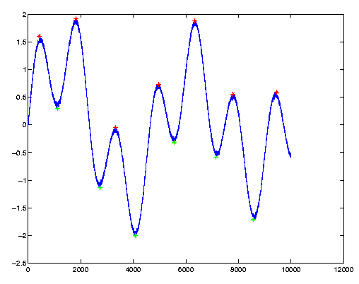
Matrix Manipulation and 2D Plotting

Slide 2
Review
Command Line
Semi Colon to suppress output
X = 3;
Entering a Matrix
Square brackets
X = [1,2,3,4,5]
Generate arrays (1D matrices)
X = Start:Step:End
X = 1:3:13

Slide 3
Matrix Manipulation
The basic unit of data storage
Extract a part of a matrix use round brackets
third entry in a 1D matrix
X(3)
last Entry
X(end)
fourth to ninth entries
X(4:9)
A 2D matrix
Entry at the third row, second column
A(3,2)
All of the third row
A(3,:)

Slide 4
Examples
Create a 5 by 5 magic square
There is a inbuilt function
Extract the value at the third row, fourth column
Extract the last value of the third column
Extract all of the fifth row
Replace the value at row 2, column 4 with 100
Replace all of the first column with zeros
Delete all of the fourth row
A = magic(5)
A(3,4)
A(end,3)
A(5,:)
A(2,4)=100
A(:,1)=0
A(4,:)=[]

Slide 5
Questions
What do the following command do?
If A is a 2D matrix
A'
B = [A';A']
A(:)

Slide 6
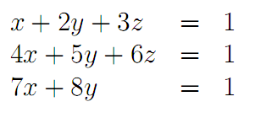
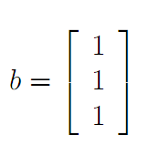
Solving linear Systems
Represent in matrix form
Use backslash operator
Inv(A)*b
A/b

Slide 7
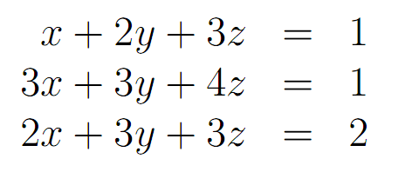
Solve

Slide 8
2D Plotting
Various, flexible, plotting routines.
The basic command is
plot(x,y)
This plots the vector of x coordinates against the vector of y coordinates
X and y must be the same size
plot(y)
Plots the vector y against its indices

Slide 9
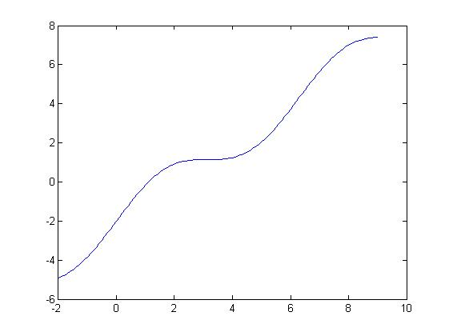
Plotting
Plot the function y = sin(x) +x -2
for x = [-2,9]
x= -2:0.1:9;
y = sin(x)+ x-2;
plot(x,y)

Slide 10
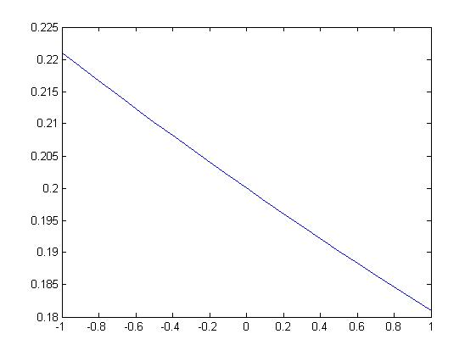
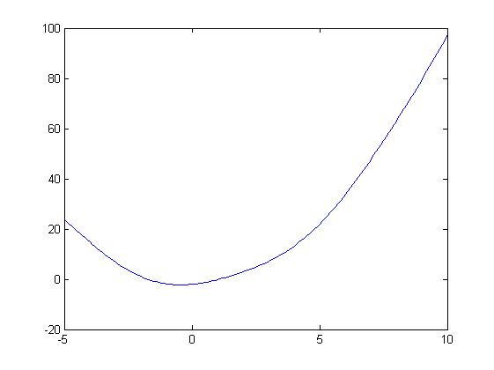
Plot the following
y = 0.2* e^{-0.1x}
for x = [-1,1]
y = sin(x) +x^2 -2
for x = [-5,10]

Slide 11
Data Loading
Navigate to appropriate directory
Right click on file and select importdata
If in plain text format
A = Load(‘file name.???’);
If a other formats (eg. Excel files)
A = importdata(‘file name.xls’);

Slide 12
Data Loading Tasks
Download and then load data file
https://files.warwick.ac.uk/kimmckelvey/files/CVBulk.tsv
Load CVBulk.tsv data
Create a plot of this data

Slide 13
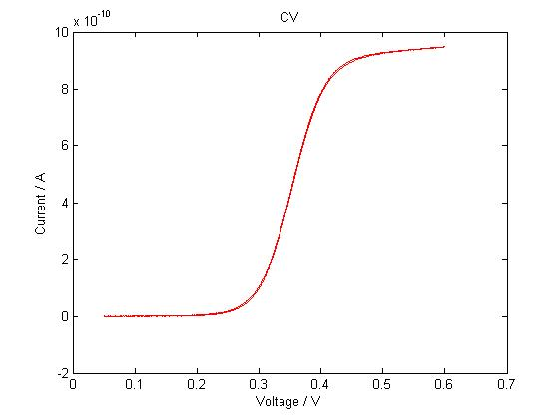
>> data = load('c:/CVBulk.tsv');
>> figure
>> plot(data(:,1),data(:,2),'r')
>> title('CV')
>> xlabel('Voltage / V')
>> ylabel('Current / A')

Slide 14
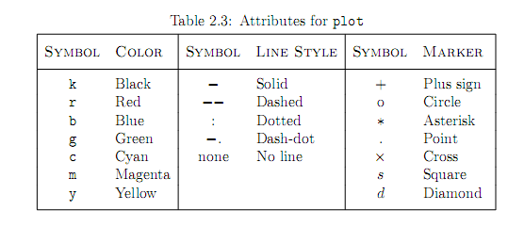
Changing Attributes
Basic usage: plot(x, y, ’Attributes’)
To plot a green dashed line
plot(x, y, ’g--’)
To plot yellow circle at the data points
plot(x, y, ‘yo’)

Slide 15
Titles etc
Adding a title
Title(‘whoop whoop’)
Axes labels
xlabel(‘Peanuts’)
ylabel(‘Vanilla’)
Legend
legend('222','33')

Slide 16
Multiple
To plot multiple line of the same plot
plot(X,Y,'y-',X1,Y1,'go')
Or use the ‘hold on’ function
plot(x, y, ’b.’)
hold on
plot(v, u, ‘r’)

Slide 17
Subplot
Used to plot multiple graphs in the same frame
Try:
Plot sine and cosine between 0 and 10 on two separate axes in the same frame
>> subplot(2,1,1)
>> plot(x, y)
>> subplot(2,1,2)
>> plot(u, v)

Slide 18
More attributes:
Plots are fully editable from the figure window. Once you have a plot, you can click Tools->Edit plot to edit anything.
plot(X1,Y1,LineSpec,'PropertyName',PropertyValue)
Plot(x, y, ’r’, ‘LineWidth’, 3, ‘MarkerSize',10)
But all this can also be done from the command line
set(gca,'XTick',-pi:pi/2:pi)

Slide 19
More types of plots
Histograms
Bar
Pie Charts
Create a bar plot of the CVBulk data

Slide 20
Task
Plot the following equations on the same graph (different colours)
Solve the system of equations
Plot the solution on the same graph
Add appropriate titles, labels and legend

