Slide 1
Introduction to Matlab

Slide 2
I use Matlab for:
Data analysis
Data plotting
Image Analysis
Also
Simulations (solving odes/pdes/finite element methods)
Minimisations, root finding, curve fitting
Data visualisation
Controlling lab equipment
Etc...
Basically anything (within reason)

Slide 3
An overview of Matlab, giving a introduction to
Plotting (2D and 3D)
Scripts
M-files
Basic Programming
Matrices
etc

Slide 4
Matlab
Matrix Laboratory
Computation, visualisation and programming environment.
Additional toolboxes
Bioinformatics
etc

Slide 5
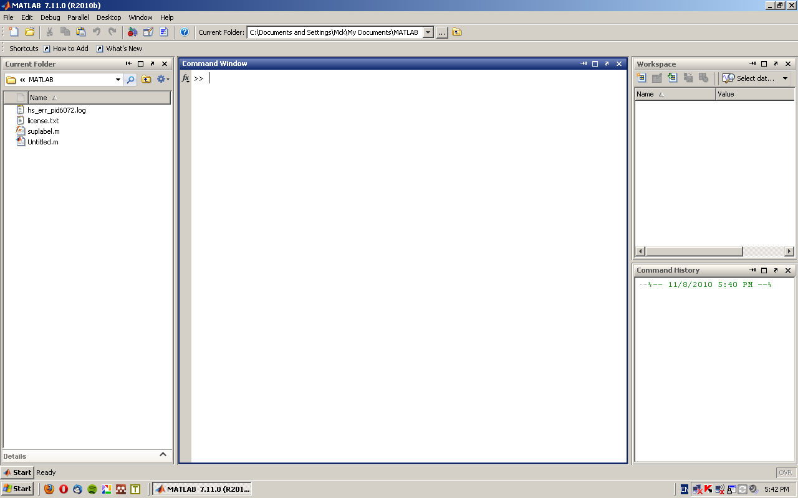
Layout
3
2
1
4

Slide 6
Basic Maths
Basic arithmetic
Addition +
Subtraction –
Multiplication *
Division /
Exponential ^
Enter into the command window

Slide 7
Examples
Enter into the command line (and press enter to evaluate)
2 +3*4
123/345 +783
(1+3)*4
1+3*4
What is the difference between the last two?

Slide 8
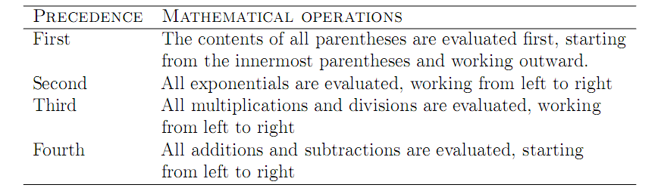
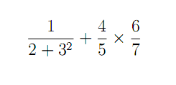
Enter the following:

Slide 9
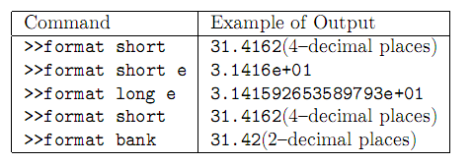
Display format
Try the different formats (enter the above command into the command windows, then enter a number)

Slide 10
Built in Functions
Matlab has lots of predefined functions.
These can be useful.

Slide 11
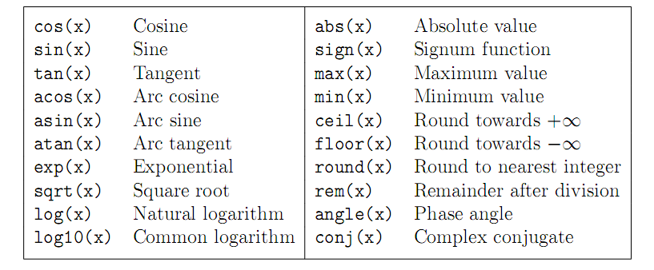
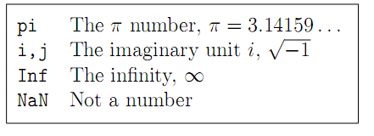

Slide 12




Enter into the command line:
What is the difference between the last two?

Slide 13
Variables
Variables can be assigned values.
For instance to assign x the value of 5 enter:
x = 5
The number of will now be substituted where ever the variable x is.
What does the following give?
x^2 +3x +4
Note defined variables appear in the Workspace

Slide 14




Try:
What does the semi colon in the first line do?

Slide 15
Help
To get help
Look in the help function browser ( or product help)
Type help followed by the function you want help with. Eg: help sin
Google is also your friend

Slide 16
Arrays/Matricies
Data can be entered into 1D arrays
x = [1,2,3,4,7,2,56]
Or 2D arrays
y = [1,3;2,5]
Or any dimension

Slide 17
What does the following give?
x = [1,2,3,4,7,2,56]; x + 6
Why does x*x return an error?
x = [1,2,3,4,7,2,56]; x.*x
y = [1,3;2,5]; z = y*y

Slide 18
Task
Define x as an array from 1 in steps of 1 to 11
Define y as an array from 2 in steps of 3 to 17
Calculate z, the mean of the array x plus the median of array y
Using inbuilt functions
Without using any inbuilt functions

Slide 19
