Slide 1
Scripts and Flow Control

Slide 2
Scripts
So far we have been entering commands directly into the command line
But there is a better way
Script files (and functions)
Text files that contain lists of commands

Slide 3
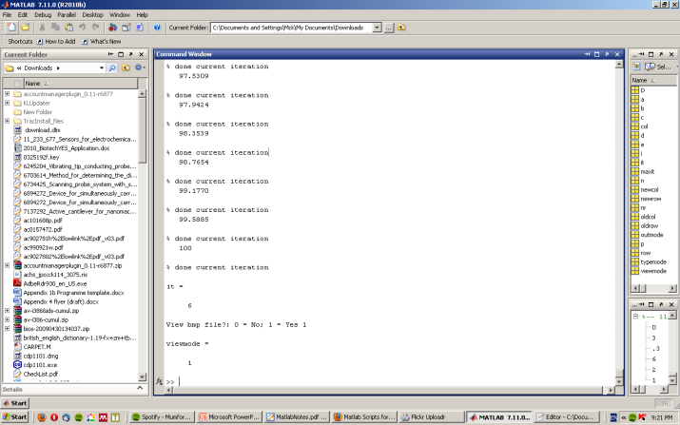
Script files are saved in plain text and end in .m (for example example.m)
A separate editor window is used to edit scripts
A new script file can be created by:
clicking the new script button (top left)
Typing
edit name_Of_Your_Script.m
File -> New -> Script

Slide 4
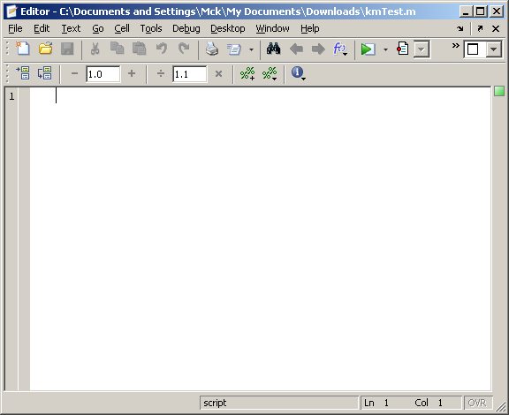
Contain a list of commands, which is executed in order.
Access to the workspace
Execute by typing name of script in command line (when in the same directory)
Or by clicking the green arrow at
the top of the editor

Slide 5
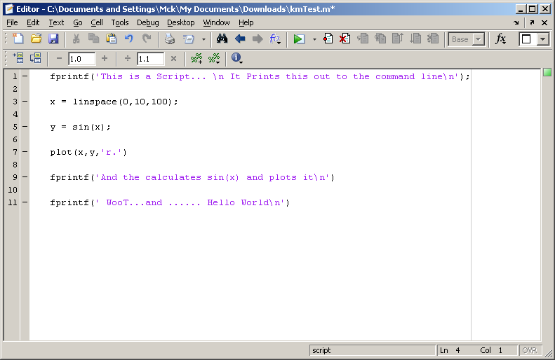
Simple Example

Slide 6
Write a script that
Plots the following equation on the same graph, adds a title and labels the axes.
y = x^2 -4
y = sin(2x)-1

Slide 7
Task
Create a script file (Called testScript) that
Plot the following equations on the same graph (different colours)
Add appropriate titles, labels and legend
Solve the system of equations
Plot the solution on the same graph

Slide 8
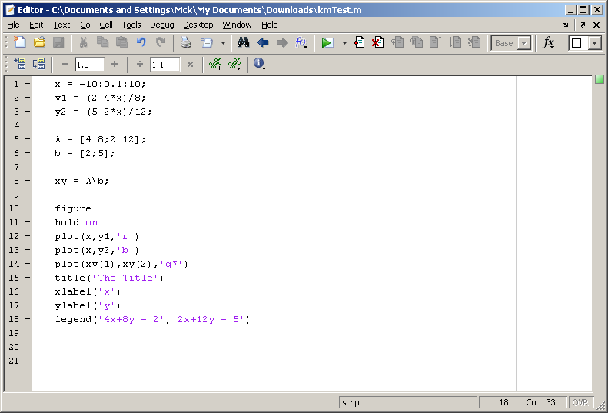
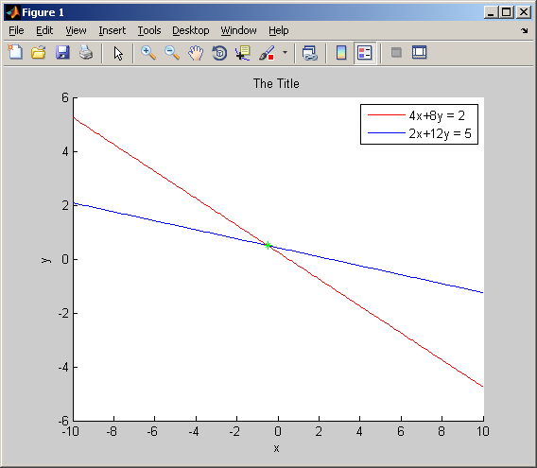

Slide 9
Flow Control
Within a script (or function) you might want to repeat a series of commands (for and while loops) or choose between a series of commands (if and case statements)

Slide 10
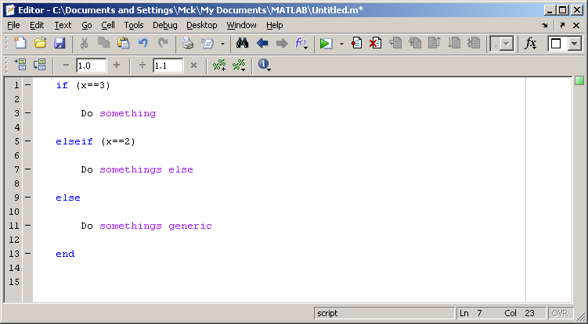
If
Choose between 2 ( or more ) blocks of code

Slide 11
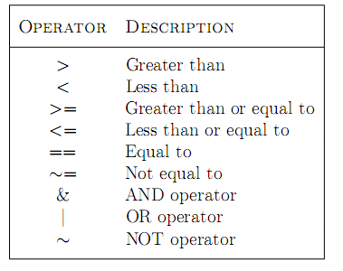
Can use a variety of conditions

Slide 12
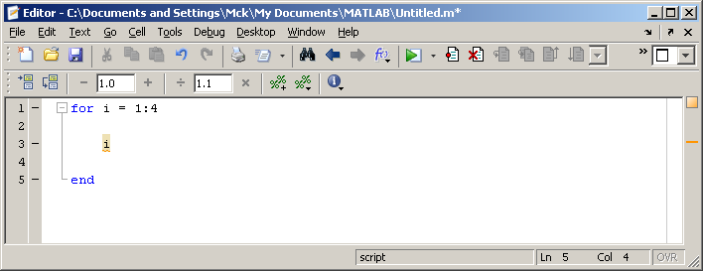
For
For loops allow you to loop over commands a pre defined number of times (with an iterator)

Slide 13
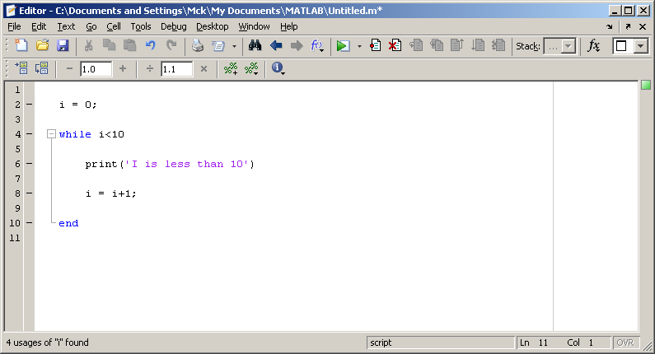
While
Loops over some code until the condition is false

Slide 14
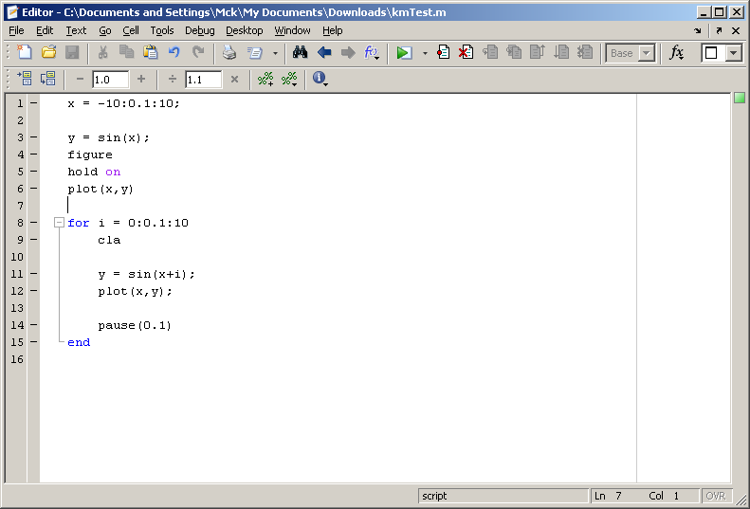
What does the following script do?

Slide 15

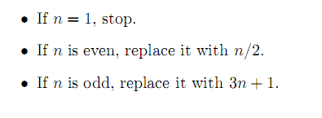
Task
Write a script implements the following
Starting from a user supplied starting n (use the input function)
Return the sequence and the number of iterations

