Slide 1
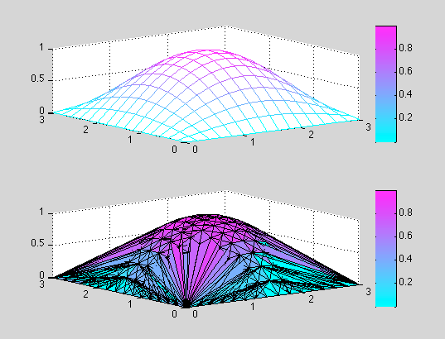
Mesh generation + Delaunay Triangulation
Chrissie Waddington
Harry Moyse
Notes:
chrissy

Slide 2
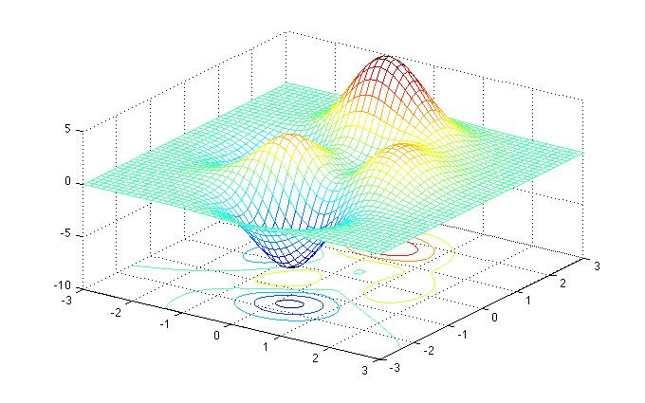
Mesh Generation
Creating a 3d polyogonal shape from data
E.g:
protein structure from microscope
Fancy 3d graphs
Computer games
Notes:
chrissy

Slide 3
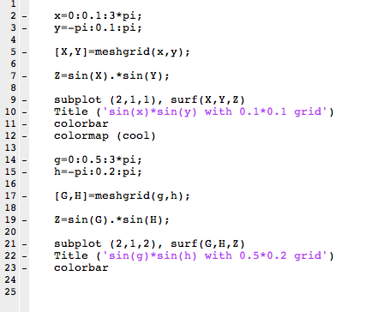
To generate a simple mesh grid in MATLAB
Notes:
chrissy

Slide 4
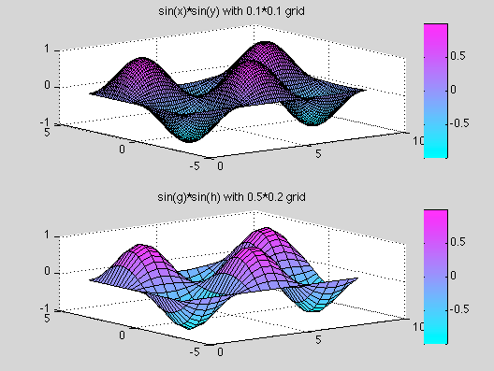

Slide 5
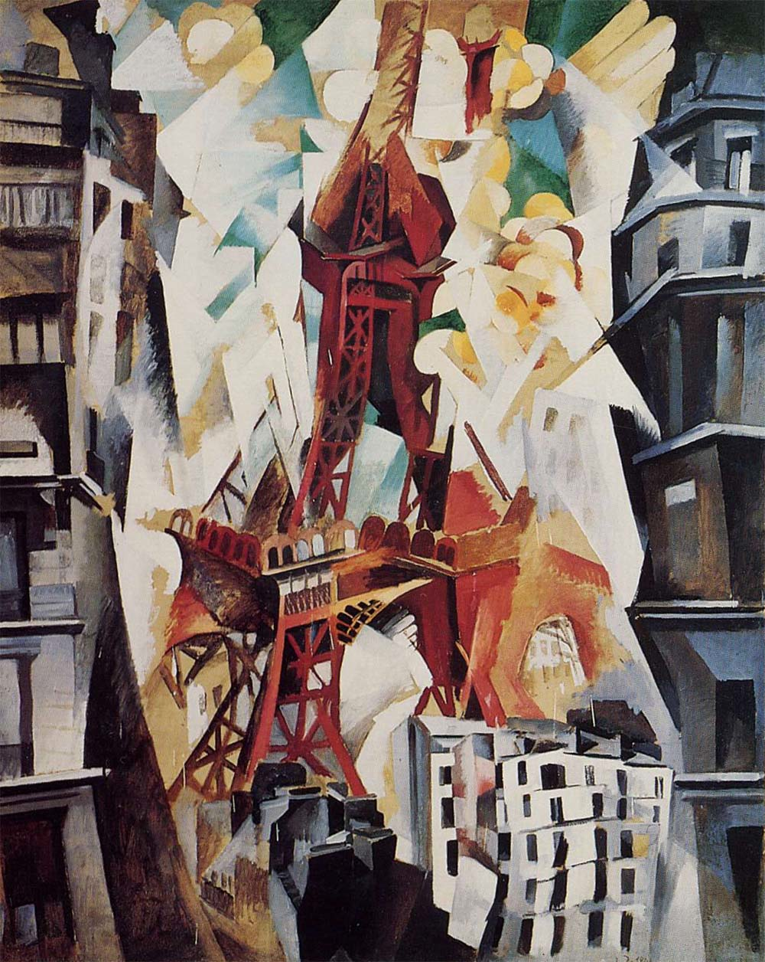
Delaunay Triangulation
A way of creating a mesh from a set of points
Unrelated to the work of the French cubist of the same name

Slide 6
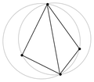
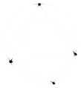
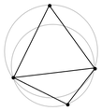
Delaunay triangulation
A triangulation where no point is inside the circumcircle of any triangle.

Slide 7
Generalizing Delaunay triangulation for large sets of points
On any 3 points one can define a circle
On any four points one can define 4 circles
The point that is not a circle is either in the region enclosed by the circle or outside of it.
If the 4th point is outside the circle then a triangulation making the three points in the circle into a triangle is locally Delaunay
If the circle for every triangle contains no other points, then the triangulation is globally Delaunay
The Delaunay triangulation for a set of points may not exist or may be non-unique

Slide 8
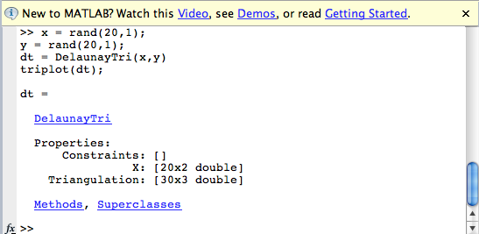
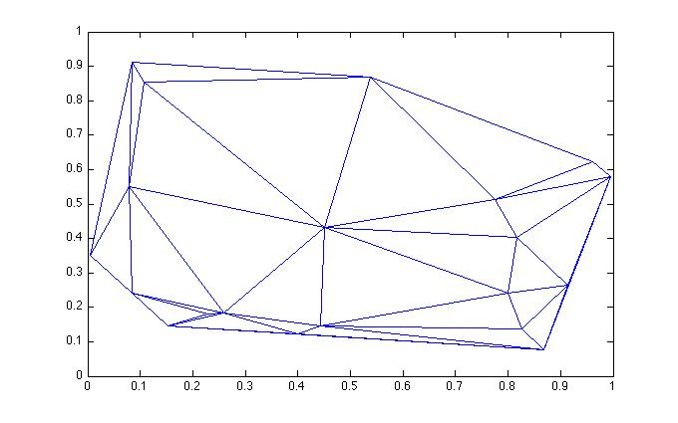
How do we do it in matlab? 2D case

Slide 9
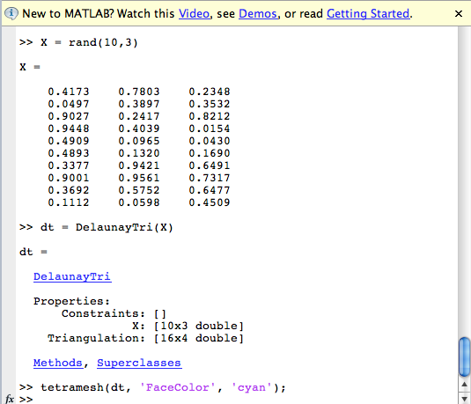
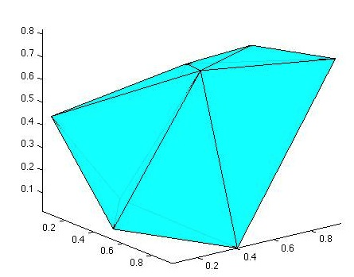
How do we do it in matlab? 3D case

Slide 10
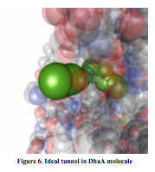
Biological Applications

Slide 11
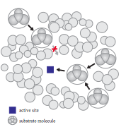
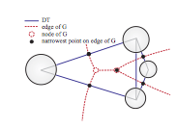
Medek et al. have used Delaunay triangulation to calculate location of tunnels in protein molecules.
Finding paths to an active site in a protein.

Slide 12
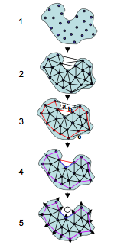
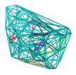
Singh et al. (1995) investigated the modeling of Crambin using carbon atoms as the vertices. This became the standard method for protein modeling using Delaunay tessellation.
Xie and Borne (2007) limited triangle side lengths so that ligand binding sites were highlighted, enabling better modeling of protein interactions.

Slide 13
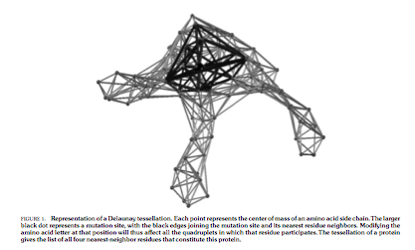
Mathe et al. (2006) have used Delaunay tessellation to model the tumor
Suppressor TP53 so that they can investigate cancer causing mutations.

Slide 14
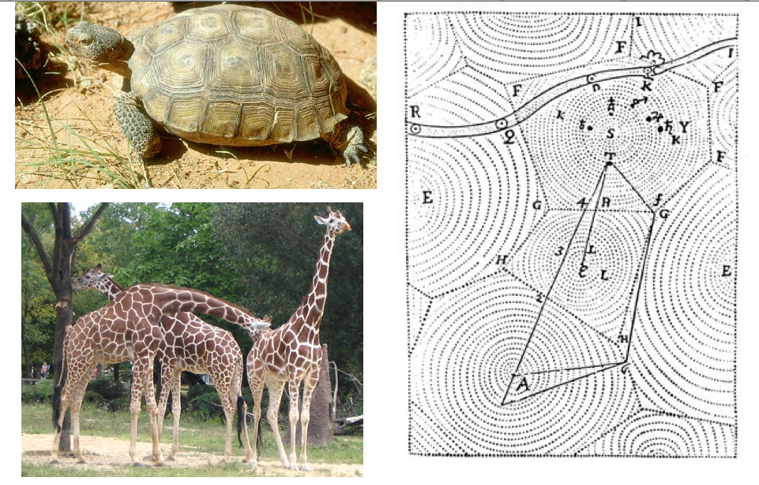
Delaunay patterns can also be observed in the colouration of animals (morphogenesis)

Slide 15
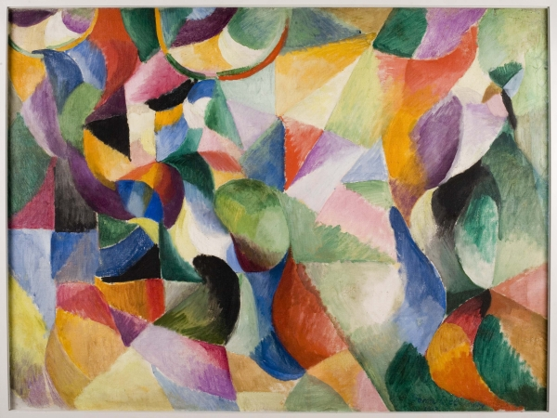

Slide 16
Triangulation links
A fun java aplet http://www.cse.unsw.edu.au/~lambert/java/3d/delaunay.html
Lecture notes http://graphics.stanford.edu/courses/cs368-06-spring/handouts/Delaunay_1.pdf http://w3.jouy.inra.fr/unites/miaj/public/vigneron/cs4235/l10cs4235.pdf

