Slide 1

Critical Phenomena in a Heterogeneous Excitable System
Marc Baghdadi
Supervisor: Hugo van den Berg

Slide 2
Background
Muscular wall of the uterus (myometrium) only acquires ability to expel the fœtus in the final days before labour
This change is believed to be the result of a phase transition from locally excited to globally excited state
Cell synchrony is achieved by electrical conduction through gap junctions
R. Smith, Parturition, N Engl J Med, 2007, 356:271-283

Slide 3
Aim of the project
To model the changes in the muscular wall of the uterus in the days before labour
Investigate the spread of induced excitation through the system

Slide 4
The Model
Smooth muscle cells can be modelled using the Fitzhugh-Nagumo system of equations
v = excitation variable
w = recovery variable
I = Input current

Slide 5
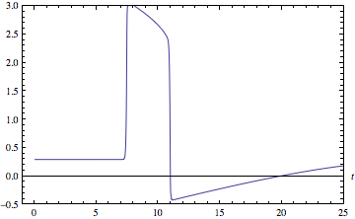
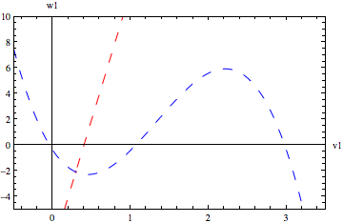
The Model
v

Slide 6
Approach Taken
Approach Taken
Construct an (m x n) lattice of cells, each obeying Fitzhugh-Nagumo dynamics, and connected by identical resistors
K

Slide 7
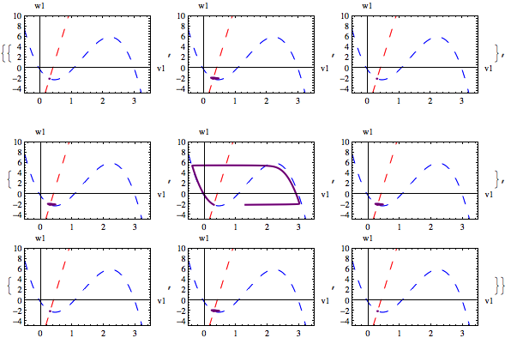
Local Excitation

Slide 8
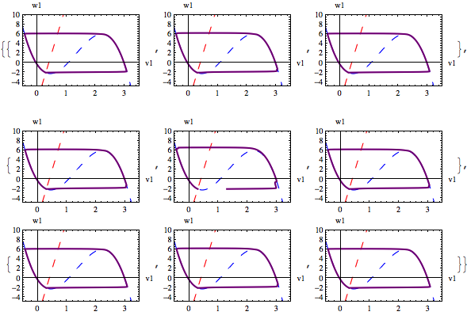
Global Excitation

Slide 9
Region of Excitation

Slide 10

Removing connections at random
Probability

Slide 11
Removing connections at random

Slide 12
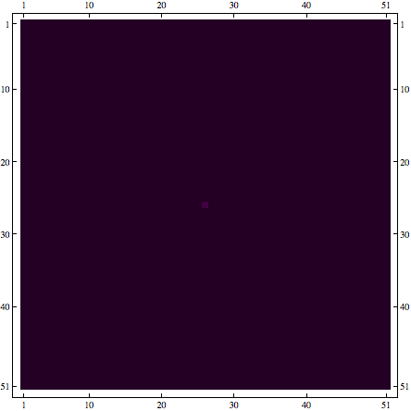
Removing connections at random

Slide 13
Percolation Points

Slide 14
Random Connection Sizes

Slide 15
Hexagonal Lattice

Slide 16
Percolation Points - HL

Slide 17
Conclusions
Minimum coupling is needed
Heterogeneity can help the transition from local excitation to global excitation

Slide 18
Further Work
Excite several cells in a larger lattice
Introduce a pacemaker cell
Introduce time-dependence in coupling parameter

Slide 19


Acknowledgements
Hugo van den Berg
Rachel
MOAC

