Slide 1

Nanoscale Redox Imaging
Marc Baghdadi
Supervisor: Prof. Pat Unwin

Slide 2
Outline
What is electrochemistry?
The technique – SECM and IC-SECM
Why nanoscale?
Fabrication of platinum ultramicroelectrodes
Testing Pt tips
CVs, ACs
Scanning hard surfaces
Gold bands, Palladium nanowires
Scanning soft surfaces
Maize roots

Slide 3
What is electrochemistry?
Study of chemical reactions (redox reactions) taking place in a solution, and involving electrical currents and potentials
Consists of electron transfers between an electrode and electrolyte (solution with ions)

Slide 4
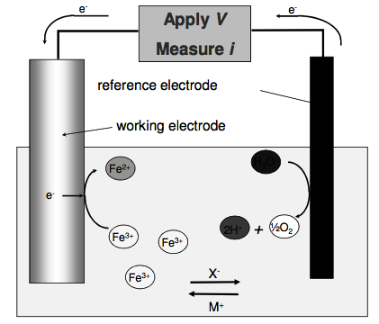
Typical Electrochemical cell

Slide 5
Conventional Scanning ElectroChemical Microscopy
Scanning probe microscopy technique
Ultramicroelectrode (UME) tip held at constant height (z-direction) above sample
Sample scanned in x and y directions, with the electrochemical response measured
S. Amemiya, A. J. Bard, F. F. Fan, M. V. Mirkin, P. R. Unwin, Scanning Electrochemical Microscopy, Annu. Rev. Anal. Chem. 2008. 1:95-131

Slide 6
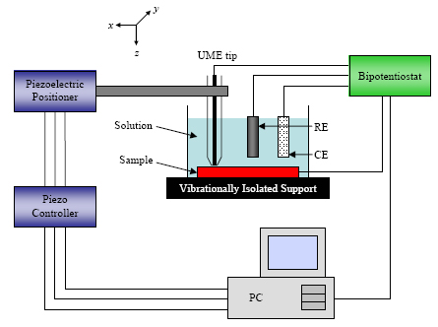
Typical SECM set-up

Slide 7
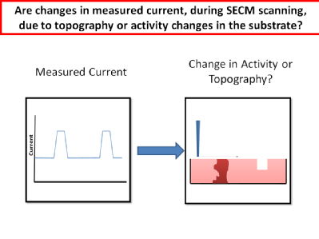
The Problem
Are changes in measured current due to topography or activity changes in the substrate?

Slide 8
A Solution – IC-SECM
Intermittent Contact SECM integrates UMEs into Atomic Force Microscopy (AFM)
Tip oscillated at constant amplitude through application of a small AC positional perturbation
Amplitude damped as tip approaches surface
Oscillation damping is detected, and is fed back during scanning to keep the tip-surface separation constant

Slide 9
Why nanoscale?
Essential for subcellular-level studies of biological systems
Nanoelectrodes provide higher signal-noise ratio
Also provide higher mass-transfer rates under steady-state conditions
Leads to much higher spatial resolution
R. W. Murray, Nanoelectrochemistry: Metal Nanoparticles, Nanoelectrodes, and Nanopores, Chem. Rev. 2008, 108, 2688–2720

Slide 10
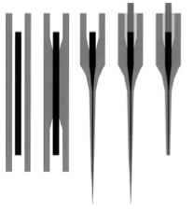
Fabrication of Platinum UMEs
B. B. Katemann, W. Schuhmann, Electroanalysis 2002, 14, 22-28

Slide 11
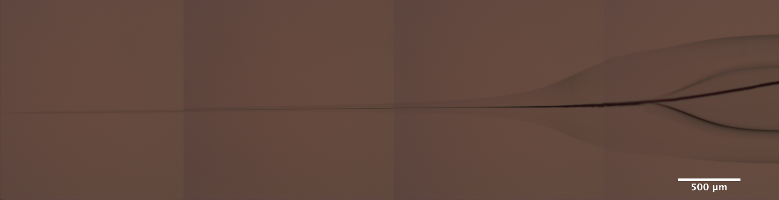
Well-Pulled Pt Tip
Unbroken wire to end of tip
Inner glass wall sealed around wire

Slide 12
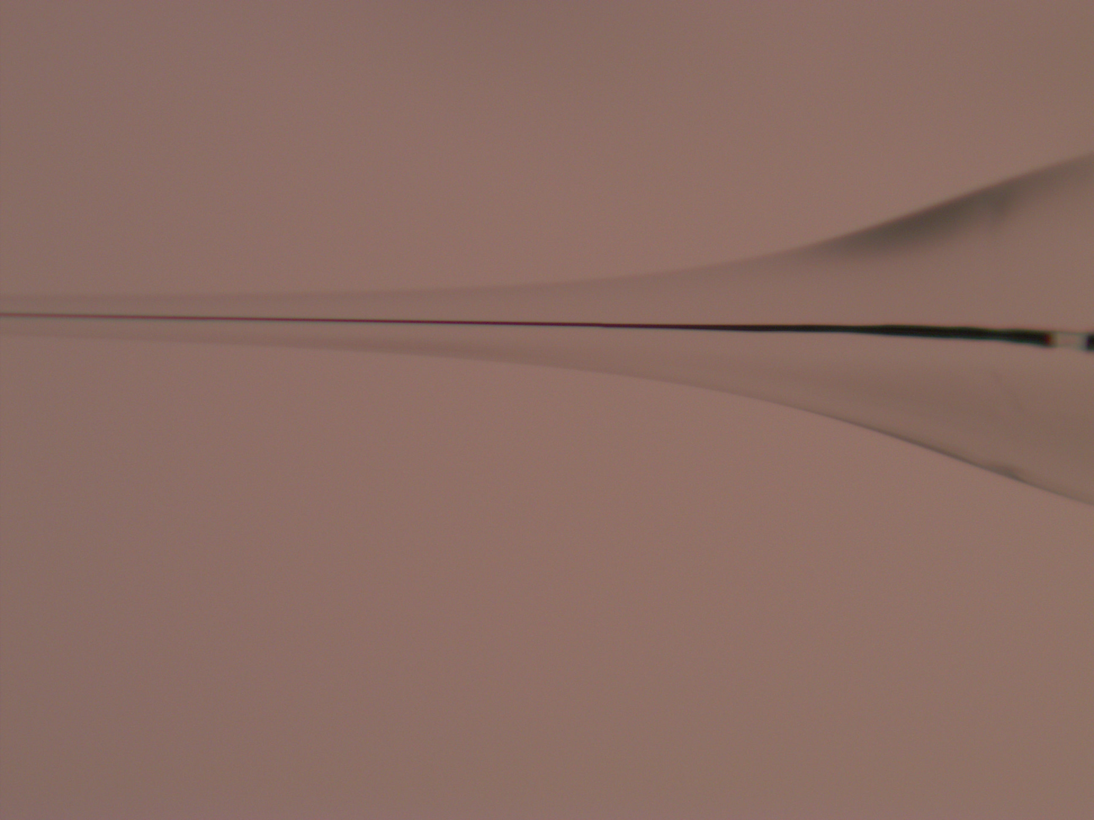
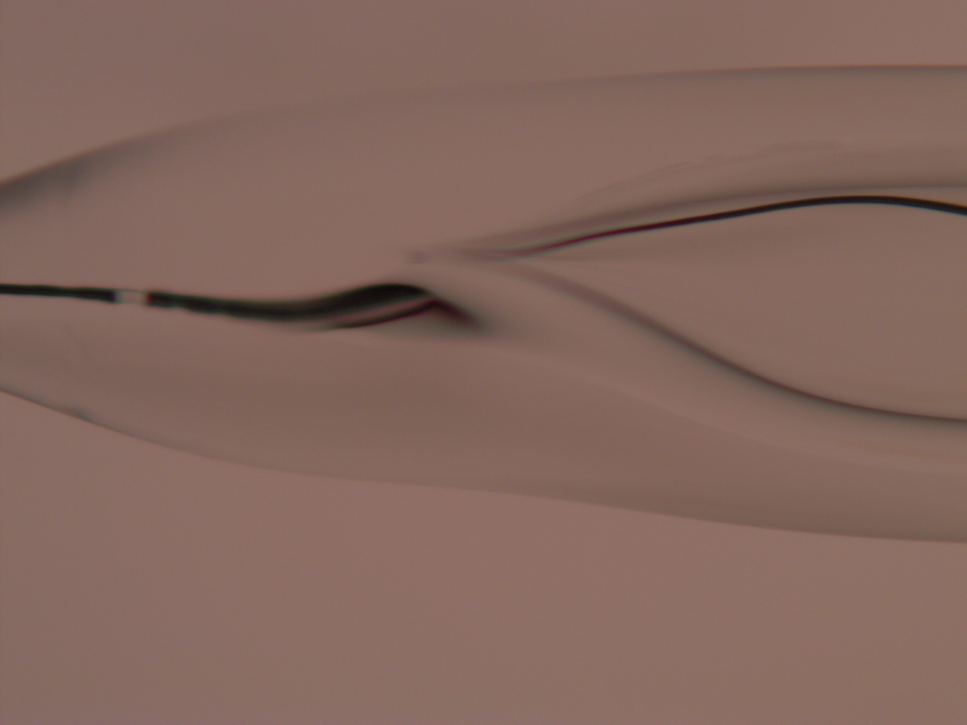
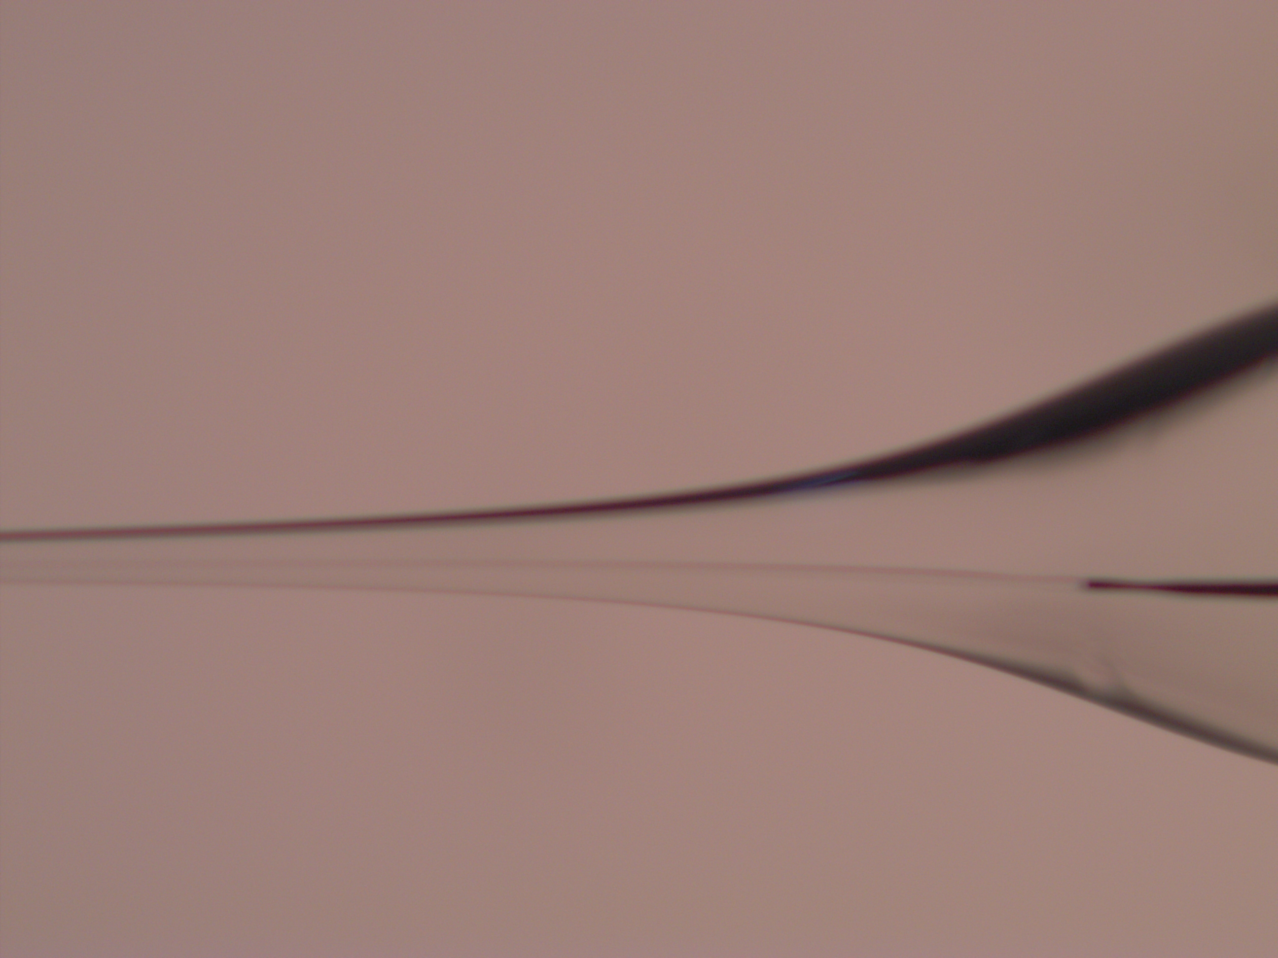
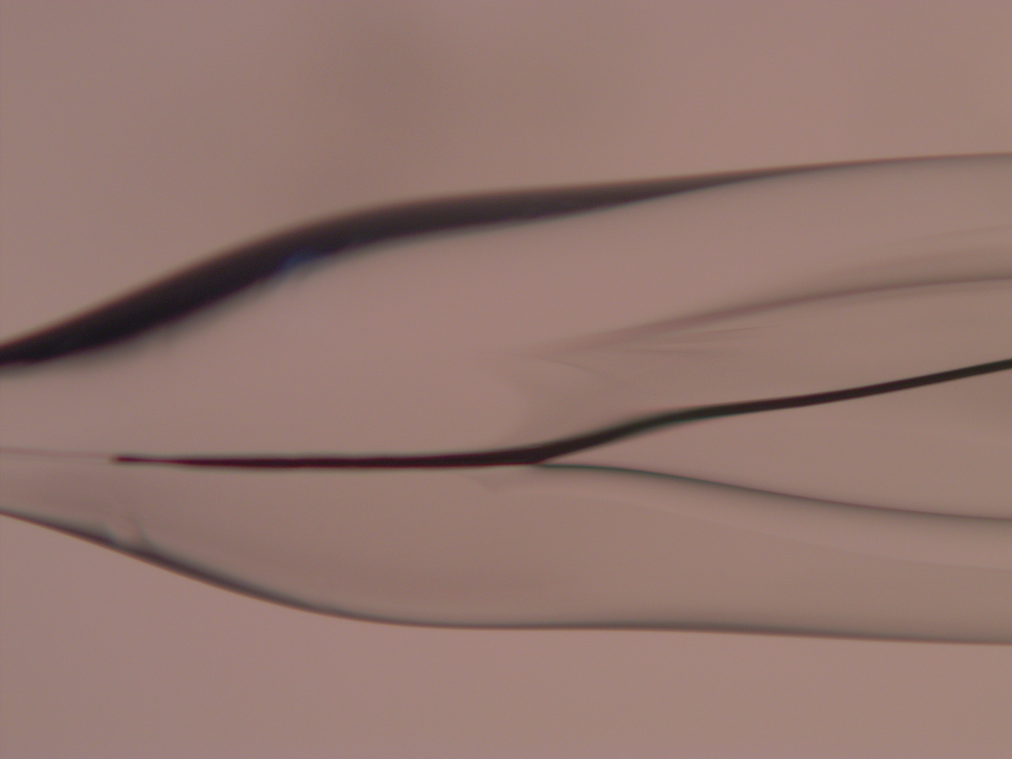
Badly-Pulled Pt Tips
Wire stops too soon
Broken wire

Slide 13
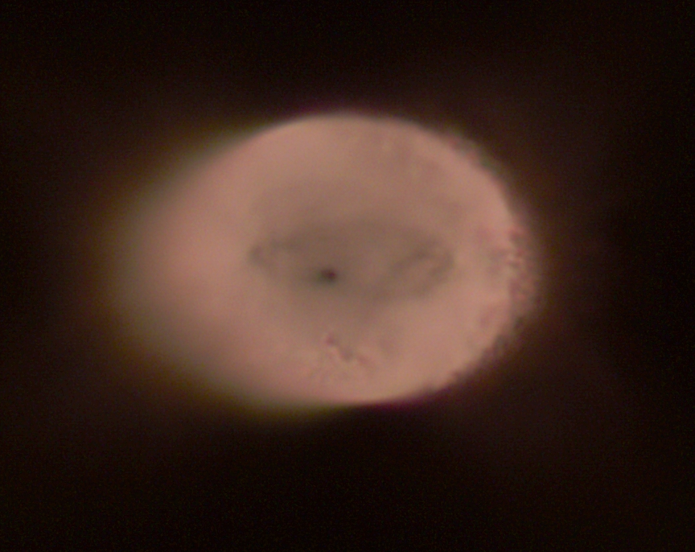
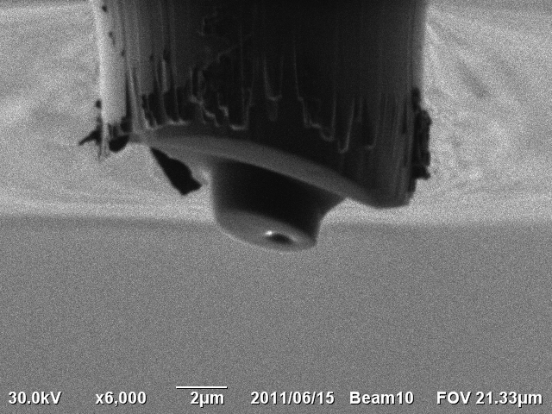
Polishing Pt Tip
Polished back by holding tip against 0.1μm micropolisher disc for few seconds.
Alternatively, cut tip using FIB (focused ion beam)
Pt wire

Slide 14
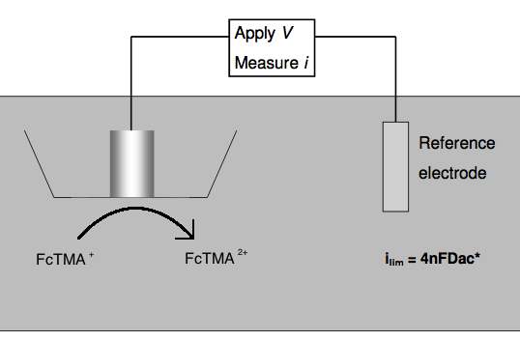
Testing Pt UMEs

Slide 15
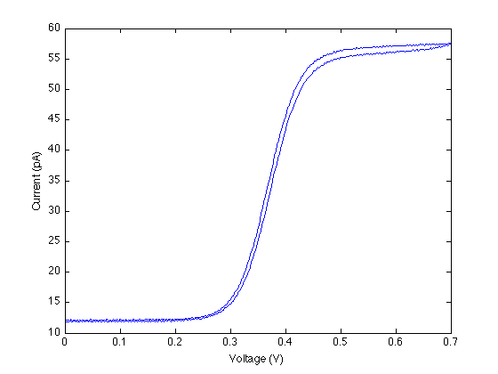
Cyclic Voltammograms (CVs)
V
t
Limiting current ~ 45pA
⇒ Tip radius of ~ 200nm

Slide 16
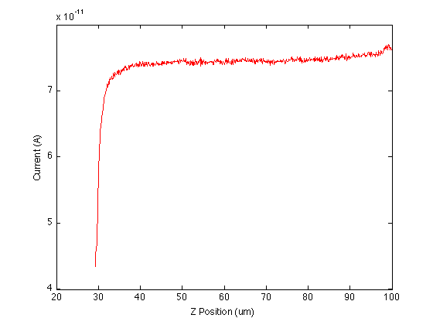
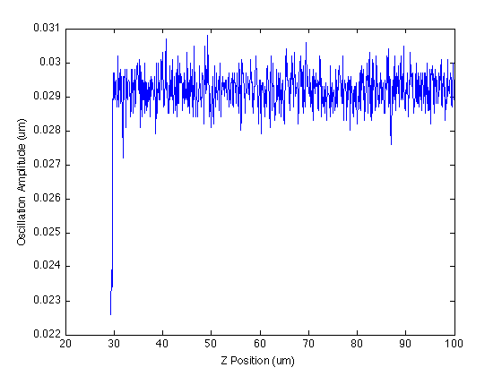
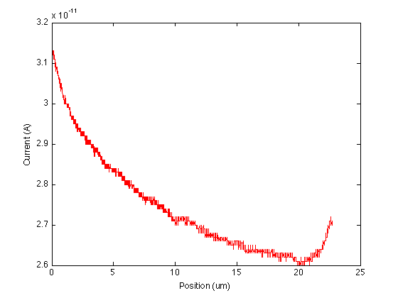
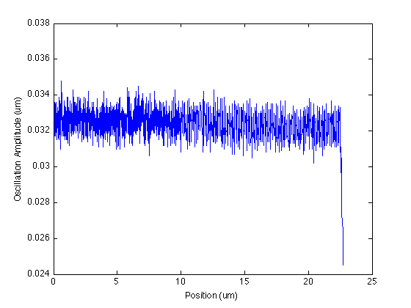
Approach curves
Inert surface
Conductive surface

Slide 17
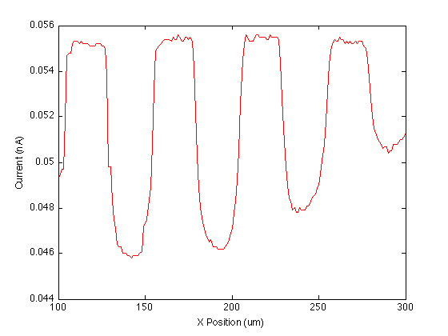
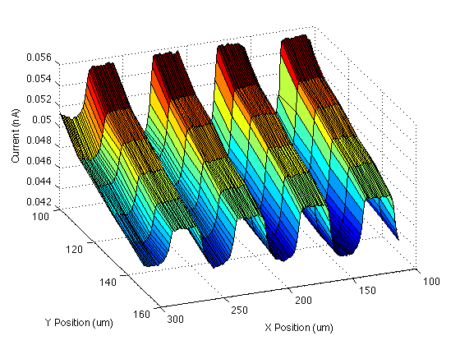
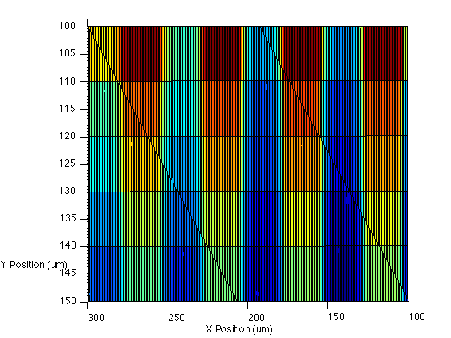
Scanning Gold Bands
First line

Slide 18
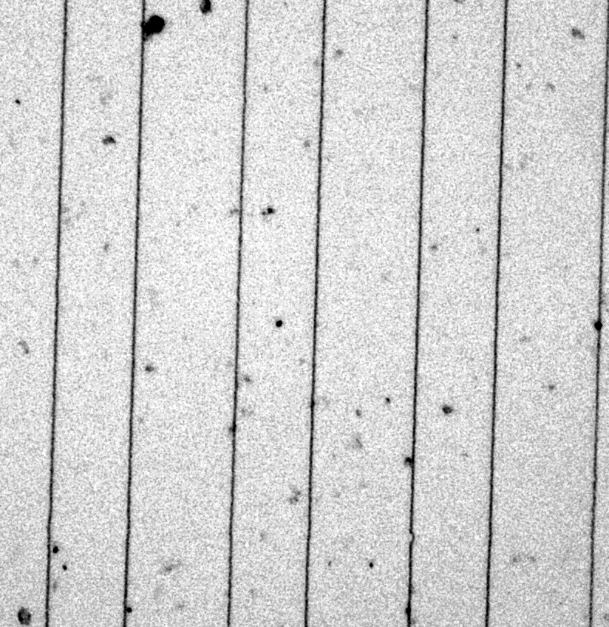
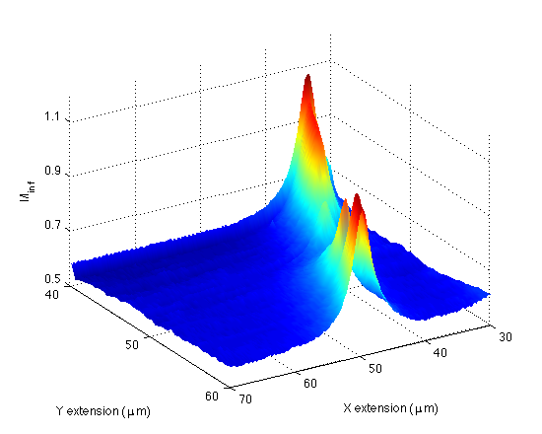
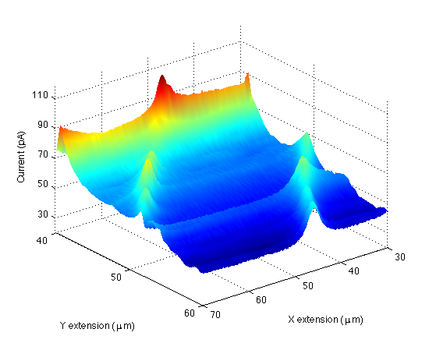
Scanning Nanowires
Nanowires
Substrate generation tip collection scan
Feedback mode scan

Slide 19
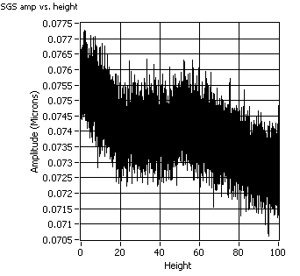
Scanning Maize Roots

Slide 20
Conclusion and Further Work
Nanoelectrodes have successfully been introduced into IC-SECM for hard surfaces
Vary oscillation frequency/amplitude to transfer to soft surfaces
Move to carbon nanoelectrodes

Slide 21


Acknowledgments
Warwick Electrochemistry and Interfaces Group
Prof. Pat Unwin, Rob Lazenby, Kim McKelvey, Mike O’Connell
MOAC
EPSRC

