Slide 1

Forces Produced by Protofilament Curls
and
Nucleotide Preference for End Binding Proteins
Rachel Sheldon
Notes:
My 8 week project was divided into two sections. I looked at the forces produced by protofilament curls during catastrophes, and nucleotide preference for end binding proteins using GTP and GTPgS microtubules

Slide 2
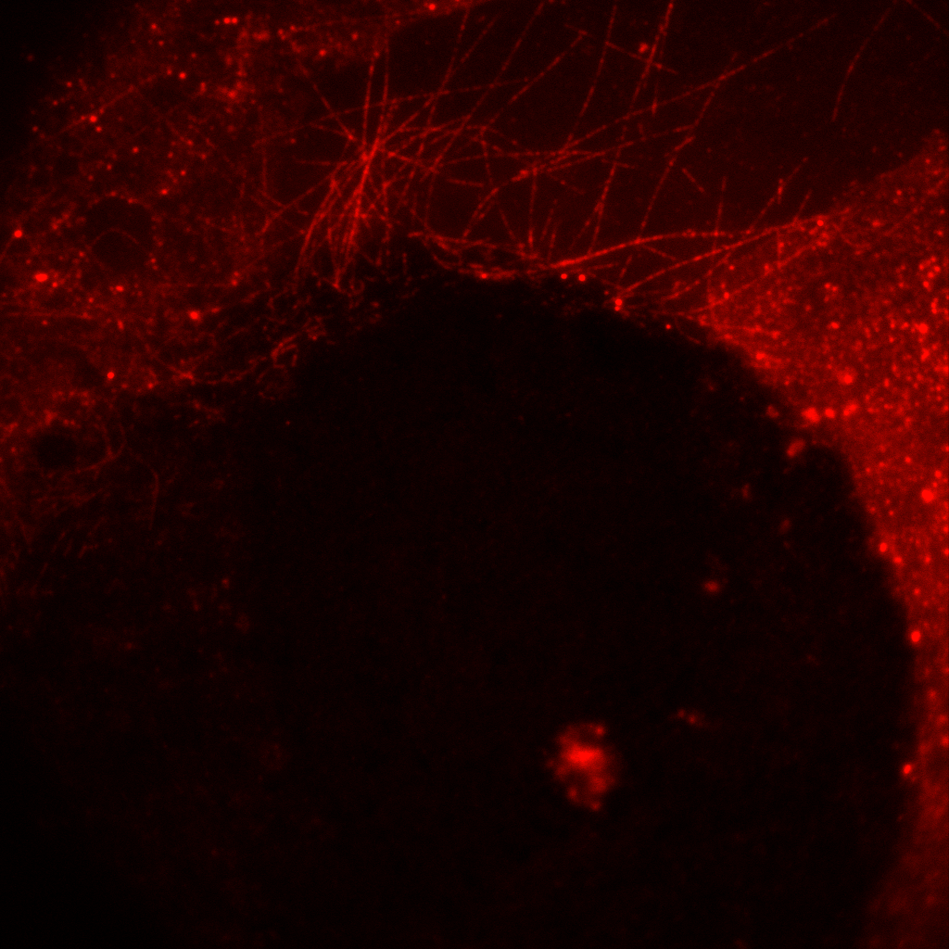
Forces Produced by Protofilament Curls
AIM: to measure whether gel-embedded microtubules shrink slower during depolymerisation
Microtubules were imaged in a channel with pillars of agarose over 15 minutes periods
No growth was seen into the agarose gel pillars
Notes:
The aim of the first project was to measure whether gel-embedded microtubules shrink slower during depolymerisation. To do this, microtubules were grown in a chamber with agarose pillars added and imaged over 15 minute periods. Microtubules could be seen but did not grow into the gel. Point out bleaching?

Slide 3
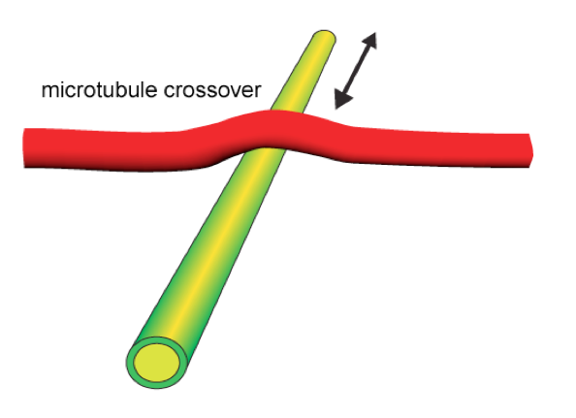
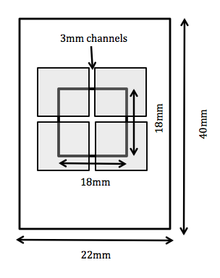
Forces Produced by Protofilament Curls
AIM: to investigate resistance and microtubule crossovers by inducing shrinkage of underpassing microtubule
Stable overpassing microtubule
Dynamic underpassing microtubule
Inconclusive results
Microtubule bleaching
Seed bleed-through
Notes:
Change method after negative results. Aim was to investigate resistance and microtubule crossovers by inducing shrinkage of the underpassing microtubule. We had a set up with 2 perpendicular channels, and flowed through dynamic seeds with protective caps in the y direction, followed by long stable microtubu;es in the x direction. No results were seen microscope problems.

Slide 4
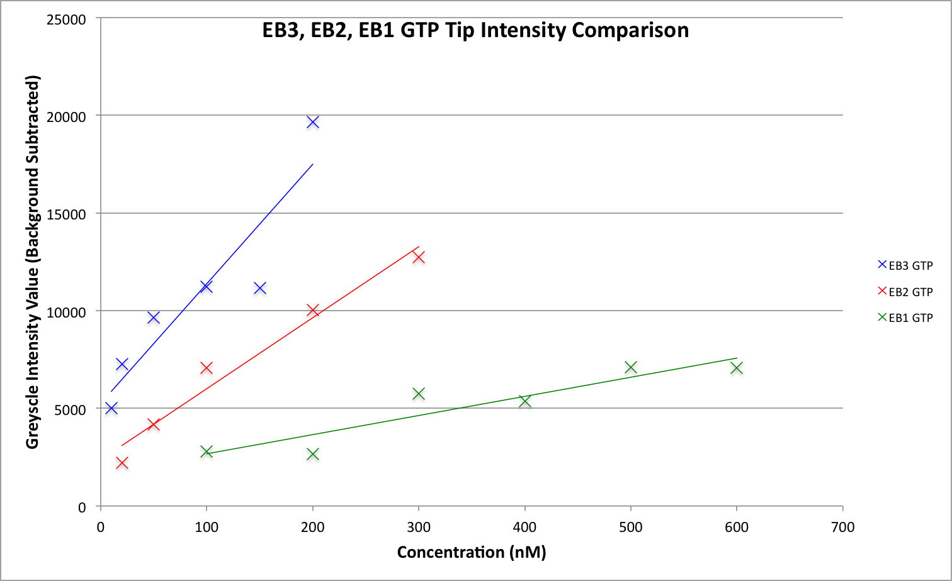
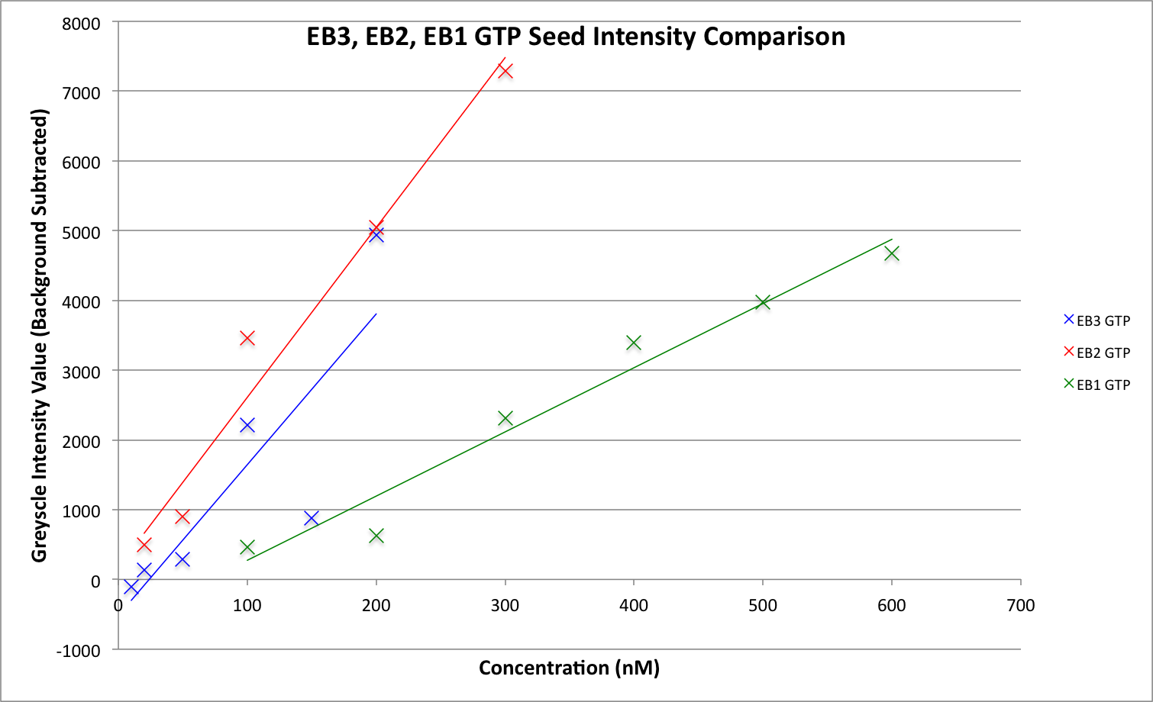
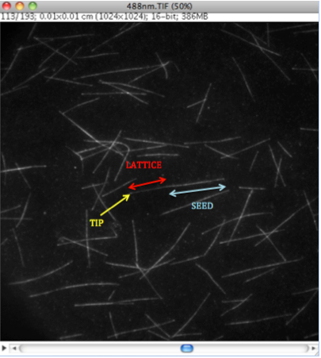
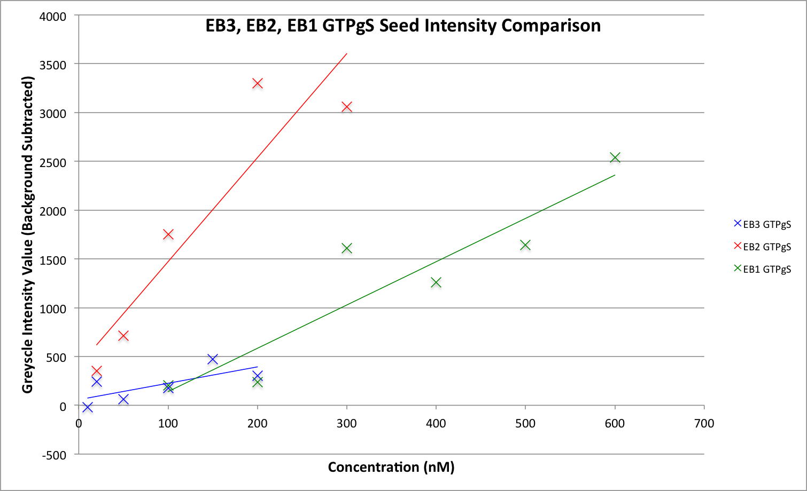
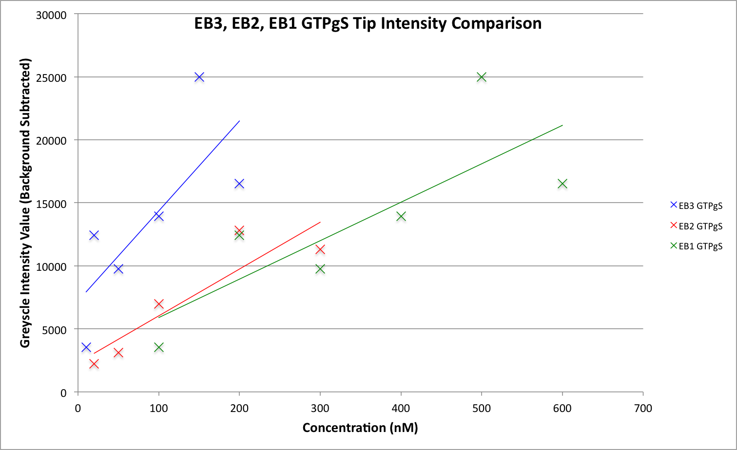
Nucleotide Preference for End Binding Proteins
AIM: to investigate the binding affinity of EB proteins with GTP and GTPγS microtubules
Measured the intensity of the tip, seed and lattice for GTP and GTPγS microtubules
GTPγS microtubules had brighter tips than GTP microtubules
EB3 showed the greatest binding affinity at the tip for both microtubule types
EB2 showed the greatest binding affinity for GTPγS microtubules
Notes:
Aim was to investigate nucleotide preference for EB proteins, using GTP and GTPgS microtubules. As a GTP microtubule polymerises the GTP cap hydrolyses into GDP and forms part of the lattice. GTPgS is non hydrolysable. Therefore no polymerisation occurs and so we would not expect EB proteins to have binding affinity for it. Tip, lattice and seed intensities were measured most EB binding happened in the tip. Larger values seen for GTPgS microtubule, particularly for EB2 seed.
----- Meeting Notes (17/05/2011 09:34) -----

Slide 5
Nucleotide Preference for End Binding Proteins
AIM: to investigate the binding affinity of EB proteins with GTP and GTPγS microtubules
In microtubule polymerisation, GTP microtubules hydrolyse to make GDP which forms part of the lattice. EB proteins have a strong binding affinity for GDP
EB proteins (EB2 in particular) showed a strong binding affinity for GTPγS microtubules.
GTPγS microtubules are non-hydrolysable and very stable
GTPγS microtubules imitate the GTP cap found on polymerising microtubules

Slide 6

Thank you!

