Slide 1
Critical Phenomena in a Heterogeneous Excitable System
Rachel Sheldon

Slide 2
Talk Outline
Aim of the project
Background to the problem
Approach Taken
n cell chain
(n x n) cell lattice
Further Work

Slide 3
Aim of the Project
To model the changes in the muscular wall of the uterus in the days before labour.
Examine the excitation of a tightly coupled system of smooth muscle cells
Investigate the spread of induced excitation through the system

Slide 4
Background
Muscular wall of the uterus only acquires the ability to expel a foetus in the final days before labour
The change is believed to be as a result of a phase transition from a locally excited to globally excited state
Cell synchrony is achieved by electrical conduction through connecting microfibrils
Activated myocytes produce prostaglandins which depolarise neighbouring myocytes
  More cells recruited into contraction
Notes:
Electrical activity transmitted to nearby muscle fibres. Acti

Slide 5
Background
Smooth muscle cells of the uterus can be modelled using the Fitzhugh-Nagumo system of equations
v – excitation variable
w – recovery variable
Notes:
Scaled down version of Hodgkin-Huxley (known to model nervous system and excitation). Parameters chosen so the system is excitable [steady state on leftmost branch close to the minimum]

Slide 6
Background
Input current needed to move muscle cells out of equilibrium
Rapid increase in voltage
Maintains a pseudo-equilibrium on the right branch
Rapid decrease in voltage to below equilibrium value
Maintains a pseudo-equilibrium on the left branch
Return to equilibrium
t
Notes:
Upstroke, excited, refactory (additional stimuli give no response), recovery.
Refactory – sodium channels still inactivated
Sodium current increased causes rise in potential
Delay between turning on and turning off sodium. Potassium activation drives potential below zero
Right branch: dv/dt>0 so moves slowly uphill until turning point. W cannot increase further so soln moves to left branch. Dv/dt<0 do solurion moves down left branch until steady state reached

Slide 7
Approach Taken
1. Consider a chain of n excitable elements, each obeying Fitzhugh-Nagumo dynamics and connected by a resistor
2. Perturb one cell from its equilibrium state so it becomes excited

Slide 8
Approach Taken
3. Investigate the spread of the excitation wave down the cell chain for different values of coupling
4. Move the kicked cell to the middle of the chain

Slide 9
Approach Taken
5. Extend to an (m x n) grid

Slide 10
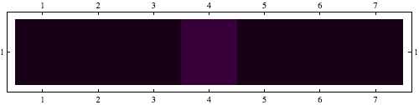
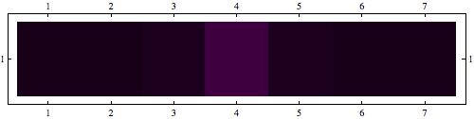
Cell Chains
K
K
K = 0.5
K = 2

Slide 11
Cell Chains
Kicked cell
Coupled cells

Slide 12
Cell Lattices
K

Slide 13
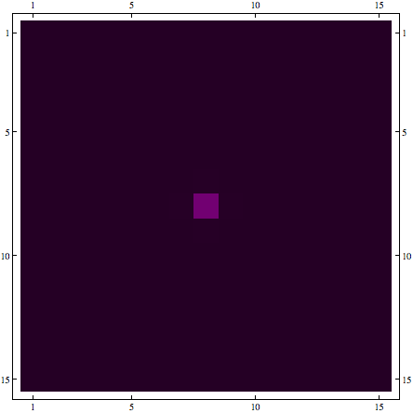

Cell Lattices
K = 0.5
K = 0.7

Slide 14
Cell Lattices
Kicked cell
Coupled cells

Slide 15
Conclusions
The system has two states:
Local excitation which does not spread across the entire tissue

Slide 16
Conclusions
Global excitation where all the cells in the tissue are excited

Slide 17
Conclusions
The transition between the two states has a coupling threshold and is instantaneous
Linearly coupled cells
Cell lattice

Slide 18
Conclusions
Excited cells follow the same voltage pathway over time
K = 5
K = 5

Slide 19
Further Work
Adjust starting parameters
K₁
K₁
K₂
K₁
K₂ >> K₁
Notes:
Are the initial conditions biologically accurate? Variable coupling values?
Didn't have much time to progress beyond setting up the models

Slide 20
Further Work
2. Remove resistor couplings at random

Slide 21



Thanks!
Thank you to:
    Hugo van den Berg
    MOAC
    EPSRC
Smith, R. Parturition. N Engl J Med. 1997, 356: 271-283.
Keener, J.; Sneyd, J. Mathematical Physiology; Springer-Verlag: New York, 1998.
Blanks,A.M. et.al. Myometrial function in prematurity. Best Pract Res Clin Obstet Gynaecol. 2007, 21(5): 807-819.

