Slide 1

Source Control in MATLAB
A tool for tracking changes in software development projects.
Stuart Nelis & Rachel Sheldon

Slide 2

Source Control
(A.K.A. Revision Control, Version Control)
The management of changes to documents, programs, and other information stored as computer files.
Used in software development where a team of people can edit the same files

Slide 3
Why Do We Use Source Control?
Allows programmers to work simultaneously on updates even when geographically far apart
Aids in the fixing of bugs as they are often only present in one version
Keeps track of who has made a change, and what change has been made

Slide 4
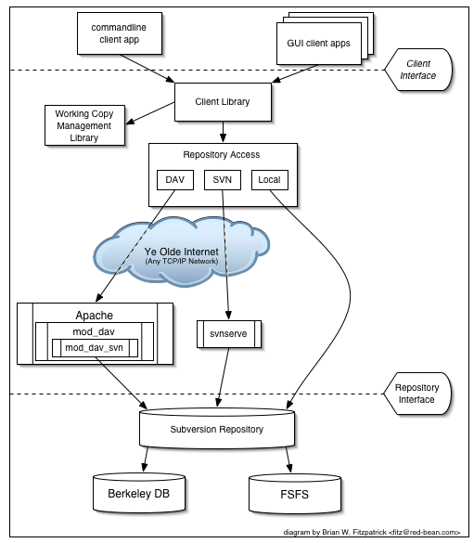

Slide 5
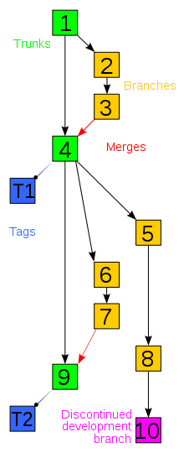
Version Development
BRANCH – A set of files under source control can be branched so two copies of the files can develop at different speeds
TRUNKS – The unique line of development that is not a branch
MERGES – Two sets of changes are applied to a set of files
TAGS – Denotes an important snapshot in time
WORKING COPY – Local copy of files from a repository, at a specific time or revision

Slide 6
Merging Scenarios
A user, working on a set of files, syncs his or her working copy with changes made.
A user tries to check-in files that have been updated by others since the files were checked out. The revision control software automatically merges the files.
A set of files is branched, a problem that existed before the branching is fixed in one branch, and the fix is then merged into the other branch.
A branch is created, the code in the files is independently edited, and the updated branch is later incorporated into a single, unified trunk.

Slide 7
Software Showcase
MATLAB has tools for utilising external source control software which can be set in the preferences and extended through plugins
We will be looking at:
Subversion (SVN) – Open source software
svnX – Open source GUI for SVN
MATLAB Interface

Slide 8
Demo Time

Slide 9
Any Questions?

