Slide 1
Molecular Dynamics Investigation of Biomimetic Antifreeze Macromolecules
Sarah-Jane Richards
Supervised by Dr. Rebecca Notman

Slide 2
What is the Scientific importance of the project?
Cryopreservation of biological materials.
Blood cell, stem cells and even whole organs¹.
Traditionally - Glycerol or DMSO²
Very expensive, large concentrations
Alternatively Antifreeze glycoproteins
1. Nutt, D. R.; Smith, J. C., J. Am. Chem. Soc., 2008, 130, 13066
2. Matsumura, K.; Hyon, S.-H., 2009, 30, 4842.

Slide 3
What are Antifreeze Glycoproteins and Why are they Important?
Prevent polar fish from freezing in Antarctic conditions¹.
1. Matsumura, K.; Hyon, S.-H., Biomaterials, 2009, 30, 4842.

Slide 4


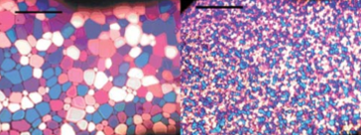
What are the antifreeze properties they show?
Thermal Hysteresis¹
Dynamic Ice Shaping²
Recrystallisation Inhibition¹
Potential Cryopreservant
1. Gibson, M. I., Polym. Chem., 2010, 1, 8, 1141
2. Tachibana, Y.; Fletcher, G. L.; Fujitani, N.; Tsuda, S.; Monde, K.; Nishimura, S-I., Angew. Chem. Int. Ed. 2004, 43, 856-856.

Slide 5
Why are glycoproteins not currently used?
Difficulties with obtaining them from natural sources¹
Challenges of total synthesis²
1. Tachibana, Y.; Fletcher, G. L.; Fujitani, N.; Tsuda, S.; Monde, K.; Nishimura, S-I., Angew. Chem. Int. Ed. 2004, 43, 856-856.
2. Heggemann, C.; Budke, C.; Schomburg, B.; Majer, Z.; Wiβbrock, M.; Koop, T.; Sewald, N., Amino Acids, 2010, 38, 213.

Slide 6
How has this been overcome?
Mimics of AFGPs^{1,2}
Gibson Lab have been synthesising glycotripeptides
However, their mechanism of action is unknown.
Aim: To use Molecular Dynamics to help elucidate mechanism of action
1. Gibson, M. I.; Barker, C. A.; Spain, S. G. et al., Biomacromolecules, 2009, 10, 2, 328.
2. Tam, R. Y.; Rowley, C. N.; Petrov, I.; Zhang, T.; Afagh, N. A.; Woo, T. K.; Ben, R. N., J. Am. Chem. Soc., 2009, 131, 15745

Slide 7
Why are Molecular Dynamics simulations important?
They can help elucidate the mechanism of action.
They can suggest a conformation of these peptides.
Help design and optimise biomimetic polymers.

Slide 8
What have I been simulating?
4 sugar functionalised peptides.
Effect of number of hydroxyl groups
Stereochemistry

Slide 9
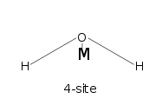
How did I go about the simulations?
All-atom model
Introducing the monosaccharides
TIP4P/ICE
NPT simulations for 100 ns at two temperatures
Analysis - Cluster Analysis
- Hydrogen Bonding
- Solvent Accessible Surface Area

Slide 10
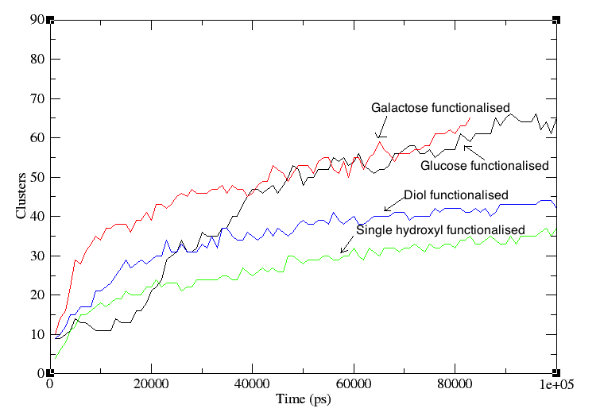
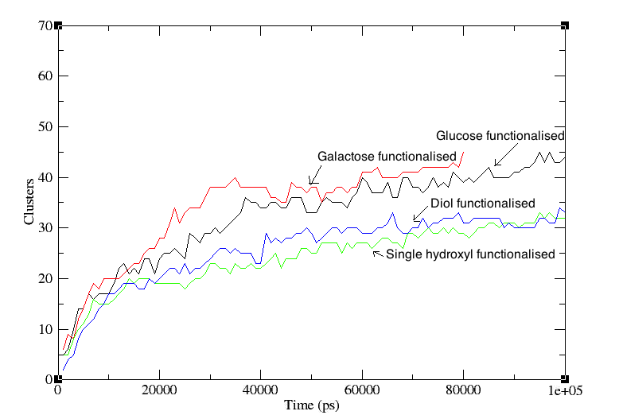
Cluster Analysis
298 K
267 K

Slide 11
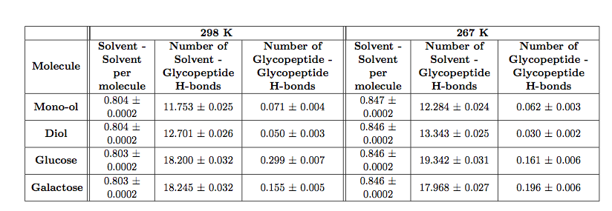
Hydrogen Bonding Analysis
Water 298 K 0.804 ± 0.0002 H-bonds
Water 267 K 0.847 ± 0.0002 H-bonds
Ice 267 K 1.000 ± 0.0002 H-bonds

Slide 12
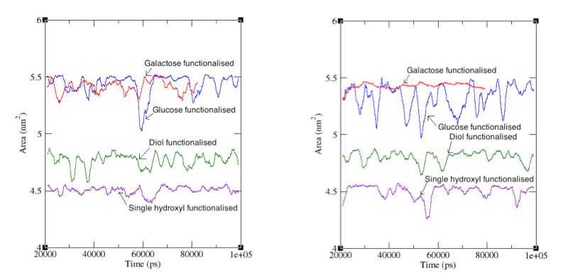
Solvent Accessible Surface Area
298 K
267 K

Slide 13
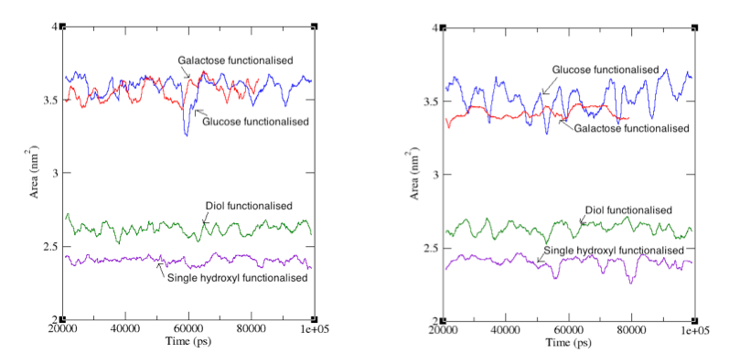
Solvent Accessible Surface Area
298 K
267 K

Slide 14
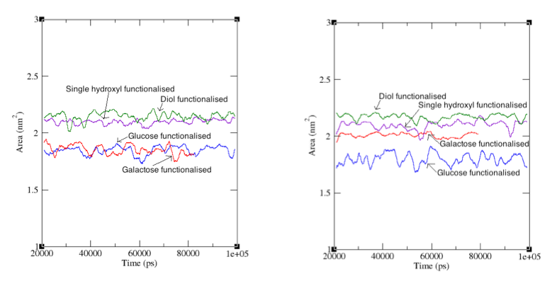
Solvent Accessible Surface Area
298 K
267 K

Slide 15
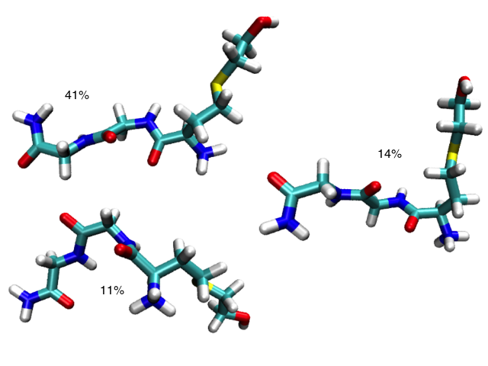
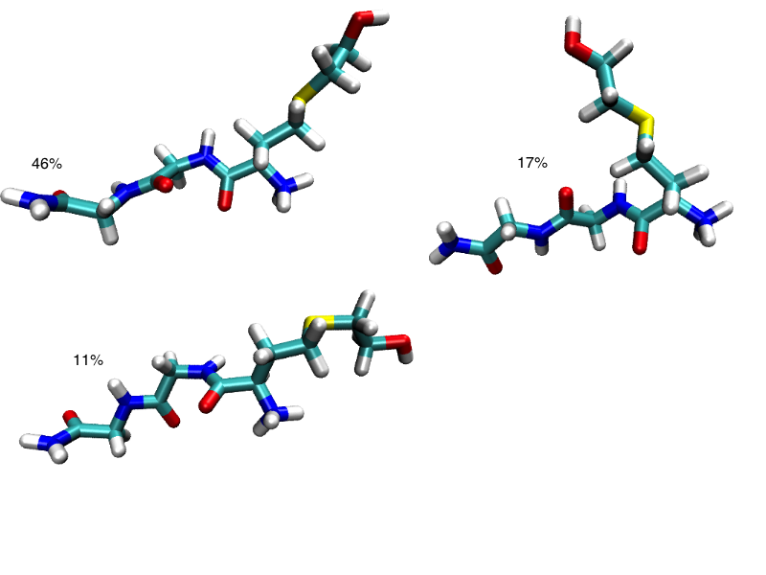
Further Cluster Analysis
298 K
267 K

Slide 16
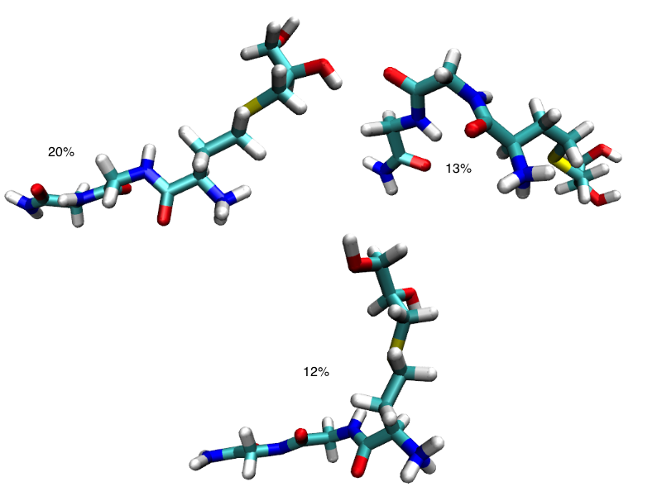
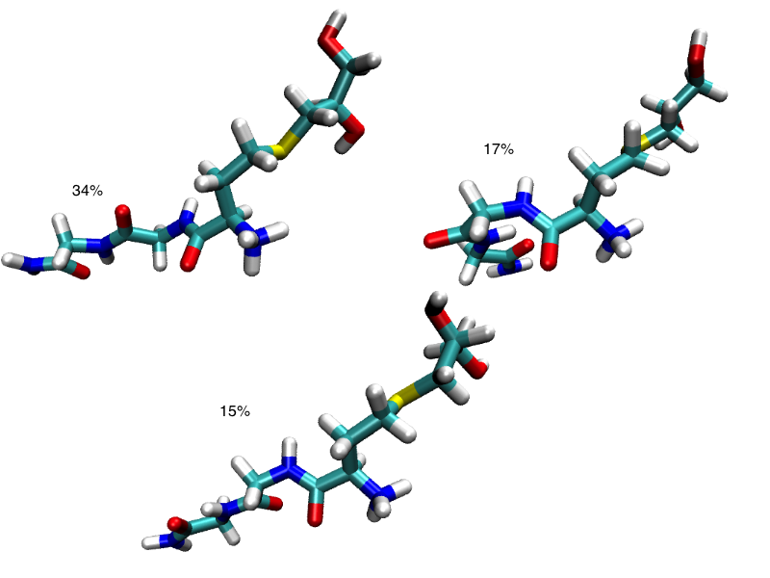
Further Cluster Analysis
298 K
267 K

Slide 17
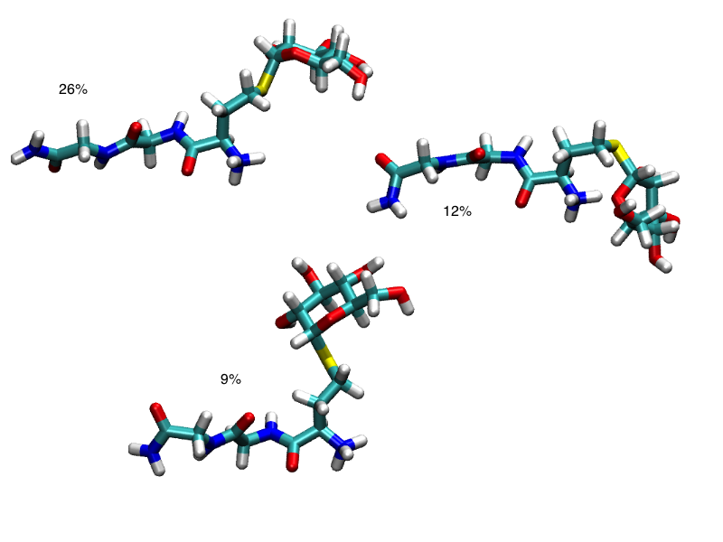
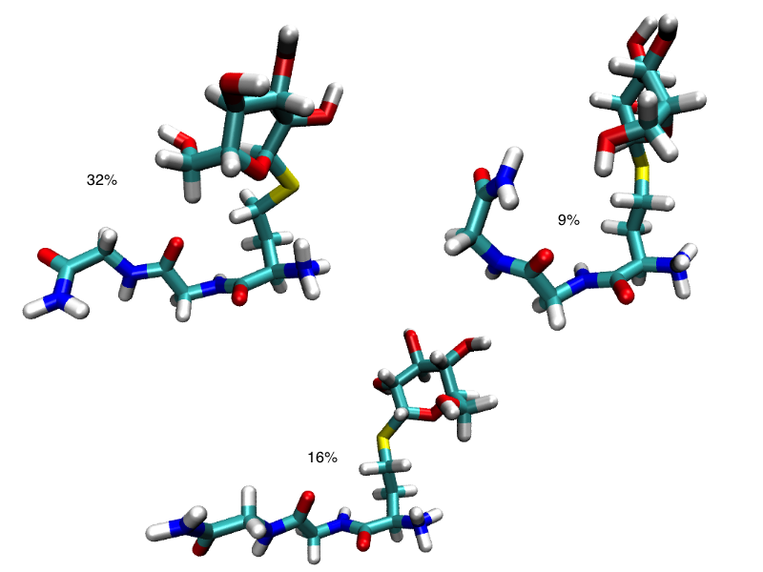
Further Cluster Analysis
298 K
267 K

Slide 18
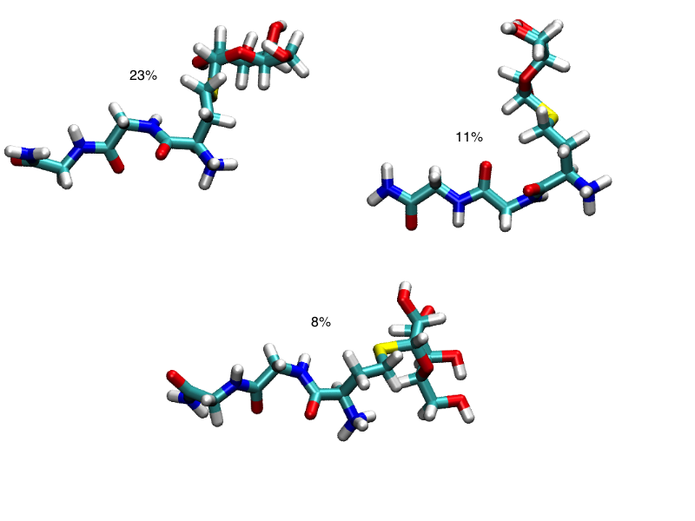
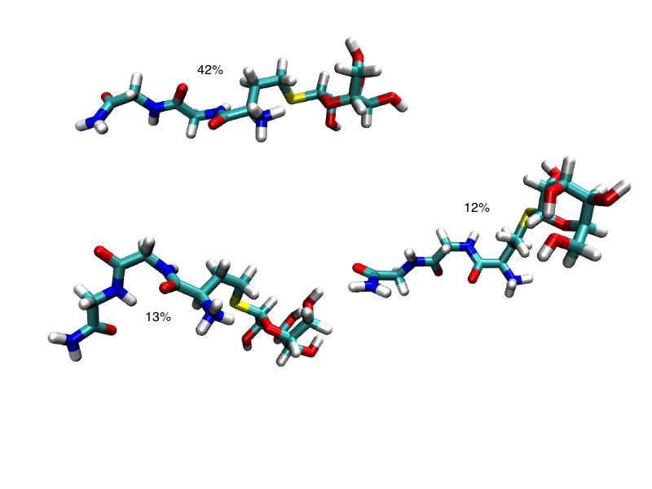
Further Cluster Analysis
298 K
267 K

Slide 19
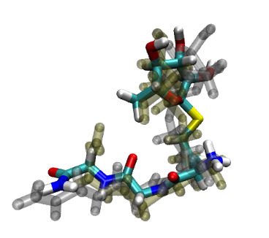
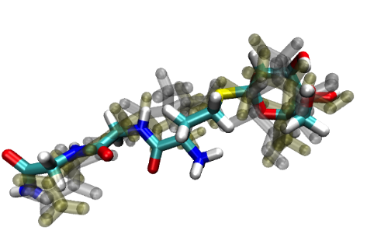
What can we conclude from these results?

Slide 20
Acknowledgements
Thank you to Becky and Matt for putting the project together.
Thanks to Becky for her support throughout the project.
Thanks to Sang and Anthony for making the write-up room a bit more interesting.

Slide 21
Thank you for listening!

