Slide 1

Cloning and Expression of Transcriptional Repressors in Escherichia coli
Sarah-Jane Richards¹
Supervised by Dr. Christophe Corre²
1. MOAC DTC
2. The Chemistry Department
The University of Warwick
Notes:
Experimental biology miniproject on cloning and expression of T.R in E.coli

Slide 2
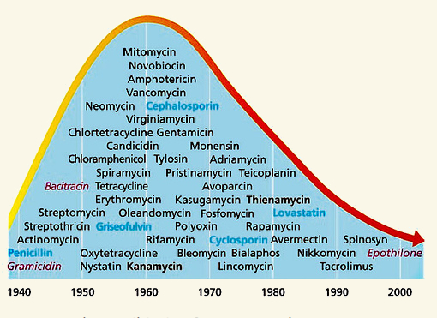
The Problem
Antibiotics
Decrease in number of antibiotics developed.¹
Increase in the resistance to
antibiotic.²
Fischbach, M.A.; Walsh, C.T., Science, 2009, 325, 1089-1093
Barbosa, T. M; Levy, S.B, Drug Resistance Updates, 2003, 3, 303-311
Notes:
Most prescribed
Decrease in development
Increase in resistance
Need for new antibiotics

Slide 3
Background
Streptomyces
Produce over 70% of the antibiotics commercially available.
Following the sequencing of entire Streptomyces genomes, an unexpectedly large number of antibiotic-like gene clusters were found to be encoded.
These biosynthetic genes are often not expressed under laboratory culture conditions.
D.A. Hopwood, ‘Streptomyces in Nature and Medicine: The Antibiotic Markers’ 2007, New York, Oxford University Press.
Notes:
Gram-+ve filamentous, soil-dewelling bacteria which produces 70% of commercially available antibiotics
Following sequencing of entire strep genomes an unexpectedly large number of antibiotic gene clusters were found to be encoded.
However, not expressed under normal lab conditions

Slide 4
Previous Research
Antibiotic Production
Antibiotic production is tightly controlled and regulated by transcriptional repressors and signalling molecules.¹
Ligand
Promoter region
+ Ligand
gene not transcribed
gene transcribed
ArpA-like protein bound to DNA
ArpA-like protein bound to ligand
Corre, C.; Song, L.; O’Rourke, S.; Chater, K.F.; Challis, G. L. Proc. Natl Acad. Sci. USA., 2008, 105, 17510-17515
Notes:
This is because they are tightly controlled by transcriptional repressors and signalling molecules.

Slide 5
Previous Research
Transcriptional Repressors
Consist of two domains:
DNA binding domain
Ligand binding domain
Signalling molecules¹:
γ-butyrolactones (GBLs)
2-alkyl-4-hydroxymethylfuran-3-carboxylic acids (AHFCAs)
O’Rourke, S.; Wietzorrek, A.; Fowler, K.; Corre, C.; Challis, G.L.; Chater, K.F., Mol Microbiol, 2009, 71, 763
Notes:
T.R consist of a DNA binding domain and a ligand binding domain
Found to respond to GBLs such as A-factor and AHFCAs such as MMF1

Slide 6
Aim
Biosynthetic gene clusters
mmfR
mmyR
S. coelicolor
savR
savR2
S. avermitilis
smdR
smdR2
S. venezuelae
ArpA-like response element
Genes coding for ArpA-like proteins
biosynthetic
genes
Notes:
The schematic of the biosynthetic pathway which controls the production of MMF1 and is controlled by MMF1 is shown and is found in the academic model streptomyces strain S. coelicolor.
Homologues in S. av and S. ven which I will be working on.

Slide 7
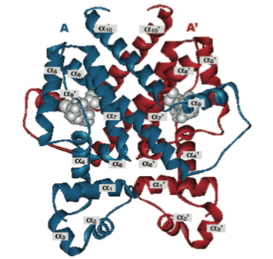
Aim
Structural Elucidation
To contribute to understanding the molecular interactions of ArpA-like proteins.
Homodimer of CprB, an ArpA homolog.¹
Horinouchi, S., Biosci, Biotechnol., Biochem., 2007, 71, 2, 283-299
Notes:
The aim is to clone and express these T.R so that they can be used to further study their structure and biding to DNA and ligands.
Currently only one crystal structure of these proteins
No structures of ligands bound.

Slide 8
Approach
Cloning and Expression
Amplify Genes
Insertion into expression vector
Determine correct insertion
Overexpression in E. coli
Overproduction of proteins
Purification of soluble proteins
Notes:
The approach taken is to:
Amplify genes
Insert into expression vector and transform in E. coli
Determine that gene is in fact present
Overexpress
Overproduce
purify

Slide 9
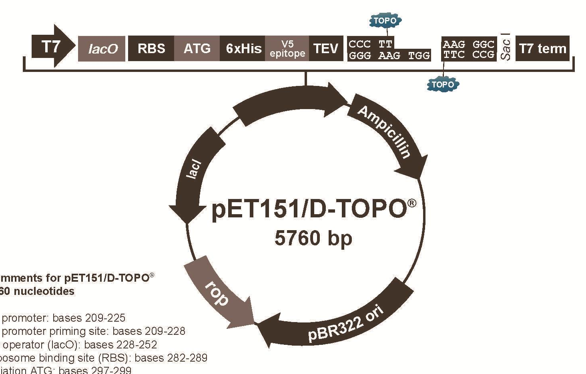
Approach
Expression Vector
T7 Promoter
smdR2 (620 bp)
200
400
600
Histidine Tag
CACC overhang
and topoisomerase
Ampicillin resistance gene
Notes:
Talk a little about the expression vector
pET151 topo expression vector
Gene primers were designed with a CACC overhang for insertion and topo vectors are more efficient at gene insertion that traditional methods using restriction enzymes and ligation enzymes.
The T7 promoter allows transcription of the gene once induced.
The histadine tag allows for purification
The amp resistance is to select only for the plasmids with my gene inserted.

Slide 10
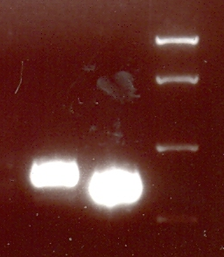
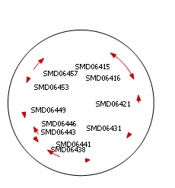
Results
Results
Gene Amplification
S. venezulae
smdR 731 bp
smdR2 620 bp
smdR
smdR2
ladder
5000 bp
2000 bp
850 bp
400 bp
Notes:
Gene was amplified using polymerase chain reaction (PCR). The DNA template used was a cosmid. Circular DNA containing all useful genomic DNA.
Electrophoresis gel showed the correct sized band of my amplified genes

Slide 11
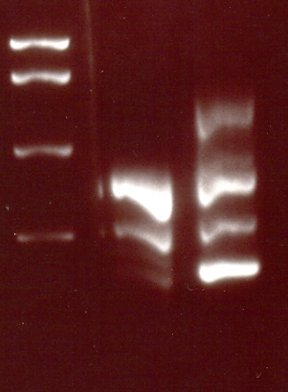
Results
S. avermitilis
savR
ladder
savR2
Amplification of savR and savR2
From genomic DNA
5000 bp
2000 bp
850 bp
400 bp
Notes:
S. av was amplified using genomic DNA
First attempt showed unspecific binding of primers leading to multiple bands

Slide 12
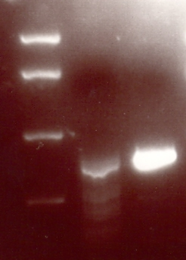
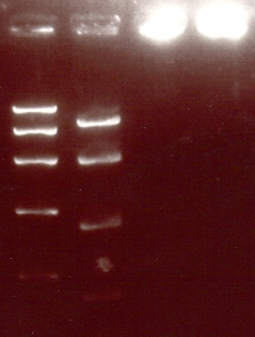
Amplification
Results
savR
ladder
savR2
Increase annealing temperature
Decrease DNA template
5000 bp
2000 bp
850 bp
400 bp
Notes:
An increase in annealing temp was tired to attempt more specific binding – did not work
Decrease the DNA template – worked for savR2

Slide 13
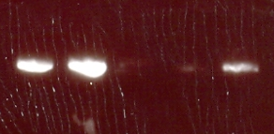
Results
Determining Correct Insertion
T7 Primers
smdR2 (620 bp)
smdR2
200
400
600
x
v
w
+ve controls
Notes:
Inserted smdR2 into expression vector, transformed in e.coli and clones were cultured overnight
PCR was carried using T7 primers to amplify the gene region.
The was run against a +ve control of similar size which was a plasmid known to contain the mmfR and mmyR genes.
W and x show amplification.

Slide 14

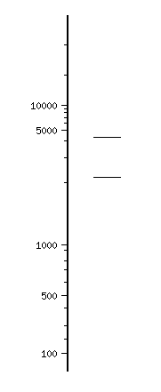
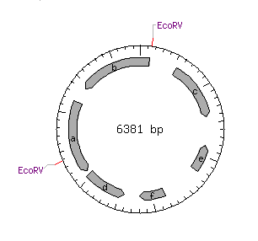
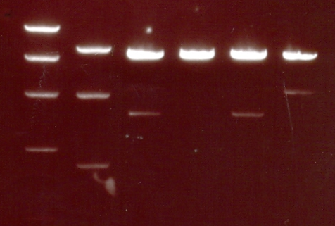
Results
Determining Correct Insertion
ladders
x
y
w
v
10000 bp
5000 bp
4000 bp
2000 bp
1000 bp
850 bp
Notes:
Further insertion determination was done using restriction enzymes.
Web program called nebcutter was used to show enzymes which cut my DNA.
EcoRV was found to cut in two places showing bands at ~4000 and ~2000.
The agrose gel showed w had the correct bands.

Slide 15
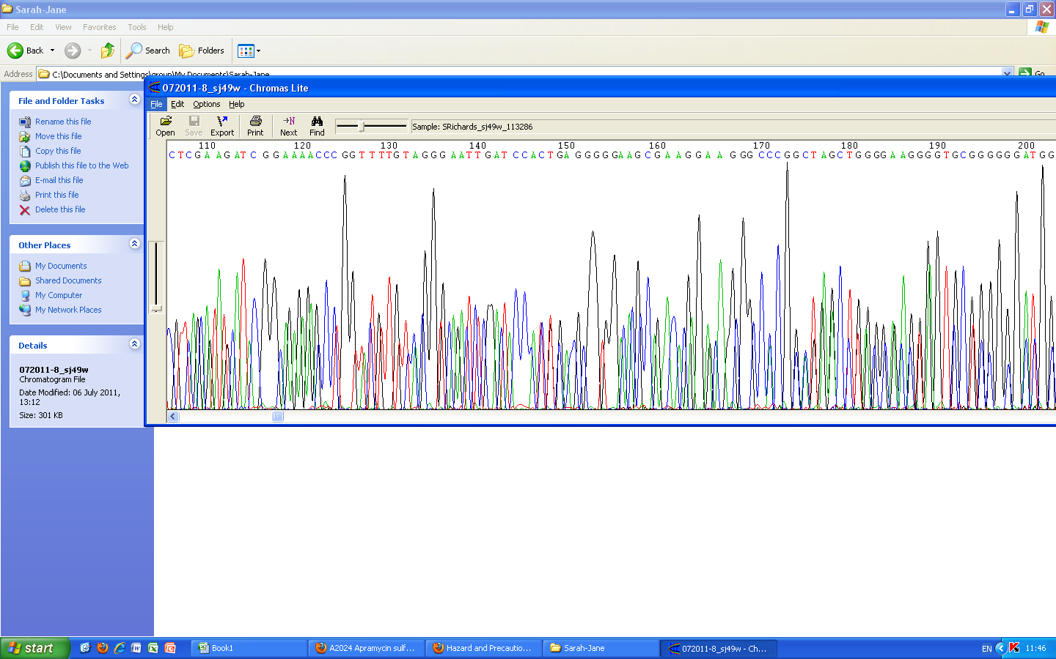
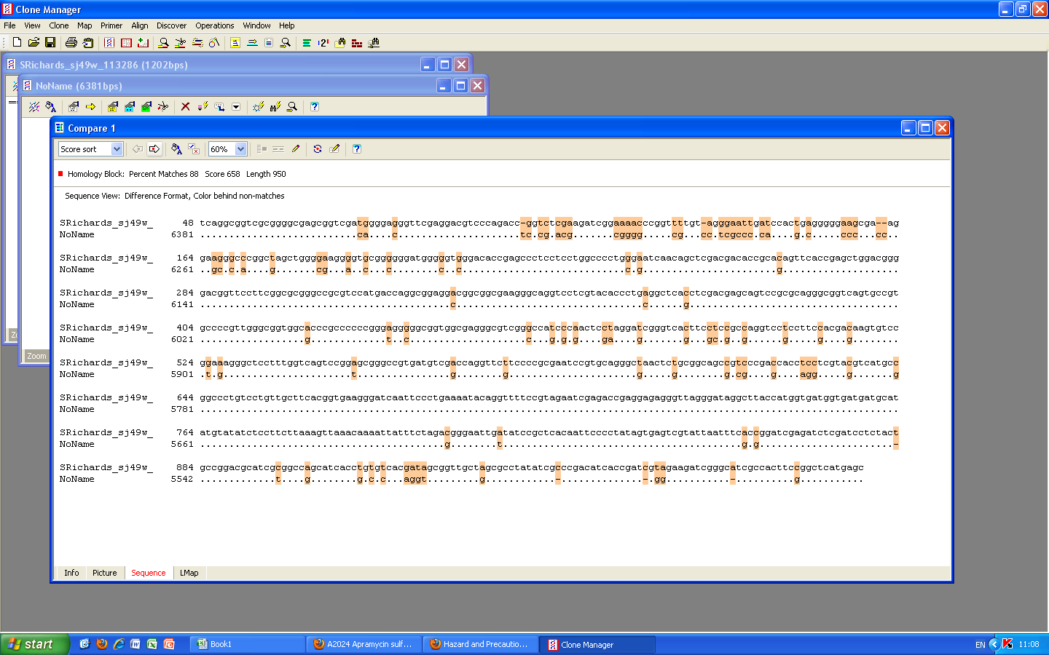
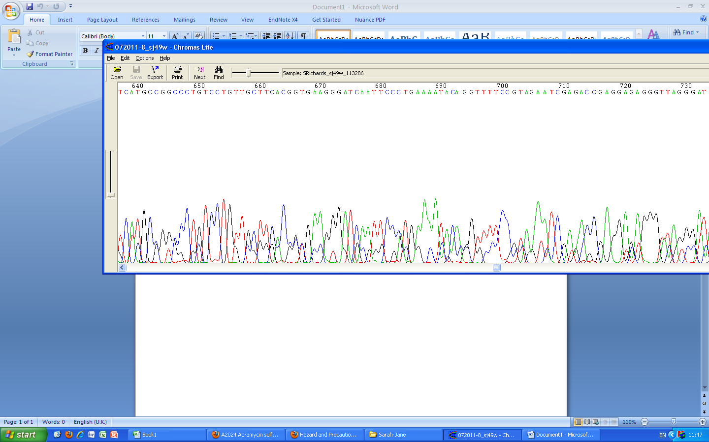
Sequencing
Results
88%
Good
Poor
Notes:
Sequencing was carried out in life sciences to determine the correct insertion to the native
88% homology was obtained. The shows that my gene is in there, but there are more mistakes than expected. There were good regions where there are sharp peaks and it is obvious which is the correct base and areas of poor sequencing where it is less obvious which base it is. At all the wrong points I checked and it appeared to be poor sequencing so it was deemed okay to carry on. Better sequencing is being carried out though.

Slide 16
Overproduction
Results
Transformation into E. coli BL21star
Overnight culture of clone
Scaled up culture
Induced using IPTG
Overproduction overnight
Purification
Notes:
Plasmid was transformed into E. coli BL21 star which is a high performance strain for increased yields with t7 promoter vectors
Clones were cultured overnight and the culture was scaled up until an appropriate opitical density was reached. Then it was induced and left to produce proteins overnight and then soluble proteins were purified.

Slide 17
Results
Purification
Soluble proteins
Imidazole
His-tagged proteins
Ni²⁺
cartridge
Ni²⁺
cartridge
His-tagged proteins
All other proteins
Notes:
The purification was carried out using FPLC and a nickel cartridge.
A french press was used to lyse the cells and release the proteins.
Soluble proteins were purified. All protiens go it, histidine-tagged protiens stick to the column ans all others are eluted as waste.
Then the proteins are eluted with imidazole. The imidazole competes with the histidine for the nickel and the his-tagged proteins are released.

Slide 18
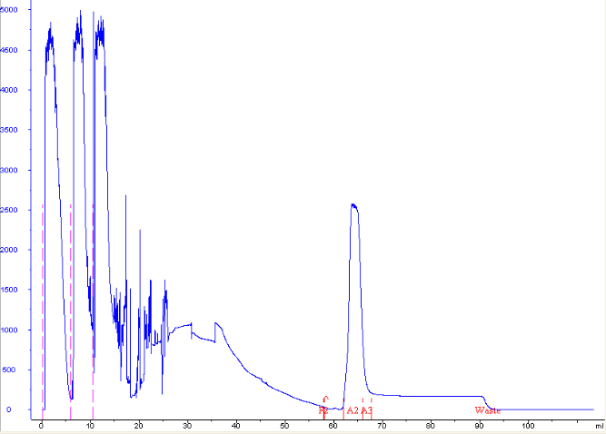
Results
Purification
All other proteins
Absorbance at 280 nm
His-tagged SmdR2
Washing
Elution
Notes:
The FPLC trace obtained.
3 injections and the absorbance at 280nm shows all the proteins released
Elution shows the histagged fraction and shows that my protein is in the soluble fraction.

Slide 19
Conclusions
Conclusions
Conclusion
Shown that transcriptional repressors can be cloned and expressed.
Due to being soluble, can now be used to further study.
A detailed understanding of the structure-activity relationships involved in ArpA-like protein binding to signalling molecules and DNA will be very important in the future of antibiotics.

Slide 20
Future Work
Still to do…
Determine insertion of smdR and savR2
Transform plasmids with the correct insertion
Overproduce proteins
Purify soluble proteins
Notes:
I still have a week left on the project so smdR and savR2 genes have been inserted and the process used for smdR2 can be followed.

Slide 21
Future Work
Future Work
Suggestion for Future Work
Electrophoretic Mobility Shift Assays (EMSA)
Co-crystallisation
Notes:
Suggestions for future work are to use electrophoretic mobility shift assays to determine signalling molecule response
Carry out crystallisation trial to obtain crystal structures and co-crystallisation to shown ligand binding.

Slide 22


Acknowledgements
Dr. Christophe Corre
The Corre Group
The Challis Group
EPSRC
MOAC
And you for listening!
Notes:
I would like to thank Christophe for his supervision
The corre and challis groups for welcoming me into their lab
The EPSRC and MOAC for providing the funding and allowing me to carry out the project
And you all for listening!

