Slide 1


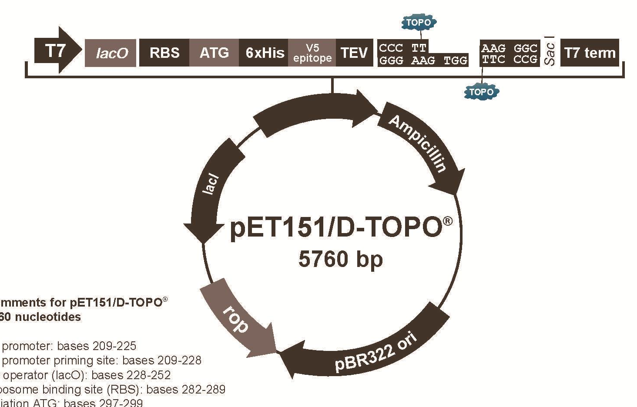
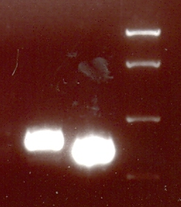
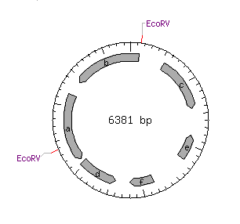
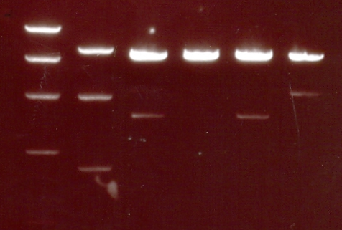
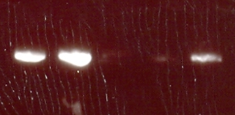

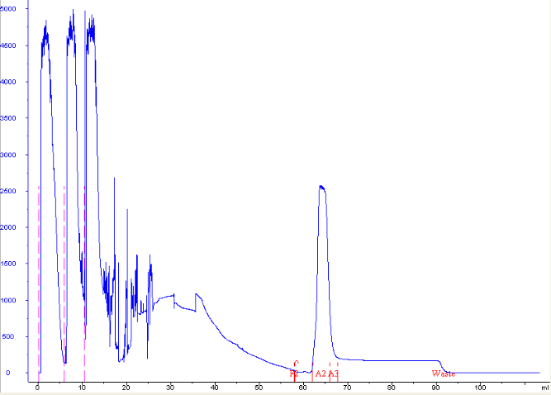
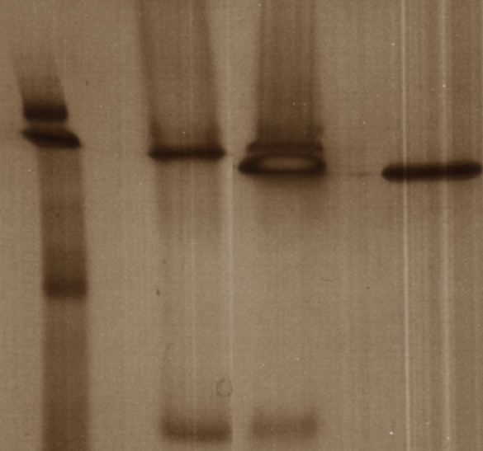


Cloning and Expression of Transcriptional Repressors in Escherichia coli.
Sarah-Jane Richards S-J.Richards@Warwick.ac.uk Supervised by Dr. Christophe Corre
1. MOTIVATION
EXPERIMENTAL RESULTS
CONCLUSIONS
Antibiotics are among the most frequently prescribed medications in modern medicine. However, there has been a decrease in the discovery of new antibiotics and an increase in antibiotic resistance. Therefore, there is a growing need for the discovery of new antibiotics. Following the sequencing of entire Streptomyces genomes, an unexpectedly large number of antibiotic-like gene clusters were found to be encoded¹.
This project aims at cloning genes that encode for four distinct ArpA-like proteins from S. avermitilis and S. venezuelae. The genes were amplified (Figure 4) and sub-cloned down-stream of a strong promoter in an inducible expression vector (pET151) (Figure 3).
Figure 3: Schematic of the S. venezuelae genes
Insertion into an inducible expression vector.
The gene smdR2 was inserted into the vector and the plasmid was transformed in E. coli. The correct construct insertion was determined by PCR using T7 primers (Figure 5) and restriction enzyme digestion using EcoRV (Figure 6). Once the correct insertion was established the inserted gene was sequenced to confirm that it was identical to the native ones.
It has been shown that transcriptional repressors can be cloned and expressed.
The protein has been shown to be soluble so now can be used for further study.
A detailed understanding of the structure-activity relationships involved in ArpA-like protein binding to signalling molecules and DNA will be very important in the future of antibiotics.
200
smdR2 (621 bp)
Expected size
smdR
smdR2
ladder
400
600
5000 bp
2. INTRODUCTION
2000 bp
These biosynthetic genes are often not expressed. The regulation of these genes have been found to be controlled by signalling molecules such as γ-butyrolactones (GBLs) or by the recently discovered 2-alkyl-4-hydroxymethylfuran-3-carboxylic acids (AHFCAs)². They are thought to interact with, and change the characteristics of, transcriptional repressor proteins that belong to the ArpA-subfamily of the TetR proteins³. They have two domains:
• A DNA-binding domain that recognise specific DNA sequences in promoter
regions.
• A ligand binding domain that interact with specific molecules.
731 bp
850 bp
621 bp
400 bp
SUGGESTIONS FOR FUTURE WORK
Figure 4: Amplified smdR and smdR2 genes for insertion into the pET151 expression vector.
Crystallisation trials can be set up on the soluble proteins. A crystal structure of the ligand bound will give insight into the conformational change that occurs allowing the transcription of the previously repressed genes.
DNA binding assays, such as Electrophoretic Mobility Shift Assays (EMSA) can be used to identify ligands which lead to the release of the repressors from the specific DNA sequence ArpA-like response region (Figure 2).
Promoter region
+ Ligand
Ligand
ladders
x
y
w
gene not transcribed
gene transcribed
x
EcoRV
v
v
w
ArpA-like protein bound to DNA
ArpA-like protein bound to ligand
+ve controls
10000 bp
5000 bp
Figure 1 : Schematic of the proposed mode of action ArpA-like proteins induced by ligands
Upon binding of a signalling molecule, repressors are released from the promoter region of the target gene, which is then transcribed.
4000 bp
REFERENCES
EcoRV
2000 bp
Expected size:
4237 bp
2144 bp
1000 bp
D.A. Hopwood, “Streptomyces in Nature and
Medicine: The Antibiotic Makers” 2007, New York, Oxford University Press
2. C. Corre, L. Song, S. O’Rourke, K.F. Chater, and G.L. Challis, Proc. Natl Acad. Sci. USA, 2008, 105, 17510.
3. S. O’Rourke, A. Wietzorrek, K. Fowler, C. Corre, G.L. Challis and K.F. Chater. Mol. Microbiol., 2009, 71, 763.
The TetR family of transcriptional proteins is widely and extensively present in Streptomyces. This project will investigate transcriptional repressors in S. avermitilis and S. venezuelae which have related repressors to those found in S. coelicolor.
Figure 2 : Transcriptional repressor genes in S. coelicolor, .S. avermitilis and S. venezuelae
A detailed understanding of the structure-activity relationships involved in ArpA-like protein binding to signalling molecules and DNA will be very important in the future of antibiotics.
850 bp
Figure 5: Amplified smdR2 from plasmids.
Figure 6: Restriction enzyme digest of plasmids using EcoRV. Expected size shown using plasmid schematic
S. coelicolor
mmfR
mmyR
The correct construct (w) was chemically transformed into E. coli BL21 star. The protein was overproduced in E. coli by induction with IPTG. A French press was used to lyse the cells and release the proteins and purification was carried out on soluble proteins using a Ni²⁺ cartridge to trap the histidine-tagged proteins. (Figure 7). Figure 8 shows a native polyacrylamide gel of the purified SmdR2.
S. avermitilis
avaR
avaR2
ladder
SmdR2
ACKNOWLEDGEMENTS
S. venezuelae
smdR
smdR2
All other soluble proteins
His-tagged SmdR2
I would like to thank the EPSRC for funding me through the MOAC DTC course and therefore enabling me to carry out this project.
I would like to thank Christophe for the day to day management of the project.
ArpA-like response region
AHFCA biosynthetic genes
Genes coding for ArpA-like proteins
Absorbance at 280 nm
Figure 7: Absorbance at 280 nm to show purification of protein.
Figure 8: Native polyacrylamide gel of SmdR2

