Slide 1
Motorisation of Centrosome Separation
Steve Norton

Slide 2
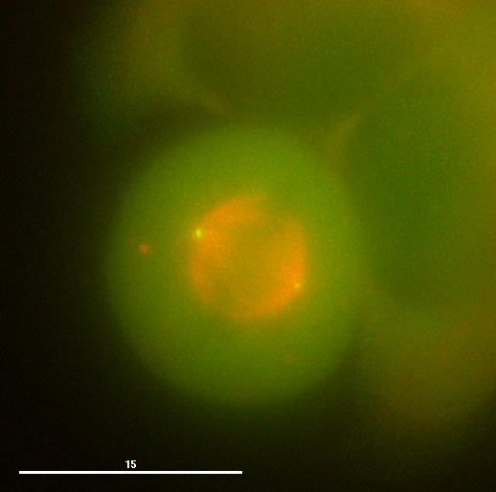
The Centrosome
Microtubule organising centre during mitosis
One positioned either side of the mitotic spindle
Microtubules used to pull kinetochores apart – divide DNA between daughter cells

Slide 3
The Centrosome Cycle

Slide 4
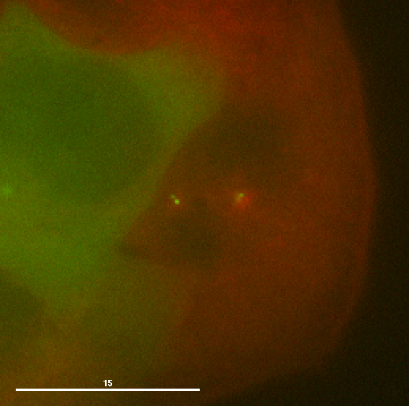
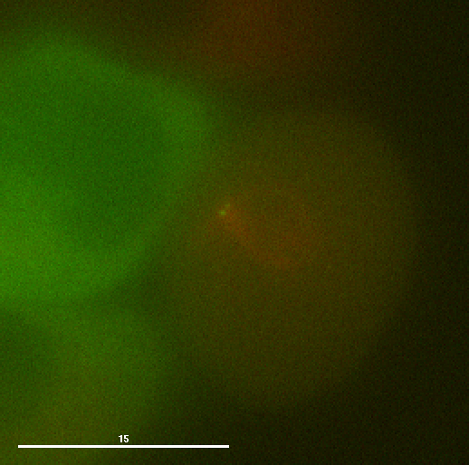
The Question…
How do centrosomes get from their position together, next to the nucleus, to being spread 10 μm apart around the spindle?

Slide 5
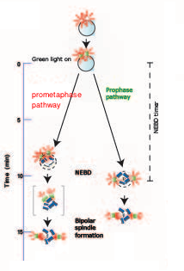
Pathways to Separation
Centrosomes can separate at different times - before, or after nuclear envelope breakdown - the prophase and prometaphase pathways

Slide 6
Aims of the Project
To observe centrosome movements in live cells during prophase
To observe patterns in centrosome separation behaviour
To make preliminary deductions about motors involved in the process

Slide 7
Methods
HeLa cells cultured
Expressing Centrin fused to GFP and α-tubulin fused to mCherry
Live-cell imaging: capture stacks through single cells at approx. 15 second intervals

Slide 8
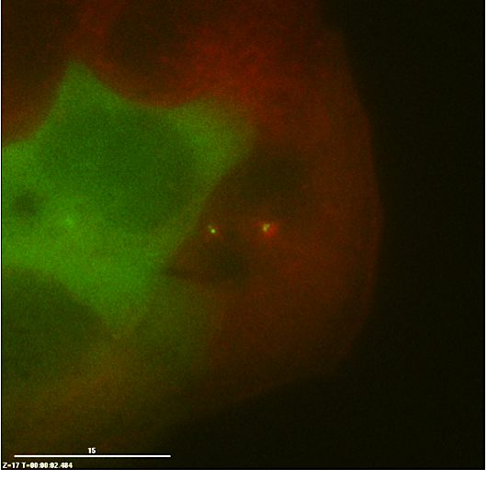
Choosing the Cells
Centrosomes and early asters should be visible…
But the nucleus should still be intact

Slide 9
Movies Generated
Able to observe whole separation process in some cells.
Saw cells rounding up, centrosomes moving around nucleus, NEBD, centrosomes positioning themselves at spindle poles.

Slide 10
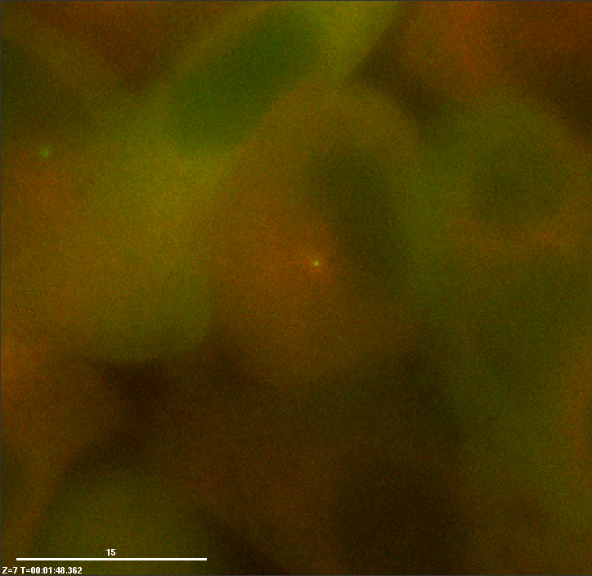
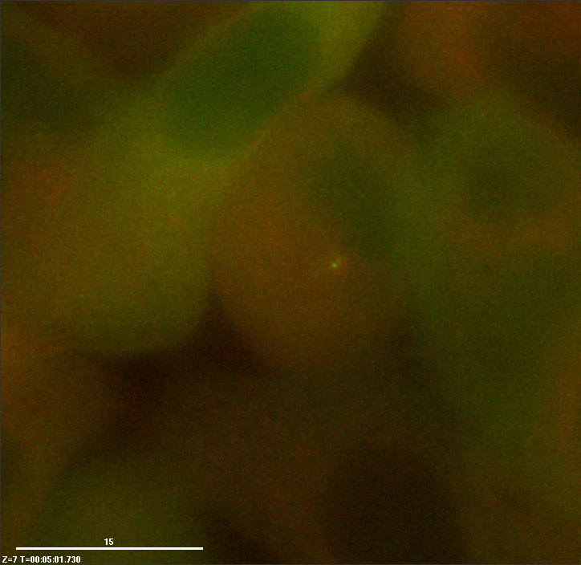
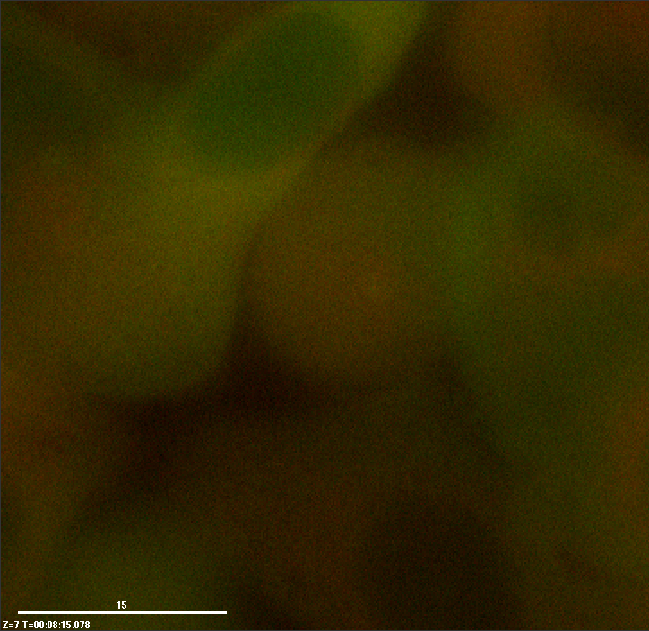
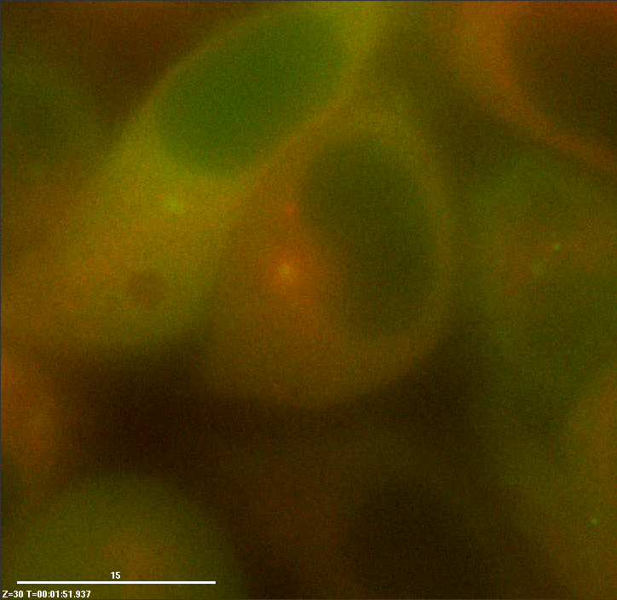
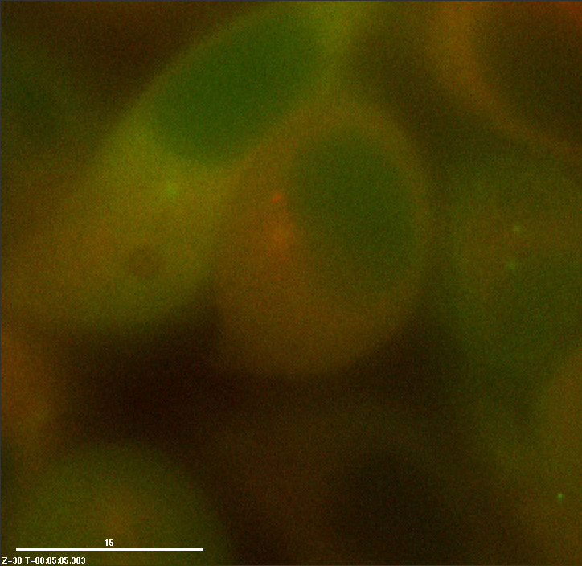
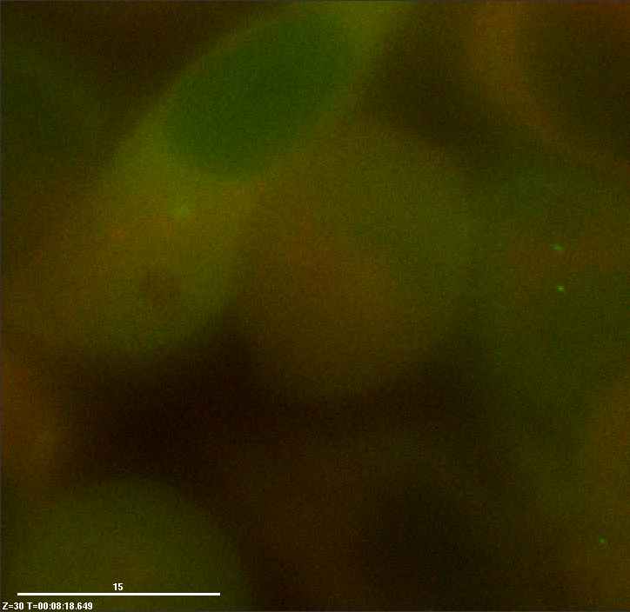
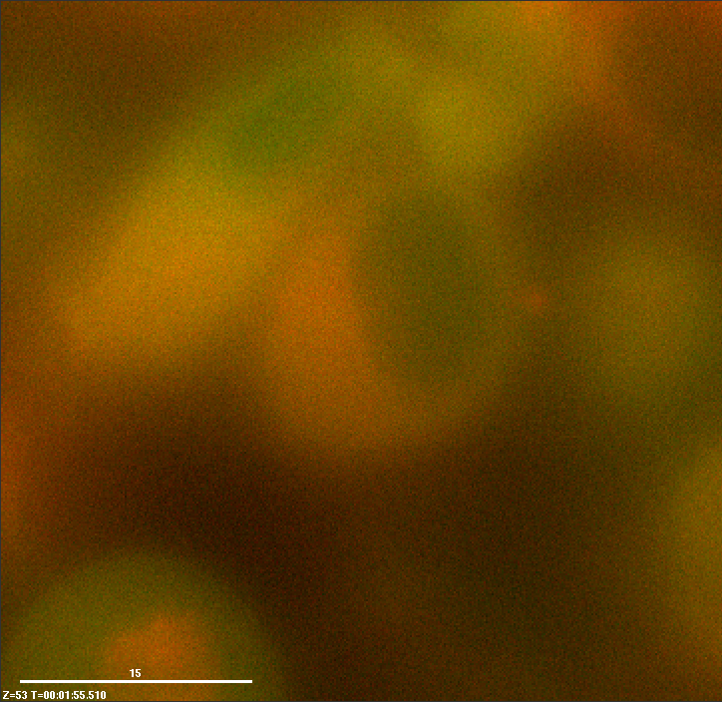
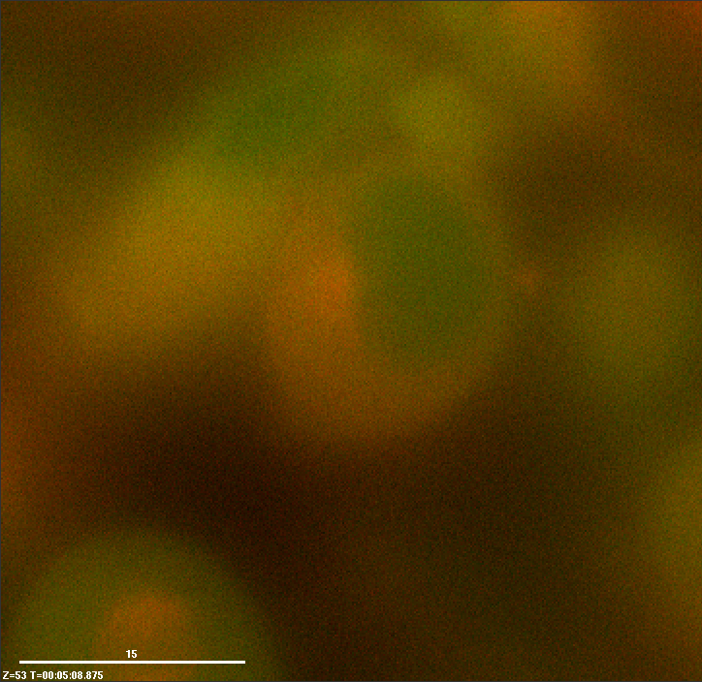
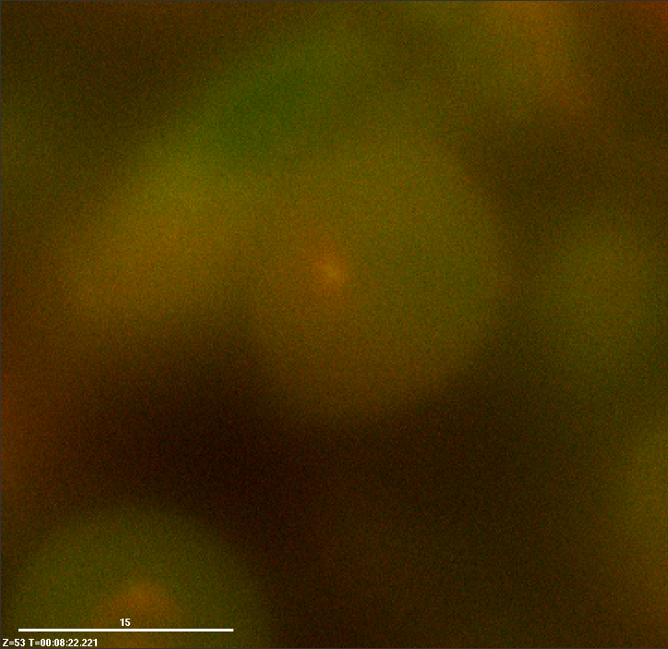
Time
At surface of LabTek
Away from surface

Slide 11
Separation over Time
Over the course of the movie, each cell’s centrosome separation was measured

Slide 12
Separation is Discontinuous
Separation happens in phases.
Not the same in every cell, but all cells show some phases of growth in separation, reduction of separation and phases of constant distance.

Slide 13
Cells 3 and 9 were prometaphase pathway (centrosomes keep growing apart long after NEBD).
All other cells prophase pathway.
Prophase pathway cells converged on separation distance of 7.41 μm (s.d. = 0.18 μm) 15 time steps after NEBD initiation. This isn’t the spindle length!

Slide 14
After converging to the 7.41 μm average separation, the centrosomes continue to move together and apart until they end of imaging. Average spindle length was 9.106 μm

Slide 15
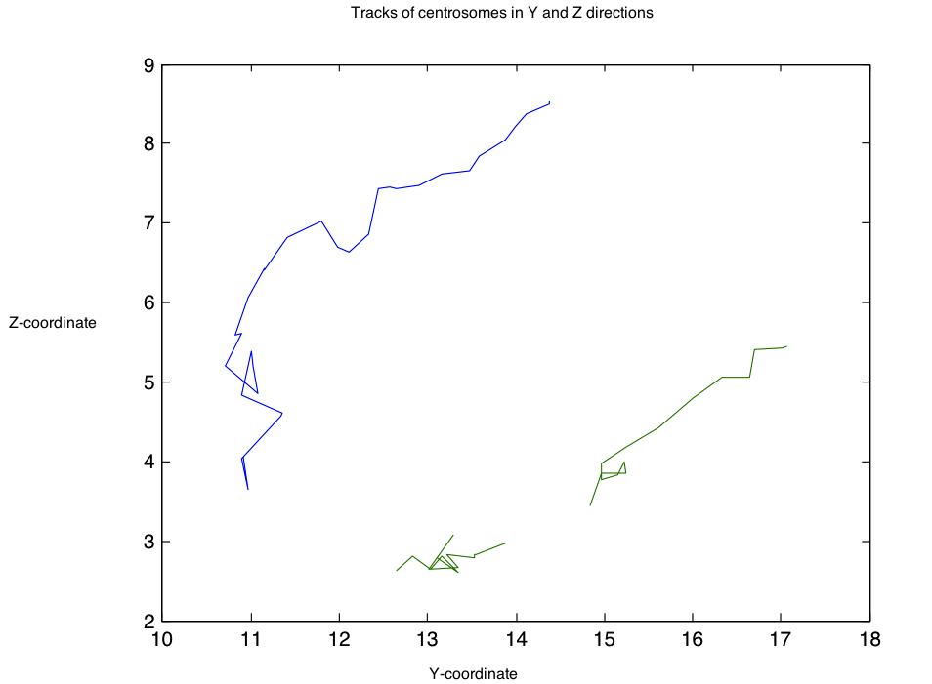
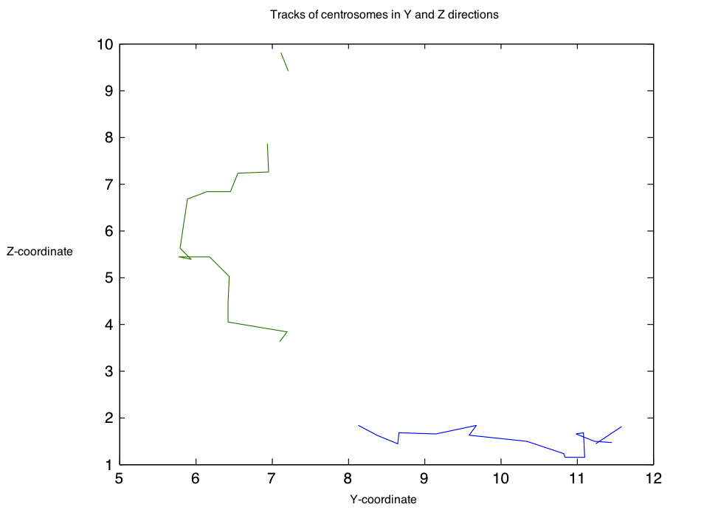
Automated Tracking
Applied Ed’s work on kinetochore tracking to centrosomes, with some success:
However, tracks were incomplete and not as good in all dimensions

Slide 16
Validation of Computer Measurements
Compared Cell 3 and Cell 6 centrosome distance measurements done manually, to those calculated by MATLAB:

Slide 17
Conclusions
Centrosomes separate discontinuously, not smoothly.
After NEBD they tend to a separation distance of 7.41 μm, though why is unclear.
After this convergence the centrosomes continue to move together and apart.
Computational tracking of centrosomes should be the best way to further these experiments in the future, perhaps needing better quality movies to work well.

