Slide 1
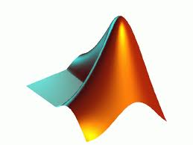
3D Plotting

Slide 2
Recap
Scripts
List of commands
Functions
Input and output
2D plotting
Plot( x, y, ’r’)

Slide 3
3D plotting
Need
x ,y, z coordinates of every point
z = f(x,y)
Then use various plotting routines
But the data (x, y, z points) needs to be in the right form.

Slide 4
3D Scatter Plot
Plot
z = sin(x +y)
For x and y between 0 and 10.
Use the plot3 command
>> x = 0:0.1:10;
>> y = 0:0.1:10;
>> z = sin(x+y);
>> plot3(x,y,z)

Slide 5
Plotting surfaces
We need to define the grid over which to plot
Then work out the value at each mesh point
Then plot
[x,y] = meshgrid(0:1:10,0:1:10);
z = x + y;
surf(x,y,z)

Slide 6
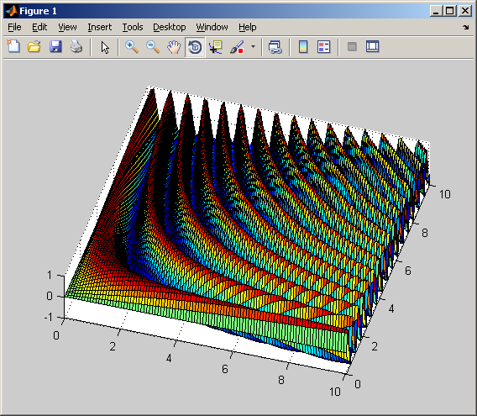
Task
Create a surf plot of
z = sin(x*y)
When x and y are between 0 and 10. Make the grid step size sensible (about 0.1)

Slide 7
Making 3D graphs pretty
>> shading('interp')
>> colormap('spring')
etc

Slide 8
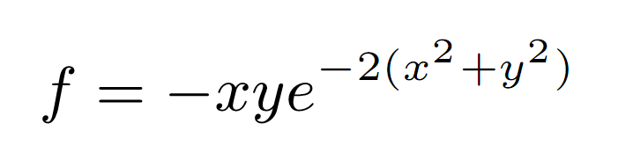

Plot a mesh and find the min and max values ( and their coordinates)

Slide 9
Find function
Finds the index of true values in an array
Find all entries, in array A, that equal 6
find(A==6)
So to find the max entry in A
A =[ 1 8 3 4 5 3]
>> find(A==max(A))
ans =
2

Slide 10
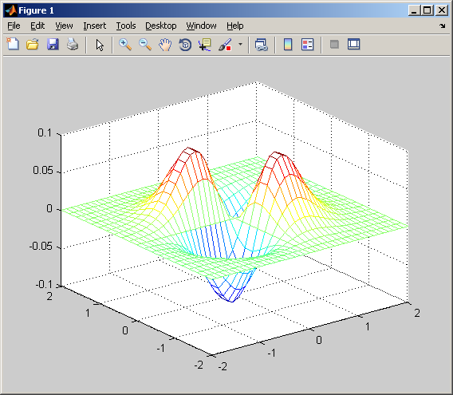

Slide 11
Write a function that accepts one array and plots it
Plot a 2D line graph if it vector
Plot a surface with a 2D array
Plot animation if a 3D array

Slide 12
Random things
If you want to know how long it takes for a function to run, use
Tic and toc
>> tic, mesh(X,Y,f), toc
Elapsed time is 0.152434 seconds.

Slide 13
...

Slide 14
Animate
z = sin(x*y*t)

