Slide 1
Matlab Tutorial (term 2, week 3)

Slide 2
Programming
Loop control:
- Continue: The continue statement passes control to the next iteration of the for loop or while loop in which it appears, skipping any remaining statements in the body of the loop.
e.g. counts the lines of code in the file magik.m, skipping all blank lines and comments.
fid = fopen('magik.m','r');
count = 0;
while ~feof(fid)
line = fgetl(fid);
if isempty(line) | strncmp(line,'%',1)
continue
end
count = count + 1;
end
disp(sprintf('%d lines',count));

Slide 3
Programming
Loop control:
- break: The break statement lets you exit early from a for loop or while loop. In nested loops, break exits from the innermost loop only.
e.g. improved example for bisection method:
a = 0; fa = -Inf;
b = 3; fb = Inf;
while b-a > eps*b
x = (a+b)/2;
fx = x^3-2*x-5;
if fx == 0
break
elseif sign(fx) == sign(fa)
a = x; fa = fx;
else
b = x; fb = fx;
end
end
x

Slide 4
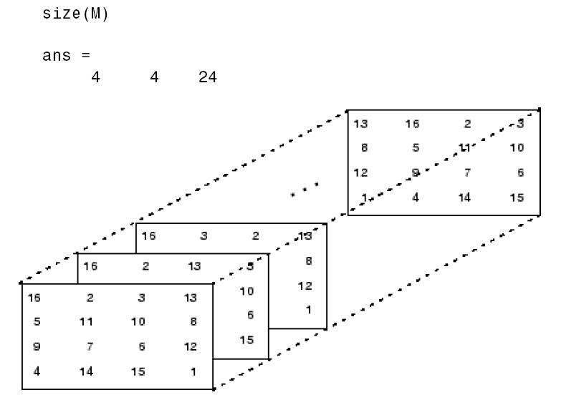
Data Structures
Multidimensional arrays
e.g. M = randn(4,4,24);

Slide 5
Data structures
Cell arrays - Cell arrays can be used to store a sequence of matrices of different sizes.
E.g.
M = cell(8,1);
for n = 1:8
M{n} = randn(n);
end
M
produces a sequence of magic squares of different order:
M =
[ 1]
[ 2x2 double]
[ 3x3 double]
[ 4x4 double]
[ 5x5 double]
[ 6x6 double]
[ 7x7 double]
[ 8x8 double]
You can retrieve the 4-by-4 magic square matrix with M{4}

Slide 6
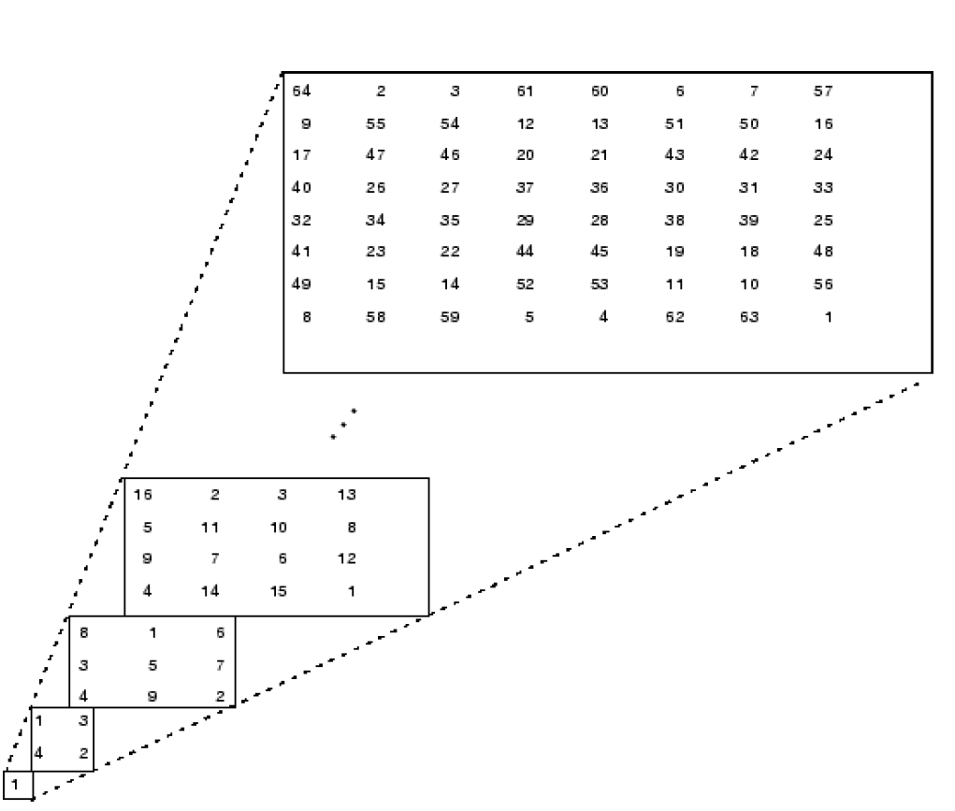

Slide 7
structures
Structures - multidimensional MATLAB arrays with elements accessed by textual field designators.
E.g.
S.name = 'Ed Plum';
S.score = 83;
S.grade = 'B+‘;
structures are arrays, so you can insert additional elements. In this case, each element of the array is a structure with several fields. The fields can be added one at a time:
e.g.
S(2).name = 'Toni Miller';
S(2).score = 91;
S(2).grade = 'A-';

Slide 8
Structures
or an entire element can be added with a single statement:
e.g.
S(3) = struct ('name’, 'Jerry Garcia', … , 'score', 70, 'grade', 'C')
There are several ways to reassemble the various fields into other MATLAB arrays. They are mostly based on the notation of a comma-separated list. If you type
e.g. S.score
MATLAB creates a numeric row vector containing the score field of each element of structure array S:
e.g. scores = [S.score]
avg_score = sum(scores)/length(scores)
e.g. names = char(S.name)

Slide 9
Scripts and functions
Two kinds of M-file:
Scripts: do not accept input arguments or return output arguments. They operate on data in the workspace.
2. Functions: can accept input arguments and return output arguments. Internal variables are local to the function.

Slide 10
Scripts
E.g. Generate normal distribution data
% generate 10000 data that follow normal distribution N(0,1) and plot the histogram
x = randn(1,10000);
hist(x)
Try to type: hist(x,100)

Slide 11
Functions
E.g. M-file rank
Matlab command: type rank / help rank
What comes out:
function r = rank(A,tol)
%RANK Matrix rank.
% RANK(A) provides an estimate of the number of linearly
% independent rows or columns of a matrix A.
% RANK(A,tol) is the number of singular values of A
% that are larger than tol.
% RANK(A) uses the default tol = max(size(A)) * eps(norm(A)).
%
% Class support for input A:
% float: double, single
% Copyright 1984-2004 The MathWorks, Inc.
% $Revision: 5.11.4.3 $ $Date: 2004/08/20 19:50:33 $
s = svd(A);
if nargin==1
tol = max(size(A)') * eps(max(s));
end
r = sum(s > tol);

Slide 12
Functions
The rank function can be used in several different ways:
rank(A)
r = rank(A)
r = rank(A,1.e-6)
Many M-files work this way. If no output argument is supplied, the result is stored in ans.
If the second input argument is not supplied, the function computes a default value.
‘nargin’ and ‘nargout’ are available that tell you the number of input
and output arguments involved in each particular use of the function.
The rank function uses nargin, but does not need to use nargout.

Slide 13
Function functions
A class of functions called “function functions” works with nonlinear functions of a scalar variable. That is, one function works on another function.
The function functions include
• Zero finding
• Optimization
• Quadrature
• Ordinary differential equations

Slide 14
Function functions
E.g. creat function
function y = humps(x)
y = 1./((x-.3).^2+.01)+1./((x-.9).^2+.04) – 6
M-file:
x = 0:.002:1;
y = humps(x);
plot(x,y)
%find value x where function reach local minimum
p = fminsearch(@humps, .5) % .5 is rough guess of starting
humps(p) % function value at the minimizer
%search for a zero
z = fzero(@humps, .5)

Slide 15
To make program run fast…
Vectorization (compare two versions)
Preallocation for ‘for’ loop
Original code:
tic
x = .01;
for k = 1:10001
y(k) = log10(x);
x = x + .01;
end
toc
A vectorized version of the same code is
tic
x = .01:.01:100;
y = log10(x);
toc

Slide 16
Next week…
Data analysis…

